Slide 1




Alankan –Cognizance 2020
INDIAN INSTITUTE OF TECHNOLOGY, ROORKEE
TEAM BLACK PANTHERS
WELINGKAR INSTITUTE OF MANAGEMENT DEVELOPMENT & RESEARCH ,MUMBAI

Slide 2
Problem Statement
To find Satisfaction level for customers travelling in Invistico Airlines with respect to various services provided.
Building a model that can predict customer satisfaction taking into consideration various significant factors.
Target Variable: Predictors:
Gender | Flight Distance | Inflight wifi service | Baggage handling
Customer Type | Seat comfort | Inflight entertainment | Checkin service
Age | Departure/Arrival time convenient | Online support | Cleanliness
Type of Travel | Food and drink | Ease of Online booking | Online boarding
Class | Gate location | On-board service
Arrival Delay in Minutes | Departure Delay in Minutes | Leg room service
Satisfaction

Slide 3
Data Preparation
Treatment of missing values.
During analysis we found in column (Arrival Delay in Minutes ) there were 393 missing values out of 129880 observations.
This was 0.3% of the total observations. Also the missing values had no dependency on any other variable like gender etc directly or any hypothetical assumption. Thus we conclude it as MCAR(missing completely at random).
We choose List wise deletion method and deleted the complete row for further analysis.
Feature engineering
As the data contained categorical values. Thus it was necessary to convert it into dummy variables.
We converted the below columns accordingly:
Column | Stated as 1 | Stated as 0
Satisfaction | Satisfied | Dissatisfied
Gender | Female | Male
Customer Type | Loyal | Disloyal
Type of Travel | Business | Personal
Class | Business class as Reference

Slide 4
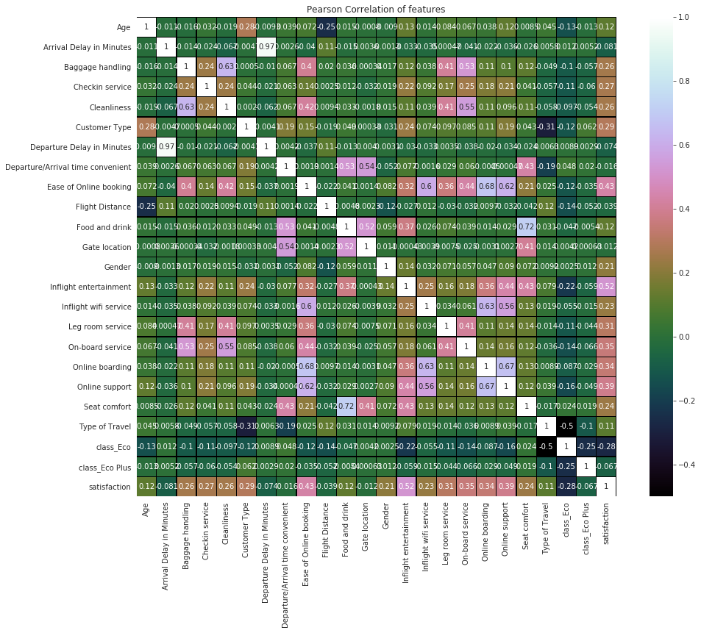
Correlation Matrix

Slide 5
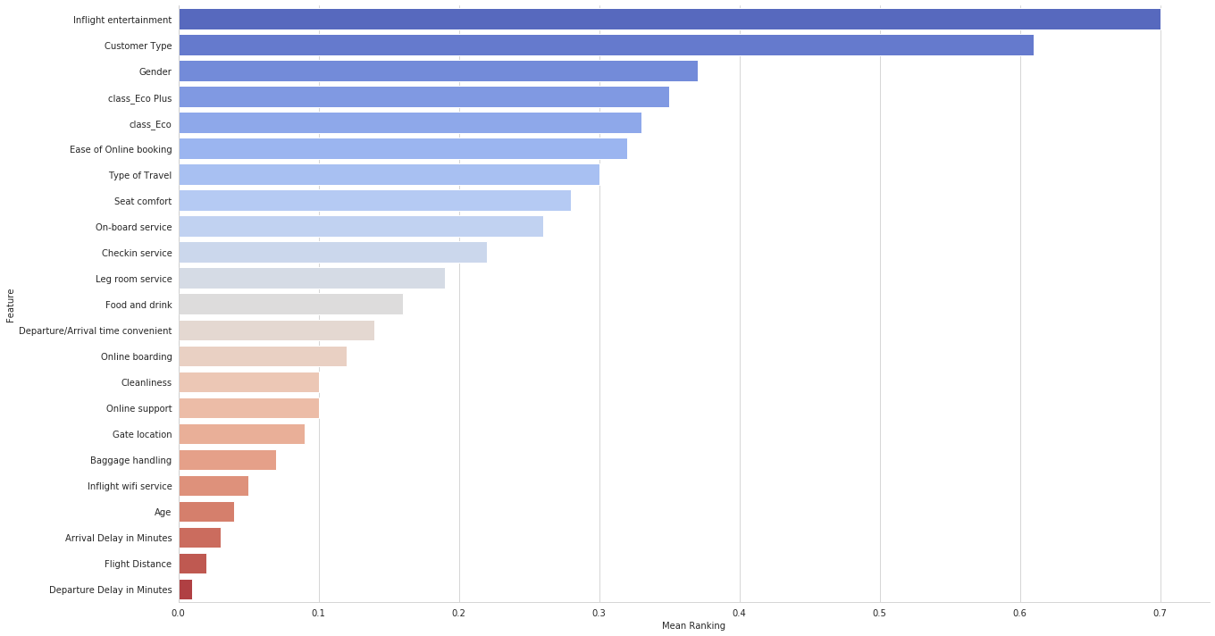
Feature Ranking
RFE , Linear Regression , Ridge , Lasso , Random Forest - These methods are used and a mean Feature ranking is developed.

Slide 6
Exclusion of non-significant Features
The feature ranking clearly shows that the top 5 features are-
Inflight Entertainment
Customer Type
Gender
Class_EcoPlus
Class_Eco
It also shows the factors which contributes negligibly-
Departure Delay in Minutes
Flight Distance
Arrival Delay in Minutes
So these features are excluded from the model.

Slide 7
Algorithms in model implementation
The most used classifier algorithms are used in the model implementation
Logistic Regression
K-nearest neighbours (KNN)
Decision Tree
Support Vector Machine (SVM)
Data is split into Train-Test randomly in the following proportion
Train -> 80%
Test -> 20%
The model is trained with the Train data and validated using the Test data. This has been iterated 5 times and the average results is taken.

Slide 8
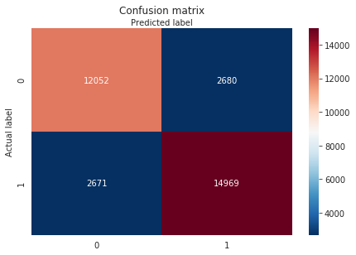
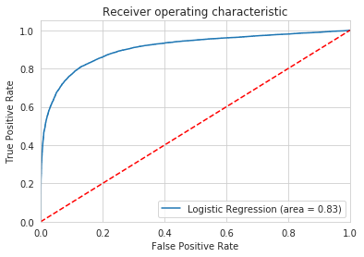
Logistic Regression
Accuracy | 0.8347
Precision | 0.8481
Recall | 0.8485
F1 Score | 0.8346

Slide 9
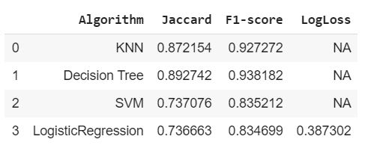
Comparison of Results
Conclusion: As per the values obtained it can be understood that KNN algorithm suits best for the given data set as it handles noisy data well and is more effective with large data set.
Second preference will be given to logistical regression model as it is best in finding influence of several independent variables on target variable.

Slide 10
Buisness Implication
The given data shows 71,087 passengers satisfied with Invistico airlines.
Invistico airlines being cost effective is attracting customer.
For continuing such growth in customer base , the airline must not use any cost cutting measures in the top 5 factors which leads to customer satisfaction.
We can use cost cutting maneuver in other factors to reduce operational cost and continue buisness.

