Slide 1



Python Project
Airlines Database
Team Members:
Sayantan Jana - 46
Mitesh Nahar - 34
Nitin Yadav - 59
Akshay Kumar Gupta - 04
Course- PDGM- Research & Business Analytics (2019-21)

Slide 2

Why Python over SPSS or R language for this analysis?
Python is developed with a strong focus on (business) applications.
Python is also the easiest language to use when using Big Data also our data size is huge thus handling it in python was more easier.
Strong in machine learning algorithms.
Has higher number of libraries like NumPy, Pandas, SciPy, Matplotlib etc.
Easy in creating dummy variables for feature engineering.
The graphical capabilities of SPSS are functional although minor changes can be made but not fully customizable for plots and visualizations.While in python we can easily customize visualizations.

Slide 3
Why was this data set selected?
The data set had large number of data points of about 129000 rows. Thus making easy for segregating trainable and testing data sets.
Also the number of variables given was about 23. It had a mix of categorical and quantitative variables.
There were missing values present thus giving an opportunity to do missing value analysis. The data set had the potential to give a good model and multiple algorithm could have been implemented.
Also it had huge business implications if the model worked with higher accuracy.

Slide 4
Literature review of previous work on this data set
Due to multiple variables it was difficult to understand the major contributors to customer satisfaction.
Also no specific model was developed in previous analysis done.
Thus the problem statement required to overcome such limitations using multiple algorithms and choose a suitable algorithm that could give higher accuracy.

Slide 5
Problem Statement
To find Satisfaction level for customers travelling in Airlines with respect to various services provided by building a predictive model.
Target Variable: Predictors:
Satisfaction
Gender | Flight Distance | Inflight wifi service | Baggage handling
Customer Type | Seat comfort | Inflight entertainment | Checkin service
Age | Departure/Arrival time convenient | Online support | Cleanliness
Type of Travel | Food and drink | Ease of Online booking | Online boarding
Class | Gate location | On-board service
Arrival Delay in Minutes | Departure Delay in Minutes | Leg room service

Slide 6
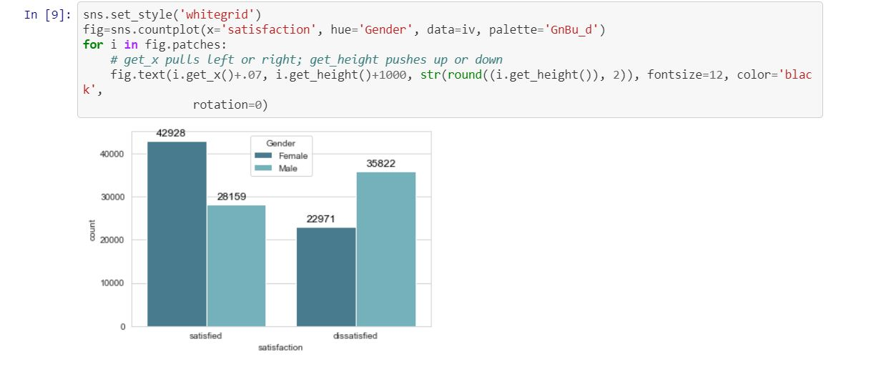
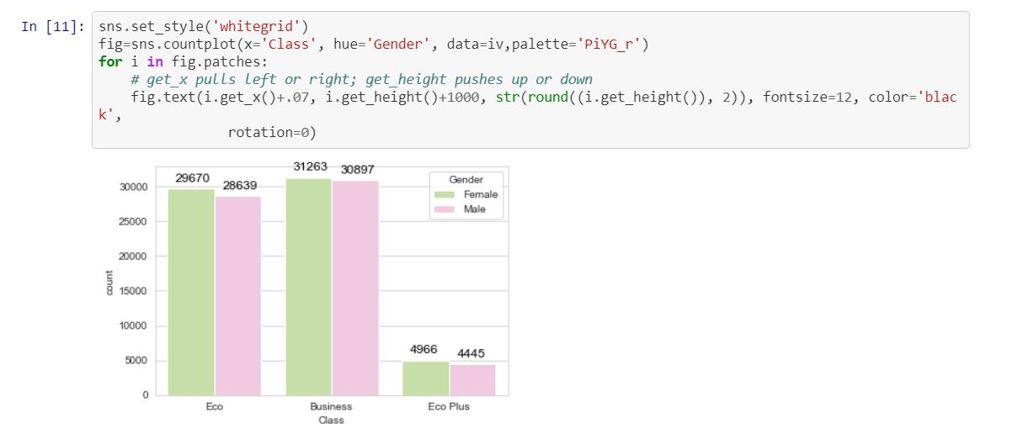
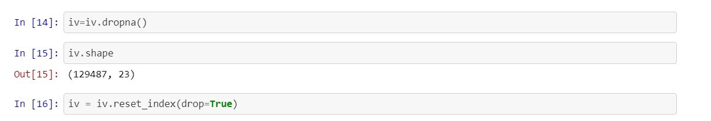
Data Visualization
Delete Null Values

Slide 7
Feature Engineering
As the data contained categorical values. Thus it was necessary to convert it into dummy variables.
We converted the below columns accordingly:
Column | Stated as 1 | Stated as 0
Satisfaction | Satisfied | Dissatisfied
Gender | Female | Male
Customer Type | Loyal | Disloyal
Type of Travel | Business | Personal
Class | Business class as Reference

Slide 8
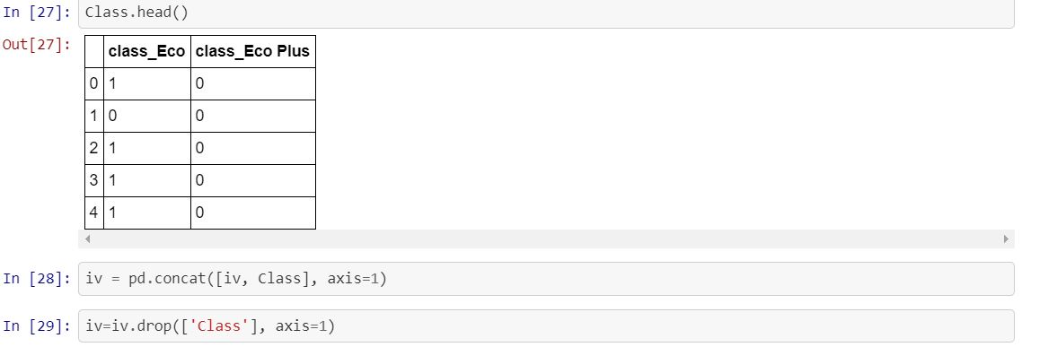

Slide 9
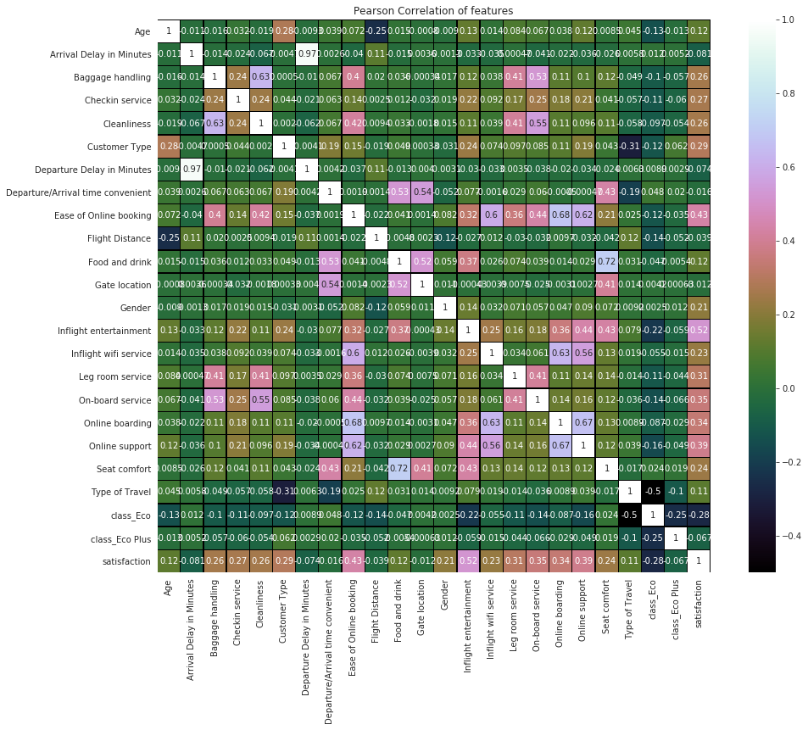
Correlation Matrix

Slide 10
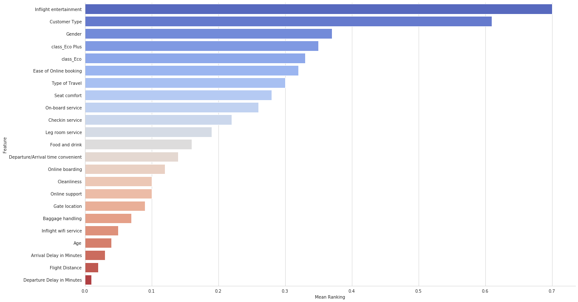
Feature Ranking
RFE , Linear Regression , Ridge , Lasso , Random Forest - These methods are used and a mean Feature ranking is developed.

Slide 11
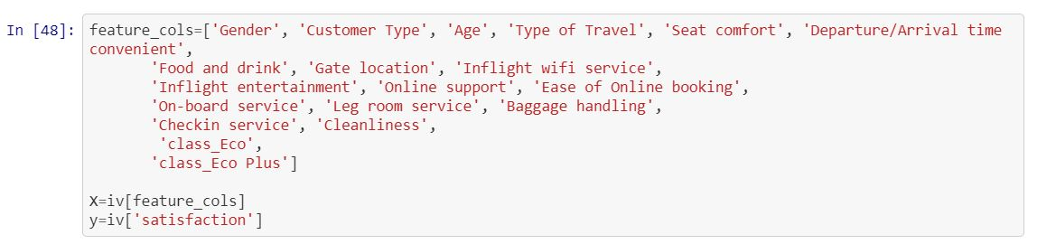
Exclusion of non-significant Features
It shows the factors which contributes negligibly-
Departure Delay in Minutes
Flight Distance
Arrival Delay in Minutes
So these features are excluded from the model.

Slide 12
Algorithms in model implementation
The most used classifier algorithms are used in the model implementation
Logistic Regression
K-nearest neighbours (KNN)
Decision Tree
Support Vector Machine (SVM)
Data is split into Train-Test randomly in the following proportion
Train -> 80%
Test -> 20%
The model is trained with the Train data and validated using the Test data. This has been iterated 5 times and the average results is taken.

Slide 13
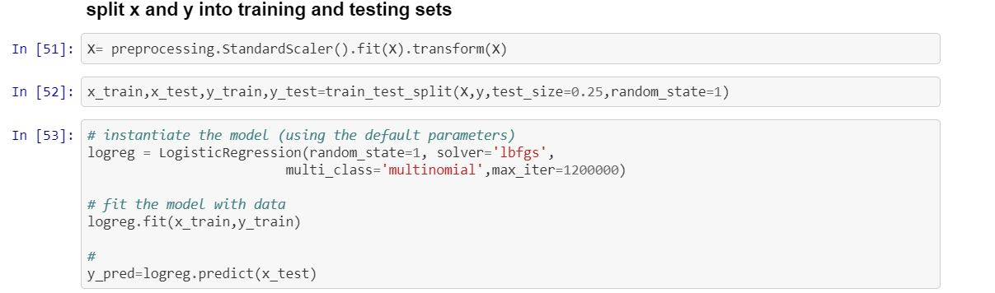
Logistic Regression

Slide 14
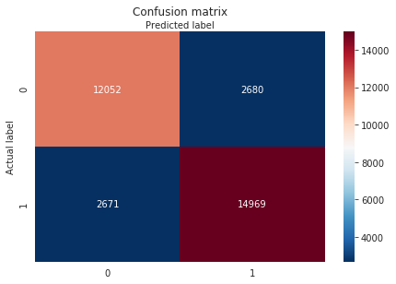
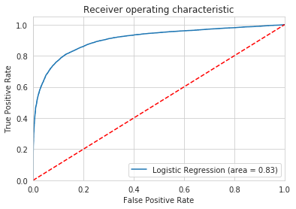
Output
Accuracy | 0.8347
Precision | 0.8481
Recall | 0.8485
F1 Score | 0.8346

Slide 15
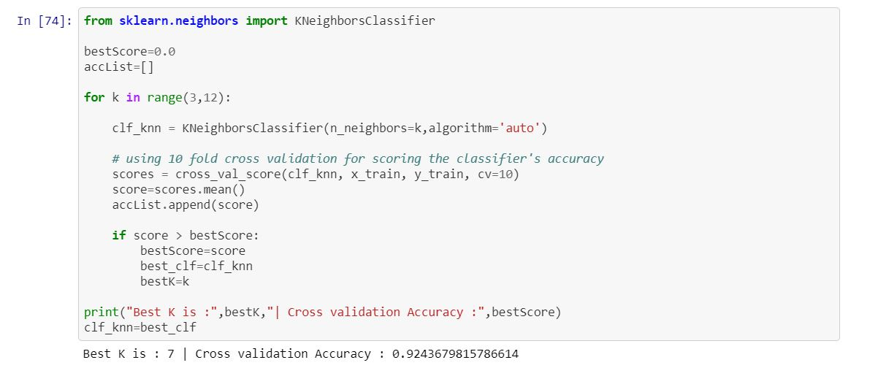
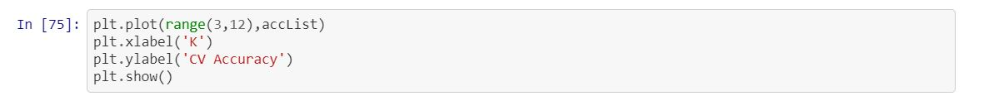
KNN Classifier

Slide 16
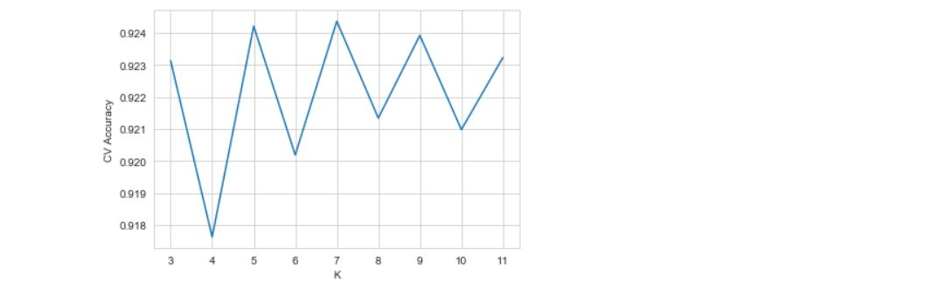
Output

Slide 17
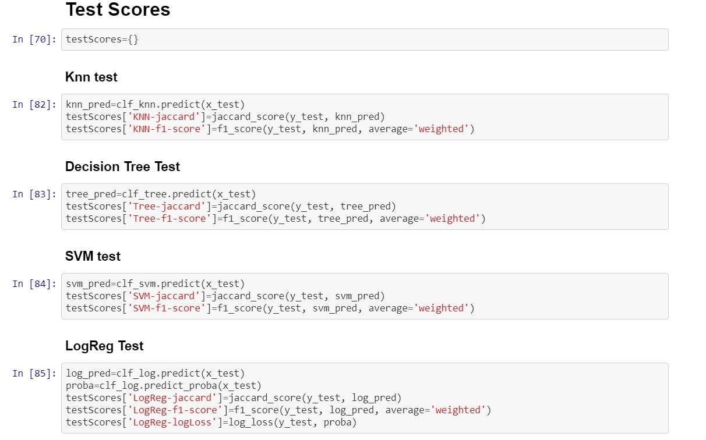

Slide 18
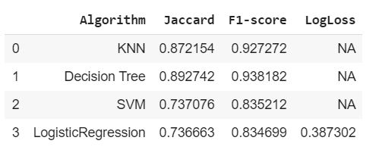
Comparison of Results
Conclusion: As per the values obtained it can be understood that KNN algorithm suits best for the given data set as it handles noisy data well and is more effective with large data set.
Second preference will be given to logistical regression model as it is best in finding influence of several independent variables on target variable.

Slide 19
Buisness Implication
The given data shows 71,087 passengers satisfied with Invistico airlines.
Invistico airlines being cost effective is attracting customer.
For continuing such growth in customer base , the airline must not use any cost cutting measures in the top 5 factors which leads to customer satisfaction.
We can use cost cutting maneuver in other factors to reduce operational cost and continue buisness.
Code link: https://github.com/sj-leshrac/Python-Trim-3

