Slide 1


Analytics Case Study
Birla Institute of Technology & Science (BITS), Pilani
Harshil Mehta
Ankur Kumar Singh
Nitin Yadav
Sayantan Jana
WELINGKAR INSTITUTE OF MANAGEMENT DEVELOPMENT & RESEARCH ,MUMBAI

Slide 2
Problem Statement
To find if a customer will default his loan considering various significant factors.
Thus build a risk model which will assess the risk of a customer defaulting after cross-selling the personal loan.
Given Data
Target Variable
V2 | V3 | V4 | V5 | V6 | V7
V8 | V9 | V10 | V11 | V12 | V13
V14 | V15 | V16 | V17 | V18 | V19
V20 | V21 | V22 | V23 | V24 | V25
V26 | V27 | V28 | V29 | V30 | V31
V32

Slide 3
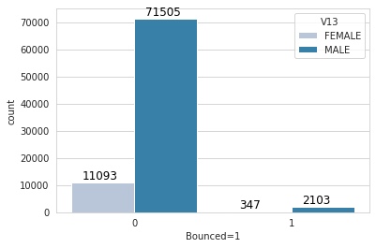
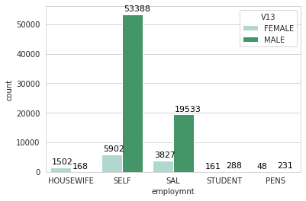
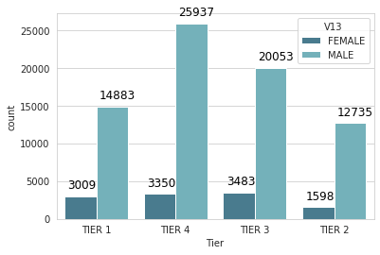
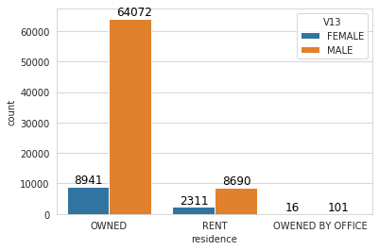
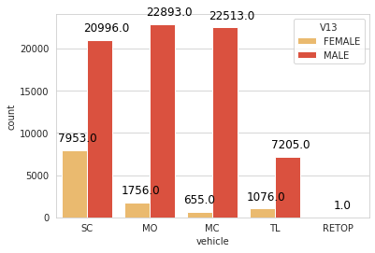
Data Visualization
A preliminary data visualization helps to summarize the data and also enlighten the next steps.

Slide 4
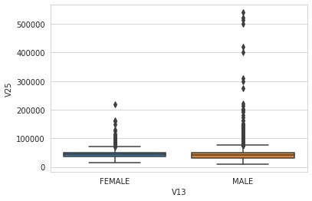
Data Preparation
Deletion of missing values:
During the data preparation we found that the columns V21,V23,V24,V26,V27 has over 80% missing values. So these columns are dropped.
The columns ranging to V4-V17 has exactly 34480 values missing from each one them. Imputing the data with any method will create a bias in the model. So we are better off without them.
Imputing missing values:
V25 column has 15061 missing values. As per the box plot
it has many outliers.So we imputed the values with the median
of this column.

Slide 5
Feature Engineering
The columns V10,V13,V14,V15,V31 has categorical values. So we transformed them as follows:
Column | As Reference | Other values
V10 (Vehicle Type) | MC | MO,MC,TL
V14 (Employment) | Housewife | PENS,SAL,SELF,STUDENT
V15 (Residence) | Owned by Office | OWNED,RENT
V31 (Tier) | Tier 1 | TIER2,TIER3,TIER4
V13 (Gender) | Male=1 | Female=0
Also column V22 ( No of new loans in last 3 months) has all values as zero. So it is dropped.

Slide 6
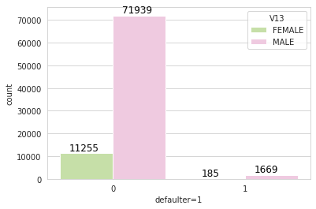
SMOTE
Synthetic Minority Over-sampling Technique is used in thee dataset because there is an imbalance in the data points regarding defaulters and non-defaulters. This creates a bias in the model development . To overcome this SMOTE method is used to synthetically create balanced data points.

Slide 7
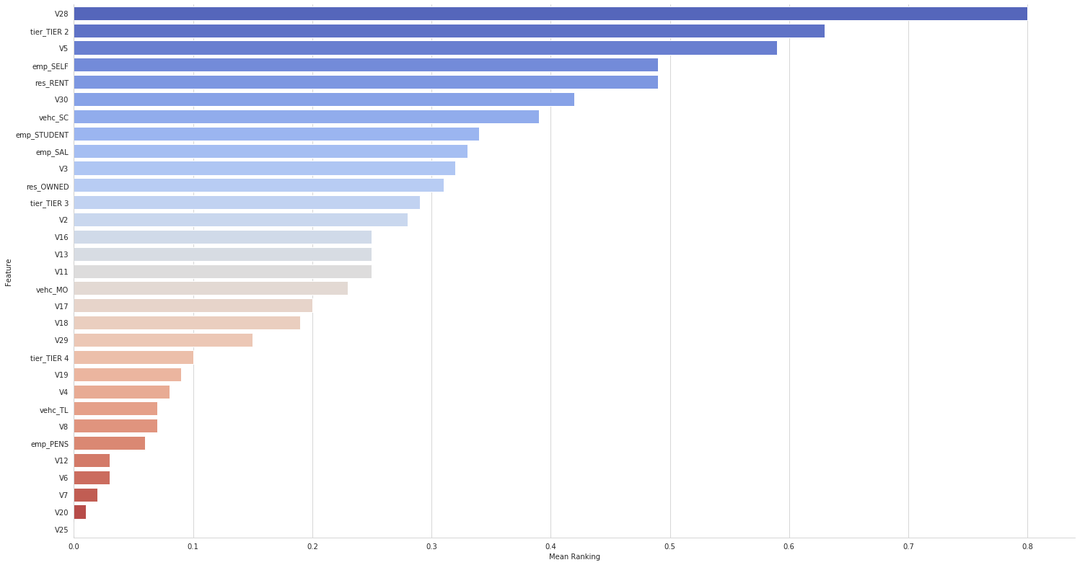
Feature Ranking
RFE , Linear Regression , Ridge , Lasso , Random Forest - These methods are used and a mean Feature ranking is developed.

Slide 8
Exclusion of non-significant Features
The feature ranking graph tells that the features V25,V20,V7,V6,V12,emp_PENS have negligible impact on the target variable. So they are dropped from the final model.
Significant features for the final model :
V2 | V3 | V4 | V5 | V11
V13 | V16 | V17 | V18 | V19
V28 | V29 | V30 | Vehc_MO | Vehc_SC
Vehc_Tl | Emp_SAL | Emp_SELF | Emp_STUDENT | Res_OWNED
Res_RENT | TIER 2 | TIER 3 | TIER 4

Slide 9
Algorithms in model implementation
The most used classifier algorithms are used in the model implementation
Logistic Regression
K-nearest neighbours (KNN)
Decision Tree
Support Vector Machine (SVM)
Data is split into Train-Test randomly in the following proportion
Train -> 80%
Test -> 20%
The model is trained with the Train data and validated using the Test data. This has been iterated 5 times and the average results is taken.

Slide 10
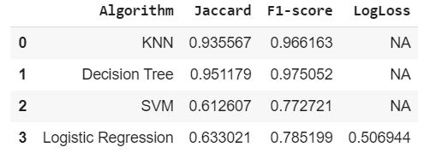
Comparison of Results
Conclusion: It is seen that among the above algorithms Decision Tree has the most promising F1-Score (Harmonic mean of precision and recall). Also KNN showed good scores too.
So the model will be at its peak performance if any of these two algorithms are used to predict the default risk of a customer.

