Slide 1
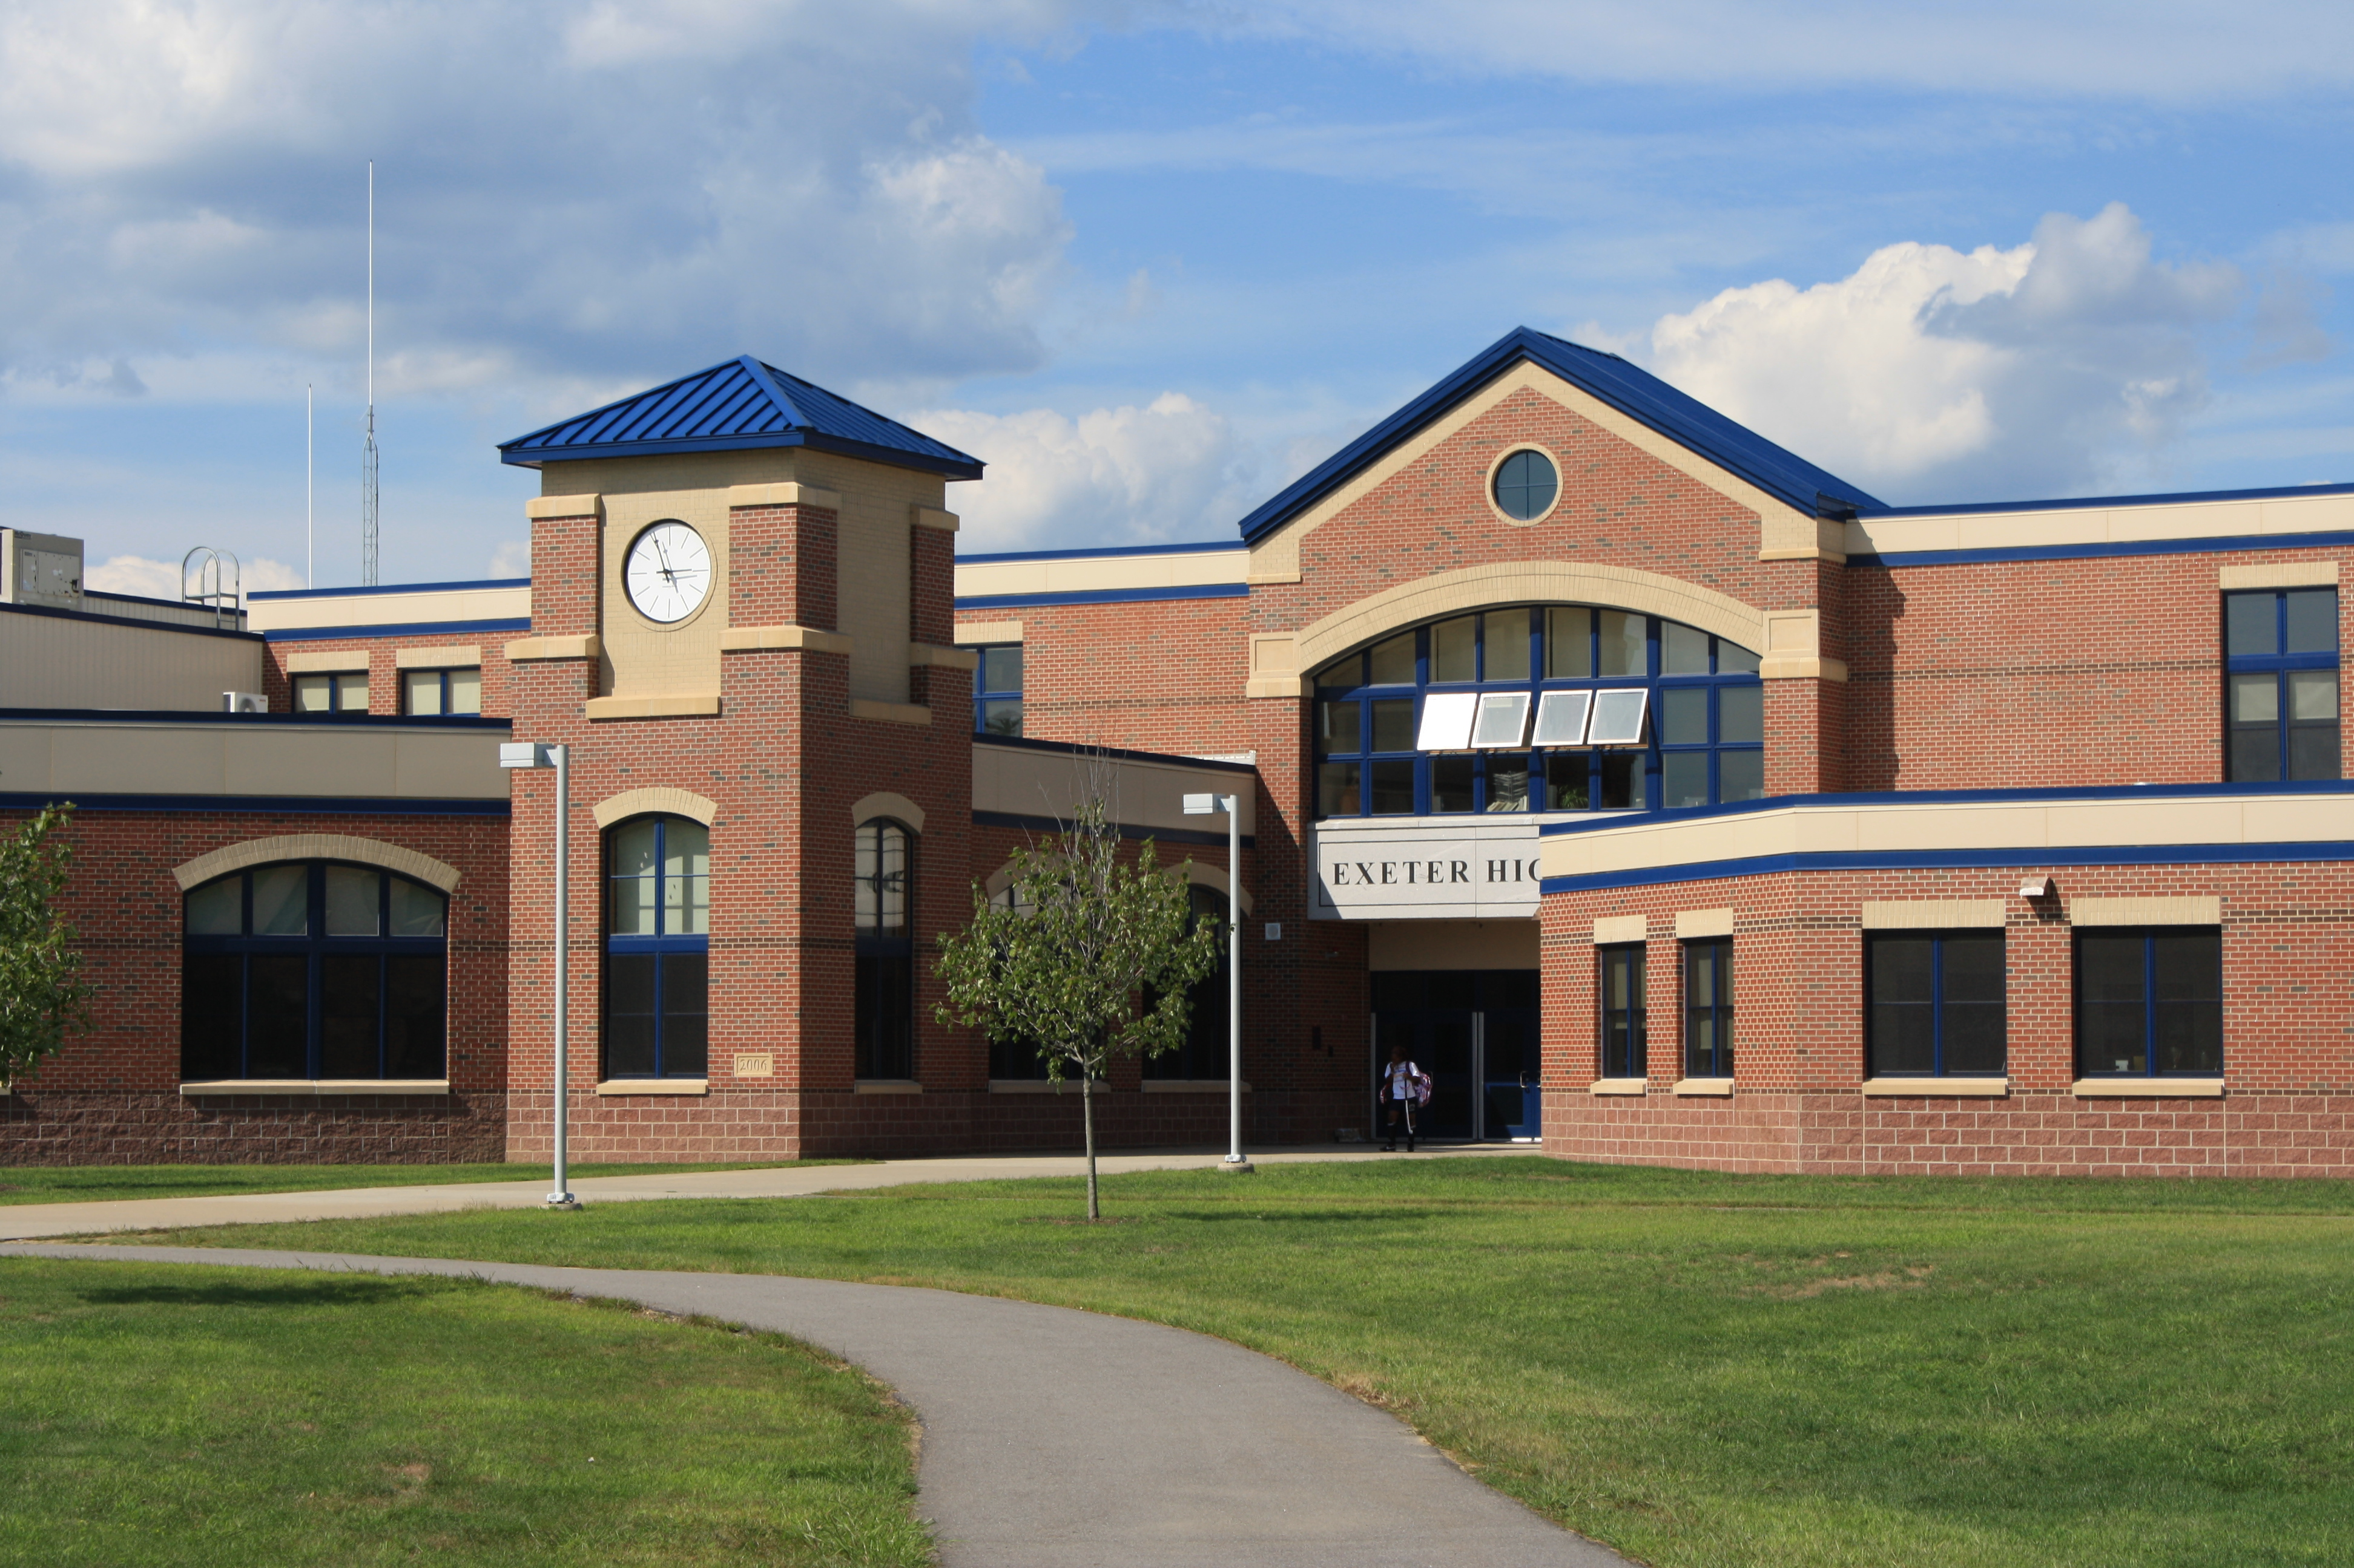
SCHOOL MANAGEMENT SYSTEM
S.Mathiyazhakan
E2245659
ICT1942
ThePhoto by PhotoAuthor is licensed under CYYSA.

Slide 2
INTRODUTION
primary objective of this project is to streamline the various administrative processes in educational institutions. Our system focuses on key functionalities like user authentication, comprehensive dashboards for administrators, and efficient management of student and teacher records. Ultimately, we aim to enhance overall efficiency, improve data management, and foster better communication within the school community.

Slide 3

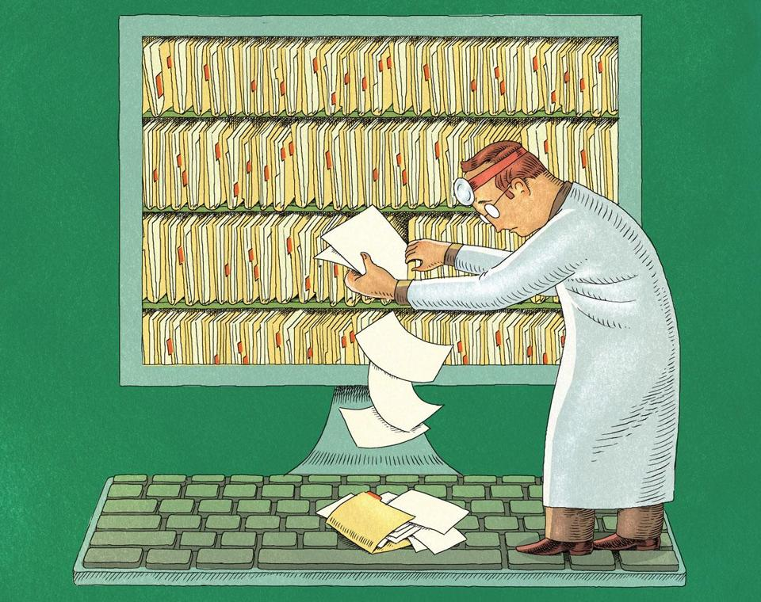
PROBLEM
Manual and time-consuming administrative tasks.
Inefficiencies and errors in student and teacher enrollment.
Difficulty in managing and analyzing vast amounts of data.
Compromised privacy and confidentiality of personal data.
Ineffective communication between teachers, students, and administrators.
ThePhoto by PhotoAhor is licensed under CCYYSA.

Slide 4

SOLUTION
Development of a comprehensive School Management System.
Automated processes for student and teacher enrollment.
Centralized record-keeping and data management.
Robust security measures to protect data privacy
Improved communication tools for administrators, teachers, and students.

Slide 5
Project Overview
Core Components: User Authentication, Administrative Dashboards, Student Management and Teacher Management
Technologies Used: C#, SQL Server
Implementation Phases: Installation and Integration, Testing and Quality Assurance, User Training and Documentation and Ongoing Support and Maintenance.

Slide 6
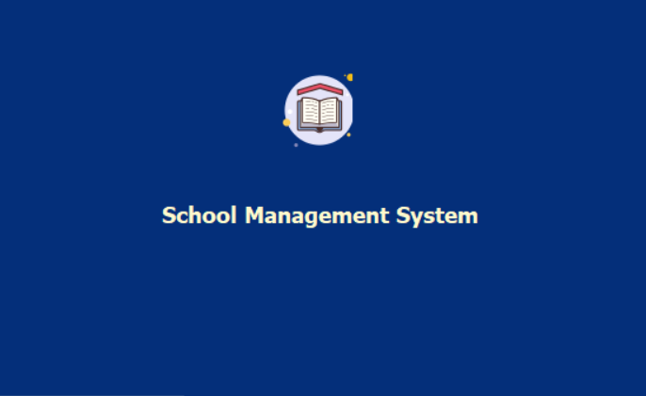
User Interface - Opening
The system is designed with a user-friendly interface, featuring intuitive navigation and a clear layout to ensure ease of use. Accessibility is a key focus, ensuring that all users, including administrators, teachers, and students, can navigate the system efficiently and effectively.“

Slide 7
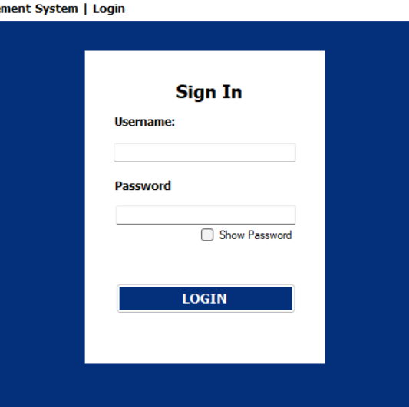
User Interface (Login)
Features
Secure user authentication
Username and password fields
Error messages for incorrect credentials
“Show Password" option

Slide 8
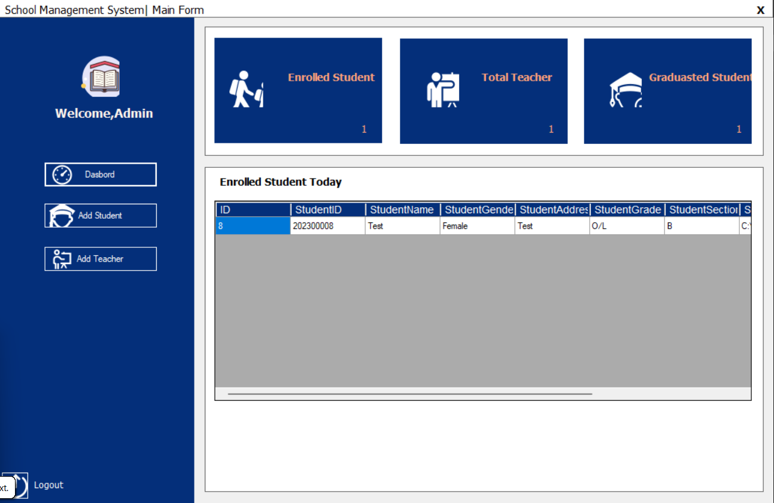
User Interface - Dashboard
Features
Overview of Today enrolled Students
Total number of students and teachers
Real-time updates
Easy access to different management sections
Add Student Data
Add Teacher Data

Slide 9
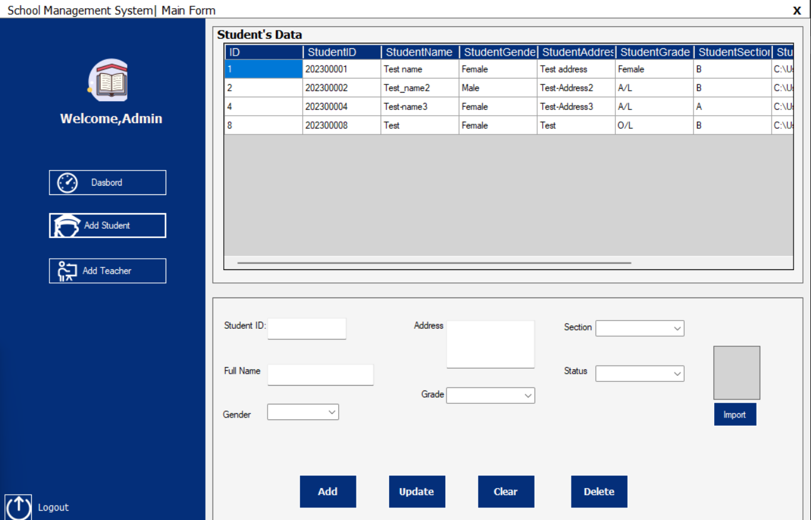
USER INTERFACE – ADD STUDENT
Features
Add Student Data
Update Student Data
Delete Student Data
Clear Student Data

Slide 10
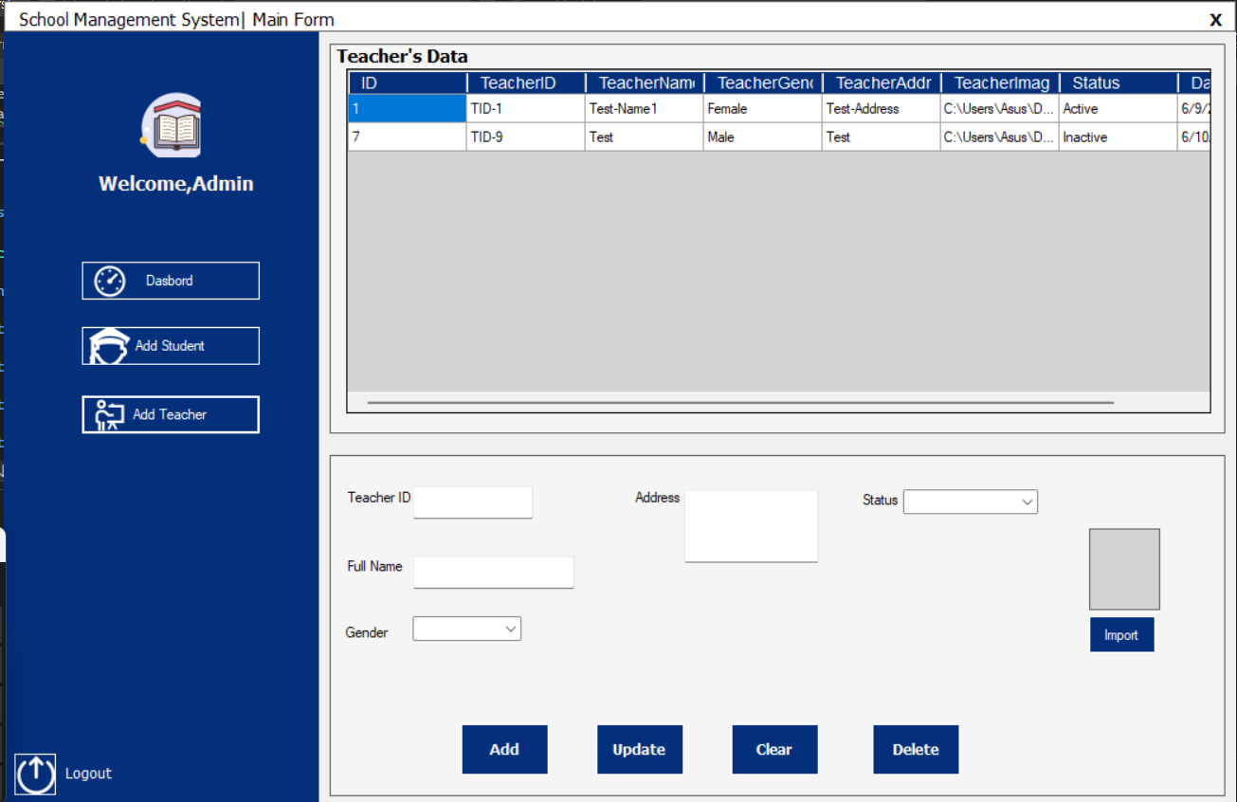
USER INTERFACE – ADD TEACHER
Features
Add Teacher Data
Update Teacher Data
Delete Teacher Data
Clear Teacher Data

Slide 11
Features
User Authentication: Secure and reliable login system.
Dashboards: Comprehensive overview for administrators.
Student Management: Add, clear, update, and delete student records.
Teacher Management: Add, update, clear and delete teacher records.
Data Integrity: Ensures accuracy and reliability of data.
Security Measures: Robust protection for sensitive information.

Slide 12
Demo
Live demonstration of the system's key functionalities:
Logging in as an administrator
Navigating the dashboard
Adding a new student record
Updating a teacher's information
Viewing real-time data updates

Slide 13
Future Development
Scalability: Enhancing the system to support larger schools.
Advanced Analytics: Integrating advanced reporting and data analysis tools.
New Features: Attendance tracking, Performance evaluations and Parent-teacher communication tools
Ongoing Maintenance: Regular updates and improvements based on user feedback.

Slide 14
THANK YOU

