Slide 1

SEMANTIC ANALYSIS OF YOUTUBE COMMENTS

Slide 2
CONTENTS
AIM
INTRODUCTION
TECHNOLOGIES AND METHODOLOGY USED
Natural Language Processing (NLP)
YouTube Data API
Data Visualization
Web Application Framework
CODE OVERVIEW
Video URL Extraction
API Requests
Sentiment Analysis
Sentiment Metrics Calculation
Data Visualization
Web Application Framework
ADVANTAGES
DISADVANTAGES
Conclusion

Slide 3
AIM
To develop an interactive web application that performs semantic analysis on YouTube comments to determine overall sentiment. The application also compares the sentiments of two videos to provide recommendations and insights on which video has a more positive reception, helping users understand audience feedback and make informed decisions.

Slide 4
INTRODUCTION
Real-time Sentiment Analysis: Utilizes advanced NLP techniques to analyze YouTube comments in real-time, providing instant insights into viewer sentiments.
Detection Methods: Incorporates rule-based and statistical NLP algorithms to detect and classify sentiments as positive, negative, or neutral.
Flexible Deployment: Can be deployed via cloud-based software applications, standalone hardware appliances, or virtual appliances, ensuring adaptability to diverse infrastructures.

Slide 5
TECHNOLOGIES AND METHODOLOGY USED :
3.1 Natural Language Processing (NLP)
NLP, a subfield of artificial intelligence, deals with the interaction between computers and human language. Its primary goal is to enable computers to understand, interpret, and generate human language in a meaningful way. NLP involves various tasks such as text classification, sentiment analysis, named entity recognition, and more.
TextBlob is a powerful Python library that simplifies NLP tasks by providing easy-to-use APIs and pre-trained models. Sentiment analysis, one of the common applications of NLP, involves analyzing text to determine the sentiment expressed, whether it's positive, negative, or neutral.

Slide 6
3.2 YouTube Data API
The YouTube Data API allows developers to programmatically access and manage YouTube data, including videos, channels, and playlists.
It provides methods for retrieving detailed information about YouTube videos, such as title, description, tags, and more.
Developers can also fetch comments posted by users on specific videos using the API.
Additionally, the API offers statistical data about videos, including view count, like count, dislike count, and more.
Integrating the YouTube Data API into applications enables the retrieval and analysis of valuable insights from YouTube's vast content repository.

Slide 7
3.3 Data Visualization
.
Matplotlib, a popular Python library, is used for creating static, animated, and interactive visualizations. It offers a wide range of plotting functions for generating various types of plots, including line plots, scatter plots, histograms, and more.
Matplotlib provides extensive customization options to control the appearance and style of plots, such as colors, labels, titles, and annotations.
With Matplotlib, developers can visualize data to gain insights, identify patterns, and communicate findings effectively.
Its versatility and flexibility make it a preferred choice for data visualization tasks across different domains and industries.

Slide 8
3.4 Web Application Framework
Streamlit is a Python library designed for building interactive web applications effortlessly.
It simplifies the process of creating web applications by allowing developers to write Python scripts that generate web pages.
Streamlit offers various built-in components and widgets for creating interactive elements, such as buttons, sliders, and text inputs.
Developers can easily integrate data visualization libraries like Matplotlib and Plotly with Streamlit to create dynamic and interactive visualizations.
Streamlit's fast iteration cycle and real-time updates make it ideal for prototyping, experimenting, and deploying data-driven web applications with ease

Slide 9
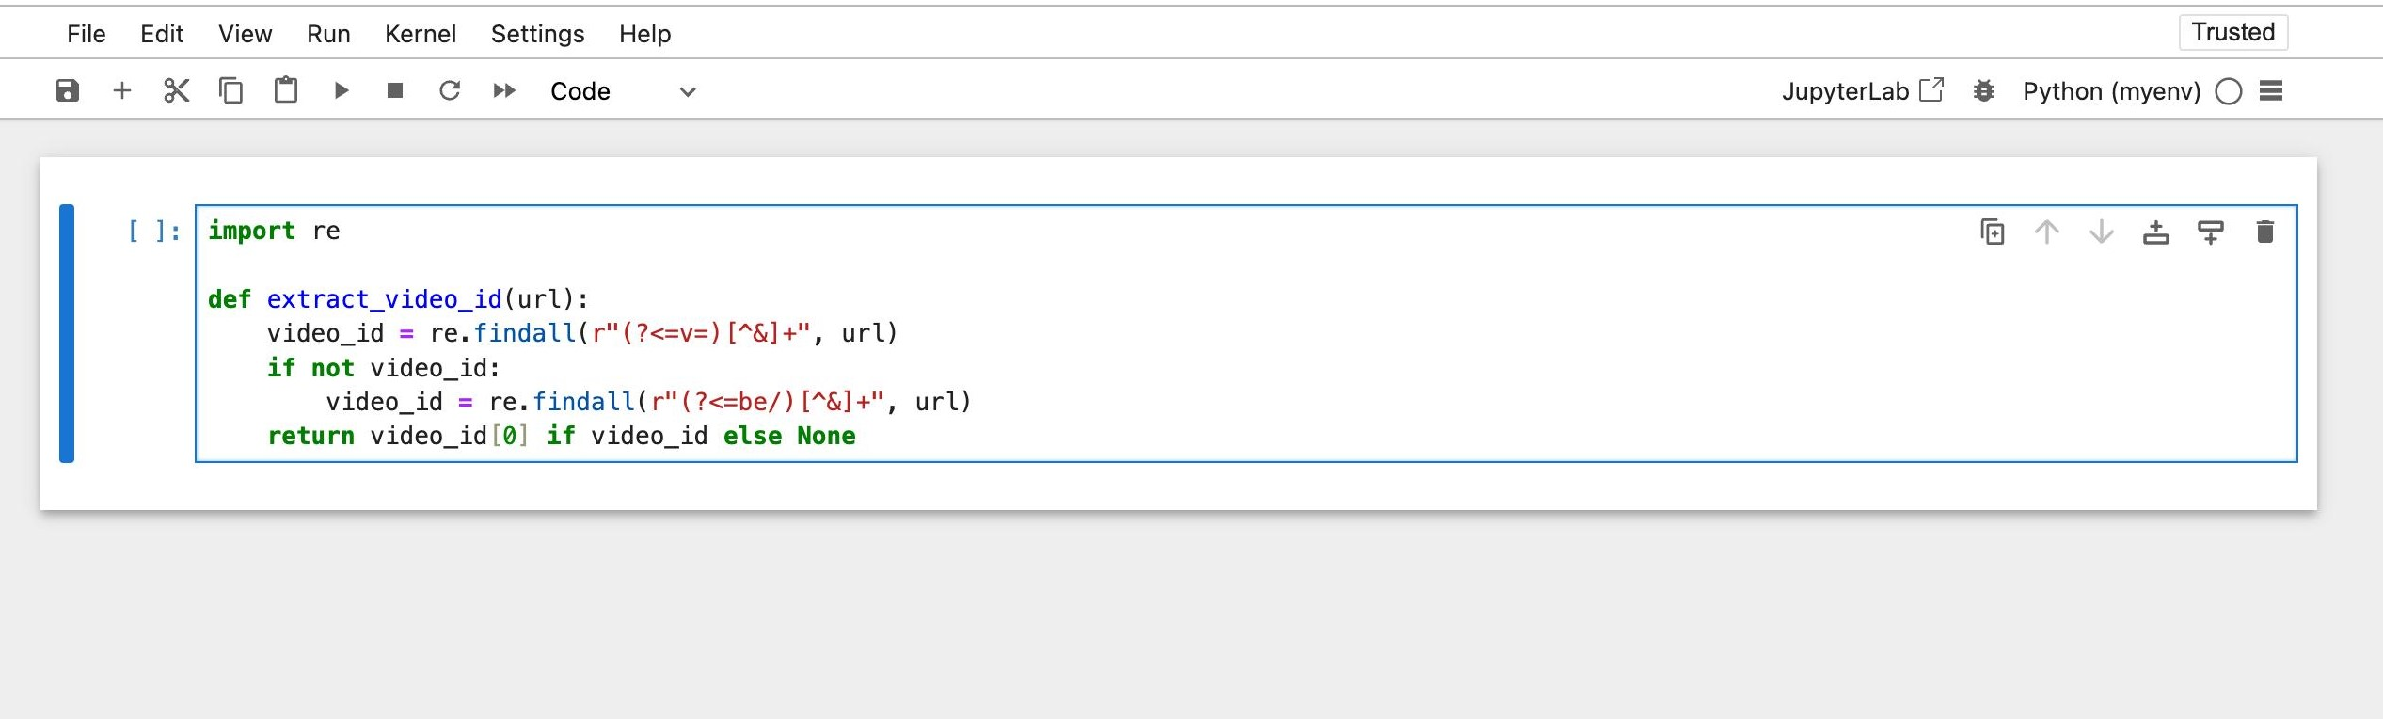
CODE OVERVIEW
4.1 Video URL Extraction
In this part of the code, regular expressions (regex) are used to extract video IDs from YouTube video URLs. Regex patterns are applied to extract the video ID from the URL provided by the user.
Implementation: The extract_video_id function uses regex to extract the video ID from the YouTube video URL. It checks for patterns like v=VIDEO_ID or be/VIDEO_ID to identify and extract the video ID.

Slide 10
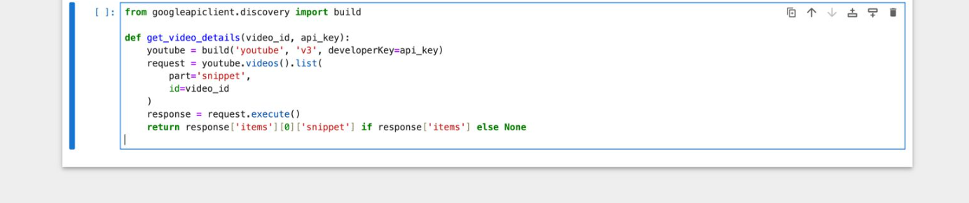
4.2 API Requests
This part of the code demonstrates how the YouTube Data API is utilized to fetch various details about the videos, including video details, comments, and statistics. The build method from googleapiclient. discovery is used to create a YouTube service object for making API requests.
Implementation: Different API endpoints such as videos().list and commentThreads().list are used to retrieve specific information about the videos based on their video IDs.

Slide 11
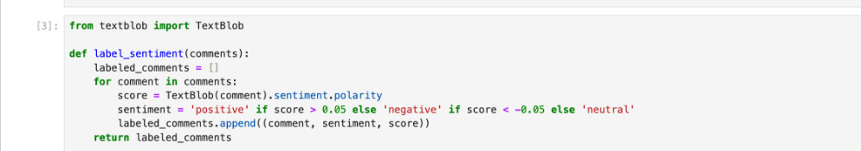
4.3 Sentiment Analysis
This section of the code demonstrates how TextBlob, a Python library for NLP, is utilized for sentiment analysis of YouTube video comments. TextBlob's sentiment property is used to determine the polarity of each comment, i.e., whether it is positive, negative, or neutral.
Implementation: The TextBlob object is created for each comment, and its sentiment property is used to obtain the polarity score. Based on the polarity score, comments are classified as positive, negative, or neutral. Code Example:

Slide 12
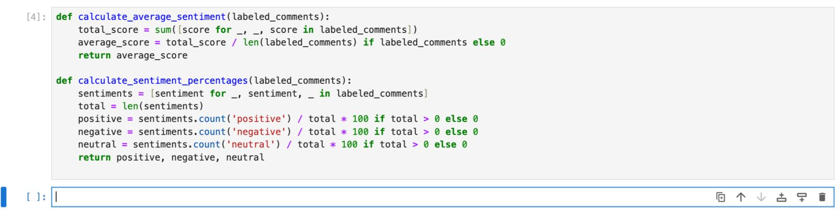
4.4 Sentiment Metrics Calculation
This part of the code calculates average sentiment scores and sentiment percentages based on the sentiment labels assigned to each comment. It aggregates sentiment scores to compute the average sentiment score and calculates the percentage of positive, negative, and neutral comments.
Implementation: The code iterates through the labeled comments and computes the total sentiment score, which is then divided by the total number of comments to obtain the average sentiment score. Additionally, the code calculates the percentage of comments falling into each sentiment category.

Slide 13
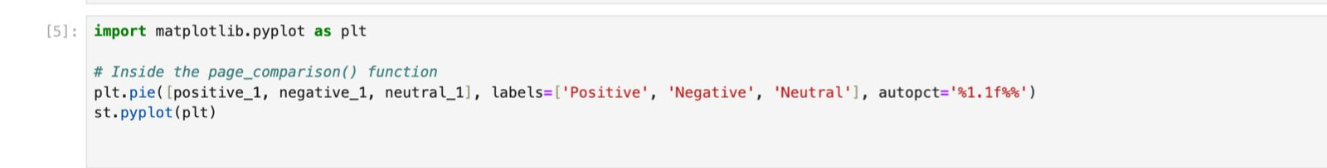
4.5 Data Visualization
This part illustrates how Matplotlib, a Python plotting library, is used for data visualization in the project. Matplotlib is employed to create pie charts representing the distribution of positive, negative, and neutral sentiments across the comments of each video.
Implementation: The matplotlib.pyplot.pie() function is utilized to generate pie charts based on the calculated sentiment percentages. These charts provide visual insights into the sentiment distribution of the comments

Slide 14
Web Application Framework
This section highlights the usage of Streamlit, a web application framework, for building the user interface of the semantic analysis tool. Streamlit simplifies the process of creating interactive web applications by allowing developers to write Python scripts.

Slide 15
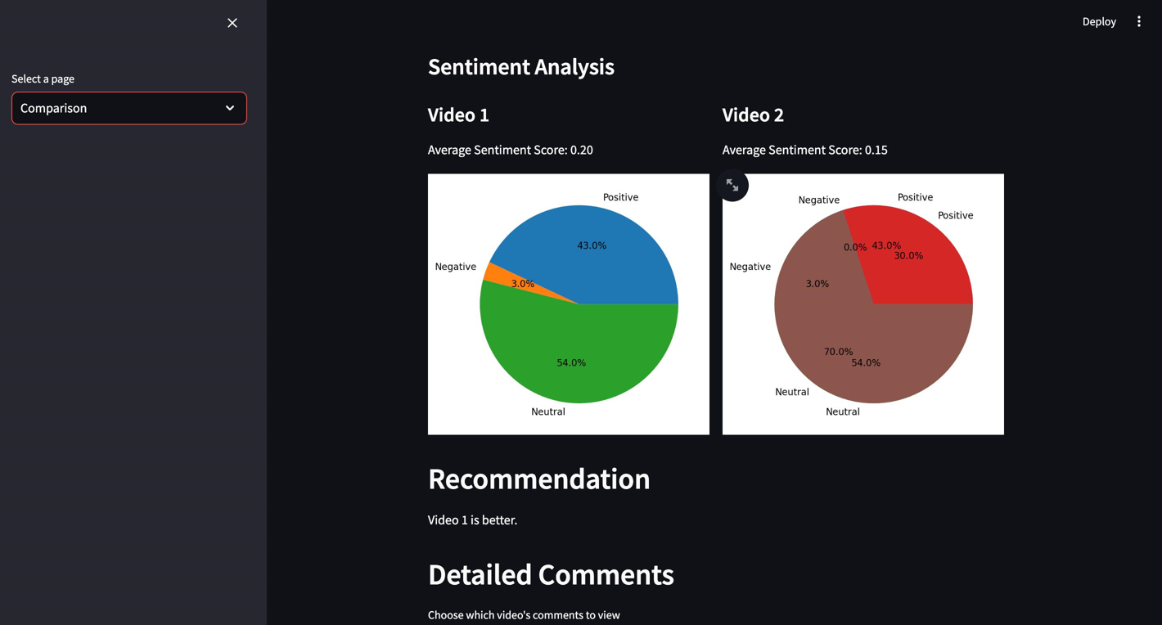
RESULT

Slide 16
ADVANTAGES
Insightful Analysis: The application provides insightful analysis of YouTube videos by extracting and analyzing comments, allowing users to understand audience sentiment.
User-Friendly Interface: With Streamlit, the web application offers a simple and intuitive interface, making it easy for users to interact with and explore the data.
Data Visualization: The use of Matplotlib enables clear visualization of sentiment distribution, enhancing the understanding of sentiment trends.
Semantic Comparison: Users can compare videos based on semantic similarity, providing valuable insights for content creators and marketers.
Recommendations: The application offers recommendations on which video is better based on sentiment analysis, aiding decision-making processes.

Slide 17
DISADVANTAGES
API Limitations: Dependency on the YouTube Data API may be subject to limitations such as request quotas and rate limits, affecting the application's scalability.
Data Accuracy: Sentiment analysis using TextBlob may not always accurately capture the nuances of human sentiment, leading to potential misinterpretations.
Limited Customization: While Streamlit offers simplicity, it may lack the customization options available in other web development frameworks, limiting the application's flexibility.
Dependency on External Libraries: The application relies on external libraries such as TextBlob and Matplotlib, which may introduce additional complexity and maintenance overhead.
Potential Bias: The application's analysis and recommendations may be influenced by biases inherent in the data and the sentiment analysis algorithm, leading to potential inaccuracies or skewed results.

Slide 18
Conclusion
In conclusion, the YouTube Semantic Analyzer is a powerful tool for analyzing sentiment in YouTube comments and comparing videos based on their semantic similarity. Key features include:
Extraction of video details and comments using the YouTube Data API. Sentiment analysis of comments using TextBlob, providing insights into the overall sentiment of each video.
Visualization of sentiment distribution through pie charts, allowing users to quickly grasp the sentiment balance.
Comparison of average sentiment scores between two videos, along with recommendations on which video is better based on sentiment analysis.

Slide 19
Thank You

