Slide 1
ANOMALY DETECTION USING
PYCARET LIBRARY

Slide 2
AVERAGE DATA

Slide 3
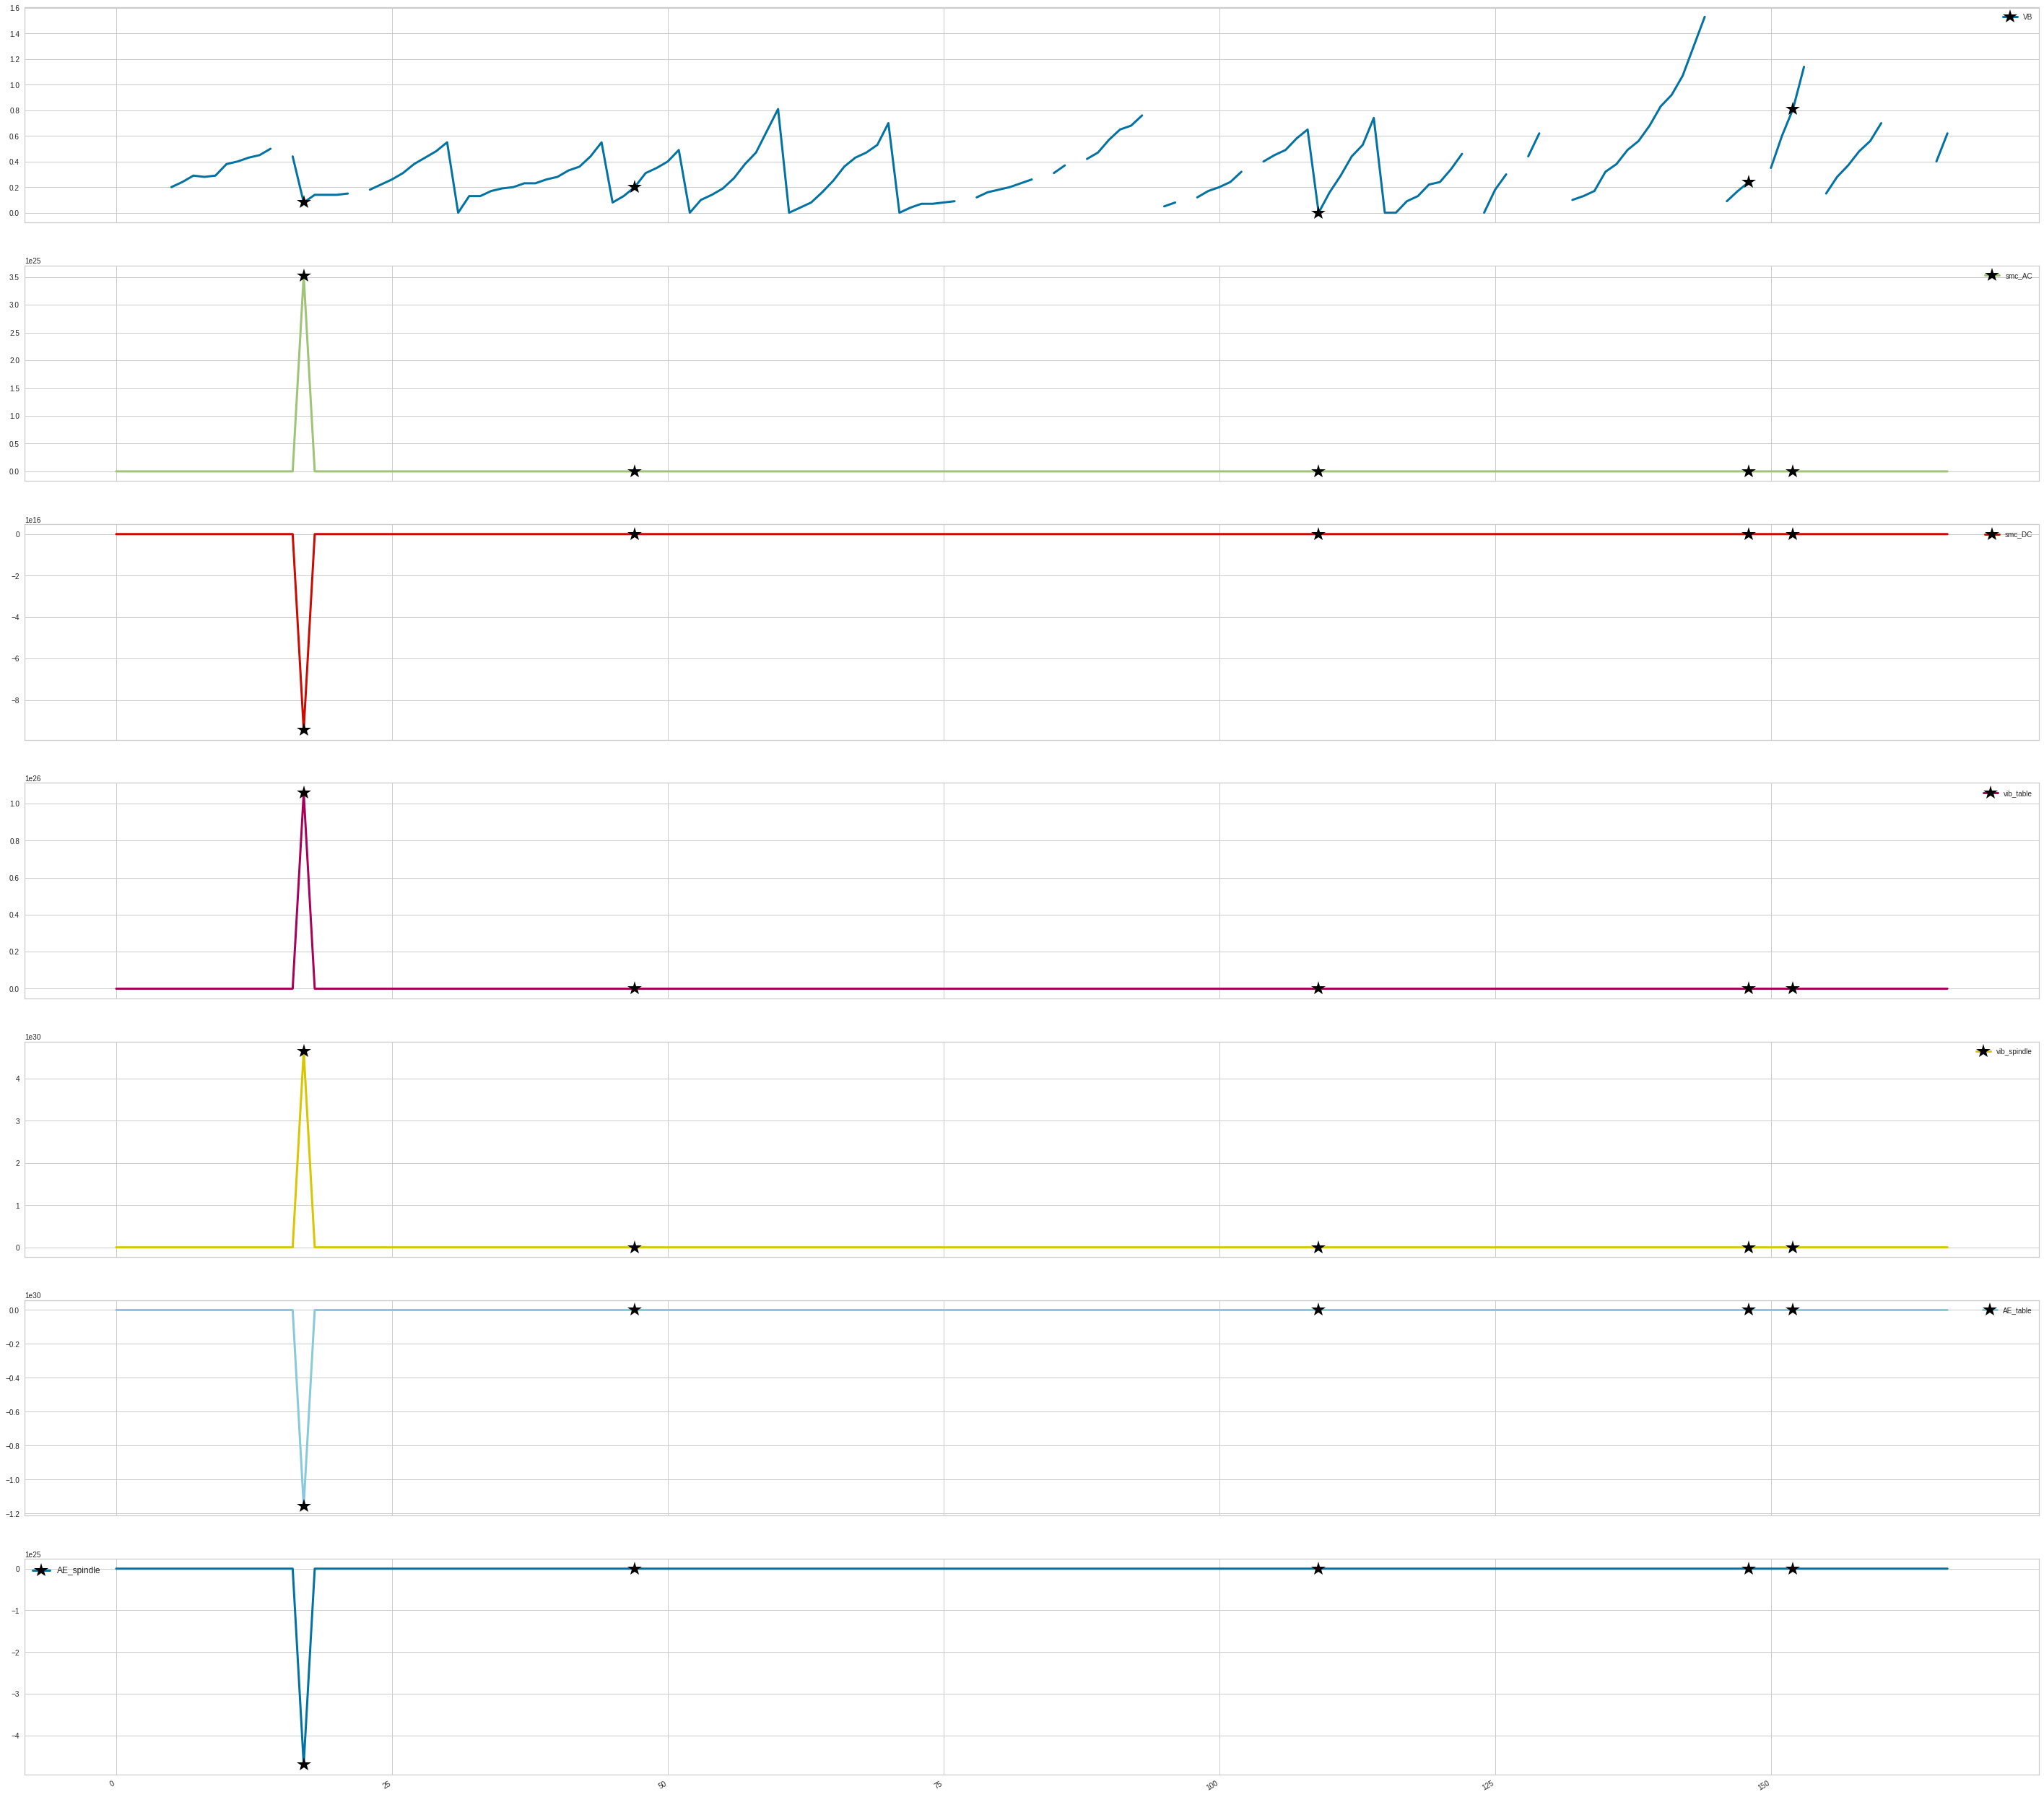
Before the removal of training example which is at index 17
Here the points marked by black star are the anomalies detected by the different models of PyCaret Library
Features used (placed in order as shown in plots):
Field Name | Description
VB | Flank wear
smc_AC | AC spindle motor current
smc_DC | DC spindle motor current
vib_table | Table vibration
vib_spindle | Spindle vibration
AE_table | Acoustic emission at table
AE_spindle | Acoustic emission at spindle

Slide 4
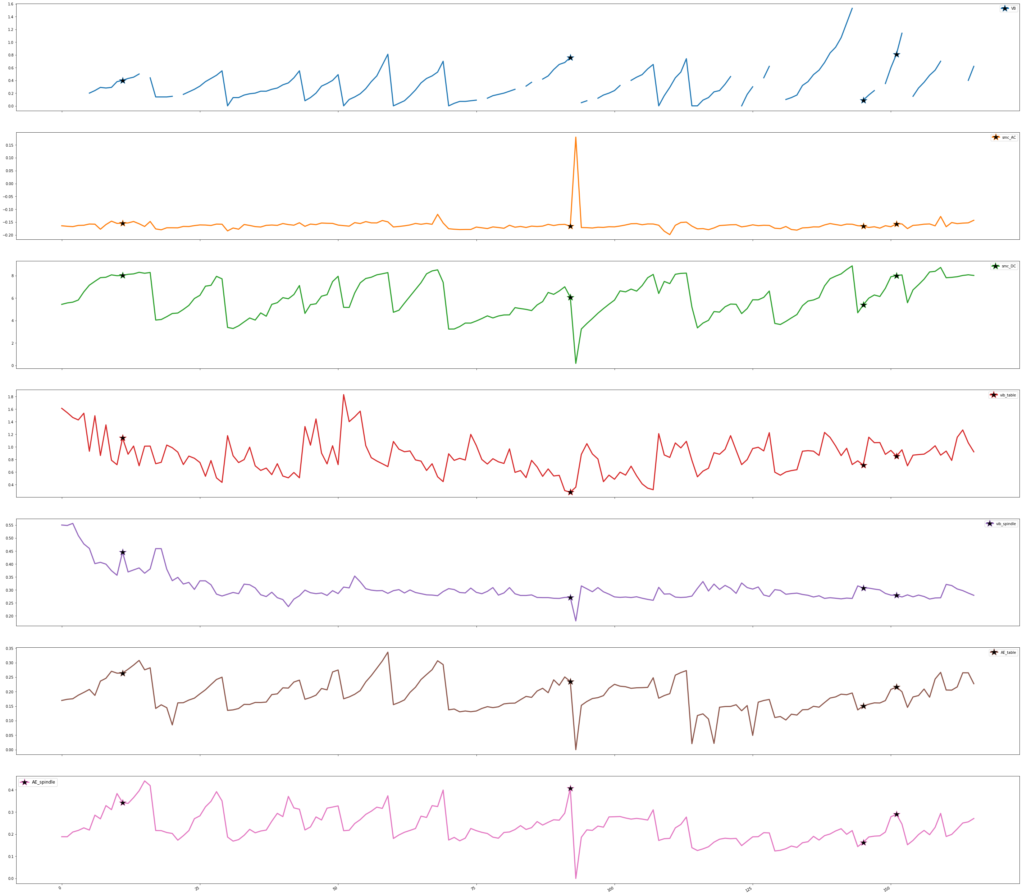
After the removal of training example which is at index 17
Models used:
Isolation Forest
One class SVM
PCA
KNN

Slide 5
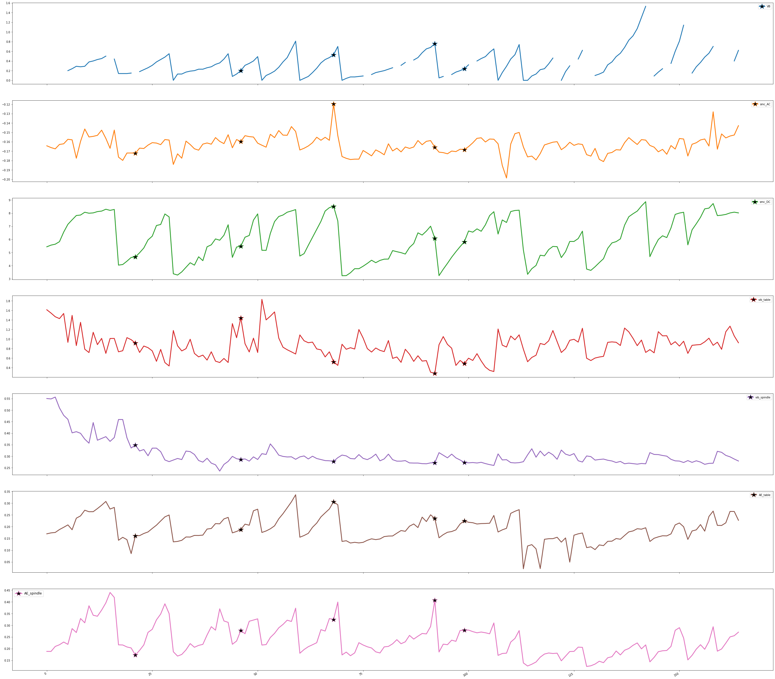
After the removal of training example which is at index 17 and at index 93

Slide 6
MINIMUM DATA

Slide 7
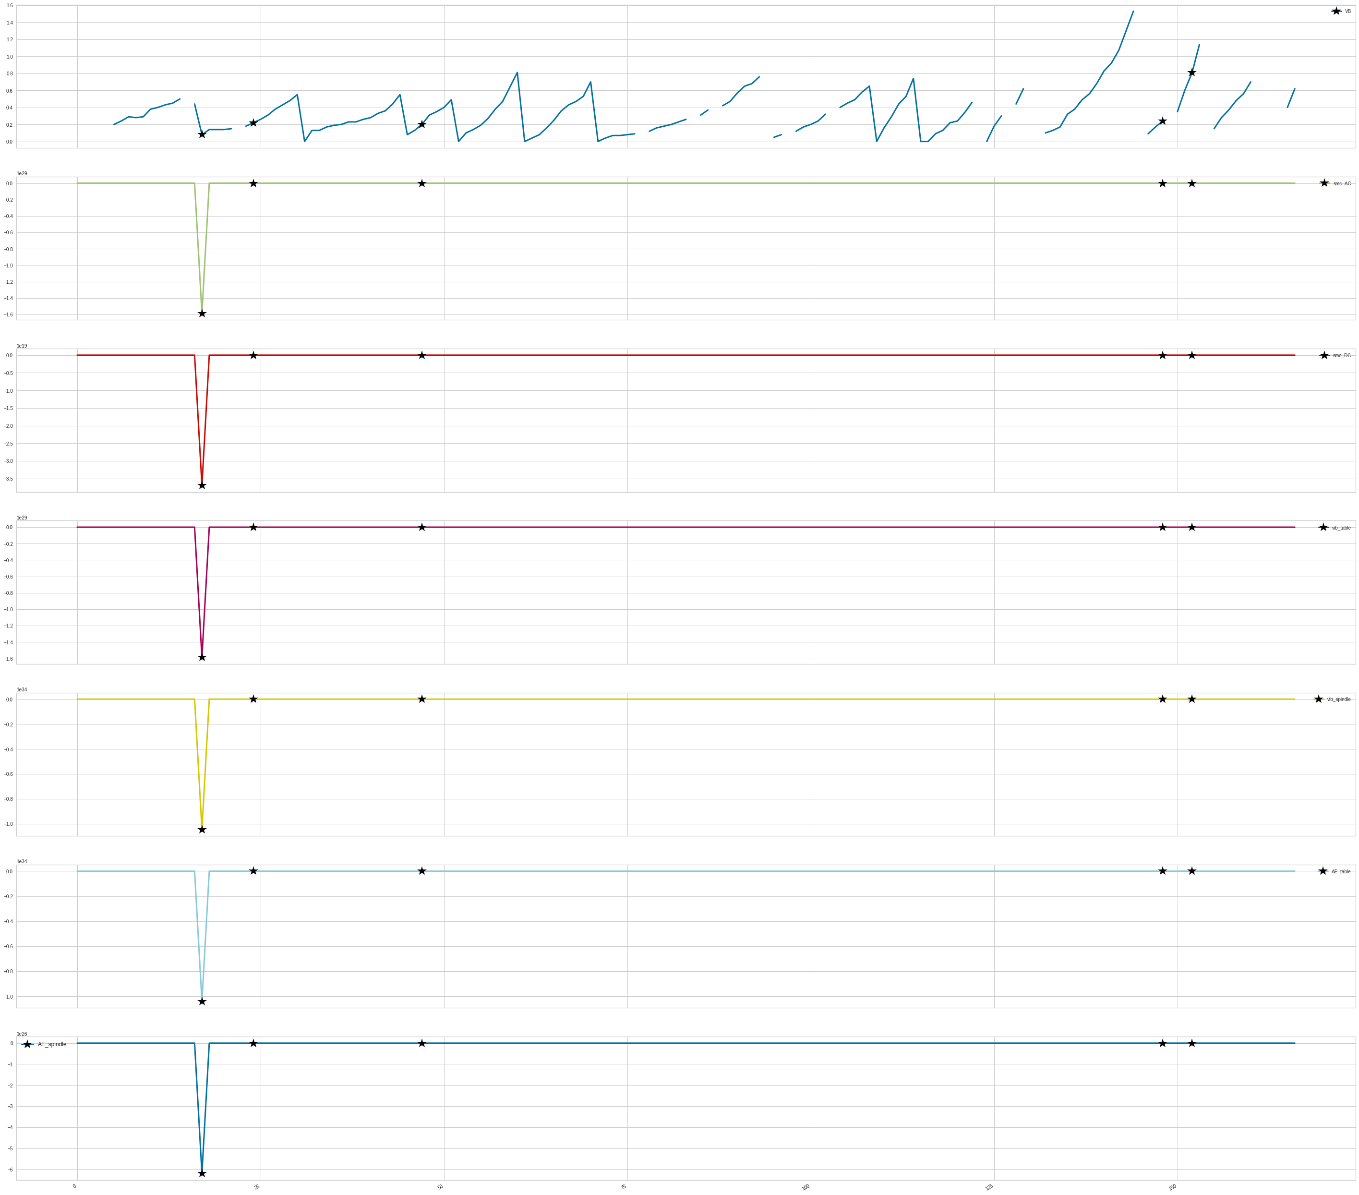
Before the removal of training example which is at index 17

Slide 8
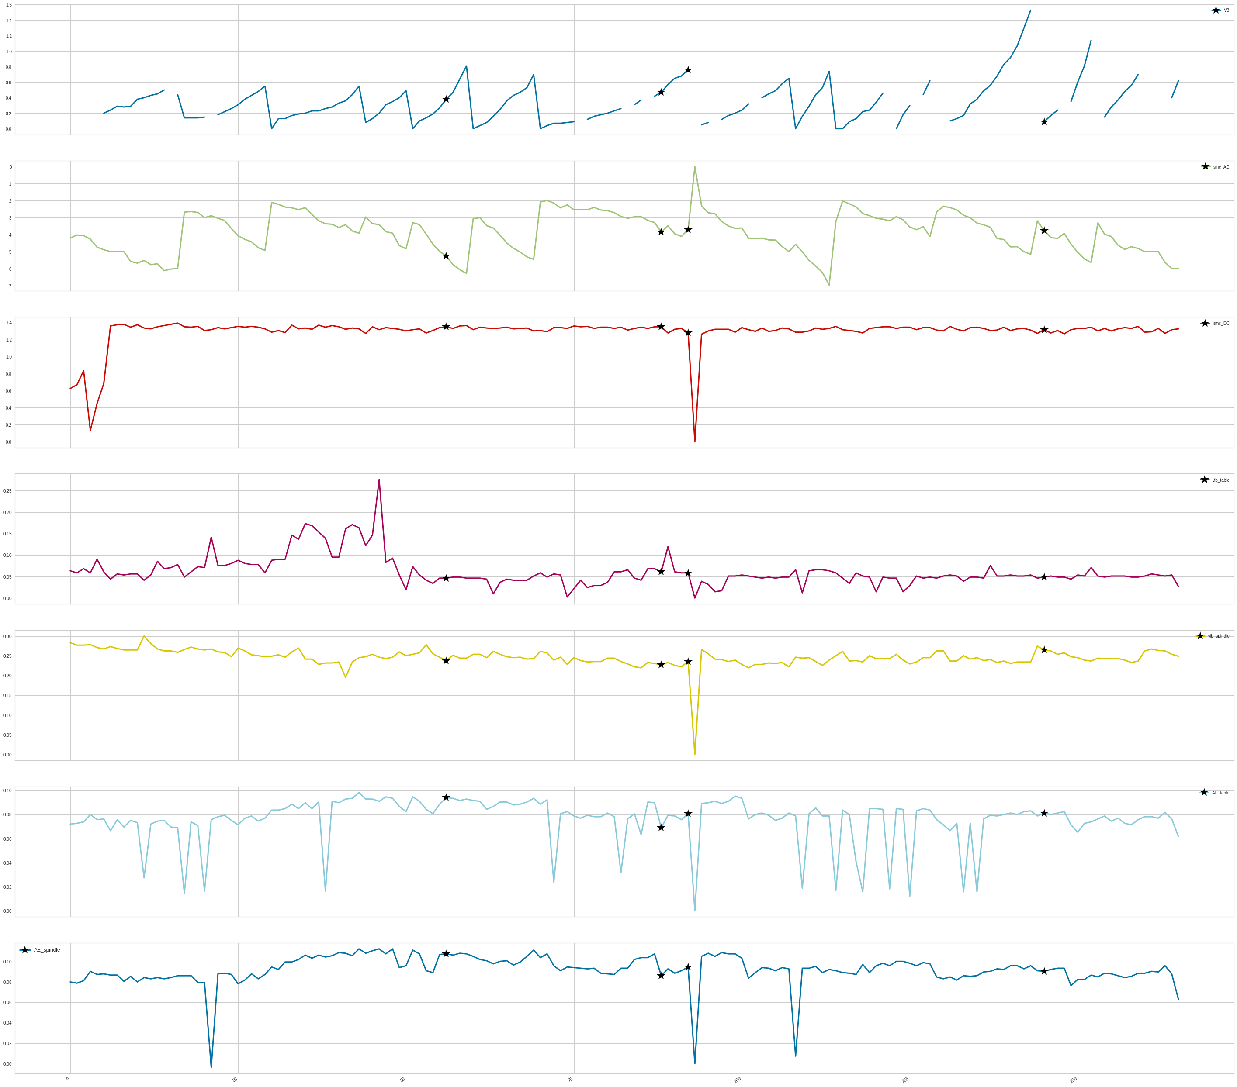
After the removal of training example which is at index 17

Slide 9
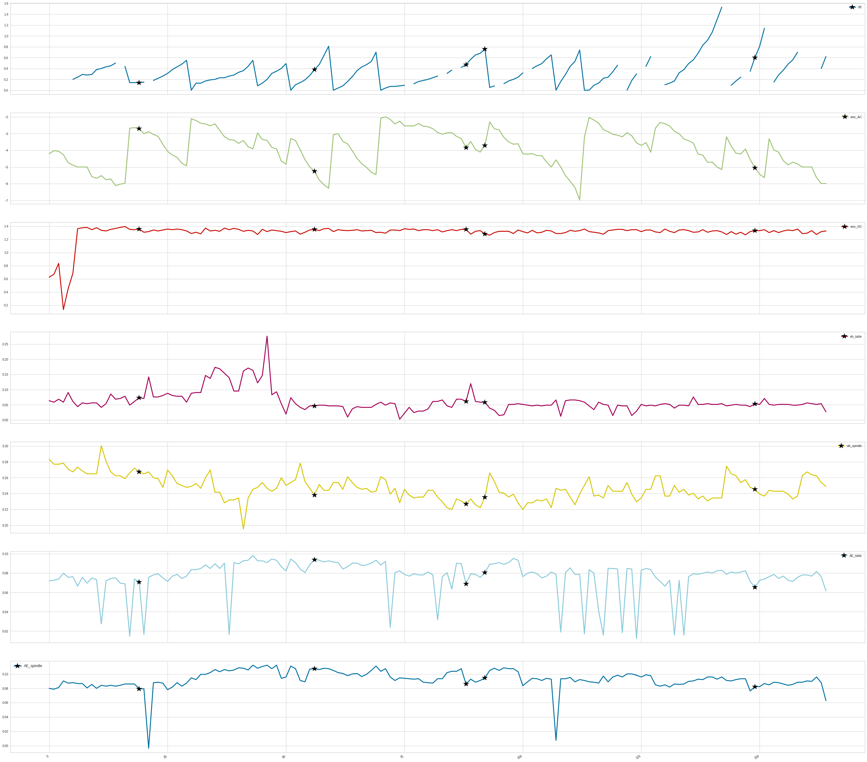
After the removal of training example which is at index 17 and at index 93

Slide 10
MAXIMUM DATA

Slide 11
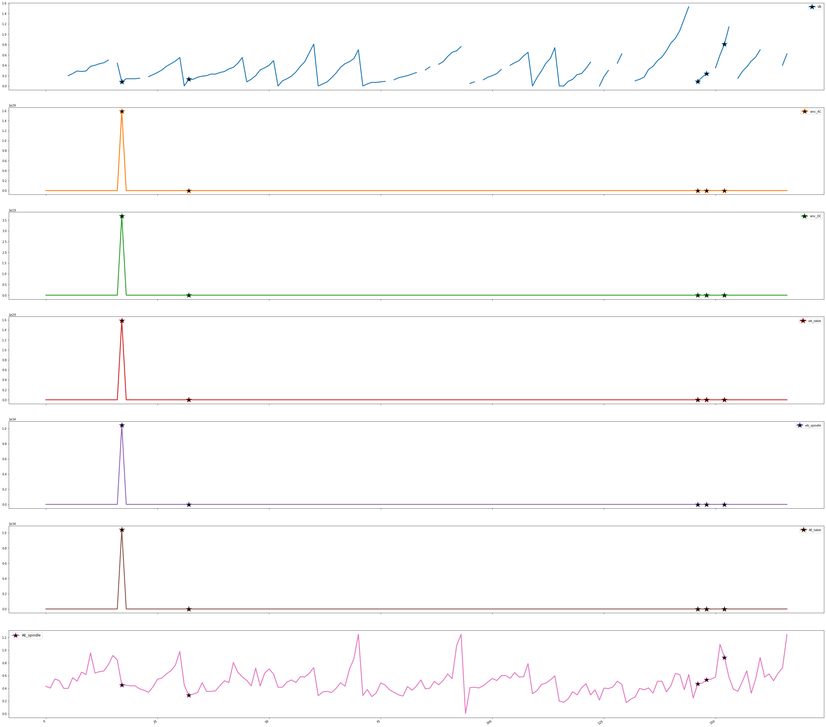
Before the removal of training example which is at index 17

Slide 12
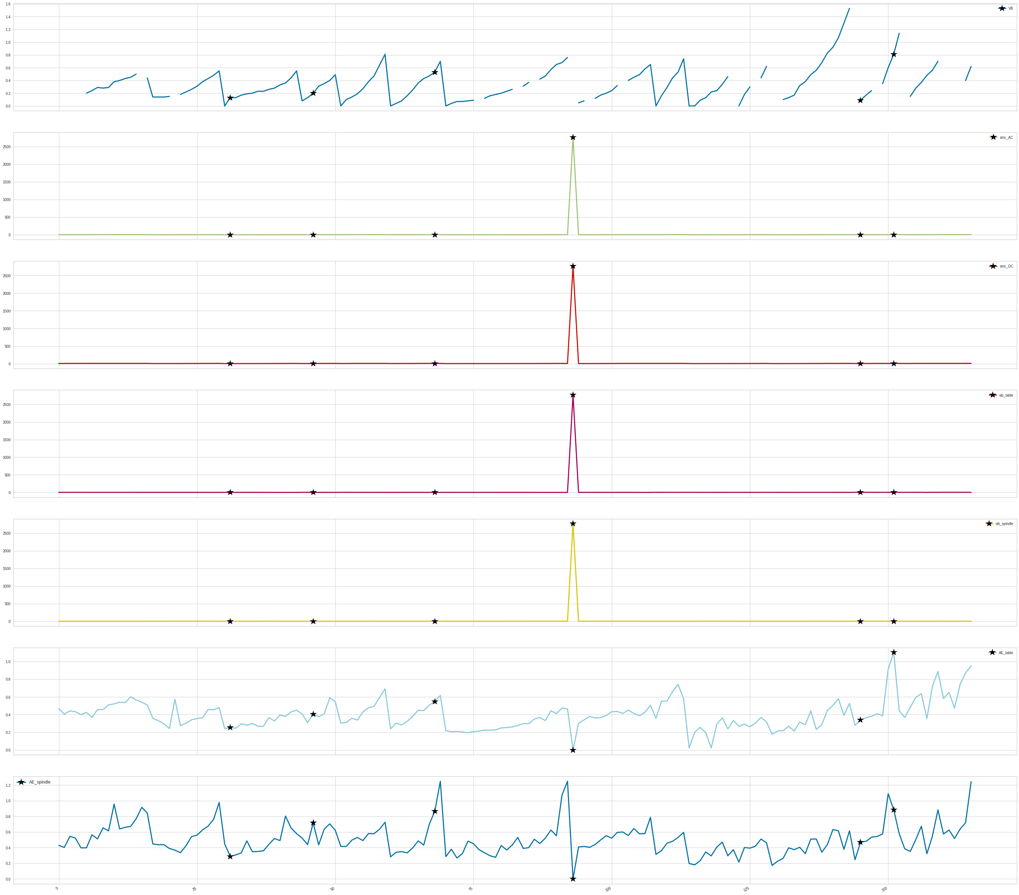
After the removal of training example which is at index 17

Slide 13
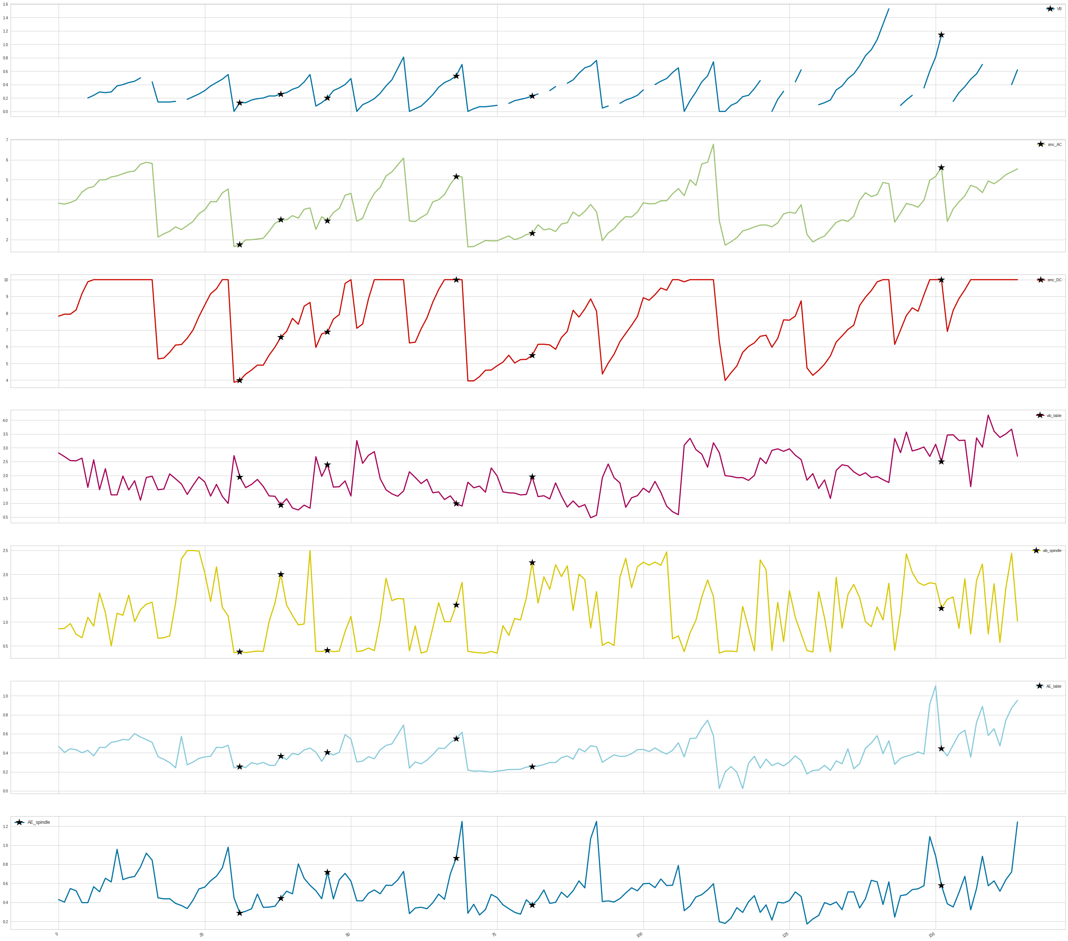
After the removal of training example which is at index 17 and at index 93

