Slide 1
MARKETING PERFORMANCE REVIEW
Maximizing Marketing
Campaign Performance
Facebook Ads vs. Google AdWords
A data-driven evaluation of conversions, engagement,
cost efficiency and campaign trends
MANAGEMENT PRESENTATION | 2019 CAMPAIGN PERFORMANCE

Slide 2
01 / DECISION BRIEF
Executive summary
11.74
5.98
32.88
76.35%
Facebook mean daily conversions
AdWords mean daily conversions
Welch t-statistic
Facebook regression R²
Facebook generated nearly 2× the average daily conversions of AdWords in the 2019 dataset.
Clicks were more strongly associated with conversions on Facebook (r = 0.87) than on AdWords (r = 0.45).
A Welch independent-samples t-test found a statistically significant difference in mean conversions (p = 9.35 × 10⁻¹³⁴).
Facebook click volume explained 76.35% of the observed variation in Facebook conversions in the fitted linear model.
MARKETING PERFORMANCE REVIEW
02

Slide 3
02 / BUSINESS CONTEXT
Business context & key questions
The agency needs to maximize client ROI by identifying which advertising platform delivers stronger outcomes and where budget can be deployed more effectively.
How frequently does each platform generate high-conversion days?
Do more ad clicks correspond to more conversions?
Is Facebook’s average conversion volume significantly higher?
Can clicks predict Facebook conversions?
How do Facebook conversions and cost metrics vary over time?
Do advertising cost and conversions exhibit a long-run relationship?
CORE RESEARCH QUESTION
Which platform is more effective in conversions, clicks and cost-effectiveness?
MARKETING PERFORMANCE REVIEW
03

Slide 4
03 / DATA FOUNDATION
Campaign scope & measurement framework
365
17
2019
2 platforms
Daily observations
Original columns
Jan 1 – Dec 31
Facebook & AdWords
CAMPAIGN MEASURES
PERFORMANCE ASSESSMENT
Views, clicks and conversions
Campaign cost, click-through rate (CTR)
Conversion rate and cost per click (CPC)
Daily date field for weekday and monthly trend analysis
Campaign performance benchmarking
Conversion and engagement trend assessment
Statistical comparison of platform outcomes
Conversion forecasting and relationship assessment
Structured review of campaign results, efficiency and performance drivers
MARKETING PERFORMANCE REVIEW
04

Slide 5
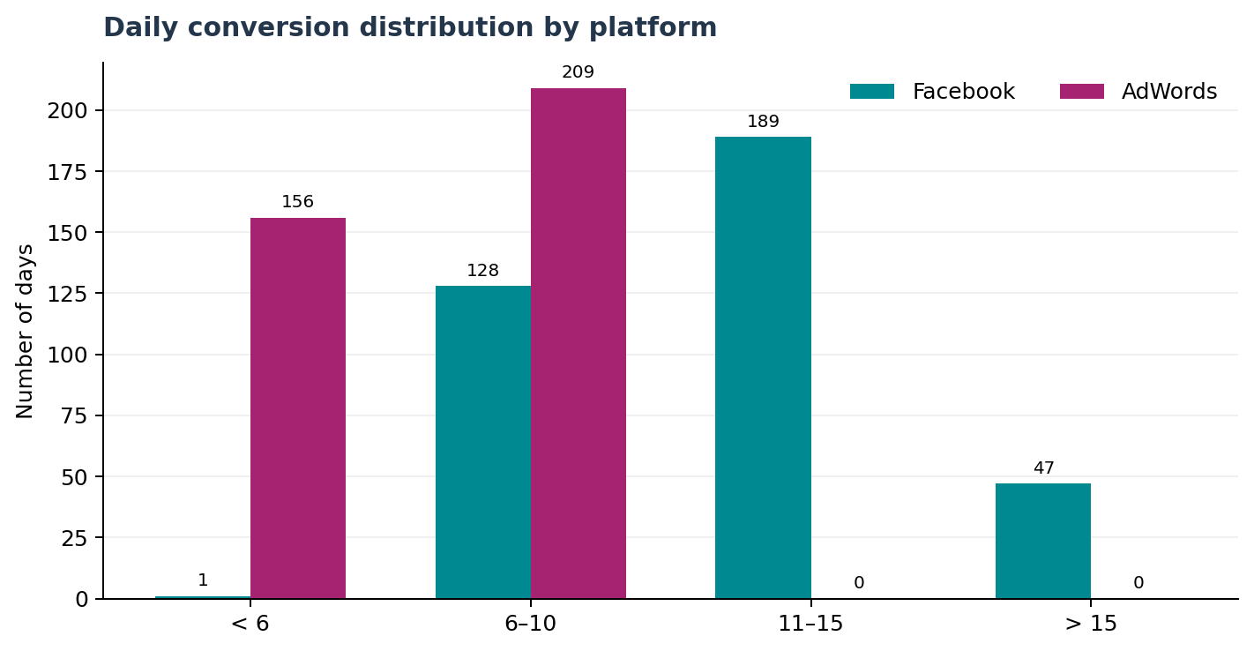
04 / CONVERSION DISTRIBUTION
Facebook delivered more high-conversion days
WHAT THE COUNTS SHOW
Facebook recorded 189 days in the 11–15 conversion band and 47 days above 15.
AdWords recorded no days above 10 conversions in the category breakdown.
AdWords had 156 days below 6 conversions and 209 days in the 6–10 band.
The distribution points to a stronger high-conversion-day profile for Facebook.
MARKETING PERFORMANCE REVIEW
05

Slide 6
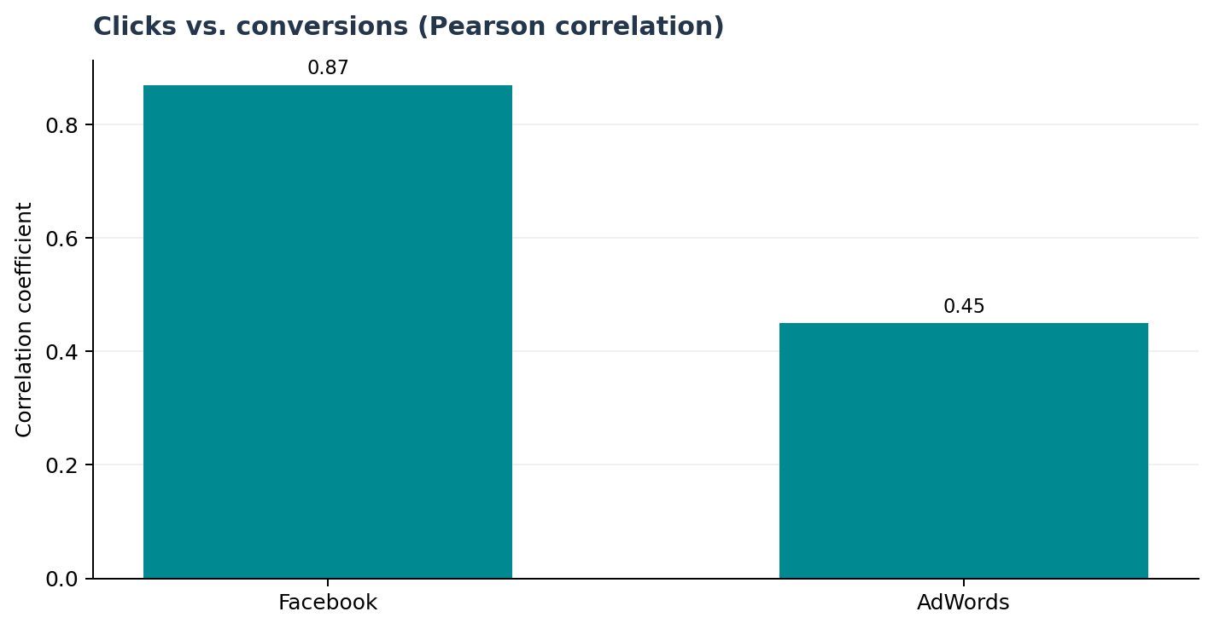
05 / RELATIONSHIP ANALYSIS
Clicks were more closely associated with Facebook conversions
PEARSON CORRELATION
0.87
Facebook clicks ↔ conversions
0.45
AdWords clicks ↔ conversions
Both relationships are positive. Facebook’s association is materially stronger in this dataset.
MARKETING PERFORMANCE REVIEW
06

Slide 7
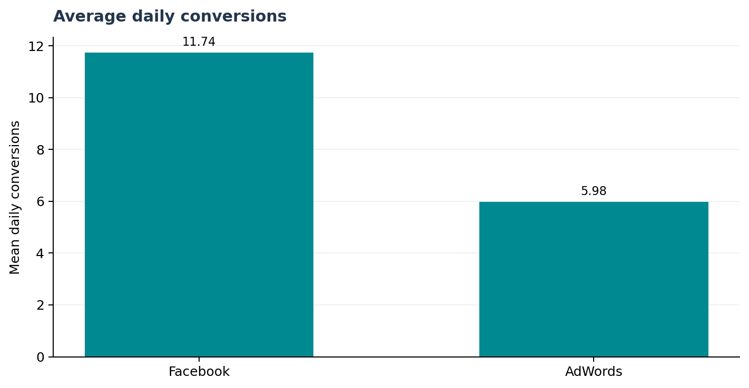
06 / STATISTICAL INFERENCE
Hypothesis test: Facebook mean conversions were higher
HYPOTHESES FROM THE NOTEBOOK
H₀: μFacebook ≤ μAdWords
H₁: μFacebook > μAdWords
32.88
9.35 × 10⁻¹³⁴
Welch t-statistic
p-value
Decision: p < 0.05 → reject H₀. The sample provides very strong evidence that Facebook’s mean daily conversions exceed AdWords’.
Method note: scipy.stats.ttest_ind(equal_var=False) was used; SciPy’s default alternative is two-sided. The reported p-value is therefore two-sided.
MARKETING PERFORMANCE REVIEW
07

Slide 8
07 / PREDICTIVE MODELLING
Predicting Facebook conversions from clicks
MODEL DESIGN
MODEL-BASED SCENARIOS
Simple linear regression
Feature: Facebook Ad Clicks
Target: Facebook Ad Conversions
13.00
19.31
Expected conversions at 50 clicks
Expected conversions at 80 clicks
76.35%
2.02
Interpretation: the fitted model explains 76.35% of the in-sample variation in Facebook conversions. Predictions are illustrative and should be validated on holdout data before operational use.
R² score
Mean squared error
Business use: translate click targets into expected conversion volumes to support campaign planning and performance forecasting.
MARKETING PERFORMANCE REVIEW
08

Slide 9
08 / TEMPORAL ANALYSIS
Time-based analysis highlights seasonality to investigate
ANALYSIS PERFORMED
NOTEBOOK OBSERVATIONS
Extracted month and weekday from the daily date field.
Aggregated Facebook conversions by weekday and by month.
Calculated monthly cost per conversion as total monthly Facebook ad cost ÷ total monthly conversions.
Notebook notes higher conversion activity early in the workweek and a generally upward monthly pattern, with several month-to-month dips.
May and November were identified as lower-cost-per-conversion months; February was highest.
Use these patterns as hypotheses for further investigation, not proof of seasonality or causal effects.
Data-quality check: pandas weekday uses Monday=0; the notebook’s weekday labels start with Sunday. Re-map labels before relying on weekday-specific conclusions.
MARKETING PERFORMANCE REVIEW
09

Slide 10
09 / TIME-SERIES ANALYSIS
Cointegration test indicates a long-run statistical relationship
QUESTION & HYPOTHESES
Do Facebook ad cost and conversions move together in the long run?
−14.76
2.13 × 10⁻²⁶
Engle–Granger test statistic
p-value
H₀: The two series are not cointegrated.
H₁: The two series are cointegrated.
At α = 0.05, reject H₀. The test provides strong evidence of cointegration between Facebook ad cost and conversions.
Caveat: confirm both series’ integration order and model assumptions. Cointegration does not establish that spend causes conversions or that the relationship is proportional.
MARKETING PERFORMANCE REVIEW
10

Slide 11
10 / FROM ANALYSIS TO ACTION
Business recommendations
Prioritize Facebook for further conversion-focused testing: it produced higher average daily conversions and a stronger clicks–conversions association in this dataset.
Run controlled budget experiments before shifting substantial spend; measure incremental conversions and cost per conversion.
Investigate AdWords’ low-conversion distribution: review targeting, creative, landing pages, audience intent and tracking quality.
Use the Facebook regression as a planning aid, then validate with a train/test split and monitor prediction error over time.
Re-check monthly cost efficiency and weekday patterns with correctly aligned date labels; use repeatable reporting to guide budget decisions.
MARKETING PERFORMANCE REVIEW
11

Slide 12
11 / ANALYTICAL RIGOR
Measurement considerations & next steps
PERFORMANCE REVIEW APPROACH
NEXT IMPROVEMENTS
Data loading, type conversion and feature engineering
Exploratory analysis and distribution comparison
Categorical aggregation and comparative visualization
Correlation analysis and hypothesis testing
Linear regression, model evaluation and prediction
Time-series aggregation and cointegration testing
Add a train/test split or time-based validation for regression.
Report confidence intervals and effect size alongside p-values.
Verify weekday label mapping and review all metric definitions.
Compare cost per conversion across both platforms consistently; avoid calling CPC cost per conversion.
Use campaign-level controls or randomized experiments to assess causal ROI.
MARKETING PERFORMANCE REVIEW
12

Slide 13
FINAL TAKEAWAY
Facebook led on conversion volume
and click-to-conversion association.
This review brings together campaign performance, conversion trends, statistical comparisons and forecasting to support practical marketing decisions.
THANK YOU

