Slide 1

NYC TAXI TRIPS · REVENUE ANALYSIS
Maximizing driver revenue: the role of payment type
Do fare amounts differ between cash and card trips, and what can drivers reasonably take from the evidence?
NYC taxi trips · An observational analysis of payment and fares.

Slide 2

RESEARCH QUESTION
What the analysis set out to answer
Compare fares paid by cash and card.
The goal is to identify customer-friendly opportunities that could support driver revenue.
A fare difference is a starting point for investigation, not evidence that changing payment method raises earnings.
A journey has distance, time and a payment choice.
2

Slide 3
EVIDENCE BASE
NYC trip records form the evidence base
Selected field | Analytical role
Passenger count | Describe the number of riders recorded per trip.
Payment type | Separate cash trips from card trips.
Fare amount | Compare the fare outcome across payment groups.
Trip distance | Check whether journey length differs.
Trip duration | Account for time spent on the journey.
The source does not specify the sample period or size, limiting assessment of representativeness.
3

Slide 4
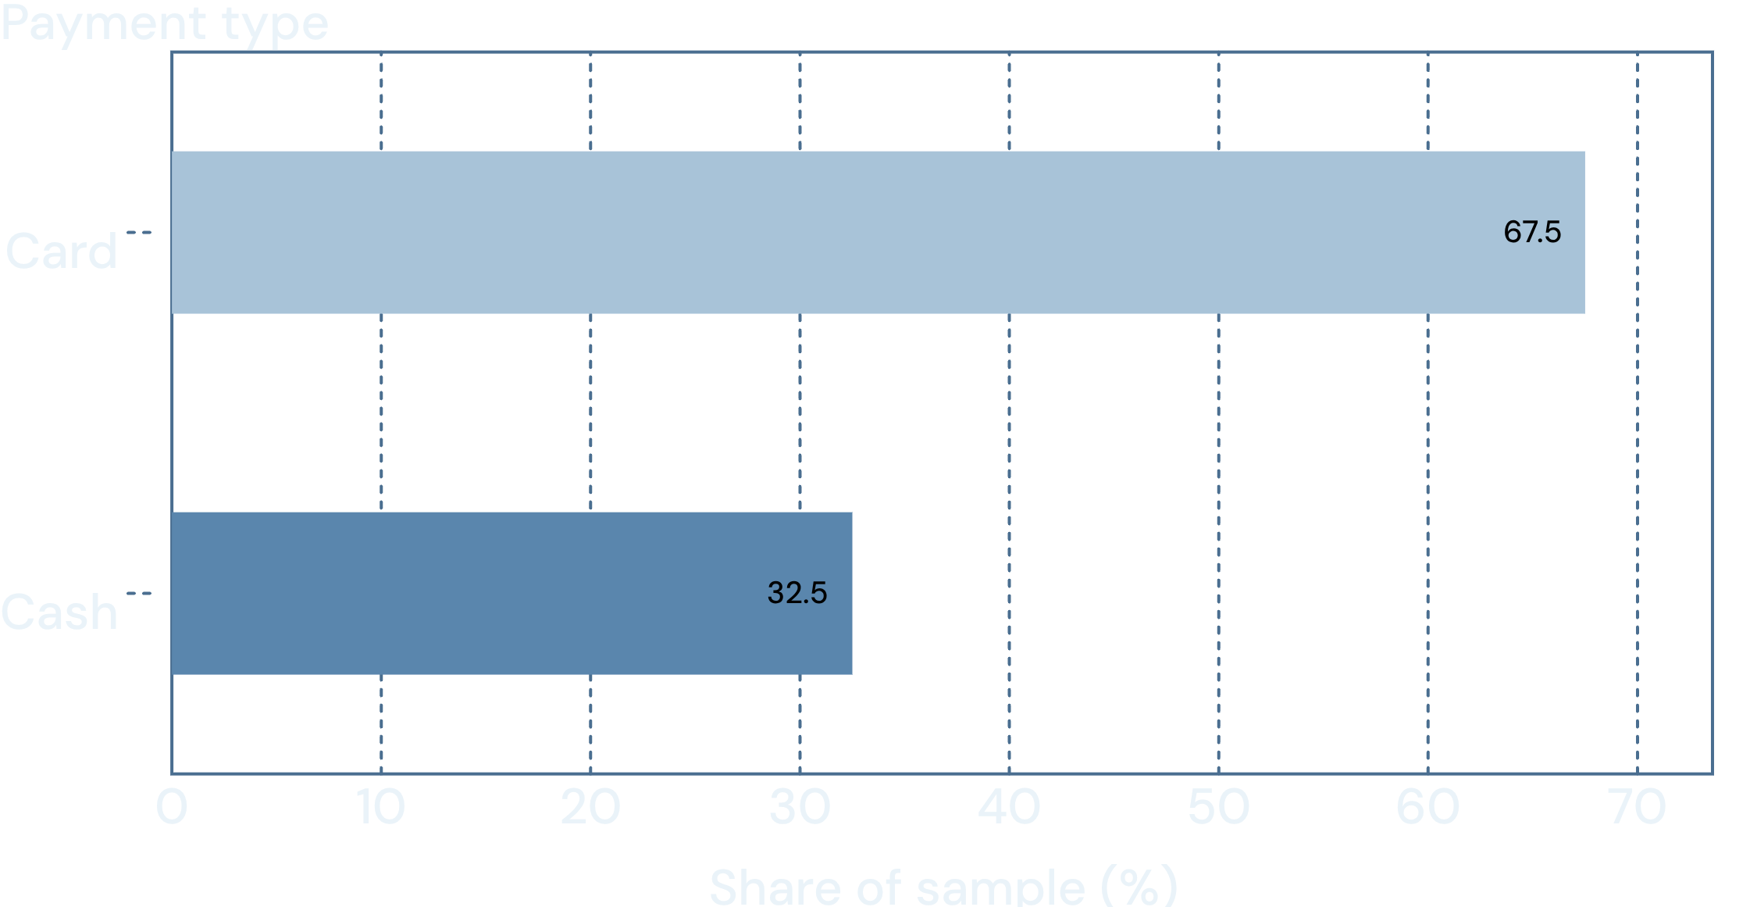
OBSERVATION · PAYMENT MIX
Card payments were more common
Card accounts for the larger share of recorded trips.
This describes the sample. It does not establish why riders chose card or whether card availability changed demand.
Reported payment shares (%) · Sample period and size unspecified.
4

Slide 5
INTERPRETATION · JOURNEY LENGTH MATTERS
Card trips had slightly higher fares and distances
The reported averages associate card payment with both higher fares and longer journeys.
OBSERVED GROUPING
POSSIBLE EXPLANATION
OBSERVED OUTCOME
Card-paid trips
Longer journeys
Slightly higher fares
Payment groups differ in the sample.
Greater distance may help explain higher fares.
No causal payment effect is established.
Compare similar journeys before attributing the fare difference to payment type.
Conceptual reasoning, not a quantified causal model. Exact average fares and distances were not supplied.
5

Slide 6
DATA QUALIFICATION
Passenger count needs careful interpretation
Single-passenger trips dominate the reported analysis, but the denominators behind the stated percentages are unclear.
40.08%
20.04%
Reported share with an unclear denominator.
Reported share with an unclear denominator.
Verify what each percentage is a share of before comparing the values or inferring rider preferences.
6

Slide 7

STATISTICAL INFERENCE
The t-test suggests a difference, not a cause
Null hypothesis
Alternative hypothesis
Mean fare amounts are equal for cash and card trips.
Mean fare amounts differ between the payment groups.
165.5
REPORTED T-STATISTIC
REPORTED SIGNIFICANCE
The result suggests a difference in means. Sample size, effect size, assumptions and uncertainty are absent, so practical importance and causal claims remain unsupported.
7

Slide 8
RECOMMENDED ANALYTICAL DESIGN
Test the revenue hypothesis more directly
Move from an unadjusted fare comparison to an earnings-focused analysis.
01
02
03
Compare like for like
Measure net earnings
Report the evidence
Compare cash and card trips with similar distance and duration.
Distinguish fare amounts from driver earnings, including tips and fees.
Publish sample size, effect estimates and uncertainty.
The decision-relevant question is whether drivers earn more on comparable trips.
8

Slide 9

RECOMMENDATION · PILOT BEFORE SCALING
Make card payment easy, then test incentives
Keep payments secure and seamless
Make card payment straightforward for customers.
Pilot discounts or incentives
Measure net driver earnings and customer experience against a comparison group.
Scale only on demonstrated benefit
Do not assume higher fares translate into earnings gains.
Payment convenience is actionable; an earnings benefit still needs testing.
9

