Slide 1
Building Web Apps with Node.JS for Web Designers
Rami Sayar - @ramisayar
Technical Evangelist @ Microsoft Canada

Slide 2
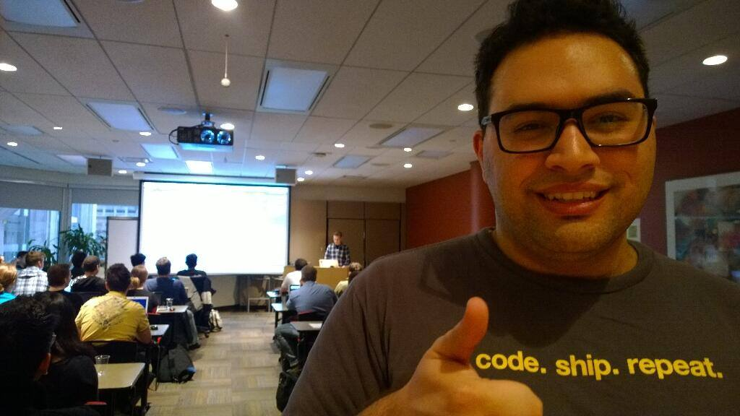
@ramisayar

Slide 3
Agenda
Building Web Apps with Node.JS for Web Designers
01 | Introduction to Node.js
02 | Introduction to Express
03 | Building a Front-end for your Express Web Apps with Jade

Slide 4
Setting Expectations
Target Audience
Web Designers
Web Developers
Developers with experience using other server side languages such as PHP, ASP.NET, Python, Ruby etc.
Suggested Prerequisites/Supporting Material
Software: aka.ms/node-101
Books: Mastering Node

Slide 5
Repository: github.com/sayar/node-for-web-designers

Slide 6
01 | Introduction to Node.js

Slide 7
What is Node?
Node.js is a runtime environment and library for running JavaScript applications outside the browser.
Node.js is mostly used to run real-time server applications and shines through its performance using non-blocking I/O and asynchronous events.

Slide 8
About Node
Leverage skills with JavaScript now on the server side
Unified development environment/language
High Performance JavaScript Engines – V8
Open source, created in 2009 by Ryan Dahl
Windows, Linux, Mac OSX
Still in “beta” phase

Slide 9
When to use Node
Node is great for streaming or event-based real-time applications like:
Chat Applications
Real time applications and collaborative environments
Game Servers
Ad Servers
Streaming Servers
Node is great for when you need high levels of concurrency but little dedicated CPU time.
Great for writing JavaScript code everywhere!

Slide 10
Node in the Wild
Microsoft
Yahoo!
LinkedIn
eBay
Dow Jones
Cloud9
The New York Times, etc

Slide 11
The Node Community
Five years after its debut, Node is the third most popular project on GitHub.
Over 2 million downloads per month.
Over 20 million downloads of v0.10x.
Over 81,000 modules on npm.
Over 475 meetups worldwide talking about Node.
Reference: http://strongloop.com/node-js/infographic/

Slide 12
01 | Setting up your environment

Slide 13
Installing Node on Windows
http://nodejs.org/ - pre-complied Node.js binaries to install
https://github.com/joyent/node/wiki/Installation - building it yourself
Via Chocolatey – package manager for Windows:
choco install nodejs.install

Slide 14
Path Variable
Double check that the node executable has been added to your PATH system environment variable.
https://www.youtube.com/watch?v=W9pg2FHeoq8 To see how to change your environment variables on Windows 8 and Windows 8.1.
You will want to make sure the following folder has been added to the PATH variable: C:\Program Files (x86)\nodejs\

Slide 15
Installing Node on Ubuntu
Easiest is to install via the terminal using the package manager.
You also want to install compilers and build essential tools for packages that might need them.
sudo apt-get install build-essential
sudo apt-get install nodejs npm

Slide 16
Installing Node on OSX
Easiest is to install via the terminal using the brew package manager.
You can also compile it from source or use the installer on nodejs.org
sudo brew install node

Slide 17
01 | First Node Application

Slide 18
Demo: Hello World Application

Slide 19
Demo: Basic HTTP Server

Slide 20
Event Driven Programming
“A programming paradigm in which the flow of the program is determined by events such as user actions (mouse clicks, key presses) or messages from other programs.” – Wikipedia

Slide 21
Node Event Loop
Node provides the event loop as part of the language.
With Node, there is no call to start the loop.
The loop starts and doesn’t end until the last callback is complete.
Event loop is run under a single thread therefore sleep() makes everything halt.

Slide 22
Blocking I/O
var fs = require('fs');
var contents = fs.readFileSync('package.json').toString();
console.log(contents);

Slide 23
Non Blocking I/O
var fs = require('fs');
fs.readFile('package.json', function (err, buf) {
console.log(buf.toString());
});

Slide 24
Callback Style Programming
Event loops result in callback-style programming where you break apart a program into its underlying data flow.
In other words, you end up splitting your program into smaller and smaller chunks until each chuck is mapped to operation with data.
Why? So that you don’t freeze the event loop on long-running operations (such as disk or network I/O).

Slide 25
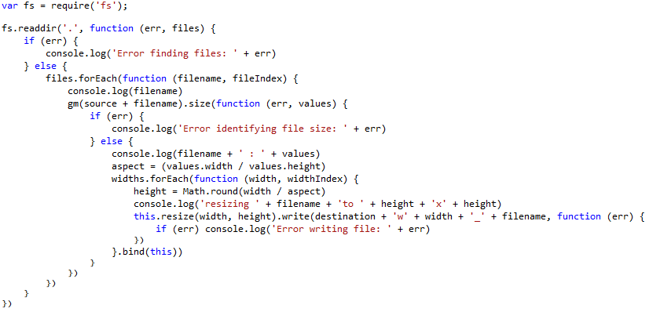
Callback Insanity

Slide 26
Promises
A function will return a promise for an object in the future.
Promises can be chained together.
Simplify programming of async systems.

Slide 27
Q Library
step1(function (value1) {
step2(value1, function (value2) {
step3(value2, function (value3) {
step4(value3, function (value4) {
// Do something with value4
});
});
});
});
Q.fcall(promisedStep1)
.then(promisedStep2)
.then(promisedStep3)
.then(promisedStep4)
.then(function (value4) {
// Do something with value4
})
.catch(function (error) {
// Handle any error from all above steps
})
.done();

Slide 28
Demo: Basic TCP Demo

Slide 29
Event Emitters
Allows you to listen for “events” and assign functions to run when events occur.
Each emitter can emit different types of events.
The “error” event is special.
Read More: http://code.tutsplus.com/tutorials/using-nodes-event-module--net-35941

Slide 30
Streams
Streams represent data streams such as I/O.
Streams can be piped together like in Unix.
var fs = require("fs");
// Read File
fs.createReadStream("package.json")
// Write File
.pipe(fs.createWriteStream("out.json"));

Slide 31
Modules and Exports
Node.js has a simple module and dependencies loading system.
Unix philosophy -> Node philosophy
Write programs that do one thing and do it well -> Write modules that do one thing and do it well.

Slide 32
Require() Module Loading System
Call the function “require” with the path of the file or directory containing the module you would like to load.
Returns a variable containing all the exported functions.
var fs = require("fs");

Slide 33
01 | Node Package Manager (NPM)

Slide 34
What is NPM?
Official package manager for Node.
Bundled and installed automatically with the environment.
Frequent Usage:
npm install --save package_name
npm update

Slide 35
How does it work?
Installs the dependencies in the local node_modules folder
In global mode, it makes a node module accessible to all.
Can install from a folder, tarball, web, etc…
Can specify dev or optional dependencies.
NPM can also install the dependencies for a project by reading the package.json

Slide 36
What is a package.json?
{
"name": "Node101",
"version": "0.1.0",
"description": “MVA Presentation Code",
"main": "1_hello_world.js",
"author": {
"name": "Rami Sayar",
"email": ""
}
}

Slide 37
Popular NPM Modules
Most Depended Upon
underscore
async
request
lodash
commander
express
optimist
coffee-script

Slide 38
Async Module
Async is a utility module which provides straight-forward, powerful functions for working with asynchronous JavaScript.
async.map(['file1','file2','file3'], fs.stat, function (err, results) {
// results is now an array of stats for each file
});
async.filter(['file1','file2','file3'], fs.exists, function (results) {
// results now equals an array of the existing files
});
async.parallel([
function () { },
function () { }
], callback);
async.series([
function () { },
function () { }
]);

Slide 39
Request Module
Request is designed to be the simplest way possible to make http calls. It supports HTTPS, streaming and follows redirects by default.
var request = require('request'); request('http://www.microsoft.com', function (error, response, body) {
if (!error && response.statusCode == 200) {
console.log(body);
}
});

Slide 40
Demo: Using the Q Library

Slide 41
02 | Introduction to Express

Slide 42
Why use Express?
Express helps you respond to requests with route support so that you may write responses to specific URLs.
Supports multiple templating engines to simplify generating HTML.

Slide 43
02 | Installing and Using Express

Slide 44
Installing and Using Express
npm install express
npm install jade

Slide 45
02 | Creating a Simple REST API

Slide 46
Explanation of Routes
A router maps HTTP requests to a callback.
HTTP requests can be sent as GET/POST/PUT/DELETE, etc.
URLs describe the location targeted.
Node helps you map a HTTP GET request like:
http://localhost:8888/index
To a request handler (callback)
app.get('/index', function (req, res) {});

Slide 47
Creating a Simple Express Application
var express = require('express');
var app = express();
app.get('/', function (req, res) {
res.json({message:'hooray! welcome to our api!'});
});
app.listen(process.env.PORT || 8080);

Slide 48
Demo: Creating a Simple REST API with Express Framework

Slide 49
Demo: Using the express-generator package.

Slide 50
Building a RESTful API for Dogs
Resource | GET | PUT | POST | DELETE
Collection URI, such as http://api.example.com/v1/dogs/ | List all the dogs | Replace all the dogs with a new collection of dogs. | Create a new dog in the collection. | Delete the entire dog collection.
Element URI, such as http://api.example.com/v1/dog/1 | Get a specific dog. | Replace a dog in the collection with another dog. | Not used. | Delete the dog from the collection.

Slide 51
Demo: Using Express to build a RESTful API

Slide 52
03 | Introduction to Jade

Slide 53
Templating with Jade
Jade is a templating language to simplify writing HTML.
Jade syntax and keywords map directly to HTML.
Jade adds the ability to separate and extend your HTML.
Helps prevent code repeat
Ensures clean HTML is generated.
Allows you to insert values into HTML through templates.

Slide 54
Templating with Jade
Simple Tags
Output
div
address
i
strong
<div>
<address></address><i></i><strong></strong>
</div>

Slide 55
Templating with Jade
Tags with Attributes
Output
h1(id="title") Welcome to Jade
button(class="btn", data-action="bea").
Be Awesome
<h1 id="title">Welcome to Jade</h1>
<button data-action="bea" class="btn">Be Awesome</button>

Slide 56
Templating with Jade
The extends keyword allows a template to extend a layout or parent template. It can then override certain pre-defined blocks of content.
The block keyword allows you to establish a block or replace the content of pre-defined blocks.

Slide 57
Demo: Using Jade Templates

Slide 58
What did we learn?
All about Node.js
ExpressJS
Jade
How Node.JS is Awesome!

Slide 59
Thank You! Questions?
tw: @ramisayar | gh: @sayar
slideshare.net/ramisayar

Slide 60
Resources
https://blog.jcoglan.com/2013/03/30/callbacks-are-imperative-promises-are-functional-nodes-biggest-missed-opportunity/
http://code.tutsplus.com/tutorials/using-nodes-event-module--net-35941
http://spin.atomicobject.com/2012/03/14/nodejs-and-asynchronous-programming-with-promises/
GitHub Repositories: https://github.com/sayar/NodeMVA
GitHub Repositories: https://github.com/sayar/node-for-web-designers

Slide 61
Resources
Express Framework http://expressjs.com/
Intro to Express http://code.tutsplus.com/tutorials/introduction-to-express--net-33367
Jade Templates http://jade-lang.com/tutorial/
JavaScript and Jade Templating http://www.slideshare.net/wearefractal/jade-javascript-templating

