Slide 1
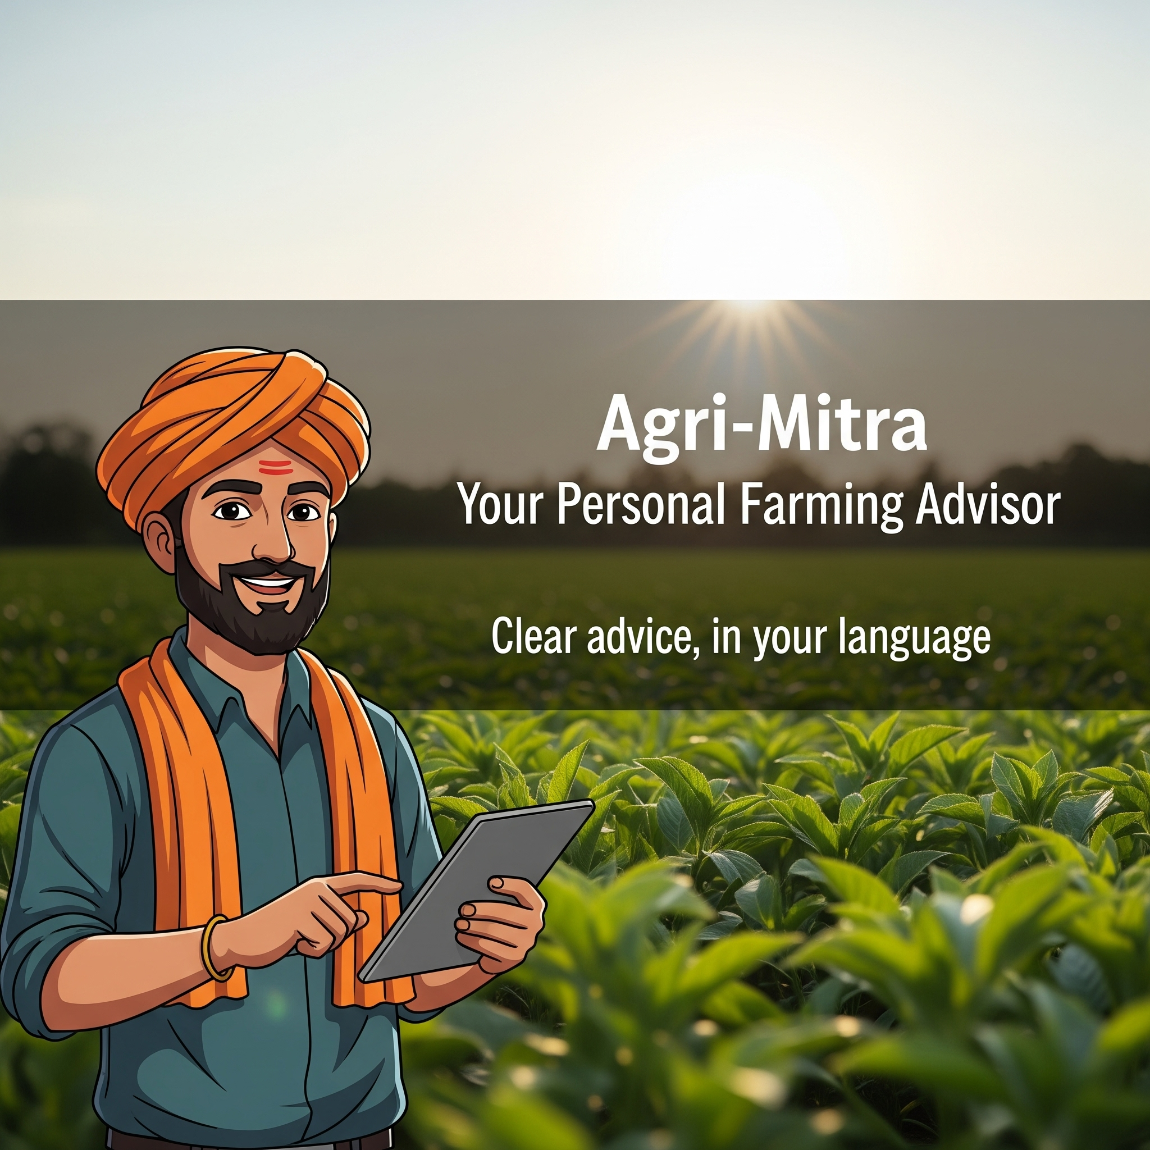
🌾
AgriSathi
🌾
Sayash Raaj
IIT Madras
Demo video:
https://youtube.com/shorts/DH7Ye1_OrZ8

Slide 2
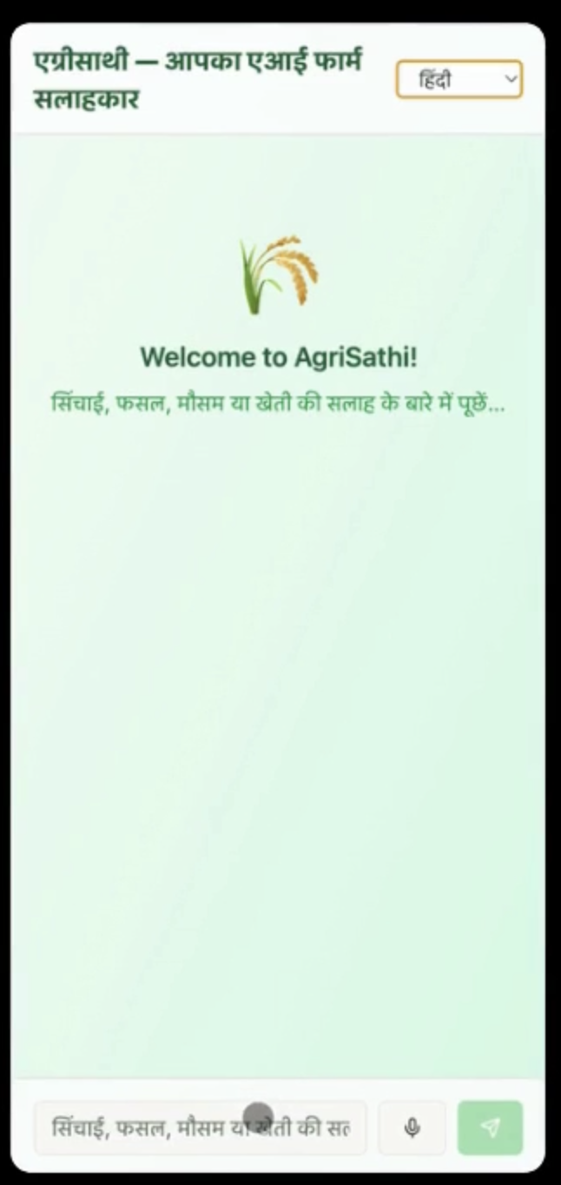
🌾
Demo video:
https://youtube.com/shorts/DH7Ye1_OrZ8
Why should a farmer's success depend on guesswork?
Every day, millions of Indian farmers face critical questions alone.
🗣️ Language Barriers: Advice is rarely in their native tongue.
📱 Digital Hurdles: Complex apps don't work for everyone.
🌐 Poor Connectivity: Slow internet makes most tools useless.
The result is uncertainty, risk, and lost income.
Demo images on the right
🌾

Slide 3
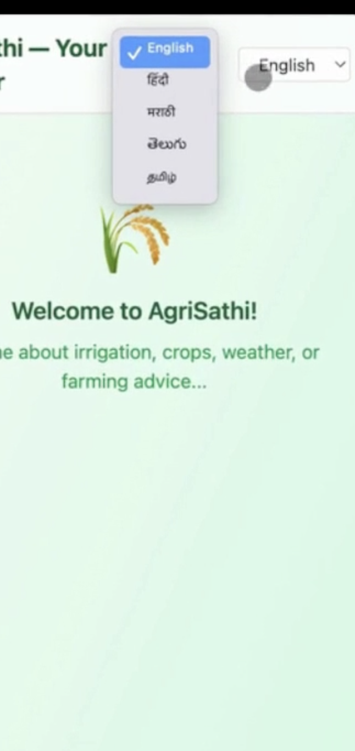
🌾
Demo video:
https://youtube.com/shorts/DH7Ye1_OrZ8
Introducing Agri-Mitra.
We are solving the critical information gap in Indian agriculture. Millions of farmers lack access totimely, localized, and understandable advice, forcing them to make high-stakes decisions based on guesswork.
Why it matters: Empowering farmers with reliable, data-driven guidance directly improves crop yields, increases income, and strengthens food security for the entire nation. We are turning complex data into simple, actionable advice.
Demo images on the right
🌾

Slide 4
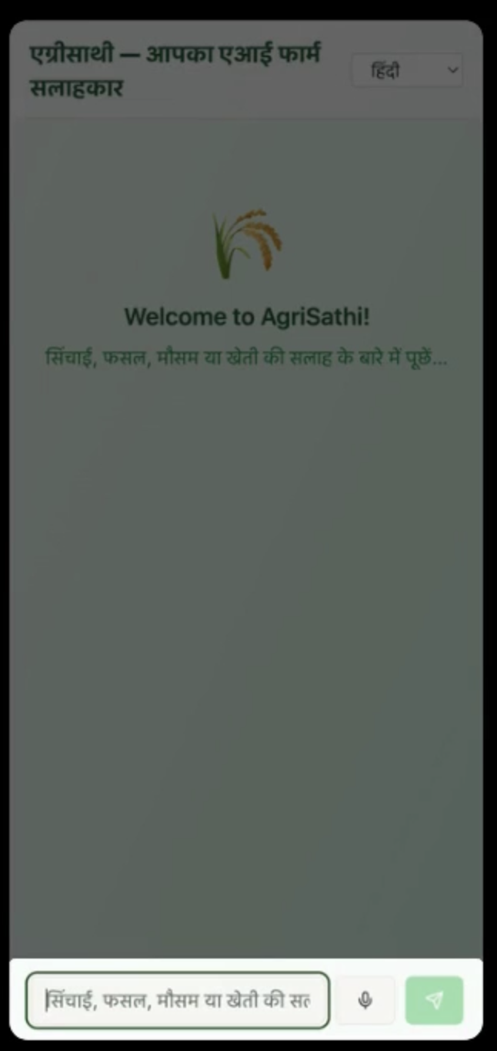
🌾
Demo video:
https://youtube.com/shorts/DH7Ye1_OrZ8
Agri-Mitra is a conversational web application that acts as a personal farming advisor.
User Interaction: The farmer asks a question in their native language (English, Hindi, Marathi, Tamil, or Telugu) using text or voice.
Contextualization Engine: The app automatically captures the user's geolocation and the current date/time.
Query Matching: Instead of a live LLM, our system matches the user's query to a curated, expert-verified Q&A knowledge base.
Localized Response: The system delivers a precise, pre-translated, and context-aware answer that is relevant to the user's specific agro-climatic zone and time of year.
Demo images on the right
🌾

Slide 5
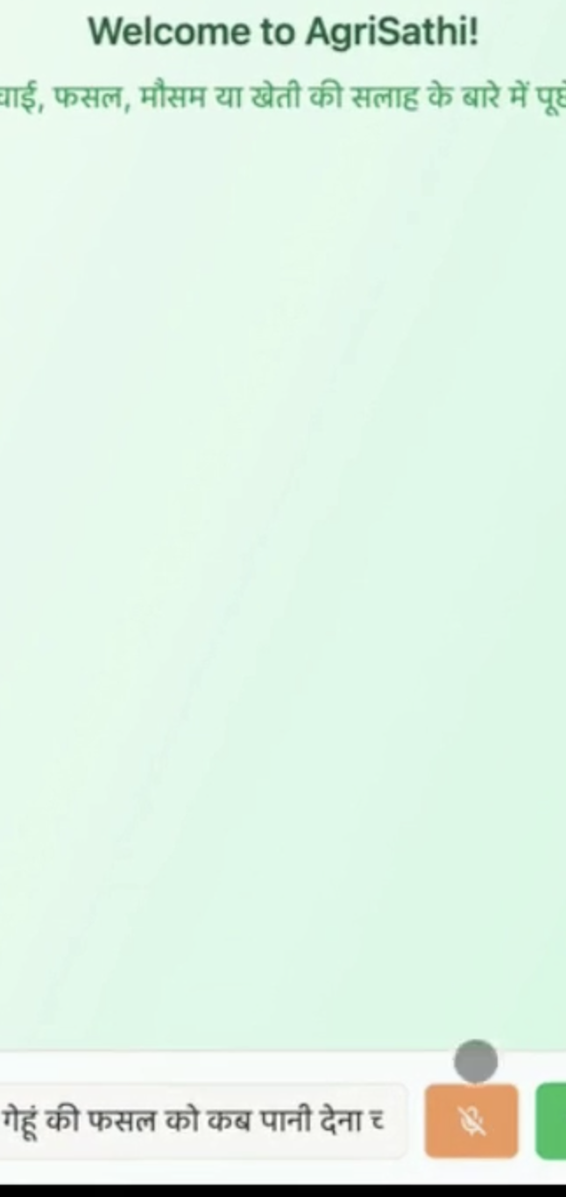
🌾
Demo video:
https://youtube.com/shorts/DH7Ye1_OrZ8
Data Sources: Curated Expert Knowledge
Our core strength is our data- a high-quality, curated knowledge base, not a massive, generic dataset.
Primary Sources: We finetuned on representative Q&A pairs from advisories published by State Agricultural Universities, ICAR (Indian Council of Agricultural Research), and government policy documents.
Data Preprocessing:
Content Curation: We focused on the most frequent and critical farmer queries: irrigation, seed selection, pest control, and government schemes.
Translation: All Q&A pairs were professionally translated and culturally adapted for our five target languages to ensure clarity and trust.
Challenges: The main challenge was not a lack of data, but filtering out noise and conflicting information to create a single, reliable source of truth for the farmer.
🌾
Demo images on the right

Slide 6
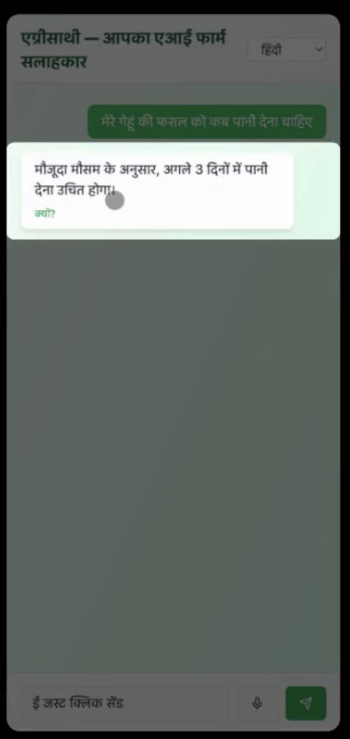
🌾
Demo video:
https://youtube.com/shorts/DH7Ye1_OrZ8
Technology & Architecture: Simplicity and Speed
Our design philosophy was "maximum impact, minimum overhead." We chose a tech stack optimized for accessibility and rapid deployment.
Architecture: This zero-dependency model ensures the app is extremely lightweight, fast, and works reliably in low-connectivity environments.
Tech Stack:
Frontend: HTML, CSS, JavaScript (No complex frameworks).
Backend: Node.js
Geolocation: Browser Geolocation API for hyper-local context.
Voice Input: Web Speech API for natural language interaction.
AI Model: We use multilingual Sarvam-1 developed in India
🌾
Demo images on the right

Slide 7
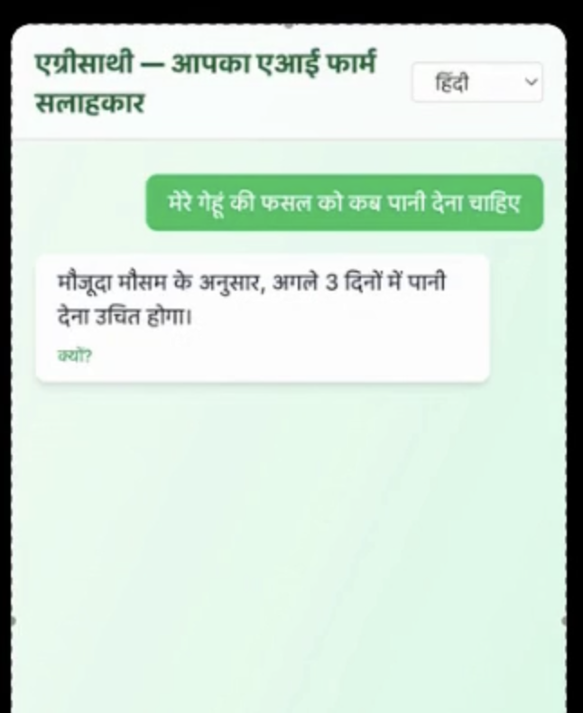
🌾
Demo video:
https://youtube.com/shorts/DH7Ye1_OrZ8
Our journey is just beginning.
More Languages: Expanding our reach across India.
Live Data: Integrating real-time market prices and weather alerts.
Community Platform: Connecting farmers to share knowledge and success.
Demo images on the right
🌾

