Slide 1
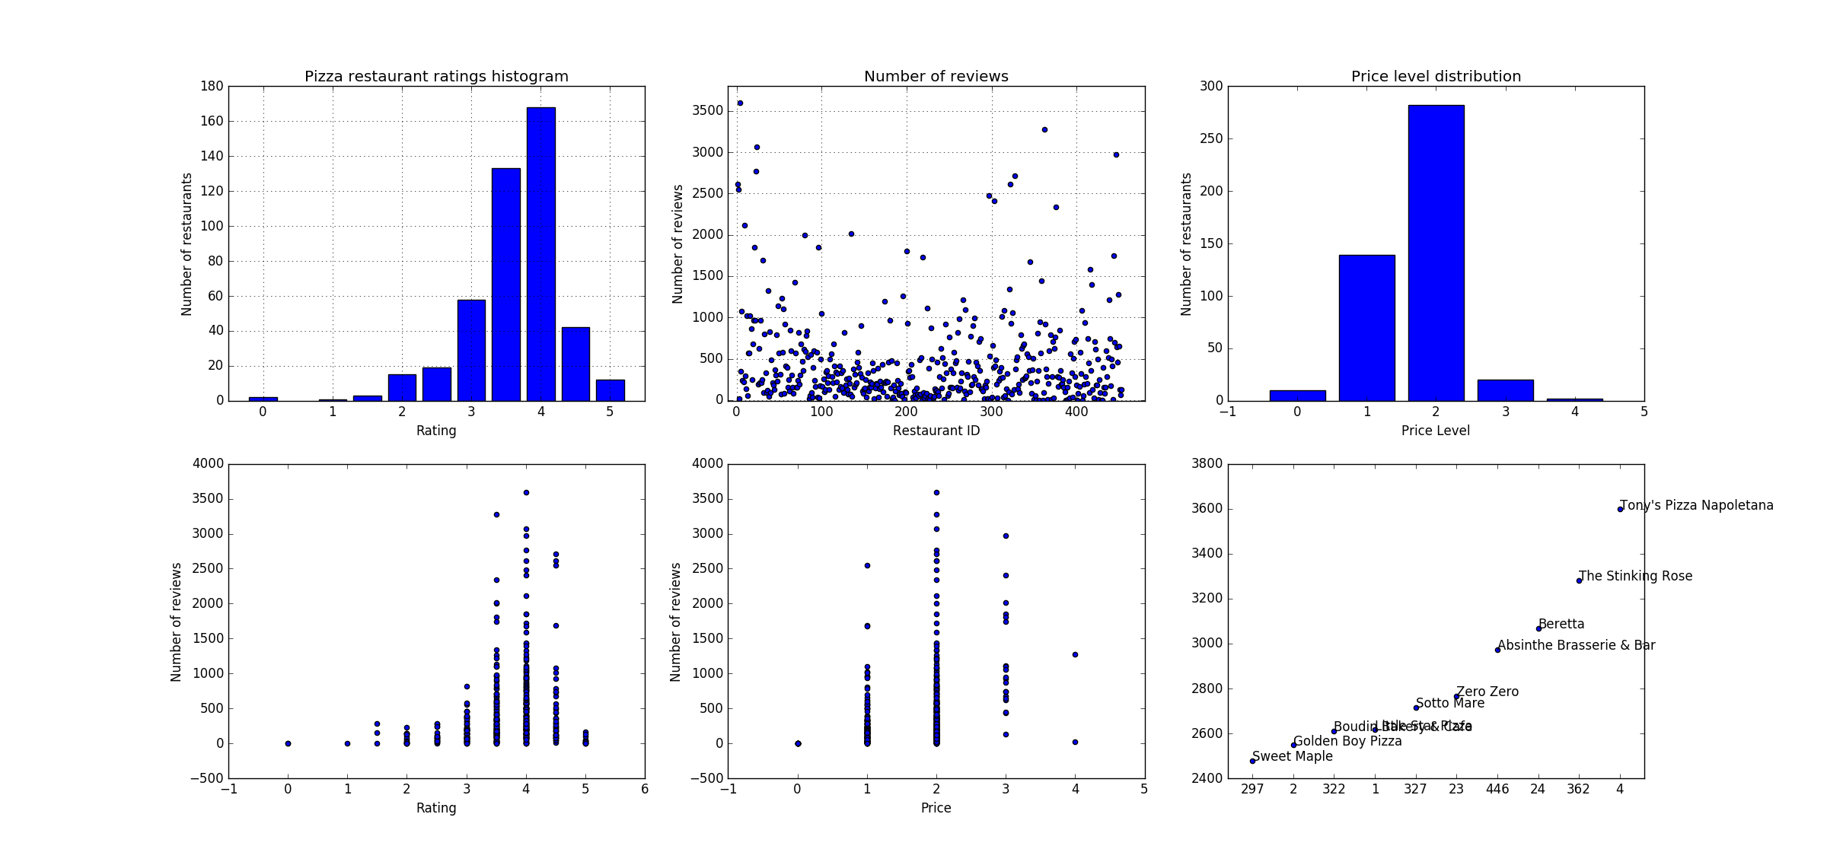

Slide 2
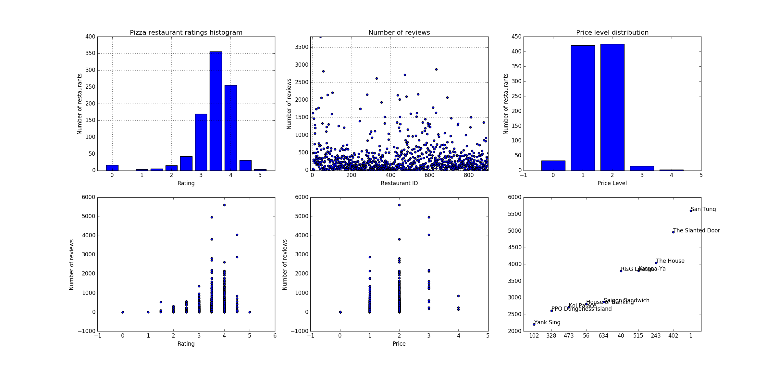

Slide 3
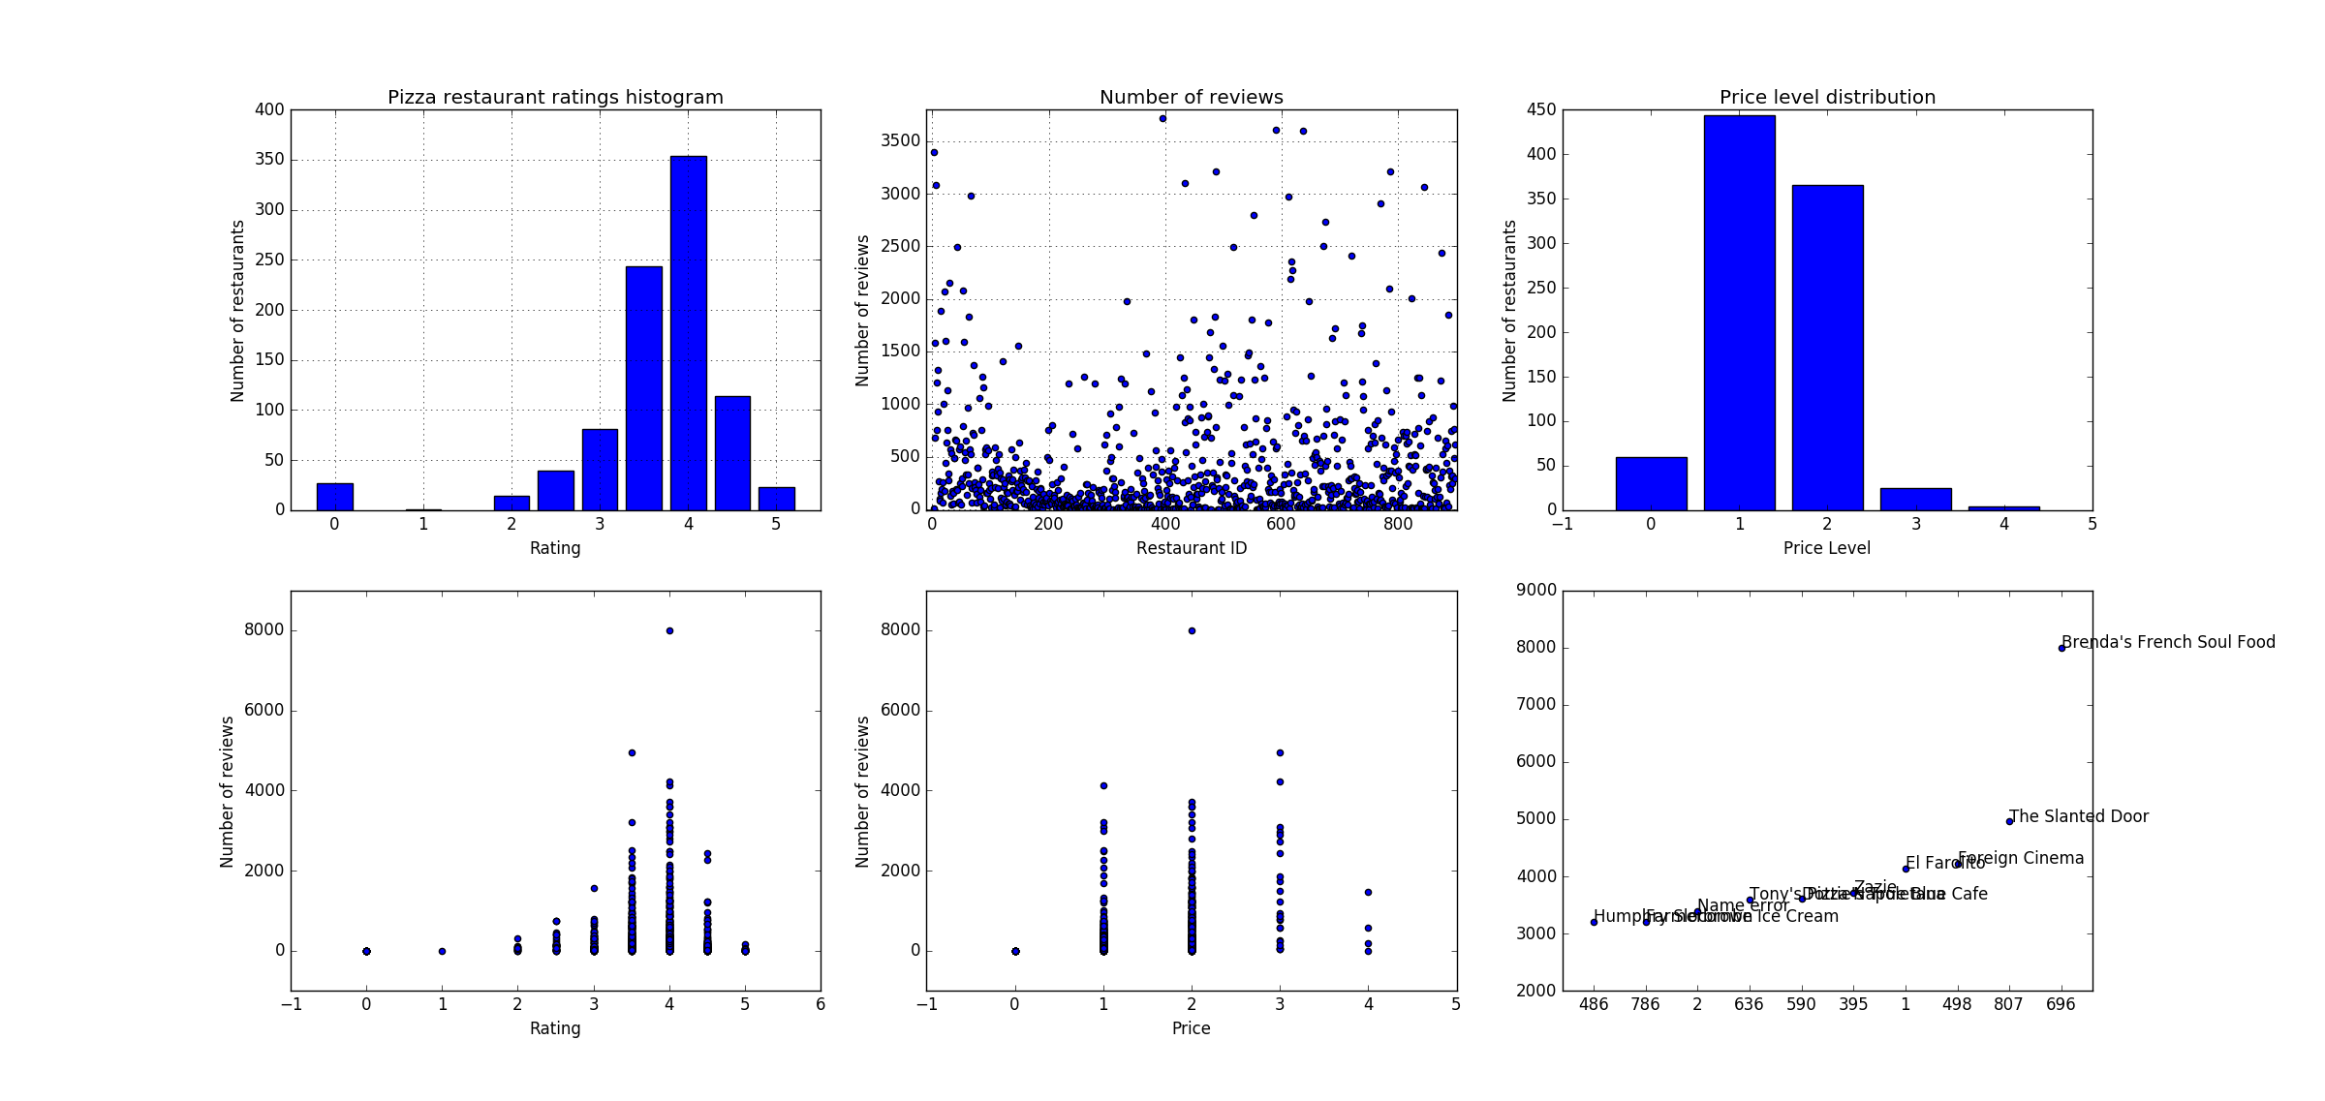

Slide 4
Mexican restaurants have more 5-star ratings. Chinese restaurants have more 3.5-star and 3-star ratings
Mexican – Mean: 3.641, Std Dev: 0.861
Chinese - Mean: 3.424, Std Dev: 0.715
Mexican restaurants have more reviews on average
Mexican – Mean: 414.064, Std Dev: 667.924
Chinese – Mean: 352.331, Std Dev: 517.739
Note that the standard deviation in this case is not too insightful since the data (# of reviews) is not centered around an expected mean. The only reason the Std Dev is higher for Mexican restaurants is because the highest reviews values are relatively higher than that of Chinese with both datasets having most of its data concentrated close to the 0-10 range.
Both cuisines have most of its restaurants priced at the 2 or 3 level with Mexican restaurants having relatively more 1 price level restaurants
Mexican – Mean: 1.408, Std Dev: 0.676
Chinese – Mean: 1.476, Std Dev: 0.613
There’s a strong correlation between # of reviews and ratings upto a rating of 4, after which the reviews start going down again. This is not surprising because we expect, in general, more 4-star ratings than 5-star ratings (rare). However, 4-star is more common than the lower ratings, especially for a common cuisine.
In terms of reviews vs price, the price levels of 2,3 and 4 have the highest reviews by far, with level 3 edging the others for both cuisines.
Mexican restaurant “Brenda’s French Soul Food” has the highest reviews (~9000). Not sure if this is actually a Mexican restaurant. Might need to filter the data better based on category.

Slide 5
