Slide 1
lab2-Defusing a Binary Bomb Spring 2018

Slide 2
1 Bomb Lab Overview
2 Assembly Refresher
3 Introduction to GDB
4 Unix Refresher
5 Bomb Lab Demo

Slide 3
Bomb Lab Overview(what)
A binary bomb is a program that consists of a sequence of phases(six phases). Each phase expects you to type a particular string on stdin. If you type the correct string, then the phase is defused and the bomb proceeds to the next phase. Otherwise, the bomb explodes by printing "BOOM!!!" and then terminating. The bomb is defused when every phase has been defused.
Your job for this lab is to defuse your bomb.

Slide 4
Bomb Lab Overview(material)
You will get:
• README: Identifies the bomb and its owners.
• bomb: The executable binary bomb.
• bomb.c: Source file with the bomb’s main routine.
• writeup.

Slide 5
Bomb Lab Overview(skill)
You can run it under a debugger, watch what it does step by step, and use this information to defuse it.
To avoid accidentally detonating the bomb, you will need to learn how to single-step through the assembly code and how to set breakpoints. You will also need to learn how to inspect both the registers and the memory states.
One of the nice side-effects of doing the lab is that you will get very good at using a debugger. This is a crucial skill that will pay big dividends the rest of your career.

Slide 6
Bomb Lab Overview(skill)
objdump -t bomb examines the symbol table
objdump -d bomb disassembles all bomb code
strings bomb prints all printable strings
gdb bomb will open up the GNU Debugger
Examine while stepping through your program
registers
the stack
contents of program memory
instruction stream

Slide 7
Bomb Lab Overview(skill)
Bomb uses sscanf for reading strings
Figure out what phase expects for input
Check out man sscanf for formatting string details

Slide 8
1 Bomb Lab Overview
2 Assembly Refresher
3 Introduction to GDB
4 Unix Refresher
5 Bomb Lab Demo

Slide 9
Assembly Refresher(x64 Assembly: Registers)
%rax
%r8
Return
%eax
%r8d
Arg 5
%rbx
%r9
%ebx
%r9d
Arg 6
%rcx
%r10
Arg 4
%ecx
%r10d
%rdx
%r11
Arg 3
%edx
%r11d
%rsi
%r12
Arg 2
%esi
%r12d
%rdi
%r13
Arg 1
%edi
%r13d
%rsp
%r14
Stack ptr
%esp
%r14d
%rbp
%r15
%ebp
%r15d

Slide 10
Assembly Refresher(x64 Assembly: Operands)
Type | Syntax | Example | Notes
Constants | Start with $ | $-42 $0x15213b | Don’t mix up decimal and hex
Registers | Start with % | %esi %rax | Can store values or addresses
Memory Locations | Parentheses around a register or an addressing mode | (%rbx) 0x1c(%rax) 0x4(%rcx, %rdi, 0x1) | Parentheses dereference. Equivalent to “*” in C. Look up different addressing modes!

Slide 11
Assembly Refresher(Representing Addresses)
Parenthesis Usage:
Most of the time parenthesis means dereference.
Example of usage:
(%eax) - contents of memory at address stored in %eax
(%ebx, %ecx) – contents of memory stored at address obtained after addition of %ebx + %ecx.
(%ebx, %ecx, 8) – contents of memory at address = %ebx+8*%ecx
4(%ebx, %ecx, 8) – Contents of memory stored at address = %ebx + 8*%ecx + 4

Slide 12
Instruction
Effect
Assembly Refresher(x64 Assembly: Arithmetic Operations)
mov %rbx, %rdx
add (%rdx), %r8
mul $3, %r8
sub $1, %r8
lea (%rdx,%rbx,2), %rdx
rdx = rbx
r8 += value at address rdx
r8 *= 3
r8--
rdx = rdx + rbx*2
Doesn’t dereference

Slide 13
Instruction
Effect
Assembly Refresher(x64 Assembly: Calling Convention)
call foo
push %eax
pop %eax
ret
nop
Push return address, jump to label foo
Push value in %eax onto stack
Pop value off of stack into %eax
Pop value off of stack into instruction pointer, return value stored in %eax
Does absolutely nothing.

Slide 14
Assembly Refresher(x64 Assembly: Comparisons)
Comparison, cmp, compares two values
Result determines next conditional jump instruction
cmp b,a computes a-b.
test b,a computes a&b
Pay attention to operand order
If %r10 > %r9, then jump to 0x8675309
cmpl %r9, %r10
jg 0x8675309

Slide 15
Assembly Refresher(x64 Assembly: Jumps)
Instruction | Effect | Instruction | Effect
jmp | Always jump | ja | Jump if above (unsigned >)
je/jz | Jump if eq / zero | jae | Jump if above / equal
jne/jnz | Jump if !eq / !zero | jb | Jump if below (unsigned <)
jg | Jump if greater (signed >) | jbe | Jump if below / equal
jge | Jump if greater / eq | js | Jump if sign bit is 1 (neg)
jl | Jump if less | jns | Jump if sign bit is 0 (pos)
jle | Jump if less / eq

Slide 16
Assembly Refresher(x64 Assembly: A Quick Drill)
cmp $0x15213, %r12
jge deadbeef
cmp %rax, %rdi
jae 15213b
test %r8, %r8
jnz (%rsi)
If , jump to addr 0xdeadbeef
If , jump to addr 0x15213b
If , jump to .

Slide 17
Assembly Refresher(x64 Assembly: A Quick Drill)
cmp $0x15213, %r12
jge deadbeef
cmp %rax, %rdi
jae 15213b
test %r8, %r8
jnz (%rsi)
If %r12 >= 0x15213, jump to 0xdeadbeef

Slide 18
Assembly Refresher(x64 Assembly: A Quick Drill)
cmp $0x15213, %r12
jge deadbeef
cmp %rax, %rdi
jae 15213b
test %r8, %r8
jnz (%rsi)
If the unsigned value of %rdi is at or above the unsigned value of %rax, jump to 0x15213b.

Slide 19
Assembly Refresher(x64 Assembly: A Quick Drill)
cmp $0x15213, %r12
jge deadbeef
cmp %rax, %rdi
jae 15213b
test %r8, %r8
jnz (%rsi)
If %r8 & %r8 is not zero, jump to the address stored in %rsi.

Slide 20
1 Bomb Lab Overview
2 Assembly Refresher
3 Introduction to GDB
4 Unix Refresher
5 Bomb Lab Demo

Slide 21
Introduction to GDB
break <location>
Stop execution at function name or address
Reset breakpoints when restarting gdb
run <args>
Run program with args <args>
Convenient for specifying text file with answers
disas <fun>, but not dis
stepi / nexti
Step through instructions.
Notes:
Use * when mentioning address in break
Delete – delete all breakpoints
Delete 1 – delete breakpoint 1
Disas address (no * required).
Stepi 4 – Execute 4 instructions at a time.
Step – Execute 1 C line at a time.

Slide 22
Introduction to GDB
info registers
Print hex values in every register
print (/x or /d) $eax - Yes, use $
Print hex or decimal contents of %eax
x $register, x 0xaddress
Prints what’s in the register / at the given address
By default, prints one word (4 bytes)
Specify format: /s, /[num][size][format]
x/4wd 0xdeadbeef
x/s 0xdeadbeef
Download gdbnotes from
http://csapp.cs.cmu.edu/2e/docs/gdbnotes-x86-64.pdf

Slide 23
1 Bomb Lab Overview
2 Assembly Refresher
3 Introduction to GDB
4 Unix Refresher
5 Bomb Lab Demo

Slide 24
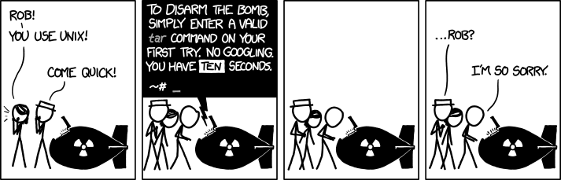
Unix Refresher
You should know cd, ls, scp, ssh, tar, and chmod by now. Use man <command> for help.
<Control-C> exits your current program.

Slide 25
1 Bomb Lab Overview
2 Assembly Refresher
3 Introduction to GDB
4 Unix Refresher
5 Bomb Lab Demo

Slide 26
Bomb Lab Demo

Slide 27
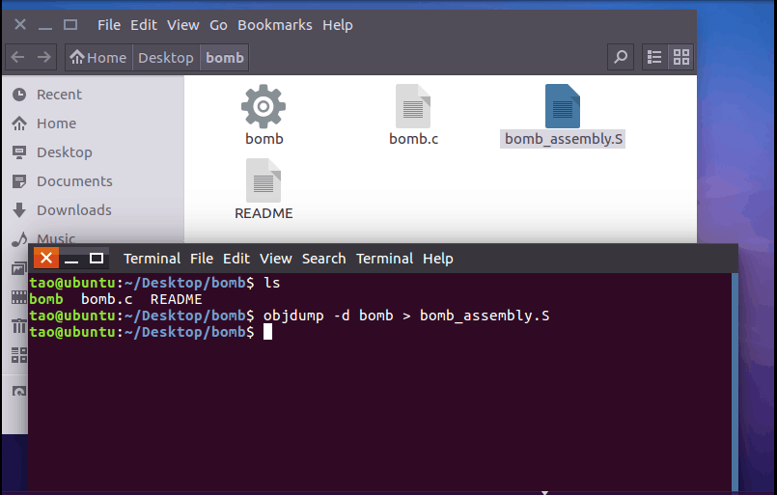
Phase 1 Solution !!

Slide 28
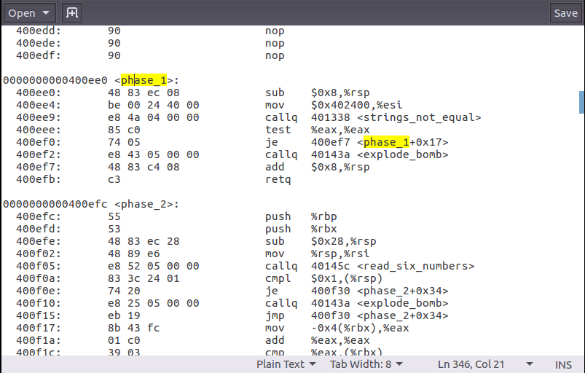

Slide 29
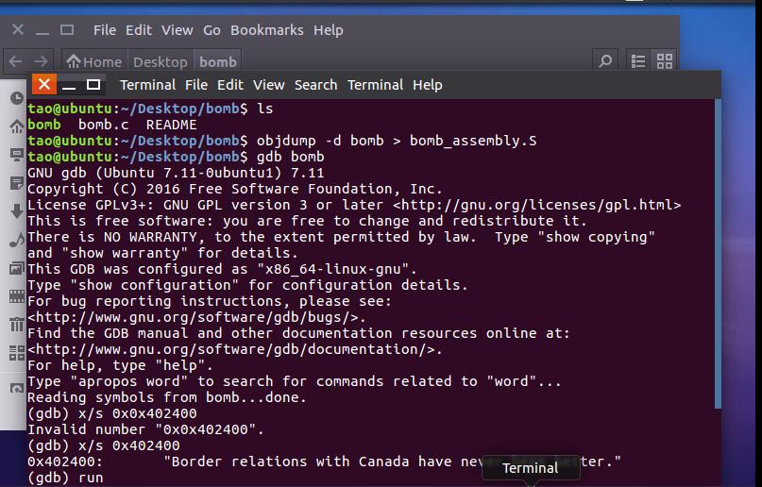

Slide 30
