Slide 1

Lab4：Cache Lab Implementation and Blocking
Spring 2018

Slide 2
Outline
Memory organization Cache lab
Caching
Different types of locality
Cache organization
Cache lab
Part (a) Building Cache Simulator
Part (b) Efficient Matrix Transpose
Blocking
Supplement

Slide 3
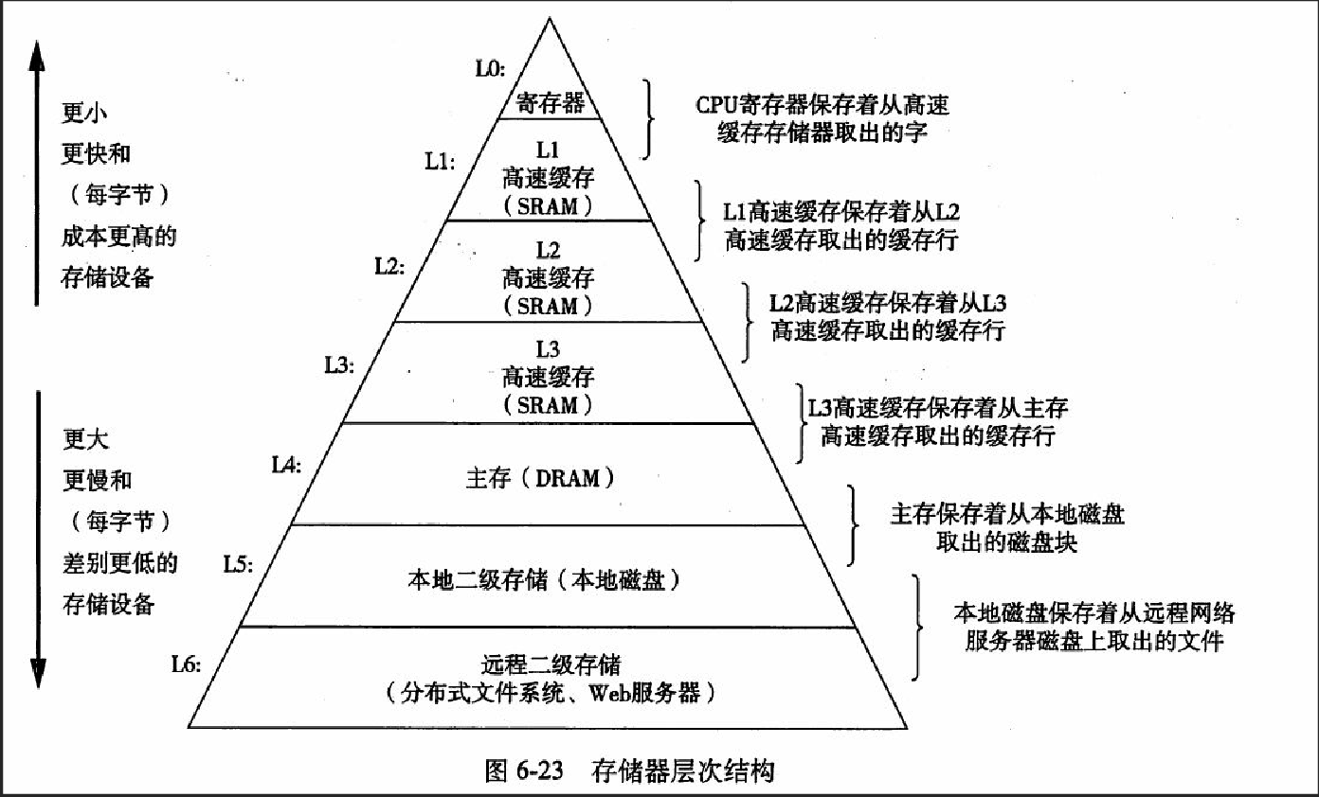
Memory Hierarchy

Slide 4
Memory Hierarchy
Registers
SRAM
DRAM
Local Secondary storage
Remote Secondary storage
We will discuss this interaction

Slide 5
SRAM vs DRAM tradeoff
SRAM (cache)
Faster (L1 cache: 1 CPU cycle)
Smaller (Kilobytes (L1) or Megabytes (L2))
More expensive and “energy-hungry”
DRAM (main memory)
Relatively slower (hundreds of CPU cycles)
Larger (Gigabytes)
Cheaper

Slide 6
Locality
Temporal locality
Recently referenced items are likely to be referenced again in the near future
After accessing address X in memory, save the bytes in cache for future access
Spatial locality
Items with nearby addresses tend to be referenced close together in time
After accessing address X, save the block of memory around X in cache for future access

Slide 7

Memory Address
64-bit machines
Block offset: b bits
Set index: s bits
Tag Bits: Address Size – b – s

Slide 8
Cache
A cache is a set of 2^s cache sets
A cache set is a set of E cache lines
E is called associativity
If E=1, it is called “direct-mapped”
Each cache line stores a block
Each block has B = 2^b bytes
Total Capacity = S*B*E

Slide 9
Visual Cache Terminology
E lines per set
Address of word:
t bits
s bits
b bits
S = 2^{s} sets
tag
set
index
block
offset
data begins at this offset
v
tag
0
1
2
B-1
valid bit
B = 2^{b} bytes per cache block (the data)

Slide 10
General Cache Concepts
Smaller, faster, more expensive
memory caches a subset of
the blocks
Cache
8
4
9
14
10
3
Data is copied in block-sized transfer units
4
10
Larger, slower, cheaper memory
viewed as partitioned into “blocks”
Memory
0
1
2
3
4
4
5
6
7
8
9
10
10
11
12
13
14
15
Notes:
Hit: it’s in the cache
Miss: the tags don’t match

Slide 11
General Cache Concepts: Miss
Request: 12
Data in block b is needed
Block b is not in cache:
Miss!
Cache
8
9
14
3
12
Block b is fetched from
memory
12
Request: 12
Block b is stored in cache
Placement policy: determines where b goes
Replacement policy: determines which block gets evicted (victim)
Memory
0
1
2
3
4
5
6
7
8
9
10
11
12
12
13
14
15

Slide 12
General Caching Concepts: Types of Cache Misses
Cold (compulsory) miss
The first access to a block has to be a miss
Conflict miss
Conflict misses occur when the level k cache is large enough, but multiple data objects all map to the same level k block
E.g., Referencing blocks 0, 8, 0, 8, 0, 8, ... would miss every time
Capacity miss
Occurs when the set of active cache blocks (working set) is larger than the cache

Slide 13
Cache Lab
Part (a) Building a cache simulator
Part (b) Optimizing matrix transpose

Slide 14
Part (a) : Cache simulator
A cache simulator is NOT a cache!
Memory contents NOT stored
Block offsets are NOT used – the b bits in your address don’t matter.
Simply count hits, misses, and evictions
Your cache simulator needs to work for different s, b, E, given at run time.
Use LRU – Least Recently Used replacement policy
Evict the least recently used block from the cache to make room for the next block.
Queues ? Time Stamps ?

Slide 15
Part (a) : Hints
A cache is just 2D array of cache lines:
struct cache_line cache[S][E];
S = 2^s, is the number of sets
E is associativity
Each cache_line has:
Valid bit
Tag
LRU counter ( only if you are not using a queue )

Slide 16
Part (a) : getopt
getopt() automates parsing elements on the unix command line If function declaration is missing
Typically called in a loop to retrieve arguments
Its return value is stored in a local variable
When getopt() returns -1, there are no more options
To use getopt, your program must include the header file unistd.h
If not running on the shark machines then you will need #include <getopt.h>.

Slide 17
Part (a) : getopt
A switch statement is used on the local variable holding the return value from getopt()
Each command line input case can be taken care of separately
“optarg” is an important variable – it will point to the value of the option argument
Think about how to handle invalid inputs
For more information,
look at man 3 getopt
http://www.gnu.org/software/libc/manual/html_node/Getopt.html

Slide 18
Part (a) : getopt Example
int main(int argc, char** argv){
int opt,x,y;
/* looping over arguments */
while(-1 != (opt = getopt(argc, argv, “x:y:"))){
/* determine which argument it’s processing */
switch(opt) {
case 'x':
x = atoi(optarg);
break;
case ‘y':
y = atoi(optarg);
break;
default:
printf(“wrong argument\n");
break;
}
}
}
Suppose the program executable was called “foo”. Then we would call “./foo -x 1 –y 3“ to pass the value 1 to variable x and 3 to y.

Slide 19
Part (a) : fscanf
The fscanf() function is just like scanf() except it can specify a stream to read from (scanf always reads from stdin)
parameters:
A stream pointer
format string with information on how to parse the file
the rest are pointers to variables to store the parsed data
You typically want to use this function in a loop. It returns -1 when it hits EOF or if the data doesn’t match the format string
For more information,
man fscanf
http://crasseux.com/books/ctutorial/fscanf.html
fscanf will be useful in reading lines from the trace files.
L 10,1
M 20,1

Slide 20
Part (a) : fscanf example
FILE * pFile; //pointer to FILE object
pFile = fopen ("tracefile.txt",“r"); //open file for reading
char identifier;
unsigned address;
int size;
// Reading lines like " M 20,1" or "L 19,3"
while(fscanf(pFile,“ %c %x,%d”, &identifier, &address, &size)>0)
{
// Do stuff
}
fclose(pFile); //remember to close file when done

Slide 21
Part (a) : Malloc/free
Use malloc to allocate memory on the heap
Always free what you malloc, otherwise may
get memory leak
some_pointer_you_malloced = malloc(sizeof(int));
Free(some_pointer_you_malloced);
Don’t free memory you didn’t allocate

Slide 22
Part (b) Efficient Matrix Transpose
Matrix Transpose (A -> B)
Matrix A Matrix B
How do we optimize this operation using the cache?
1 | 2 | 3 | 4
5 | 6 | 7 | 8
9 | 10 | 11 | 12
13 | 14 | 15 | 16
1 | 5 | 9 | 13
2 | 6 | 10 | 14
3 | 7 | 11 | 15
4 | 8 | 12 | 16

Slide 23
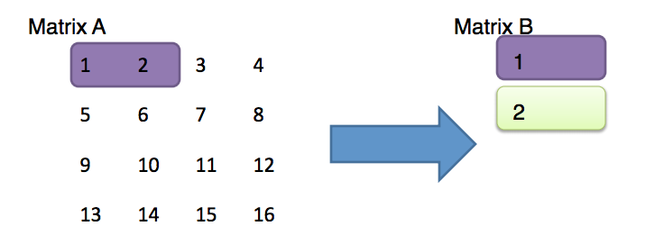
Part (b) : Efficient Matrix Transpose
Suppose Block size is 8 bytes ?
Access A[0][0] cache miss Should we handle 3 & 4
Access B[0][0] cache miss next or 5 & 6 ?
Access A[0][1] cache hit
Access B[1][0] cache miss

Slide 24
Part (b) : Blocking
Blocking: divide matrix into sub-matrices.
Size of sub-matrix depends on cache block size, cache size, input matrix size.
Try diﬀerent sub-matrix sizes.

Slide 25
Example: Matrix Multiplication
c = (double *) calloc(sizeof(double), n*n);
/* Multiply n x n matrices a and b */
void mmm(double *a, double *b, double *c, int n) {
int i, j, k;
for (i = 0; i < n; i++)
for (j = 0; j < n; j++)
for (k = 0; k < n; k++)
c[i*n + j] += a[i*n + k] * b[k*n + j];
}
j
c
a
b
=
*
i

Slide 26
Cache Miss Analysis
Assume:
Matrix elements are doubles
Cache block = 8 doubles
Cache size C << n (much smaller than n)
First iteration:
n/8 + n = 9n/8 misses
Afterwards in cache: (schematic)
n
=
*
=
*
8 wide

Slide 27
Cache Miss Analysis
Assume:
Matrix elements are doubles
Cache block = 8 doubles
Cache size C << n (much smaller than n)
Second iteration:
Again: n/8 + n = 9n/8 misses
Total misses:
9n/8 * n² = (9/8) * n³
n
=
*
8 wide

Slide 28
Blocked Matrix Multiplication
c = (double *) calloc(sizeof(double), n*n);
/* Multiply n x n matrices a and b */
void mmm(double *a, double *b, double *c, int n) {
int i, j, k;
for (i = 0; i < n; i+=B)
for (j = 0; j < n; j+=B)
for (k = 0; k < n; k+=B)
/* B x B mini matrix multiplications */
for (i1 = i; i1 < i+B; i++)
for (j1 = j; j1 < j+B; j++)
for (k1 = k; k1 < k+B; k++)
c[i1*n+j1] += a[i1*n + k1]*b[k1*n + j1];
}
j1
c
a
b
c
=
*
+
i1
Block size B x B

Slide 29
Cache Miss Analysis
Assume:
Cache block = 8 doubles
Cache size C << n (much smaller than n)
Three blocks fit into cache: 3B² < C
First (block) iteration:
B²/8 misses for each block
2n/B * B²/8 = nB/4 (omitting matrix c)
Afterwards in cache (schematic)
n/B blocks
=
*
Block size B x B
=
*

Slide 30
Cache Miss Analysis
Assume:
Cache block = 8 doubles
Cache size C << n (much smaller than n)
Three blocks fit into cache: 3B² < C
Second (block) iteration:
Same as first iteration
2n/B * B²/8 = nB/4
Total misses:
nB/4 * (n/B)² = n³/(4B)
n/B blocks
=
*
Block size B x B

Slide 31
Part(b) : Blocking Summary
No blocking: (9/8) * n³
Blocking: 1/(4B) * n³
Suggest largest possible block size B, but limit 3B² < C!
Reason for dramatic difference:
Matrix multiplication has inherent temporal locality:
Input data: 3n², computation 2n³
Every array elements used O(n) times!
But program has to be written properly

Slide 32
Part (b) : Specs
Cache:
You get 1 kilobytes of cache
Directly mapped (E=1)
Block size is 32 bytes (b=5)
There are 32 sets (s=5)
Test Matrices:
32 by 32
64 by 64
61 by 67

Slide 33
Part (b)
Things you’ll need to know:
Warnings are errors
Header files
Eviction policies in the cache

Slide 34
Warnings are Errors
Strict compilation flags
Reasons:
Avoid potential errors that are hard to debug
Learn good habits from the beginning
Add “-Werror” to your compilation flags

Slide 35
Missing Header Files
Remember to include files that we will be using functions from
If function declaration is missing
Find corresponding header files
Use: man <function-name>
Live example
man 3 getopt

Slide 36
Eviction policies of Cache
The first row of Matrix A evicts the first row of Matrix B
Caches are memory aligned.
Matrix A and B are stored in memory at addresses such that both the first elements align to the same place in cache!
Diagonal elements evict each other.
Matrices are stored in memory in a row major order.
If the entire matrix can’t fit in the cache, then after the cache is full with all the elements it can load. The next elements will evict the existing elements of the cache.
Example:- 4x4 Matrix of integers and a 32 byte cache.
The third row will evict the first row!

Slide 37
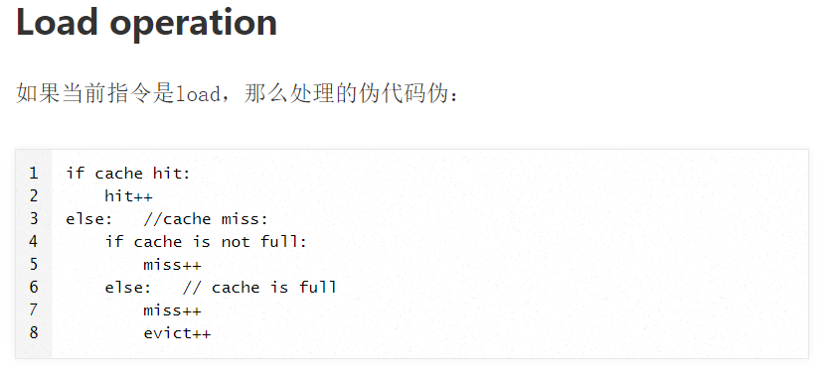
补充

Slide 38
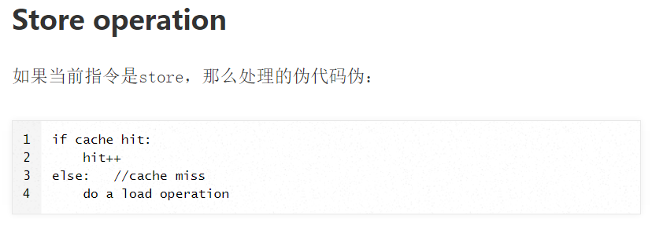
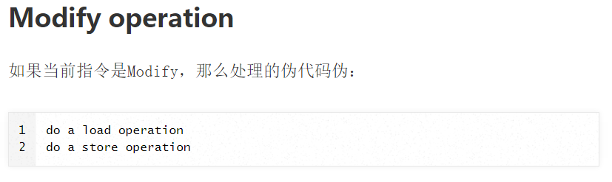

Slide 39
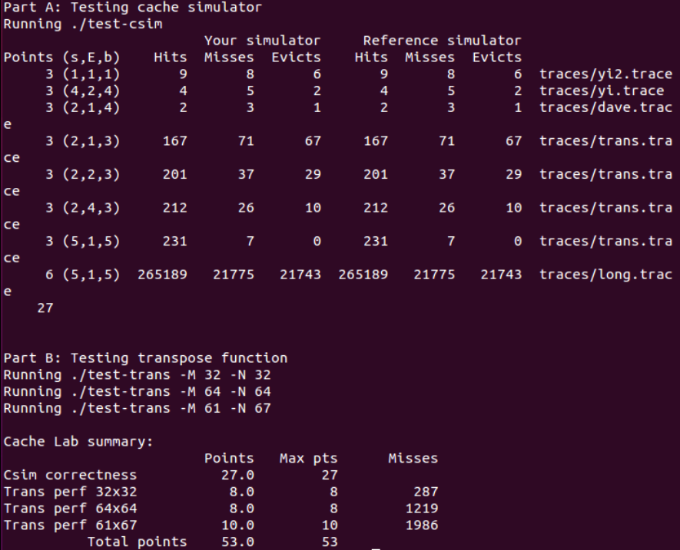
运行driver的跑分

