Slide 1
CIS 6930: Chip Multiprocessor: Parallel Architecture and Programming
Fall 2009
Jih-Kwon Peir
Computer Information Science Engineering
University of Florida

Slide 2
CIS 6930: Chip Multiprocessor: Parallel Architecture and Programming
Acknowledgement: Slides borrowed from
  Accelerators for Science and Engineering Applications: GPUs and Multicores, by David Kirk / NVIDIA and Wen-mei Hwu / University of Illinois, 2006-2008, (http://www.greatlakesconsortium.org/events/GPUMulticore/agenda.html)
  Course material posted from CUDA zone (http://www.nvidia.com/object/cuda_education.html)
  Intel Software Network (http://software.intel.com/en-us/academic/)
  The Art of Multiprocessor Programming (http://software.intel.com/en-us/academic/ )
  Presentation slides from various papers

Slide 3
Part 2: The CUDA Programming Model
CUDA programming model – basic concepts and data types
CUDA application programming interface - basic
Simple examples to illustrate basic concepts and functionalities
Performance features will be covered later

Slide 4
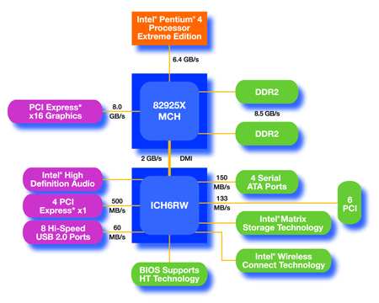
An Example of Physical Reality Behind CUDA
CPU
(host)
GPU w/
local DRAM
(device)

Slide 5
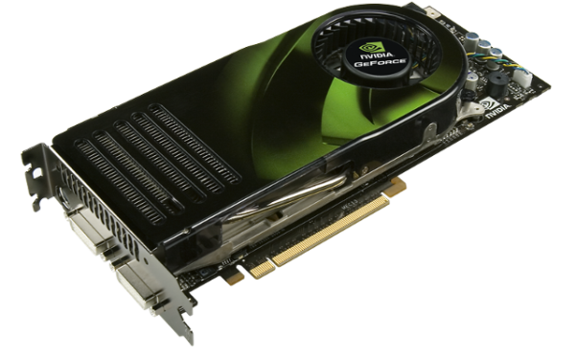
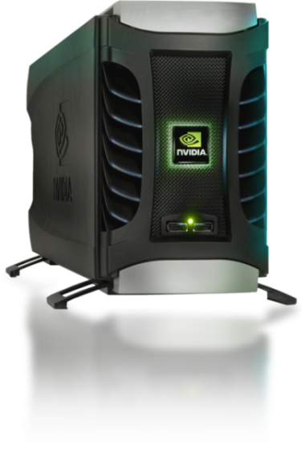
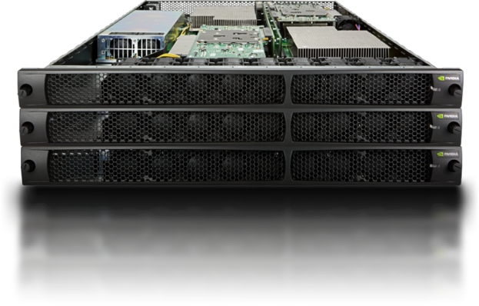
Parallel Computing on a GPU
8-series GPUs deliver 25 to 200+ GFLOPS
on compiled parallel C applications
  Available in laptops, desktops, and clusters
GPU parallelism is doubling every year
Programming model scales transparently
Programmable in C with CUDA tools
Multithreaded SPMD model uses application
data parallelism and thread parallelism
GeForce 8800
Tesla D870
Tesla S870

Slide 6
CUDA – C with no shader limitations!
Integrated host+device app C program
  Serial or modestly parallel parts in host C code
  Highly parallel parts in device SPMD kernel C code
Serial Code (host)‏
Parallel Kernel (device)‏
KernelA<<< nBlk, nTid >>>(args);
. . .
Serial Code (host)‏
Parallel Kernel (device)‏
KernelB<<< nBlk, nTid >>>(args);
. . .

Slide 7
CUDA Devices and Threads
A compute device
  Is a coprocessor to the CPU or host
  Has its own DRAM (device memory)‏
  Runs many threads in parallel
  Is typically a GPU but can also be another type of parallel processing device
Data-parallel portions of an application are expressed as device kernels which run on many threads
Differences between GPU and CPU threads
  GPU threads are extremely lightweight
    Very little creation overhead
  GPU needs 1000s of threads for full efficiency
    Multi-core CPU needs only a few

Slide 8
G80 – Graphics Mode
The future of GPUs is programmable processing
So – build the architecture around the processor
Host
Input Assembler
Setup / Rstr / ZCull
Vtx Thread Issue
Geom Thread Issue
Pixel Thread Issue
SP
SP
SP
SP
SP
SP
SP
SP
SP
SP
SP
SP
SP
SP
SP
SP
Thread Processor
TF
L1
TF
L1
TF
L1
TF
L1
TF
L1
TF
L1
TF
L1
TF
L1
L2
L2
L2
L2
L2
L2
FB
FB
FB
FB
FB
FB

Slide 9
G80 CUDA mode – A Device Example
Processors execute computing threads
New operating mode/HW interface for computing
Host
Input Assembler
Thread Execution Manager
Parallel Data
Cache
Parallel Data
Cache
Parallel Data
Cache
Parallel Data
Cache
Parallel Data
Cache
Parallel Data
Cache
Parallel Data
Cache
Parallel Data
Cache
Texture
Texture
Texture
Texture
Texture
Texture
Texture
Texture
Texture
Load/store
Load/store
Load/store
Load/store
Load/store
Load/store
Global Memory

Slide 10
Extended C
Declspecs
  global, device, shared, local, constant
Keywords
  threadIdx, blockIdx
Intrinsics
  __syncthreads
Runtime API
  Memory, symbol, execution management
Function launch
__device__ float filter[N];
__global__ void convolve (float *image) {
__shared__ float region[M];
...
region[threadIdx] = image[i];
__syncthreads()
...
image[j] = result;
}
// Allocate GPU memory
void *myimage = cudaMalloc(bytes)
// 100 blocks, 10 threads per block
convolve<<<100, 10>>> (myimage);

Slide 11
Extended C
Roughly speaking only four additions to
standard C
- Function type qualifiers to specify whether a
function executes on the host or on the device
- Variable type qualifiers to specify the memory
location on the device
- A new directive to specify how a kernel is
executed on the device (kernel call)
- Four built-in variables that specify the grid and
block dimensions and the block and thread
indices

Slide 12
Extended C
Integrated source
(foo.cu)
cudacc
EDG C/C++ frontend
Open64 Global Optimizer
GPU Assembly
foo.s
CPU Host Code
foo.cpp
OCG
gcc / cl
G80 SASS
foo.sass
Mark Murphy, “NVIDIA’s Experience with Open64,”
www.capsl.udel.edu/conferences/open64/2008/Papers/101.doc
Notes:
TBD: Define SASS = SPA Assembly language.
OCG: Optimized Code Generation

Slide 13
Arrays of Parallel Threads
A CUDA kernel is executed by an array of threads
  All threads run the same code (SPMD)‏
  Each thread has an ID that it uses to compute memory addresses and make control decisions
threadID
0
1
2
3
4
5
6
7
…
float x = input[threadID];
float y = func(x);
output[threadID] = y;
…

Slide 14
Thread Blocks: Scalable Cooperation
Divide monolithic thread array into multiple blocks
  Threads within a block cooperate via shared memory, atomic operations and barrier synchronization
  Threads in different blocks cannot cooperate
Thread Block 0
Thread Block 0
Thread Block N - 1
threadID
0
1
2
3
4
5
6
7
0
1
2
3
4
5
6
7
0
1
2
3
4
5
6
7
…
float x = input[threadID];
float y = func(x);
output[threadID] = y;
…
…
float x = input[threadID];
float y = func(x);
output[threadID] = y;
…
…
float x = input[threadID];
float y = func(x);
output[threadID] = y;
…
…

Slide 15
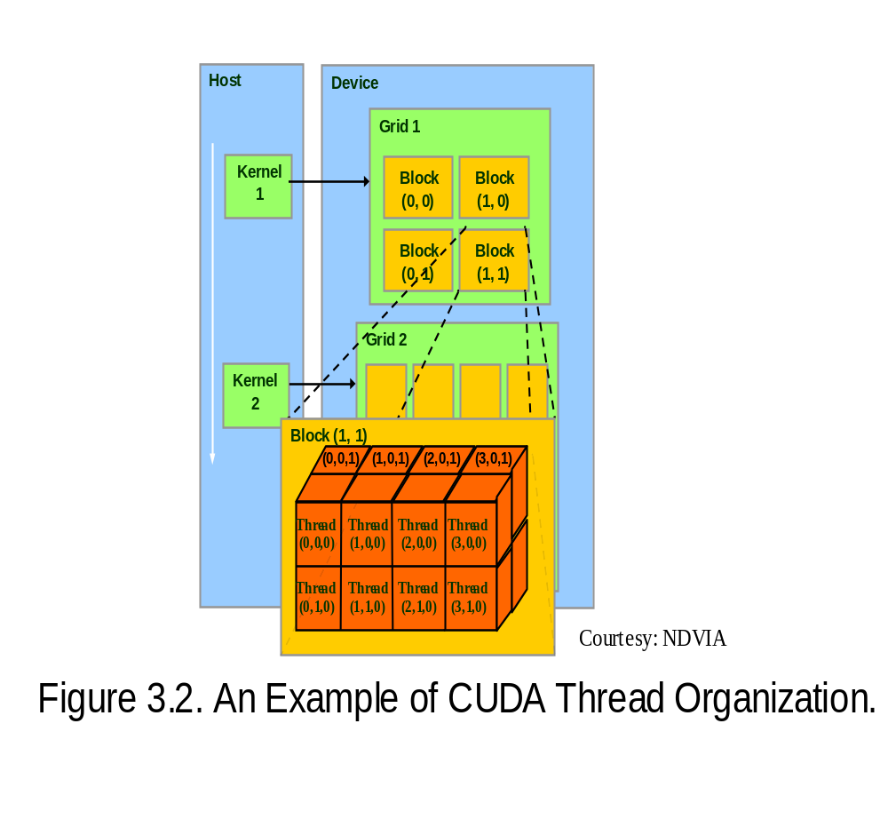
Block IDs and Thread IDs
Each thread uses IDs to decide what data to work on
  Block ID: 1D or 2D
  Thread ID: 1D, 2D, or 3D
Simplifies memory
addressing when processing
multidimensional data
  Image processing
  Solving PDEs on volumes
  …

Slide 16
CUDA Memory Model Overview
Global memory
  Main means of communicating R/W Data between host and device
  Contents visible to all threads
  Long latency access
We will focus on global memory for now
  Constant and texture memory will come later
Grid
Block (0, 0)‏
Block (1, 0)‏
Shared Memory
Shared Memory
Registers
Registers
Registers
Registers
Thread (0, 0)‏
Thread (1, 0)‏
Thread (0, 0)‏
Thread (1, 0)‏
Host
Global Memory

Slide 17
CUDA API Highlights:
Easy and Lightweight
The API is an extension to the ANSI C programming language
Low learning curve
The hardware is designed to enable lightweight runtime and driver
High performance

Slide 18
CUDA Device Memory Allocation
cudaMalloc()
  Allocates object in the device Global Memory
  Requires two parameters
    Address of a pointer to the allocated object
    Size of of allocated object
cudaFree()
  Frees object from device Global Memory
    Pointer to freed object
Grid
Block (0, 0)‏
Block (1, 0)‏
Shared Memory
Shared Memory
Registers
Registers
Registers
Registers
Thread (0, 0)‏
Thread (1, 0)‏
Thread (0, 0)‏
Thread (1, 0)‏
Host
Global
Memory

Slide 19
CUDA Device Memory Allocation (cont.)‏
Code example:
  Allocate a 64 * 64 single precision float array
  Attach the allocated storage to Md
  “d” is often used to indicate a device data structure
TILE_WIDTH = 64;
Float* Md
int size = TILE_WIDTH * TILE_WIDTH * sizeof(float);
cudaMalloc((void**)&Md, size);
cudaFree(Md);

Slide 20
CUDA Host-Device Data Transfer
cudaMemcpy()‏
  memory data transfer
  Requires four parameters
    Pointer to destination
    Pointer to source
    Number of bytes copied
    Type of transfer
      Host to Host
      Host to Device
      Device to Host
      Device to Device
Asynchronous transfer
Grid
Block (0, 0)‏
Block (1, 0)‏
Shared Memory
Shared Memory
Registers
Registers
Registers
Registers
Thread (0, 0)‏
Thread (1, 0)‏
Thread (0, 0)‏
Thread (1, 0)‏
Host
Global
Memory

Slide 21
CUDA Host-Device Data Transfer (cont.)
Code example:
  Transfer a 64 * 64 single precision float array
  M is in host memory and Md is in device memory
  cudaMemcpyHostToDevice and cudaMemcpyDeviceToHost are symbolic constants
cudaMemcpy(Md, M, size, cudaMemcpyHostToDevice);
cudaMemcpy(M, Md, size, cudaMemcpyDeviceToHost);

Slide 22
CUDA Function Declarations
Executed on the:
Only callable from the:
__device__ float DeviceFunc()‏
device
device
__global__ void KernelFunc()‏
device
host
__host__ float HostFunc()‏
host
host
__global__ defines a kernel function
  Must return void
__device__ and __host__ can be used together

Slide 23
CUDA Function Declarations (cont.)‏
__device__ functions cannot have their address taken (cannot call outside device)
For functions executed on the device:
  No recursion
  No static variable declarations inside the function
  No variable number of arguments

Slide 24
Restrictions on Declarations ‏
__device__ functions are always inlined
__device__ and __global__ do not support recursion
__device__ and __global__ cannot declare static variables
inside their bodies
__device__ and __global__ cannot have a variable number of inputs
__device__ functions cannot have their address taken but
function pointers to __global__ functions are supported
The __global__ and __host__ qualifiers cannot be used together
__global__ functions must have void return type
Any call to a __global__ function must specify its execution
configuration
A call to a __global__ function is asynchronous, meaning it
returns before the device has completed its execution
__global__ function parameters are currently passed via shared
memory to the device and limited to 256 bytes.

Slide 25
Calling a Kernel Function – Thread Creation
A kernel function must be called with an execution configuration:
__global__ void KernelFunc(...);
dim3 DimGrid(100, 50); // 5000 thread blocks
dim3 DimBlock(4, 8, 8); // 256 threads per block
size_t SharedMemBytes = 64; // 64 bytes of shared memory
KernelFunc<<< DimGrid, DimBlock, SharedMemBytes >>>(...);
Any call to a kernel function is asynchronous from CUDA 1.0 on, explicit synch needed for blocking

Slide 26
A Simple Running Example
Matrix Multiplication
A simple matrix multiplication example that illustrates the basic features of memory and thread management in CUDA programs
  Leave shared memory usage until later
  Local, register usage
  Thread ID usage
  Memory data transfer API between host and device
  Assume square matrix for simplicity

Slide 27
Programming Model:
Square Matrix Multiplication Example
P = M * N of size WIDTH x WIDTH
Without tiling:
  One thread calculates one element of P
  M and N are loaded WIDTH times from global memory
N
WIDTH
M
P
WIDTH
WIDTH
WIDTH

Slide 28
Memory Layout of a Matrix in C
M_{0,0}
M_{1,0}
M_{2,0}
M_{3,0}
M_{0,1}
M_{1,1}
M_{2,1}
M_{3,1}
M_{0,2}
M_{1,2}
M_{2,2}
M_{3,2}
M_{0,3}
M_{1,3}
M_{2,3}
M_{3,3}
M
M_{0,0}
M_{1,0}
M_{2,0}
M_{3,0}
M_{0,1}
M_{1,1}
M_{2,1}
M_{3,1}
M_{0,2}
M_{1,2}
M_{2,2}
M_{3,2}
M_{0,3}
M_{1,3}
M_{2,3}
M_{3,3}

Slide 29
Step 1: Matrix Multiplication
A Simple Host Version in C
// Matrix multiplication on the (CPU) host in double precision
void MatrixMulOnHost(float* M, float* N, float* P, int Width)‏
{
for (int i = 0; i < Width; ++i)‏
for (int j = 0; j < Width; ++j) {
double sum = 0;
for (int k = 0; k < Width; ++k) {
double a = M[i * width + k];
double b = N[k * width + j];
sum += a * b;
}
P[i * Width + j] = sum;
}
}
N
k
j
WIDTH
M
P
i
WIDTH
k
WIDTH
WIDTH

Slide 30
Step 2: Input Matrix Data Transfer
(Host-side Code)‏
void MatrixMulOnDevice(float* M, float* N, float* P, int Width)‏
{
int size = Width * Width * sizeof(float);
float* Md, Nd, Pd;
…
1. // Allocate and Load M, N to device memory
cudaMalloc(&Md, size);
cudaMemcpy(Md, M, size, cudaMemcpyHostToDevice);
cudaMalloc(&Nd, size);
cudaMemcpy(Nd, N, size, cudaMemcpyHostToDevice);
// Allocate P on the device
cudaMalloc(&Pd, size);

Slide 31
Step 3: Output Matrix Data Transfer
(Host-side Code)‏
2. // Kernel invocation code – to be shown later
…
3. // Read P from the device
cudaMemcpy(P, Pd, size, cudaMemcpyDeviceToHost);
// Free device matrices
cudaFree(Md); cudaFree(Nd); cudaFree (Pd);
}

Slide 32
Step 4: Kernel Function
// Matrix multiplication kernel – per thread code
__global__ void MatrixMulKernel(float* Md, float* Nd, float* Pd, int Width)‏
{
// Pvalue is used to store the element of the matrix
// that is computed by the thread
float Pvalue = 0;

Slide 33
Step 4: Kernel Function (cont.)‏
for (int k = 0; k < Width; ++k)‏ {
float Melement = Md[threadIdx.y*Width+k];
float Nelement = Nd[k*Width+threadIdx.x];
Pvalue += Melement * Nelement;
}
Pd[threadIdx.y*Width+threadIdx.x] = Pvalue;
}
Nd
k
tx
WIDTH
Md
Pd
ty
ty
WIDTH
k
tx
WIDTH
WIDTH
Notes:
This should be emphasized! Maybe another slide on “This is the first thing”

Slide 34
Step 5: Kernel Invocation
(Host-side Code)
// Setup the execution configuration
dim3 dimGrid(1, 1);
dim3 dimBlock(Width, Width);
// Launch the device computation threads!
MatrixMulKernel<<<dimGrid, dimBlock>>>(Md, Nd, Pd, Width);

Slide 35







Only One Thread Block Used
One Block of threads compute matrix Pd
  Each thread computes one element of Pd
Each thread
  Loads a row of matrix Md
  Loads a column of matrix Nd
  Perform one multiply and addition for each pair of Md and Nd elements
  Compute to off-chip memory access ratio close to 1:1 (not very high)‏
However - Size of matrix limited by number of threads allowed in a thread block
  ➔ Use multiple blocks
Nd
Grid 1
Block 1
Thread
(2, 2)‏
48
WIDTH
Md
Pd

Slide 36
Step 7: Handling Arbitrary Sized Square Matrices
Have each 2D thread block to compute a (TILE_WIDTH)² sub-matrix (tile) of the result matrix
  Each block has (TILE_WIDTH)² threads
Generate a 2D Grid of (WIDTH/TILE_WIDTH)² blocks
Nd
WIDTH
Note, you still need to put a loop around the kernel call for cases where WIDTH/TILE_WIDTH is greater than max grid size (64K)!
Md
Pd
by
TILE_WIDTH
ty
WIDTH
bx
tx
WIDTH
WIDTH

Slide 37
Some Useful Tool Information
Notes:
Try to update tool slides with the tutorial?

Slide 38
CUDA Occupancy Calculator
Here is a sample Makefile:
# Add source files here
EXECUTABLE := matrixMul
# Cuda source files (compiled with cudacc)
CUFILES := matrixMul.cu
# C/C++ source files (compiled with gcc / c++)
CCFILES := \ matrixMul_gold.cpp
# Need measure occupancy (this is the flag for CUDA occupancy calculator)
CUDACCFLAGS := --ptxas-options=-v
##########################################################################Rules and targets
include ../../common/common.mk

Slide 39
CUDA Occupancy Calculator
After make, the information below can be used in CUDA Occupancy Calculator: BFS and verify are two different kernel functions (in a different program for Breath-First Search):
$ make
ptxas info : Compiling entry function '_Z3BFSPiS_S_S_S_i'
ptxas info : Used 11 registers, 24+16 bytes smem, 12 bytes cmem[1]
ptxas info : Compiling entry function '_Z6verifyPiS_'
ptxas info : Used 2 registers, 120+16 bytes smem, 4 bytes cmem[1]
$
The calculator Can be downloaded

Slide 40
Get System Information
C:\Documents and Settings\All Users\Application Data\NVIDIA Corporation\NVIDIA G
PU Computing SDK\C\bin\win32\Release>devicequery (after make)
CUDA Device Query (Runtime API) version (CUDART static linking)
There is 1 device supporting CUDA
Device 0: "GeForce 9200"
CUDA Driver Version: 2.30
CUDA Runtime Version: 2.30
CUDA Capability Major revision number: 1
CUDA Capability Minor revision number: 1
Total amount of global memory: 266010624 bytes
Number of multiprocessors: (SM) 1
Number of cores: 8
Total amount of constant memory: 65536 bytes
Total amount of shared memory per block: 16384 bytes
Total number of registers available per block: 8192
Warp size: 32
Maximum number of threads per block: 512
Maximum sizes of each dimension of a block: 512 x 512 x 64
Maximum sizes of each dimension of a grid: 65535 x 65535 x 1
Maximum memory pitch: 262144 bytes
Texture alignment: 256 bytes
Clock rate: 1.20 GHz
Concurrent copy and execution: No
Run time limit on kernels: Yes
Integrated: Yes
Support host page-locked memory mapping: Yes
Compute mode: Default (multiple host threads
can use this device simultaneously)

Slide 41
Measure Timing from Host
/*****************Start execution and timing********************/
CUT_SAFE_CALL(cutCreateTimer(&timer));
CUT_SAFE_CALL(cutStartTimer(timer));
BFS<<<BFS_G, BFS_T>>>(d_Graph, d_F1, d_F2, d_X, d_C, H);
CUT_SAFE_CALL(cutStopTimer(timer));
printf("\nTime:%f ms\n", cutGetTimerValue(timer));

Slide 42
Measure Timing from Device
B.9 Time Function (CUDA Programming Guide 2.3)
clock_t clock();
when executed in device code, returns the value of a per-multiprocessor counter that is incremented every clock cycle. Sampling this counter at the beginning and at the end of a kernel, taking the difference of the two samples, and recording the result per thread provides a measure for each thread of the number of clock cycles taken by the device to completely execute the thread, but not of the number of clock cycles the device actually spent executing thread instructions. The former number is greater that the latter since threads are time sliced.

Slide 43
Compiling a CUDA Program
  C/C++ CUDA
  Application
float4 me = gx[gtid];
me.x += me.y * me.z;
Parallel Thread eXecution (PTX)‏
  Virtual Machine and ISA
  Programming model
  Execution resources and state
NVCC
  CPU Code
Virtual
  PTX Code
Physical
PTX to Target
Compiler
ld.global.v4.f32 {$f1,$f3,$f5,$f7}, [$r9+0];
mad.f32 $f1, $f5, $f3, $f1;
  G80
  …
GPU
Target code

Slide 44
Compilation
Any source file containing CUDA language extensions must be compiled with NVCC
NVCC is a compiler driver
  Works by invoking all the necessary tools and compilers like cudacc, g++, cl, ...
NVCC outputs:
  C code (host CPU Code)‏
    Must then be compiled with the rest of the application using another tool
  PTX
    Object code directly
    Or, PTX source, interpreted at runtime

Slide 45
Linking
Any executable with CUDA code requires two dynamic libraries:
  The CUDA runtime library (cudart)‏
  The CUDA core library (cuda)‏

