Slide 1
CIS 6930: Chip Multiprocessor: Parallel Architecture and Programming
Fall 2009
Jih-Kwon Peir
Computer Information Science Engineering
University of Florida

Slide 2
CIS 6930: Chip Multiprocessor: Parallel Architecture and Programming
Acknowledgement: Slides borrowed from
  Accelerators for Science and Engineering Applications: GPUs and Multicores, by David Kirk / NVIDIA and Wen-mei Hwu / University of Illinois, 2006-2008, (http://www.greatlakesconsortium.org/events/GPUMulticore/agenda.html)
  Course material posted from CUDA zone (http://www.nvidia.com/object/cuda_education.html)
  Intel Software Network (http://software.intel.com/en-us/academic/)
  The Art of Multiprocessor Programming (http://software.intel.com/en-us/academic/ )
  Presentation slides from various papers

Slide 3
Part 3: CUDA Threads

Slide 4
Programming Model:
Square Matrix Multiplication Example
P = M * N of size WIDTH x WIDTH
Without tiling:
  One thread calculates one element of P
  M and N are loaded WIDTH times from global memory
N
WIDTH
M
P
WIDTH
WIDTH
WIDTH

Slide 5
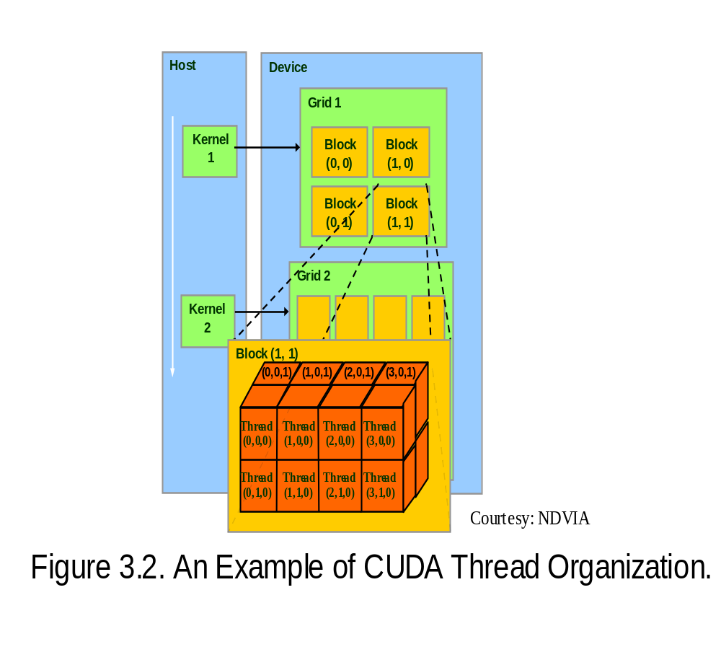
Block IDs and Thread IDs
Each thread uses IDs to decide what data to work on
  Block ID: 1D or 2D
  Thread ID: 1D, 2D, or 3D
Simplifies memory
addressing when processing
multidimensional data
  Image processing
  Solving PDEs on volumes
  …

Slide 6
Matrix Multiplication Using Multiple Blocks
bx
0
1
2
tx
0
TILE_WIDTH-1
1
2
Break-up Pd into tiles
Each block calculates one tile
  Each thread calculates one element
  Block size equal tile size
Nd
WIDTH
Md
Pd
0
0
Pd_{sub}
1
ty
2
WIDTH
by
1
TILE_WIDTHE
TILE_WIDTH-1
TILE_WIDTH
2
WIDTH
WIDTH

Slide 7
A Small Example
Block(0,0)
Block(1,0)
P_{0,0}
P_{1,0}
P_{2,0}
P_{3,0}
TILE_WIDTH = 2
P_{0,1}
P_{1,1}
P_{2,1}
P_{3,1}
P_{0,2}
P_{1,2}
P_{2,2}
P_{3,2}
P_{0,3}
P_{1,3}
P_{2,3}
P_{3,3}
Block(0,1)
Block(1,1)

Slide 8
A Small Example: Multiplication
Nd_{0,0}
Nd_{1,0}
Nd_{0,1}
Nd_{1,1}
Four threads in one code block (0,0)
Nd_{0,2}
Nd_{1,2}
Nd_{0,3}
Nd_{1,3}
Md_{0,0}
Md_{1,0}
Md_{2,0}
Md_{3,0}
Pd_{0,0}
Pd_{1,0}
Pd_{2,0}
Pd_{3,0}
Md_{0,1}
Md_{1,1}
Md_{2,1}
Md_{3,1}
Pd_{0,1}
Pd_{1,1}
Pd_{2,1}
Pd_{3,1}
Pd_{0,2}
Pd_{1,2}
Pd_{2,2}
Pd_{3,2}
Pd_{0,3}
Pd_{1,3}
Pd_{2,3}
Pd_{3,3}

Slide 9
Revised Matrix Multiplication Kernel using Multiple Blocks
__global__ void MatrixMulKernel(float* Md, float* Nd, float* Pd, int Width)
{
// Calculate the row index of the Pd element and M
int Row = blockIdx.y*TILE_WIDTH + threadIdx.y;
// Calculate the column idenx of Pd and N
int Col = blockIdx.x*TILE_WIDTH + threadIdx.x;
float Pvalue = 0;
// each thread computes one element of the block sub-matrix
for (int k = 0; k < Width; ++k)
Pvalue += Md[Row*Width+k] * Nd[k*Width+Col];
Pd[Row*Width+Col] = Pvalue;
}

Slide 10
CUDA Thread Block
All threads in a block execute the same kernel program (SPMD)
Programmer declares block:
  Block size 1 to 512 concurrent threads
  Block shape 1D, 2D, or 3D
  Block dimensions in threads
Threads have thread id numbers within block
  Thread program uses thread id to select work and address shared data
Threads in the same block share data and synchronize while doing their share of the work
Threads in different blocks cannot cooperate
  Each block can execute in any order relative to other blocs!
CUDA Thread Block
Thread Id #:
0 1 2 3 … m
Thread program
Courtesy: John Nickolls, NVIDIA

Slide 11
Transparent Scalability
Hardware is free to assigns blocks to any processor at any time (no sync between block!)
  A kernel scales across any number of parallel processors
Device
Kernel grid
Block 0
Block 1
Device
Block 2
Block 3
Block 0
Block 1
Block 4
Block 5
Block 6
Block 7
time
Block 0
Block 1
Block 2
Block 3
Block 2
Block 3
Block 4
Block 5
Block 6
Block 7
Block 4
Block 5
Each block can execute in any order relative to other blocks.
Block 6
Block 7

Slide 12
G80 Example: Executing Thread Blocks
SM 0
SM 1
t0 t1 t2 … tm
t0 t1 t2 … tm
MT IU
MT IU
Blocks
SP
SP
Blocks
Threads are assigned to Streaming Multiprocessors in block granularity
  Up to 8 blocks to each SM as resource allows
  SM in G80 can take up to 768 threads
    Could be 256 (threads/block) * 3 blocks
    Or 128 (threads/block) * 6 blocks, etc.
Threads run concurrently
  SM maintains thread/block id #s
  SM manages/schedules thread execution
Shared
Memory
Shared
Memory

Slide 13
G80 Example: Thread Scheduling
Each Block is executed as 32-thread Warps
  An implementation decision, not part of the CUDA programming model
  Warps are scheduling units in SM
If 3 blocks are assigned to an SM and each block has 256 threads, how many Warps are there in an SM?
  Each Block is divided into 256/32 = 8 Warps
  There are 8 * 3 = 24 Warps
Max. threads 768/32 = 24 Warps
…
Block 1 Warps
…
Block 2 Warps
…
Block 1 Warps
…
…
…
t0 t1 t2 … t31
t0 t1 t2 … t31
t0 t1 t2 … t31
Streaming Multiprocessor
Instruction L1
Instruction Fetch/Dispatch
Shared Memory
SP
SP
SP
SP
SFU
SFU
SP
SP
SP
SP

Slide 14
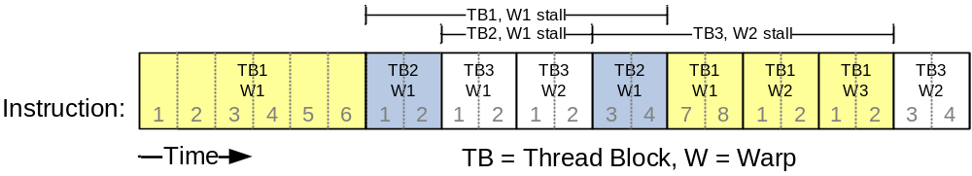
G80 Example: Thread Scheduling (cont.)
SM implements zero-overhead warp scheduling
  At any time, only one of the warps is executed by SM
  Warps whose next instruction has its operands ready for consumption are eligible for execution
  Eligible Warps are selected for execution on a prioritized scheduling policy
  All threads in a warp execute the same instruction when selected

Slide 15
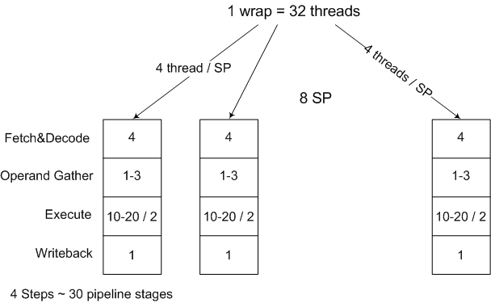
Thread Scheduling (cont.)
Each code block assigned to one SM, each SM can take up to 8 blocks
Each block up to 512 threads, divided into 32-therad wrap, each wrap scheduled on 8 SP, 4 threads on one SP, wrap executed SIMT mode
SP is pipelined ~30 stages, fetch, decode, gather and write-back act on whole warps, so they have a throughput of 1 warp/slow clock
Execute acts on group of 8 threads or quarter-warps (there are only 8 SP/SM), so their throughput is 1 warp/4 fast clocks or 1 warp/2 slow clocks
The Fetch/decode/... stages have a higher throughput to feed both the MAD and the SFU/MUL units alternatively. Hence the peak rate of 8 MAD + 8 MUL per (fast) clock cycle
Need 6 warps (or 192 threads) per SM to hide the read-after-write latencies

Slide 16
Multi-issued / Multithreaded Categories
Simultaneous
Multithreading
Superscalar
Fine-Grained
Coarse-Grained
Multiprocessing
Time (processor cycle)
Thread 1
Thread 3
Thread 5
Thread 2
Thread 4
Idle slot

Slide 17
G80 Block Granularity Considerations
For Matrix Multiplication using multiple blocks, should I use 8X8, 16X16 or 32X32 blocks?
  For 8X8, we have 64 threads per Block. Since each SM can take up to 768 threads, there are 12 Blocks. However, each SM can only take up to 8 Blocks, only 512 threads will go into each SM!
  For 16X16, we have 256 threads per Block. Since each SM can take up to 768 threads, it can take up to 3 Blocks and achieve full capacity unless other resource considerations overrule.
  For 32X32, we have 1024 threads per Block. Not even one can fit into an SM!

Slide 18
Some Additional API Features

Slide 19
Application Programming Interface
The API is an extension to the C programming language
It consists of:
  Language extensions
    To target portions of the code for execution on the device
  A runtime library split into:
    A common component providing built-in vector types and a subset of the C runtime library in both host and device codes
    A host component to control and access one or more devices from the host
    A device component providing device-specific functions

Slide 20
Language Extensions:
Built-in Variables
dim3 gridDim;
  Dimensions of the grid in blocks (gridDim.z unused)
dim3 blockDim;
  Dimensions of the block in threads
dim3 blockIdx;
  Block index within the grid
dim3 threadIdx;
  Thread index within the block

Slide 21
Common Runtime Component:
Mathematical Functions
pow, sqrt, cbrt, hypot
exp, exp2, expm1
log, log2, log10, log1p
sin, cos, tan, asin, acos, atan, atan2
sinh, cosh, tanh, asinh, acosh, atanh
ceil, floor, trunc, round
Etc.
  When executed on the host, a given function uses the C runtime implementation if available
  These functions are only supported for scalar types, not vector types

Slide 22
Device Runtime Component:
Mathematical Functions
Some mathematical functions (e.g. sin(x)) have a less accurate, but faster device-only version (e.g. __sin(x))
  __pow
  __log, __log2, __log10
  __exp
  __sin, __cos, __tan

Slide 23
Host Runtime Component
Provides functions to deal with:
  Device management (including multi-device systems)
  Memory management
  Error handling
Initializes the first time a runtime function is called
A host thread can invoke device code on only one device
  Multiple host threads required to run on multiple devices

Slide 24
Device Runtime Component:
Synchronization Function
void __syncthreads();
Synchronizes all threads in a block
Once all threads have reached this point, execution resumes normally
Used to avoid RAW / WAR / WAW hazards when accessing shared or global memory
Allowed in conditional constructs only if the conditional is uniform across the entire thread block
Notes:
Atomic Operations?

