Slide 1
An Introduction to Parallel Programming
Peter Pacheco
Chapter 2
Parallel Hardware and Parallel Software
Copyright © 2010, Elsevier Inc. All rights Reserved
Notes:
The University of Adelaide, School of Computer Science
Chapter 2 — Instructions: Language of the Computer

Slide 2
Roadmap
# Chapter Subtitle
Some background
Modifications to the von Neumann model
Parallel hardware
Parallel software
Input and output
Performance
Parallel program design
Writing and running parallel programs
Assumptions
Copyright © 2010, Elsevier Inc. All rights Reserved
Notes:
The University of Adelaide, School of Computer Science
Chapter 2 — Instructions: Language of the Computer

Slide 3
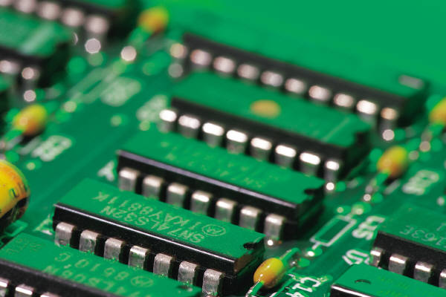
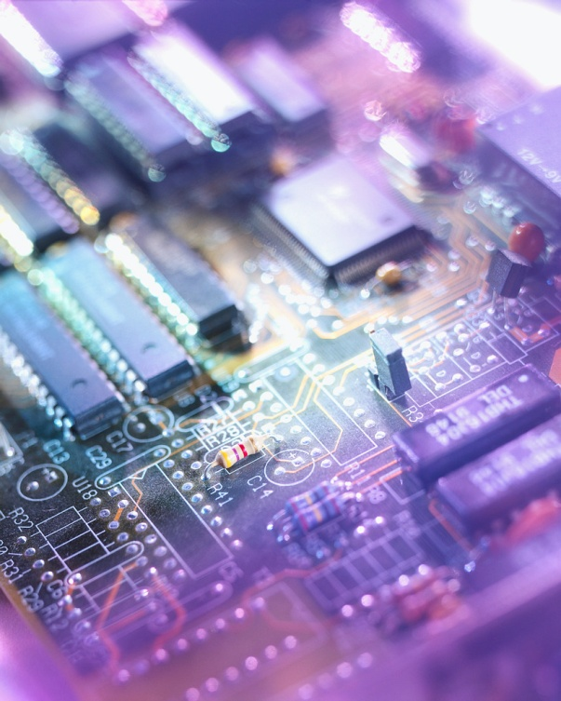
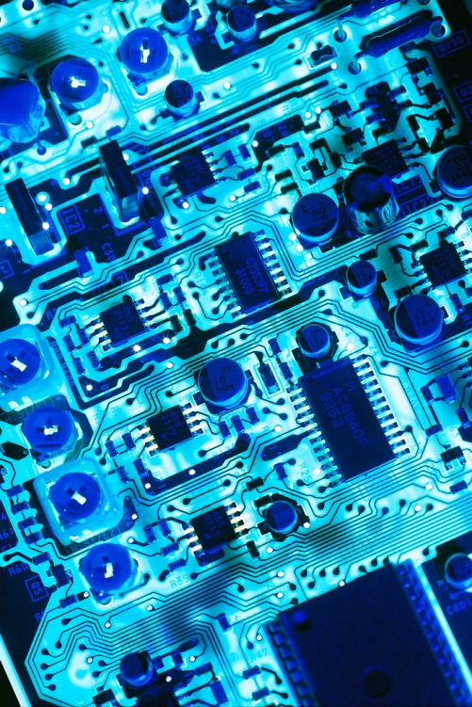
SOME BACKGROUND
Copyright © 2010, Elsevier Inc. All rights Reserved

Slide 4



Serial hardware and software
programs
input
Computer runs one
program at a time.
output
Copyright © 2010, Elsevier Inc. All rights Reserved

Slide 5
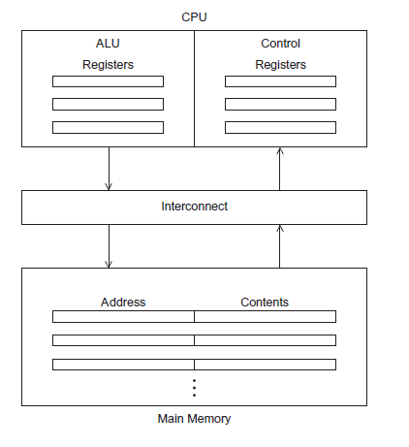
The von Neumann Architecture
# Chapter Subtitle
Figure 2.1
Copyright © 2010, Elsevier Inc. All rights Reserved

Slide 6
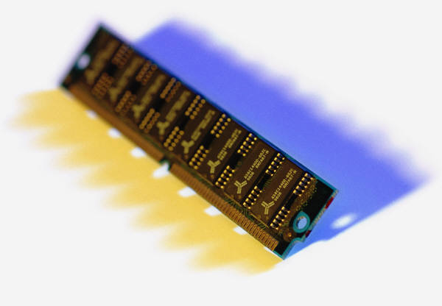
Main memory
This is a collection of locations, each of which is capable of storing both instructions and data.
Every location consists of an address, which is used to access the location, and the contents of the location.
Copyright © 2010, Elsevier Inc. All rights Reserved

Slide 7

Central processing unit (CPU)
Divided into two parts.
Control unit - responsible for
deciding which instruction in
a program should be
executed. (the boss)
Arithmetic and logic unit (ALU) - responsible for executing the actual instructions. (the worker)
add 2+2
Copyright © 2010, Elsevier Inc. All rights Reserved

Slide 8

Key terms
Register – very fast storage, part of the CPU.
Program counter – stores address of the next instruction to be executed.
Bus – wires and hardware that connects the CPU and memory.
Copyright © 2010, Elsevier Inc. All rights Reserved

Slide 9
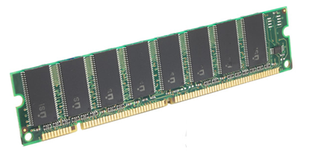

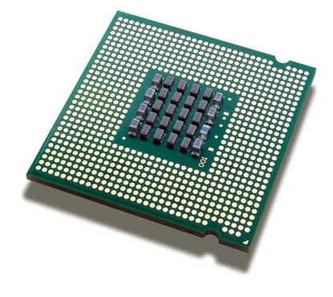
memory
fetch/read
CPU
Copyright © 2010, Elsevier Inc. All rights Reserved

Slide 10

memory
write/store
CPU
Copyright © 2010, Elsevier Inc. All rights Reserved

Slide 11




von Neumann bottleneck
Copyright © 2010, Elsevier Inc. All rights Reserved

Slide 12
An operating system “process”
An instance of a computer program that is being executed.
Components of a process:
  The executable machine language program.
  A block of memory.
  Descriptors of resources the OS has allocated to the process.
  Security information.
  Information about the state of the process.
Copyright © 2010, Elsevier Inc. All rights Reserved

Slide 13
Multitasking
Gives the illusion that a single processor system is running multiple programs simultaneously.
Each process takes turns running. (time slice)
After its time is up, it waits until it has a turn again. (blocks)
Copyright © 2010, Elsevier Inc. All rights Reserved

Slide 14
Threading
Threads are contained within processes.
They allow programmers to divide their programs into (more or less) independent tasks.
The hope is that when one thread blocks because it is waiting on a resource, another will have work to do and can run.
Copyright © 2010, Elsevier Inc. All rights Reserved

Slide 15
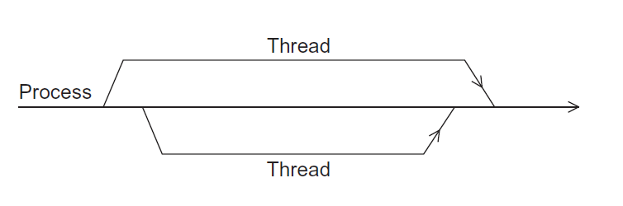
A process and two threads
the “master” thread
terminating a thread
Is called joining
starting a thread
Is called forking
Figure 2.2
Copyright © 2010, Elsevier Inc. All rights Reserved

Slide 16

MODIFICATIONS TO THE VON NEUMANN MODEL
Copyright © 2010, Elsevier Inc. All rights Reserved

Slide 17

Basics of caching
A collection of memory locations that can be accessed in less time than some other memory locations.
A CPU cache is typically located on the same chip, or one that can be accessed much faster than ordinary memory.
Copyright © 2010, Elsevier Inc. All rights Reserved

Slide 18
Principle of locality
Accessing one location is followed by an access of a nearby location.
Spatial locality – accessing a nearby location.
Temporal locality – accessing in the near future.
Copyright © 2010, Elsevier Inc. All rights Reserved

Slide 19
Principle of locality
float z[1000];
…
sum = 0.0;
for (i = 0; i < 1000; i++)
sum += z[i];
Copyright © 2010, Elsevier Inc. All rights Reserved

Slide 20


Levels of Cache
smallest & fastest
L1
L2
L3
largest & slowest
Copyright © 2010, Elsevier Inc. All rights Reserved

Slide 21
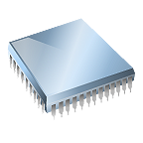
Cache hit
fetch x
L1
x sum
L2
y z total
L3
A[ ] radius r1 center
Copyright © 2010, Elsevier Inc. All rights Reserved

Slide 22
Cache miss
fetch x
x
main
memory
L1
y sum
L2
r1 z total
L3
A[ ] radius center
Copyright © 2010, Elsevier Inc. All rights Reserved

Slide 23
Issues with cache
When a CPU writes data to cache, the value in cache may be inconsistent with the value in main memory.
Write-through caches handle this by updating the data in main memory at the time it is written to cache.
Write-back caches mark data in the cache as dirty. When the cache line is replaced by a new cache line from memory, the dirty line is written to memory.
Copyright © 2010, Elsevier Inc. All rights Reserved

Slide 24
Cache mappings
Full associative – a new line can be placed at any location in the cache.
Direct mapped – each cache line has a unique location in the cache to which it will be assigned.
n-way set associative – each cache line can be place in one of n different locations in the cache.
Copyright © 2010, Elsevier Inc. All rights Reserved

Slide 25

n-way set associative
When more than one line in memory can be mapped to several different locations in cache we also need to be able to decide which line should be replaced or evicted.
x
Copyright © 2010, Elsevier Inc. All rights Reserved

Slide 26
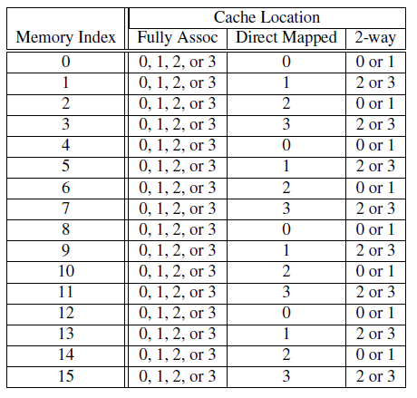
Example
Table 2.1: Assignments of a 16-line main memory to a 4-line cache
Copyright © 2010, Elsevier Inc. All rights Reserved

Slide 27
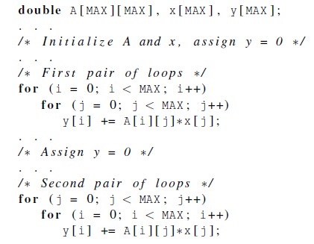
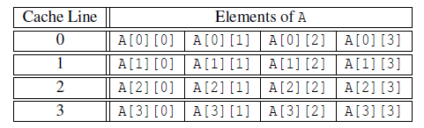
Caches and programs
Copyright © 2010, Elsevier Inc. All rights Reserved

Slide 28
Virtual memory (1)
If we run a very large program or a program that accesses very large data sets, all of the instructions and data may not fit into main memory.
Virtual memory functions as a cache for secondary storage.
Copyright © 2010, Elsevier Inc. All rights Reserved

Slide 29
Virtual memory (2)
It exploits the principle of spatial and temporal locality.
It only keeps the active parts of running programs in main memory.
Copyright © 2010, Elsevier Inc. All rights Reserved

Slide 30
Virtual memory (3)
Swap space - those parts that are idle are kept in a block of secondary storage.
Pages – blocks of data and instructions.
  Usually these are relatively large.
  Most systems have a fixed page
  size that currently ranges from
  4 to 16 kilobytes.
Copyright © 2010, Elsevier Inc. All rights Reserved

Slide 31
Virtual memory (4)
program A
main memory
program B
program C
Copyright © 2010, Elsevier Inc. All rights Reserved

Slide 32
Virtual page numbers
When a program is compiled its pages are assigned virtual page numbers.
When the program is run, a table is created that maps the virtual page numbers to physical addresses.
A page table is used to translate the virtual address into a physical address.
Copyright © 2010, Elsevier Inc. All rights Reserved

Slide 33
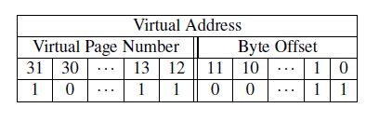
Page table
Table 2.2: Virtual Address Divided into Virtual Page Number and Byte Offset
Copyright © 2010, Elsevier Inc. All rights Reserved

Slide 34
Translation-lookaside buffer (TLB)
Using a page table has the potential to significantly increase each program’s overall run-time.
A special address translation cache in the processor.
Copyright © 2010, Elsevier Inc. All rights Reserved

Slide 35
Translation-lookaside buffer (2)
It caches a small number of entries (typically 16–512) from the page table in very fast memory.
Page fault – attempting to access a valid physical address for a page in the page table but the page is only stored on disk.
Copyright © 2010, Elsevier Inc. All rights Reserved

Slide 36
Instruction Level Parallelism (ILP)
Attempts to improve processor performance by having multiple processor components or functional units simultaneously executing instructions.
Copyright © 2010, Elsevier Inc. All rights Reserved

Slide 37
Instruction Level Parallelism (2)
Pipelining - functional units are arranged in stages.
Multiple issue - multiple instructions can be simultaneously initiated.
Copyright © 2010, Elsevier Inc. All rights Reserved

Slide 38





Pipelining
Copyright © 2010, Elsevier Inc. All rights Reserved

Slide 39
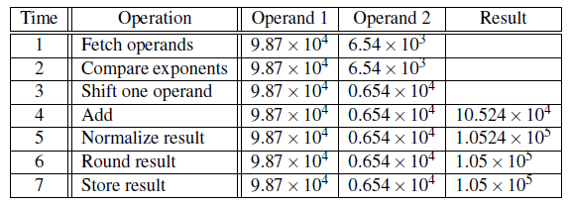
Pipelining example (1)
Add the floating point numbers 9.87×10⁴ and 6.54×10³
Copyright © 2010, Elsevier Inc. All rights Reserved

Slide 40

Pipelining example (2)
Assume each operation takes one nanosecond (10⁻⁹ seconds).
This for loop takes about 7000 nanoseconds.
Copyright © 2010, Elsevier Inc. All rights Reserved

Slide 41
Pipelining (3)
Divide the floating point adder into 7 separate pieces of hardware or functional units.
First unit fetches two operands, second unit compares exponents, etc.
Output of one functional unit is input to the next.
Copyright © 2010, Elsevier Inc. All rights Reserved

Slide 42
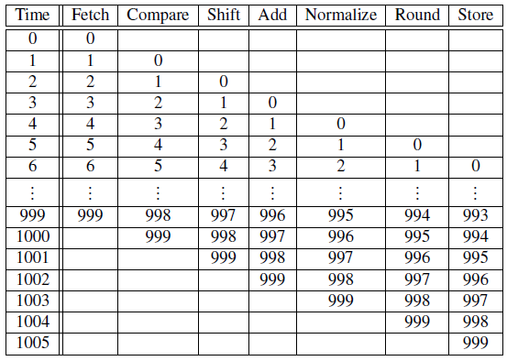
Pipelining (4)
Table 2.3: Pipelined Addition.
Numbers in the table are subscripts of operands/results.
Copyright © 2010, Elsevier Inc. All rights Reserved

Slide 43

Pipelining (5)
One floating point addition still takes
7 nanoseconds.
But 1000 floating point additions
now takes 1006 nanoseconds!
Copyright © 2010, Elsevier Inc. All rights Reserved

Slide 44
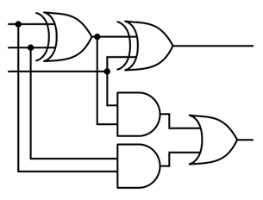
Multiple Issue (1)
Multiple issue processors replicate functional units and try to simultaneously execute different instructions in a program.
for (i = 0; i < 1000; i++)
z[i] = x[i] + y[i];
z[3]
z[4]
z[1]
z[2]
adder #1
adder #2
Copyright © 2010, Elsevier Inc. All rights Reserved

Slide 45
Multiple Issue (2)
static multiple issue - functional units are scheduled at compile time.
dynamic multiple issue – functional units are scheduled at run-time.
superscalar
Copyright © 2010, Elsevier Inc. All rights Reserved

Slide 46

Speculation (1)
In order to make use of multiple issue, the system must find instructions that can be executed simultaneously.
In speculation, the compiler or the processor makes a guess about an instruction, and then executes the instruction on the basis of the guess.
Copyright © 2010, Elsevier Inc. All rights Reserved

Slide 47

Speculation (2)
z = x + y ;
i f ( z > 0)
w = x ;
e l s e
w = y ;
Z will be
positive
If the system speculates incorrectly,
it must go back and recalculate w = y.
Copyright © 2010, Elsevier Inc. All rights Reserved

Slide 48
Hardware multithreading (1)
There aren’t always good opportunities for simultaneous execution of different threads.
Hardware multithreading provides a means for systems to continue doing useful work when the task being currently executed has stalled.
  Ex., the current task has to wait for data to be loaded from memory.
Copyright © 2010, Elsevier Inc. All rights Reserved

Slide 49
Hardware multithreading (2)
Fine-grained - the processor switches between threads after each instruction, skipping threads that are stalled.
  Pros: potential to avoid wasted machine time due to stalls.
  Cons: a thread that’s ready to execute a long sequence of instructions may have to wait to execute every instruction.
Copyright © 2010, Elsevier Inc. All rights Reserved

Slide 50
Hardware multithreading (3)
Coarse-grained - only switches threads that are stalled waiting for a time-consuming operation to complete.
  Pros: switching threads doesn’t need to be nearly instantaneous.
  Cons: the processor can be idled on shorter stalls, and thread switching will also cause delays.
Copyright © 2010, Elsevier Inc. All rights Reserved

Slide 51
Hardware multithreading (3)
Simultaneous multithreading (SMT) - a variation on fine-grained multithreading.
Allows multiple threads to make use of the multiple functional units.
Copyright © 2010, Elsevier Inc. All rights Reserved

Slide 52
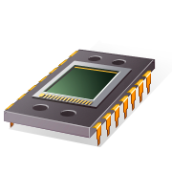
PARALLEL HARDWARE
A programmer can write code to exploit.
Copyright © 2010, Elsevier Inc. All rights Reserved

Slide 53
Flynn’s Taxonomy
classic von Neumann
SISD
Single instruction stream
Single data stream
(SIMD)
Single instruction stream
Multiple data stream
MISD
Multiple instruction stream
Single data stream
(MIMD)
Multiple instruction stream
Multiple data stream
not covered
Copyright © 2010, Elsevier Inc. All rights Reserved

Slide 54
SIMD
Parallelism achieved by dividing data among the processors.
Applies the same instruction to multiple data items.
Called data parallelism.
Copyright © 2010, Elsevier Inc. All rights Reserved

Slide 55
SIMD example
n data items
n ALUs
control unit
…
x[1]
x[2]
x[n]
ALU₁
ALU₂
ALU_{n}
for (i = 0; i < n; i++)
x[i] += y[i];
Copyright © 2010, Elsevier Inc. All rights Reserved

Slide 56
SIMD
What if we don’t have as many ALUs as data items?
Divide the work and process iteratively.
Ex. m = 4 ALUs and n = 15 data items.
Round3 | ALU₁ | ALU₂ | ALU₃ | ALU₄
1 | X[0] | X[1] | X[2] | X[3]
2 | X[4] | X[5] | X[6] | X[7]
3 | X[8] | X[9] | X[10] | X[11]
4 | X[12] | X[13] | X[14]
Copyright © 2010, Elsevier Inc. All rights Reserved

Slide 57
SIMD drawbacks
All ALUs are required to execute the same instruction, or remain idle.
In classic design, they must also operate synchronously.
The ALUs have no instruction storage.
Efficient for large data parallel problems, but not other types of more complex parallel problems.
Copyright © 2010, Elsevier Inc. All rights Reserved

Slide 58
Vector processors (1)
Operate on arrays or vectors of data while conventional CPU’s operate on individual data elements or scalars.
Vector registers.
  Capable of storing a vector of operands and operating simultaneously on their contents.
Copyright © 2010, Elsevier Inc. All rights Reserved

Slide 59
Vector processors (2)
Vectorized and pipelined functional units.
  The same operation is applied to each element in the vector (or pairs of elements).
Vector instructions.
  Operate on vectors rather than scalars.
Copyright © 2010, Elsevier Inc. All rights Reserved

Slide 60
Vector processors (3)
Interleaved memory.
  Multiple “banks” of memory, which can be accessed more or less independently.
  Distribute elements of a vector across multiple banks, so reduce or eliminate delay in loading/storing successive elements.
Strided memory access and hardware scatter/gather.
  The program accesses elements of a vector located at fixed intervals.
Copyright © 2010, Elsevier Inc. All rights Reserved

Slide 61

Vector processors - Pros
Fast.
Easy to use.
Vectorizing compilers are good at identifying code to exploit.
Compilers also can provide information about code that cannot be vectorized.
  Helps the programmer re-evaluate code.
High memory bandwidth.
Uses every item in a cache line.
Copyright © 2010, Elsevier Inc. All rights Reserved

Slide 62

Vector processors - Cons
They don’t handle irregular
data structures as well as other
parallel architectures.
A very finite limit to their ability to handle ever larger problems. (scalability)
Copyright © 2010, Elsevier Inc. All rights Reserved

Slide 63
Graphics Processing Units (GPU)
Real time graphics application programming interfaces or API’s use points, lines, and triangles to internally represent the surface of an object.
Copyright © 2010, Elsevier Inc. All rights Reserved

Slide 64

GPUs
A graphics processing pipeline converts the internal representation into an array of pixels that can be sent to a computer screen.
Several stages of this pipeline
(called shader functions) are programmable.
  Typically just a few lines of C code.
Copyright © 2010, Elsevier Inc. All rights Reserved

Slide 65
GPUs
Shader functions are also implicitly parallel, since they can be applied to multiple elements in the graphics stream.
GPU’s can often optimize performance by using SIMD parallelism.
The current generation of GPU’s use SIMD parallelism.
  Although they are not pure SIMD systems.
Copyright © 2010, Elsevier Inc. All rights Reserved

Slide 66
MIMD
Supports multiple simultaneous instruction streams operating on multiple data streams.
Typically consist of a collection of fully independent processing units or cores, each of which has its own control unit and its own ALU.
Copyright © 2010, Elsevier Inc. All rights Reserved

Slide 67
Shared Memory System (1)
A collection of autonomous processors is connected to a memory system via an interconnection network.
Each processor can access each memory location.
The processors usually communicate implicitly by accessing shared data structures.
Copyright © 2010, Elsevier Inc. All rights Reserved

Slide 68
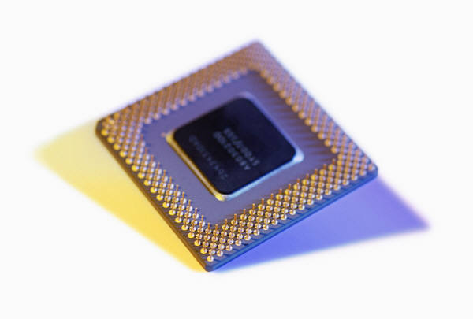
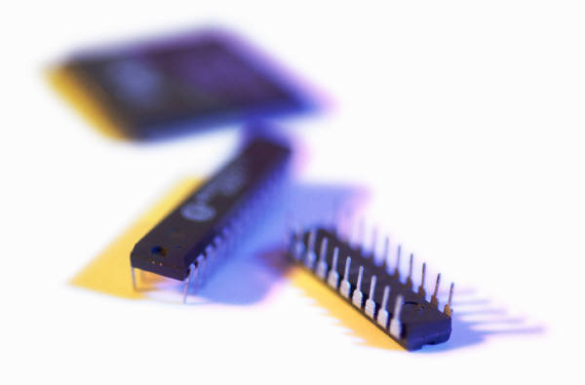
Shared Memory System (2)
Most widely available shared memory systems use one or more multicore processors.
  (multiple CPU’s or cores on a single chip)
Copyright © 2010, Elsevier Inc. All rights Reserved

Slide 69
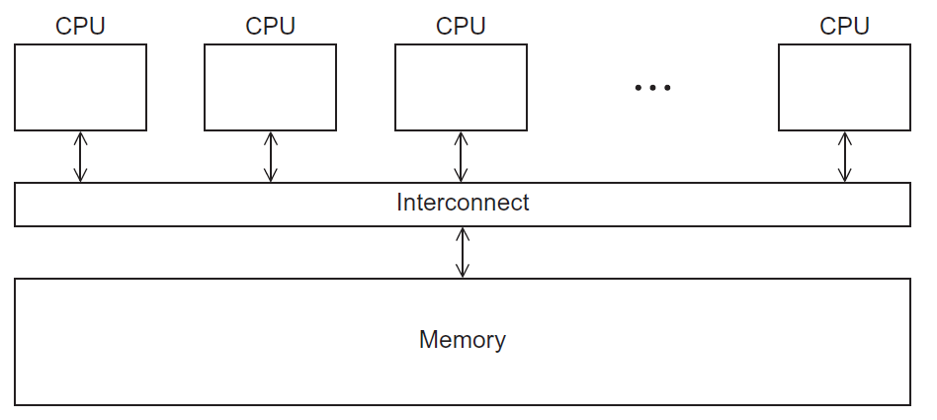
Shared Memory System
Figure 2.3
Copyright © 2010, Elsevier Inc. All rights Reserved

Slide 70
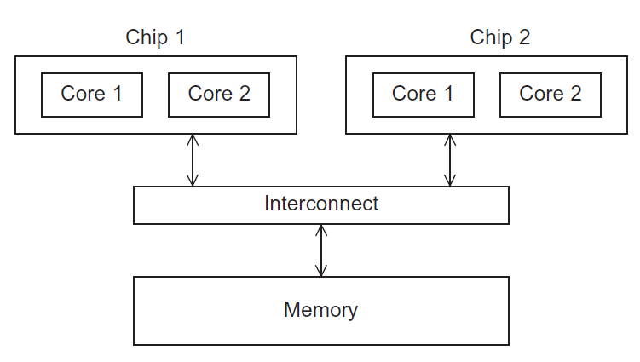
UMA multicore system
Time to access all
the memory locations
will be the same for
all the cores.
Figure 2.5
Copyright © 2010, Elsevier Inc. All rights Reserved

Slide 71
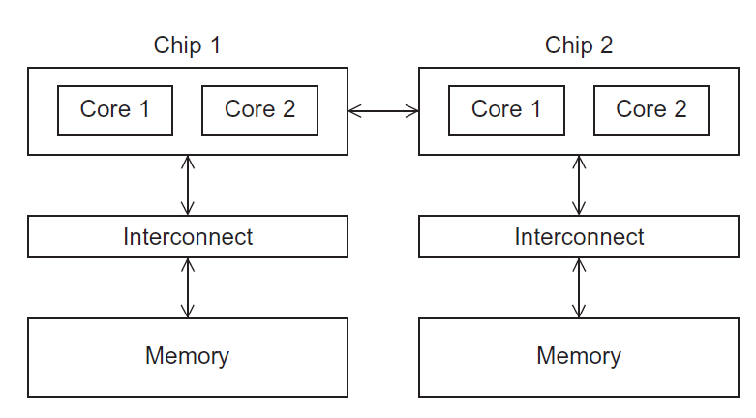
NUMA multicore system
A memory location a core is directly connected to can be accessed faster than a memory location that must be accessed through another chip.
Figure 2.6
Copyright © 2010, Elsevier Inc. All rights Reserved

Slide 72
Distributed Memory System
Clusters (most popular)
  A collection of commodity systems.
  Connected by a commodity interconnection network.
Nodes of a cluster are individual computations units joined by a communication network.
a.k.a. hybrid systems
Copyright © 2010, Elsevier Inc. All rights Reserved

Slide 73
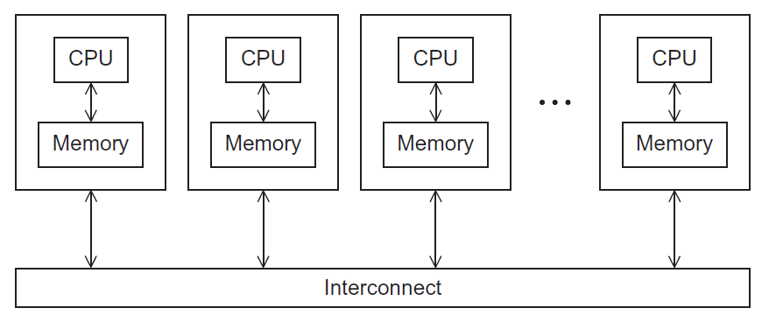
Distributed Memory System
Figure 2.4
Copyright © 2010, Elsevier Inc. All rights Reserved

Slide 74
Interconnection networks
Affects performance of both distributed and shared memory systems.
Two categories:
  Shared memory interconnects
  Distributed memory interconnects
Copyright © 2010, Elsevier Inc. All rights Reserved

Slide 75
Shared memory interconnects
Bus interconnect
  A collection of parallel communication wires together with some hardware that controls access to the bus.
  Communication wires are shared by the devices that are connected to it.
  As the number of devices connected to the bus increases, contention for use of the bus increases, and performance decreases.
Copyright © 2010, Elsevier Inc. All rights Reserved

Slide 76
Shared memory interconnects
Switched interconnect
  Uses switches to control the routing of data among the connected devices.
  Crossbar –
    Allows simultaneous communication among different devices.
    Faster than buses.
    But the cost of the switches and links is relatively high.
Copyright © 2010, Elsevier Inc. All rights Reserved

Slide 77
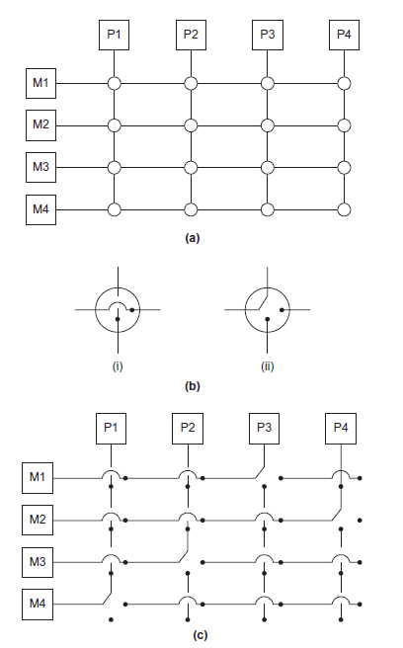
Figure 2.7
(a)
A crossbar switch connecting 4 processors (Pi) and 4 memory modules (Mj)
(b)
Configuration of internal switches in a crossbar
(c) Simultaneous memory accesses by the processors
Copyright © 2010, Elsevier Inc. All rights Reserved

Slide 78
Distributed memory interconnects
Two groups
  Direct interconnect
    Each switch is directly connected to a processor memory pair, and the switches are connected to each other.
  Indirect interconnect
    Switches may not be directly connected to a processor.
Copyright © 2010, Elsevier Inc. All rights Reserved

Slide 79
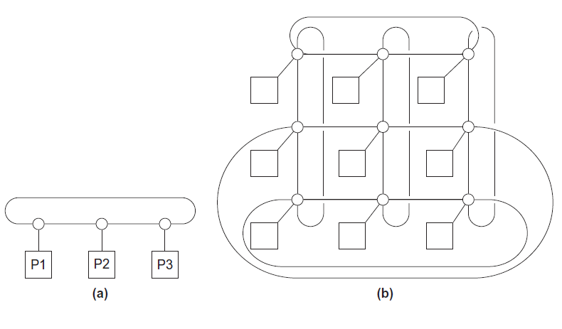
Direct interconnect
Figure 2.8
ring
toroidal mesh
Copyright © 2010, Elsevier Inc. All rights Reserved

Slide 80

Bisection width
A measure of “number of simultaneous communications” or “connectivity”.
How many simultaneous communications can take place “across the divide” between the halves?
Copyright © 2010, Elsevier Inc. All rights Reserved

Slide 81
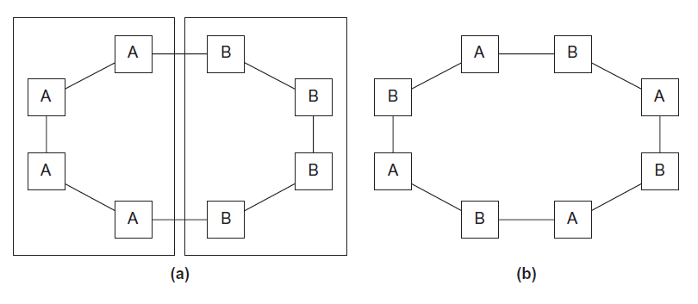
Two bisections of a ring
Figure 2.9
Copyright © 2010, Elsevier Inc. All rights Reserved

Slide 82
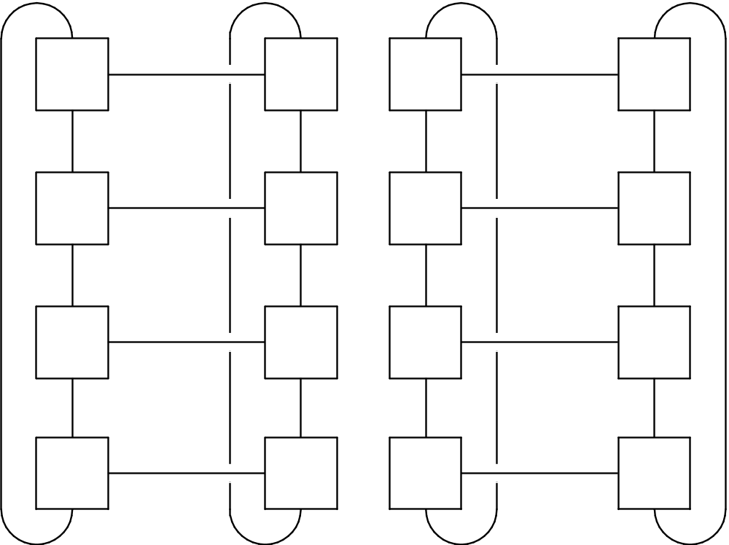
A bisection of a toroidal mesh
Figure 2.10
Copyright © 2010, Elsevier Inc. All rights Reserved

Slide 83
Definitions
Bandwidth
  The rate at which a link can transmit data.
  Usually given in megabits or megabytes per second.
Bisection bandwidth
  A measure of network quality.
  Instead of counting the number of links joining the halves, it sums the bandwidth of the links.
Copyright © 2010, Elsevier Inc. All rights Reserved

Slide 84

Fully connected network
Each switch is directly connected to every other switch.
impractical
bisection width = p²/4
Figure 2.11
Copyright © 2010, Elsevier Inc. All rights Reserved

Slide 85
Hypercube
Highly connected direct interconnect.
Built inductively:
  A one-dimensional hypercube is a fully-connected system with two processors.
  A two-dimensional hypercube is built from two one-dimensional hypercubes by joining “corresponding” switches.
  Similarly a three-dimensional hypercube is built from two two-dimensional hypercubes.
Copyright © 2010, Elsevier Inc. All rights Reserved

Slide 86
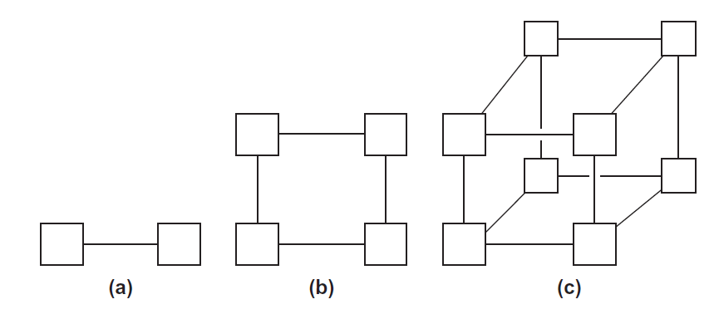
Hypercubes
Figure 2.12
one-
two-
three-dimensional
Copyright © 2010, Elsevier Inc. All rights Reserved

Slide 87
Indirect interconnects
Simple examples of indirect networks:
  Crossbar
  Omega network
Often shown with unidirectional links and a collection of processors, each of which has an outgoing and an incoming link, and a switching network.
Copyright © 2010, Elsevier Inc. All rights Reserved

Slide 88
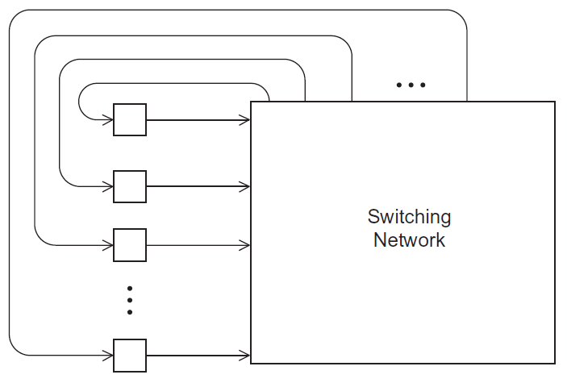
A generic indirect network
Figure 2.13
Copyright © 2010, Elsevier Inc. All rights Reserved

Slide 89
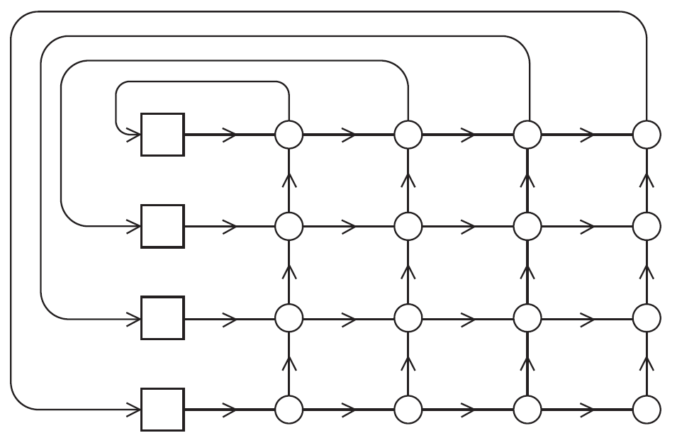
Crossbar interconnect for distributed memory
Figure 2.14
Copyright © 2010, Elsevier Inc. All rights Reserved

Slide 90
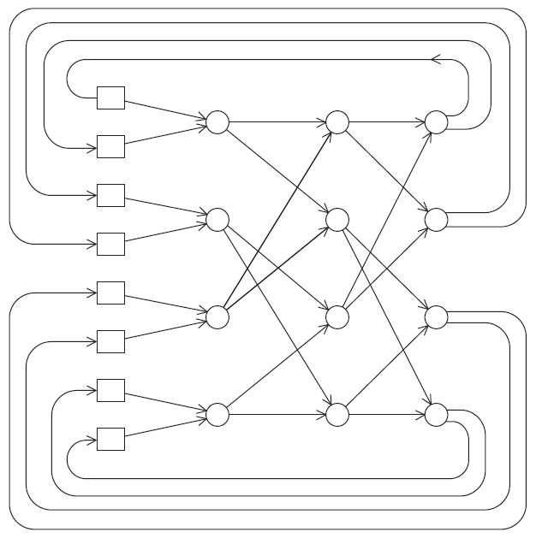
An omega network
Figure 2.15
Copyright © 2010, Elsevier Inc. All rights Reserved

Slide 91
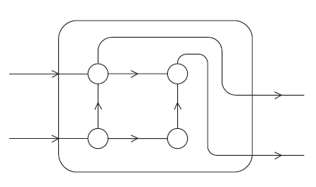
A switch in an omega network
Figure 2.16
Copyright © 2010, Elsevier Inc. All rights Reserved

Slide 92
More definitions
Any time data is transmitted, we’re interested in how long it will take for the data to reach its destination.
Latency
  The time that elapses between the source’s beginning to transmit the data and the destination’s starting to receive the first byte.
Bandwidth
  The rate at which the destination receives data after it has started to receive the first byte.
Copyright © 2010, Elsevier Inc. All rights Reserved

Slide 93
Message transmission time = l + n / b
latency (seconds)
length of message (bytes)
bandwidth (bytes per second)
Copyright © 2010, Elsevier Inc. All rights Reserved

Slide 94
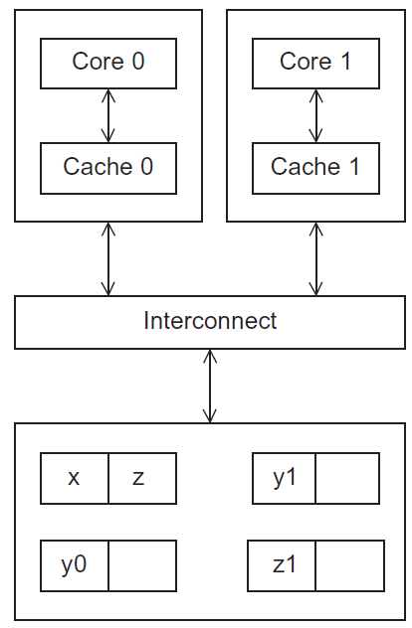
Cache coherence
Programmers have no
control over caches
and when they get updated.
Figure 2.17
A shared memory system with two cores and two caches
Copyright © 2010, Elsevier Inc. All rights Reserved
Notes:
The University of Adelaide, School of Computer Science
Chapter 2 — Instructions: Language of the Computer

Slide 95
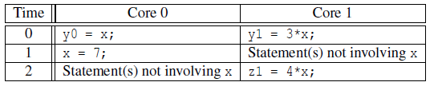
Cache coherence
y0 privately owned by Core 0
y1 and z1 privately owned by Core 1
x = 2; /* shared variable */
y0 eventually ends up = 2
y1 eventually ends up = 6
z1 = ???
Copyright © 2010, Elsevier Inc. All rights Reserved

Slide 96
Snooping Cache Coherence
The cores share a bus .
Any signal transmitted on the bus can be “seen” by all cores connected to the bus.
When core 0 updates the copy of x stored in its cache it also broadcasts this information across the bus.
If core 1 is “snooping” the bus, it will see that x has been updated and it can mark its copy of x as invalid.
Copyright © 2010, Elsevier Inc. All rights Reserved

Slide 97
Directory Based Cache Coherence
Uses a data structure called a directory that stores the status of each cache line.
When a variable is updated, the directory is consulted, and the cache controllers of the cores that have that variable’s cache line in their caches are invalidated.
Copyright © 2010, Elsevier Inc. All rights Reserved

Slide 98

PARALLEL SOFTWARE
Copyright © 2010, Elsevier Inc. All rights Reserved

Slide 99
The burden is on software
Hardware and compilers can keep up the pace needed.
From now on…
  In shared memory programs:
    Start a single process and fork threads.
    Threads carry out tasks.
  In distributed memory programs:
    Start multiple processes.
    Processes carry out tasks.
Copyright © 2010, Elsevier Inc. All rights Reserved

Slide 100

SPMD – single program multiple data
A SPMD programs consists of a single executable that can behave as if it were multiple different programs through the use of conditional branches.
if (I’m thread process i)
do this;
else
do that;
Copyright © 2010, Elsevier Inc. All rights Reserved

Slide 101
Writing Parallel Programs
double x[n], y[n];
…
for (i = 0; i < n; i++)
x[i] += y[i];
Divide the work among the
processes/threads
  so each process/thread
  gets roughly the same
  amount of work
  and communication is
  minimized.
Arrange for the processes/threads to synchronize.
Arrange for communication among processes/threads.
Copyright © 2010, Elsevier Inc. All rights Reserved

Slide 102
Shared Memory
Dynamic threads
  Master thread waits for work, forks new threads, and when threads are done, they terminate
  Efficient use of resources, but thread creation and termination is time consuming.
Static threads
  Pool of threads created and are allocated work, but do not terminate until cleanup.
  Better performance, but potential waste of system resources.
Copyright © 2010, Elsevier Inc. All rights Reserved

Slide 103

Nondeterminism
. . .
printf ( "Thread %d > my_val = %d\n" ,
my_rank , my_x ) ;
. . .
Thread 0 > my_val = 7
Thread 1 > my_val = 19
Thread 1 > my_val = 19
Thread 0 > my_val = 7
Copyright © 2010, Elsevier Inc. All rights Reserved

Slide 104
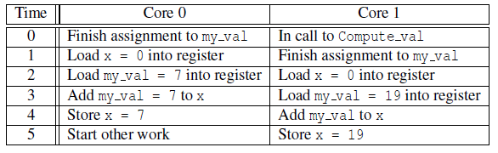
Nondeterminism
my_val = Compute_val ( my_rank ) ;
x += my_val ;
Copyright © 2010, Elsevier Inc. All rights Reserved

Slide 105
Nondeterminism
Race condition
Critical section
Mutually exclusive
Mutual exclusion lock (mutex, or simply lock)
my_val = Compute_val ( my_rank ) ;
Lock(&add_my_val_lock ) ;
x += my_val ;
Unlock(&add_my_val_lock ) ;
Copyright © 2010, Elsevier Inc. All rights Reserved

Slide 106
busy-waiting
my_val = Compute_val ( my_rank ) ;
i f ( my_rank == 1)
whi l e ( ! ok_for_1 ) ; /* Busy−wait loop */
x += my_val ; /* Critical section */
i f ( my_rank == 0)
ok_for_1 = true ; /* Let thread 1 update x */
Copyright © 2010, Elsevier Inc. All rights Reserved

Slide 107
message-passing
char message [ 1 0 0 ] ;
. . .
my_rank = Get_rank ( ) ;
i f ( my_rank == 1) {
sprintf ( message , "Greetings from process 1" ) ;
Send ( message , MSG_CHAR , 100 , 0 ) ;
} e l s e i f ( my_rank == 0) {
Receive ( message , MSG_CHAR , 100 , 1 ) ;
printf ( "Process 0 > Received: %s\n" , message ) ;
}
Copyright © 2010, Elsevier Inc. All rights Reserved

Slide 108
Partitioned Global Address Space Languages
shared i n t n = . . . ;
shared double x [ n ] , y [ n ] ;
private i n t i , my_first_element , my_last_element ;
my_first_element = . . . ;
my_last_element = . . . ;
/ * Initialize x and y */
. . .
f o r ( i = my_first_element ; i <= my_last_element ; i++)
x [ i ] += y [ i ] ;
Copyright © 2010, Elsevier Inc. All rights Reserved

Slide 109
Input and Output
In distributed memory programs, only process 0 will access stdin. In shared memory programs, only the master thread or thread 0 will access stdin.
In both distributed memory and shared memory programs all the processes/threads can access stdout and stderr.
Copyright © 2010, Elsevier Inc. All rights Reserved

Slide 110
Input and Output
However, because of the indeterminacy of the order of output to stdout, in most cases only a single process/thread will be used for all output to stdout other than debugging output.
Debug output should always include the rank or id of the process/thread that’s generating the output.
Copyright © 2010, Elsevier Inc. All rights Reserved

Slide 111
Input and Output
Only a single process/thread will attempt to access any single file other than stdin, stdout, or stderr. So, for example, each process/thread can open its own, private file for reading or writing, but no two processes/threads will open the same file.
Copyright © 2010, Elsevier Inc. All rights Reserved

Slide 112

PERFORMANCE
Copyright © 2010, Elsevier Inc. All rights Reserved

Slide 113

Speedup
Number of cores = p
Serial run-time = T_{serial}
Parallel run-time = T_{parallel}
linear speedup
T_{parallel} = T_{serial} / p
Copyright © 2010, Elsevier Inc. All rights Reserved

Slide 114
Speedup of a parallel program
T_{serial}
S =
T_{parallel}
Copyright © 2010, Elsevier Inc. All rights Reserved

Slide 115
Efficiency of a parallel program
T_{serial}
T_{parallel}
S
T_{serial}
E =
=
=
.
p
p
p T_{parallel}
Copyright © 2010, Elsevier Inc. All rights Reserved

Slide 116

Speedups and efficiencies of a parallel program
Copyright © 2010, Elsevier Inc. All rights Reserved

Slide 117
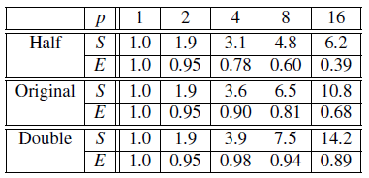
Speedups and efficiencies of parallel program on different problem sizes
Copyright © 2010, Elsevier Inc. All rights Reserved

Slide 118
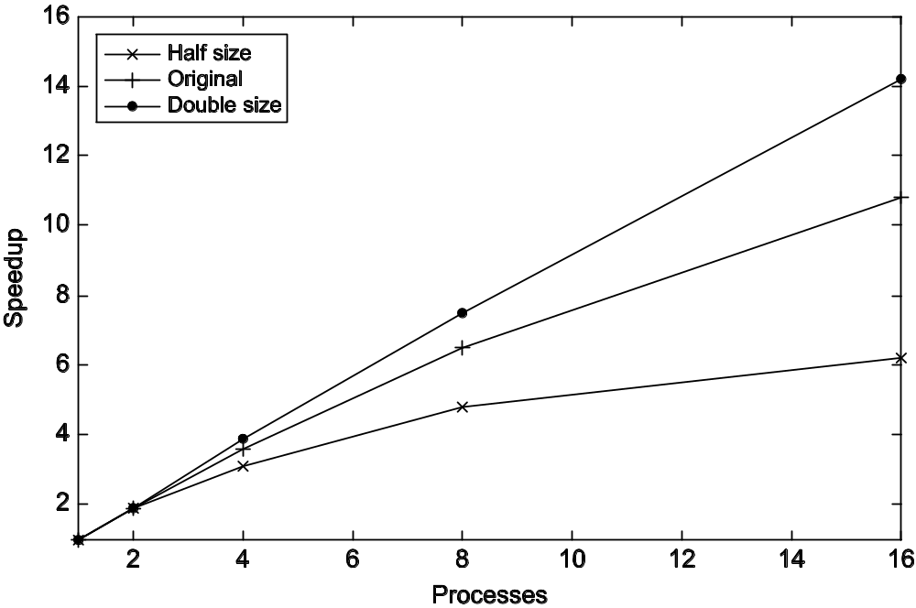
Speedup
Copyright © 2010, Elsevier Inc. All rights Reserved

Slide 119
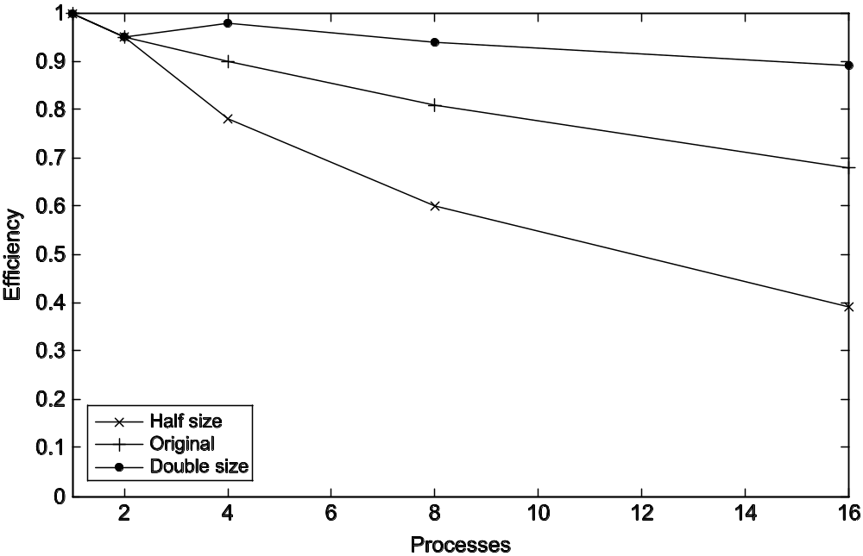
Efficiency
Copyright © 2010, Elsevier Inc. All rights Reserved

Slide 120
Effect of overhead
T_{parallel} = T_{serial} / p + T_{overhead}
Copyright © 2010, Elsevier Inc. All rights Reserved

Slide 121

Amdahl’s Law
Unless virtually all of a serial program is parallelized, the possible speedup is going to be very limited — regardless of the number of cores available.
Copyright © 2010, Elsevier Inc. All rights Reserved

Slide 122
Example
We can parallelize 90% of a serial program.
Parallelization is “perfect” regardless of the number of cores p we use.
T_{serial} = 20 seconds
Runtime of parallelizable part is
0.9 x T_{serial} / p = 18 / p
Copyright © 2010, Elsevier Inc. All rights Reserved

Slide 123
Example (cont.)
Runtime of “unparallelizable” part is
Overall parallel run-time is
0.1 x T_{serial} = 2
T_{parallel} = 0.9 x T_{serial} / p + 0.1 x T_{serial} = 18 / p + 2
Copyright © 2010, Elsevier Inc. All rights Reserved

Slide 124
Example (cont.)
Speed up
T_{serial}
20
S =
=
0.9 x T_{serial} / p + 0.1 x T_{serial}
18 / p + 2
Copyright © 2010, Elsevier Inc. All rights Reserved

Slide 125
Scalability
In general, a problem is scalable if it can handle ever increasing problem sizes.
If we increase the number of processes/threads and keep the efficiency fixed without increasing problem size, the problem is strongly scalable.
If we keep the efficiency fixed by increasing the problem size at the same rate as we increase the number of processes/threads, the problem is weakly scalable.
Copyright © 2010, Elsevier Inc. All rights Reserved

Slide 126

Taking Timings
What is time?
Start to finish?
A program segment of interest?
CPU time?
Wall clock time?
Copyright © 2010, Elsevier Inc. All rights Reserved

Slide 127
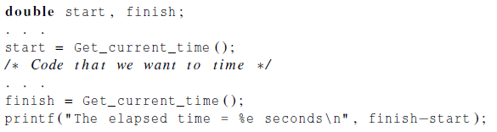
Taking Timings
theoretical
function
omp_get_wtime
MPI_Wtime
Copyright © 2010, Elsevier Inc. All rights Reserved

Slide 128
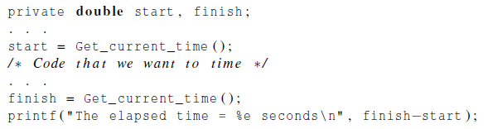
Taking Timings
Copyright © 2010, Elsevier Inc. All rights Reserved

Slide 129
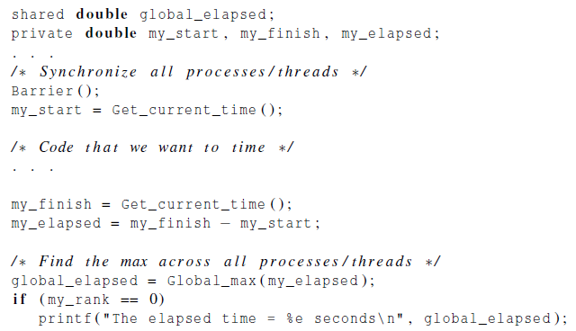
Taking Timings
Copyright © 2010, Elsevier Inc. All rights Reserved

Slide 130

PARALLEL PROGRAM
DESIGN
Copyright © 2010, Elsevier Inc. All rights Reserved

Slide 131
Foster’s methodology
Partitioning: divide the computation to be performed and the data operated on by the computation into small tasks.
The focus here should be on identifying tasks that can be executed in parallel.
Copyright © 2010, Elsevier Inc. All rights Reserved

Slide 132

Foster’s methodology
Communication: determine what communication needs to be carried out among the tasks identified in the previous step.
Copyright © 2010, Elsevier Inc. All rights Reserved

Slide 133
Foster’s methodology
Agglomeration or aggregation: combine tasks and communications identified in the first step into larger tasks.
For example, if task A must be executed before task B can be executed, it may make sense to aggregate them into a single composite task.
Copyright © 2010, Elsevier Inc. All rights Reserved

Slide 134
Foster’s methodology
Mapping: assign the composite tasks identified in the previous step to processes/threads.
This should be done so that communication is minimized, and each process/thread gets roughly the same amount of work.
Copyright © 2010, Elsevier Inc. All rights Reserved

Slide 135
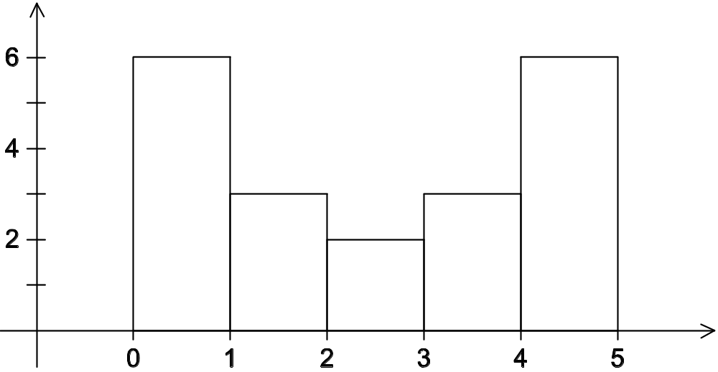
Example - histogram
1.3,2.9,0.4,0.3,1.3,4.4,1.7,0.4,3.2,0.3,4.9,2.4,3.1,4.4,3.9,0.4,4.2,4.5,4.9,0.9
Copyright © 2010, Elsevier Inc. All rights Reserved

Slide 136
Serial program - input
The number of measurements: data_count
An array of data_count floats: data
The minimum value for the bin containing the smallest values: min_meas
The maximum value for the bin containing the largest values: max_meas
The number of bins: bin_count
Copyright © 2010, Elsevier Inc. All rights Reserved

Slide 137
Serial program - output
bin_maxes : an array of bin_count floats
bin_counts : an array of bin_count ints
Copyright © 2010, Elsevier Inc. All rights Reserved

Slide 138
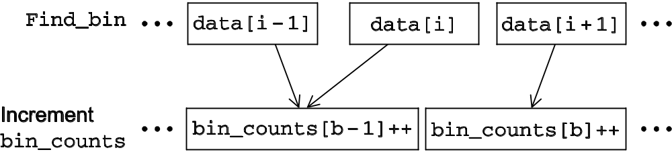
First two stages of Foster’s Methodology
Copyright © 2010, Elsevier Inc. All rights Reserved

Slide 139
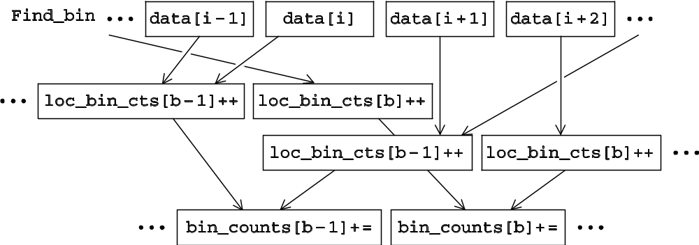
Alternative definition of tasks and communication
Copyright © 2010, Elsevier Inc. All rights Reserved

Slide 140
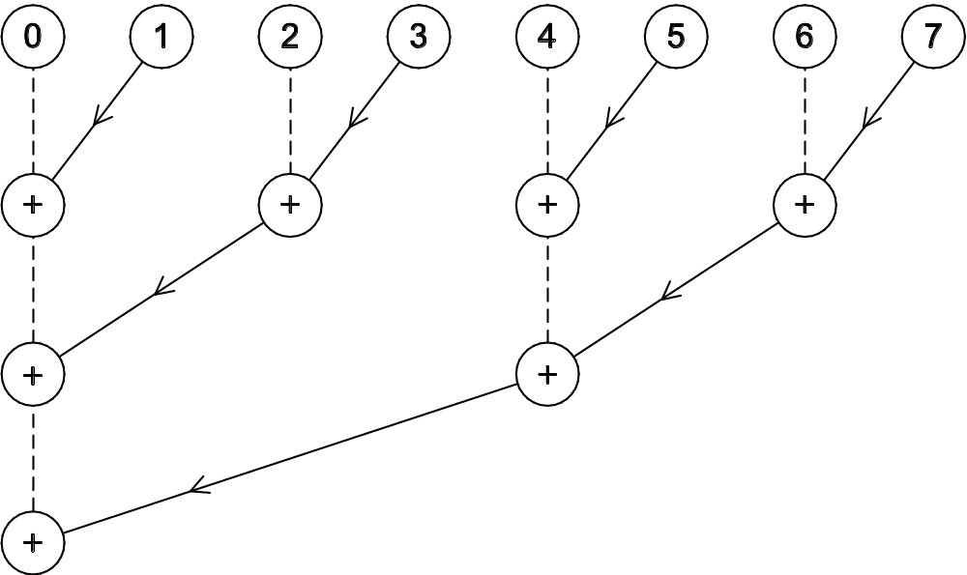
Adding the local arrays
Copyright © 2010, Elsevier Inc. All rights Reserved

Slide 141
Concluding Remarks (1)
Serial systems
  The standard model of computer hardware has been the von Neumann architecture.
Parallel hardware
  Flynn’s taxonomy.
Parallel software
  We focus on software for homogeneous MIMD systems, consisting of a single program that obtains parallelism by branching.
  SPMD programs.
Copyright © 2010, Elsevier Inc. All rights Reserved

Slide 142
Concluding Remarks (2)
Input and Output
  We’ll write programs in which one process or thread can access stdin, and all processes can access stdout and stderr.
  However, because of nondeterminism, except for debug output we’ll usually have a single process or thread accessing stdout.
Copyright © 2010, Elsevier Inc. All rights Reserved

Slide 143
Concluding Remarks (3)
Performance
  Speedup
  Efficiency
  Amdahl’s law
  Scalability
Parallel Program Design
  Foster’s methodology
Copyright © 2010, Elsevier Inc. All rights Reserved

