Slide 1
An Introduction to Parallel Programming
Peter Pacheco
Chapter 3
Distributed Memory Programming with
MPI
Copyright © 2010, Elsevier Inc. All rights Reserved
Notes:
The University of Adelaide, School of Computer Science
Chapter 2 — Instructions: Language of the Computer

Slide 2
Roadmap
# Chapter Subtitle
Writing your first MPI program.
Using the common MPI functions.
The Trapezoidal Rule in MPI.
Collective communication.
MPI derived datatypes.
Performance evaluation of MPI programs.
Parallel sorting.
Safety in MPI programs.
Copyright © 2010, Elsevier Inc. All rights Reserved
Notes:
The University of Adelaide, School of Computer Science
Chapter 2 — Instructions: Language of the Computer

Slide 3
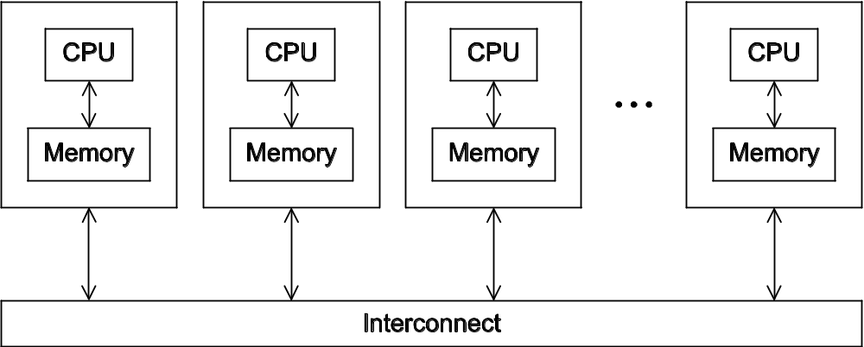
A distributed memory system
Copyright © 2010, Elsevier Inc. All rights Reserved

Slide 4
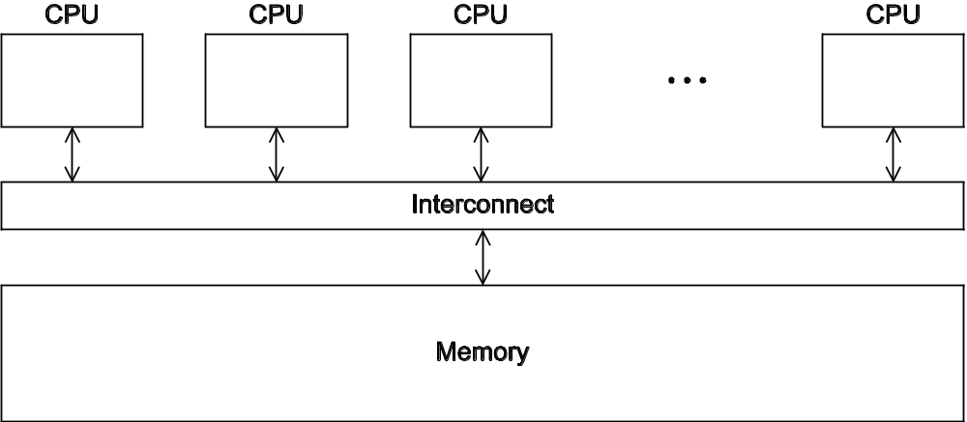
A shared memory system
Copyright © 2010, Elsevier Inc. All rights Reserved

Slide 5
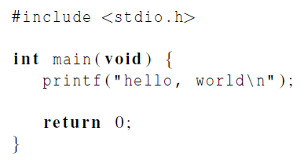

Hello World!
(a classic)
Copyright © 2010, Elsevier Inc. All rights Reserved

Slide 6
Identifying MPI processes
Common practice to identify processes by nonnegative integer ranks.
p processes are numbered 0, 1, 2, .. p-1
Copyright © 2010, Elsevier Inc. All rights Reserved

Slide 7

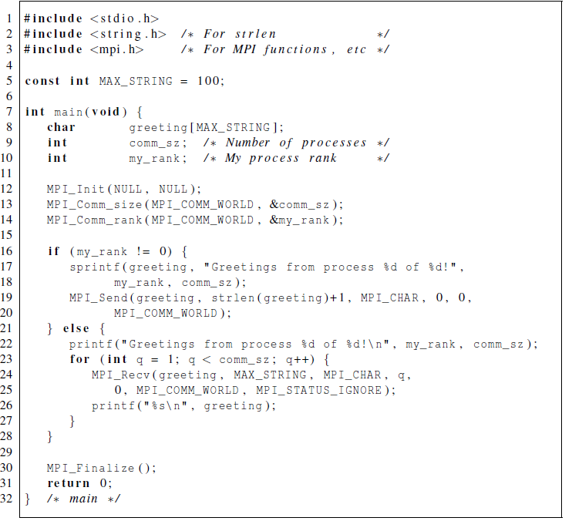
Our first MPI program
Copyright © 2010, Elsevier Inc. All rights Reserved

Slide 8
Compilation
wrapper script to compile
source file
mpicc -g -Wall -o mpi_hello mpi_hello.c
produce
debugging
information
create this executable file name
(as opposed to default a.out)
turns on all warnings
Copyright © 2010, Elsevier Inc. All rights Reserved

Slide 9
Execution
mpiexec -n <number of processes> <executable>
mpiexec -n 1 ./mpi_hello
run with 1 process
mpiexec -n 4 ./mpi_hello
run with 4 processes
Copyright © 2010, Elsevier Inc. All rights Reserved

Slide 10
Execution
mpiexec -n 1 ./mpi_hello
Greetings from process 0 of 1 !
mpiexec -n 4 ./mpi_hello
Greetings from process 0 of 4 !
Greetings from process 1 of 4 !
Greetings from process 2 of 4 !
Greetings from process 3 of 4 !
Copyright © 2010, Elsevier Inc. All rights Reserved

Slide 11
MPI Programs
Written in C.
  Has main.
  Uses stdio.h, string.h, etc.
Need to add mpi.h header file.
Identifiers defined by MPI start with “MPI_”.
First letter following underscore is uppercase.
  For function names and MPI-defined types.
  Helps to avoid confusion.
Copyright © 2010, Elsevier Inc. All rights Reserved

Slide 12


MPI Components
MPI_Init
  Tells MPI to do all the necessary setup.
MPI_Finalize
  Tells MPI we’re done, so clean up anything allocated for this program.
Copyright © 2010, Elsevier Inc. All rights Reserved

Slide 13
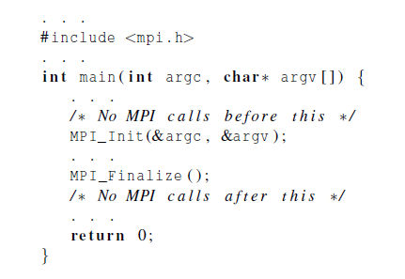
Basic Outline
Copyright © 2010, Elsevier Inc. All rights Reserved

Slide 14
Communicators
A collection of processes that can send messages to each other.
MPI_Init defines a communicator that consists of all the processes created when the program is started.
Called MPI_COMM_WORLD.
Copyright © 2010, Elsevier Inc. All rights Reserved

Slide 15



Communicators
number of processes in the communicator
my rank
(the process making this call)
Copyright © 2010, Elsevier Inc. All rights Reserved

Slide 16
SPMD
Single-Program Multiple-Data
We compile one program.
Process 0 does something different.
  Receives messages and prints them while the other processes do the work.
The if-else construct makes our program SPMD.
Copyright © 2010, Elsevier Inc. All rights Reserved

Slide 17
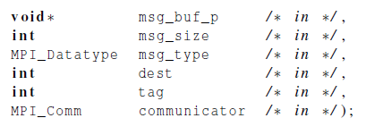

Communication
Copyright © 2010, Elsevier Inc. All rights Reserved

Slide 18
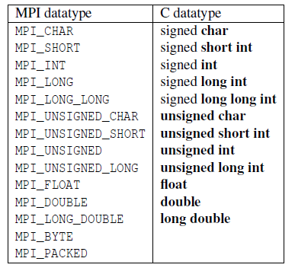
Data types
Copyright © 2010, Elsevier Inc. All rights Reserved

Slide 19
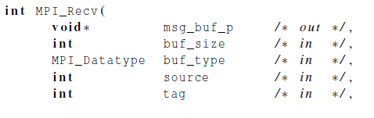

Communication
Copyright © 2010, Elsevier Inc. All rights Reserved

Slide 20

Message matching
r
MPI_Send
src = q
MPI_Recv
dest = r
q
Copyright © 2010, Elsevier Inc. All rights Reserved

Slide 21

Receiving messages
A receiver can get a message without knowing:
  the amount of data in the message,
  the sender of the message,
  or the tag of the message.
Copyright © 2010, Elsevier Inc. All rights Reserved

Slide 22
status_p argument
MPI_Status*
MPI_Status* status;
status.MPI_SOURCE
status.MPI_TAG
MPI_SOURCE
MPI_TAG
MPI_ERROR
Copyright © 2010, Elsevier Inc. All rights Reserved

Slide 23


How much data am I receiving?
Copyright © 2010, Elsevier Inc. All rights Reserved

Slide 24

Issues with send and receive
Exact behavior is determined by the MPI implementation.
MPI_Send may behave differently with regard to buffer size, cutoffs and blocking.
MPI_Recv always blocks until a matching message is received.
Know your implementation;
don’t make assumptions!
Copyright © 2010, Elsevier Inc. All rights Reserved

Slide 25

TRAPEZOIDAL RULE IN MPI
Copyright © 2010, Elsevier Inc. All rights Reserved

Slide 26
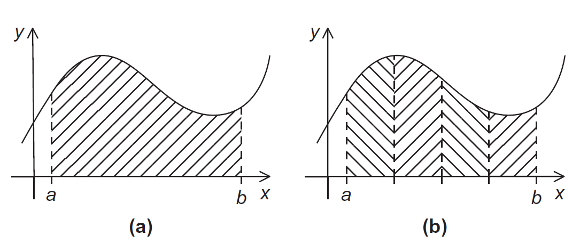
The Trapezoidal Rule
Copyright © 2010, Elsevier Inc. All rights Reserved

Slide 27


The Trapezoidal Rule
Copyright © 2010, Elsevier Inc. All rights Reserved

Slide 28
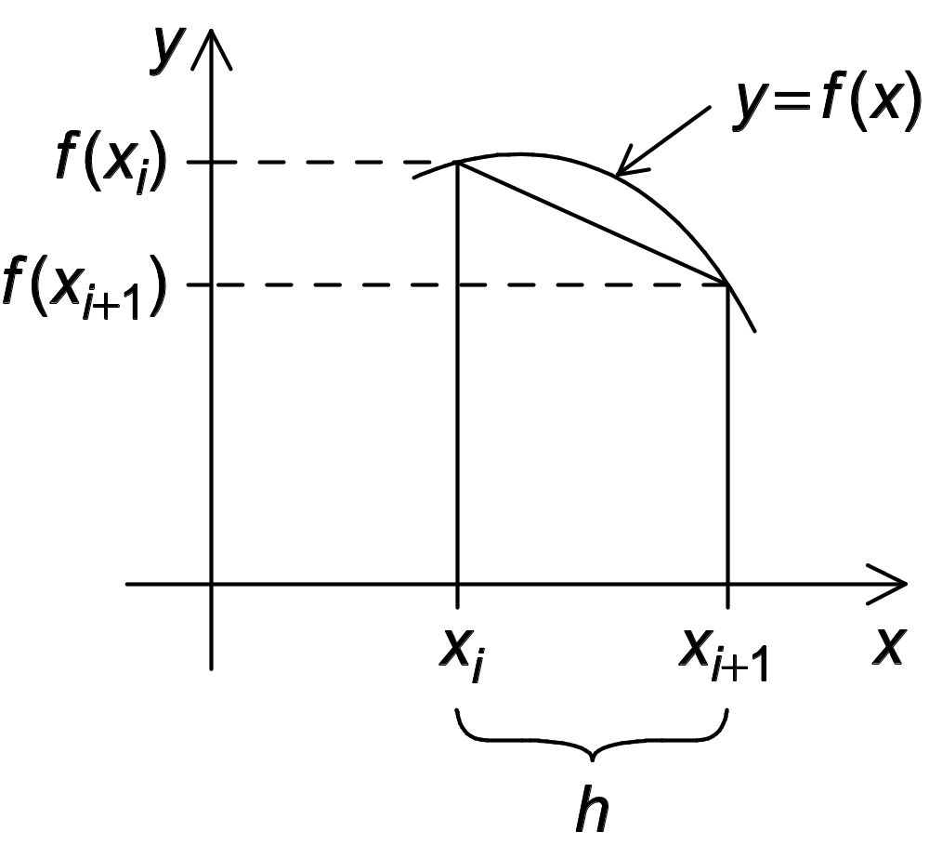
One trapezoid
Copyright © 2010, Elsevier Inc. All rights Reserved

Slide 29
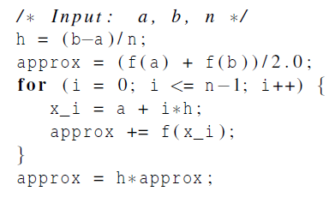
Pseudo-code for a serial program
Copyright © 2010, Elsevier Inc. All rights Reserved

Slide 30
Parallelizing the Trapezoidal Rule
Partition problem solution into tasks.
Identify communication channels between tasks.
Aggregate tasks into composite tasks.
Map composite tasks to cores.
Copyright © 2010, Elsevier Inc. All rights Reserved

Slide 31
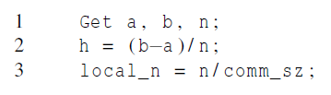
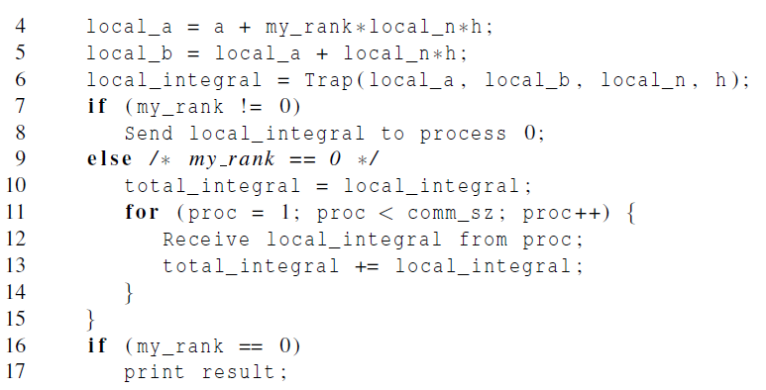
Parallel pseudo-code
Copyright © 2010, Elsevier Inc. All rights Reserved

Slide 32
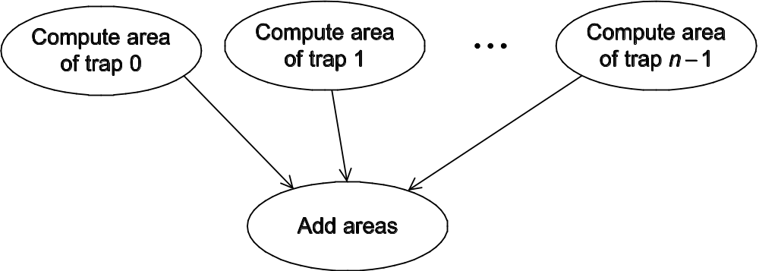
Tasks and communications for Trapezoidal Rule
Copyright © 2010, Elsevier Inc. All rights Reserved

Slide 33
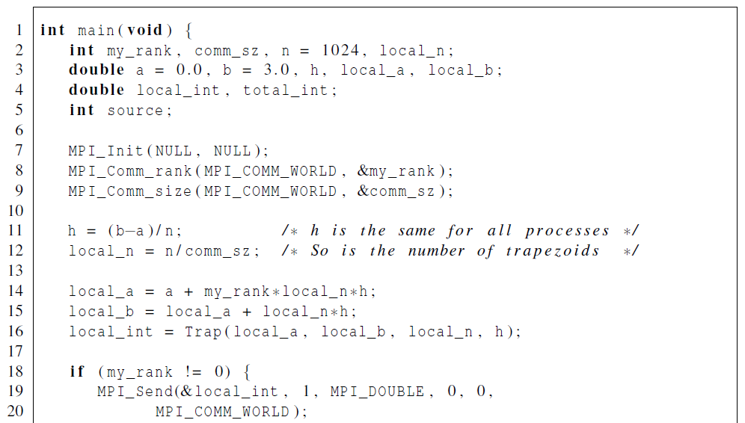
First version (1)
Copyright © 2010, Elsevier Inc. All rights Reserved

Slide 34
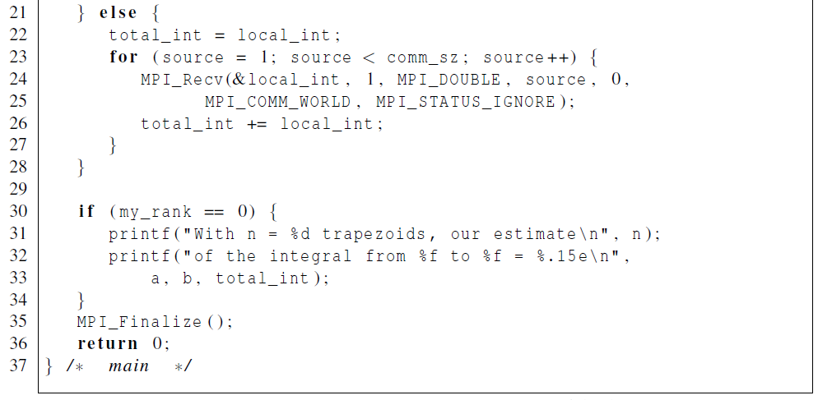
First version (2)
Copyright © 2010, Elsevier Inc. All rights Reserved

Slide 35
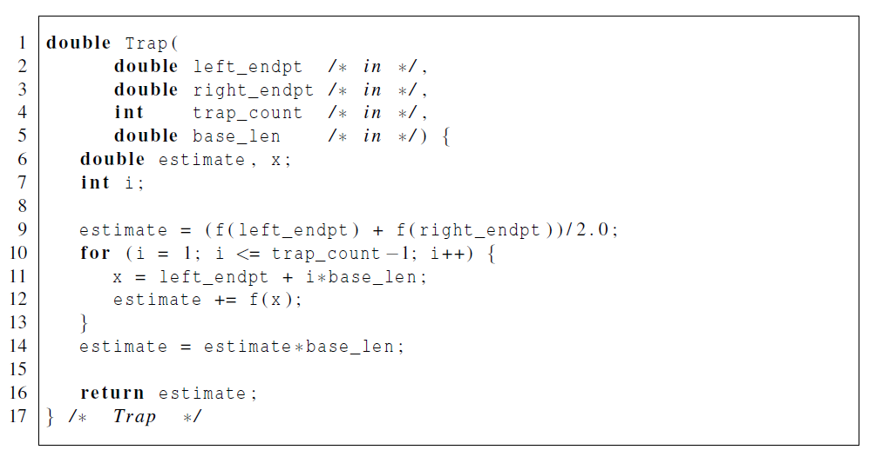
First version (3)
Copyright © 2010, Elsevier Inc. All rights Reserved

Slide 36
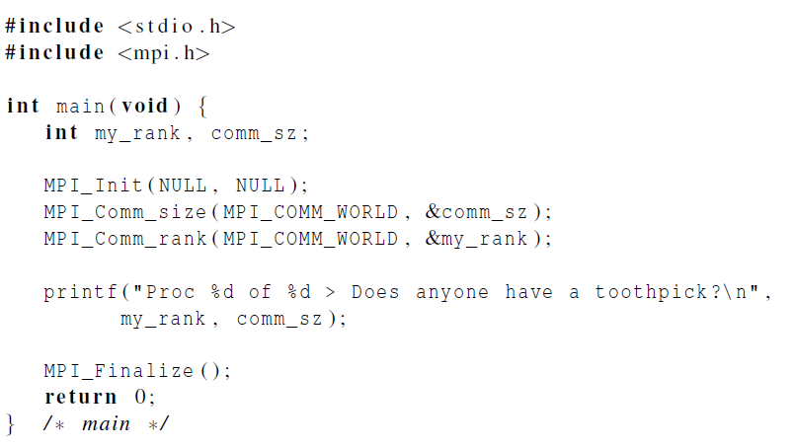
Dealing with I/O
Each process just
prints a message.
Copyright © 2010, Elsevier Inc. All rights Reserved

Slide 37
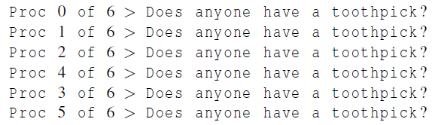

Running with 6 processes
unpredictable output
Copyright © 2010, Elsevier Inc. All rights Reserved

Slide 38
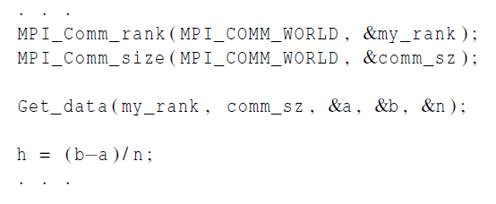
Input
Most MPI implementations only allow process 0 in MPI_COMM_WORLD access to stdin.
Process 0 must read the data (scanf) and send to the other processes.
Copyright © 2010, Elsevier Inc. All rights Reserved

Slide 39
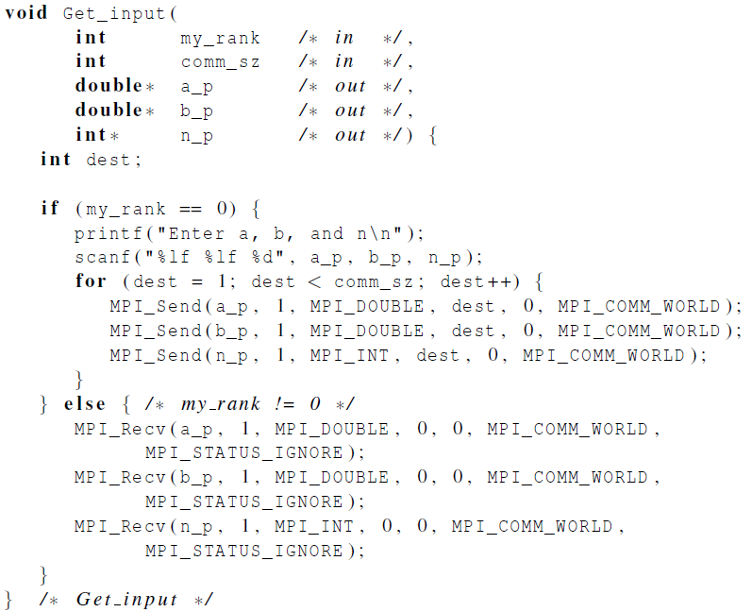
Function for reading user input
Copyright © 2010, Elsevier Inc. All rights Reserved

Slide 40

COLLECTIVE COMMUNICATION
Copyright © 2010, Elsevier Inc. All rights Reserved

Slide 41
Tree-structured communication
In the first phase:
(a) Process 1 sends to 0, 3 sends to 2, 5 sends to 4, and 7 sends to 6.
(b) Processes 0, 2, 4, and 6 add in the received values.
(c) Processes 2 and 6 send their new values to processes 0 and 4, respectively.
(d) Processes 0 and 4 add the received values into their new values.
(a) Process 4 sends its newest value to process 0.
(b) Process 0 adds the received value to its newest value.
Copyright © 2010, Elsevier Inc. All rights Reserved

Slide 42
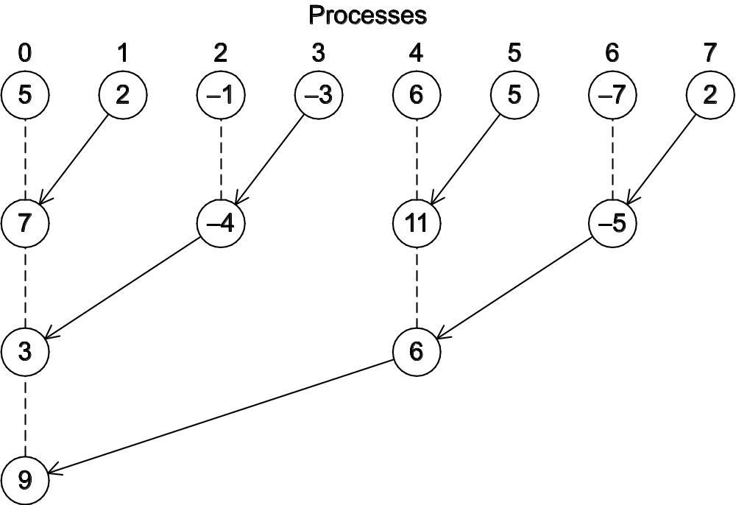
A tree-structured global sum
Copyright © 2010, Elsevier Inc. All rights Reserved

Slide 43
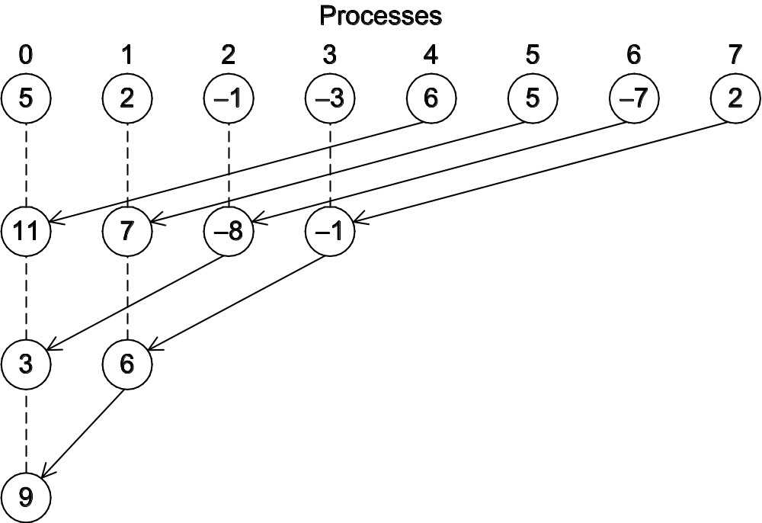
An alternative tree-structured global sum
Copyright © 2010, Elsevier Inc. All rights Reserved

Slide 44
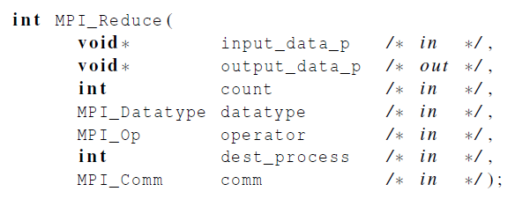
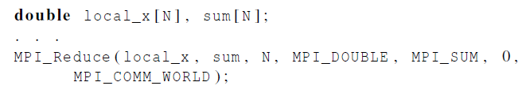
MPI_Reduce
Copyright © 2010, Elsevier Inc. All rights Reserved

Slide 45
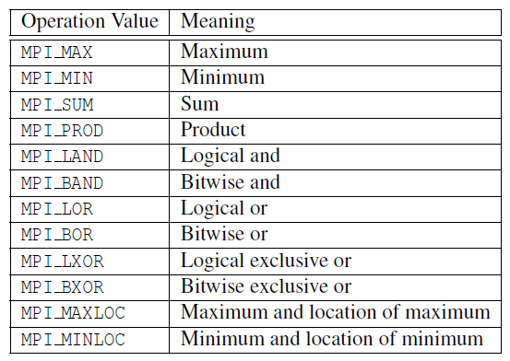
Predefined reduction operators in MPI
Copyright © 2010, Elsevier Inc. All rights Reserved

Slide 46
Collective vs. Point-to-Point Communications
All the processes in the communicator must call the same collective function.
For example, a program that attempts to match a call to MPI_Reduce on one process with a call to MPI_Recv on another process is erroneous, and, in all likelihood, the program will hang or crash.
Copyright © 2010, Elsevier Inc. All rights Reserved

Slide 47
Collective vs. Point-to-Point Communications
The arguments passed by each process to an MPI collective communication must be “compatible.”
For example, if one process passes in 0 as the dest_process and another passes in 1, then the outcome of a call to MPI_Reduce is erroneous, and, once again, the program is likely to hang or crash.
Copyright © 2010, Elsevier Inc. All rights Reserved

Slide 48
Collective vs. Point-to-Point Communications
The output_data_p argument is only used on dest_process.
However, all of the processes still need to pass in an actual argument corresponding to output_data_p, even if it’s just NULL.
Copyright © 2010, Elsevier Inc. All rights Reserved

Slide 49
Collective vs. Point-to-Point Communications
Point-to-point communications are matched on the basis of tags and communicators.
Collective communications don’t use tags.
They’re matched solely on the basis of the communicator and the order in which they’re called.
Copyright © 2010, Elsevier Inc. All rights Reserved

Slide 50
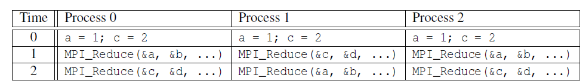
Example (1)
Multiple calls to MPI_Reduce
Copyright © 2010, Elsevier Inc. All rights Reserved

Slide 51
Example (2)
Suppose that each process calls MPI_Reduce with operator MPI_SUM, and destination process 0.
At first glance, it might seem that after the two calls to MPI_Reduce, the value of b will be 3, and the value of d will be 6.
Copyright © 2010, Elsevier Inc. All rights Reserved

Slide 52
Example (3)
However, the names of the memory locations are irrelevant to the matching of the calls to MPI_Reduce.
The order of the calls will determine the matching so the value stored in b will be 1+2+1 = 4, and the value stored in d will be 2+1+2 = 5.
Copyright © 2010, Elsevier Inc. All rights Reserved

Slide 53
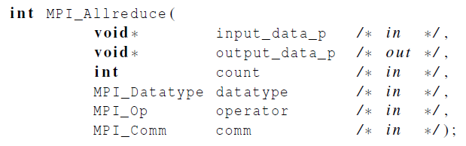
MPI_Allreduce
Useful in a situation in which all of the processes need the result of a global sum in order to complete some larger computation.
Copyright © 2010, Elsevier Inc. All rights Reserved

Slide 54
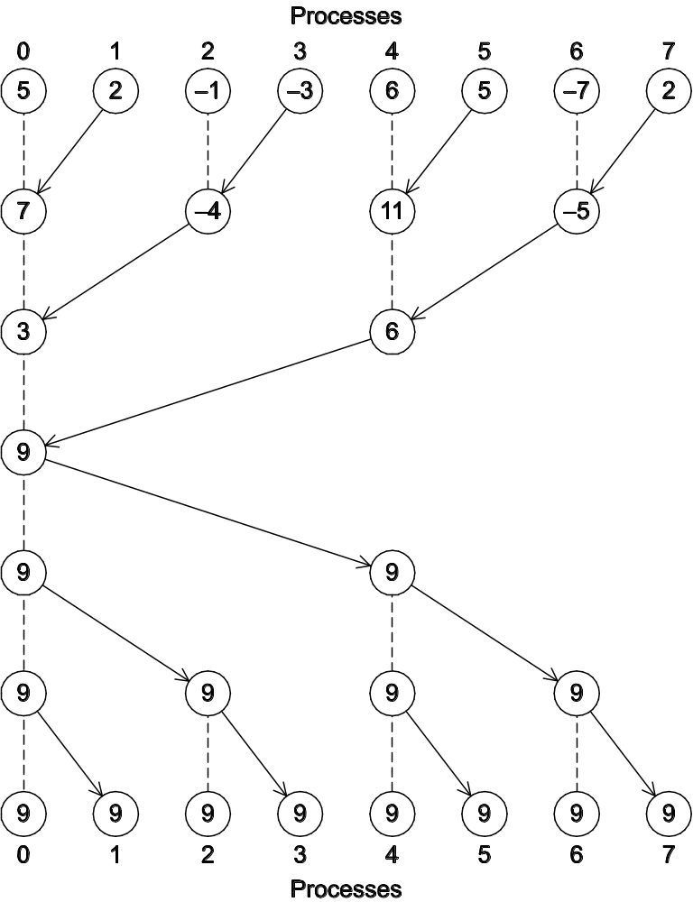
A global sum followed
by distribution of the
result.
Copyright © 2010, Elsevier Inc. All rights Reserved

Slide 55

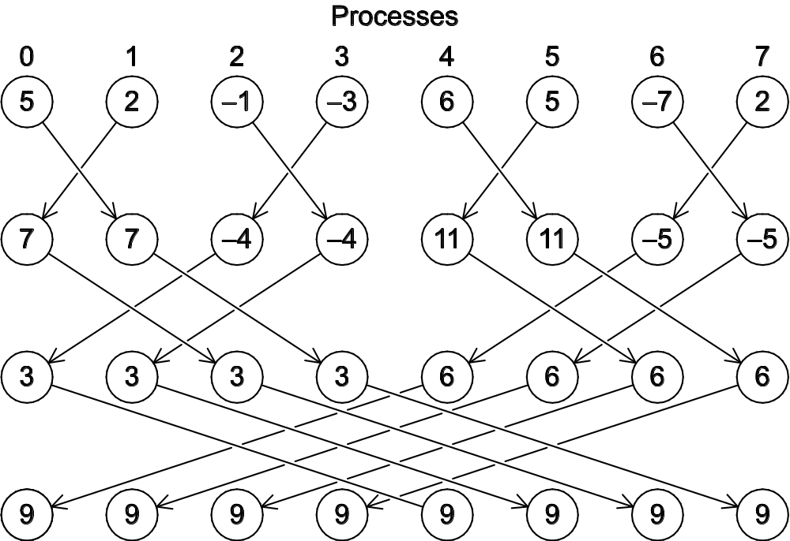
A butterfly-structured global sum.
Copyright © 2010, Elsevier Inc. All rights Reserved

Slide 56
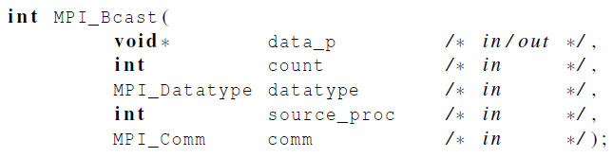
Broadcast
Data belonging to a single process is sent to all of the processes in the communicator.
Copyright © 2010, Elsevier Inc. All rights Reserved

Slide 57

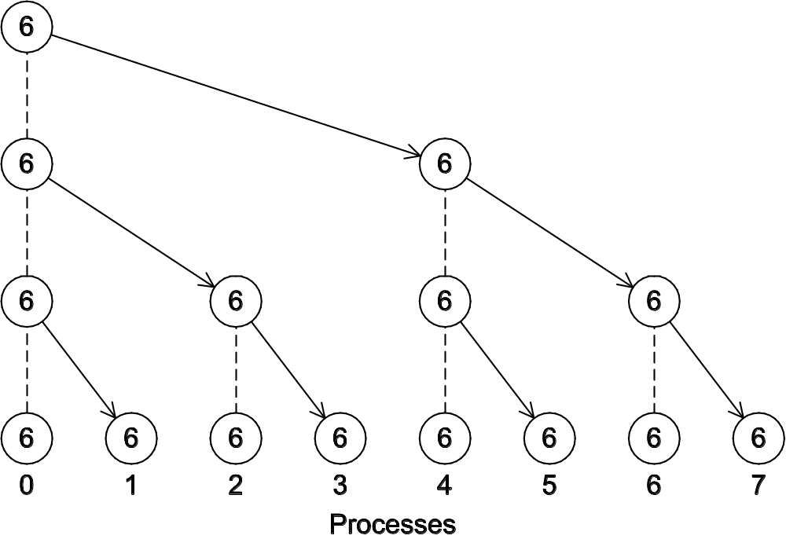
A tree-structured broadcast.
Copyright © 2010, Elsevier Inc. All rights Reserved

Slide 58
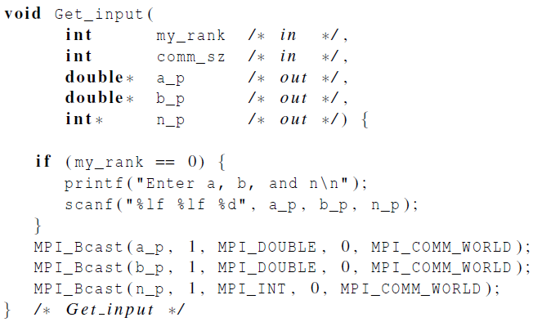
A version of Get_input that uses MPI_Bcast
Copyright © 2010, Elsevier Inc. All rights Reserved

Slide 59
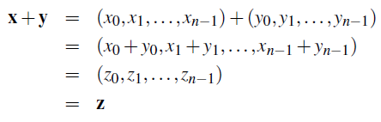
Data distributions
Compute a vector sum.
Copyright © 2010, Elsevier Inc. All rights Reserved

Slide 60
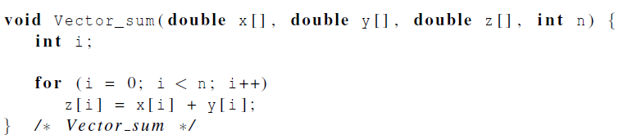
Serial implementation of vector addition
Copyright © 2010, Elsevier Inc. All rights Reserved

Slide 61
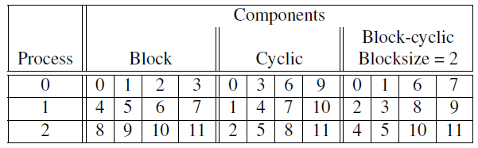
Different partitions of a 12-component vector among 3 processes
Copyright © 2010, Elsevier Inc. All rights Reserved

Slide 62
Partitioning options
Block partitioning
  Assign blocks of consecutive components to each process.
Cyclic partitioning
  Assign components in a round robin fashion.
Block-cyclic partitioning
  Use a cyclic distribution of blocks of components.
Copyright © 2010, Elsevier Inc. All rights Reserved

Slide 63
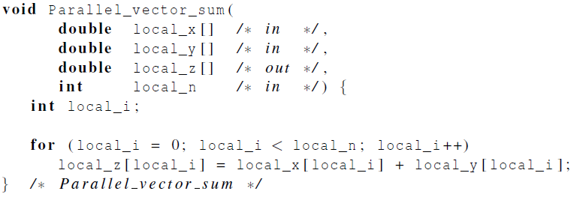
Parallel implementation of vector addition
Copyright © 2010, Elsevier Inc. All rights Reserved

Slide 64
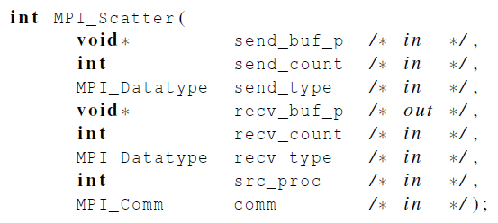
Scatter
MPI_Scatter can be used in a function that reads in an entire vector on process 0 but only sends the needed components to each of the other processes.
Copyright © 2010, Elsevier Inc. All rights Reserved

Slide 65
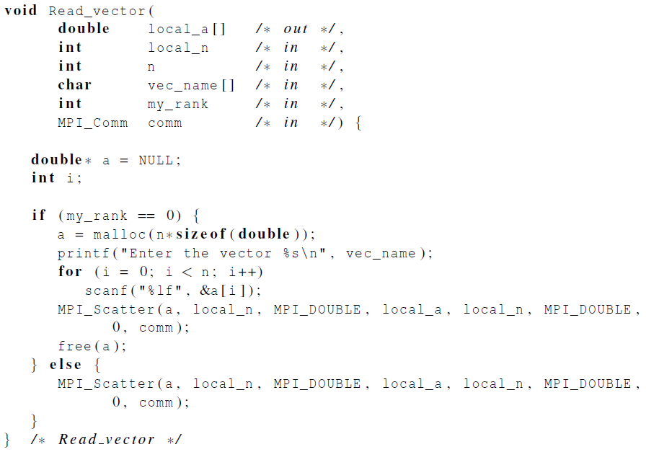
Reading and distributing a vector
Copyright © 2010, Elsevier Inc. All rights Reserved

Slide 66
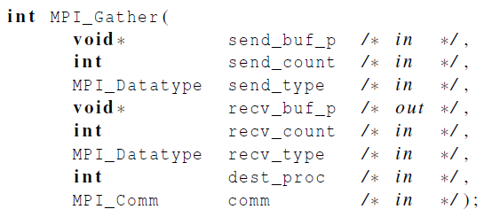
Gather
Collect all of the components of the vector onto process 0, and then process 0 can process all of the components.
Copyright © 2010, Elsevier Inc. All rights Reserved

Slide 67
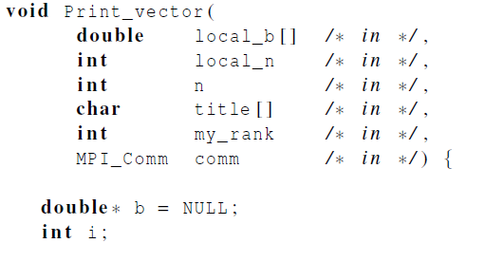
Print a distributed vector (1)
Copyright © 2010, Elsevier Inc. All rights Reserved

Slide 68
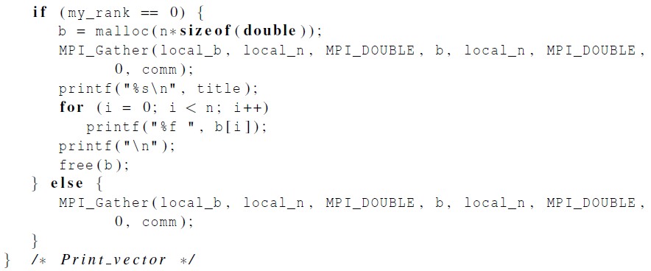
Print a distributed vector (2)
Copyright © 2010, Elsevier Inc. All rights Reserved

Slide 69
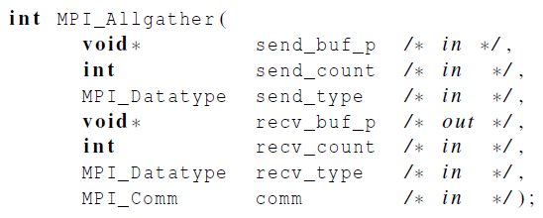
Allgather
Concatenates the contents of each process’ send_buf_p and stores this in each process’ recv_buf_p.
As usual, recv_count is the amount of data being received from each process.
Copyright © 2010, Elsevier Inc. All rights Reserved

Slide 70

Matrix-vector multiplication
i-th component of y
Dot product of the ith
row of A with x.
Copyright © 2010, Elsevier Inc. All rights Reserved

Slide 71
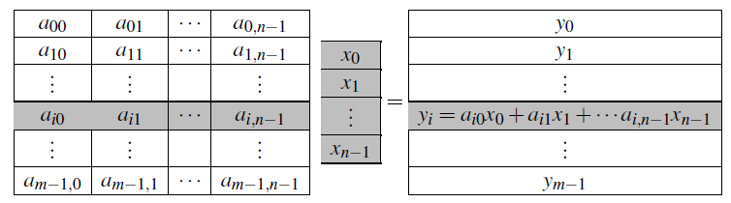
Matrix-vector multiplication
Copyright © 2010, Elsevier Inc. All rights Reserved

Slide 72
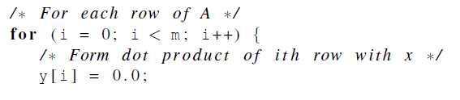

Multiply a matrix by a vector
Serial pseudo-code
Copyright © 2010, Elsevier Inc. All rights Reserved

Slide 73
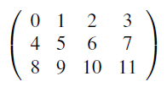

C style arrays
stored as
Copyright © 2010, Elsevier Inc. All rights Reserved

Slide 74
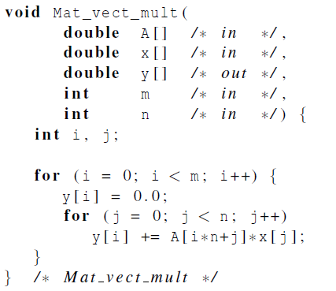
Serial matrix-vector multiplication
Copyright © 2010, Elsevier Inc. All rights Reserved

Slide 75
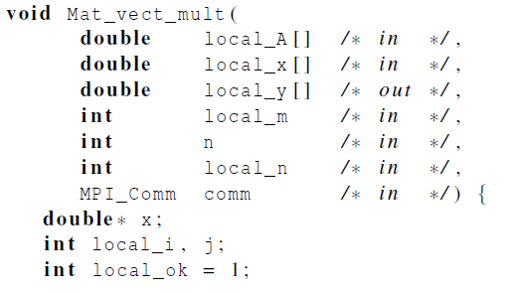
An MPI matrix-vector multiplication function (1)
Copyright © 2010, Elsevier Inc. All rights Reserved

Slide 76
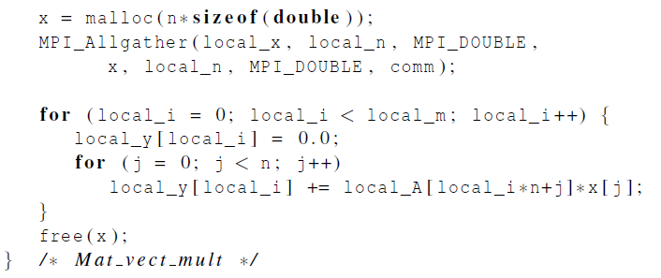
An MPI matrix-vector multiplication function (2)
Copyright © 2010, Elsevier Inc. All rights Reserved

Slide 77

MPI DERIVED DATATYPES
Copyright © 2010, Elsevier Inc. All rights Reserved

Slide 78
Derived datatypes
Used to represent any collection of data items in memory by storing both the types of the items and their relative locations in memory.
The idea is that if a function that sends data knows this information about a collection of data items, it can collect the items from memory before they are sent.
Similarly, a function that receives data can distribute the items into their correct destinations in memory when they’re received.
Copyright © 2010, Elsevier Inc. All rights Reserved

Slide 79
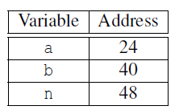
Derived datatypes
Formally, consists of a sequence of basic MPI data types together with a displacement for each of the data types.
Trapezoidal Rule example:
Copyright © 2010, Elsevier Inc. All rights Reserved

Slide 80

MPI_Type create_struct
Builds a derived datatype that consists of individual elements that have different basic types.
Copyright © 2010, Elsevier Inc. All rights Reserved

Slide 81

MPI_Get_address
Returns the address of the memory location referenced by location_p.
The special type MPI_Aint is an integer type that is big enough to store an address on the system.
Copyright © 2010, Elsevier Inc. All rights Reserved

Slide 82
MPI_Type_commit
Allows the MPI implementation to optimize its internal representation of the datatype for use in communication functions.
Copyright © 2010, Elsevier Inc. All rights Reserved

Slide 83
MPI_Type_free
When we’re finished with our new type, this frees any additional storage used.
Copyright © 2010, Elsevier Inc. All rights Reserved

Slide 84

Get input function with a derived datatype (1)
Copyright © 2010, Elsevier Inc. All rights Reserved

Slide 85

Get input function with a derived datatype (2)
Copyright © 2010, Elsevier Inc. All rights Reserved

Slide 86

Get input function with a derived datatype (3)
Copyright © 2010, Elsevier Inc. All rights Reserved

Slide 87

PERFORMANCE EVALUATION
Copyright © 2010, Elsevier Inc. All rights Reserved

Slide 88


Elapsed parallel time
Returns the number of seconds that have elapsed since some time in the past.
Copyright © 2010, Elsevier Inc. All rights Reserved

Slide 89


Elapsed serial time
In this case, you don’t need to link in the MPI libraries.
Returns time in microseconds elapsed from some point in the past.
Copyright © 2010, Elsevier Inc. All rights Reserved

Slide 90

Elapsed serial time
Copyright © 2010, Elsevier Inc. All rights Reserved

Slide 91

MPI_Barrier
Ensures that no process will return from calling it until every process in the communicator has started calling it.
Copyright © 2010, Elsevier Inc. All rights Reserved

Slide 92


MPI_Barrier
Copyright © 2010, Elsevier Inc. All rights Reserved

Slide 93

Run-times of serial and parallel matrix-vector multiplication
(Seconds)
Copyright © 2010, Elsevier Inc. All rights Reserved

Slide 94

Speedup
Copyright © 2010, Elsevier Inc. All rights Reserved

Slide 95

Efficiency
Copyright © 2010, Elsevier Inc. All rights Reserved

Slide 96

Speedups of Parallel Matrix-Vector Multiplication
Copyright © 2010, Elsevier Inc. All rights Reserved

Slide 97

Efficiencies of Parallel Matrix-Vector Multiplication
Copyright © 2010, Elsevier Inc. All rights Reserved

Slide 98

Scalability
A program is scalable if the problem size can be increased at a rate so that the efficiency doesn’t decrease as the number of processes increase.
Copyright © 2010, Elsevier Inc. All rights Reserved

Slide 99
Scalability
Programs that can maintain a constant efficiency without increasing the problem size are sometimes said to be strongly scalable.
Programs that can maintain a constant efficiency if the problem size increases at the same rate as the number of processes are sometimes said to be weakly scalable.
Copyright © 2010, Elsevier Inc. All rights Reserved

Slide 100
A PARALLEL SORTING ALGORITHM
Copyright © 2010, Elsevier Inc. All rights Reserved

Slide 101
Sorting
n keys and p = comm sz processes.
n/p keys assigned to each process.
No restrictions on which keys are assigned to which processes.
When the algorithm terminates:
  The keys assigned to each process should be sorted in (say) increasing order.
  If 0 ≤ q < r < p, then each key assigned to process q should be less than or equal to every key assigned to process r.
Copyright © 2010, Elsevier Inc. All rights Reserved

Slide 102


Serial bubble sort
Copyright © 2010, Elsevier Inc. All rights Reserved

Slide 103


Odd-even transposition sort
A sequence of phases.
Even phases, compare swaps:
Odd phases, compare swaps:
Copyright © 2010, Elsevier Inc. All rights Reserved

Slide 104
Example
Start: 5, 9, 4, 3
Even phase: compare-swap (5,9) and (4,3)
getting the list 5, 9, 3, 4
Odd phase: compare-swap (9,3)
getting the list 5, 3, 9, 4
Even phase: compare-swap (5,3) and (9,4)
getting the list 3, 5, 4, 9
Odd phase: compare-swap (5,4)
getting the list 3, 4, 5, 9
Copyright © 2010, Elsevier Inc. All rights Reserved

Slide 105

Serial odd-even transposition sort
Copyright © 2010, Elsevier Inc. All rights Reserved

Slide 106

Communications among tasks in odd-even sort
Tasks determining a[i] are labeled with a[i].
Copyright © 2010, Elsevier Inc. All rights Reserved

Slide 107

Parallel odd-even transposition sort
Copyright © 2010, Elsevier Inc. All rights Reserved

Slide 108

Pseudo-code
Copyright © 2010, Elsevier Inc. All rights Reserved

Slide 109

Compute_partner
Copyright © 2010, Elsevier Inc. All rights Reserved

Slide 110
Safety in MPI programs
The MPI standard allows MPI_Send to behave in two different ways:
  it can simply copy the message into an MPI managed buffer and return,
  or it can block until the matching call to MPI_Recv starts.
Copyright © 2010, Elsevier Inc. All rights Reserved

Slide 111
Safety in MPI programs
Many implementations of MPI set a threshold at which the system switches from buffering to blocking.
Relatively small messages will be buffered by MPI_Send.
Larger messages, will cause it to block.
Copyright © 2010, Elsevier Inc. All rights Reserved

Slide 112
Safety in MPI programs
If the MPI_Send executed by each process blocks, no process will be able to start executing a call to MPI_Recv, and the program will hang or deadlock.
Each process is blocked waiting for an event that will never happen.
(see pseudo-code)
Copyright © 2010, Elsevier Inc. All rights Reserved

Slide 113
Safety in MPI programs
A program that relies on MPI provided buffering is said to be unsafe.
Such a program may run without problems for various sets of input, but it may hang or crash with other sets.
Copyright © 2010, Elsevier Inc. All rights Reserved

Slide 114


MPI_Ssend
An alternative to MPI_Send defined by the MPI standard.
The extra “s” stands for synchronous and MPI_Ssend is guaranteed to block until the matching receive starts.
Copyright © 2010, Elsevier Inc. All rights Reserved

Slide 115


Restructuring communication
Copyright © 2010, Elsevier Inc. All rights Reserved

Slide 116
MPI_Sendrecv
An alternative to scheduling the communications ourselves.
Carries out a blocking send and a receive in a single call.
The dest and the source can be the same or different.
Especially useful because MPI schedules the communications so that the program won’t hang or crash.
Copyright © 2010, Elsevier Inc. All rights Reserved

Slide 117


MPI_Sendrecv
Copyright © 2010, Elsevier Inc. All rights Reserved

Slide 118

Safe communication with five processes
Copyright © 2010, Elsevier Inc. All rights Reserved

Slide 119

Parallel odd-even transposition sort
Copyright © 2010, Elsevier Inc. All rights Reserved

Slide 120

Run-times of parallel odd-even sort
(times are in milliseconds)
Copyright © 2010, Elsevier Inc. All rights Reserved

Slide 121
Concluding Remarks (1)
MPI or the Message-Passing Interface is a library of functions that can be called from C, C++, or Fortran programs.
A communicator is a collection of processes that can send messages to each other.
Many parallel programs use the single-program multiple data or SPMD approach.
Copyright © 2010, Elsevier Inc. All rights Reserved

Slide 122
Concluding Remarks (2)
Most serial programs are deterministic: if we run the same program with the same input we’ll get the same output.
Parallel programs often don’t possess this property.
Collective communications involve all the processes in a communicator.
Copyright © 2010, Elsevier Inc. All rights Reserved

Slide 123
Concluding Remarks (3)
When we time parallel programs, we’re usually interested in elapsed time or “wall clock time”.
Speedup is the ratio of the serial run-time to the parallel run-time.
Efficiency is the speedup divided by the number of parallel processes.
Copyright © 2010, Elsevier Inc. All rights Reserved

Slide 124
Concluding Remarks (4)
If it’s possible to increase the problem size (n) so that the efficiency doesn’t decrease as p is increased, a parallel program is said to be scalable.
An MPI program is unsafe if its correct behavior depends on the fact that MPI_Send is buffering its input.
Copyright © 2010, Elsevier Inc. All rights Reserved

