Slide 1
Introduction to System Modeling using Simulink

Slide 2
Simulink介绍
提供图形化界面
调用现有的模块，并把它们连接构成系统的模型
以该模型为对象运行Simulink的仿真程序
观察仿真结果、干预仿真结果
可为各个模块提供参数配置。

Slide 3
Simulink模块库
输入信号源模块库（sources）；
输出接受模块库（Sinks）;
连续系统模块库（Continuous）;
离散系统模块库（Discrete）;
数学操作模块库（Math Operations）；
…….

Slide 4
仿真模型的构成
信号源模块：系统的输入；
被模拟的模块：中心模块，运用Simulink所要解决的问题；
输出显示模块：系统的输出。

Slide 5
基本特点
提供了许多如scope(示波器)等的接收模块，用Simulink仿真，具有像做实验一样的图形化显示结果；
具有层次性，通过底层子系统可以构建上层母系统；
对子系统的封装的功能，用户可以自定义子系统的图标和设置参数对话框。

Slide 6
建立仿真的基本过程
打开一个空白的Simulink 模型窗口；
在Simulink 模块库浏览界面，将相应模块库所需的模块拖入到编辑窗口；
按照给定的框图修改编辑窗口中模块的参数；
将各个模块按照给定的框图连接起来，搭建所需要的系统模型；
采用菜单或命令窗口输入命令进行仿真分析，观察仿真结果，对不对的地方进行修改；
若结果满意，则完成模型的建立。

Slide 7
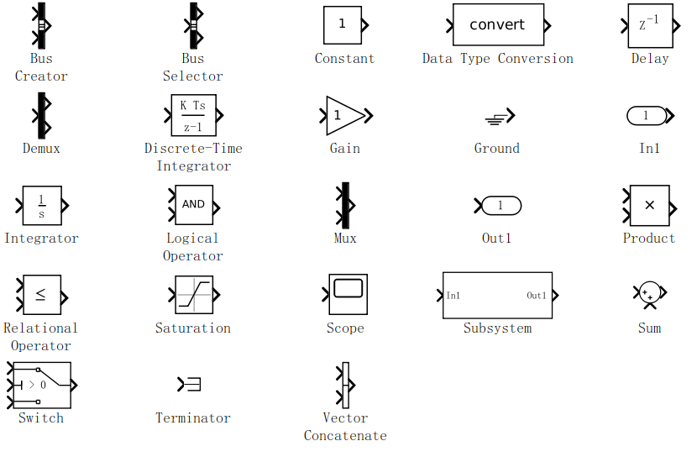
模块库简介—Commonly Used blocks
将最常用的基本模块集中在一起形成的。

Slide 8
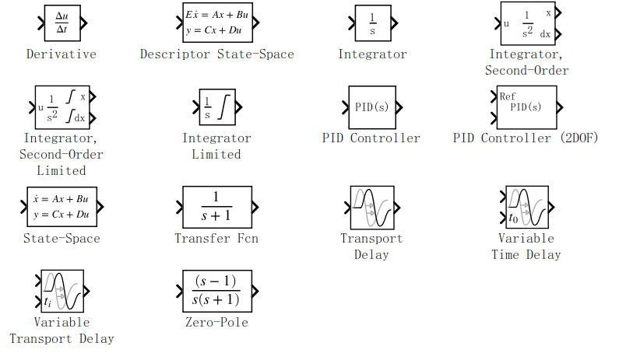
模块库简介—Continuous

Slide 9
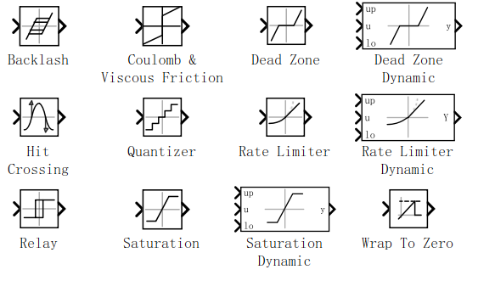
模块库简介—Discontinuities

Slide 10
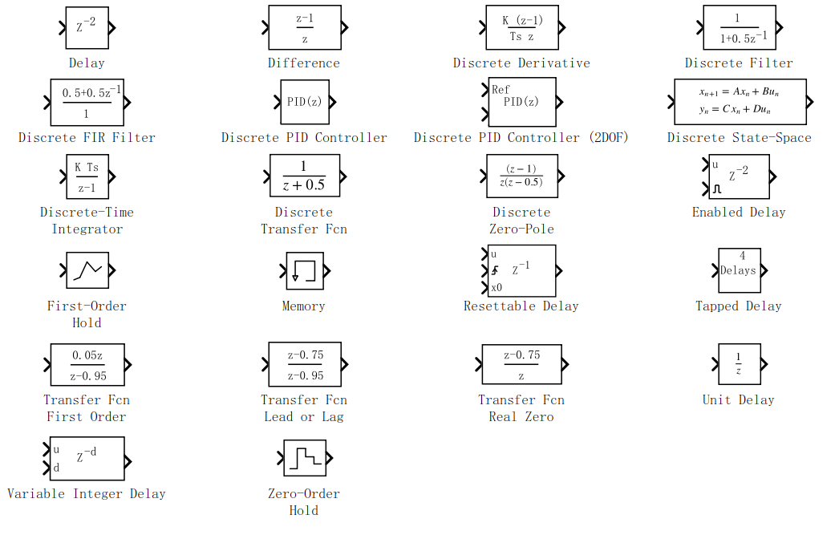
模块库简介--Discrete

Slide 11
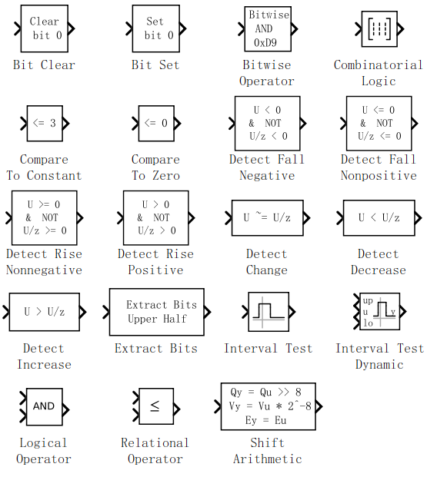
模块库简介—Logic and Bit Operation

Slide 12
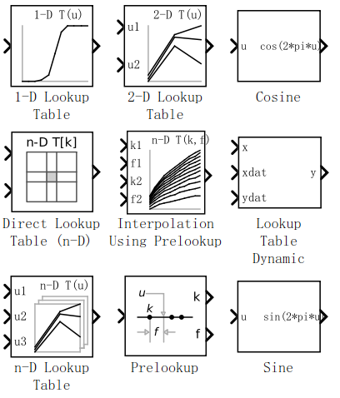
模块库简介—Lookup Tables

Slide 13
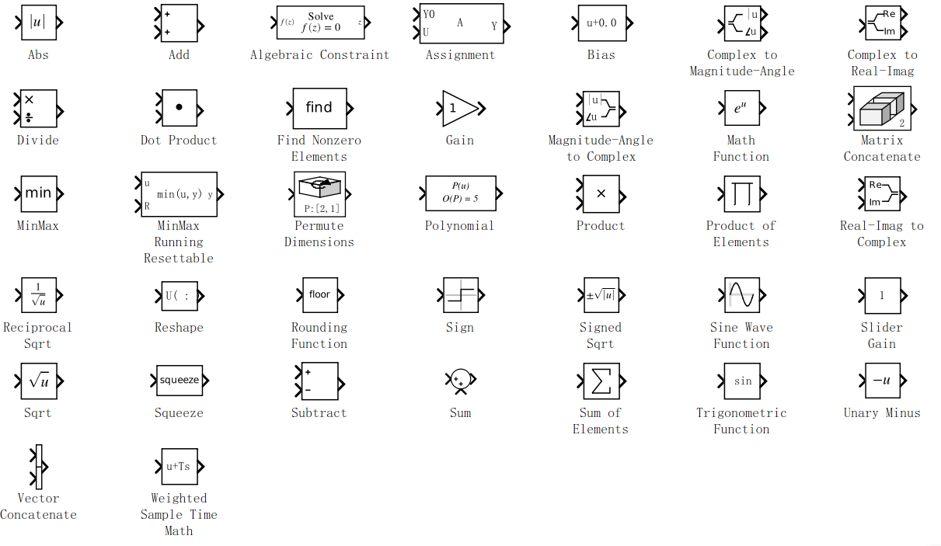
模块库简介—Math Operations

Slide 14
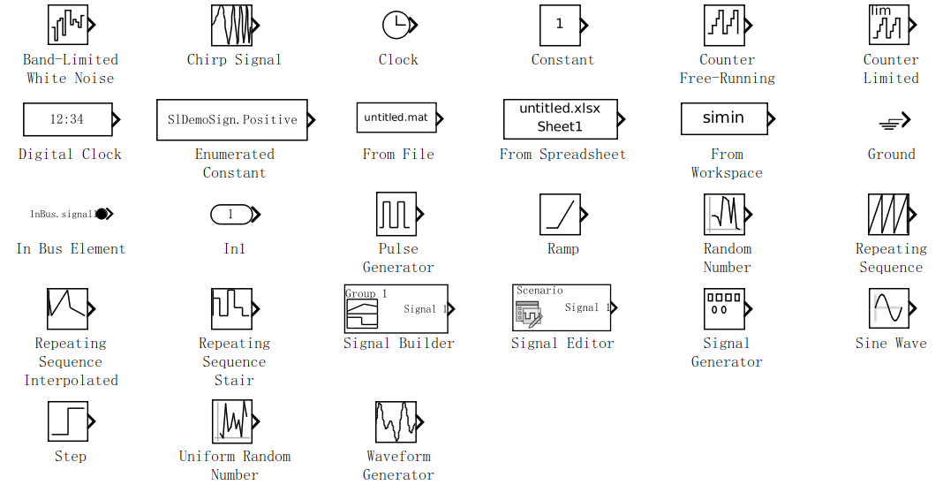
模块库简介—Sources
信号源模块库包含各种信号生成模块
  模块与子系统输入信号源：In1，Ground, From File, From Workspace
  信号生成器: 其余的

Slide 15
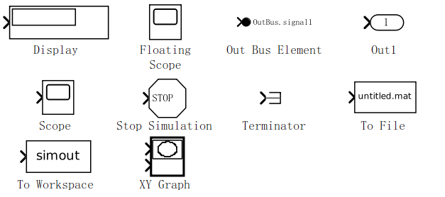
模块库简介—Sinks
接收模块库
  模块与子系统输出: Out1
  数据观察器:Terminator, To File, To Workspace
  仿真终止模块:其余的

Slide 16
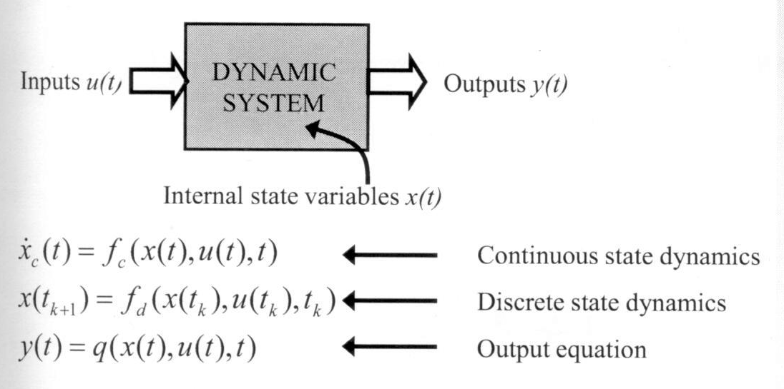
Overview of a General Dynamic System
Continuous state dynamics: the first derivative of the state vector is a function of the state, input, and time
Discrete state dynamics: the next value of the state depends on the current state, input and time
Outputs: the output value is a function of states, inputs and time.

Slide 17
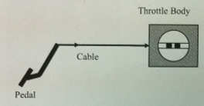
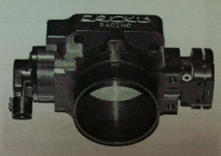
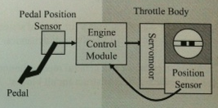
Electronic Throttle Control
(电子油门控制系统)

Slide 18
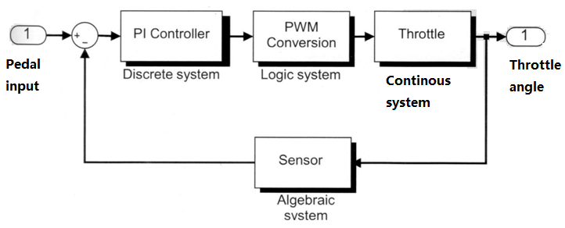
Layout

Slide 19
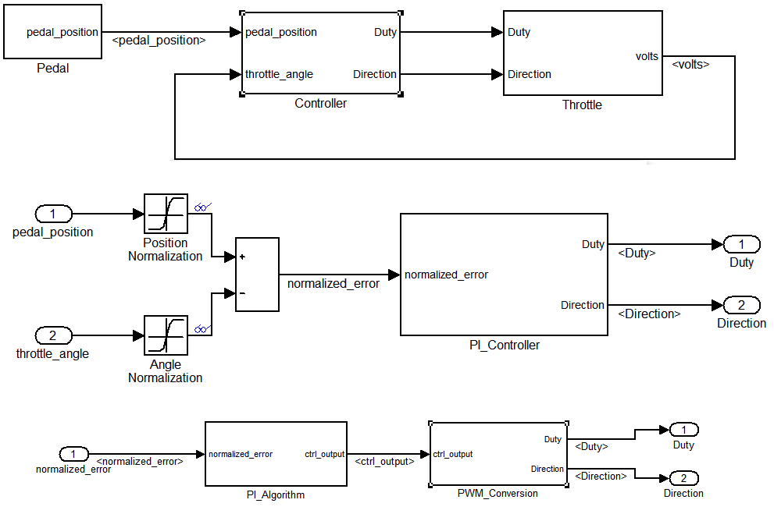

Slide 20
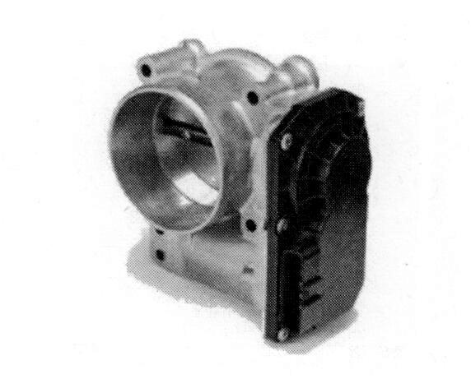
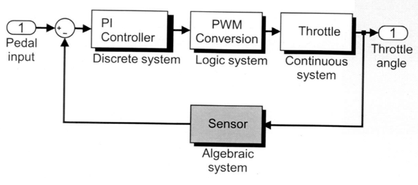
Modeling Sensor
Define the potentiometer(电位计) system
Simulate the model and analyze results

Slide 21
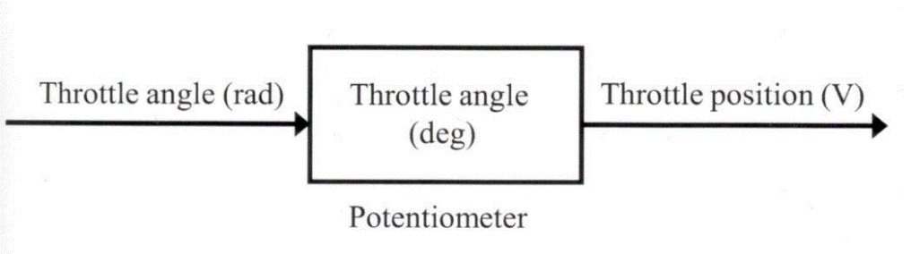
Defining the System and Identifying Its Components
One of the outputs of the throttle subsystem is its angle. This is computed in radians and needs to be translated to degrees for analysis, and then translated to voltage for use in the controller by a potentiometer（电位计）.
Before modeling the system with equations, answer the following questions:
  How many inputs?
  How many outputs?
  How many states?
  What are the parameters?
  Are there any intermediate signals?

Slide 22
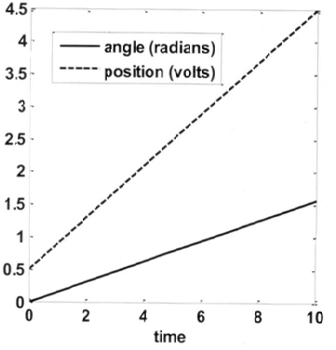
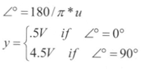
Modeling the System with Equations
input u : the angle in radians of the throttle subsystem
Output y : volt of a potentiometer
the relationship between the angle in radians, u, and the position in volts, y.
Computing y using a lookup table angles between 0º and 90º.

Slide 23

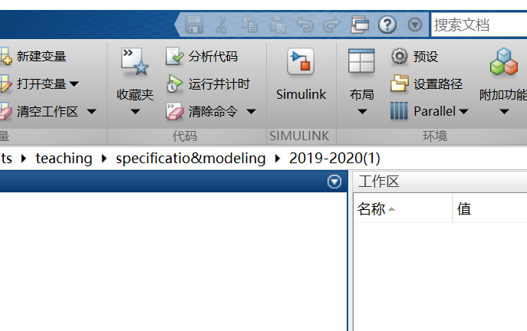
Starting Simulink
Open the Simulink Library Browser by type

Slide 24
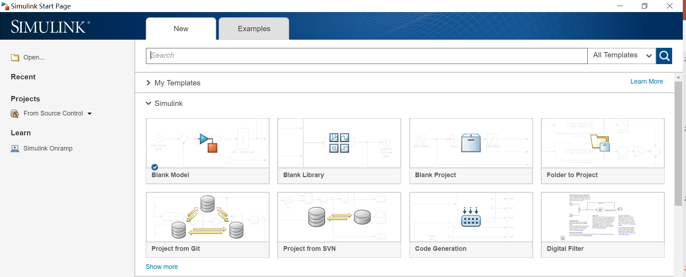
Select
Blank Model

Slide 25
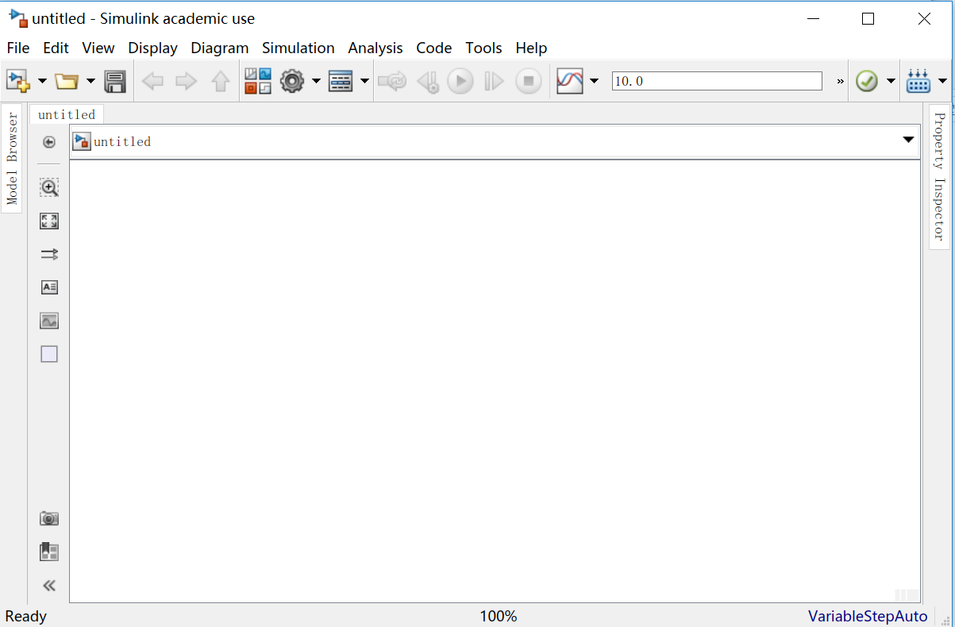
Edit Window
Open Simulink Library Browser

Slide 26
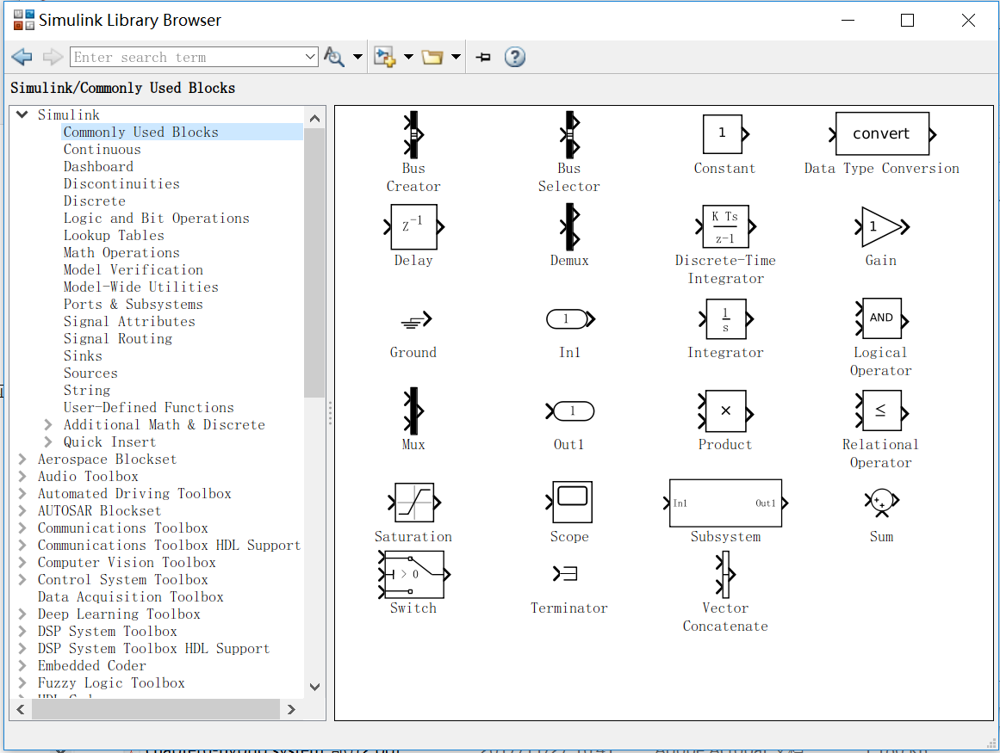
Using the Simulink Library Browser
Block Search
Block
Library
Blockset

Slide 27
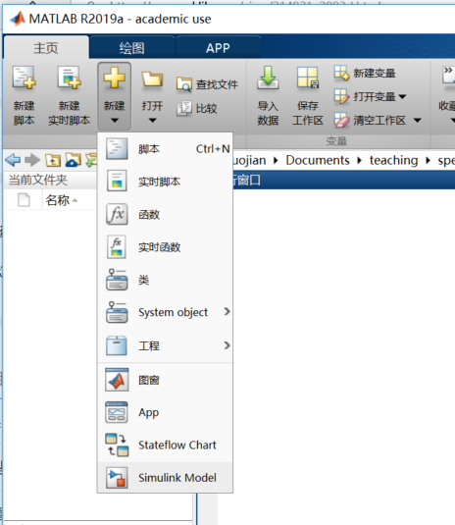
Building a Block Diagram for the Model

Slide 28
Select
Blank Model

Slide 29
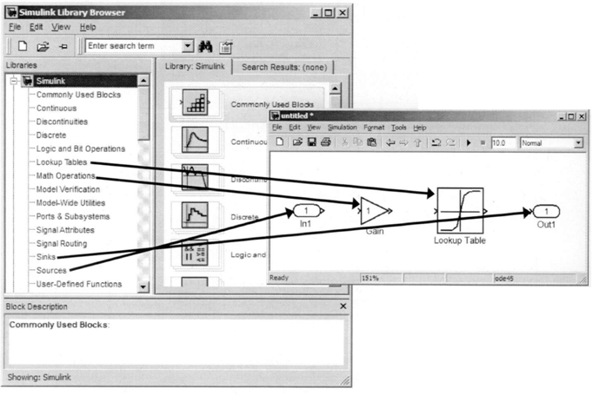
Adding Blocks
To add blocks, drag and drop them from the Simulink Library Browser into the model.

Slide 30
blocks
(Sources)输入信号的接口： In1
(Sink)输出信号的接口：Out1
(Math Operation)增益模块Gain,设置信号放大的倍数；
(Lookup Table)基本表格查询模块

Slide 31
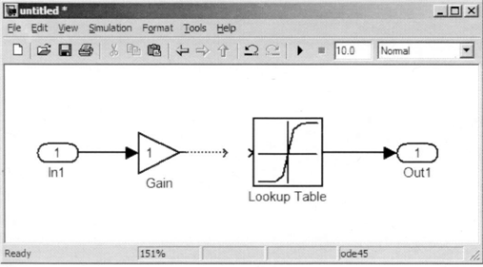
Connecting Blocks
To connect blocks.

Slide 32
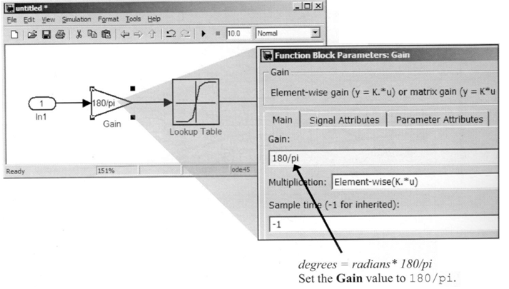
Defining the Block Parameters
To view and modify block parameters, double-click the block icon.

Slide 33
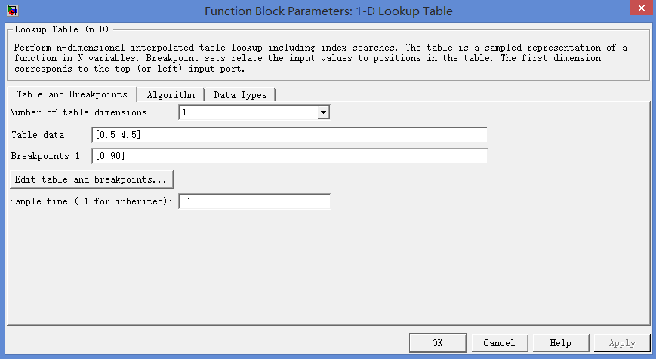

Defining the Lookup Table Parameters

Slide 34
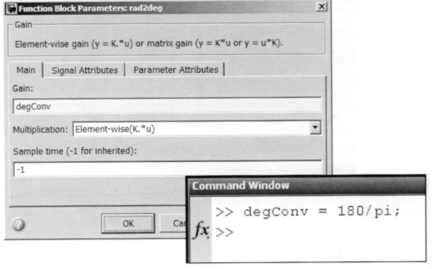
Defining the parameter Values Using MATLAB®

Slide 35
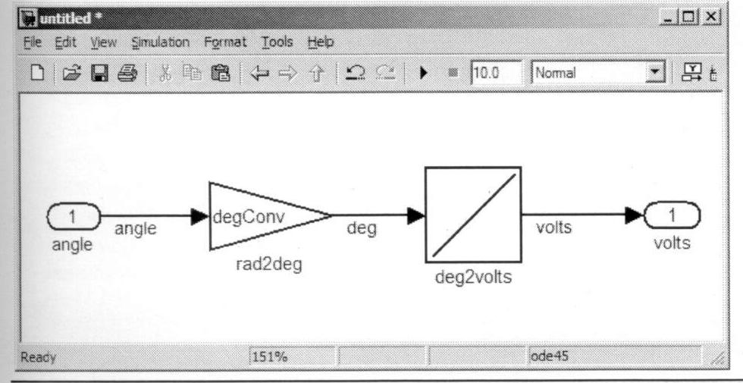
Labeling Blocks and Signals
To rename a block, click the block label and edit.
Block labels must be unique.
To label a signal, double-click the signal line and enter text.
sim_ex_1.mdl

Slide 36
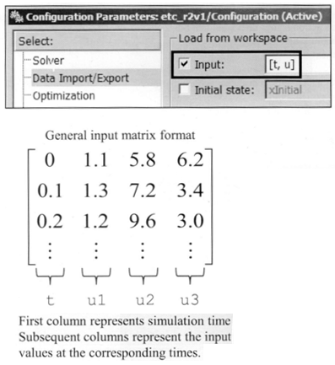
Defining the System Output
Signals can be loaded from the MATLAB workspace.
  Simulation →Model Configuration Parameters →Data Import/Export
  Define t and u in the MATLAB workspace
    >>t= linspace(0,10,101)’;
    >>u=linspace(0,pi/2,101)’;

Slide 37
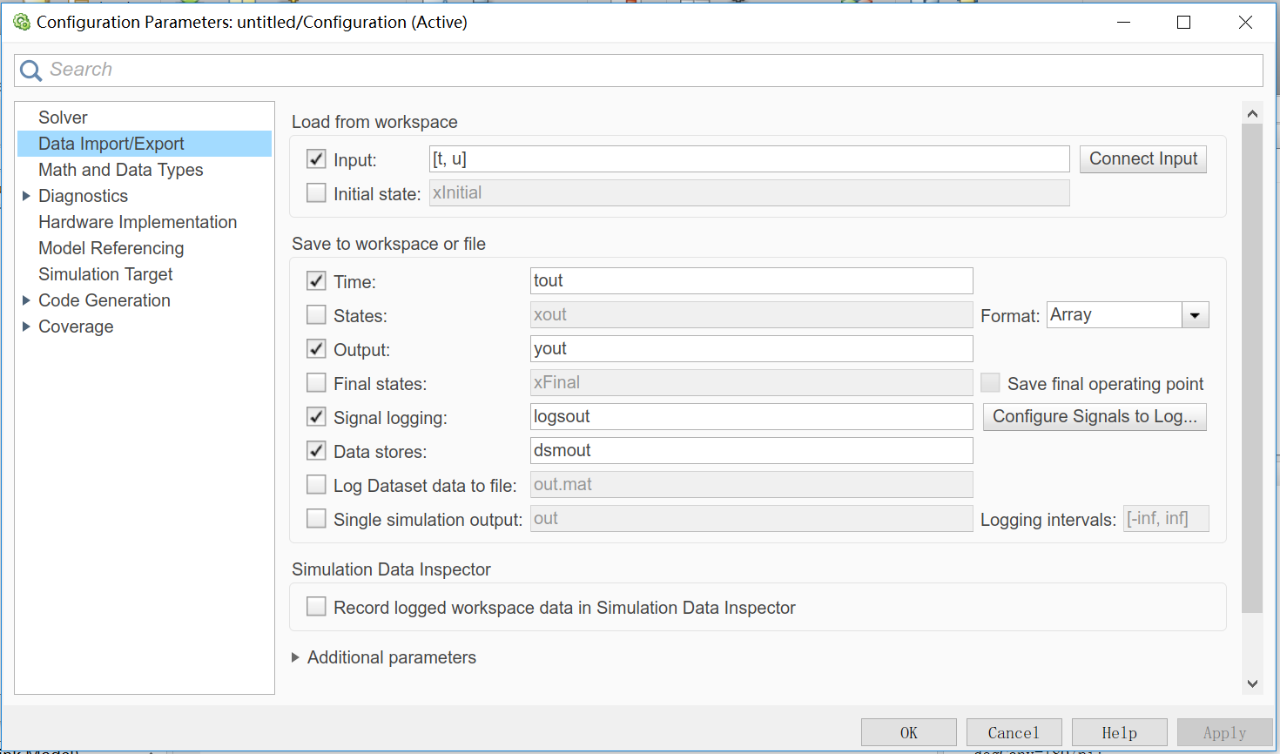
Defining the System Output

Slide 38
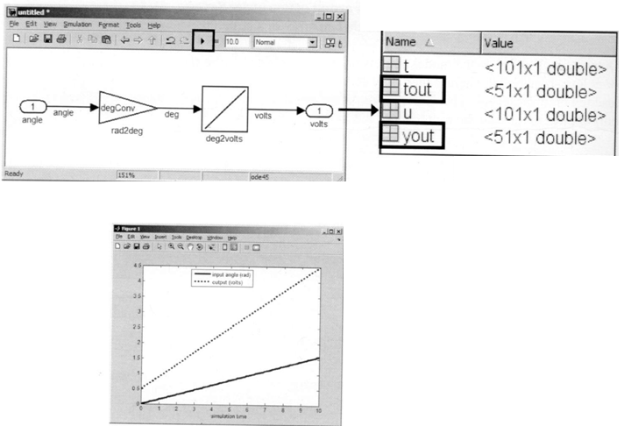
Simulating the Model and visualizing the Response
Visualize the simulations response:
  >>plot(t,u,tout,yout,’k:’)
  >>xlabel(‘simulation time’)
  >>legend(‘input angle (rad)’ , ’output (volts)’)

Slide 39
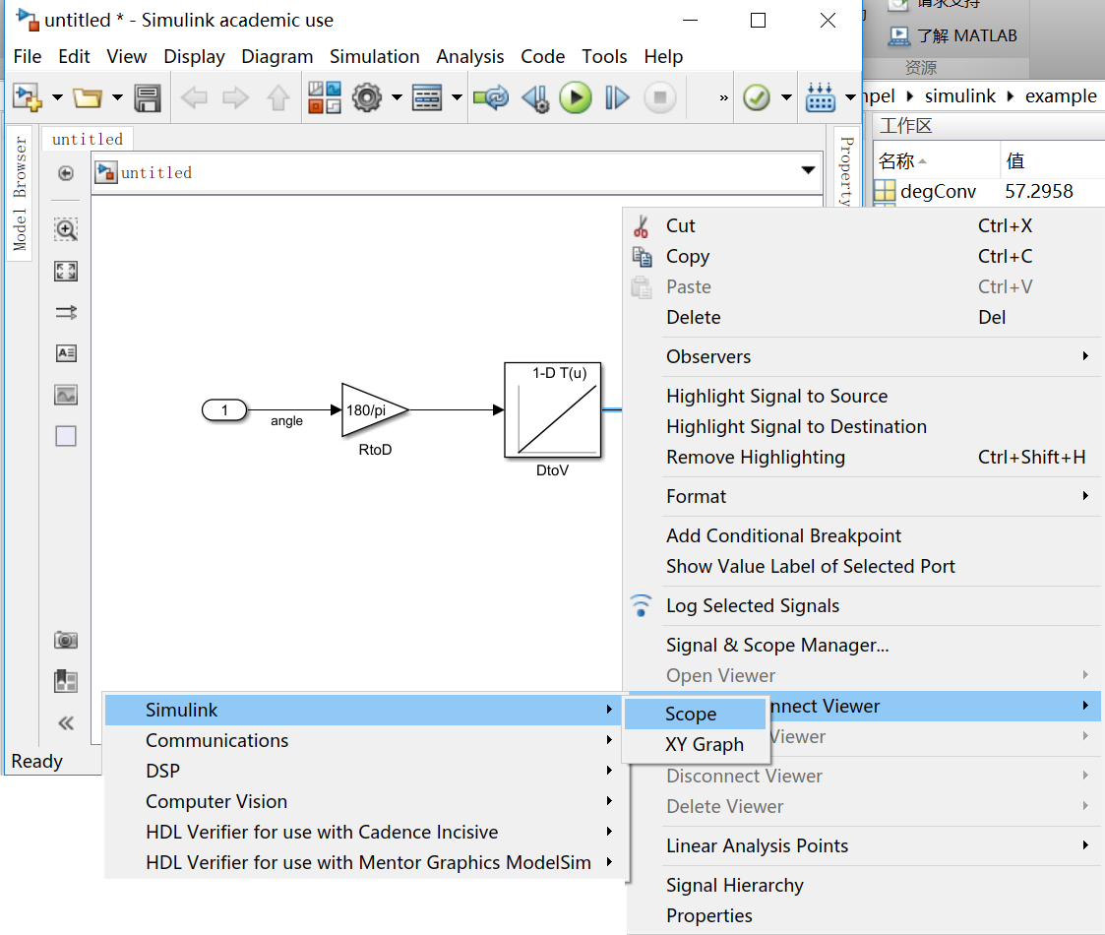
Adding Signal Viewers

Slide 40
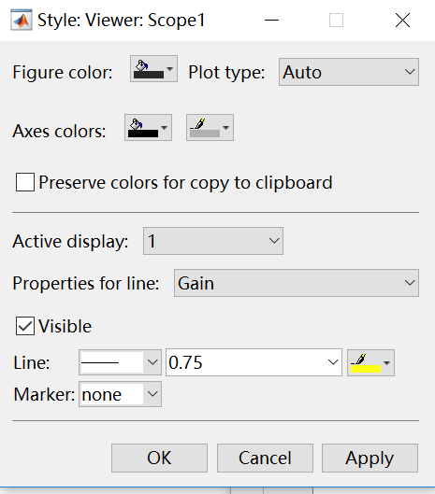
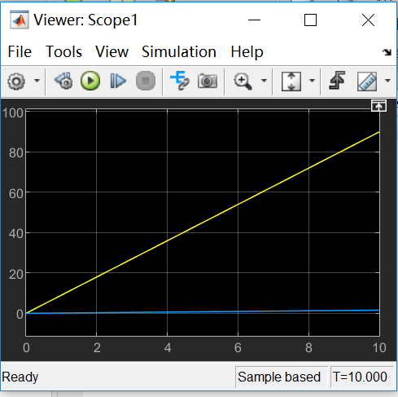
Modifying the Viewer Parameters
Signal selector

Slide 41
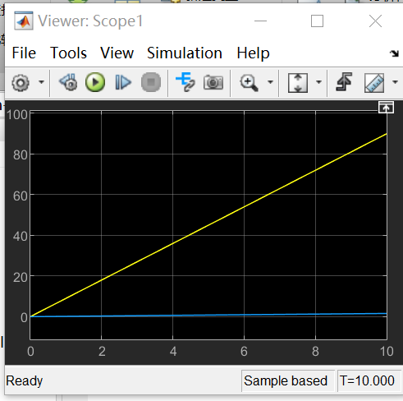
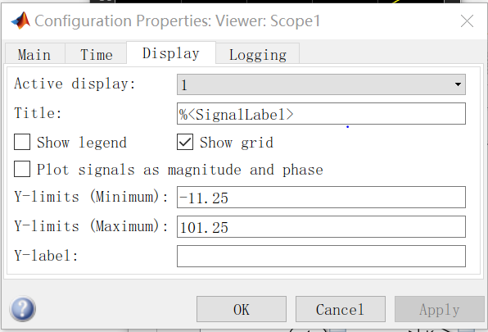
Controlling the Vertical Limits of the Viewer
Open the axis properties dialog box by selecting Axes properties from the context menu after right-clicking →Configuration Properties in the axis.

Slide 42
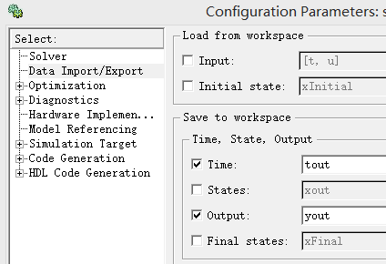
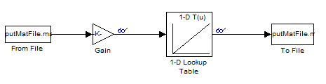
Data from file
Notes:
注：当文件作为输入时，特别注意他的格式，应该是矩阵，第一行是时间、第二行是数据。

Slide 43
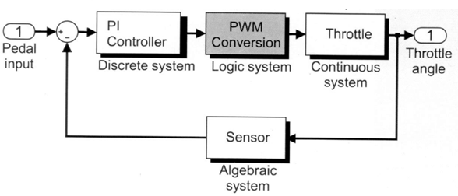
Modeling PWM conversion system
Model comparisons and decision statements
Model the PWM conversion system
Vector signals
Embedded MATLAB® Function block.

Slide 44
Approaches to Modeling Programming Constructs
Common programming constructs
  Relational comparisons(<, >, ==, etc.)
  Logical operators( AND, OR, NOT, etc.)
  Decision statements(if-else, switch-case, etc.)
  Loop constructs(for-loop, while-loop, etc.)

Slide 45
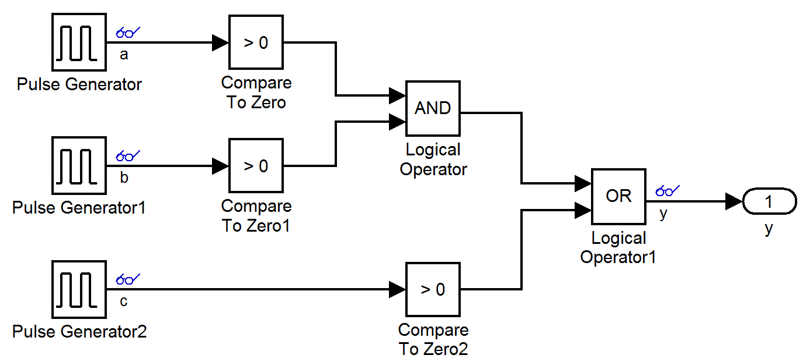
Modeling Comparisons
blocks are in the Logic and Bit Operation library
Simplelogic.mdl
Notes:
对于scope可以分几个窗口，通过selector选择每个窗口要显示的数据。

Slide 46
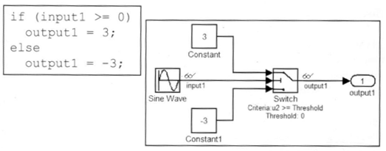
Modeling Decision Statements
blocks are in the Signal Routing library
Switch模块的第二个信号与阈值的比较，若真，执行上面的赋值为3，否则赋值为-3；
Simpleswitch.mdl

Slide 47
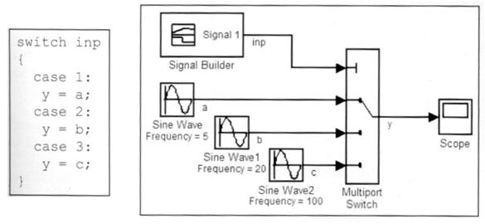
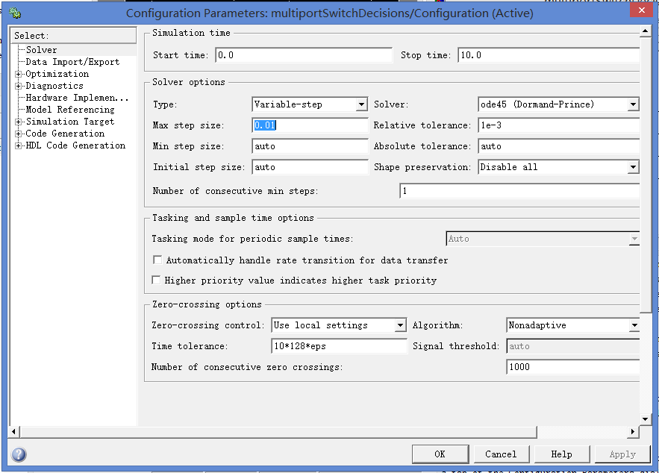

Modeling Decision Statements
blocks are in the Signal Routing library
Multiport Switch模块的第一个信号与阈值的比较，若为1，执行第二行的赋值，若为2,3，依次为执行第三、四的赋值；
MultiportSwitchDecision.mdl

Slide 48
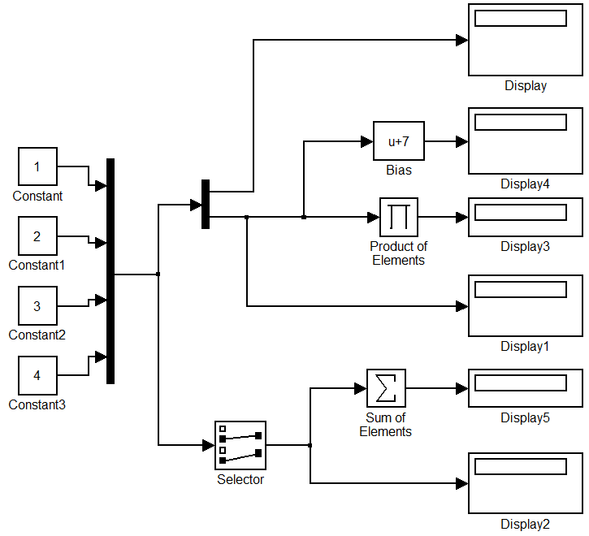
Extracting and Combining Data Using Vectors
Most blocks are in the Signal Routing library
  Mux-----Concatenate two or more signals into a vector signal
  Demux-----Split a vector signal into separate signals
  Selector-----Output specific elements of a vector signal，（用于从向量中、矩阵或多维信号中选择输入元素）。
simpleVector.mdl
Notes:
按ctrol可以分叉

Slide 49
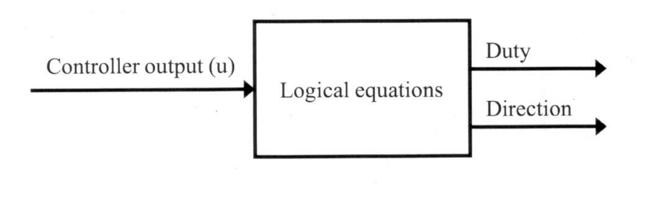
Defining the System and Identifying Its Components
The variables in this system are the controller output(u), duty, and direction
  The controller output, u, is the system input.
  Duty and direction are the system outputs.
  There are no state or parameters to this system both duty and direction are computed directly from the input signal.

Slide 50
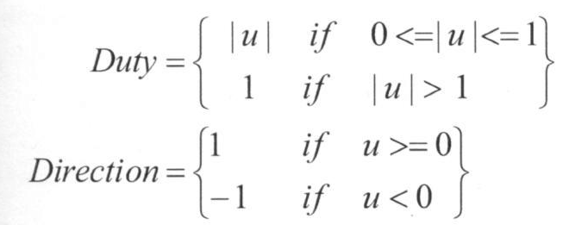
Modeling the System with Equations
The system input is u. duty and direction are the system outputs.
The duty is constrained to fall within the range of 0<=duty<=1.

Slide 51
blocks
Abs: 求一个数的绝对值；
Saturation：在Discontinuities模块库中，饱和度模块，对一个信号限定上下限，当输入在有Lower limit 和Upper limit参数指定的范围内时，输入信号无变化输出。若超出，则信号就被限幅（值为上限或下限）

Slide 52
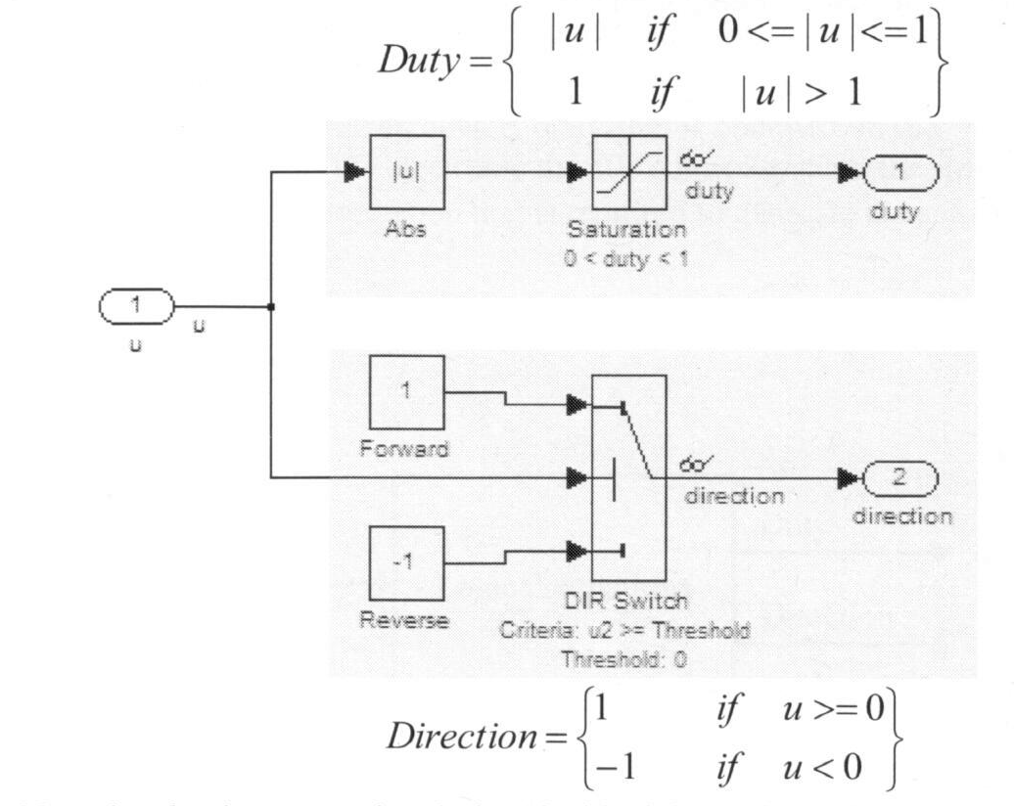
Building a Block Diagram for the Model

Slide 53

Modeling Logic with Embedded MATLAB® Function Blocks
using MATLAB Function block in user defined function library
ect_logic_eml.mdl

Slide 54



Load data file

