Slide 1
Introduction to System Modeling using Simulink
（二）

Slide 2
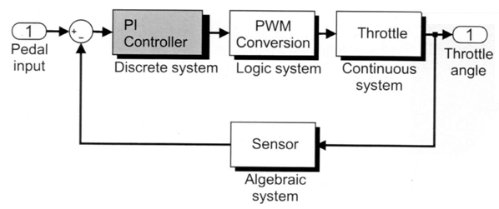
PI controller system modeling
Define the PI controller system
Define discrete states
Create a model of the PI controller
Model discrete transfer functions and state-space systems

Slide 3
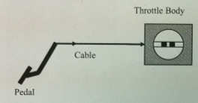
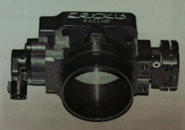
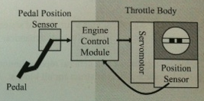
Electronic Throttle Control
(电子油门控制系统)

Slide 4
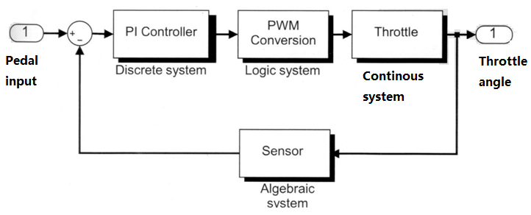
Layout

Slide 5
PI controller system modeling
Define the PI controller system
Define discrete states
Create a model of the PI controller
Model discrete transfer functions and state-space systems

Slide 6
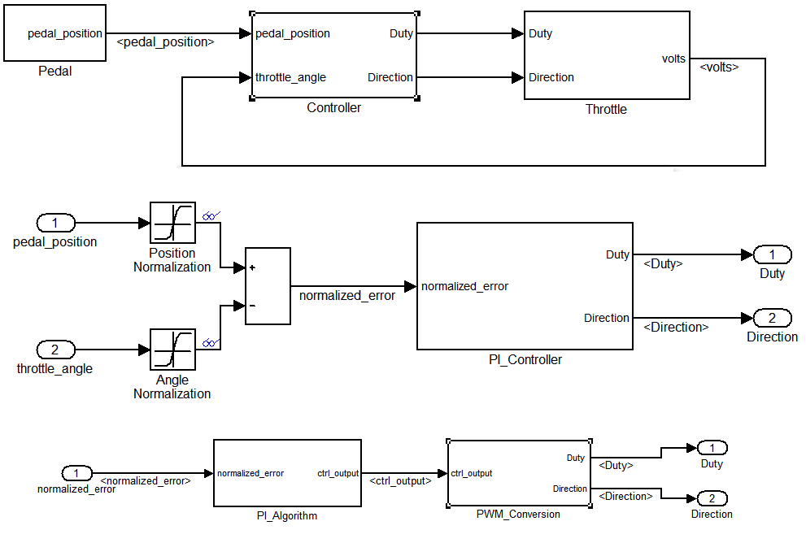

Slide 7
Defining the System
The proportional integral (PI，比例积分) controller is the throttle plate position controller.
It receives throttle position sensory information and pedal position command information,
and then determines the needed motor-control voltage, the corresponding pulse-width modulation duty cycle, and direction to produce the needed voltage.

Slide 8
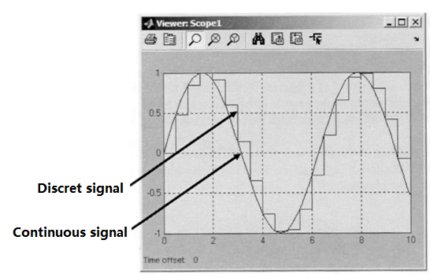
Defining Discrete System Characteristics
Dynamics are updated at a finite time interval referred to as the sample time.
System outputs can depend on memory elements (referred to as discrete states), system inputs, and/or time.
The mathematical representation of a discrete-state system is:
  State update equation:
x(k)=f(x(k-1),u(k),k)
  Output equation:
y(k)=f(x(k),x(k-1),…, u(k),k)

Slide 9
Difference equation(差分方程)
Definition
  微分方程的离散化，一个微分方程不一定可以解出精确地解，但把它变成差分方程，离散化后，就可以求出近似的解。
要实现微分方程的离散化，可以把x的区间分割为许多小区间 [0,1/n],[1/n,2/n],...[(n-1)/n,1]

Slide 10
Difference equation(差分方程)
微分方程可以离散化为差分方程：
y((k+1)/n)-y(k/n)+y(k/n)*(1/n)=0， k＝0,1,2,...,n-1 （n 个离散方程组）
利用y(0)=1的条件，以及上面的差分方程，就可以计算出 y(k/n) 的近似值了。

Slide 11
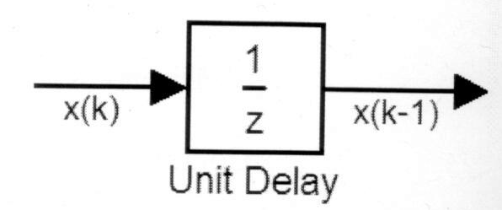
Modeling Difference Equations
The Unit Delay block in Discrete block set is the generic building block of difference equations.
  It holds and delays its input for a sample period.
  It requires a sample time and initial conditions.

Slide 12
Modeling Difference Equations
(Continued)
Determine the number of Unit Delay blocks required (one for each sample difference):
  For example, x(k)=x(k-1)+u(k)-u(k-1)
  Two are necessary: x(k)=>x(k-1), u(k)=>u(k-1)
Starting with the Unit Delay blocks, provide proper labels to their input and output signals.
Construct its right side one difference equation at a time.
Connect the returned signal of its right side as a source to its left side if necessary.
Set the sample time and assign initial conditions.

Slide 13
Modeling the System with Equations
A discrete PI controller is used as the throttle position controller based on the following equation.
y(k)=y_{p}(k)+y_{i} (k)= K_{p}e(k)+y_{i}(k-1)+K_{i}T_{s}e(k)
where
y_{p}(k)=K_{p}e(k)
y_{i}(k)=y_{i}(k-1)+K_{i}T_{s}e(k)
-1<y_{i}(k)<1
e(k)——Error(difference between desired output and actual output)
T_{s} —— Sample Time
K_{p}—— Proportional gain
K_{i}—— Integral gain

Slide 14
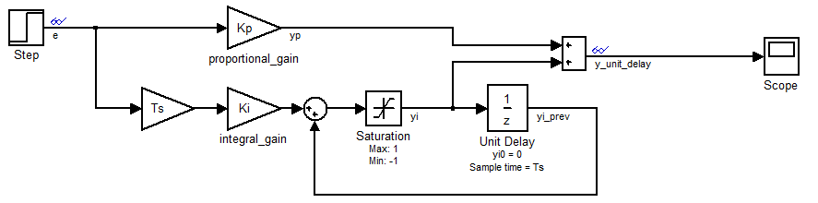
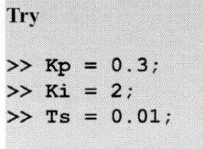
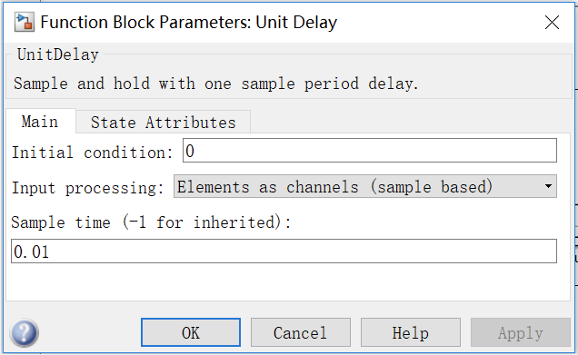
Building a Block Diagram Model of the System
y(k)=y_{p}(k)+y_{i} (k)
y_{p}(k)=K_{p}e(k)
y_{i}(k)=y_{i}(k-1)+K_{i}T_{s}e(k)
-1<y_{i}(k)<1
etc_PI.mdl

Slide 15
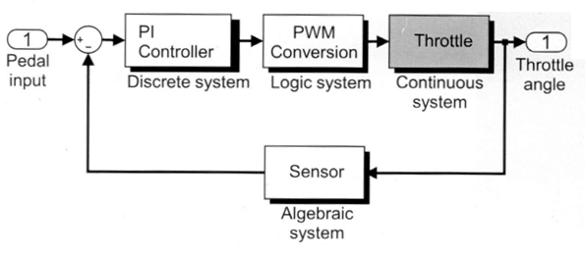
Modeling Throttle system
Define the throttle system
Create a model of the throttle system
Define continuous states
Simulate the model and analyze results
Model impact dynamics

Slide 16
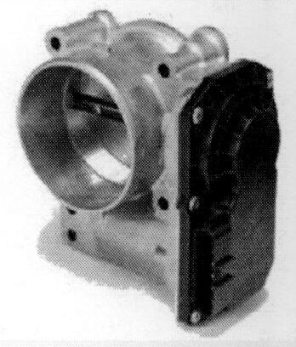
Defining the System
The electronic throttle body opens and closes the throttle plate valve in accordance with the accelerator pedal effort, and controls the amount of an inducted petrol into the engine.

Slide 17
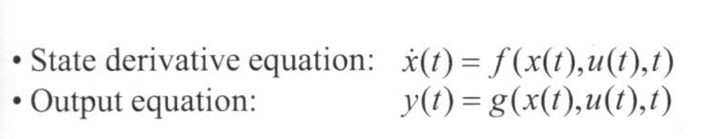
Defining Continuous-State System Characteristics
Dynamics are updated at an infinitesimal(微小) time interval.
System outputs depend on memory elements referred to as continuous states, system inputs, and/or time.
Rates of continuous states govern the variation of system dynamics.
The mathematical representation of a continuous-state system is

Slide 18
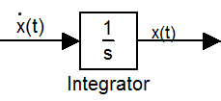
Modeling Differential Equations
Solve the equation for the highest order derivative term.
Determine the number of Integrator blocks required (one for each order of derivative) which blocks are in the continuous library.
Starting with the Integrator blocks, provide proper labels to their input and output signals.
One ordinary differential equation at a time, construct its right-hand side.
Connect returned signal of its right side as a source to its left side if necessary
Assign initial conditions.

Slide 19
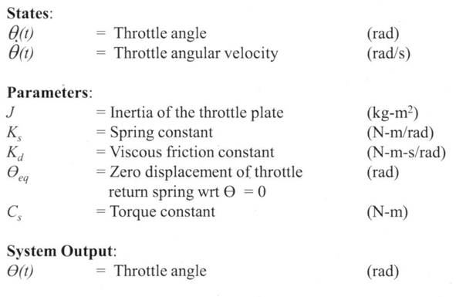
Identifying the System Components
System Input:
T(t) = Torque

Slide 20
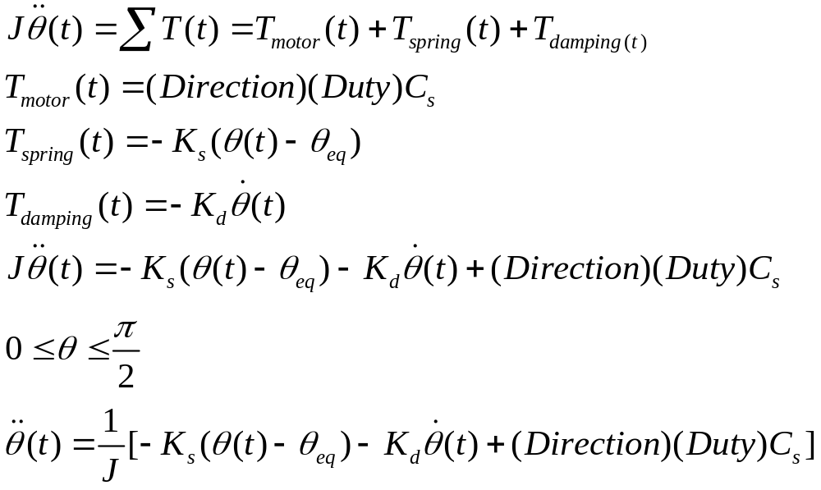
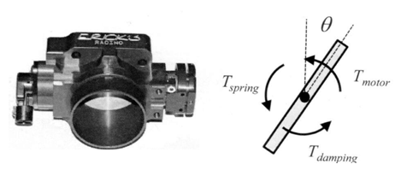
Modeling the System with Equations

Slide 21
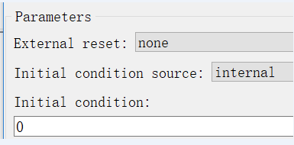
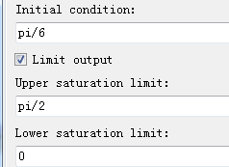
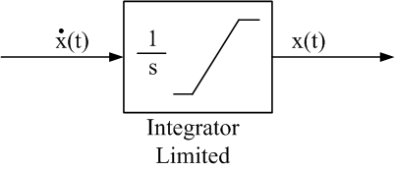
Continuous blocks
Integrator:只有初始条件
Integrator Limited: 上下界是有限制的。

Slide 22
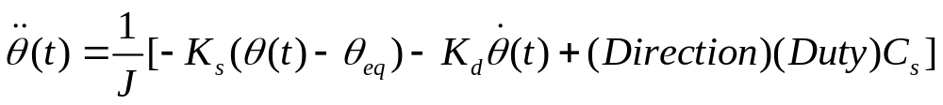
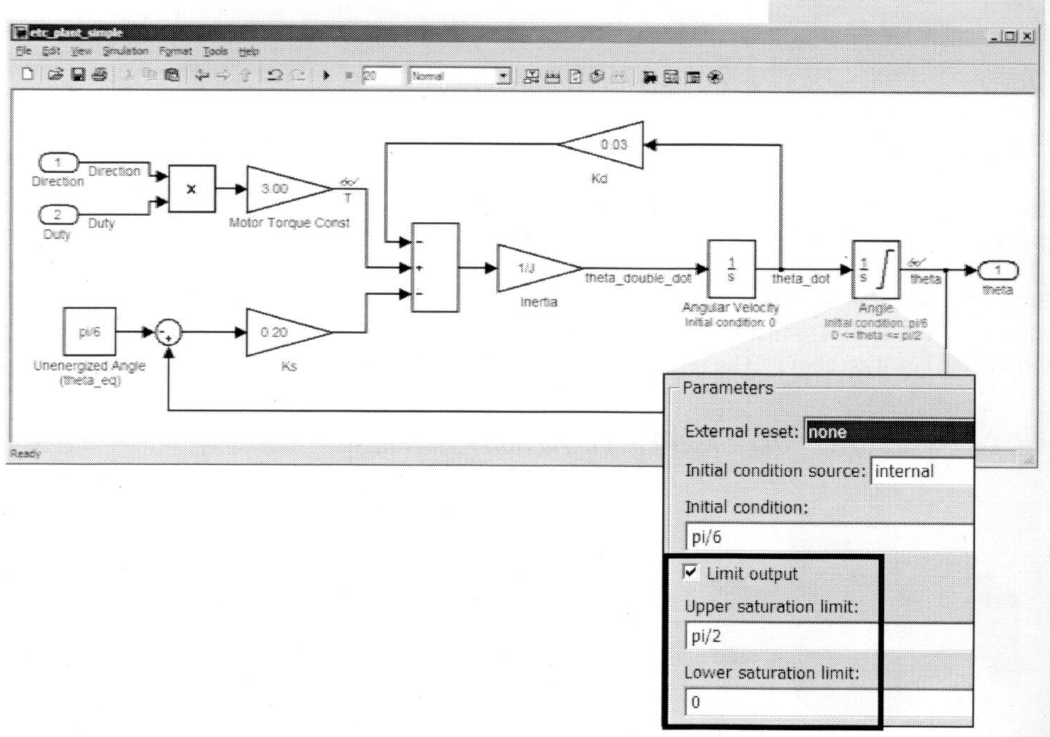
Building a Block Diagram form the Model
模块的旋转：选中模块鼠标右键选rotate(Ctrl+r:顺时针旋转90度)

Slide 23
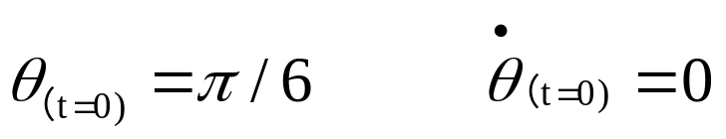
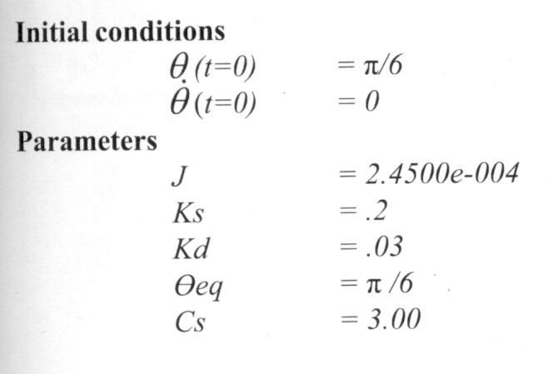
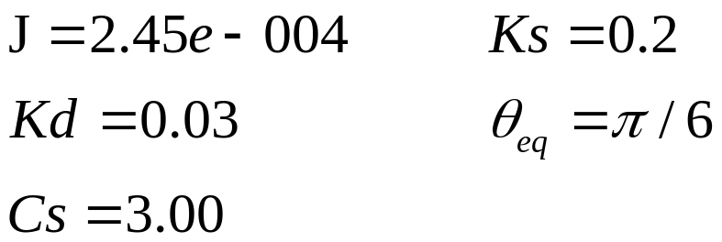
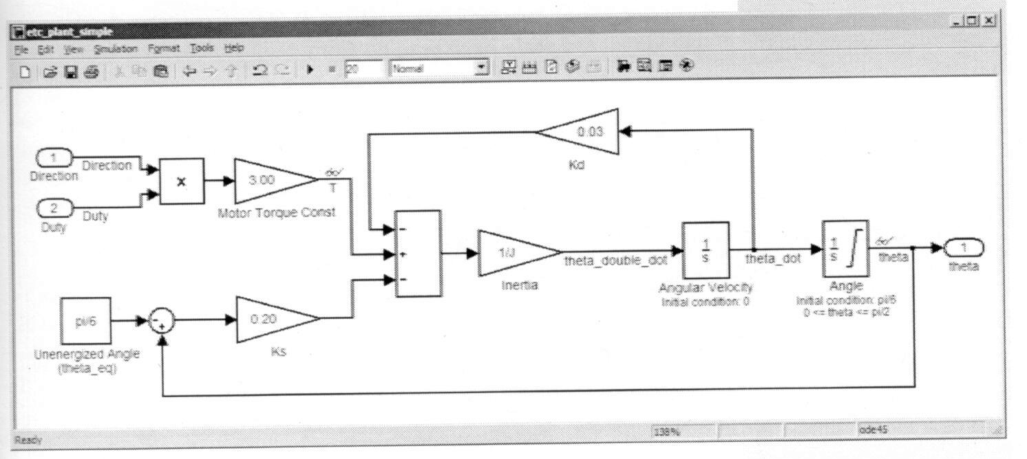

Defining Block Parameters
初始条件：
参 数：
Etc_plant_simple1.mdl
输入：Direction
Duty
输出：

Slide 24
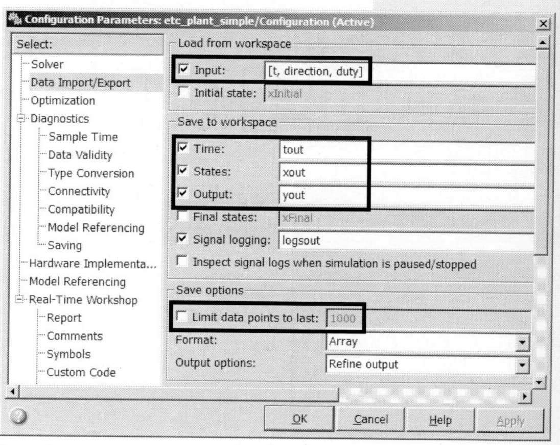



Defining the System I/O
  Simulation →Configuration Parameters →Data Import/Export

Slide 25
Introducing Subsystems
Using subsystems has these advantages:
  It helps reduce the number of blocks displayed in you model window
  It allows you to keep functionality related blocks together
  It enables you to establish a hierarchical block diagram

Slide 26
Creating subsystems
Add a subsystem block to your model, open that block, and add the blocks to the subsystem window
Select the blocks that make up the subsystem
Example

Slide 27
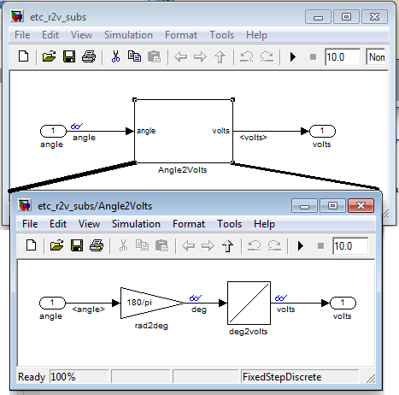
etc_r2v3_subsystem.mdl

Slide 28
Handling cross-system gateways
After creating a subsystem, notice that inports and outports are automatically inserted and connected.
Inport and outport are the gateways between the subsystem and its parent
Each inport/outport is associated with an input/output port of the subsystem
The block label is the same as the port name

Slide 29
Using subsystems to create a visual hierarchy
Subsystem can been dragged and dropped into other models.
Ways
  Open two models
  Copy the subsystem into the other model
  Simplify the diagram by making a subsystem

Slide 30
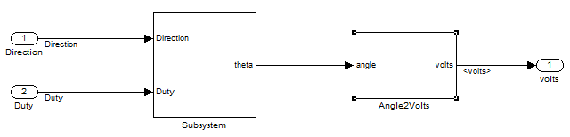
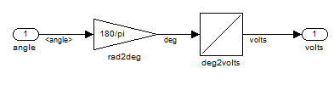
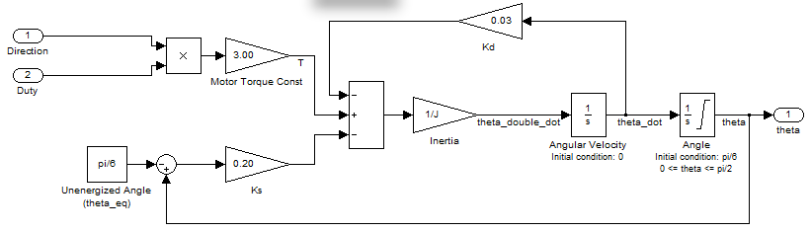

Slide 31
Layout

Slide 32
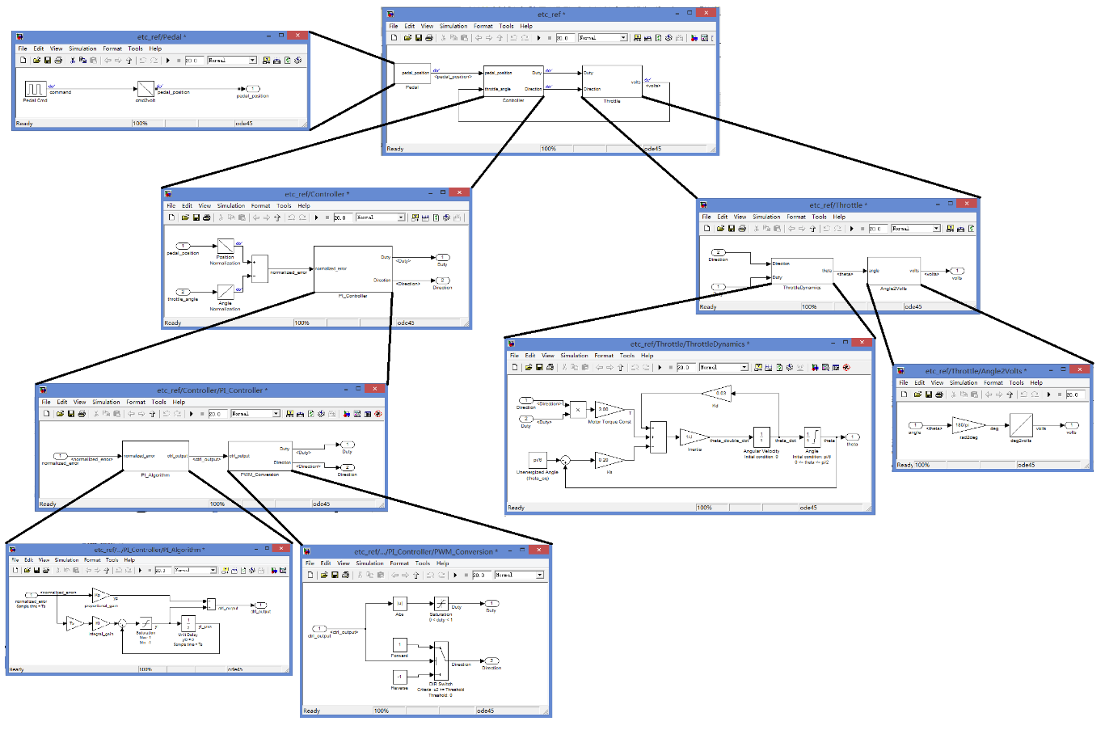

Slide 33
Summary
Build a continuous system
Build a discrete system
Build subsystem

