Slide 1
Stateflow
I

Slide 2
Stateflow入门介绍
Stateflow是一个交互式设计工具，用来对复杂的事件驱动模型系统进行建模与仿真。
与Simulink和MATLAB集成，Stateflow将复杂的控制和监督逻辑有效地结合到Simulink模型。
提供了一个设计嵌入式系统的完美解决方案。

Slide 3
Stateflow入门介绍
Stateflow能够做：
建立复杂的判定流，建立流程图
基于有限状态机理论对复杂的响应型系统进行可视化建模与仿真
设计和开发复杂的监控逻辑
在Stateflow框图中同时使用流程图和状态转移图表示法
自动地从模型中生成整数或浮点数代码
可随时方便修改设计，评估结果，验证系统性能

Slide 4
stateflow基本概念
有限状态机
状态
转移
事件
条件
动作
数据对象
连接节点
缺省转移

Slide 5
Flow Graph（流程图）
State machine（状态机）

Slide 6
Modeling complex logic flow

Slide 7
What is a flow graph
A flow graph is a chain of logical patterns that implement a series of decision flows
Implement sequential, conditional and iterative flow

Slide 8
An example of a flow graph
Two input: data, failFlag
One output: out
The value of out should be set to data as long as no failure has occurred(failFlag=0)
When failure occurs(failFlag=1), the next five values of out should be 0.

Slide 9
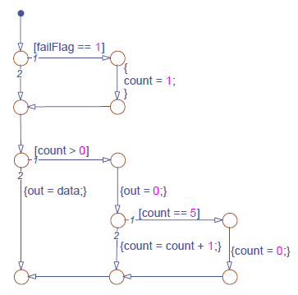
Junction(节点) , transition, condition and action
Example：checkData.mdl
if failflag
count=1
end
if count>0
out=0
if count==5
count=0
else
count=count+1
end
else
out=data
end

Slide 10
Design stateflow diagram
Open the stateflow diagram: double click the chart to open its stateflow diagram editor
Add junctions
Add default transition
Add transition: drag from the border of the flow origin to the border of the flow destination.
Label transition:

Slide 11
Design stateflow diagram(cont’)
Label transition:
  Select the transition,？Appears if the transition is unlabeled.
  Click the ? to enable text editing
  Enter the condition and/or the action statements.
  A generic transition label can consist of
    A comment /**/
    A condition enclosed in []
    A group of condition actions enclosed in {}

Slide 12
Junction(节点) , transition, condition and action
Example：checkData.mdl
if failflag
count=1
end
if count>0
out=0
if count==5
count=0
else
count=count+1
end
else
out=data
end

Slide 13
Execution of a flow graph
Begin from a default transition and stop at a terminating junction
Conditions govern the selection of an execution
Action carries out the consequences of the decision.

Slide 14
Behaviors of a flow graph
Start from a default transition
Test individual transitions one at a time from each junction based on the indicated priority.
Proceeds from one junction to the next along the search path once a valid transition is found.
Executes actions that are associated with the valid transition once the transition is qualified
Stop at a terminating junction.

Slide 15
Create a flow graph
Implement a sequence of conditional actions governed by
  Decisional constructs
  Iterative constructs
  Nested decisional and iterative construct
Model decision flows that do not require history
  System behavior is independent of the previous one
  Decision outcome need not be stored for later use

Slide 16
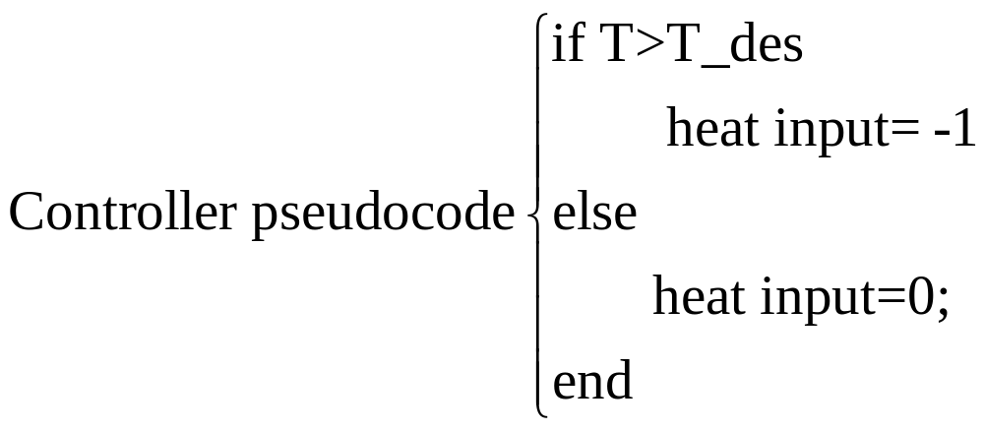
Example: climate control
Input: T_des , T
Output: heat input

Slide 17
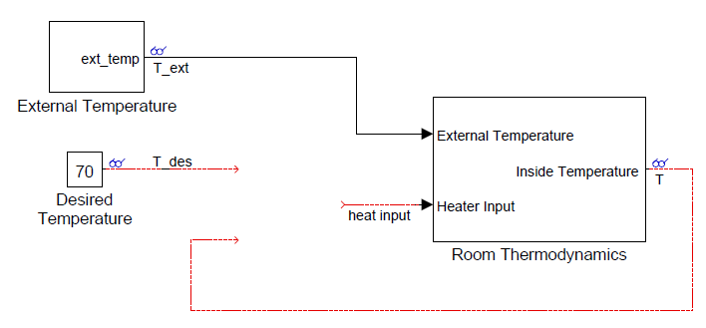
Example: climate control(cont’)

Slide 18
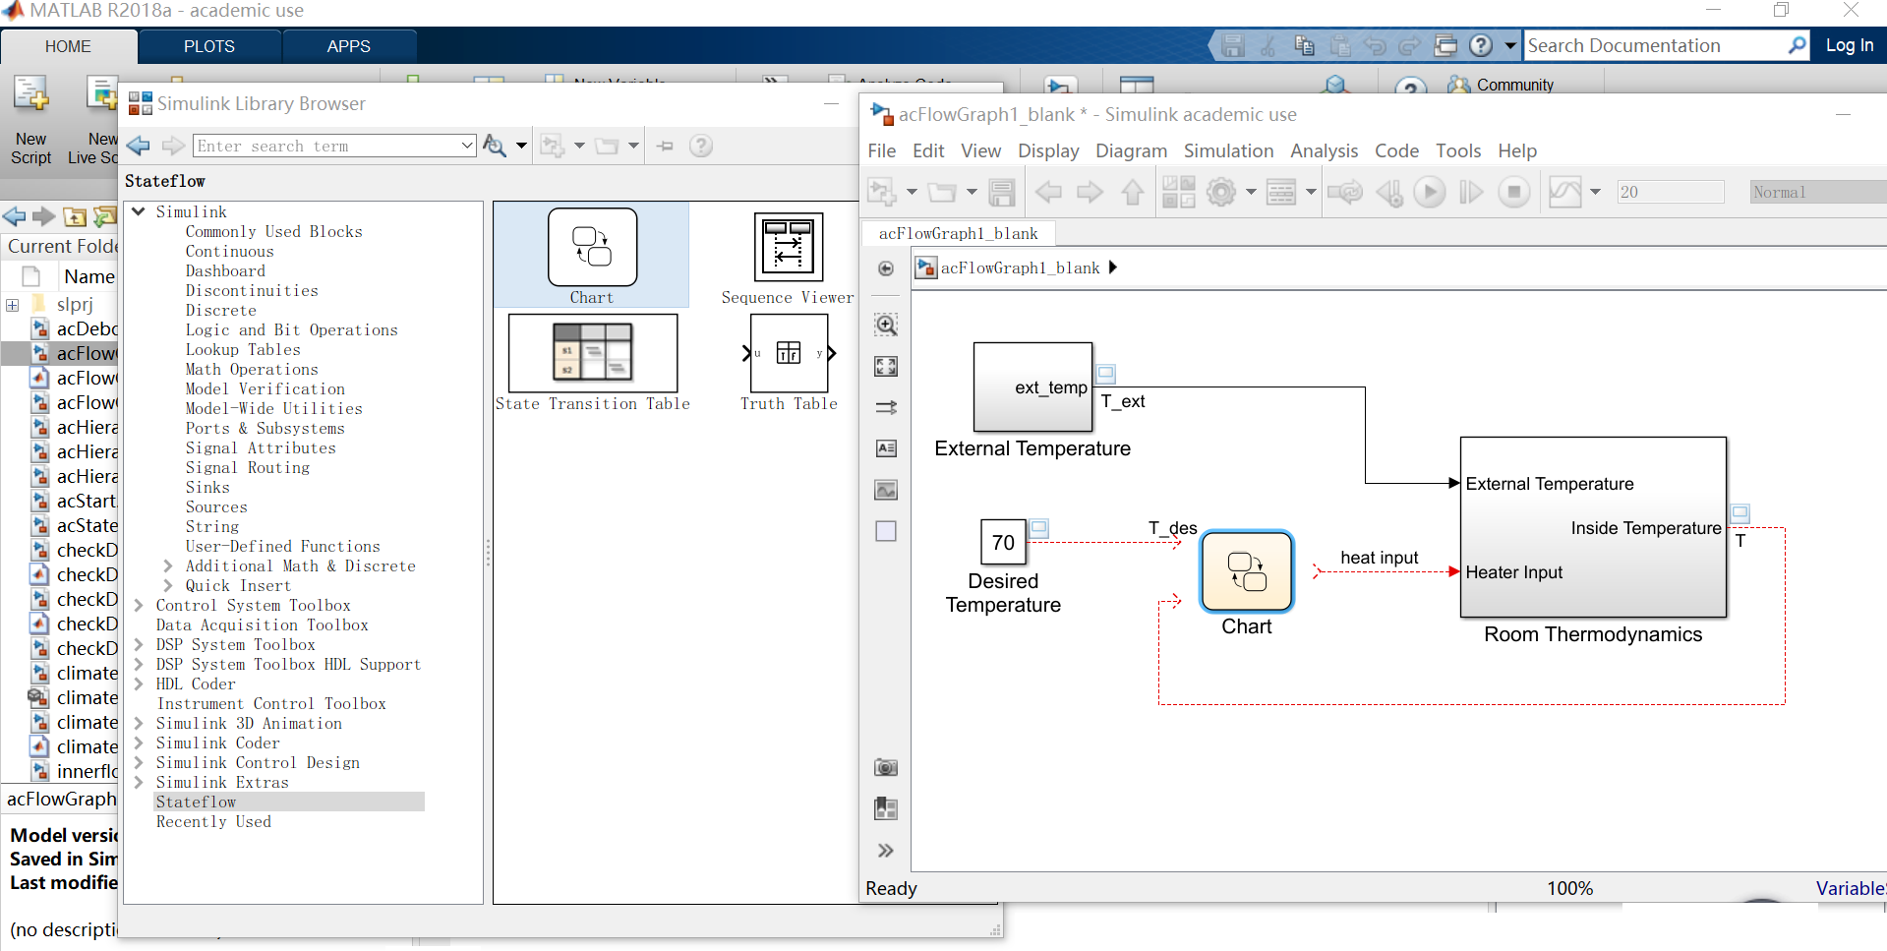
Creating a new chart
Using command to create a new model with a new chart
>>sfnew
Filename : acFlowGraph1_blank.mdl

Slide 19
Design stateflow diagram
Open the stateflow diagram: double click the chart to open its stateflow diagram editor
Add junctions
Add default transition
Add transition: drag from the border of the flow origin to the border of the flow destination.
Label transition:

Slide 20
Design stateflow diagram(cont’)
Label transition:
  Select the transition,？Appears if the transition is unlabeled.
  Click the ? to enable text editing
  Enter the condition and/or the action statements.
  A generic transition label can consist of
    A comment /**/
    A condition enclosed in []
    A group of condition actions enclosed in {}
  Be expressed in the order as shown above

Slide 21
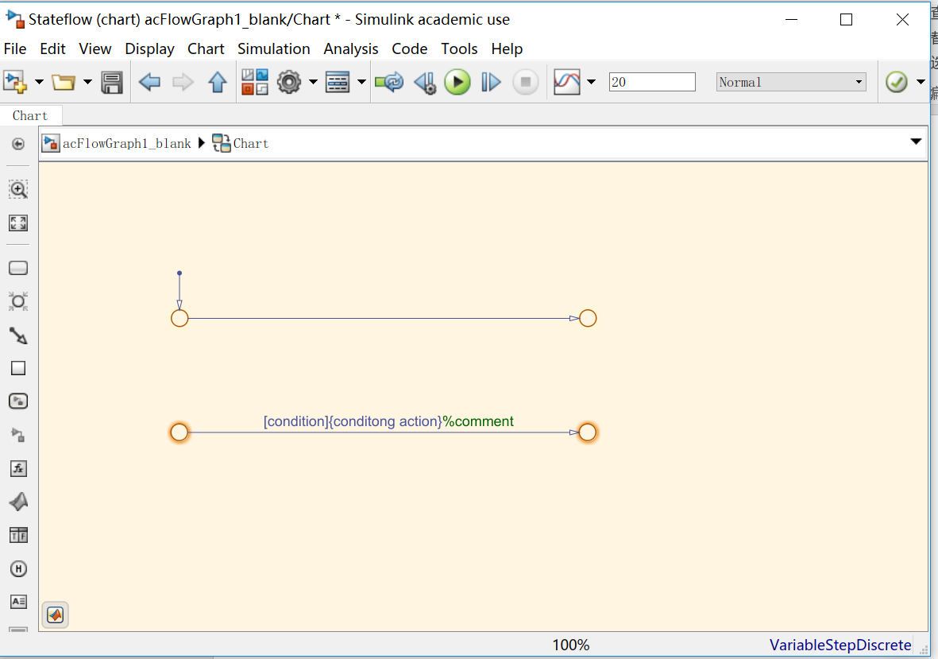

Slide 22
Condition statement syntax
A condition statement must be a boolean expression
  A logical comparison with boolean operator (>,<,>=,<=,==,!=)
  A call to function that returns a boolean value
  Multiple conditions can be combined with logical operator such as &&, ||

Slide 23
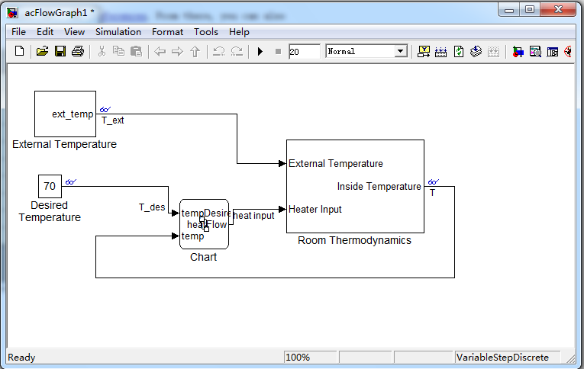
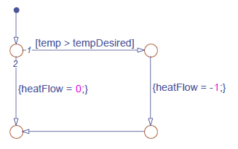
Data in the chart
temp from a simulink signal(chart input)
tempDesired from a Simulink signal (chart input)
heatFlow feeds to a simulink signal(chart output)

Slide 24
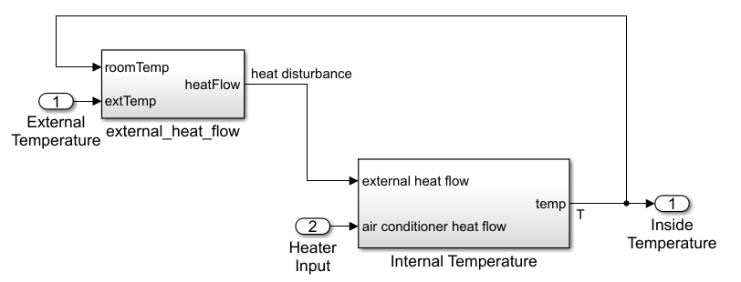
Defining chart parameter data

Slide 25
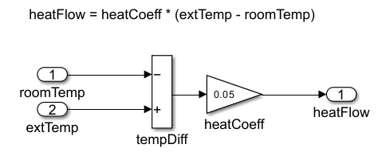
Defining chart parameter data

Slide 26
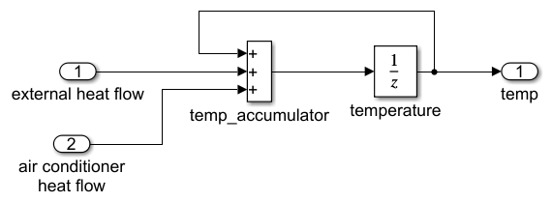
Defining chart parameter data

Slide 27
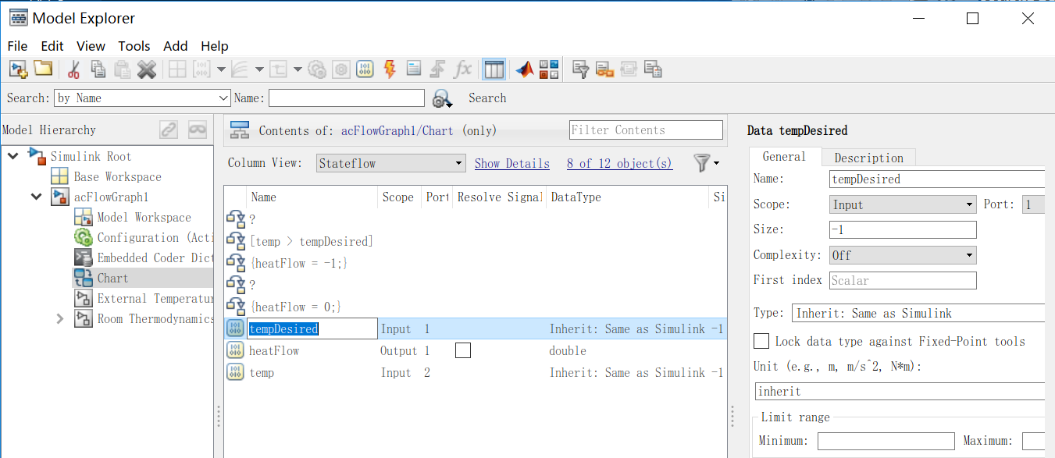
Defining chart I/O data
In your stateflow (chart):view->model Explorer
  View→Model Explorer from the Stateflow Editor menu
  Expand the model in the model Hierarchy pane on the left, then select the chart
  Add →Data from the menu to add a variable
  Set the data properties

Slide 28
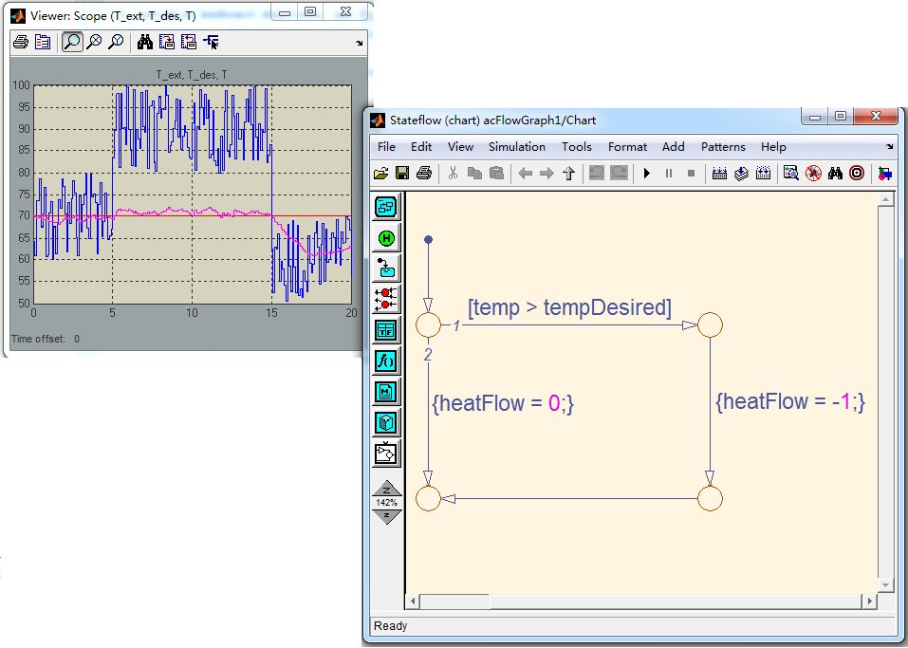
Animating the flow graph
Example:acFlowGraph1.mdl

Slide 29
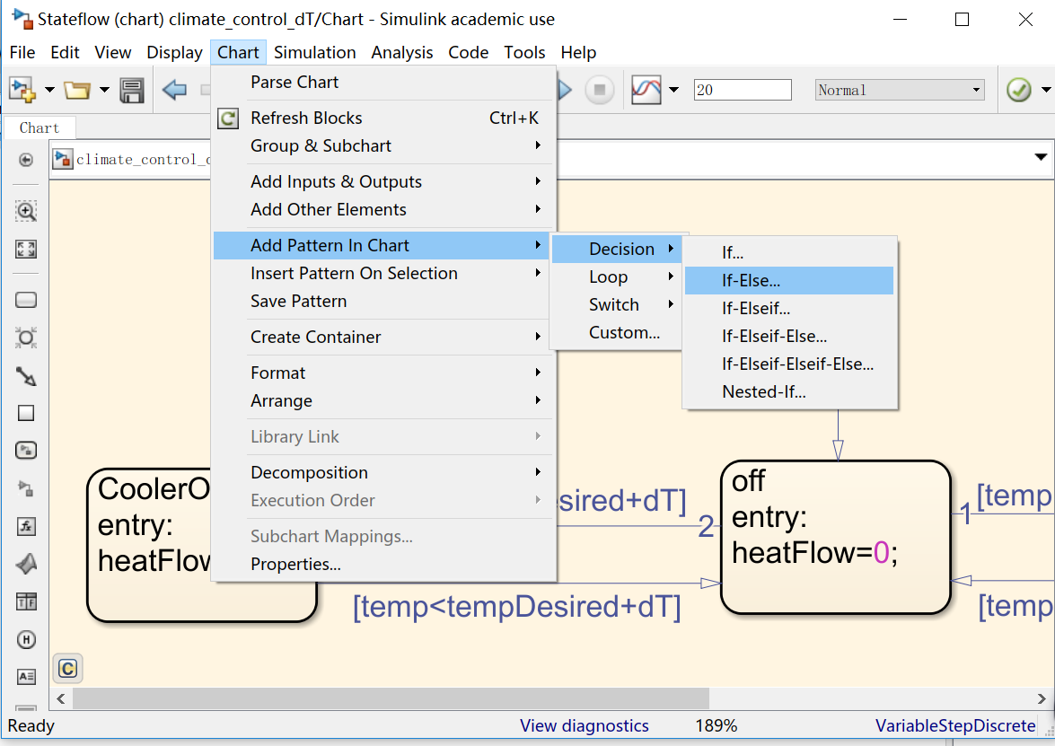
Modeling standard programming constructs
Using the Stateflow Pattern Wizard

Slide 30
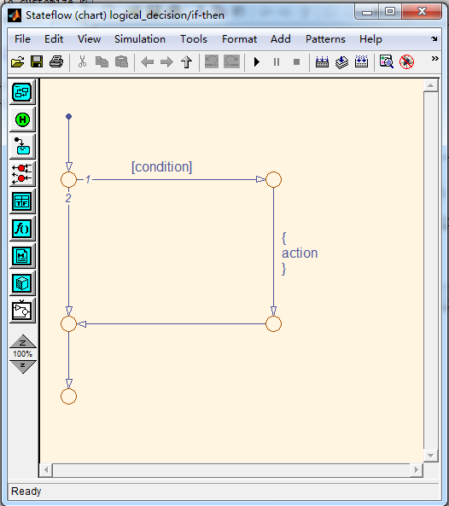
Common decisional patterns(1)
if (condition)
{
action;
}

Slide 31
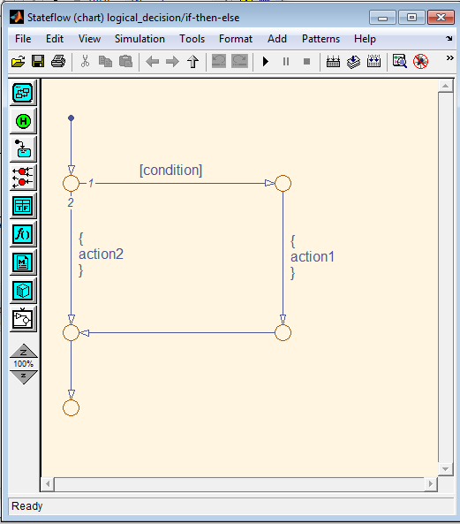
Common decisional patterns(2)
if (condition)
{
action1;
}
else
{
action2;
}

Slide 32
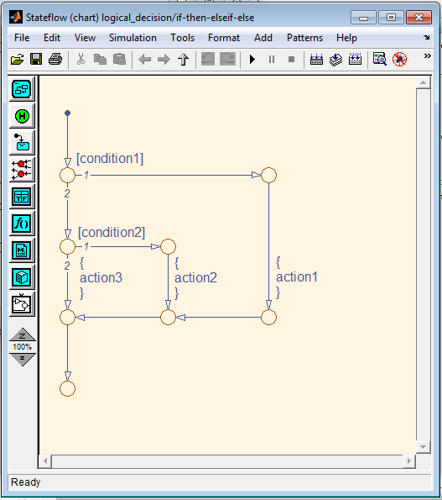
Common decisional patterns(3)
if (condition1)
{ action1;}
else if (condition2)
{action2;}
else
{action3;}

Slide 33
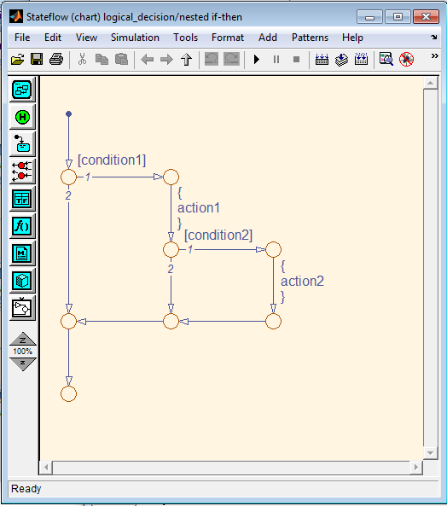
Common decisional patterns(4)
if (condition1)
{ action1;
if (condition2)
{action2;}
}

Slide 34
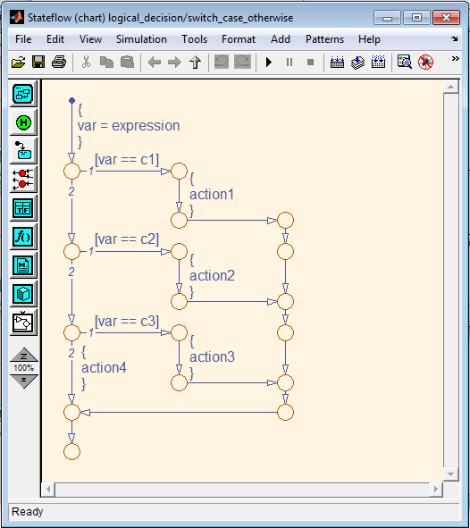
Common decisional patterns(5)
switch(var)
{case c1:
action1;
break;
case c2:
action2;
break;
case c3:
action3;
break;
default:
action4;
}

Slide 35
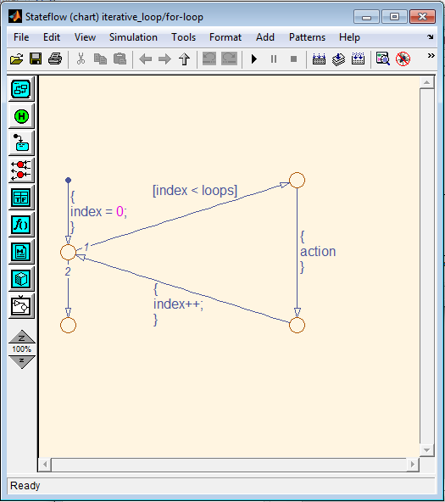
Common loop patterns(1)
for(index=0;index<loops;index++)
{
action;
}

Slide 36
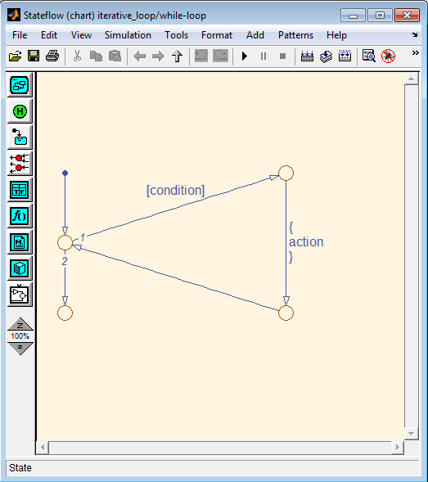
Common loop patterns(2)
while(condition)
{
action;
}

Slide 37
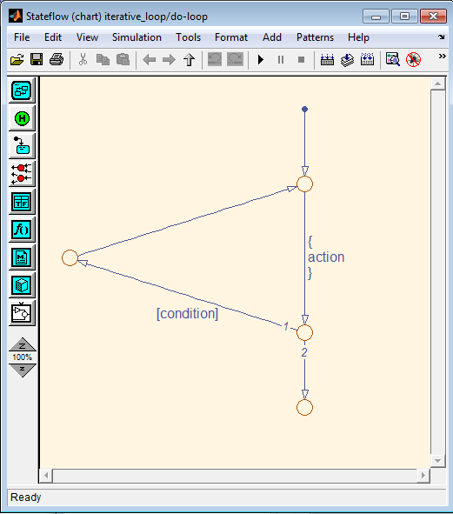
Common loop patterns(3)
do
{
action;
}
while(condition);

Slide 38
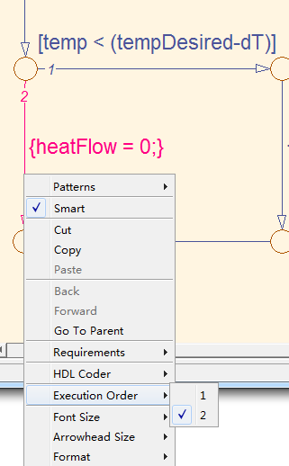
Setting explicit transition priority
  Explicit change: right-click the transition and then select Execution Order
  File→Model Properties→Chart Properties to select “User specified state/transition execution order”

Slide 39
Implicit transition priority
  Two or more transitions guarded with a condition originating from the same junction, set the priorities in the clockwise starting from the 12 o’clock position.

Slide 40
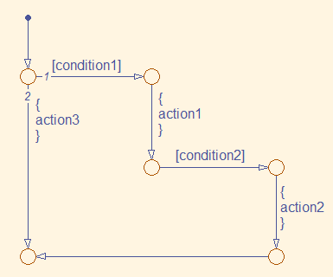
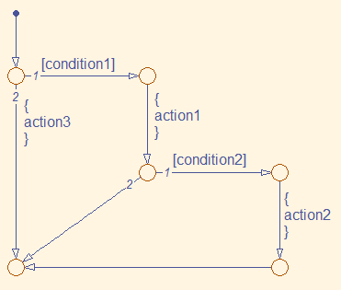
Backtracking of a flow graph
if (condition1)
{action1
if condition2
action2
else action3; }
else action3 ;
File:checkData_condition
if (condition1)
{action1
if condition2
action2
}
else
action3

Slide 41
summary
What is a flow graph?
Constructing a flow graph
  Laying out the logic flow pattern
  Applying the flow governing syntax
Semantics of a flow graph
Animation the flow graph

Slide 42
Modeling state machines

Slide 43
A State Machine
A system that can only exist in a finite number of modes
Behave in a predefined number of ways.
Displays all possible modes that its implementation can exhibit
Expose the logic that commences changes to the system from one mode to another

Slide 44
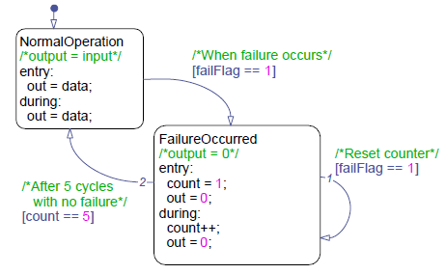
Modeling state machines
Finite number of modes
Can only behave in a predefined number of ways.

Slide 45
An example of a state machine
Algorithm has two modes:
  Normal operation--out=data
  Failure occurred--out=0

Slide 46
States and transitions
Default transition
States
transitions

Slide 47
States and transitions(2)
State:
  Exclusive: only enter one of the states at a time
  Parallel: multiple states are active at a time
transition path: a chain of transitions from one state to another
junction: a transition path can never settle at a junction , a transition path must proceed until it reaches a state.
Default transition: activating the default state when the state machine becomes live.

Slide 48
Behavior of a state machine
Contains one or more states
Enters the default state following the default transition when first activated
Searches for a valid path from the current active state at the next update
  Takes the path to a new state if one is found
  Remains in the current state if none is found
Holds its status after completing the necessary transition until the next update

Slide 49
When would I create a state machine?
Implement a system that exhibits a finite set of behaviors based on event-driven and/or condition-driven logic.
Model reactive or supervisory system where future system behavior depends on the current operate mode.

Slide 50
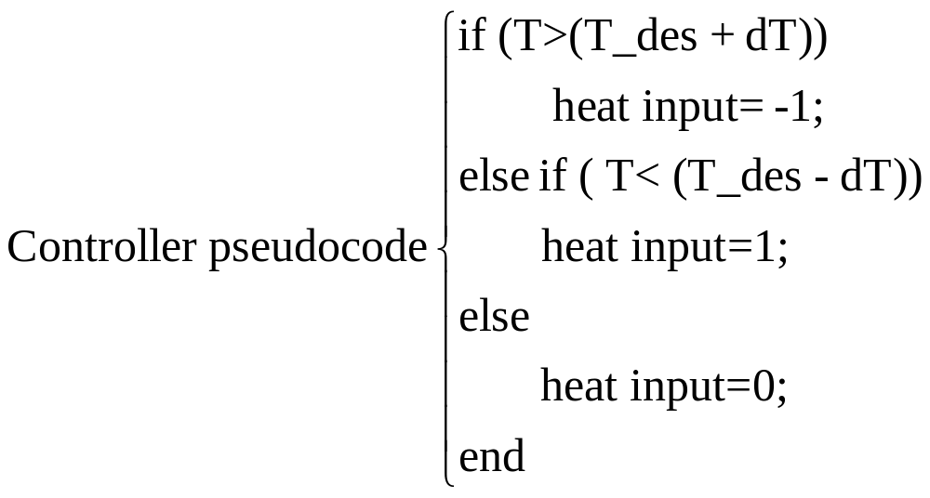
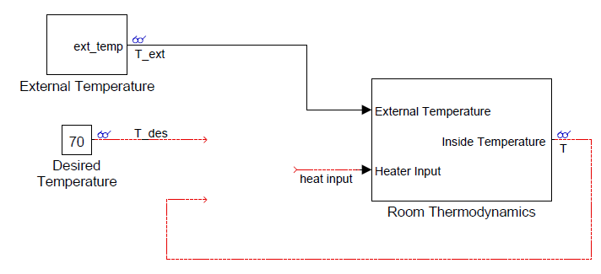
Example: climate control
-climate_control_dT_blank.mdl

Slide 51
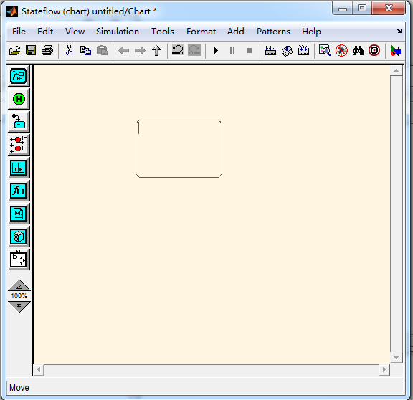
Adding states
Double-click it to enable its multiple-insertion mode

Slide 52
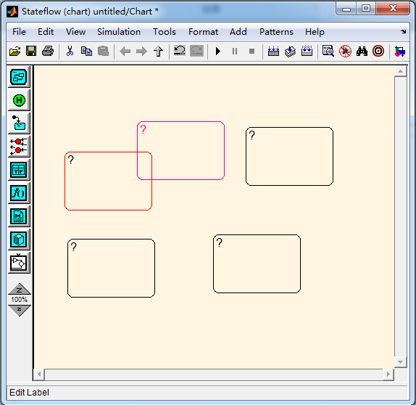
Labeling state
Click it to enable text editing

Slide 53
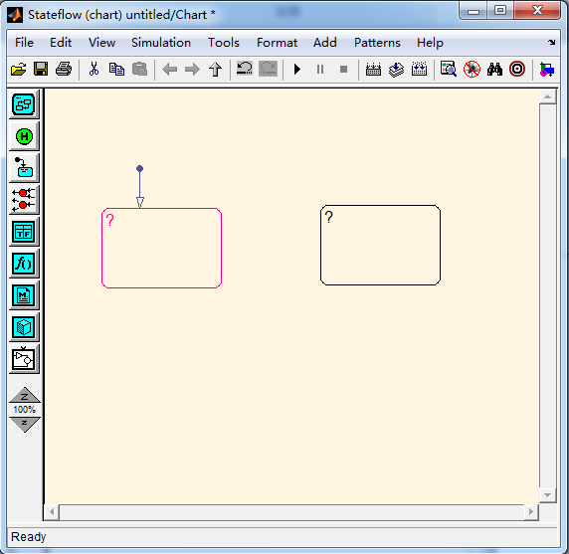
Adding a default transition

Slide 54
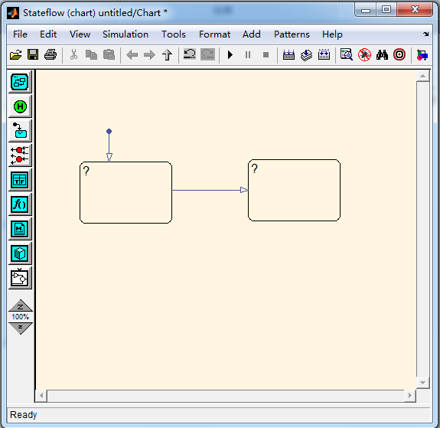
Adding transitions

Slide 55
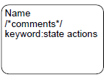
State labeling syntax
A generic state label can consist of
  Name
  State actions(keyword: statement)
The name is mandatory while the actions are optional.
The keyword can be either entry, exit and during

Slide 56
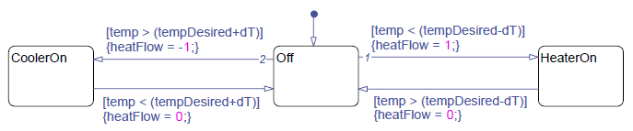
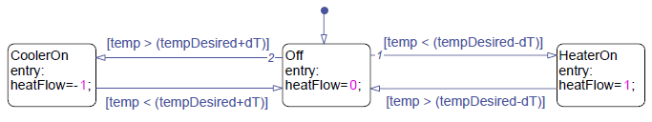
When to use state actions?
Use state actions when it makes intuitive sense in your model.

Slide 57
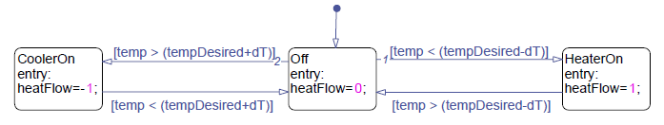
Activating chart at initialization
The chart to enter the default state prior to the start of the simulation
File→Model Properties→Chart Properties →enable Execute(enter) Chart At Initialization

Slide 58
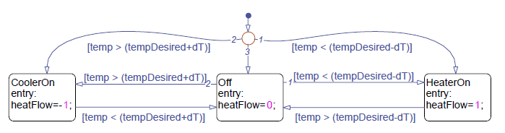
Activating chart at initialization
Add initialization logic
View→Model explorer→ Model explorer Input: temp, tempDesired; output: heatFlow
Parameter:dT
  Simulink->file ->model property->model property->callbacks -> PreLoadFcn->dT=2;

Slide 59
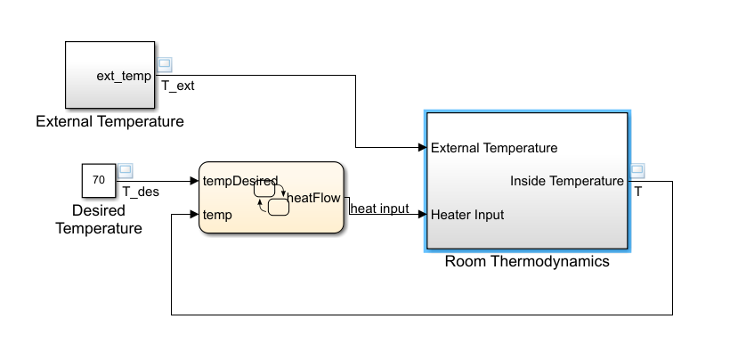
Defining chart parameter data

Slide 60
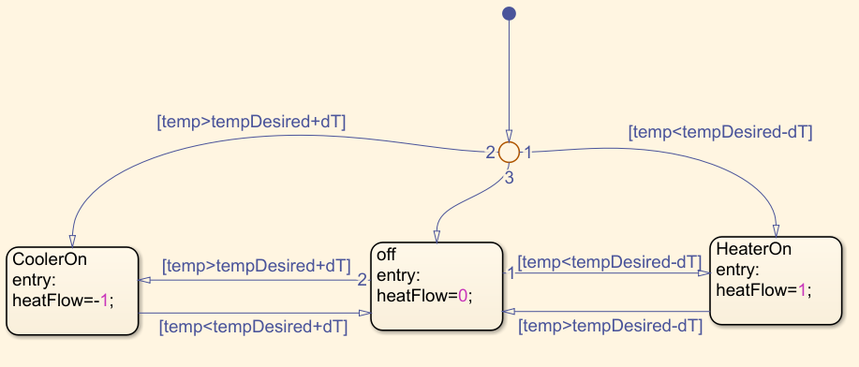
Defining chart parameter data

Slide 61
Defining chart parameter data

Slide 62
Defining chart parameter data

Slide 63
Defining chart parameter data

Slide 64
Defining chart parameter data
In your chart
  View→Model Explorer
  Expand the model
    Add →Data to add a variable
    Set the data Scope to Parameter and give the name
    Define the parameter value in the MATLAB Workspace
      >> dT=2

