Slide 1
Stateflow
II

Slide 2
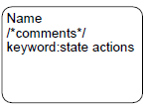
State labeling syntax
A generic state label can consist of
  Name
  State actions(keyword: statement)
The name is mandatory while the actions are optional.
The keyword can be either entry, exit and during
  entry: enter the state to do actions
  during: stay in the state to do actions
  exit: leave the state to do action

Slide 3
State labeling syntax
exit actions are executed when a state is active and a transition out of the state occurs.
during actions are executed when an state is active and:
event occurs
no valid transition to another state is available.

Slide 4
Transition labeling syntax
A generic transition label can consist of
  Comment
  An event
  A condition enclosed in []
  A group of condition actions enclosed in {}
  A group of transition actions preceded by a /
All components are optional, but must be expressed in the order as shown above if used

Slide 5
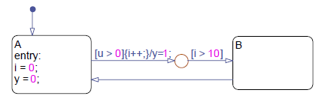
What is a transition action?
Transition action happens from the current state into the next state
junction: a transition path can never settle at a junction , a transition path must proceed until it reaches a state.
transVsCond.mdl

Slide 6
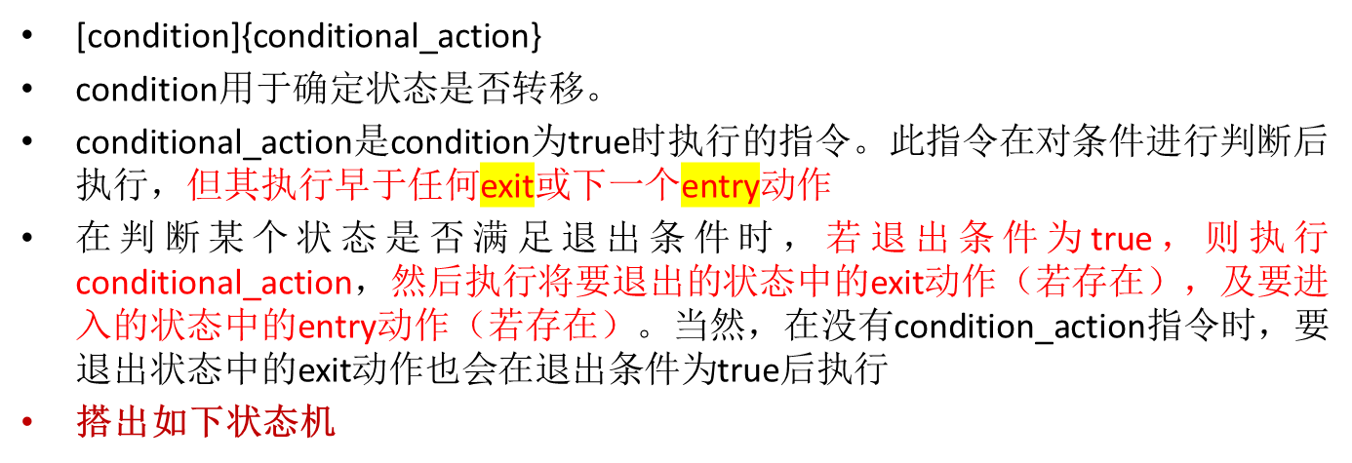
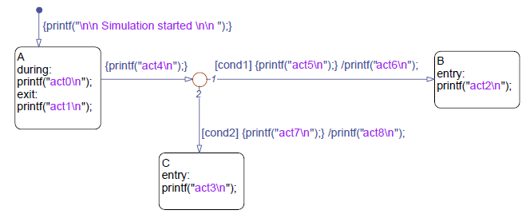
Semantics of a state transition

Slide 7
Semantics of a state transition
If we start A and cond1 is true and cond2 is false , in what order are the actions executed?
act4,act5,act1,act6,act2
注意during和exit的语义

Slide 8
Semantics of a state transition(cont’)
If we start A and cond1 is false and cond2 is false , in what order are the actions executed?
act4,act0……
注意during和exit的语义

Slide 9
Semantics of a state transition(cont’)
If we start A and cond1 is false and cond2 is true , in what order are the actions executed?

Slide 10
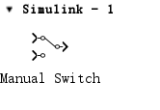
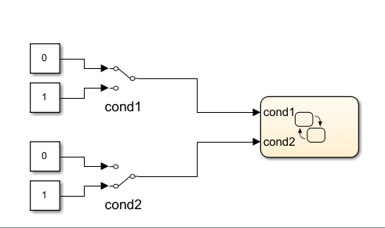
Semantics of a state transition(cont’)
actionExecOrder.mdl

Slide 11
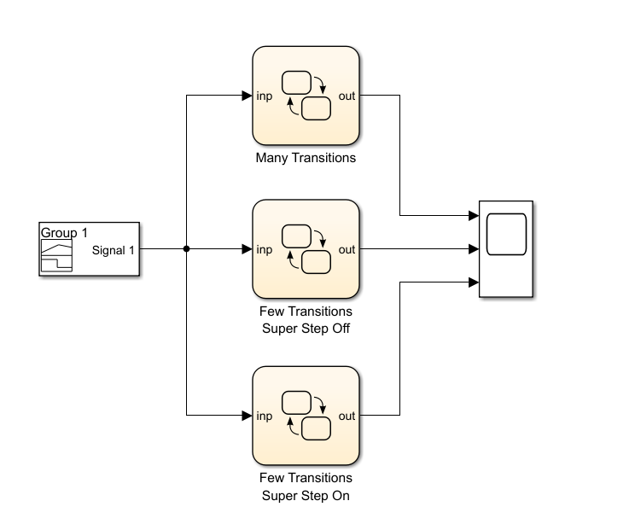

3 state machines

Slide 12
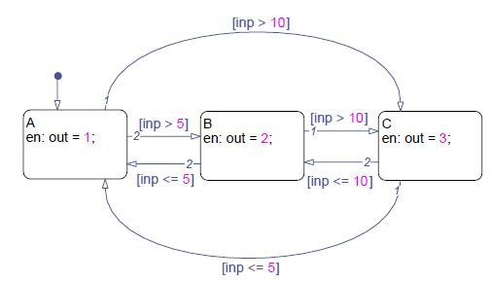
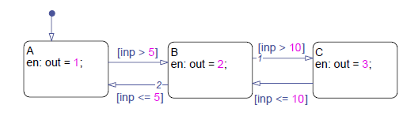

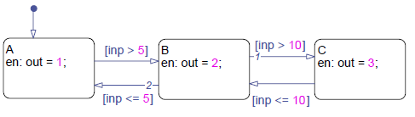
3 state machines

Slide 13
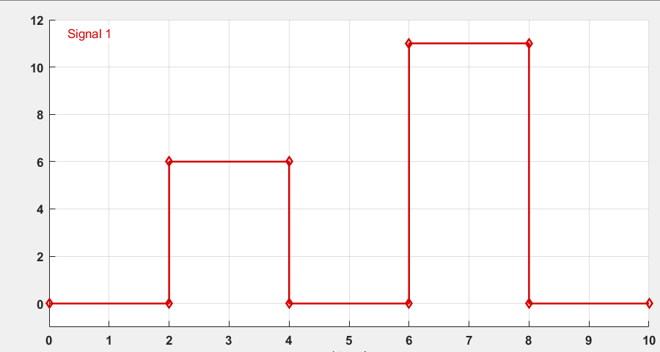
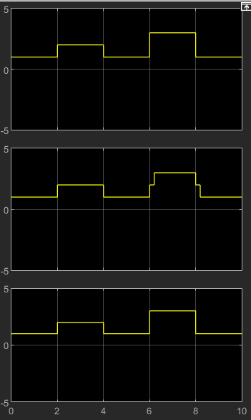
Superstep解释

Slide 14
Superstep解释

Slide 15
Superstep解释
默认不开启：每个事件或者步长执行一次仿真
开启：
When you enable super step semantics, the chart takes all valid transitions in one step, stopping at state C.

Slide 16
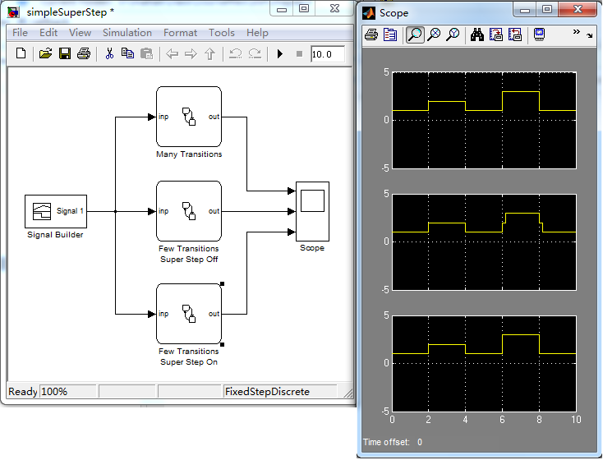
Taking multiple transitions in a single chart update simpleSuperStep.mdl

Slide 17
The state flow action language
An action statement can consist of:
  Operation on variables
    Mathematical operators
    Logical operators
  Calls to functions
  An event broadcast
  Standard style guidelines
    http://www.mathworks.com/industries/auto/maab.html

Slide 18
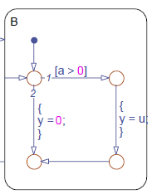
Inner flow graph
A chain of logical patterns that exist entirely within the boundary of a state
Useful in carrying out entry-equivalent and during-equivalent actions conditionally.
Equivalent to during actions
Equivalent to entry actions

Slide 19
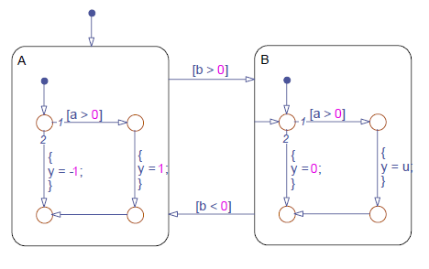
Behavior of an inner flow graph example：innerflow1.mdl

Slide 20
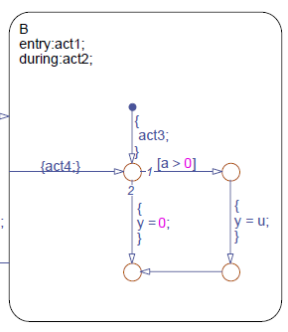
Semantics of an inner flow graph
First entry action, then inner flow graph
example：innerflow.mdl 修改
act1 before act3
act2 before act4

Slide 21
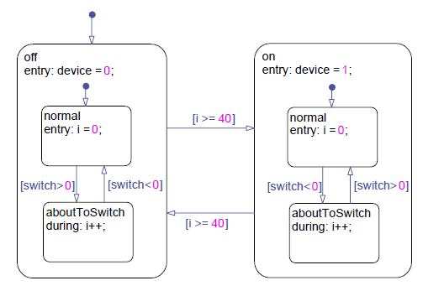
The concept of state hierarchy
A child state can enter only if its parent state is active.
A child state must exit if its parent state becomes inactive.
example：debouncer.mdl
superstates
substates

Slide 22
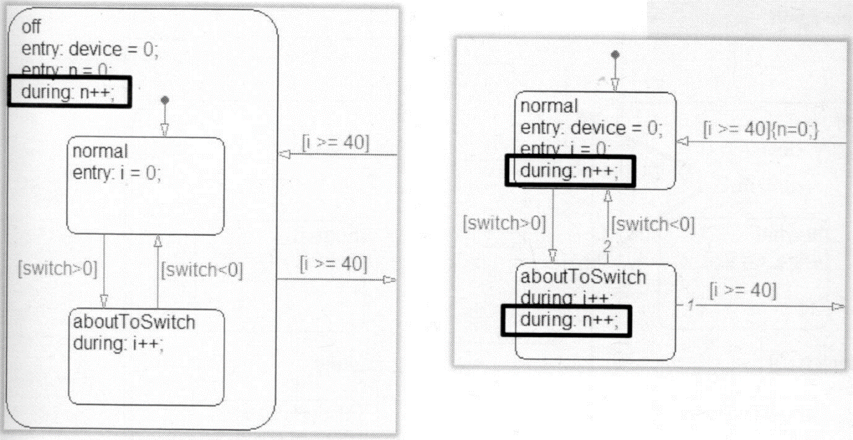
When would I create a multilevel state machine?
Simplify state-transition diagram for models that contain natural hierarchy
Unify common actions and conditions
Provide an extra degree of transition testing priority control

Slide 23
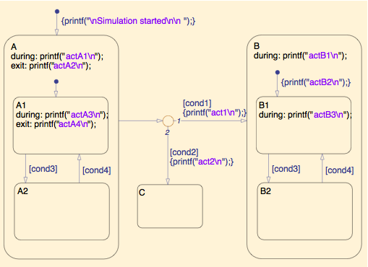
Semantics of a multilevel state transition
Assume that A and A1 are currently active. When cond1 is true, and cond2 is false. How to execute?
  act1, actA4, actA2,actB2…
  （A child state must exit if its parent state becomes inactive.）
example：actionExecHier.mdl （搭建）

Slide 24
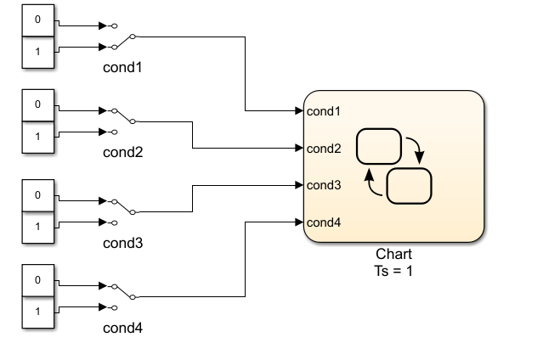
Semantics of a multilevel state transition

Slide 25
Example: climate control
input: T_des, T, power
Output: heat input
Parameters: dT
If(power==1)
heater maintains normal operation
else if (power=0)
heat input=0;
end

Slide 26
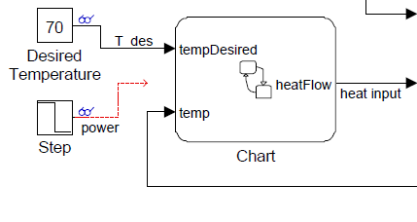

Slide 27
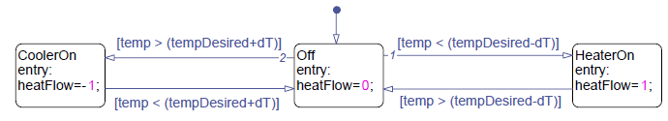
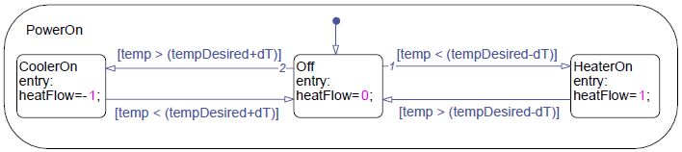
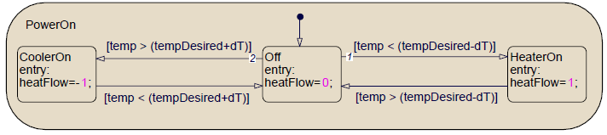
Creating superstates and substates
Resize the superstate such that all its substates can fit within its boundary
Click right, select: Group&Subchart->Grouped
SM
ungrouped
Grouped
states

Slide 28
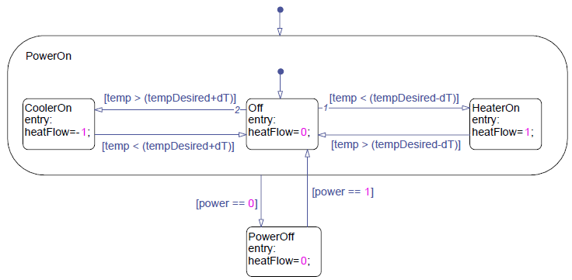
Designating default substates
Default states should be define at every level of hierarchy
You can override default substates using supertransitions that go directly to a substate.

Slide 29
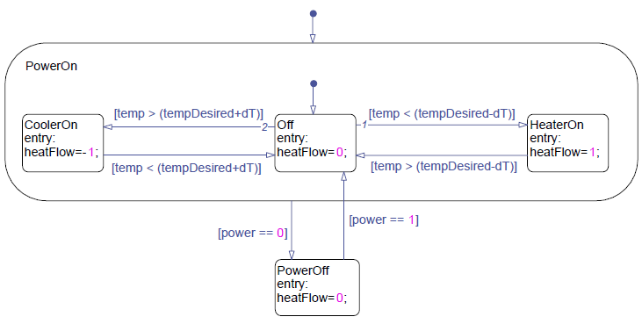
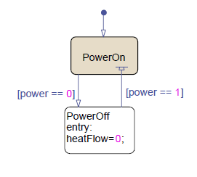
Creating a subchart
Right-click the state to open its context menu
Select Group&Subchart→Subcharted
Example: acHierarchical.mdl

Slide 30
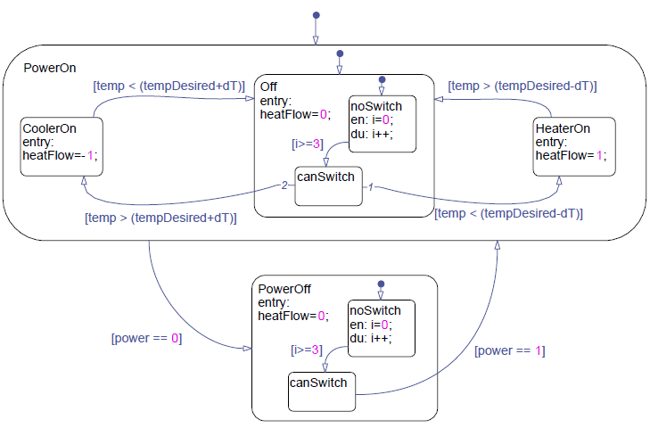
Chart-level and State-level Data
In the climate control state machine, add logic to prevents the system from excessive switching.
Example: acDebouncerStart.mdl （搭建实现）

Slide 31
Examining multilevel activations and state transitions
When the chart is first activated, the multilevel state machine performs the default transition paths to enter the PowerOn,Off,and noSwitch state
Only when the canSwitch state is active can the chart leave the off state.

Slide 32
Recovering active substates
（可选学）
In general, whenever a superstate is reactivated, the superstate enters the default transition to enter its default substate.
If you want the superstate to recover the last active substate, accomplish by adding a history junction in the superstate.
Note: do not adding a history junction directly at the chart level .

Slide 33
Defining state-level data
Select the state under the Model Hierarchy pane in the Model Explorer.
Select add→data from the model explorer to add a new data to the state
Rename the data
Set the type and value attributes of the data

Slide 34
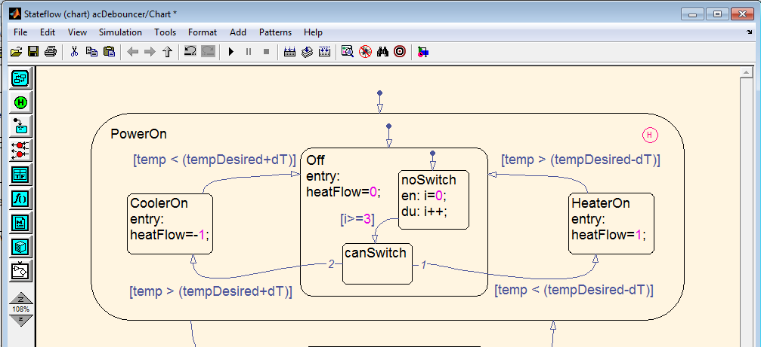


Slide 35
The concepts of parallelism
State:
  exclusive : only one active child state at a time
    With solid boundaries
  parallel: all its child states active as long as it is active.
    Modeling concurrency and interdependency in a system
    With dotted boundaries

Slide 36
The concepts of parallelism(2)
The term parallel is used to indicate that multiple states are active at one time, not that multiple states execute at the same time
Parallel states execute sequentially based on their assigned execution order
  Upper right corner of the state

Slide 37
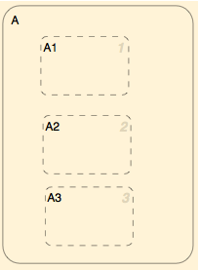
Execution
order

Slide 38
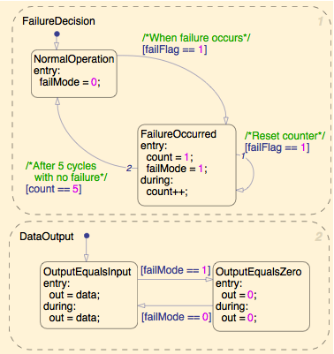
multiprocessing state machine example: checkDataParallel.mdl（搭建）
Failure
determination
Mode logic

Slide 39
When could I create a multiprocessing state machine
Combine interdependent state machines into a single diagram
Enable a more intuitive leader-follower implementations
Provide clear separation of logical components

Slide 40
Example:climate control
Can modify the acceptable temperature thresholds depending on the time of day
  At night, we want to conserve energy
  if (hour<6)||(hour>21)
  temperature threshold is T_des+/-10
  Else
  temperature threshold is T_des+/-2
  end

Slide 41
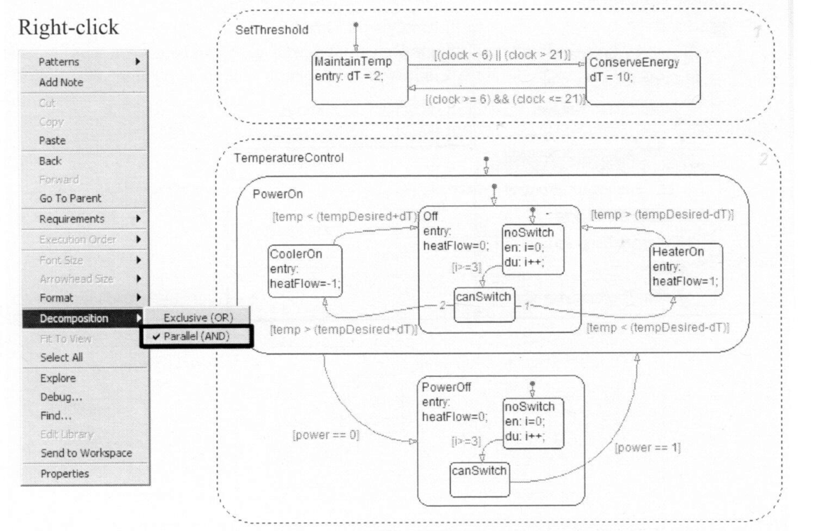
Creating Parallel states
Right-click in the parent. This opens a context menu of the chart or state
Select Decomposition→parallel(AND) from the context menu
example: acParallel.mdl

Slide 42
Defining data in parallel states
Chart level- the data can be accessed by the entire chart.
State level- the data can be accessed only by the state it is defined in, and any substates of that state.
Communicating between parallel states

Slide 43
Activation order of parallel states
Explicitly set by user
  Enable File->Chart Properties->User specified state/transition execution order
  Right click and setting the Execution Order
Derived from state location
  Disable File->Chart Properties->User specified state/transition execution order
  Order from top to bottom

Slide 44
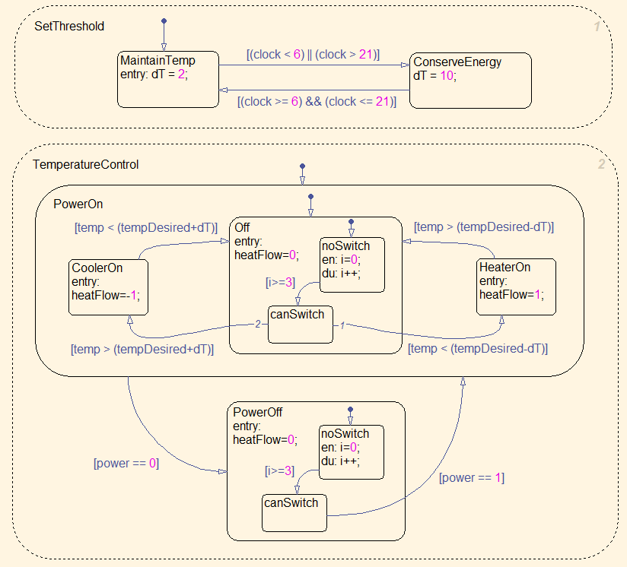

Slide 45
Summary
Flow graph
State machine
  Simple state machine
  Hierarchical state machine
  Parallel state machine

