Slide 1
嵌入式系统建模与规范
wkmiao@sei.ecnu.edu.cn
数学馆306

Slide 2

教材
Introduction to Embedded System（嵌入式系统）-the Second Edition
--A Cyber-Physical System Approach
Edward Ashford Lee and Seshia

Slide 3
由软件到系统建模的思维转变

Slide 4
建模的本质
用特定的语言或符号，力求直观而精确地刻画软件的预期
功能和行为等特征。
系统控制功能
系统模型
抽象
从现实世界的问题向软件解决方案的转化
做什么
从做什么到怎样做的途径

Slide 5
引入系统工程以后
系统需求分析
系统建模
系统设计
系统实现
系统级验证评测
发布与维护

Slide 6
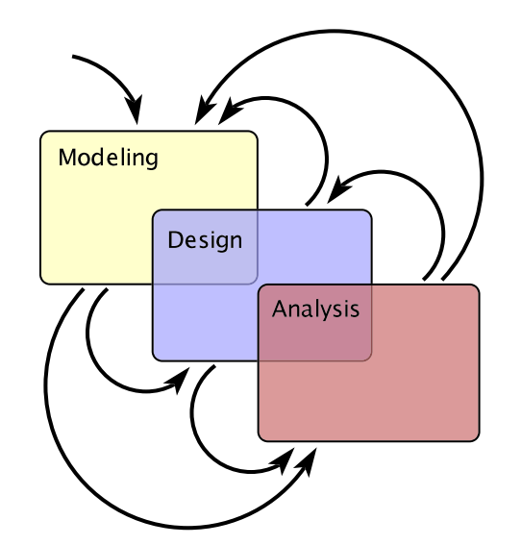
问题理解
建模——设计——分析
反映了人们对于系统要解决问题的认识过程
建模
what：系统做什么
设计
how：系统怎么做
分析
why：为什么系统是我们要的
对系统有深入了解

Slide 7
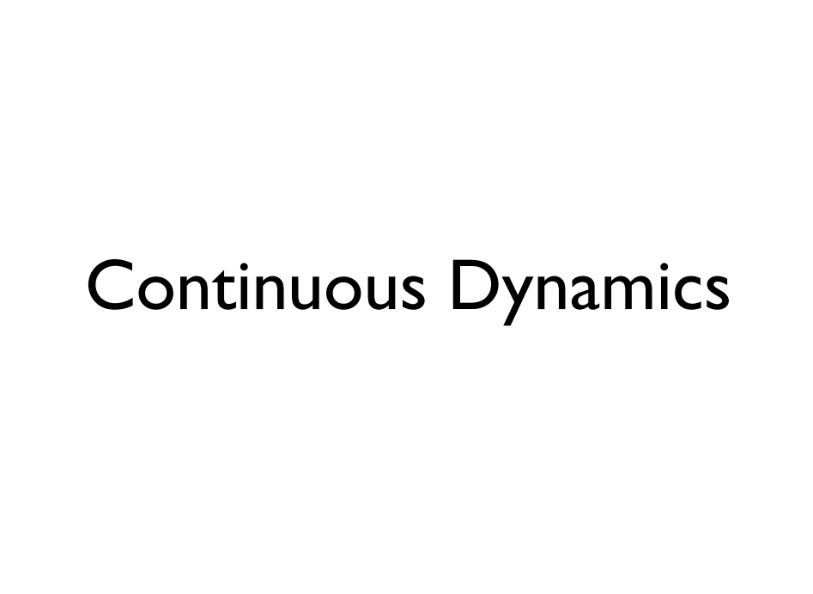

Slide 8
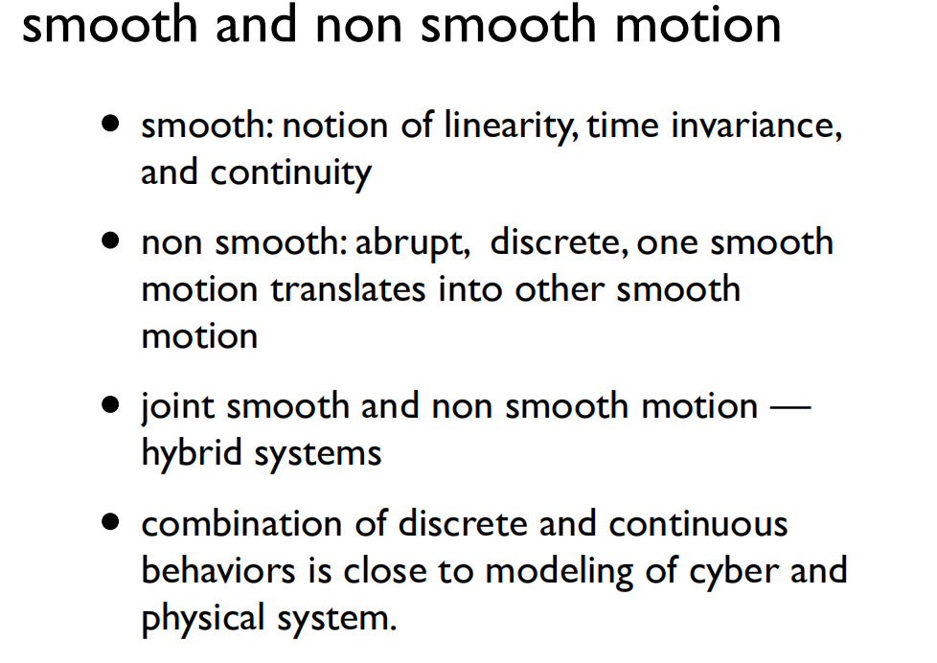

Slide 9
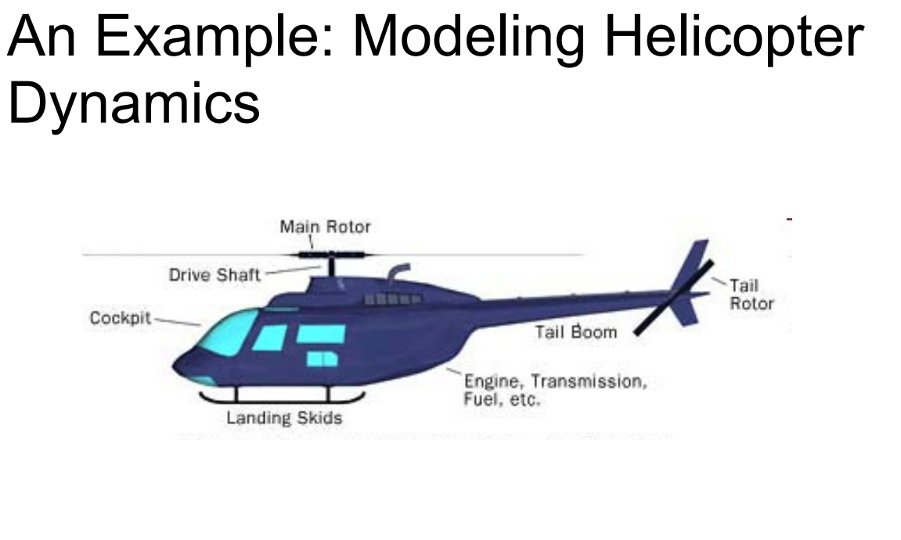

Slide 10
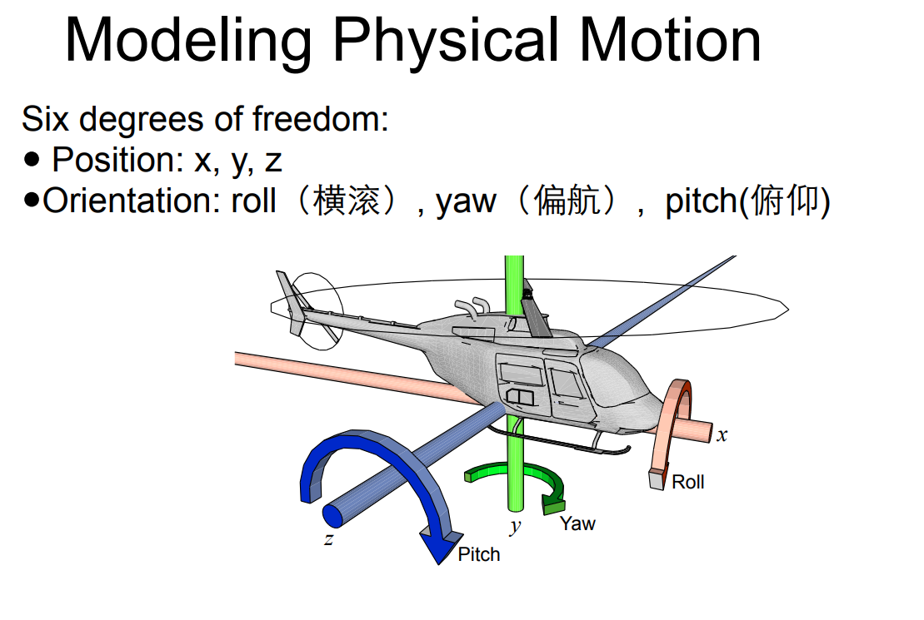

Slide 11
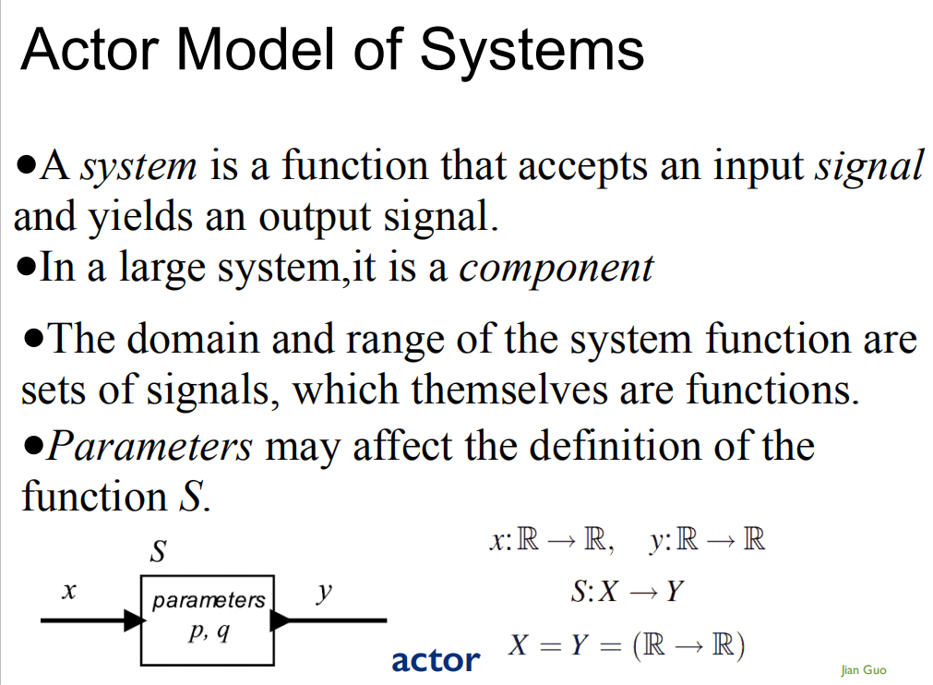

Slide 12
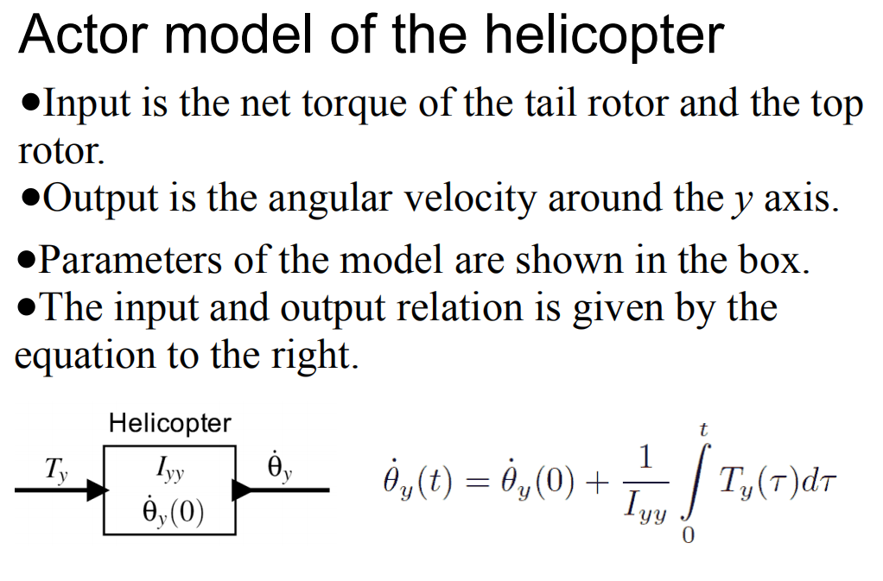

Slide 13
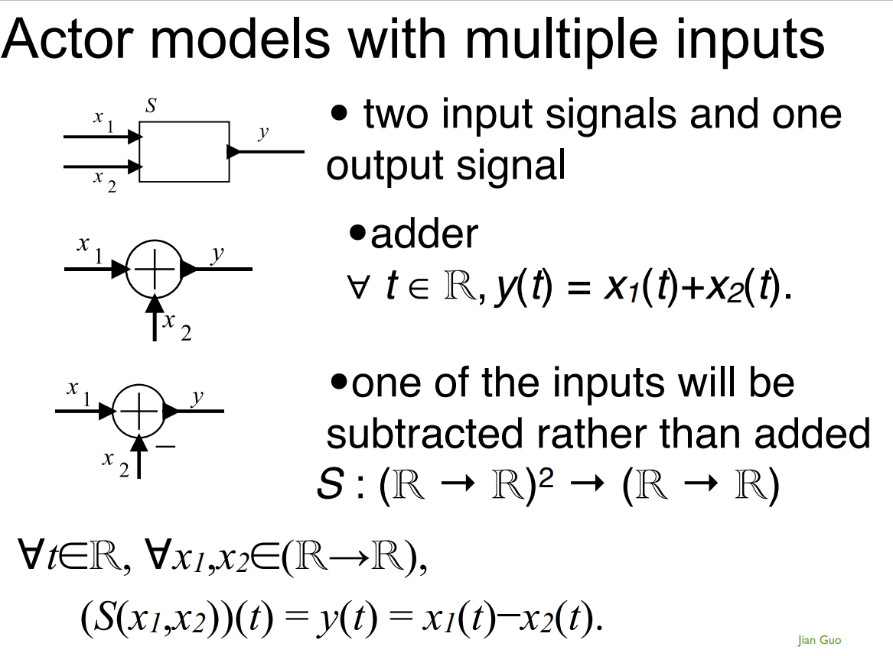

Slide 14
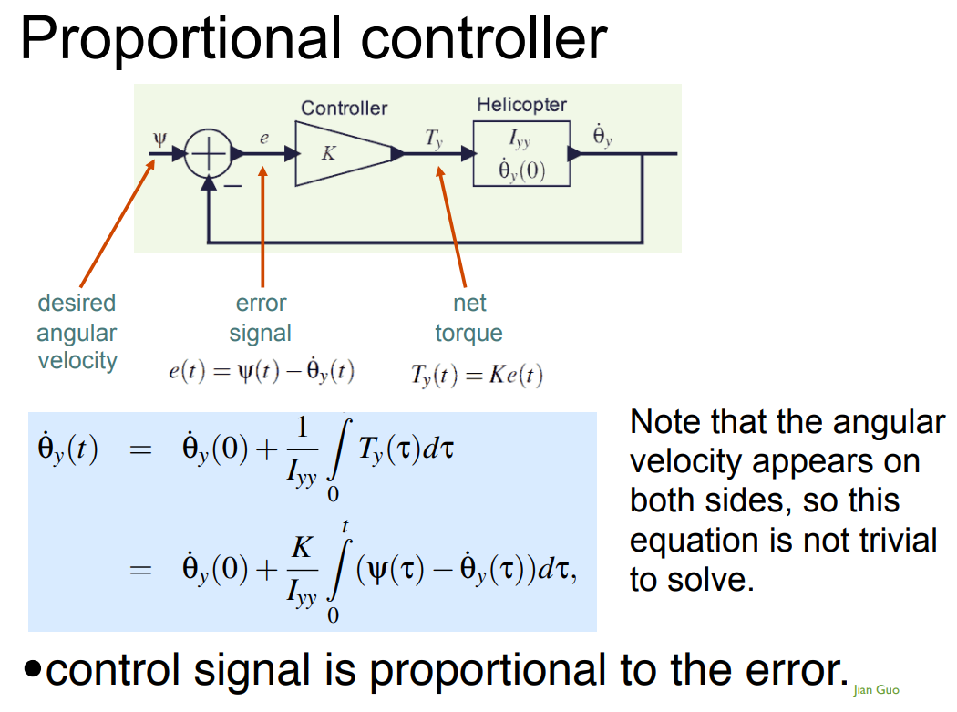

Slide 15
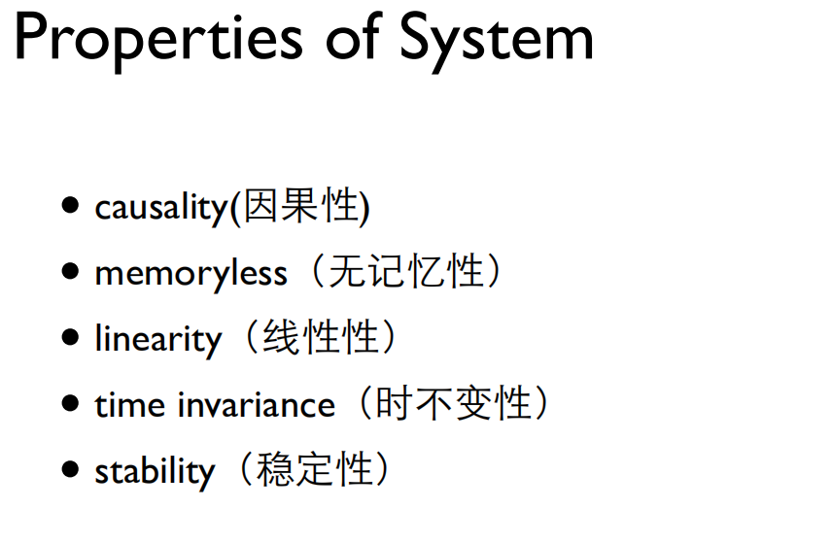

Slide 16


y(n)=nx(n)是否满足线性？
y(t)=sin[x(t)]是否满足时不变性？

Slide 17
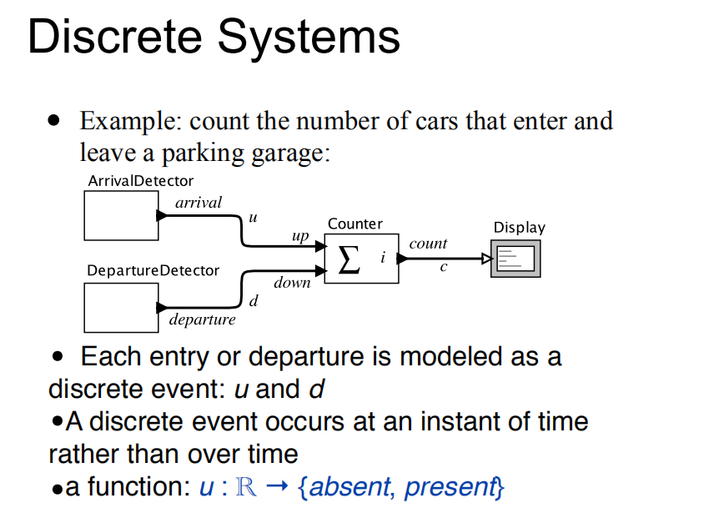

Slide 18
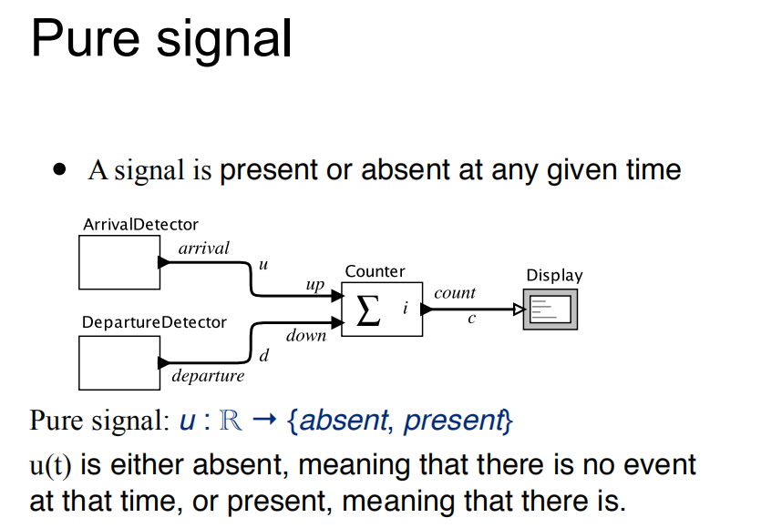

Slide 19
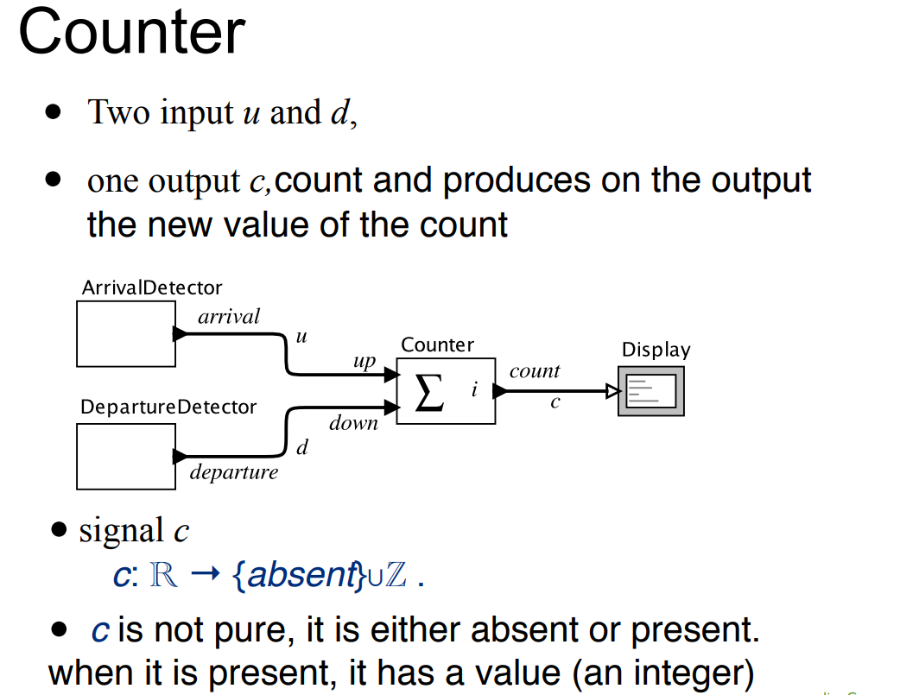

Slide 20
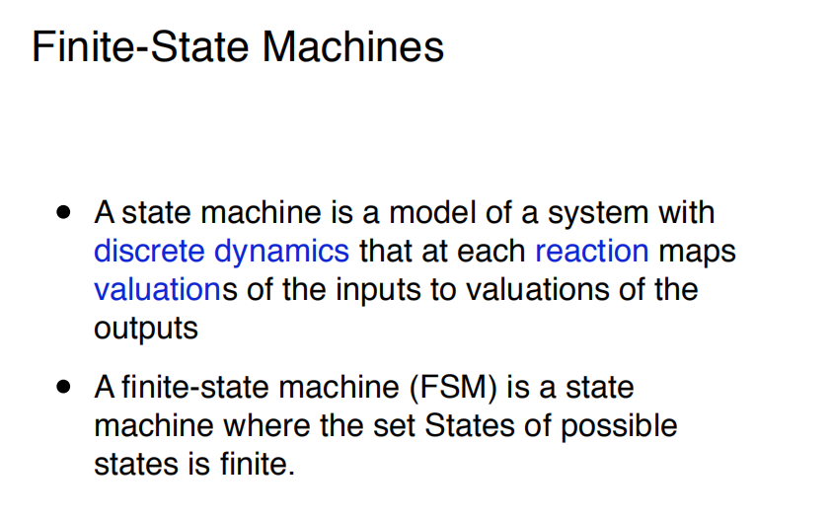

Slide 21
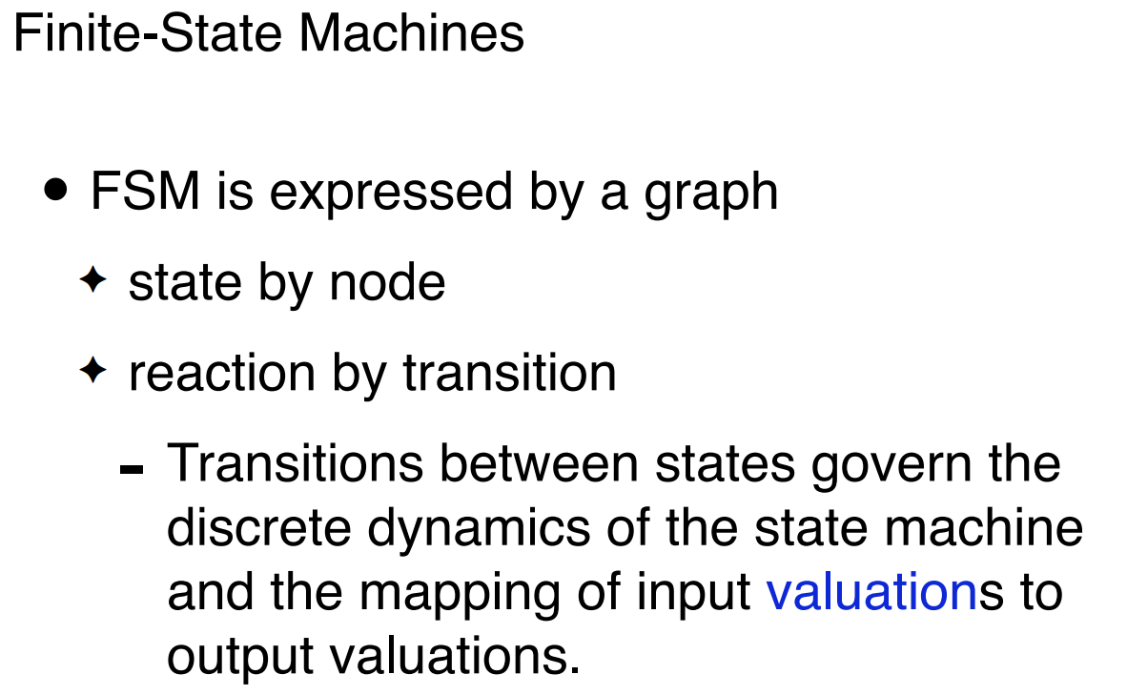

Slide 22
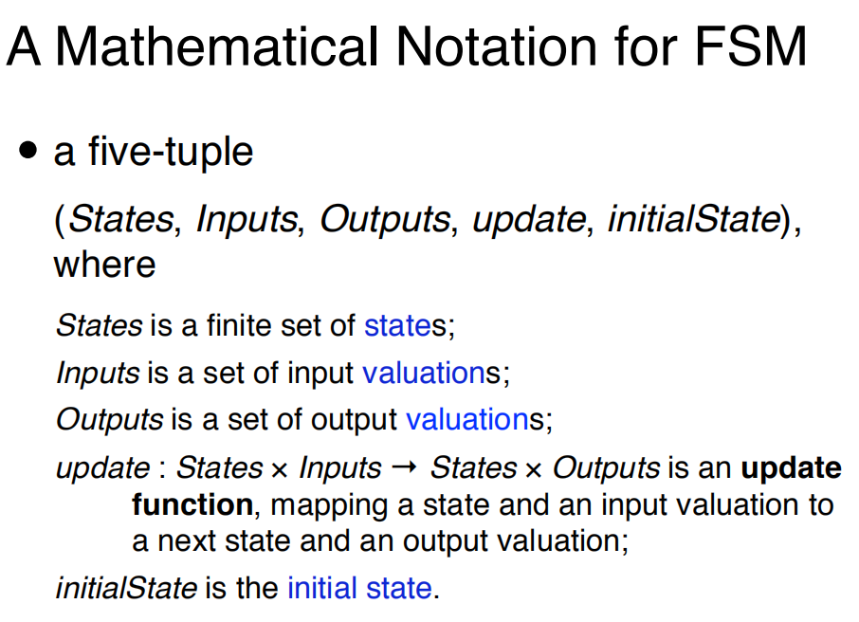

Slide 23
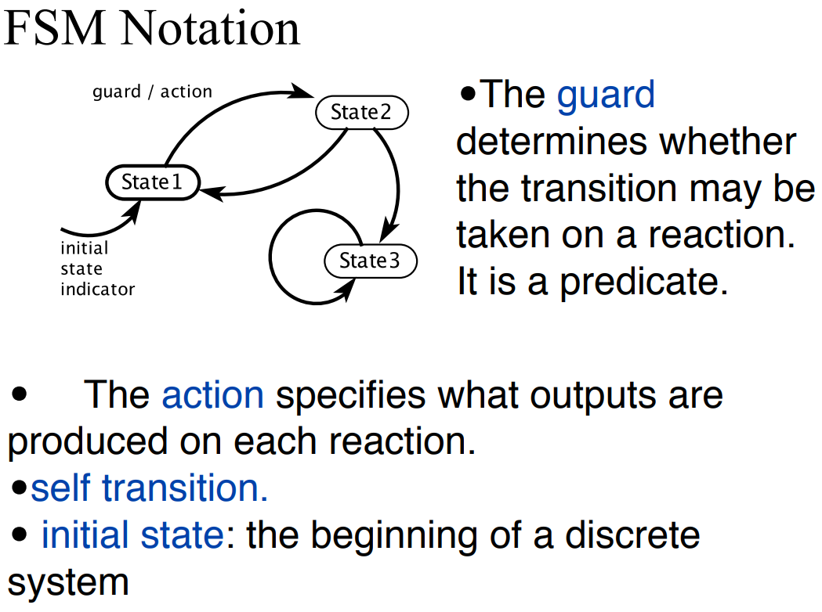

Slide 24
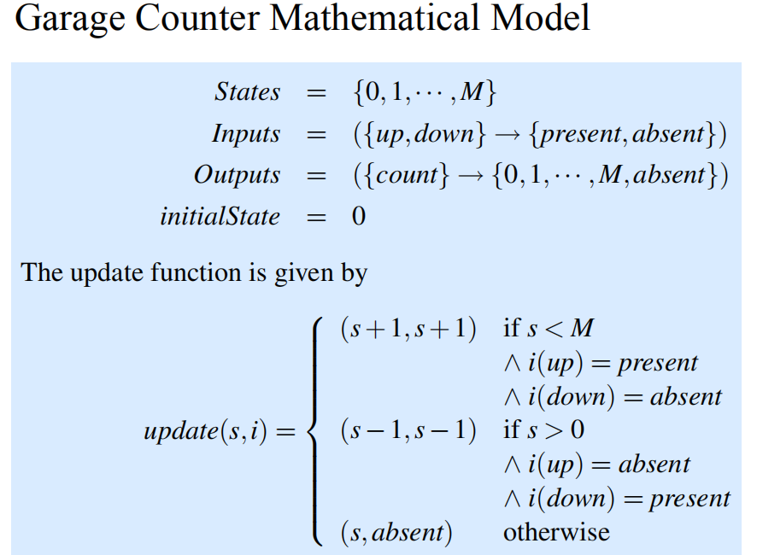

Slide 25
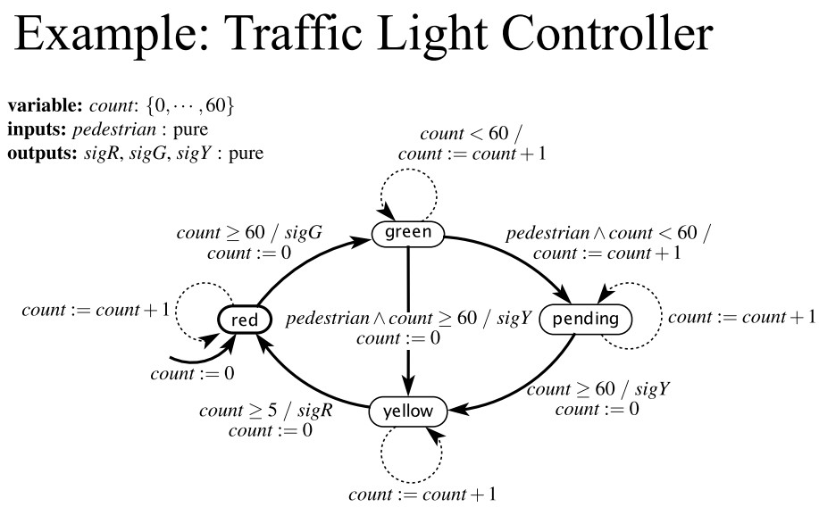

Slide 26
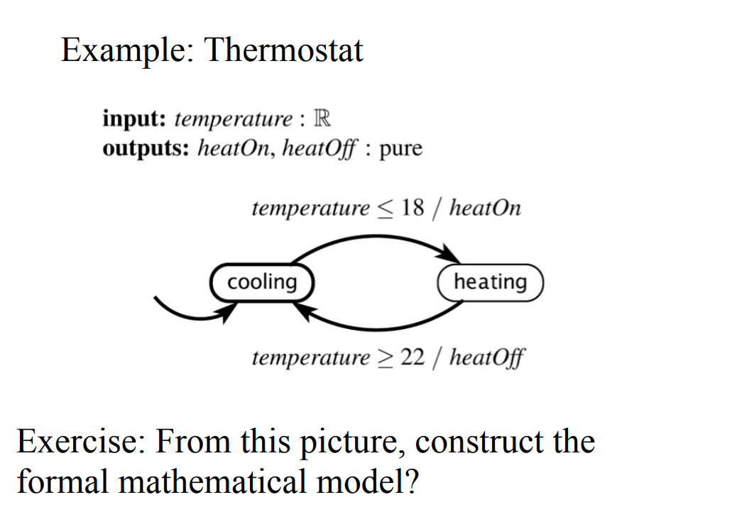

Slide 27
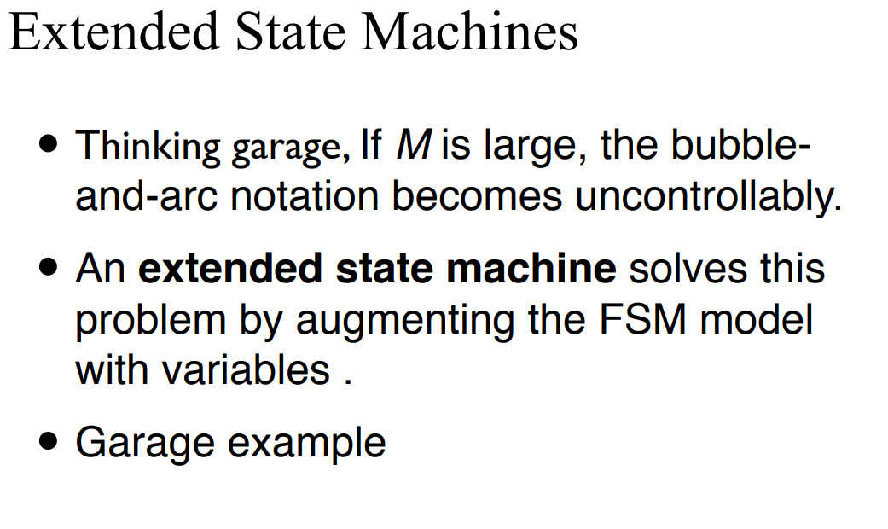

Slide 28
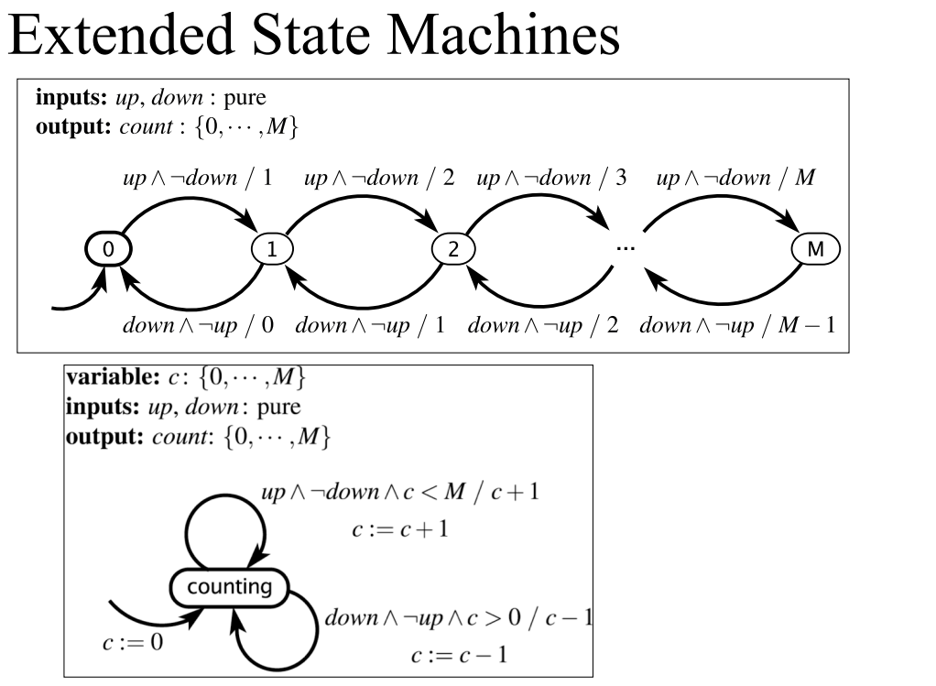

Slide 29
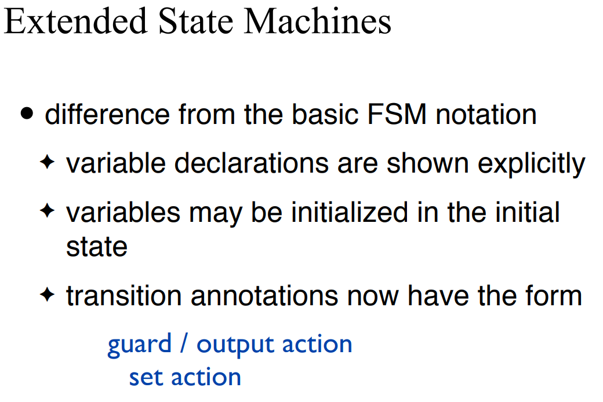

Slide 30
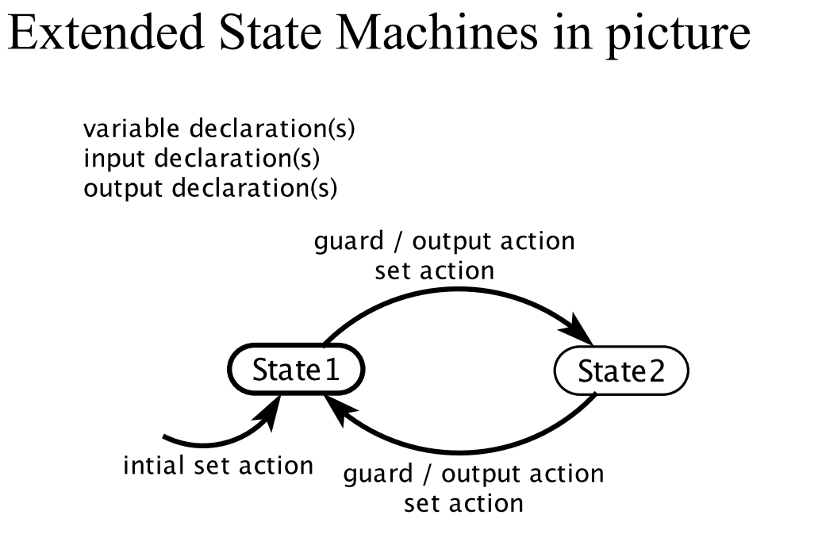

Slide 31
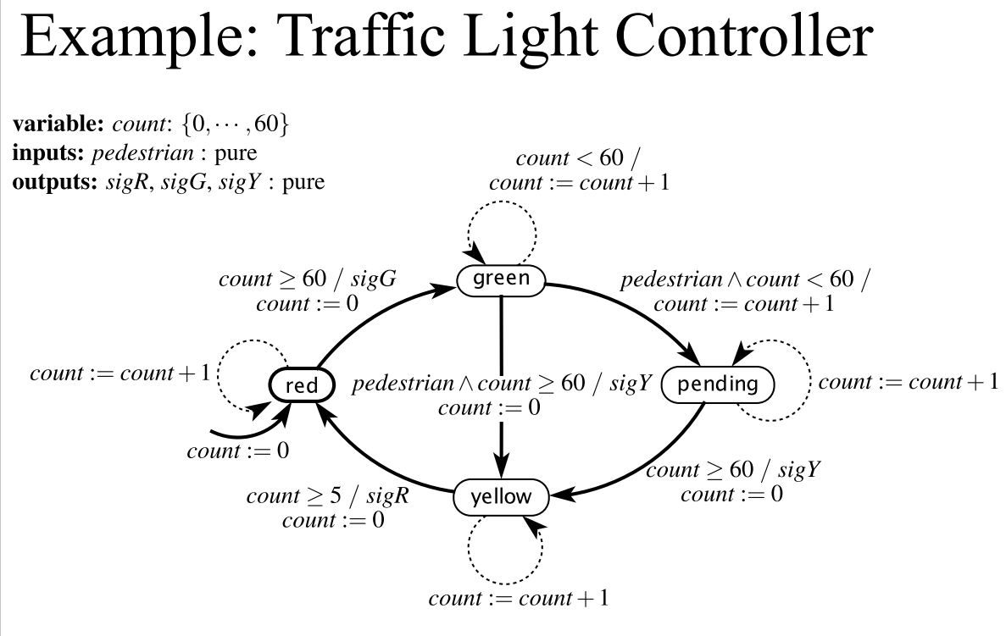

Slide 32
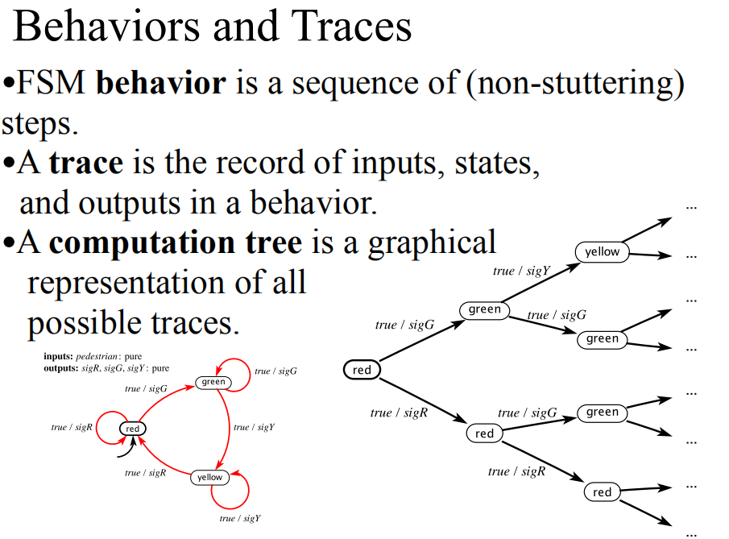

Slide 33
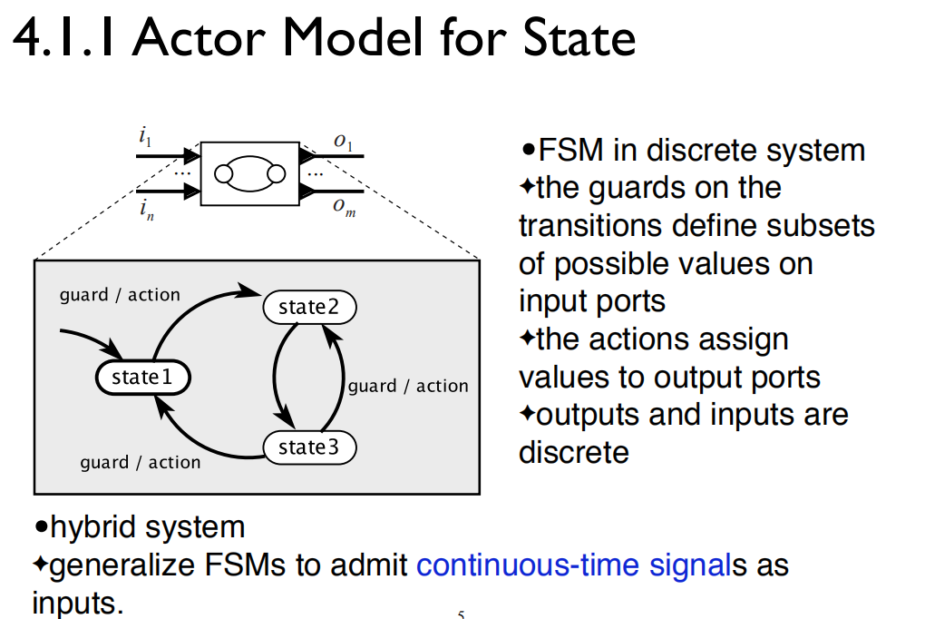

Slide 34
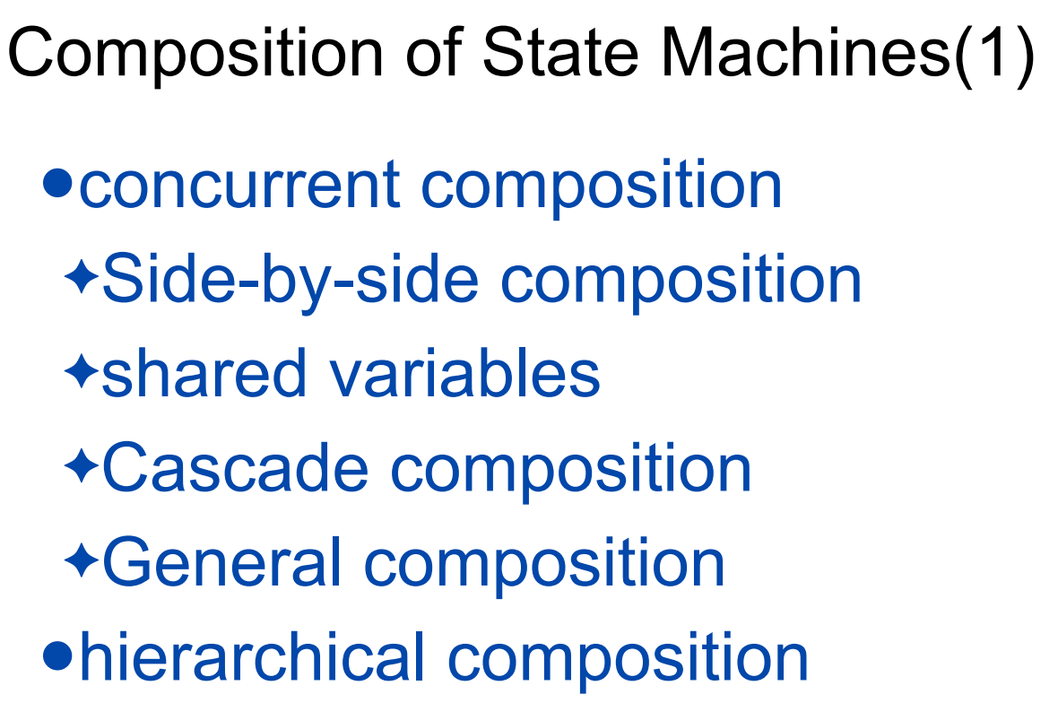

Slide 35
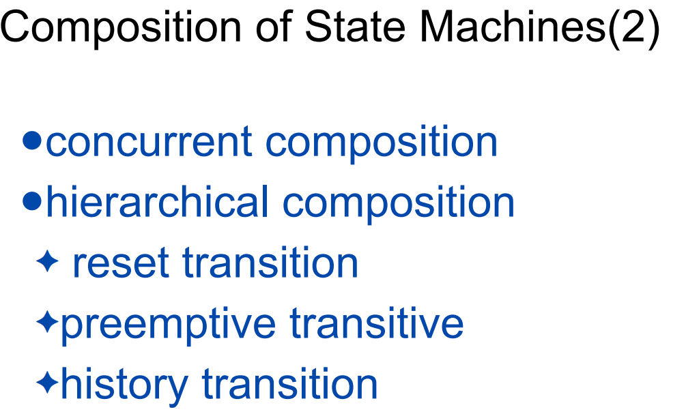

Slide 36
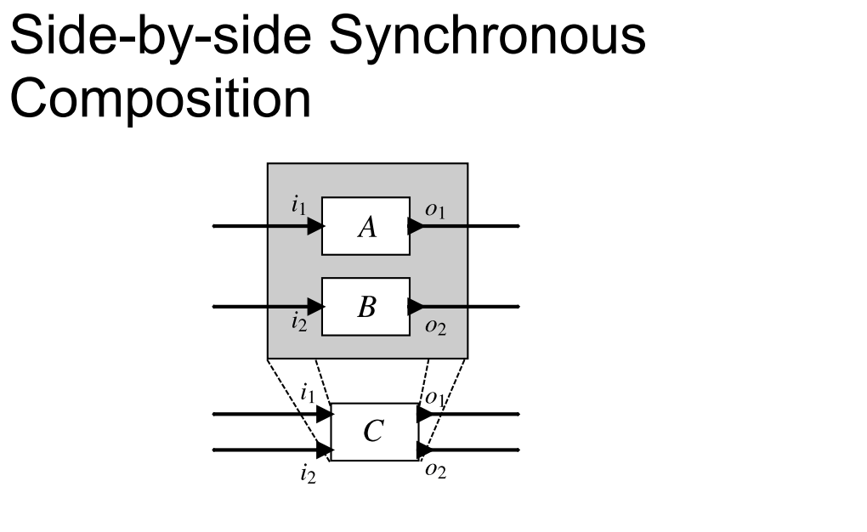

Slide 37
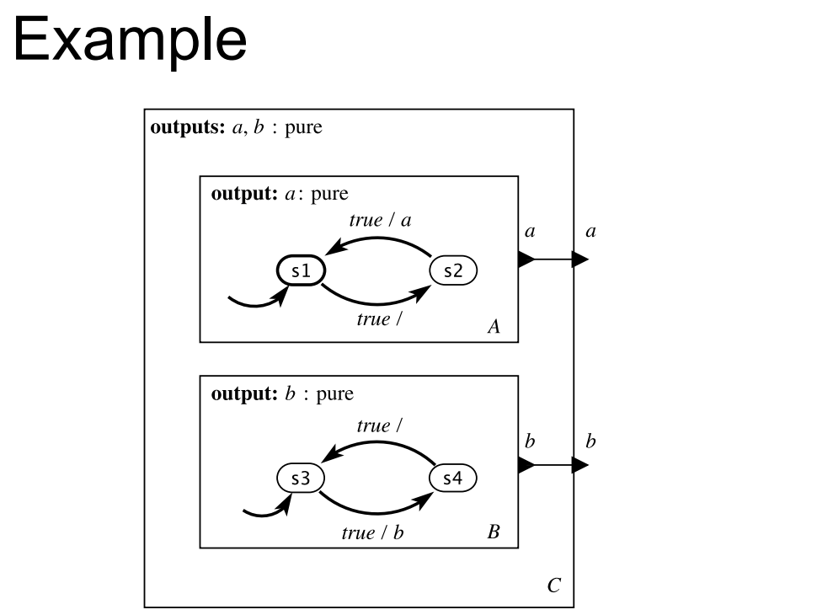

Slide 38
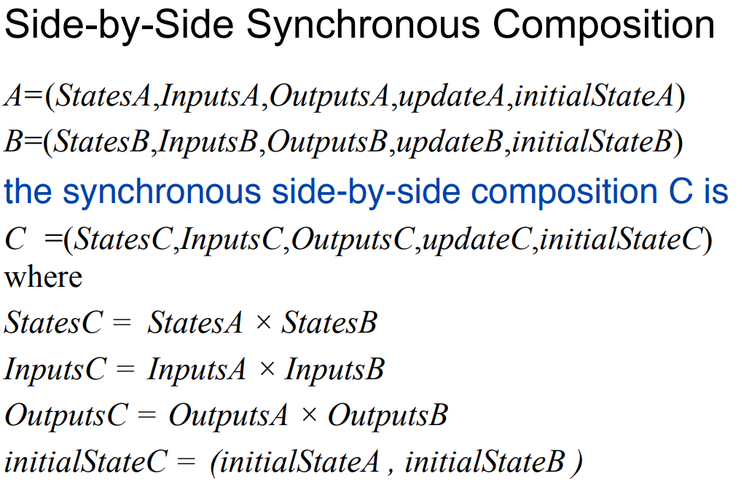

Slide 39
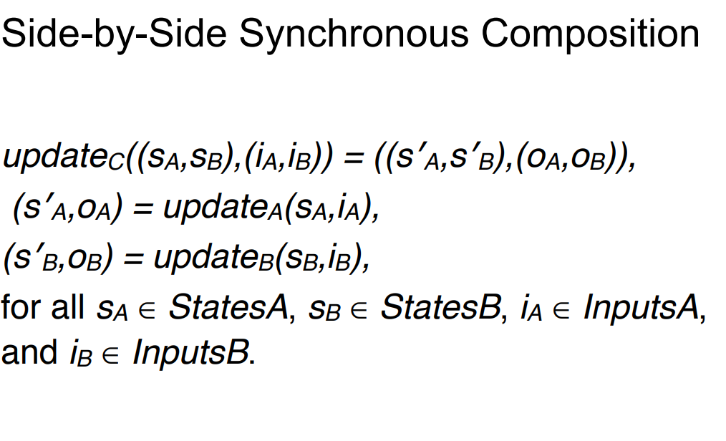

Slide 40
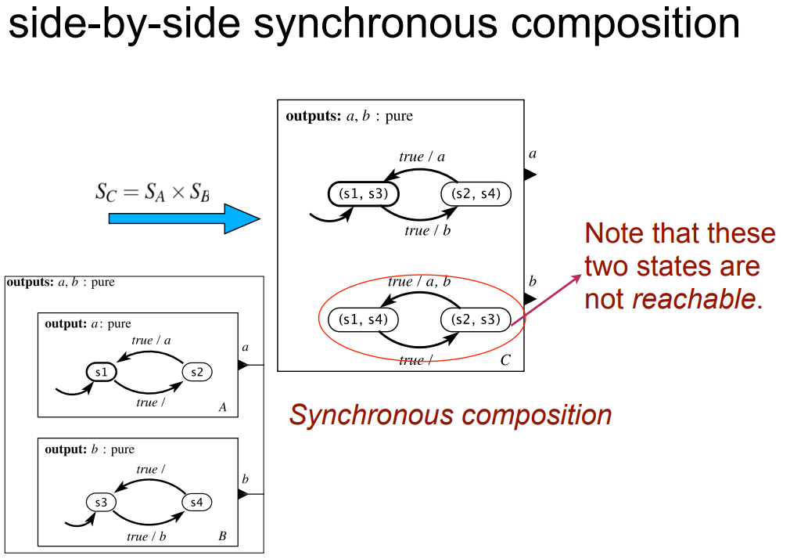

Slide 41
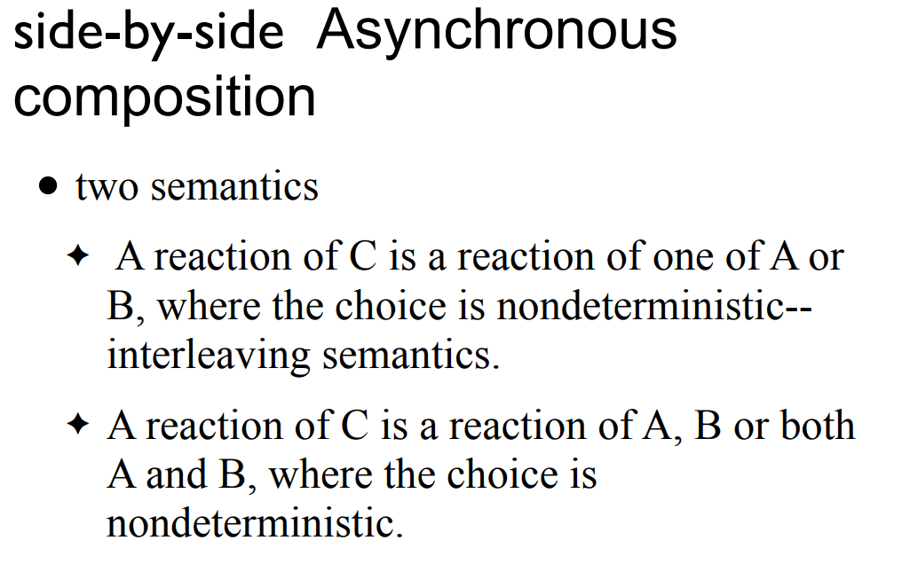

Slide 42
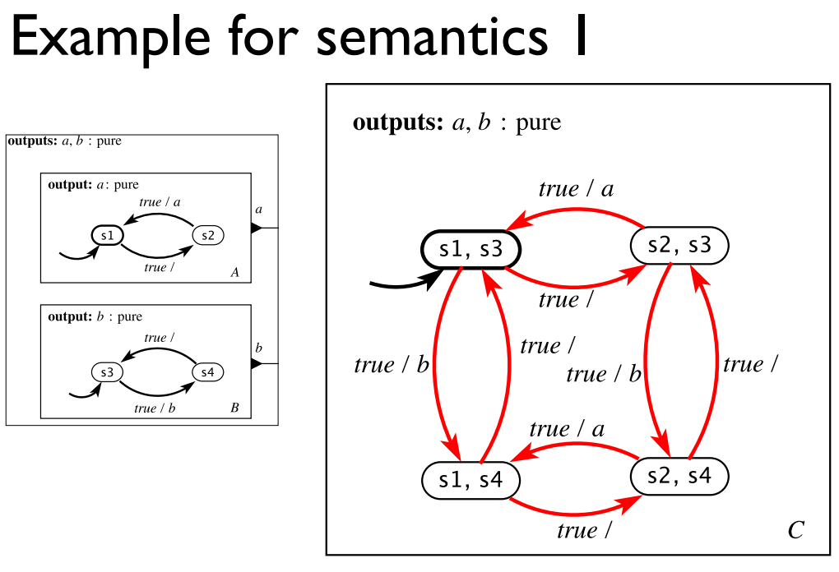

Slide 43
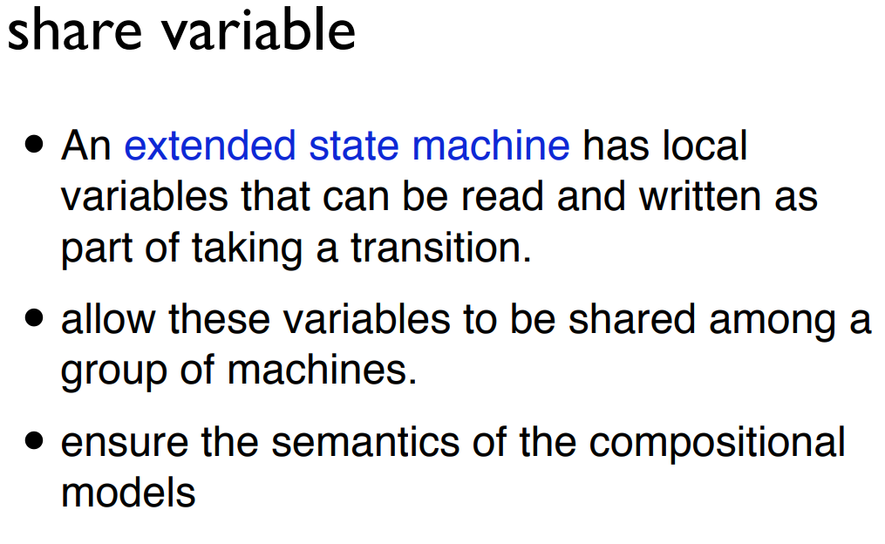

Slide 44
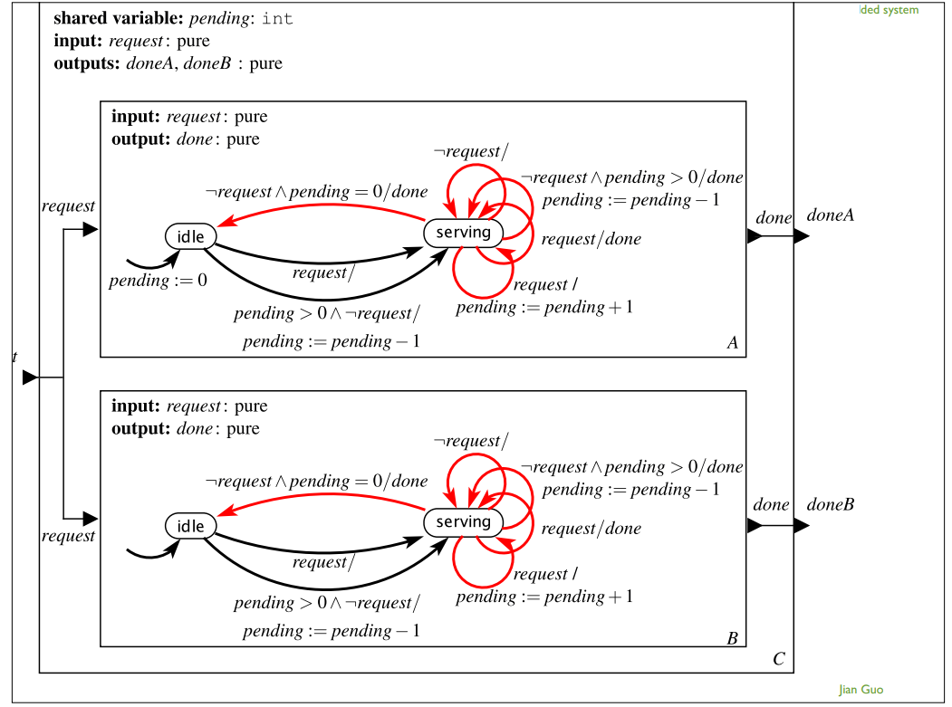

Slide 45
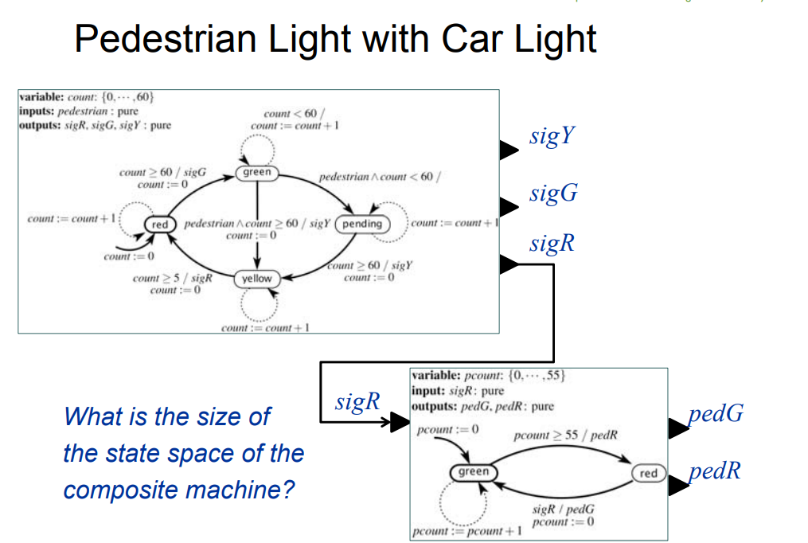

Slide 46
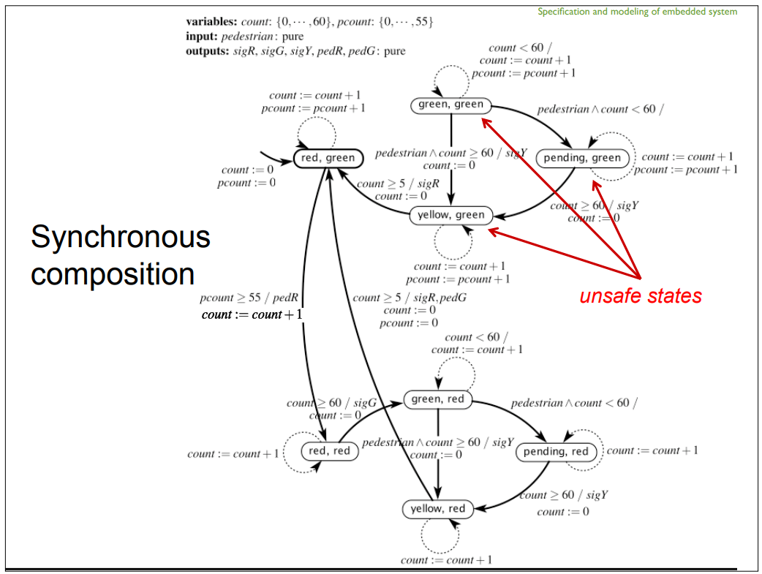

Slide 47
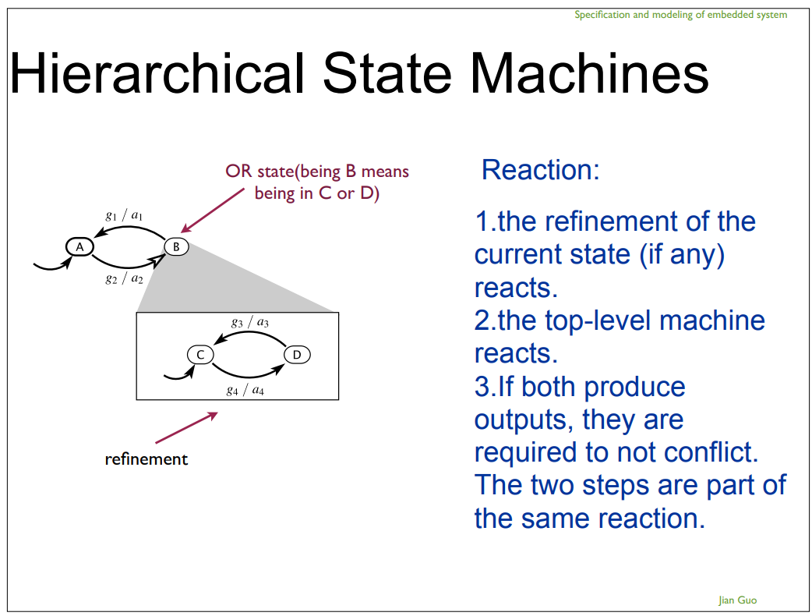

Slide 48
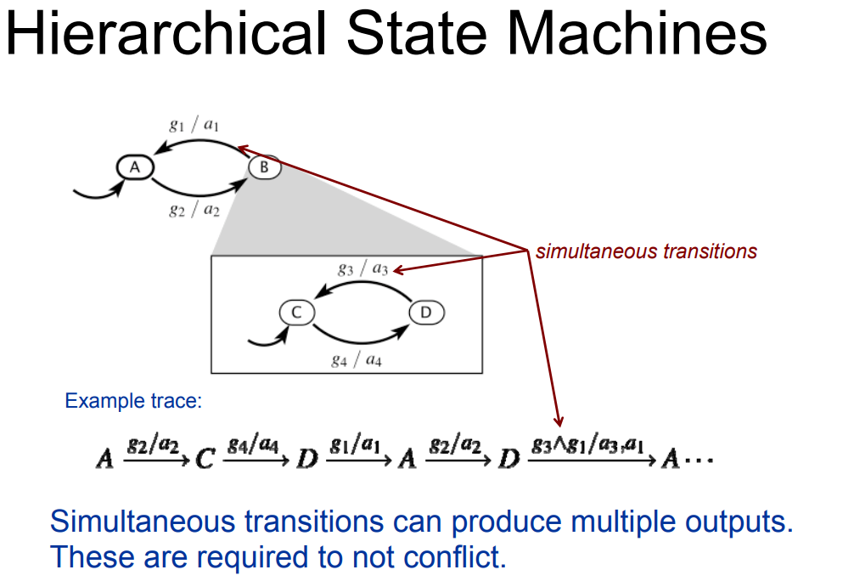

Slide 49

MATLAB/Simulink 与工具箱
MATLAB 在数值分析，特别在数值线性代数。后来出现很多工具箱，它的应用也扩展到其他领域。
1980年美国学者 Cleve Moler 等人推出的交互式MATLAB 语言逐渐受到了控制界研究者的普遍重视
图形交互式的模型输入计算机仿真环境 Simulink 的出现为MATLAB应用的进一步推广起到了积极性的推动作用。
现在，MATLAB 已经风靡了全世界，成为控制系统仿真与计算机辅助设计领域最普及也是最受欢迎的首选计算机语言。

Slide 50
MATLAB
早期的 MATLAB 的功能十分简单，当时它作为免费软件出现以来，还是吸引了大批的使用者。
前期用Fortran编写的
Cleve Moler 和 John Little 等人于1984年成立了一个名为 The MathWorks 的 公司
1984年，完全用C语言改写
The MathWorks 公司于1992 年推出了具有划时代意义的 MATLAB 4.0版本。----支持在windows进行界面编写

Slide 51
MATLAB foundation

Slide 52
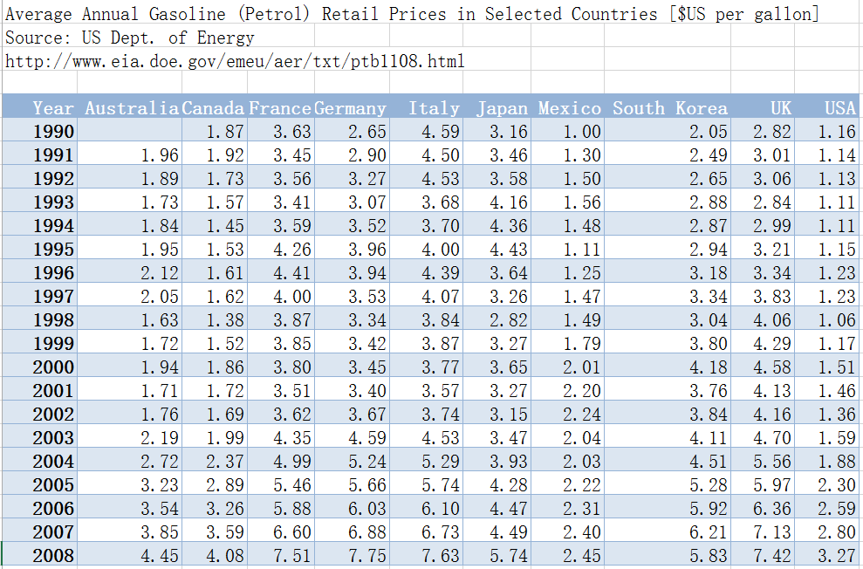
Example: Gas Price Data

Slide 53
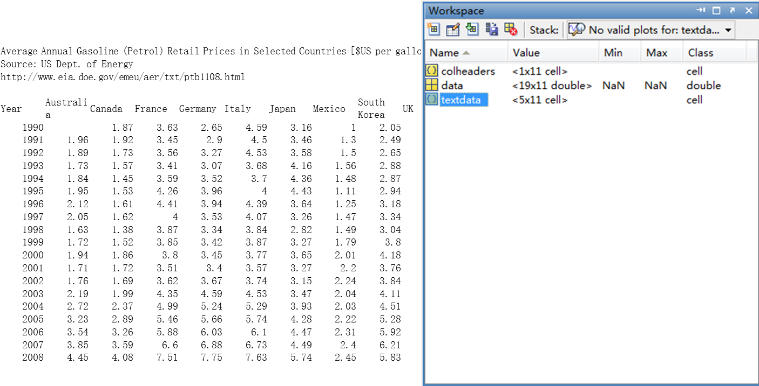
The Import Wizard
Chose File→Import Data

Slide 54
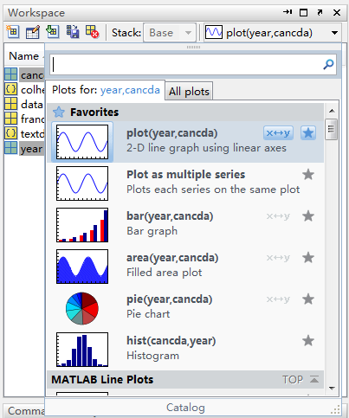
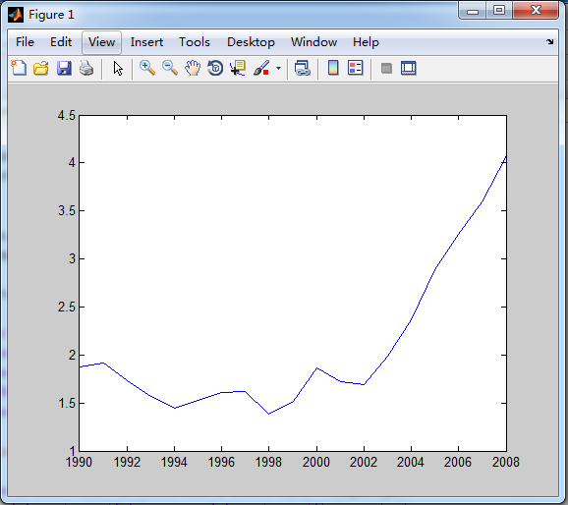
Plot and Data
creating appropriate visualizations of data
offer many plotting routine for bother vector and matrix data
Ctrl+选择canada
第一次选择

Slide 55
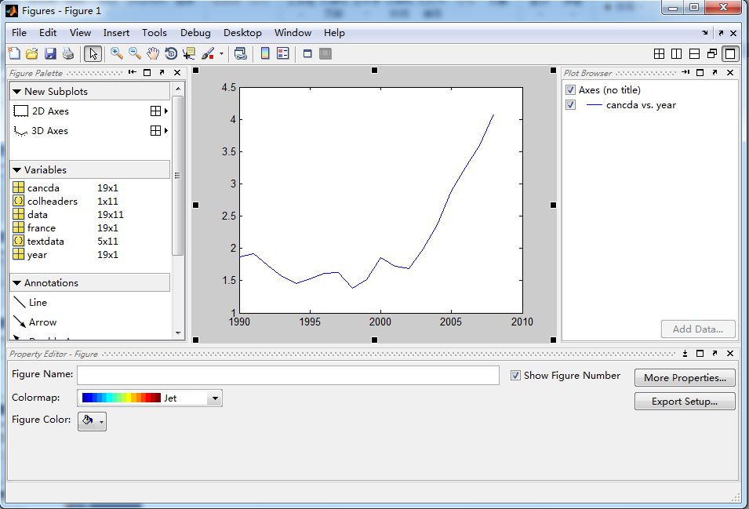
Plot Tools
Add axes to create subplots within the figure window
Drag and drop variable from the base workspace into any axes
Add a variety of annotations of a plot

Slide 56
Matrix Operations
As with vectors, arithmetic operations on matrices are defined in their usual mathematical sense.
>> C = A + B;
creates a matrix C such that C(k) is A(k) + B(k).
>> C = k * A;
>> C = A + k;
Mathematically, matrix multiplication of the form
>> C = A * B
requires that the inner dimensions --- the number of columns in A and the number of rows in B --- agree. If A is m-by-n and B is n-by-p, then C will be m-by-p.

Slide 57
Cell Arrays
MATLAB arrays must always have the same number of columns in each row( and vice versa)
A single string is treated as a 1-by-n array of characters.
>> x = [‘hello’; ‘ciao’; ‘guten tag’]----- error
Vertical concatenation of strings fails unless they are all the same length.
To concatenate elements into a cell array, use curly braces ({ }) instead of square brackets:
>> x = {‘hello’; ‘ciao’; ‘guten tag’}----correct, 3*1,each container has 1*n.
>> y = {pi, []; ‘foo’, 42; ones(2), eye(3)}
>> z = {x, y}
>> z = {x; y}
>> z = [x, y] % ok
>> z = [x; y] % no! dimension mismatch

Slide 58
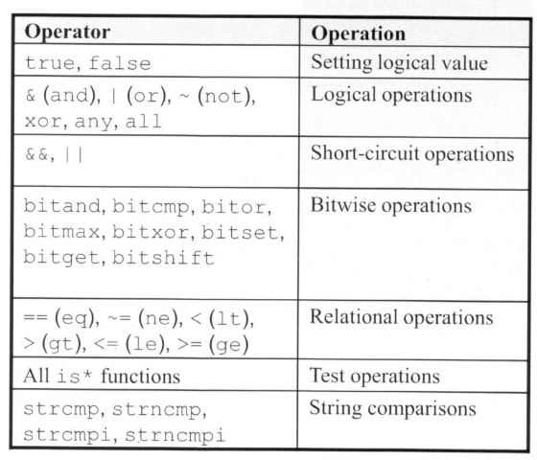
Logical Functions

Slide 59
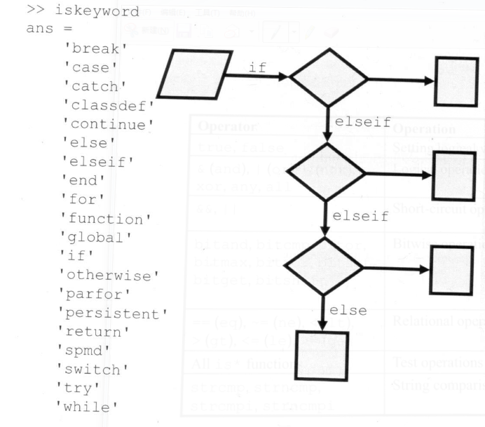
Programming Keywords

Slide 60
MATLAB 语言函数的 基本结构
Function[返回变量列表]=函数名（输入变量列表）
注释说明语句段，由%引导
输入、返回变量格式的检测
函数体语句
nargin， nargout：Matlab保留变量，只要进入函数就自动生成这2个变量，分别表示输入、输出参数的个数
varargin：所有输入变量列表；
varargout：所有输出变量列表；

Slide 61
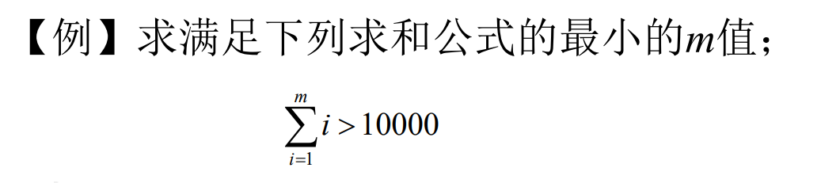


Slide 62
【例】编写一个函数生成n×m阶的Hilbert矩阵
Hilbert矩阵：
若只给出一个输入参数，则会自动生成一个方阵
在函数中给出合适的帮助信息
检测输入和返回变量的个数
第i行第j列的元素值为：

Slide 63


Slide 64

模块库简介—Commonly Used blocks
将最常用的基本模块集中在一起形成的。

Slide 65

模块库简介—Sinks
接收模块库
模块与子系统输出: Out1
数据观察器:Terminator, To File, To Workspace
仿真终止模块:其余的

Slide 66

Modeling Comparisons
blocks are in the Logic and Bit Operation library
Simplelogic.mdl
Notes:
对于scope可以分几个窗口，通过selector选择每个窗口要显示的数据。

Slide 67

Modeling Decision Statements
blocks are in the Signal Routing library
Switch模块的第二个信号与阈值的比较，若真，执行上面的赋值为3，否则赋值为-3；
Simpleswitch.mdl

Slide 68
Stateflow入门介绍
Stateflow能够做：
建立复杂的判定流，建立流程图
基于有限状态机理论对复杂的响应型系统进行可视化建模与仿真
设计和开发复杂的监控逻辑
在Stateflow框图中同时使用流程图和状态转移图表示法
自动地从模型中生成整数或浮点数代码
可随时方便修改设计，评估结果，验证系统性能

Slide 69
stateflow基本概念
有限状态机
状态
转移
事件
条件
动作
数据对象
连接节点
缺省转移

Slide 70
Flow Graph（流程图）
State machine（状态机）

Slide 71

Junction(节点) , transition, condition and action
Example：checkData.mdl
if failflag
count=1
end
if count>0
out=0
if count==5
count=0
else
count=count+1
end
else
out=data
end

Slide 72

State labeling syntax
exit actions are executed when a state is active and a transition out of the state occurs.
during actions are executed when a state is active, an event occurs, and no valid transition to another state is available.

Slide 73

Semantics of a state transition
If we start A and cond1 is true and cond2 is false , in what order are the actions executed?
act4,act5,act1,act6,act2
注意during和exit的语义

Slide 74

Behavior of an inner flow graph example：innerflow.mdl

Slide 75

Semantics of an inner flow graph
First entry action, then inner flow graph
act1 before act3
act2 before act4

Slide 76

Semantics of a multilevel state transition
Assume that A and A1 are currently active. When cond1 is true, and cond2 is false. How to execute?
act1, actA4, actA2,actB2…
（A child state must exit if its parent state becomes inactive.）

Slide 77
Example: climate control
input: T_des, T, power
Output: heat input
Parameters: dT
If(power==1)
heater maintains normal operation
else if (power=0)
heat input=0;
end

Slide 78


Slide 79



Creating superstates and substates
Resize the superstate such that all its substates can fit within its boundary
Click right, select: Group&Subchart->Grouped
SM
ungrouped
Grouped
states

Slide 80

Designating default substates
Default states should be define at every level of hierarchy
You can override default substates using supertransitions that go directly to a substate.

Slide 81


Creating a subchart
Right-click the state to open its context menu
Select Group&Subchart→Subcharted
Example: acHierarchical.mdl

Slide 82

Chart-level and State-level Data
In the climate control state machine, add logic to prevents the system from excessive switching.
Example: acDebouncerStart.mdl （搭建实现）

Slide 83
The concepts of parallelism
State:
exclusive : only one active child state at a time
With solid boundaries
parallel: all its child states active as long as it is active.
Modeling concurrency and interdependency in a system
With dotted boundaries

Slide 84
The concepts of parallelism(2)
The term parallel is used to indicate that multiple states are active at one time, not that multiple state execute at the same time
Parallel state execute sequentially based on their assigned execution order
Upper right corner of the state

Slide 85

Execution
order

Slide 86

multiprocessing state machine example: checkDataParallel.mdl（搭建）
Failure
determination
Mode logic

Slide 87
Example:climate control
Can modify the acceptable temperature thresholds depending on the time of day
At night, we want to conserve energy
if (hour<6)||(hour>21)
temperature threshold is T_des+/-10
Else
temperature threshold is T_des+/-2
end

Slide 88


