Slide 1
Stateflow

Slide 2
Stateflow入门介绍
Stateflow是一个交互式设计工具，用来对复杂的事件驱动模型系统进行建模与仿真。
与Simulink和MATLAB集成，Stateflow将复杂的控制和监督逻辑有效地结合到Simulink模型。
提供了一个设计嵌入式系统的完美解决方案。

Slide 3
Stateflow入门介绍
Stateflow能够做：
建立复杂的判定流，建立流程图
基于有限状态机理论对复杂的响应型系统进行可视化建模与仿真
设计和开发复杂的监控逻辑
在Stateflow框图中同时使用流程图和状态转移图表示法
自动地从模型中生成整数或浮点数代码
可随时方便修改设计，评估结果，验证系统性能

Slide 4
stateflow基本概念
有限元状态机
状态
转移
事件
条件
动作
数据对象
连接节点
缺省转移

Slide 5
Flow Graph（流程图）
State machine（状态机）

Slide 6
Modeling complex logic flow

Slide 7
What is a flow graph
A flow graph is a chain of logical patterns that implement a series of decision flows
Implement sequential, conditional and iterative flow

Slide 8
An example of a flow graph
Two input: data, failFlag
One output: out
The value of out should be set to data as long as no failure has occurred(failFlag=0)
When failure occurs(failFlag=1), the next five values of out should be 0.

Slide 9
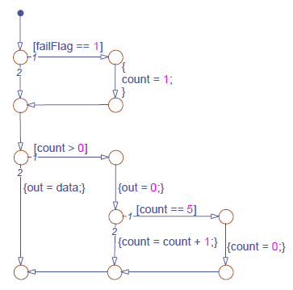
Junction(节点) , transition, condition and action
if failflag
coungter=1
end
if counter>0
out=0
if counter==5
counter=0
else
counter=counter+1
end
else
out=data
end

Slide 10
Execution of a flow graph
Begin from a default transition and stop at a terminating junction
Conditions govern the selection of a execution
Action carries out the consequences of the decision.

Slide 11
Behaviors of a flow graph
Start from a default transition
Test individual transitions one at a time from each junction based on the indicated priority.
Proceeds from one junction to the next along the search path once a valid transition is found.
Executes actions that are associated with the valid transition once the transition is qualified
Stop at a terminating junction.

Slide 12
Create a flow graph
Implement a sequence of conditional actions governed by
  Decisional constructs
  Iterative constructs
  Nested decisional and iterative construct
Model decision flows that do not require history
  System behavior is independent of the previous one
  Decision outcome need not be stored for later use

Slide 13
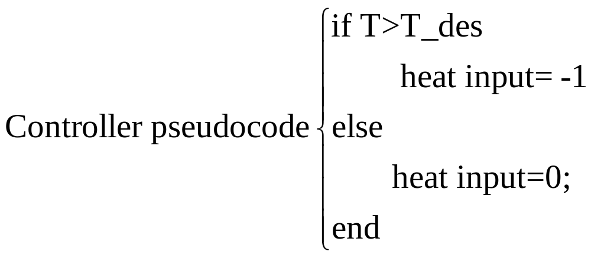
Example: climate control
Input: T_des , T
Output: heat input

Slide 14
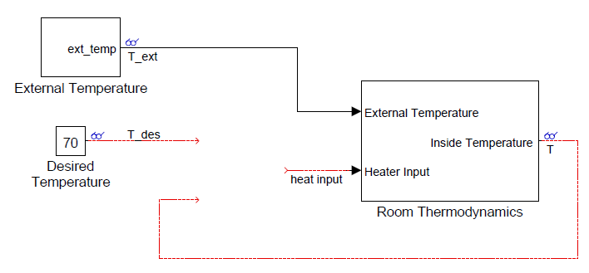
Example: climate control(cont’)

Slide 15
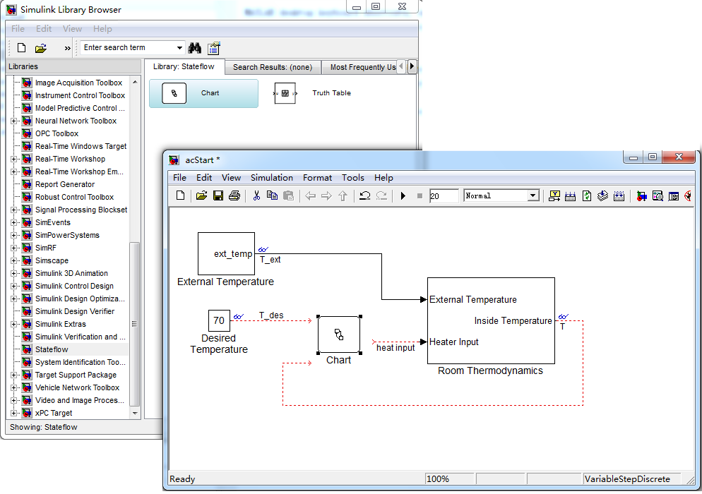
Creating a new chart
Using command to create a new model with a new chart
>>sfnew

Slide 16
Design stateflow diagram
Open the stateflow diagram: double click the chart to open its stateflow diagram editor
Add junctions
Add default transition
Add transition: drag from the border of the flow origin to the border of the flow destination.
Label transition:

Slide 17
Design stateflow diagram(cont’)
Label transition:
  Select the transition,？Appears if the transition is unlabeled.
  Click the ? to enable text editing
  Enter the condition and/or the action statements.
  A generic transition label can consist of
    A comment /**/
    A condition enclosed in []
    A group of condition actions enclosed in {}
  Be expressed in the order as shown above

Slide 18
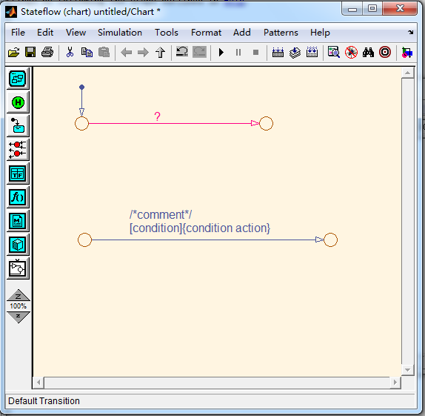

Slide 19
Condition statement syntax
A condition statement must be a boolean expression
  A logical comparison with boolean operator (>,<,>=,<=,==,!=)
  A call to function that returns a boolean value
  Multiple conditions can be combined with logical operator such as &&, ||

Slide 20
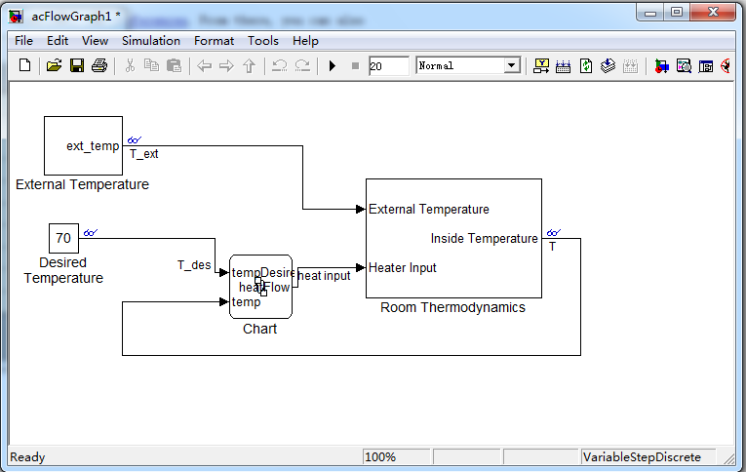
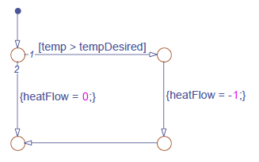
Data in the chart
tem from a simulink signal(chart input)
tempDesired from a Simulink signal (chart input)
heatFlow feeds to a simulink signal(chart output)

Slide 21
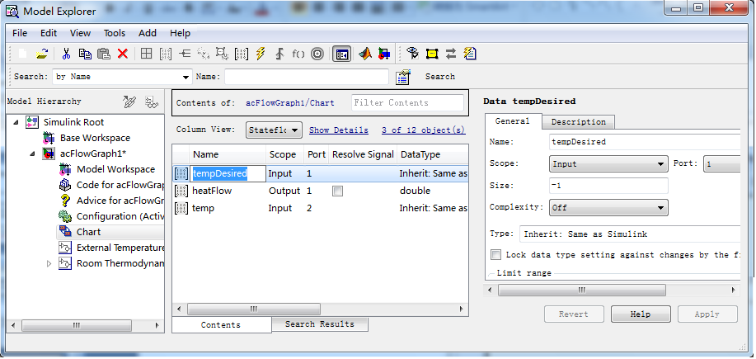
Defining chart I/O data
In your chart
  View→Model Explorer from the Stateflow Editor menu
  Expand the model in the model Hierarchy pane on the left, then select the chart
  Add →Data from the menu to add a variable
  Set the data properties

Slide 22
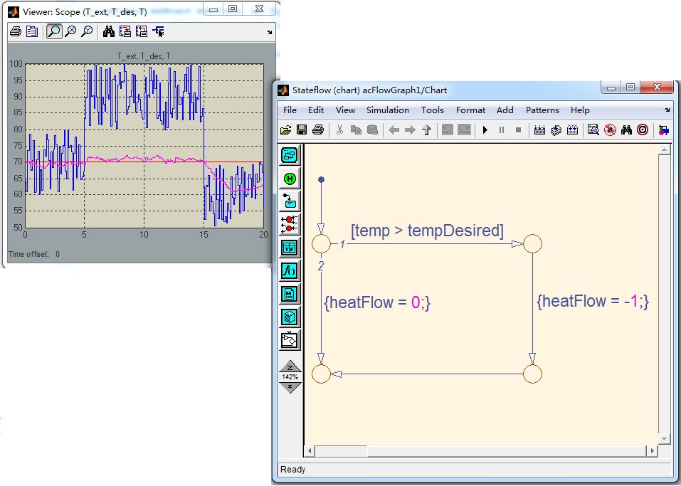
Animating the flow graph

Slide 23
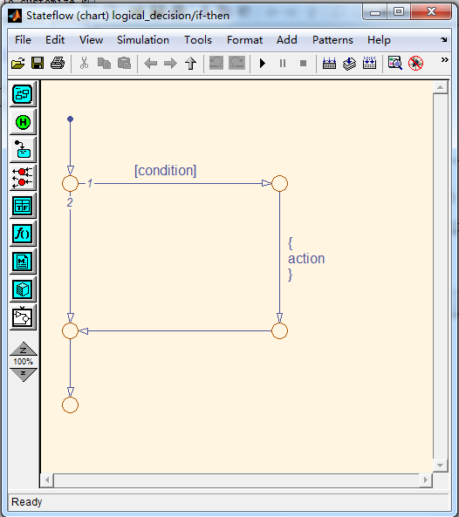
Common decisional patterns(1)
if (condition)
{
action;
}

Slide 24
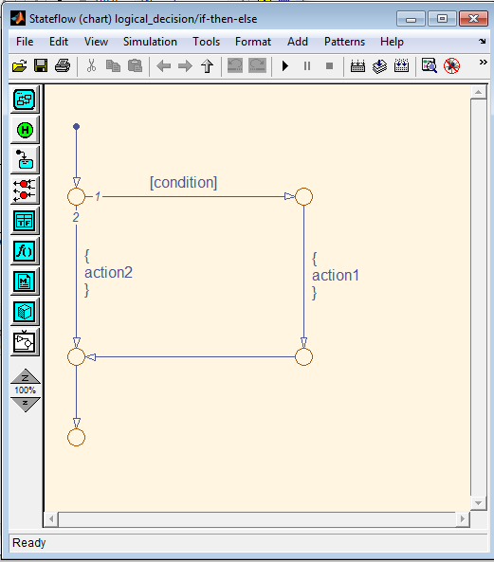
Common decisional patterns(2)
if (condition)
{
action1;
}
else
{
action2;
}

Slide 25
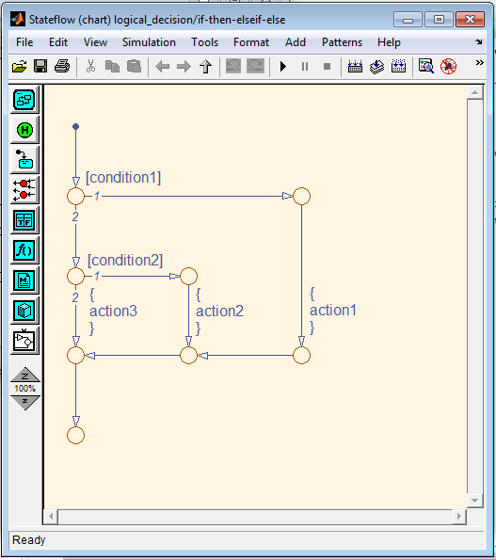
Common decisional patterns(3)
if (condition1)
{ action1;}
else if (condition2)
{action2;}
else
{action3;}

Slide 26
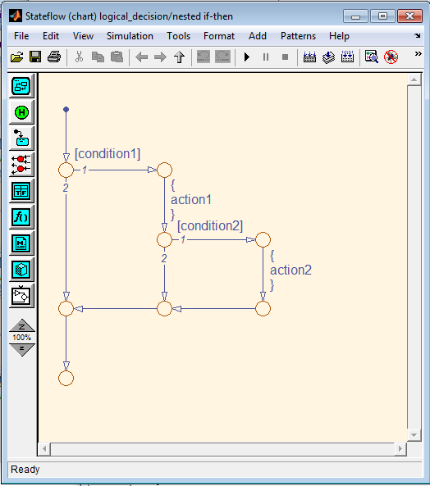
Common decisional patterns(4)
if (condition1)
{ action1;
if (condition2)
{action2;}
}

Slide 27
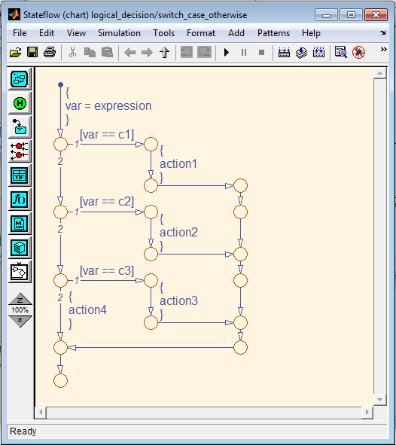
Common decisional patterns(5)
switch(var)
{case c1:
action1;
break;
case c2:
action2;
break;
case c3:
action3;
break;
default:
action4;
}

Slide 28
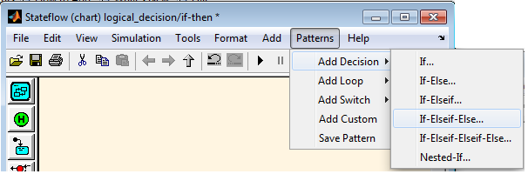
Modeling standard programming constructs
Using the Stateflow Pattern Wizard

Slide 29
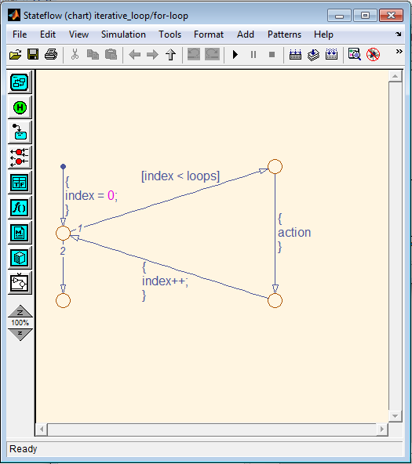
Common loop patterns(1)
for(index=0;index<loops;index++)
{
action;
}

Slide 30
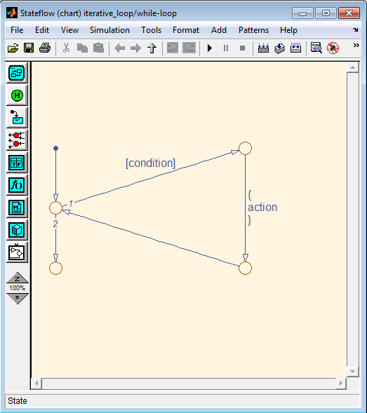
Common loop patterns(2)
while(condition)
{
action;
}

Slide 31
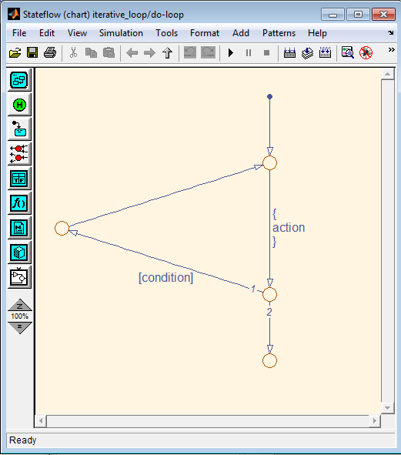
Common loop patterns(3)
do
{
action;
}
while(condition);

Slide 32
Defining chart parameter data
In your chart
  View→Model Explorer
  Expand the model
  Add →Data to add a variable
  Set the data Scope to Parameter and give the name
  Define the parameter value in the MATLAB Workspace
    >> dT=2

Slide 33
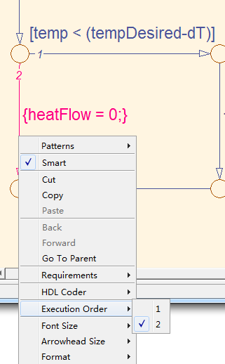
Setting explicit transition priority
  Explicit change: right-click the transition and then select Execution Order
  To activate this feature, in the stateFlow select File→Chart Properties and enable the User specified state/transition execution order option

Slide 34
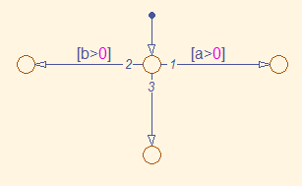
Implicit transition priority
    the more restrictive a transitions is, the higher priority it has
    Two or more transitions guarded with a condition originating from the same junction, set the priorities in the clockwise starting from the 12 o’clock position.
    To activate this feature, in the stateFlow select File→Chart Properties and disable the User specified state/transition execution order option

Slide 35
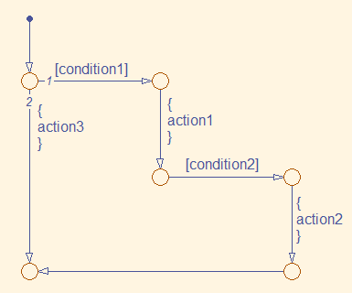
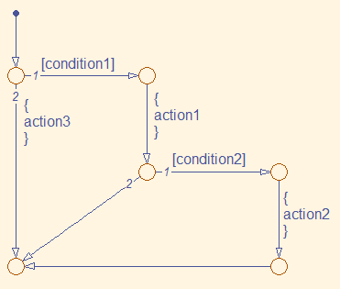
Backtracking of a flow graph
if (condition1)
{action1
if condition2
action2
else action3; }
else action3 ;
if (condition1)
{action1
if condition2
action2
}
else
action3

Slide 36
summary
What is a flow graph?
Constructing a flow graph
  Laying out the logic flow pattern
  Applying the flow governing syntax
Semantics of a flow graph
Animation the flow graph

Slide 37
Modeling state machines

Slide 38
A State Machine
A system that can only exist in a finite number of modes
Behave in a predefined number of ways.
Displays all possible modes that its implementation can exhibit
Expose the logic that commences changes to the system from one mode to another

Slide 39
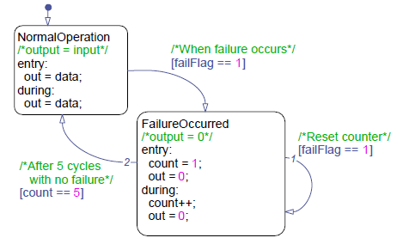
Modeling state machines
Finite number of modes
Can only behave in a predefined number of ways.

Slide 40
An example of a state machine
Algorithm has two modes:
  Normal operation--out=data
  Failure occurred--out=0

Slide 41
States and transitions
Default transition
States
transitions

Slide 42
State and transitions(2)
State:
  Exclusive: only enter one of the states at a time
  Parallel: multiple states are active at a time
transition path: a chain of transitions from one state to another
junction: a transition path can never settle at a junction , a transition path must proceed until it reaches a state.
Default transition: activating the default state when the state machine becomes live.

Slide 43
Behavior of a state machine
Contains one or more states
Enters the default state following the default transition when first activated
Searches for a valid path from the current active state at the next update
  Takes the path to a new state if one is found
  Remains in the current state if none is found
Holds its status after completing the necessary transition until the next update

Slide 44
When would I create a state machine?
Implement a system that exhibits a finite set of behaviors based on event-driven and/or condition-driven logic.
Model reactive or supervisory system where future system behavior depends on the current operate mode.

Slide 45
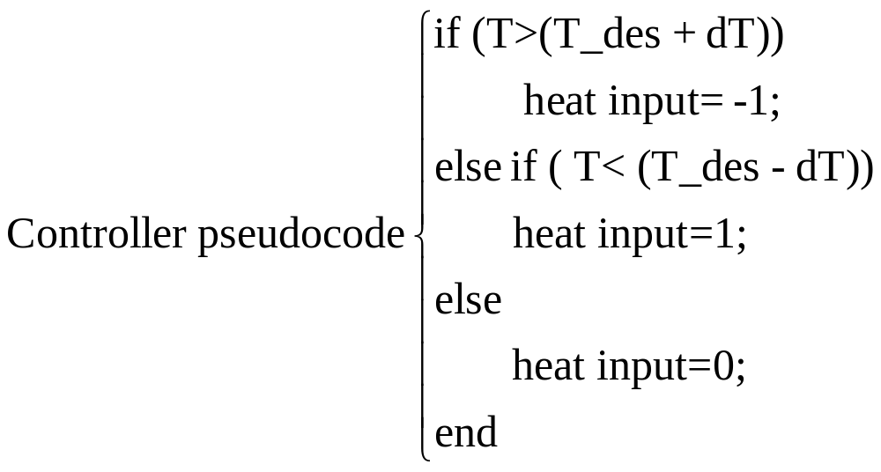
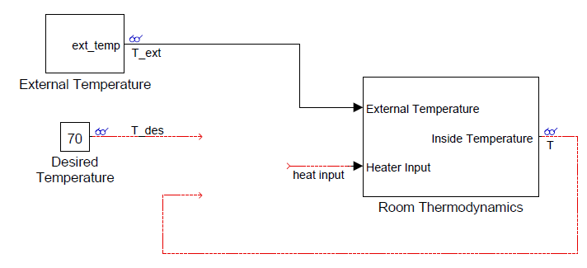
Example: climate control

Slide 46
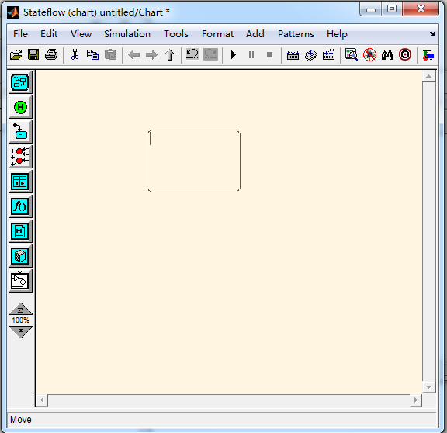
Adding states
Double-click it to enable its multiple-insertion mode

Slide 47
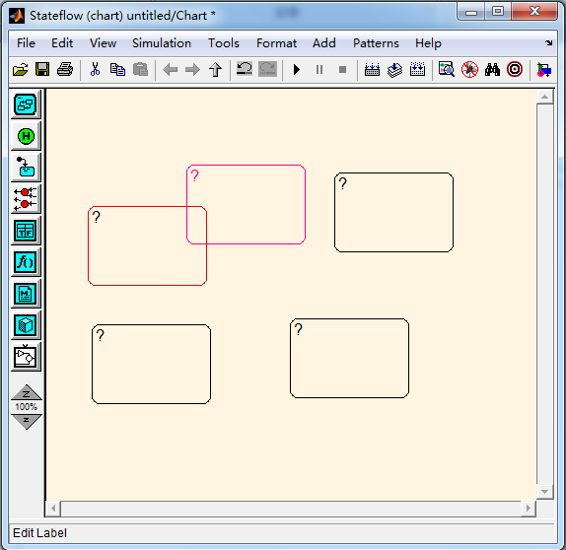
Labeling state
Click it to enable text editing

Slide 48
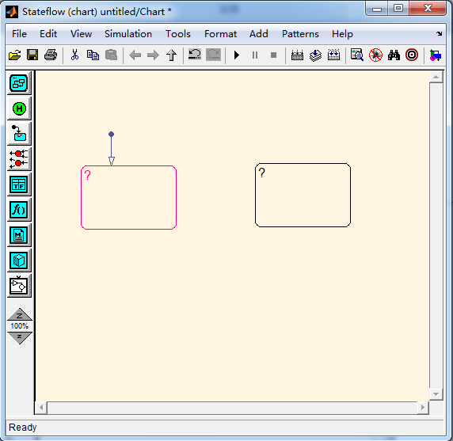
Adding a default transition

Slide 49
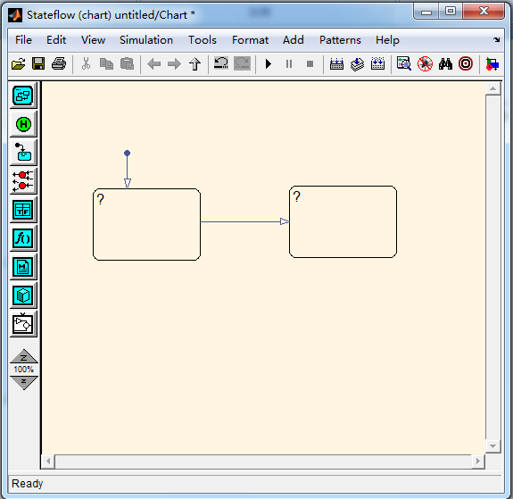
Adding transitions

Slide 50
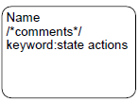
State labeling syntax
A generic state label can consist of
  Name
  State actions(keyword: statement)
The name is mandatory while the actions are optional.
The keyword can be either entry, exit and during

Slide 51
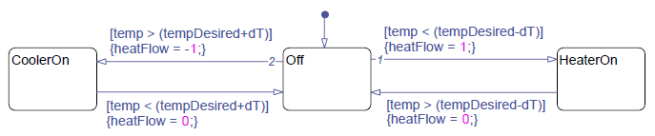
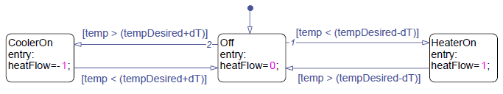
When to use state actions?
Use state actions when it makes intuitive sense in your model.

Slide 52
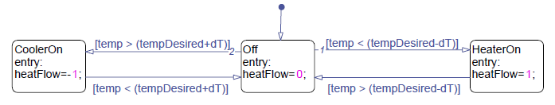
Activating chart at initialization
The chart to enter the default state prior to the start of the simulation
File→Chart Properties →enable Execute(enter) Chart At Initialization

Slide 53
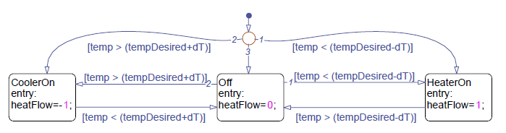
Activating chart at initialization
Add initialization logic

Slide 54
Transition labeling syntax
A generic transition label can consist of
  Comment
  An event
  A condition enclosed in []
  A group of condition actions enclosed in {}
  A group of transition actions preceded by a /
All component are optional, but must be expressed in the order as shown below if used

Slide 55
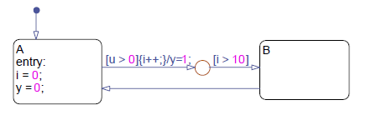
What is a transition action?
junction: a transition path can never settle at a junction , a transition path must proceed until it reaches a state.

Slide 56
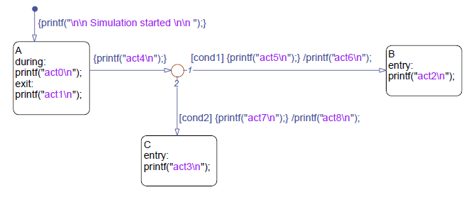
Semantics of a state transition
If we start A and cond1 is true and cond2 is false , in what order are the actions executed?
Act4,act5,act1,act6,act2

Slide 57
Semantics of a state transition(cont’)
If we start A and cond1 is false and cond2 is false , in what order are the actions executed?
Act4,act0

Slide 58
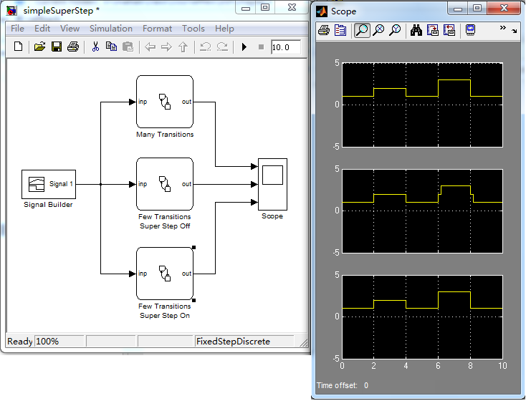
Taking multiple transitions in a single chart update

Slide 59
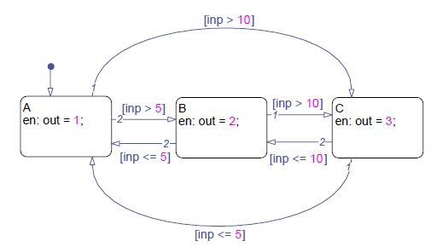
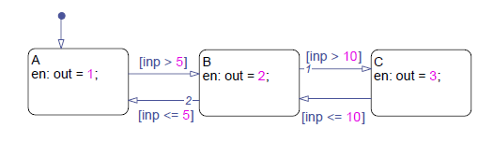
3 state machins

Slide 60

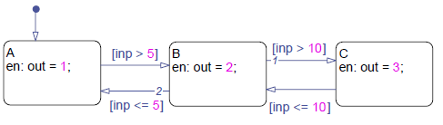
3 state machines

Slide 61
The state flow action language
An action statement can consist of:
Operation on variables
  Mathematical operators
  Logical operators
Calls to functions
An event broadcast
Standard style guidelines
  http://www.mathworks.com/industries/auto/maab.html

Slide 62
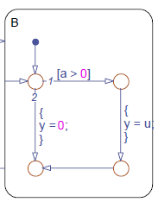
Inner flow graph
A chain of logical patterns that exist entirely within the boundary of a state
Useful in carrying out entry-equivalent and during-equivalent actions conditionally.
Equivalent to during actions
Equivalent to entry actions

Slide 63
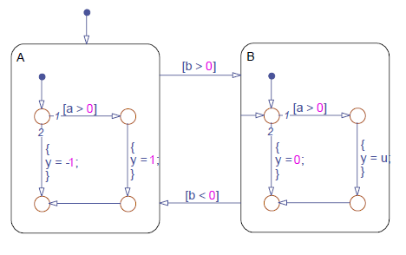
Behavior of an inner flow graph

Slide 64
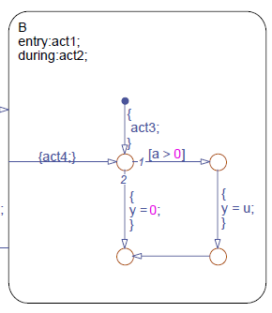
Semantics of an inner flow graph
act1 before act3
act2 before act4

Slide 65
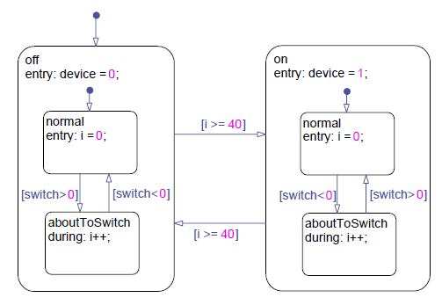
The concept of state hierarchy
A child state can enter only if its parent state is active.
A child state must exit if its parent state becomes inactive.
superstates
substates

Slide 66
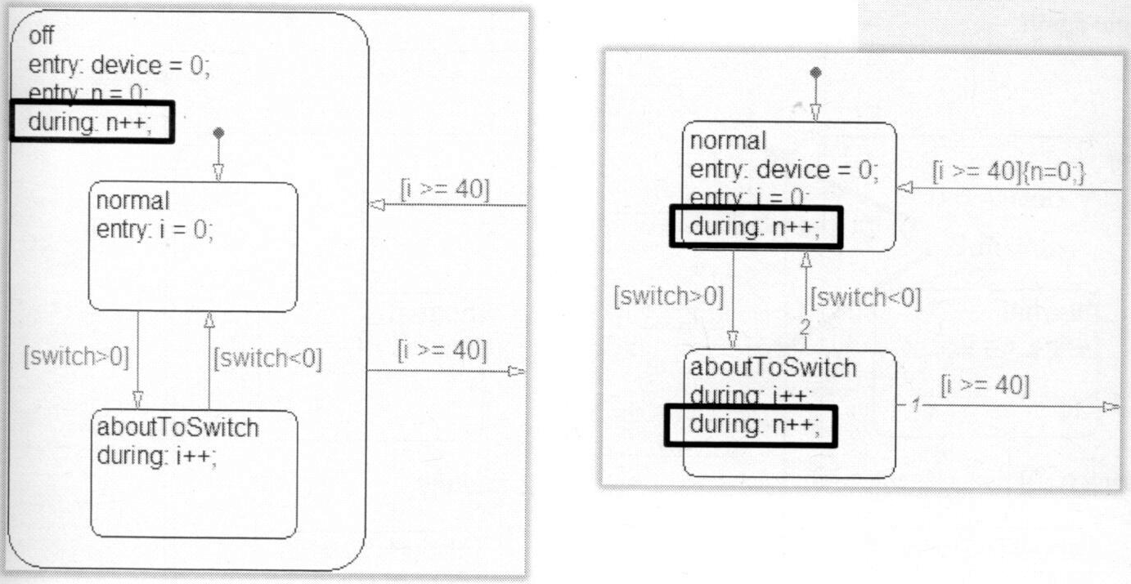
When would I create a multilevel state machine?
Simplify state-transition diagram for models that contain natural hierarchy
Unify common actions and conditions
Provide an extra degree of transition testing priority control

Slide 67
Example: climate control
input: T_des, T, power
Output: heat input
Parameters: dT
If(power==1)
heater maintains normal operation
Else if (power=0)
heat input=0;
end

Slide 68
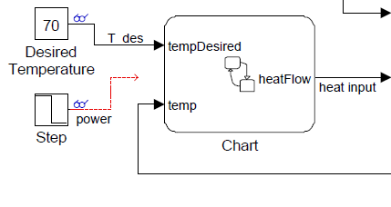

Slide 69
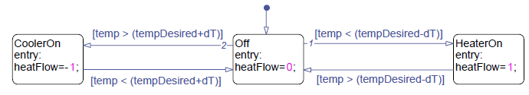
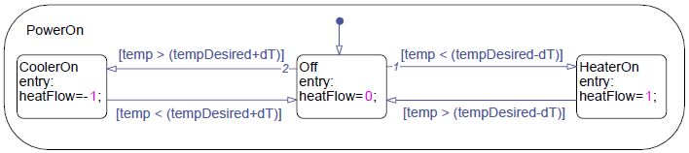
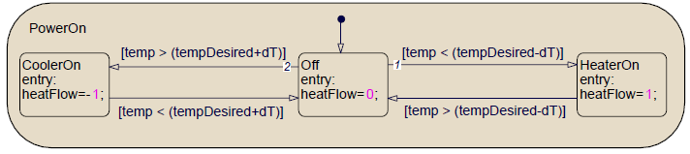
Creating superstates and substates
Resize the superstate such that all its substates can fit within its boundary
SM
ungrouped
Grouped
Multilevel states

Slide 70
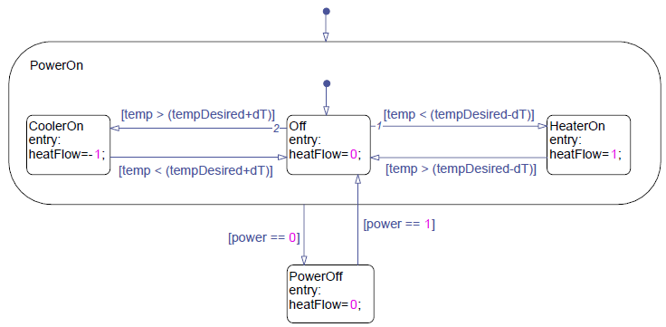
Designating default substates
Default states should be define at every level of hierarchy
You can override default substates using supertransitions that go directly to a substate.

Slide 71


Creating a subchart
Right-click the state to open its context menu
Select Make Contents→Subcharted
while viewing the content of a subchart, you can click the
icon to browse up to the next level.

Slide 72
Creating supertransitions
Drag a transition across the boundary of the subchart,
Continue dragging towards the center of the worm hole, the editor switches to display the contents in the subchart
Attach the transition to the substate you want to connect to.

Slide 73

Chart-level and State-level Data
In the climate control state machine, add logic to prevents the system from excessive switching.

Slide 74
Defining state-level data
Select the state under the Model Hierarchy pane in the Model Explorer.
Select add→data from the model explorer to add a new data to the state
Rename the data
Set the type and value attributes of the data

Slide 75
Examining multilevel activations and state transitions
When the chart is first activated, the multilevel state machine performs the default transition paths to enter the PowerOn,Off,and noSwitch state
Only when the canSwitch state is active can the chart leave the off state.

Slide 76
Recovering active substates
In general, whenever a superstate is reactivated, the superstate to enter the default transition to enter its default substate.
If you want the superstate to recover the last active substate, accomplish by adding a history junction in the superstate.
Note: donot adding a history junction directly at the chart level .

Slide 77



Slide 78
Semantics of a multilevel state transiton
Assume that A and A1 are currently active. When cond1 is true, and cond2 is false. How to execute?

Slide 79


Slide 80
The concepts of parallelism
State:
  exclusive : only one active child state at a time
    With solid boundaries
  parallel: all its child states active as long as it is active.
    Modeling concurrency and interdependency in a system
    With dotted boundaries

Slide 81
The concepts of parallelism(2)
The term parallel is used to indicate that multiple states are active at one time, not that multiple state execute at the same time
Parallel state execute sequentially based on their assigned execution order
  Upper right corner of the state

Slide 82

Execution
order

Slide 83

An example of multiprocessing state machine
Failure
determination
Mode logic

Slide 84
When could I create a multiprocessing state machine
Combine interdependent state machines into a single diagram
Enable a more intuitive leader-follower implementations
Provide clear separation of logical components

Slide 85
Example:climate control
Can modify the acceptable temperature thresholds depending on the time of day
  At night, we want to conserve energy
  if (hour<6)||(hour>21)
  temperature threshold is T_des+/-10
  Else
  temperature threshold is T_des+/-2
  end

Slide 86

Creating Parallel states
Right-click in the parent. This opens a context menu of the chart or state
Select Decomposition→parallel(AND) from the context menu

Slide 87
Defining data in parallel states
Chart level- the data can be accessed by the entire chart.
State level- the data can be accessed only by the state it is defined in, and any substates of that state.
Communicating between parallel states is

Slide 88
Activation order of parallel states
Explicitly set by user
  Enable File->Chart Properties->User specified state/transition execution order
  Right click and setting the Execution Order
Derived from state location
  Disable File->Chart Properties->User specified state/transition execution order
  Order from top to bottom

Slide 89

Examining the behavior of a Parallel state machine
When a parallel state is entered, it must execute its contents to completion before the next parallel state activates.

Slide 90
Summary
Flow graph
State machine
  Simple state machine
  Hierarchical state machine
  Parallel state machine

