Slide 1
MATLAB foundation

Slide 2
Working With the User Interface

Slide 3
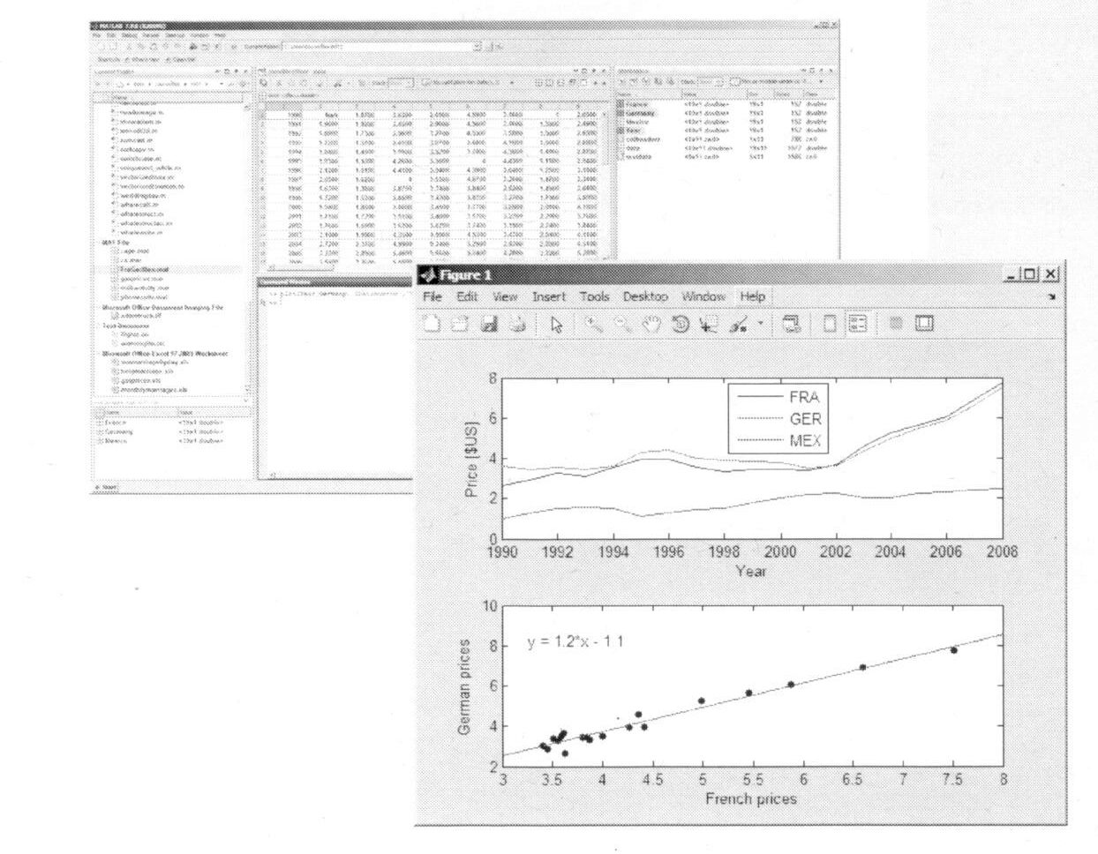
Outline
Reading data from file
Saving and loading variables
Plotting data
Customizing plots
Calculating statistics and best-fit line
Exporting graphics for use in other applications

Slide 4
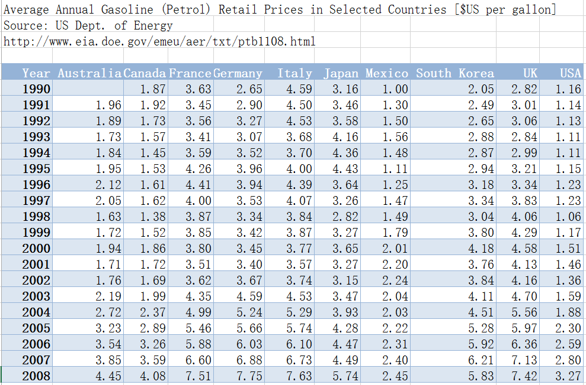
Example: Gas Price Data

Slide 5
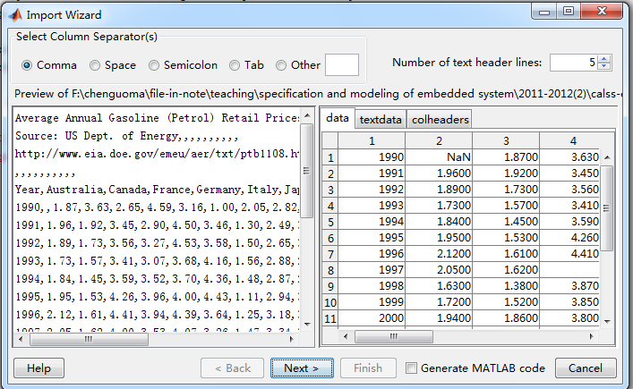
The Import Wizard
Chose File→Import Data

Slide 6
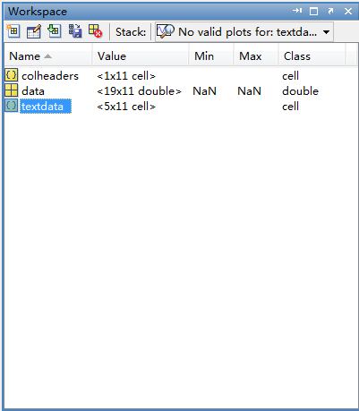
The Base Workplace
Delete a variable
Average Annual Gasoline (Petrol) Retail Prices in Selected Countries [$US per gallon]
Source: US Dept. of Energy
http://www.eia.doe.gov/emeu/aer/txt/ptb1108.html
Year | Australia | Canada | France | Germany | Italy | Japan | Mexico | South Korea | UK | USA
1990 |  | 1.87 | 3.63 | 2.65 | 4.59 | 3.16 | 1 | 2.05 | 2.82 | 1.16
1991 | 1.96 | 1.92 | 3.45 | 2.9 | 4.5 | 3.46 | 1.3 | 2.49 | 3.01 | 1.14
1992 | 1.89 | 1.73 | 3.56 | 3.27 | 4.53 | 3.58 | 1.5 | 2.65 | 3.06 | 1.13
1993 | 1.73 | 1.57 | 3.41 | 3.07 | 3.68 | 4.16 | 1.56 | 2.88 | 2.84 | 1.11
1994 | 1.84 | 1.45 | 3.59 | 3.52 | 3.7 | 4.36 | 1.48 | 2.87 | 2.99 | 1.11
1995 | 1.95 | 1.53 | 4.26 | 3.96 | 4 | 4.43 | 1.11 | 2.94 | 3.21 | 1.15
1996 | 2.12 | 1.61 | 4.41 | 3.94 | 4.39 | 3.64 | 1.25 | 3.18 | 3.34 | 1.23
1997 | 2.05 | 1.62 | 4 | 3.53 | 4.07 | 3.26 | 1.47 | 3.34 | 3.83 | 1.23
1998 | 1.63 | 1.38 | 3.87 | 3.34 | 3.84 | 2.82 | 1.49 | 3.04 | 4.06 | 1.06
1999 | 1.72 | 1.52 | 3.85 | 3.42 | 3.87 | 3.27 | 1.79 | 3.8 | 4.29 | 1.17
2000 | 1.94 | 1.86 | 3.8 | 3.45 | 3.77 | 3.65 | 2.01 | 4.18 | 4.58 | 1.51
2001 | 1.71 | 1.72 | 3.51 | 3.4 | 3.57 | 3.27 | 2.2 | 3.76 | 4.13 | 1.46
2002 | 1.76 | 1.69 | 3.62 | 3.67 | 3.74 | 3.15 | 2.24 | 3.84 | 4.16 | 1.36
2003 | 2.19 | 1.99 | 4.35 | 4.59 | 4.53 | 3.47 | 2.04 | 4.11 | 4.7 | 1.59
2004 | 2.72 | 2.37 | 4.99 | 5.24 | 5.29 | 3.93 | 2.03 | 4.51 | 5.56 | 1.88
2005 | 3.23 | 2.89 | 5.46 | 5.66 | 5.74 | 4.28 | 2.22 | 5.28 | 5.97 | 2.3
2006 | 3.54 | 3.26 | 5.88 | 6.03 | 6.1 | 4.47 | 2.31 | 5.92 | 6.36 | 2.59
2007 | 3.85 | 3.59 | 6.6 | 6.88 | 6.73 | 4.49 | 2.4 | 6.21 | 7.13 | 2.8
2008 | 4.45 | 4.08 | 7.51 | 7.75 | 7.63 | 5.74 | 2.45 | 5.83 | 7.42 | 3.27
Double clicking, display a content

Slide 7
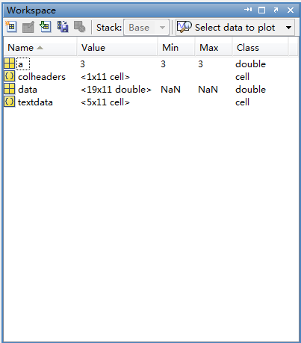
Date Type
Double array
Cell array

Slide 8
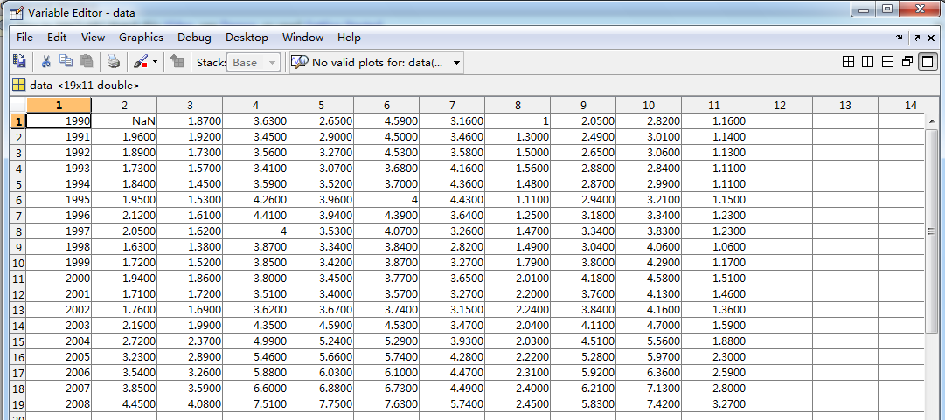
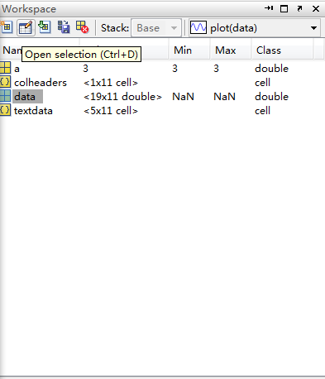
The Variable Editor

Slide 9
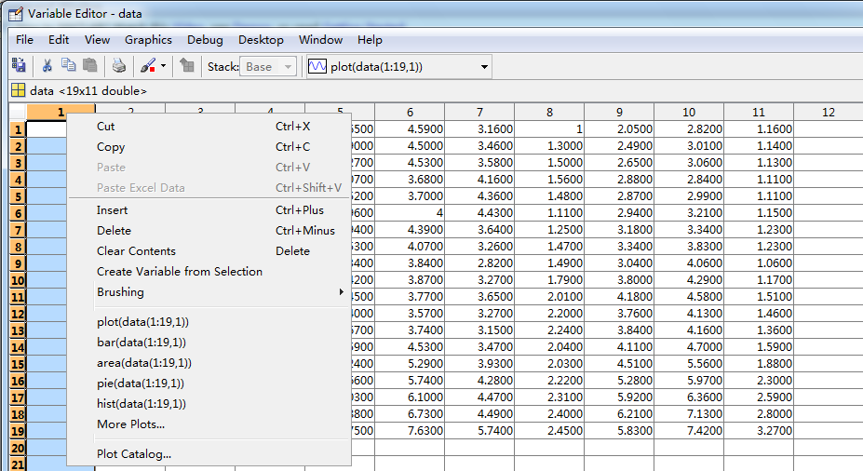
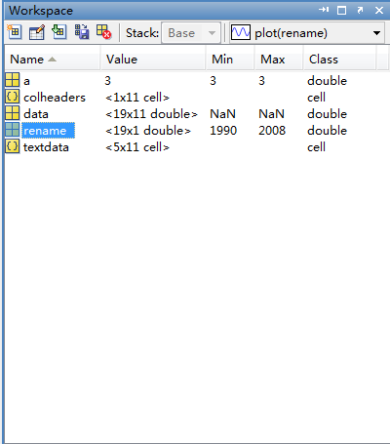
New Variables

Slide 10
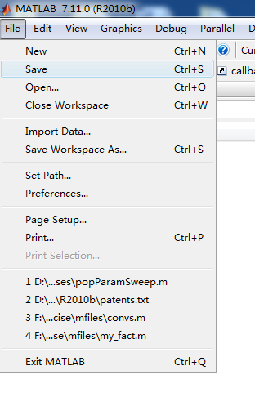
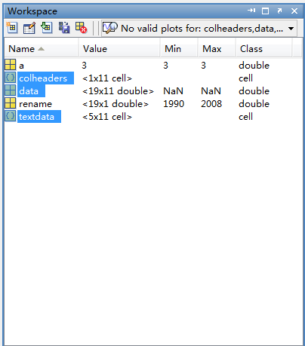
Saving and Loading
The variable is save in a MAT-file(.mat extension)

Slide 11
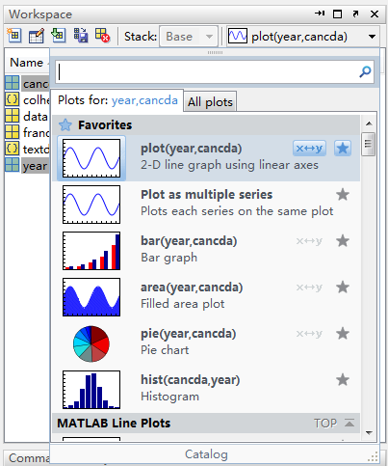
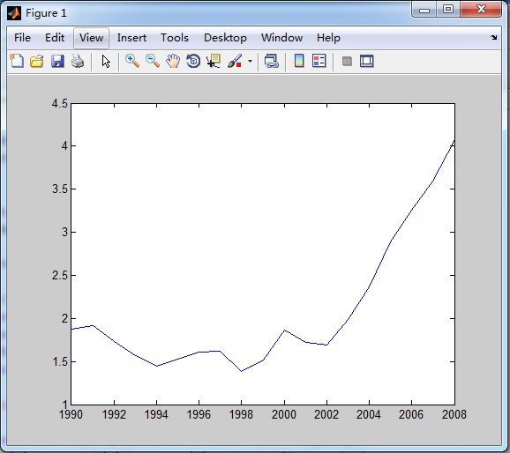
Plot and Data
creating appropriate visualizations of data
offer many plotting routine for bother vector and matrix data
Ctrl+选择canada
第一次选择

Slide 12
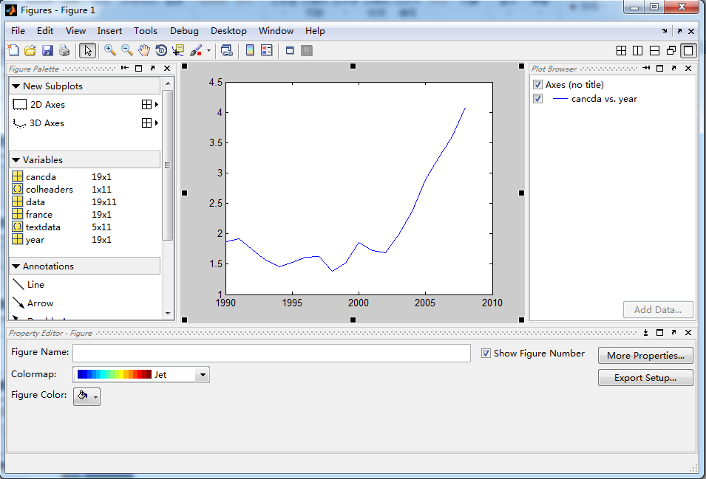
Plot Tools
Add a variety of annotations of a plot

Slide 13
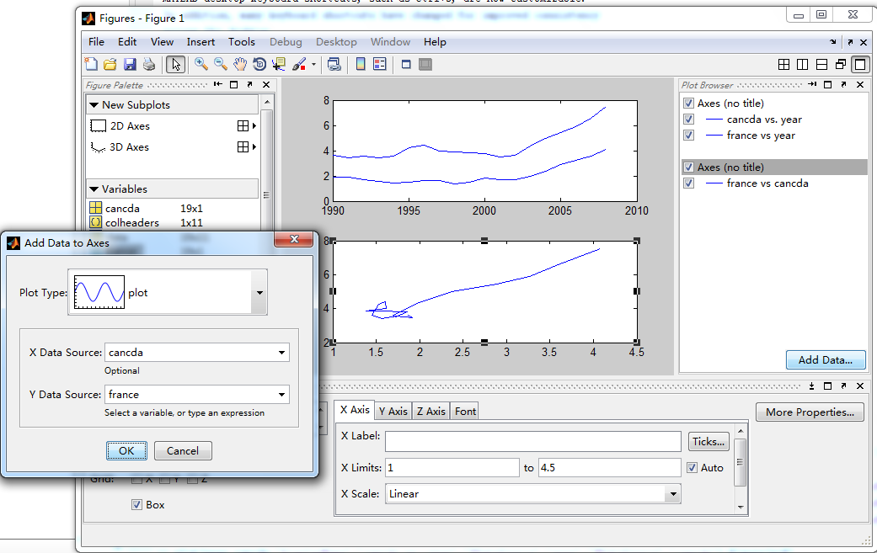
Multiple Plots

Slide 14
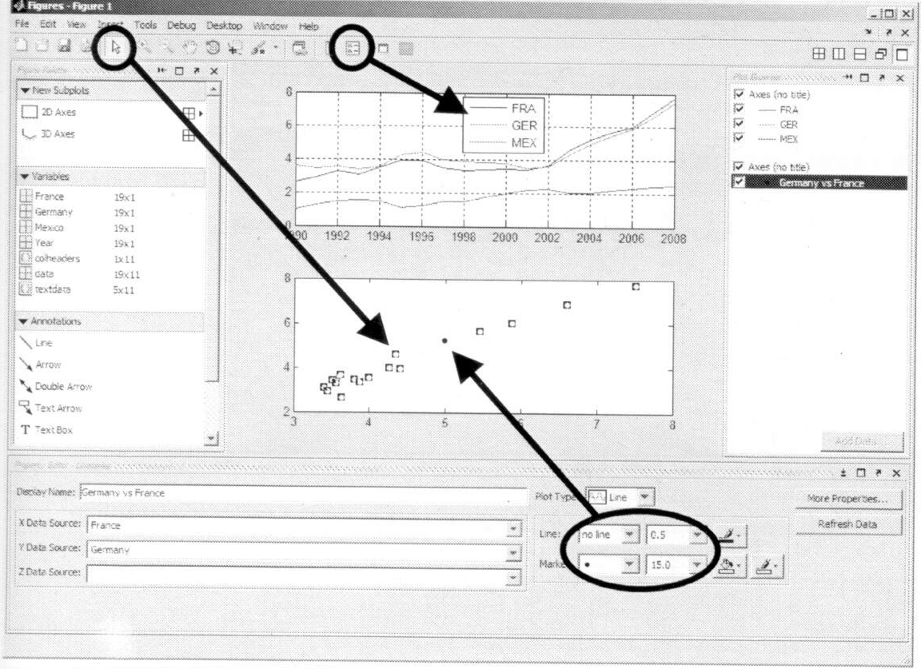
Format the Plot

Slide 15
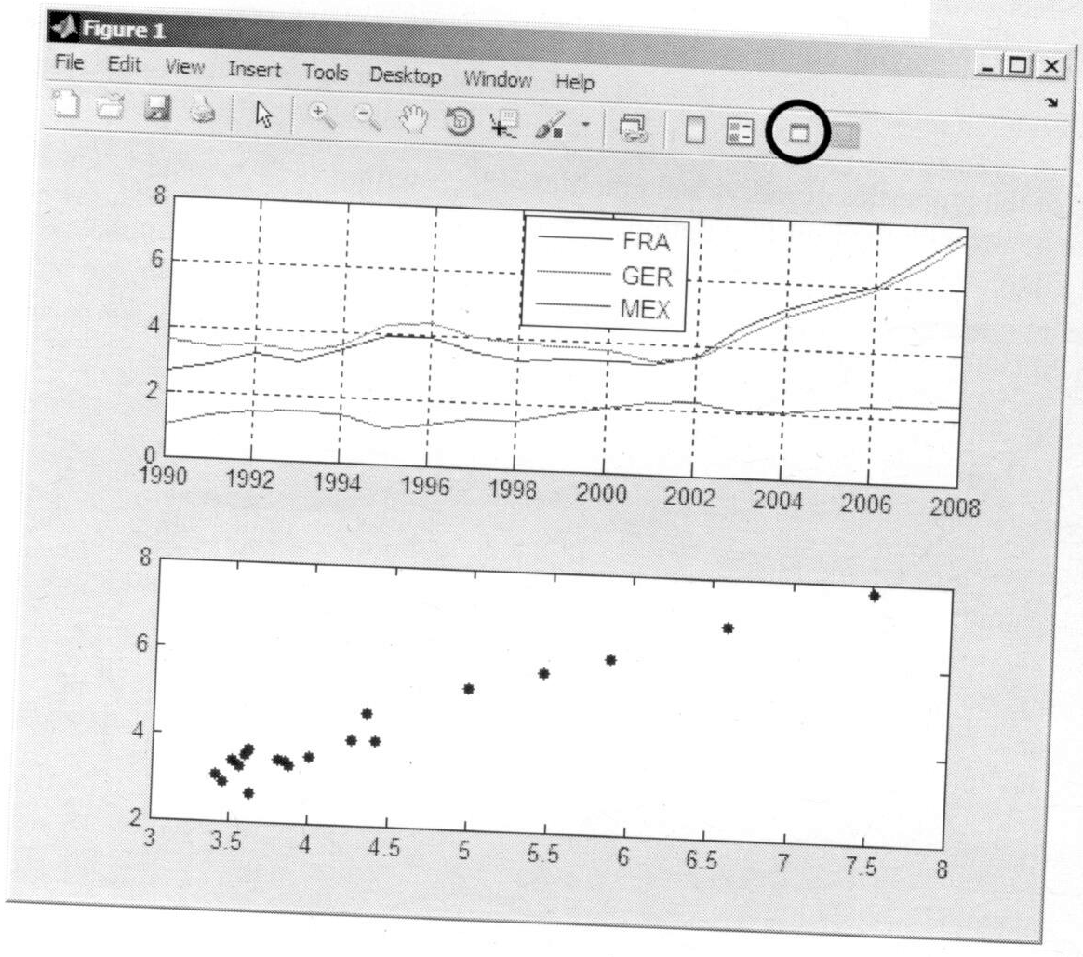
Hide the Plot Tools

Slide 16
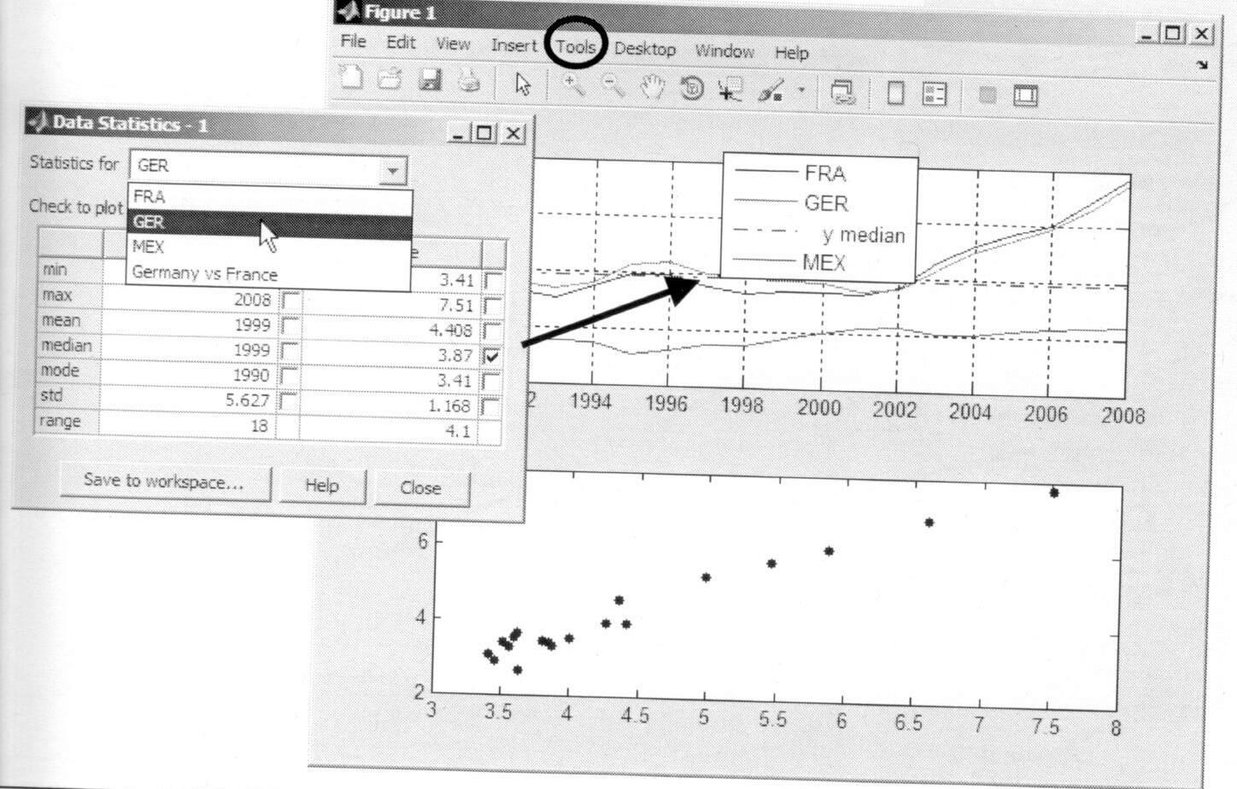
Data Statistics Tool

Slide 17
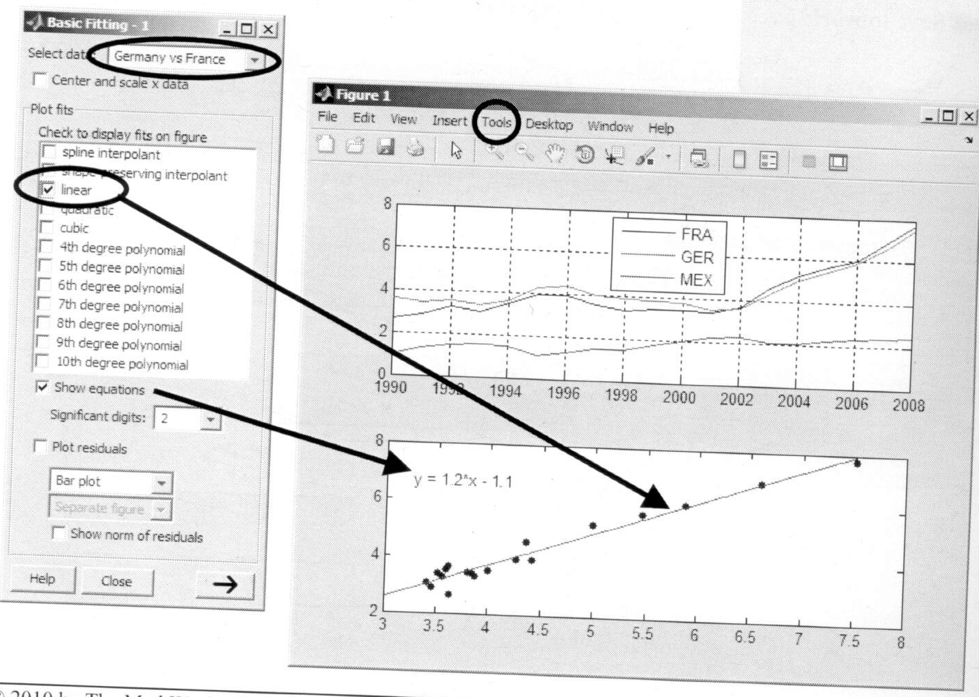
Basic Fitting Tool

Slide 18
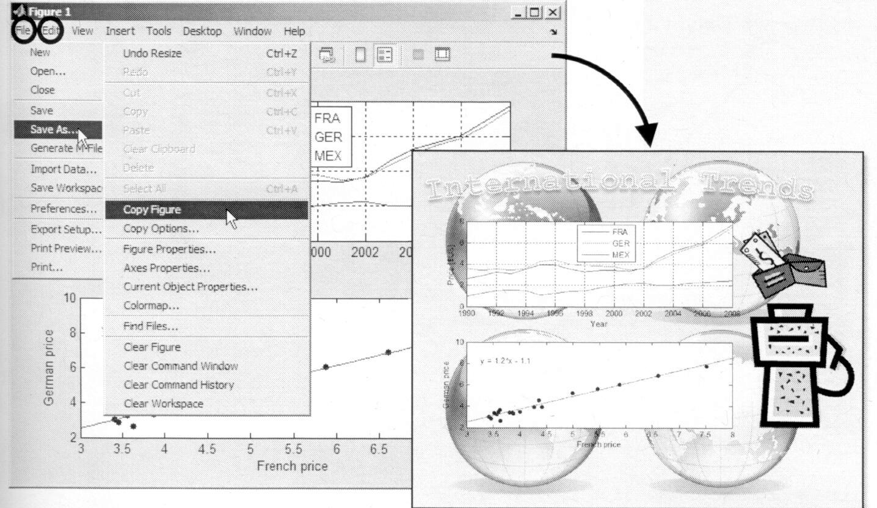
Export to Another Application

Slide 19
Shortcuts
clear clears base workspace variable from memory
clc clears the command windows
close closes the current figure
Shortcuts allows you to execute the commands at the push of a button.
  Shortcuts-(right-clicking)new shortcut-edit a dialog

Slide 20
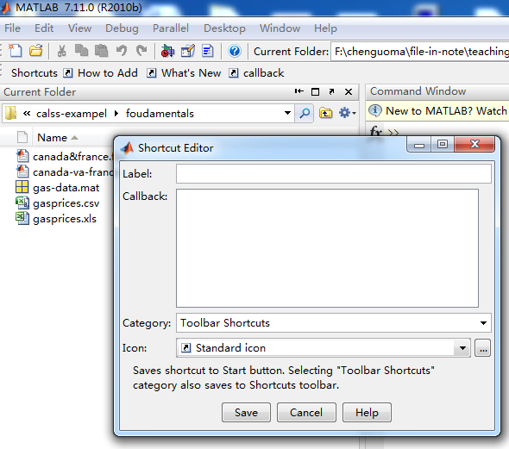

Slide 21
Variables and Expressions

Slide 22
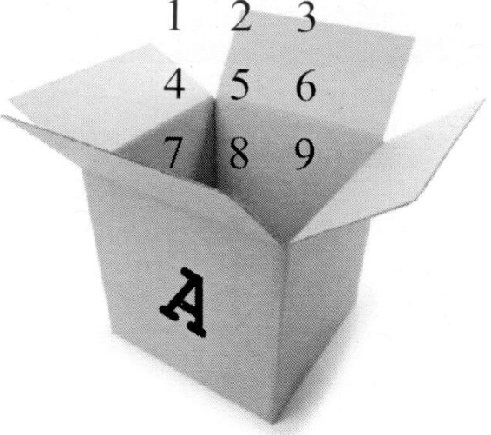
Outline
Entering commands
Creating variables
Getting help
Accessing and modifying values in variables
Creating character variables

Slide 23
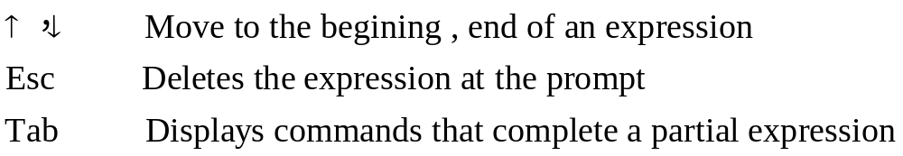
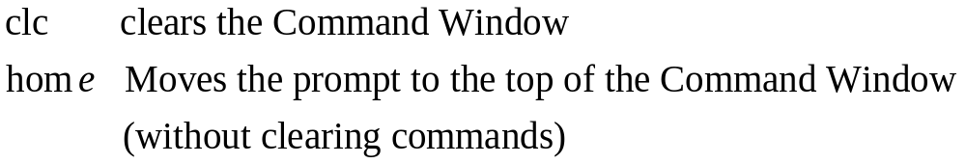
MATLAB® Commands
MATLAB is case sensitive
MATLAB commands are entered in the Command Window at the MATLAB prompt(>>). Commands are executed once the Enter key is pressed.
A semicolon(;) at the end of a command suppresses any output
A number of keyboard shortcuts are available to assist in entering commands:
Useful commands for managing the Command Window are:

Slide 24
Saving and Loading MAT-Files
Variables can be saved to the native MATLAB format (MAT-files) directly from the Command Window using the save command:
>> save gasprices country gpdata
saves the two variables country and gpdata to the file gasprices.mat in the current directory.
Saved variables can be loaded back to the workspace using the load command. You can specify particular variables to load, or load all variables in the MAT-file:
>> load gasprices gpdata
loads just the variable gpdata, whereas
>> load gasprices
loads everything in gasprices.mat.

Slide 25
Assignment
Variables can be created in MATLAB using the assignment equality
>> x = 1 – 1i, y=pi;
MATLAB variable names
  must start with a letter
  Contain (a-z and A-Z), number (0-9), and the underscore (_).
  They can be anywhere from 1 to 63 characters long.

Slide 26
Assignment(cont’)
There is no requirement in MATLAB to declare the name, type, or size of a variable before making an assignment statement.
  numerical data are created as double arrays:
  each data value in memory to double (64 bit, 8 byte) precision.
>> z = 3
creates a double-precision value.
>> z = 5
overwrites z with a complex double-precision value.

Slide 27
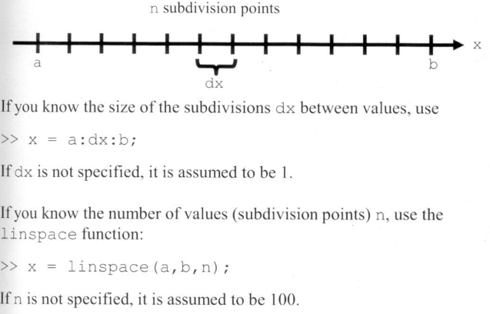
Creating Vectors
Vectors, or 1-dimensional arrays, are the basis for computing and displaying sequences of data in MATLAB.
There are two basic methods for creating equally spaced vectors.

Slide 28
Creating Vectors(cont’)
There are methods for creating nonequally spaced vectors.
  Vectors of arbitrary data ---a row vector
  >> x=[1,2,3,4,pi,7]
  Vectors of data---column vector
  >>x=[cos(0);0;-42;7]
  Transpose a row vector
  >> y=x’

Slide 29
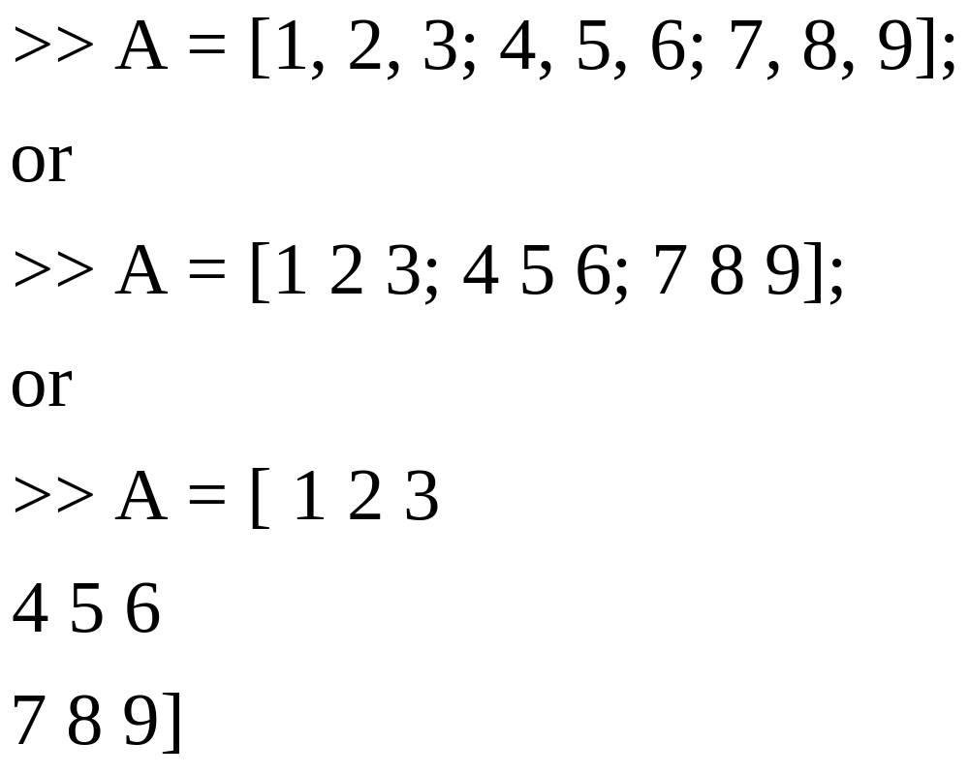
Creating Matrices

Slide 30
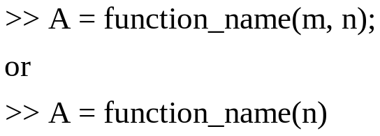
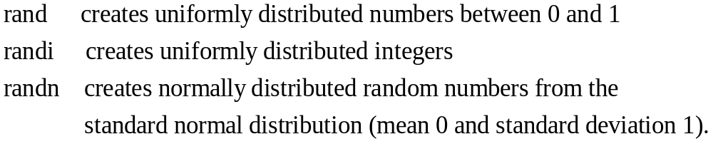
Matrix Creation Functions
MATLAB has a large number of matrix creation functions that output variables with certain characteristics and avoid tedious data entry.
The basic syntax for matrix creation functions is:
  zeros creates a matrix with all values initialized to zero.
  Ones creates a matrix with all values initialized to one.

Slide 31
Help and Documentation
MATLAB help and documentation can show you
  The various ways to call a function
  The algorithm implemented by a function
  Examples of how to use a function
  Links to related functions
  Tutorials and background information
To see the help on a particular function, such as rand, type
>> help rand
For complete documentation for the function, type
>> doc rand
help, doc, docsearch

Slide 32
Row, Column Indexing
Row and column index begins with 1
Array stores in column priority
Data in MATLAB variables is accessed using one of several methods of indexing.
  row, column indexing
>> A(m, n)
points MATLAB to the m^{th} row and n^{th} column of the variable A.
  >> x = A(m, n);
  MATLAB keyword end : the end of either a row or a column
  >>x=A(3,end)
  A single index
  >>x=A(4)

Slide 33
Multiple Row, Column Indices
You can reference multiple elements of an array using vectors as indices
>> x = A([1,2,5],[2,3]);
creates a 3-by-2 matrix of six elements of A: A(1,2), A(1,3), A(2,2), A(2,3), A(5,2), and A(5,3).
You can indicate a range of rows or columns in a variable using the colon (:) notation
>> Ger90s = gpdata(1:10, 5);
extracts a portion of the fifth column of gasprice, and
>> Year = gpdata(1:end, 1);
extracts the entire first column.

Slide 34
Indexed Assignment
subscripted assignment
>> A(m,n) = x;
it assigns the value x to the (m,n) element of A.
Referencing and assignment can be combined in a single statement:
>> A(3,7) = 4 * A(3, 7);
replaces the (3,7) element of A with 4 times its current value.

Slide 35
Concatenation
square brackets ([ ]) to delimit the start and end of an array.
The square brackets are actually the concatenation operator in MATLAB. Recall that even scalar variables in MATLAB are 1-by-1 arrays. Hence, when you enter
>> A = [1, 2, 3; 4, 5, 6; 7, 8, 9];
concatenation operator
>> A = [1, 2, 3; 4, 5, 6; 7, 8,9];
>> B = [A; 10, 11, 12];
>> C =[A,[12,34,45]'] or
>> C=[A,[12;34;45]]
>> not correct C = [A, 10; 11; 12]

Slide 36
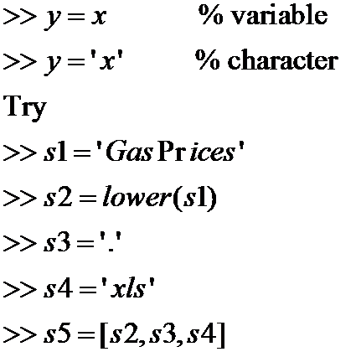
Characters and Strings

Slide 37
Analysis and Visualization with Vectors

Slide 38
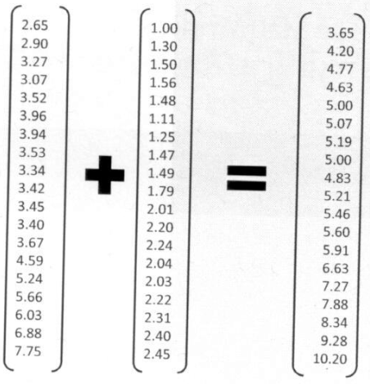
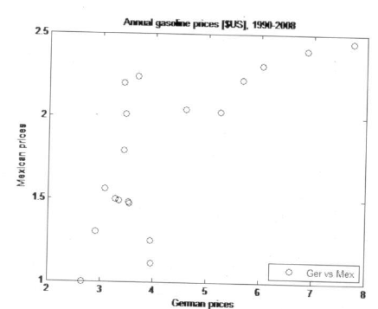
Outline
Calculations with vectors
Plotting vectors
Basic plot options
Annotating plots

Slide 39
Statistical Functions
Basic statistical functions in MATLAB can be applied to a vector of data to produce a single output:
>> GerMean = mean(Germany)
>> MaxStart = max(StartPrices)
Some of these functions can return extra optional arguments.
>> [MaxMex, MMIndex] = max(Mexico);
Note the use of square brackets (concatenation) construction for multiple function outputs

Slide 40
Array Operations
MATLAB is designed to work with matrices and vectors as mathematical objects.
Matrix addition and subtraction is defined as an element-by-element operation --- this is, if
>> C = A + B
Then C(k) is A(k)+B(k). Similarly, scalar multiplication or division of an array is defined mathematically:
>> B = 2*A
Multiplies each element of A by 2.

Slide 41
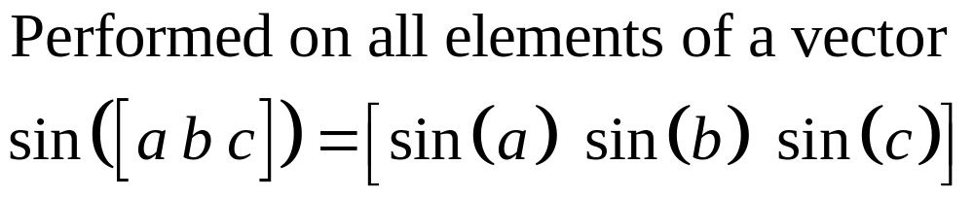
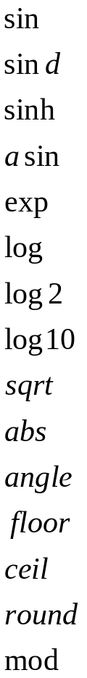
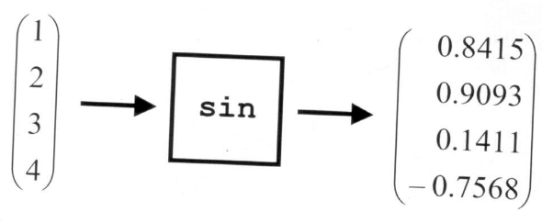
Mathematical Operations

Slide 42
Plotting Vectors
The vectors of the same length can be plotted against each other with the plot function:
>> plot(x,y)
  This plots each element of x on the horizontal axis against the corresponding element of y on the vertical axis. Neither vector is stored before plotting.
If only a single input vector is passed to plot, the vector is plotted on the vertical axis, using the array index as the horizontal axis.

Slide 43
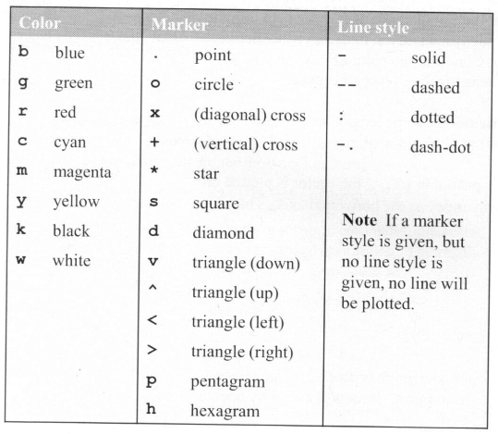
Plot Options
The plot function accepts an
optional third argument that
allows you to specify the basic
properties of the plot’s
appearance: line style, line
color, and marker style.
The codes can be combined in
any order, so
>> plot(Year, Mexico, ‘k^:’)
and
>> plot(Year, Mexico,’:^k’)
Both plot Mexican gas prices with a black dotted line and triangular markers.

Slide 44
Annotating Plots
Textual information can be added to plots using separate annotation functions: title, xlabel, ylabel, and legend. All functions take a string input:
  >> title(‘Annual gasoline prices’)
  >> xlabel(‘German prices’)
  >> ylabel(‘Mexican prices’)
  >> legend(‘Ger vs Mex’)

Slide 45
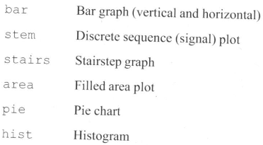
Additional Vector Plot Types
MATLAB has many specialized plotting commands to allow you to visualize and present your data with exactly the right emphasis on the data features you find important. Some of the additional plot types for vector data include

Slide 46
Analysis and Visualization with Matrices

Slide 47
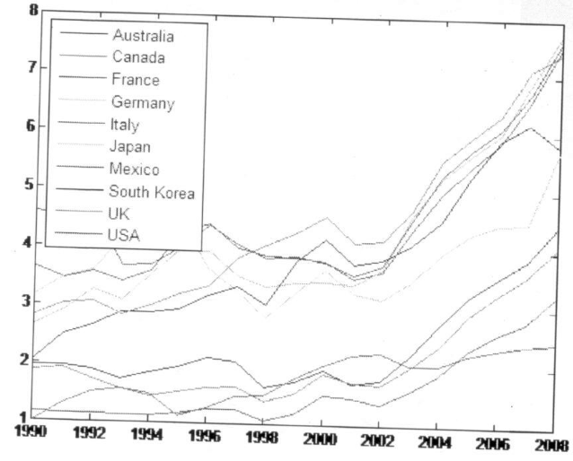
Outline
Size and dimensionally
Calculations with matrices
Statistics with matrix data
Plotting multiple columns
Reshaping and linear
indexing
Multidimensional arrays

Slide 48
Determining Size
The size function returns the number of rows and columns as either a vector or two separate scalars:
>> s = size(Prices)
>> [m, n] = size(Prices)
The length function returns the largest value returned by size:
>> length(Prices)
The numel function returns the total number of elements:
>> numel(Prices)

Slide 49
Matrix Operations
As with vectors, arithmetic operations on matrices are defined in their usual mathematical sense.
>> C = A + B;
  creates a matrix C such that C(k) is A(k) + B(k).
>> C = k * A;
>> C = A + k;
Mathematically, matrix multiplication of the form
>> C = A * B
requires that the inner dimensions --- the number of columns in A and the number of rows in B --- agree. If A is m-by-n and B is n-by-p, then C will be m-by-p.

Slide 50
Array Operations
Can perform an array. Simply prefix the operator with a dot (.):
>> GMRatio = Germany ./ Mexico
  Simply, to calculate the geometric mean of the German and Mexican prices, enter
>> GMProd = Germany .* Mexico
>> GMGMean = sqrt(GMProd)

Slide 51
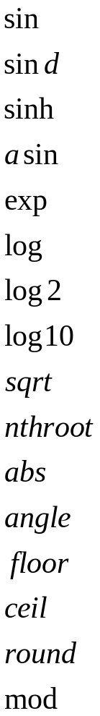
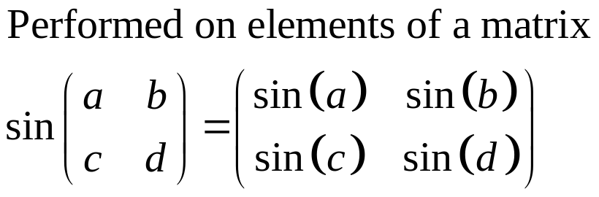
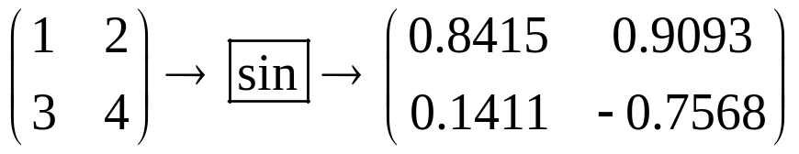
Mathematical Operations

Slide 52
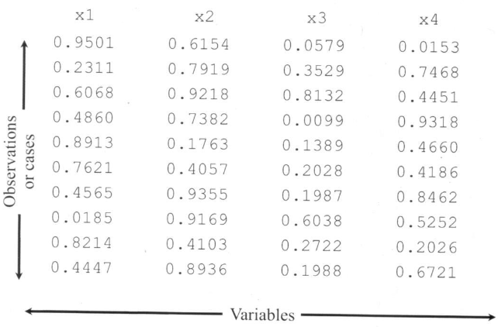
Data in the MATLAB® Environment
Statistical functions treat the columns of a matrix independently

Slide 53
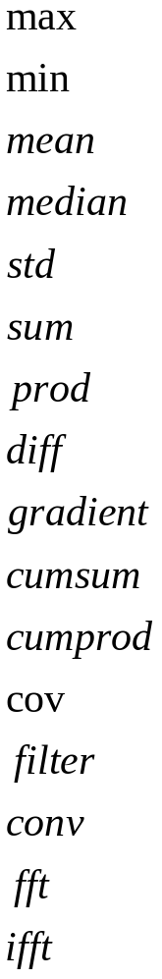
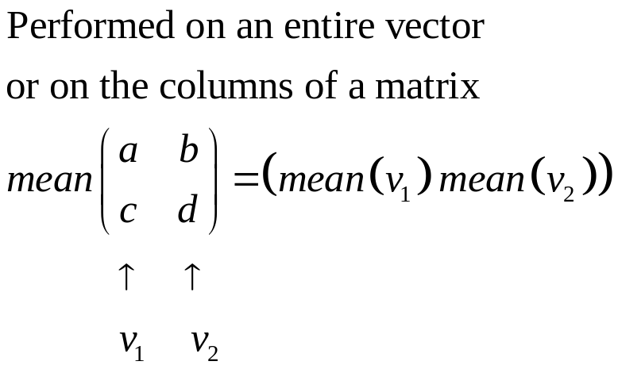
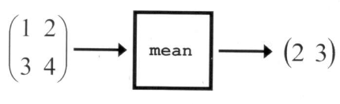
Statistical Operations

Slide 54
Random Numbers
rand : returns uniformly distributed random numbers continuously distributed between 0 and 1.
To generate uniformly distributed random numbers between arbitrary bounds a and b, simply stretch and shift the density:
>> a + (b-a)*rand(m, n)
randn: returns normally distributed random numbers from the standard normal distribution with mean 0 and standard deviation 1.
>> a + b*randn(m, n)
  returns normally distributed random numbers from the normal distribution with mean a and standard deviation b.
randi: returns uniformly distributed intergers

Slide 55
Plotting Multiple Columns
Two-dimensional plotting functions (plot, bar, stem, etc.) behave in the same manner as statistical functions when dealing with matrices: the columns are assumed to be independent variables. Hence,
>> plot(Year, Prices)
Makes 10 simultaneous plots, each equivalent to
>> plot(Year, Prices(:, k))
  To distinguish the various variables, each column is plotted with a different color, cycling through the standard sequence (‘b’, ‘g’, ‘r’, ‘c’, ‘m’, ‘y’, ‘k’), excluding white.

Slide 56
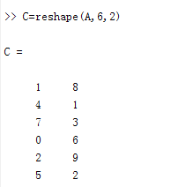
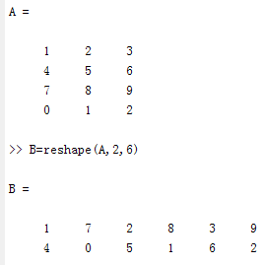
Reshaping

Slide 57
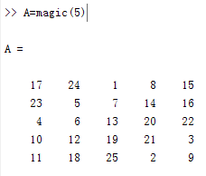
Linear Indexing
A(1)=17, A(2)=23, A(3)=4, A(4)=10, A(5)=11,
A(6)=24, …
…
A(25)=9

Slide 58
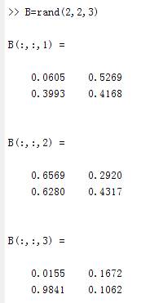
Multidimensional Arrays

Slide 59
Automating Commands with Scripts

Slide 60
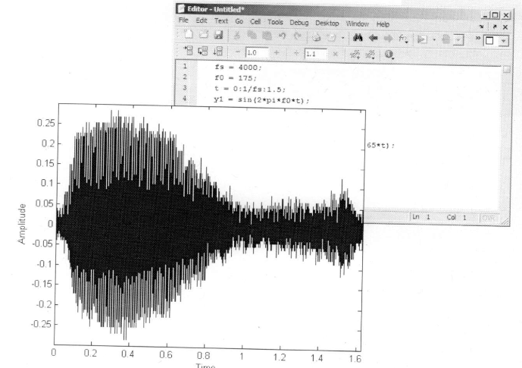
Outline
A modeling example
The Command History
Crating script files
Running scripts

Slide 61
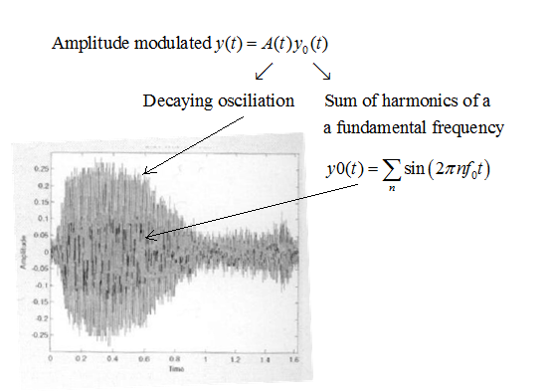
Modeling a Whale Call

Slide 62


The Command History
MATLAB keeps a history of the commands you type, and displays them in the Command History window on the MATLAB desktop.
These commands remain from session to session until you choose to delete them, and they can be referenced from the command prompt using the up arrow key or by dragging (click and holding) them from the command History and dropping them at the prompt.
You can select a range of commands
in the history by holding down the Shift
key, or separated commands by holding
down the Ctrl key.

Slide 63

The MATLAB® Editor
choose “Create script” from the command history by right-click
choose “File-New-script” from the menus at the top of the MATLAB desktop
>> edit can open the editor and begin a new file
>> edit filename can open an existing file in the editor.

Slide 64
Script Files
Scripts do not have inputs and outputs. MATLAB executes the commands as a batch, in order.
Scripts are used to automate useful blocks of commands.
Text following a percent sign(%) is a comment.
The first contiguous block of comments in an file is reserved for help information. Help is displayed when you use the syntax
>> help filename
The first comment line in the help is called the H1 line. It should contain the filename and a brief description of the purpose of the file.

Slide 65
Running a Script
Run a script by typing the file name (without the .m extension) if it is in the current directory.
>> callmodel
Click on the Run button at the top of the Editor to run a script if it is displayed in the Editor. Equivalently, you can press F5.

Slide 66
Working with Data Files

Slide 67

Outline
Importing data
Cell arrays
Numbers, strings,
and dates
Exporting data

Slide 68
File Types and File Formats
File type refers very generally to the origins of the data
File format refers the encoded in a file
File Type
Import Wizard
File Format
Audio
Computer Aided Design (CAD)
Document
Spreadsheet
Database
Presentation
Webpage
Script
Page description
Graphics
Video
Scientific data
Geographic information
…
WAV
AIFF
RAW
AU
MP3
RA
MIDI
…
wavread

Slide 69

The *read Functions

Slide 70
Mixed Data Types
Often data files contain a mix of data types, such as text and numeric values. For example,
>> M = xlsread(‘belgmarriage.xls’)
  read in only the numeric data.
>> [M, txt] = xlsread(‘belgmarriage.xls’)
  To avoid this common problem, many import functions in MATLAB return the data in cell arrays.

Slide 71
Cell Arrays
MATLAB arrays must always have the same number of columns in each row( and vice versa)
A single string is treated as a 1-by-n array of characters.
>> x = [‘hello’; ‘ciao’; ‘guten tag’]----- error
  Vertical concatenation of strings fails unless they are all the same length.
To concatenate elements into a cell array, use curly braces ({ }) instead of square brackets:
>> x = {‘hello’; ‘ciao’; ‘guten tag’}----correct, 3*1,each container has 1*n.
>> y = {pi, []; ‘foo’, 42; ones(2), eye(3)}
>> z = {x, y}
>> z = {x; y}
>> z = [x, y] % ok
>> z = [x; y] % no! dimension mismatch

Slide 72
Cell Indexing
Indexing into cell arrays is very similar to indexing into any other type of array.
MATLAB provides two ways to index into cell arrays:
  use parentheses to reference the container
  >> a = x(1) % a is a 1-by-1 cell array (the container),
  use curly braces to reference the contents:
>> b = x{1} % b is a 1-by-5 character array (the contents).

Slide 73

Converting Numbers and Strings
num2str
str2double, str2num

Slide 74

The *write Functions
xlswrite(‘gasdata’, data)% write data into file ‘gasdata’

Slide 75
Logic and Flow Control

Slide 76


Outline
Logical operations and variables
Logical indexing
Flow control
Loops
User input and output

Slide 77
Logical Operations and Variables
logical variables have only two possible values: true and false, 1 and 0
>> x = pi > 3 %x=1,which is a logical variable
To test for equality, use a double equal sign, which is the logical equality operator in MATLAB:
>> x = pi == 3
>> x = (pi > 3) & (pi < 4)
see all the relational and logical operators, enter
>> help ops

Slide 78

Logical Functions

Slide 79
Finding and Counting
The find function returns the indices of true values in a logical array.
>> find(HiMex)
>> find(Mexico > 2.2)
One way to count the number of trues in a logical array is to apply the sum function:
>> sum(HiMex)
An alternative solution is provided by the nnz function, which returns the number of nonzero elements in an array:
>> nnz(HiMex)

Slide 80
Logical Indexing
MATLAB provides an elegant way to index into arrays without having to use find: logical indexing.
You can use a logical variable as an array index, in which case MATLAB extracts the array elements where the index is true:
>> x = [42, pi, 0, 7];
>> y = [true, false, false, true];
>> x(y)
This is commonly done by using a logical condition to create the logical index:
>> y = (x > 4)
>> x = x(y)
or even just
>> x = x(x > 4)

Slide 81

Programming Keywords

Slide 82
Flow Control
Flow control constructions allows you to introduce conditional branching into your programs.
if (logical test 1)
statements 1
elseif (logical test 2)
statements 2
else
statements 3
end
switch expression
case value 1
statements 1
case value 2
statements 2
otherwise
statements 3
end

Slide 83
example
Example for ‘if’
  ‘ifelse.m’
Example for ‘switch’
  ‘switchcase.m’

Slide 84
For-Loops
for index = first:increment:last
statements
end
Example:
  v= [1,2,3,5,8,13];
  for k = v
  statements
  end
Another example ‘forloop.m’

Slide 85
While-Loops
while condition
statements
end
Example:
  x=3;
  while (x>2)
  x=2*x;
  end
Another example ‘whileloop.m’

Slide 86
Providing Output
To display information while the program is running, the MATLAB commands disp, fprintf, and sprintf are useful.
>> disp(‘Ciao’)
>>fprintf(‘%s\n’, ‘Ciao’)
>> disp(sprintf(‘%s\n’, ‘Ciao’))
It can also provide errors and warnings to users using error and warning.
if (x<0)
error(‘Negative square root?! I quit!’)
else
y=sqrt(x);
end

Slide 87
Obtaining User Input
The input command pauses execution and displays a message (or prompt) to the user.
uage = input(‘Please enter your age: ‘);
When expecting text input, add ‘s’ option to the input function.
uname = input(‘Please enter your name: ‘, ‘s’);

Slide 88

Obtaining User Input
The menu function is a simple way to create a graphical menu of a finite number of discrete choices.
fruit = menu(‘Pick a fruit’, ‘Orange’, ‘Banana’, ‘Kiwifruit’, ‘Mango’, ‘Aardvark’)
The return variable fruit will take an integer value corresponding to the number of the option selected by the user (“Orange”=1, “Banana”=2, etc.):
if (fruit==5)
Error(‘Aardvarks are mammals, not fruit!’)
end

Slide 89
函数编写与调试
M-脚本文件（M-script）
  包含一组由matlab语言所支持的语句。
  执行：在提示符下输入该文件名
  M-script 适合于小规模运算
M-函数格式
  每个M-函数文件包括一个主函数
  函数的调用通过M-函数文件名，再加参数调用。
  M-函数是 MATLAB 编程的主流方法

Slide 90

【例】若最大值不为 10000，需修改程序
对 m 和 10000 值的设置，不适合于M-script

Slide 91
MATLAB 语言函数的
基本结构
Function[返回变量列表]=函数名（输入变量列表）
注释说明语句段，由%引导
输入、返回变量格式的检测
函数体语句
nargin， nargout, varargin, varargout

Slide 92
【例】前面的要求，m, 10000
function [m,s]=findsum(k)
S=0;m=0;
While(s<=k), m=m+1;s=s+m;end
>> [m1,s1]=findsum(145323)
无需修改程序

Slide 93

【例】编写一个函数生成nm阶的Hilbert矩阵
Hilbert矩阵：
若只给出一个输入参数，则会自动生成一个方阵
在函数中给出合适的帮助信息
检测输入和返回变量的个数
第i行第j列的元素值为：

Slide 94
Look the file ‘ hilbert.m’
function A = myhilb(n, m)
if nargout>1, error('too many output arguments.');
end
if nargin==1,m=n;
elseif nargin==0|nargin>2
error('wrong number of input arguments.'); end
for i=1:n
for j=1:m
A(i,j)=1/(i+j-1);
end end
end

Slide 95
>>help hilbert
>>hilbert(3,4)
>>hilbert(3)

Slide 96

【例】函数的递归调用：阶乘
function k=my_fact(n)
if nargin~=1,error; end
if nargout>1,error;end
if abs(n-floor(n))>epsln<0, error; end
if n>1 %若你>1，进行递归调用
k=n*my_fact(n-1);
elseif any([0 1]==n) %0!=1!=1已知
k=1;
end

Slide 97


>>my_fact(11）
>>my_fact(170)
>>my_fact(300）

Slide 98
【例】比较递归算法和循环算法在Fibonacci
数列中应用的优劣
Fibonacci数列：a₁=a₂=a, 第k项（k=3,4,5…)
可以写成a_{k}=a_{k-1}+a_{k-2}
function a=my_fibo(k)
if k==1 |k==2, a=1;
else, a=my_fibo(k-1）+my_fibo(k-2); end

Slide 99
循环算法：my_fibo_for.m
function a = my_fibo_for( k )
a=[1,1];
for(t=3:k)
a(t)=a(t-1)+a(t-2);
end
end
比较两种算法：
tic,…,toc:计算在这两个之间的计算所花费的时间
>>tic, my_fibo(25); toc
>>tic, my_fibo_for(25); toc

Slide 100
可变输入输出个数
【例】 conv() 可以计算两个多项式的积
用 varargin 实现任意多个多项式的积
function a=conv(varargin)
a=1;
for i=1: length(varargin),
a=conv(a,varargin{i});
end
>>P=[1 2 4 0 5]; Q=[1 2]; F=[1 2 3];
D=convs(p,Q,F)

Slide 101
summary
Working with the user interface
Variables and expressions
Analysis and visualization with vectors and matrices
Automating commands with scripts
Working with data files
Logic and flow control
function

