Slide 1
Introduction to System Modeling using Simulink

Slide 2
Simulink介绍
提供图形化界面
调用现有的模块，并把它们连接构成系统的模型
以该模型为对象运行Simulink的仿真程序
观察仿真结果、干预仿真结果
可为各个模块提供参数配置。

Slide 3
Simulink模块库
输入信号源模块库（sources）；
输出接受模块库（Sinks）;
连续系统模块库（Continuous）;
离散系统模块库（Discrete）;
数学操作模块库（Math Operations）；
…….

Slide 4
仿真模型的构成
信号源模块：系统的输入；
被模拟的模块：中心模块，运用Simulink所要解决的问题；
输出显示模块：系统的输出。

Slide 5
基本特点
提供了许多如scope(示波器)等的接收模块，用Simulink仿真，具有像做实验一样的图形化显示结果；
具有层次性，通过底层子系统可以构建上层母系统；
对子系统的封装的功能，用户可以自定义子系统的图标和设置参数对话框。

Slide 6
建立仿真的基本过程
打开一个空白的Simulink 模型窗口；
在Simulink 模块库浏览界面，将相应模块库所需的模块拖入到编辑窗口；
按照给定的框图修改编辑窗口中模块的参数；
将各个模块按照给定的框图连接起来，搭建所需要的系统模型；
采用菜单或命令窗口输入命令进行仿真分析，观察仿真结果，对不对的地方进行修改；
若结果满意，则完成模型的建立。

Slide 7
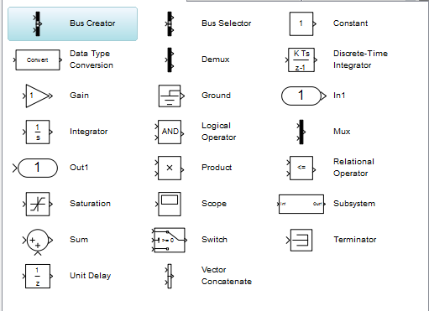
模块库简介—Commonly Used blocks
将最常用的基本模块集中在一起形成的。

Slide 8
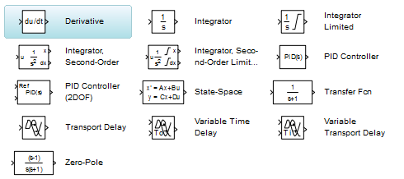
模块库简介—Continuous

Slide 9
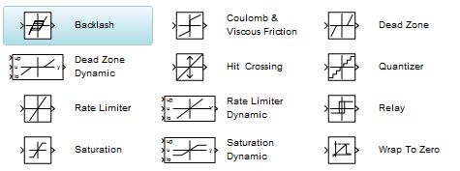
模块库简介—Discontinues

Slide 10
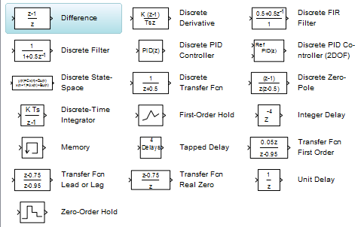
模块库简介--Discrete

Slide 11
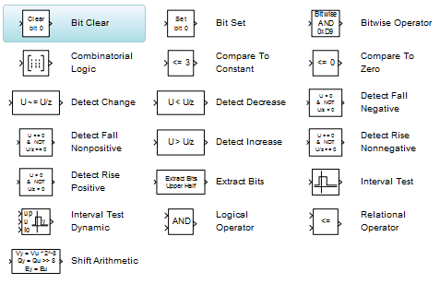
模块库简介—Logic and Bit Operation

Slide 12
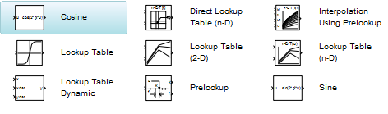
模块库简介—Lookup Tables

Slide 13
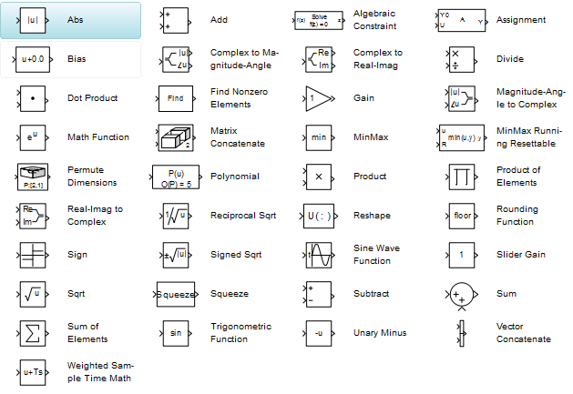
模块库简介—Math Operations

Slide 14
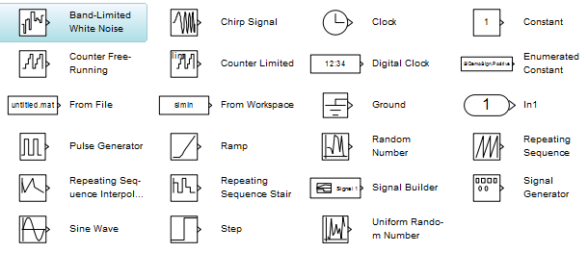
模块库简介—Sources
信号源模块库包含各种信号生成模块
模块与子系统输入信号源：In1，Ground, From File, From Workspace
信号生成器: 其余的

Slide 15
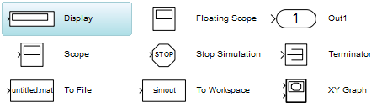
模块库简介—Sinks
接收模块库
模块与子系统输出: Out1
数据观察器:Terminator, To File, To Workspace
仿真终止模块:其余的

Slide 16
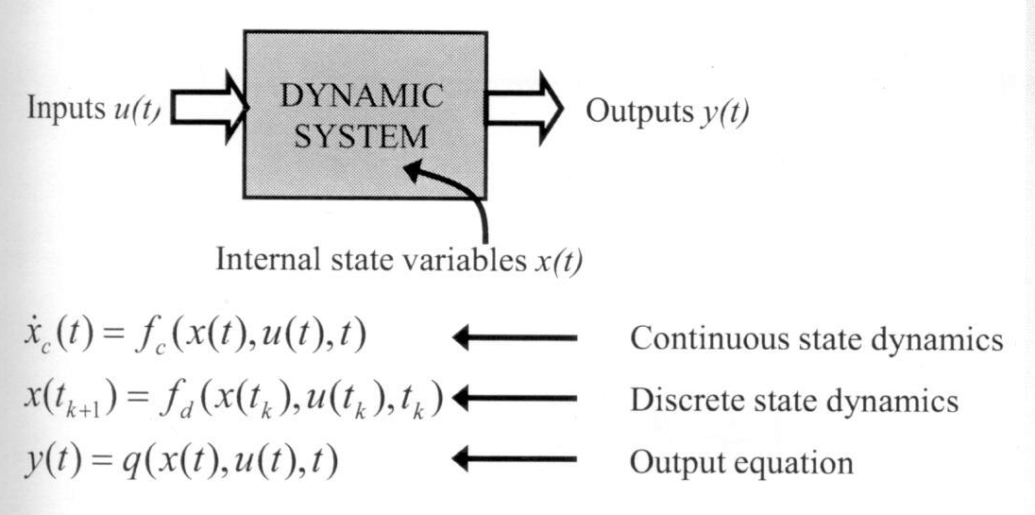
Overview of a General Dynamic System
Continuous state dynamics: the first derivative of the state vector is a function of the state, input, and time
Discrete state dynamics: the next value of the state depends on the current state, input and time
Outputs: the output value is a function of states, inputs and time.

Slide 17
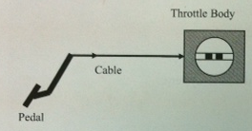
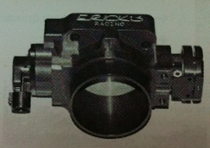
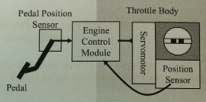
Electronic Throttle Control (电子油门控制系统)

Slide 18
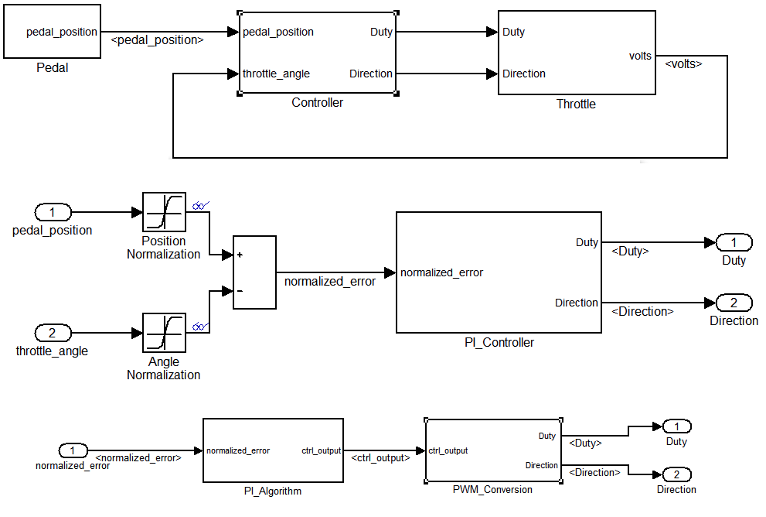

Slide 19
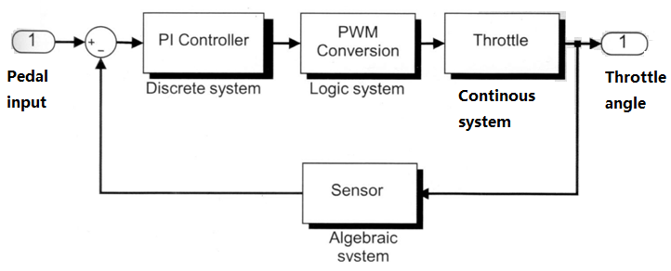
Layout

Slide 20
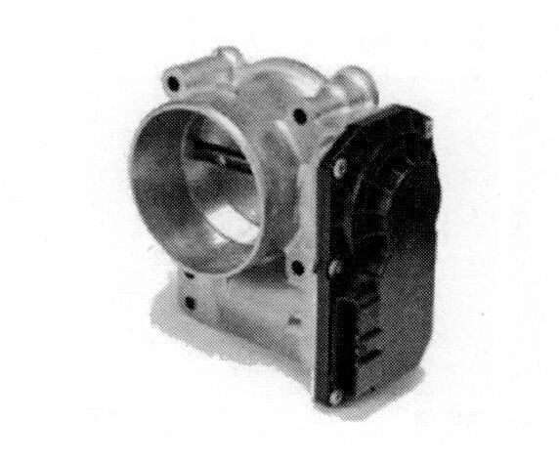
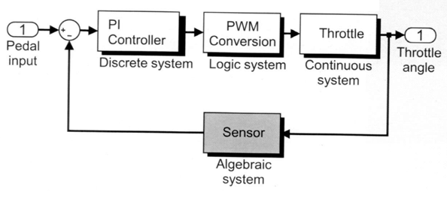
Modeling Sensor
Define the potentiometer(电位计) system
Simulate the model and analyze results

Slide 21
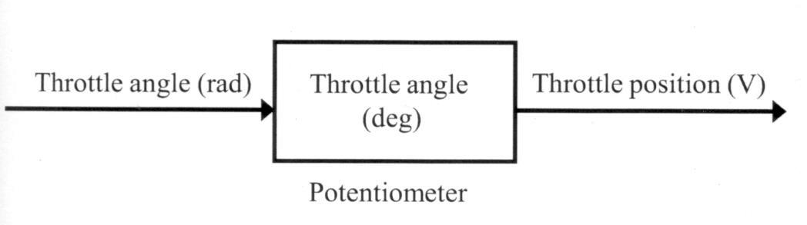
Defining the System and Identifying Its Components
One of the outputs of the throttle subsystem is its angle. This is computed in radians and needs to be translated to degrees for analysis, and then translated to voltage for use in the controller by a potentiometer.
Before modeling the system with equations, answer the following questions:
How many inputs?
How many outputs?
How many states?
What are the parameters?
Are there any intermediate signals?

Slide 22
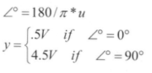
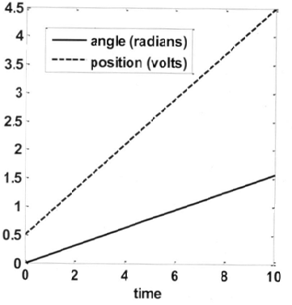
Modeling the System with Equations
the relationship between the angle in radians, u, and the position in volts, y.
Computing y using a lookup table angles between 0º and 90º.

Slide 23
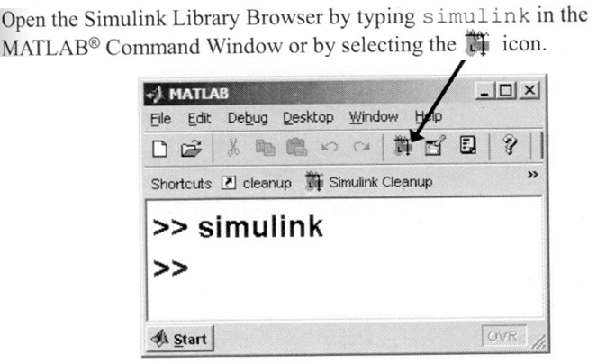
Starting Simulink

Slide 24
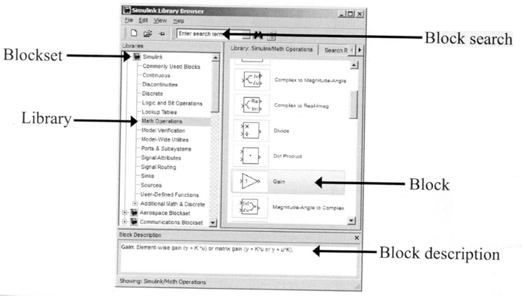
Using the Simulink Library Browser

Slide 25
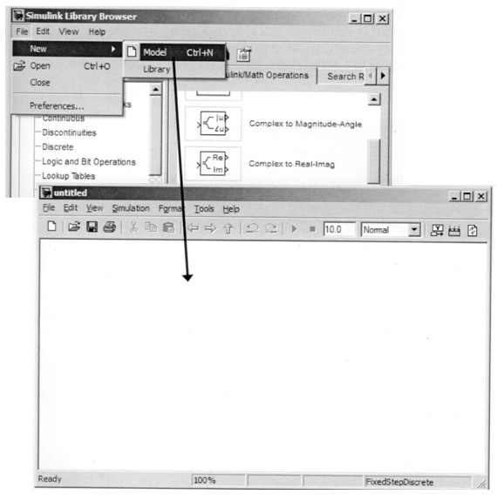
Building a Block Diagram for the Model

Slide 26
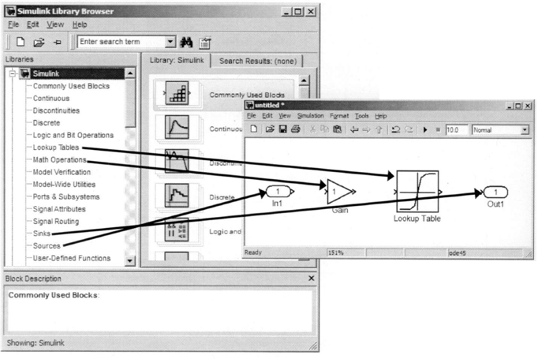
Adding Blocks
To add blocks, drag and drop them from the Simulink Library Browser into the model.

Slide 27
blocks
(Sources)输入信号的接口： In1
(Sink)输出信号的接口：Out1
(Math Operation)增益模块Gain,设置信号放大的倍数；
(Lookup Table)基本一维表格查询模块
低版本：Lookup Table;
高版本2011a: 1-D Lookup Table

Slide 28
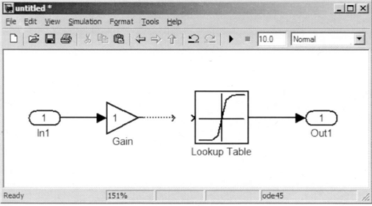
Connecting Blocks
To connect blocks, select the output port of the source block, and then left-click and drag a line to the destination block.

Slide 29
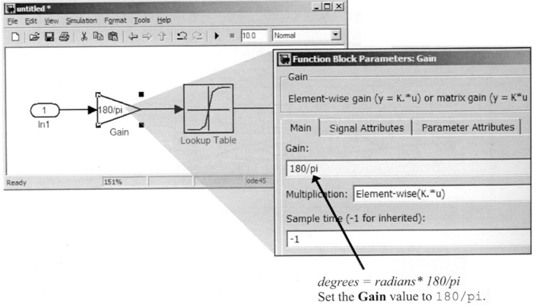
Defining the Block Parameters
To view and modify block parameters, double-click the block icon.

Slide 30
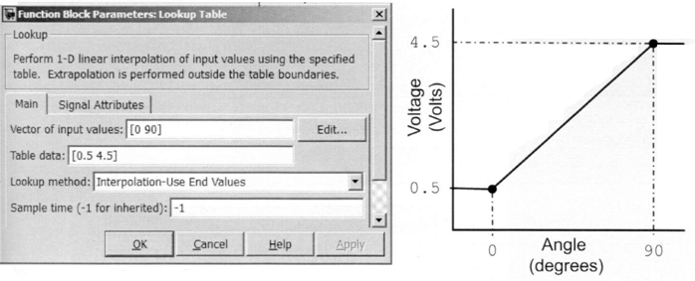
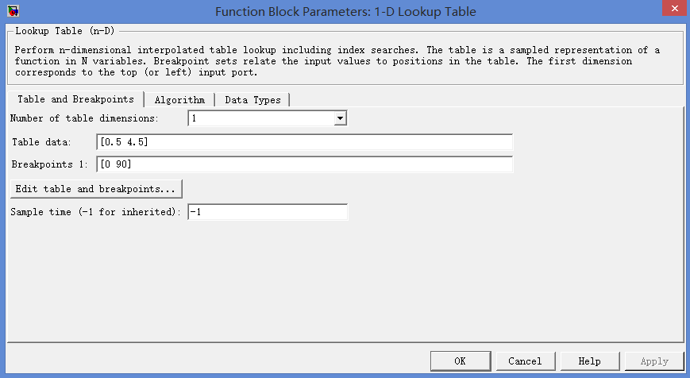

Defining the Lookup Table Parameters

Slide 31
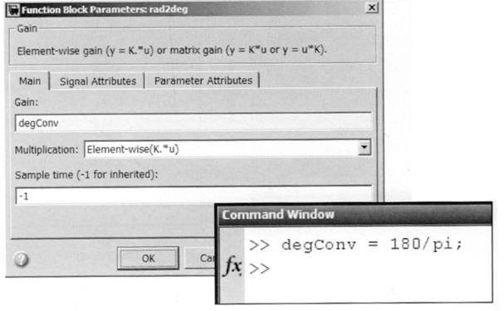
Defining the parameter Values Using MATLAB®

Slide 32
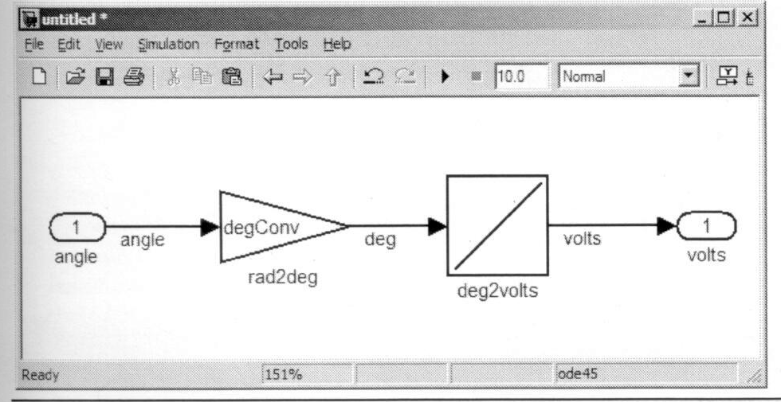
Labeling Blocks and Signals
To rename a block, click the block label and edit.
Block labels must be unique.
To label a signal, double-click the signal line and enter text.

Slide 33
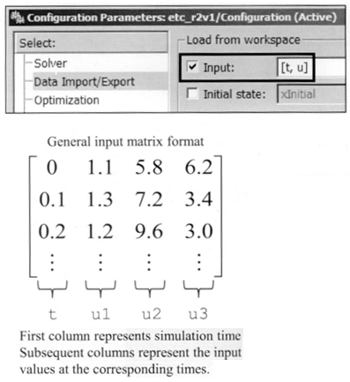
Defining the System Output
Signals can be loaded from the MATLAB workspace.
Simulation →Configuration Parameters →Data Import/Export
Define t and u in the MATLAB workspace
>>t= linspace(1,10,101)’;
>>u=linspace(0,pi/2,101)’;

Slide 34
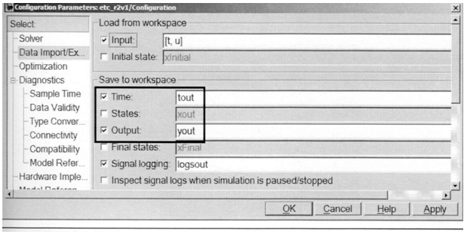
Defining the System Output

Slide 35
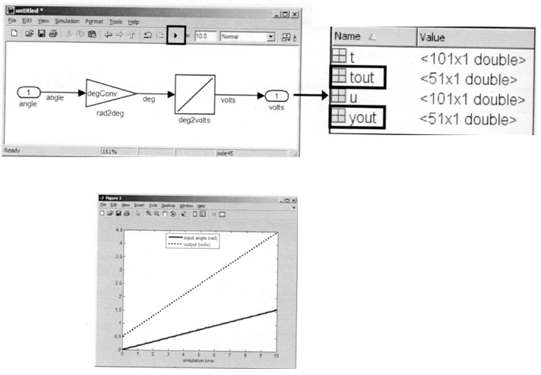
Simulating the Model and visualizing the Response
Visualize the simulations response:
>>plot(t,u,tout,yout,’k:’)
>>xlabel(‘simulation time’)
>>legend(‘input angle (rad)’ , ’output (volts)’)

Slide 36
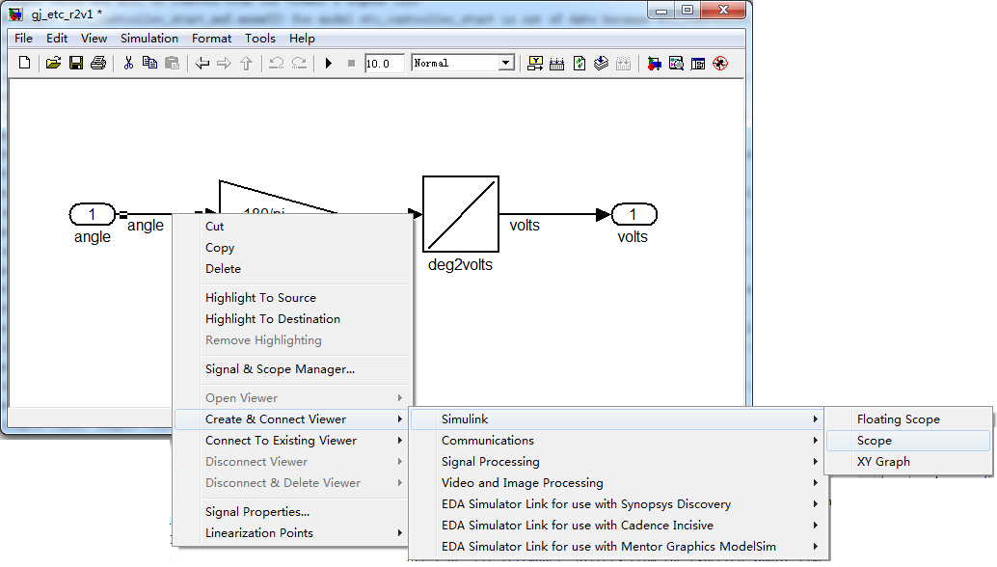
Adding Signal Viewers

Slide 37
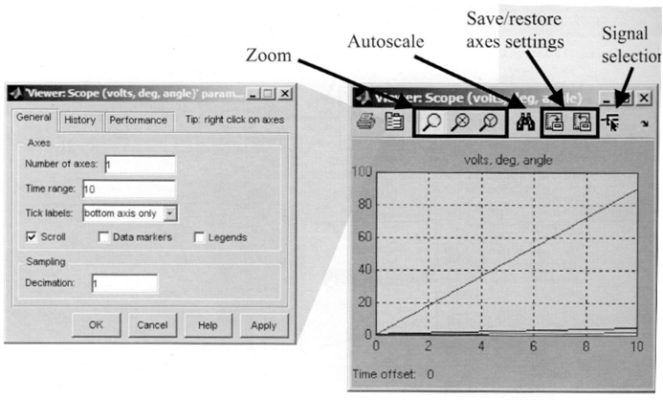
Modifying the Viewer Parameters

Slide 38
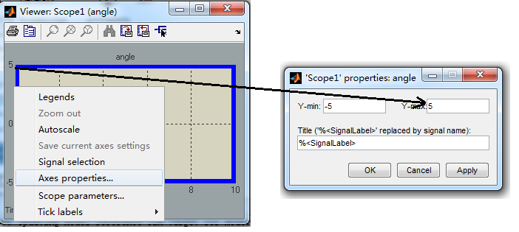
Controlling the Vertical Limits of the Viewer
Open the axis properties dialog box by selecting Axes properties from the context menu after right-clicking →preperty in the axis.

Slide 39
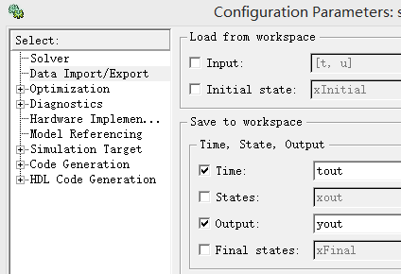
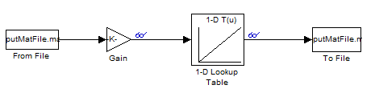
Data from file

Slide 40
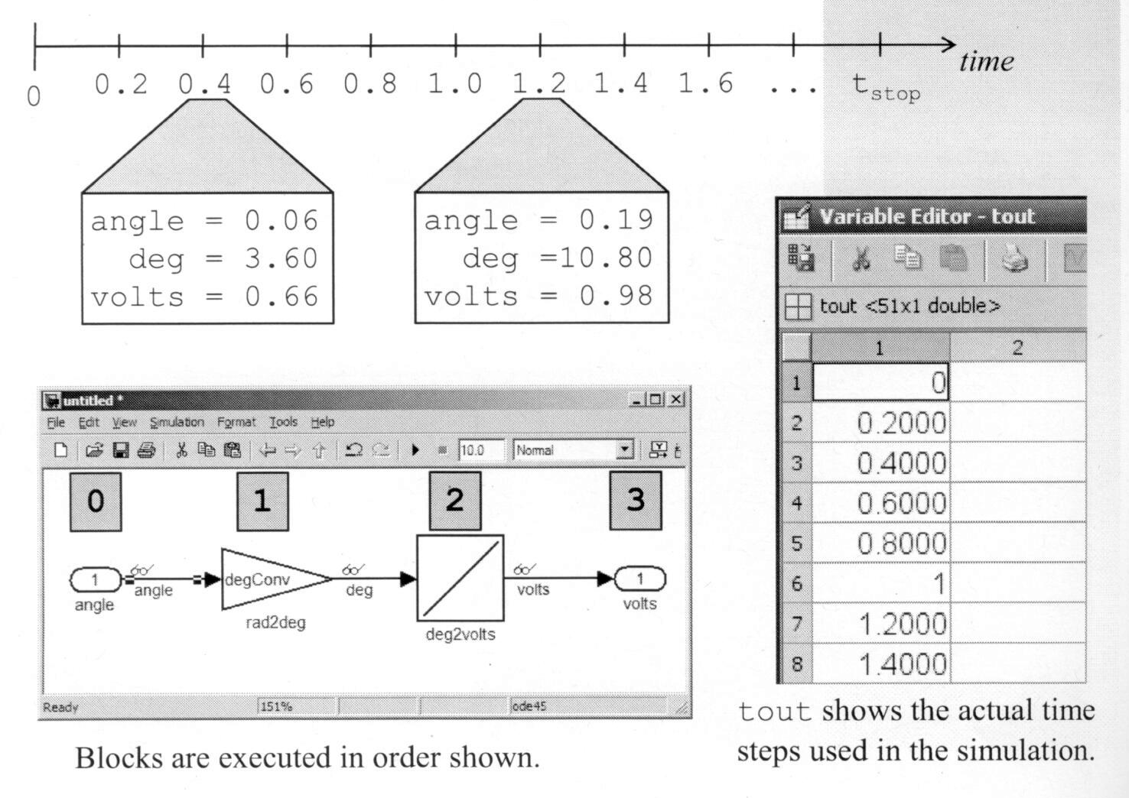
Overview of Simulink® Solver
Model is simulated using a series of discrete time steps.

Slide 41
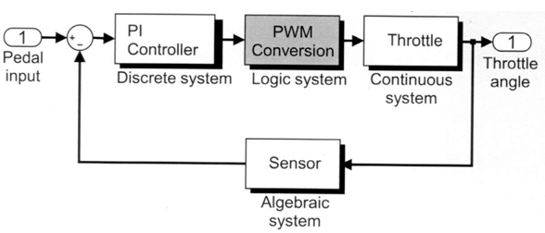
Modeling PWM conversion system
Model comparisons and decision statements
Model the PWM conversion system
Vector signals
Embedded MATLAB® Function block.

Slide 42
Approaches to Modeling Programming Constructs
Common programming constructs
Relational comparisons(<, >, ==, etc.)
Logical operators( AND, OR, NOT, etc.)
Decision statements(if-else, switch-case, etc.)
Loop constructs(for-loop, while-loop, etc.)

Slide 43
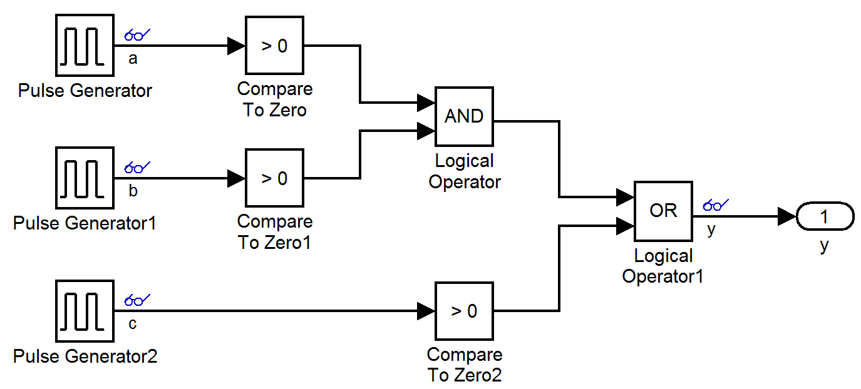
Modeling Comparisons
blocks are in the Logic and Bit Operation library

Slide 44
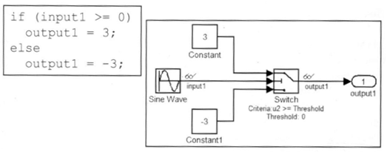
Modeling Decision Statements
blocks are in the Signal Routing library
Switch模块的第二个信号与阈值的比较，若真，执行上面的赋值为3，否则赋值为-3；

Slide 45
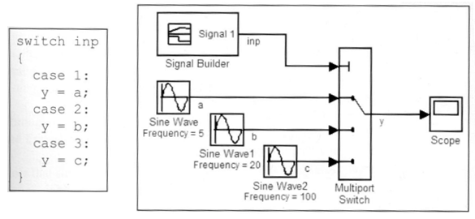
Modeling Decision Statements
blocks are in the Signal Routing library
Multiport Switch模块的第一个信号与阈值的比较，若为1，执行第二行的赋值，若为2,3，依次为执行第三、四的赋值；

Slide 46
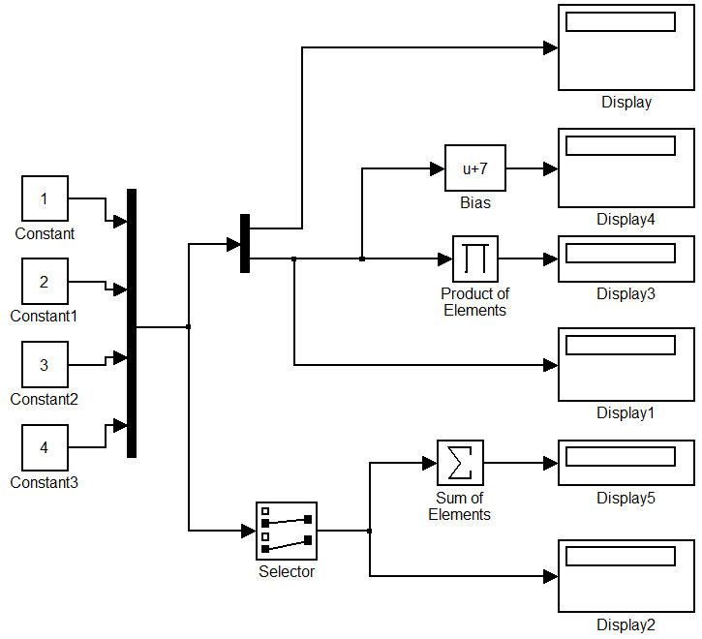
Extracting and Combining Data Using Vectors
Most blocks are in the Signal Routing library
Mux-----Concatenate two or more signals into a vector signal
Demux-----Split a vector signal into separate signals
Selector-----Output specific elements of a vector signal，（用于从向量中、矩阵或多维信号中选择输入元素）。

Slide 47
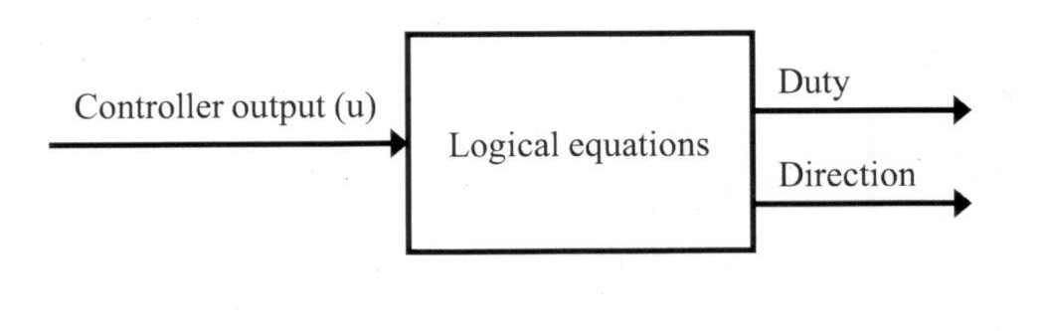
Defining the System and Identifying Its Components
The variables in this system are the controller output(u), duty, and direction
The controller output, u, is the system input.
Duty and direction are the system outputs.
There are no state or parameters to this system both duty and direction are computed directly from the input signal.

Slide 48
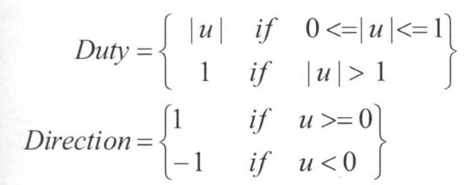
Modeling the System with Equations
The system input is u. duty and direction are the system outputs.
The duty is constrained to fall within the range of 0<=duty<=1.

Slide 49
blocks
Abs: 求一个数的绝对值；
Saturation：饱和度模块，对一个信号限定上下限，当输入在有Lower limit 和Upper limit参数指定的范围内时，输入信号无变化输出。若超出，则信号就被限幅（值为上限或下限）

Slide 50
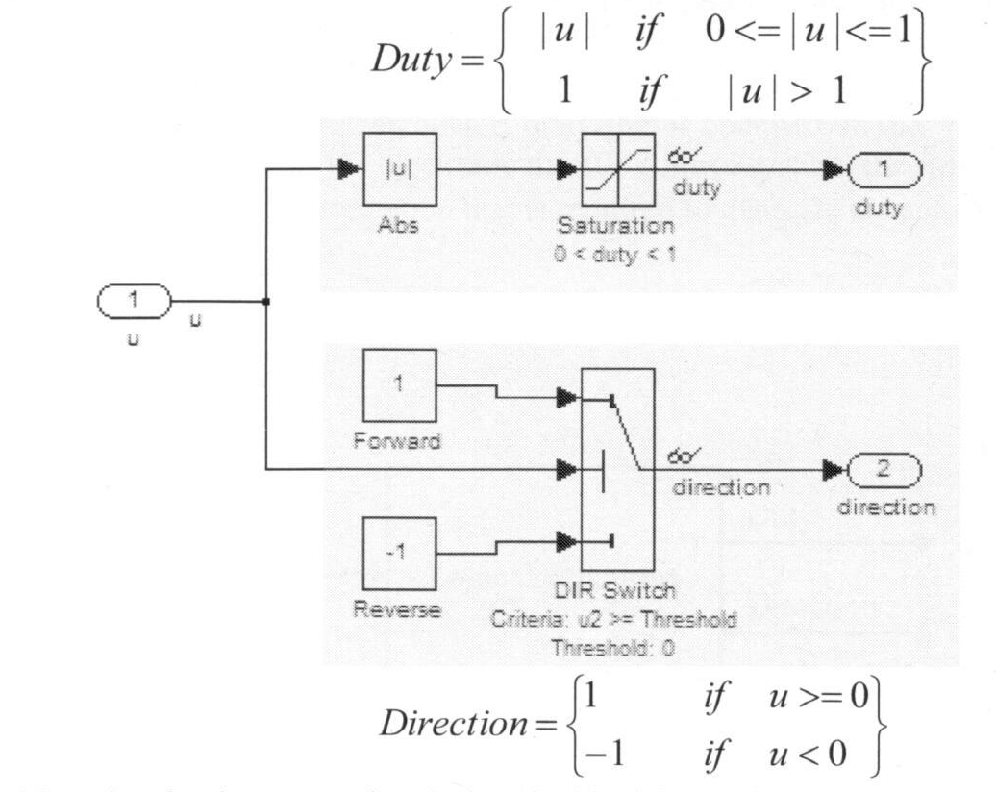
Building a Block Diagram for the Model

Slide 51
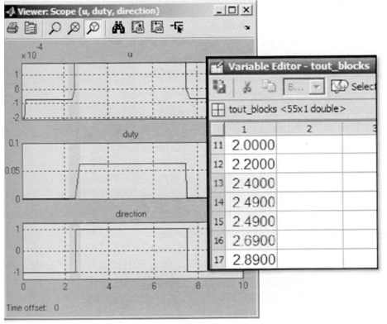
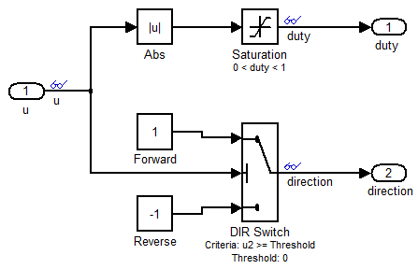
Zero Crossing Detection
Blocks with discontinuous behavior can cause the solver to take additional time steps before and after a discontinuity.

Slide 52
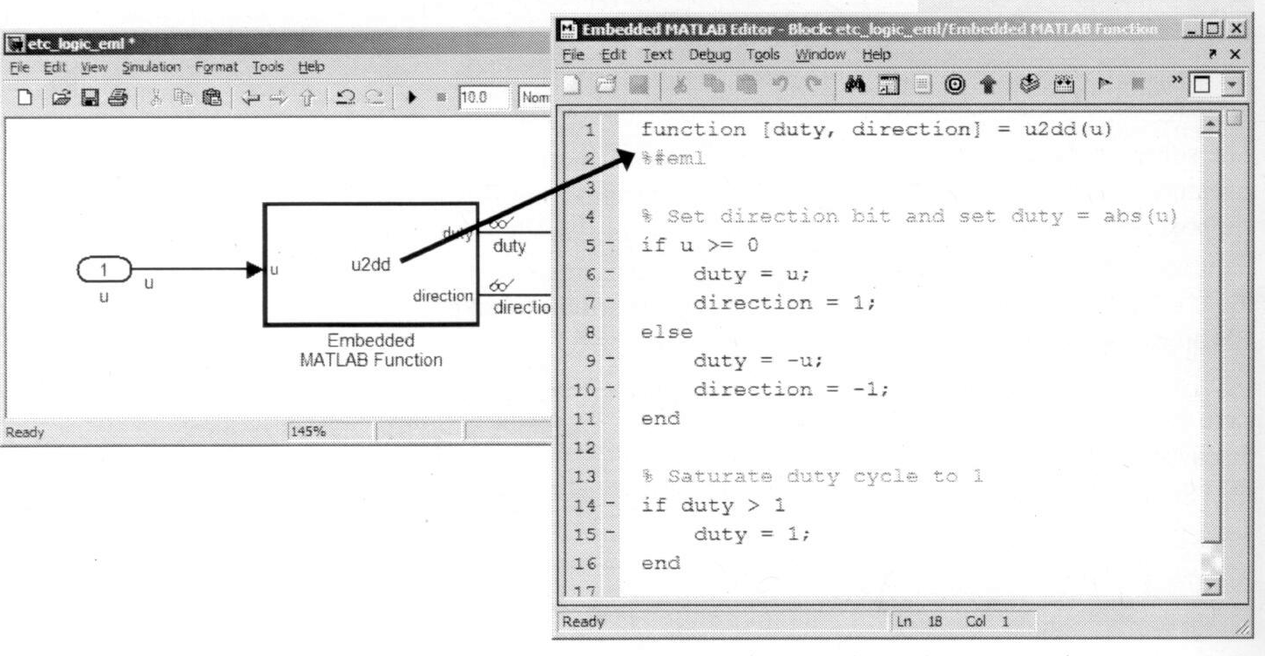
Modeling Logic with Embedded MATLAB® Function Blocks
using Embedded MATLAB Function block in user defined function library

Slide 53


Understanding the Embedded MATLAB® Function Block
Embedded MATLAB Library
Supported functions are simulated via code generation
Non-supported functions call MATLAB interpreter

Slide 54

PI controller system modeling
Define the PI controller system
Define discrete states
Create a model of the PI controller
Model discrete transfer functions and state-space systems

Slide 55
Defining the System
The proportional integral (PI) controller is the throttle plate position controller.
It receives throttle position sensory information and throttle position command information,
and then determines the needed motor-control voltage, the corresponding pulse-width modulation duty cycle, and direction to produce the needed voltage.

Slide 56

Defining Discrete System Characteristics
Dynamics are updated at a finite time interval referred to as the sample time.
System outputs can depend on memory elements (referred to as discrete states), system inputs, and/or time.
The mathematical representation of a discrete-state system is:
State update equation:
x(k)=f(x(k-1),u(k),k)
Output equation:
y(k)=f(x(k),x(k-1),…, u(k),k)

Slide 57

Modeling Difference Equations
The Unit Delay block in Discrete block set is the generic building block of difference equations.
It holds and delays its input for a sample period.
It requires a sample time and initial conditions.

Slide 58
Modeling Difference Equations (Continued)
Determine the number of Unit Delay blocks required (one for each sample difference):
For example, x(k)=x(k-1)+u(k)-u(k-1)
Two are necessary: x(k)=>x(k-1), u(k)=>u(k-1)
Starting with the Unit Delay blocks, provide proper labels to their input and output signals.
Construct its right side one difference equation at a time.
Connect the returned signal of its right side as a source to its left side if necessary.
Set the sample time and assign initial conditions.

Slide 59
Modeling the System with Equations
A discrete PI controller is used as the throttle position controller based on the following equation.
y(k)=y_{p}(k)+y_{i} (k)
where
y_{p}(k)=K_{p}e(k)
y_{i}(k)=y_{i}(k-1)+K_{i}T_{s}e(k)
-1<y_{i}(k)<1
e(k)——Error(difference between desired output and actual output)
T_{s} —— Sample Time
K_{p}—— Proportional gain
K_{i}—— Integral gain

Slide 60


Building a Block Diagram Model of the System
y(k)=y_{p}(k)+y_{i} (k)
y_{p}(k)=K_{p}e(k)
y_{i}(k)=y_{i}(k-1)+K_{i}T_{s}e(k)
-1<y_{i}(k)<1

Slide 61

Modeling Throttle system
Define the throttle system
Create a model of the throttle system
Define continuous states
Simulate the model and analyze results
Model impact dynamics

Slide 62

Defining the System
The electronic throttle body opens and closes the throttle plate valve in accordance with the accelerator pedal effort, and controls the amount of an inducted into the engine.

Slide 63

Defining Continuous-State System Characteristics
Dynamics are updated at an infinitesimal time interval.
System outputs depend on memory elements referred to as continuous states, system inputs, and/or time.
Rates of continuous states govern the variation of system dynamics.
The mathematical representation of a continuous-state system is

Slide 64
Difference equation(差分方程)
Definition
微分方程的离散化，一个微分方程不一定可以解出精确地解，但把它变成差分方程，离散化后，就可以求出近似的解。
dy+y*dx=0 ,y(0)=1 是一个微分方程的， x取值[0,1] (注： 解为y(x)=e^(-x));
要实现微分方程的离散化，可以把x的区间分割为许多小区间 [0,1/n],[1/n,2/n],...[(n-1)/n,1]

Slide 65
Difference equation(差分方程)
微分方程可以离散化为差分方程：
y((k+1)/n)-y(k/n)+y(k/n)*(1/n)=0， k＝0,1,2,...,n-1 （n 个离散方程组）
利用y(0)=1的条件，以及上面的差分方程，就可以计算出 y(k/n) 的近似值了。

Slide 66

Modeling Differential Equations
Solve the equation for the highest order derivative term.
Determine the number of Integrator blocks required (one for each order of derivative) which blocks are in the continuous library.
Starting with the Integrator blocks, provide proper labels to their input and output signals.
One ordinary differential equation at a time, construct its right-hand side.
Connect returned signal of its right side as a source to its left side if necessary
Assign initial conditions.

Slide 67

Identifying the System Components
System Input:
T(t) = Torque

Slide 68

Modeling the System with Equations

Slide 69



Continuous blocks
Integrator:只有初始条件
Integrator Limited: 上下界是有限制的。

Slide 70

Building a Block Diagram form the Model

Slide 71


Defining Block Parameters
初始条件：
参 数：

Slide 72



Defining the System I/O
Simulation →Configuration Parameters →Data Import/Export

Slide 73

Modeling Physical Boundaries (Integrator, Second-Order)
Angular velocity is zero when angle is saturated.

Slide 74
Introducing Subsystems
Using subsystems has these advantages:
It helps reduce the number of blocks displayed in you model window
It allows you to keep functionality related blocks together
It enables you to establish a hierarchical block diagram

Slide 75
Creating subsystems
Add a subsystem block to your model, open that block, and add the blocks to the subsystem window
Select the blocks that make up the subsystem, and then select Edit→Creat subsystem
Example

Slide 76


Slide 77
Handling cross-system gateways
After creating a subsystem, notice that inports and outports are automatically inserted and connected.
Inport and outport are the gateways between the subsystem and its parent
Each inport/outport is associated with an input/output port of the subsystem
The block label is the same as the port name

Slide 78
Using subsystems to create a visual hierarchy
Subsystem can been dragged and dropped into other models.
Ways
Open two models
Copy the subsystem into the other model
Simplify the diagram by making a subsystem
example

Slide 79




Slide 80
Summary
Build a continuous system
Build a discrete system
Build subsystem

