Slide 1


求实创造 为人师表
Measuring the Consistency
Between Data and Control Plane in SDN
author：Kai Lei , Guanjie Lin , Meimei Zhang, Keke Li, Qi Li, Xiaojun Jing, and Peng Wang
汇报人：张建夫 郑凯夫 孙涵彬
时间：2025/11/28

Slide 2
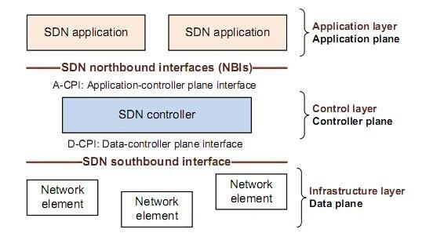
00
A Brief Introduction to SDN
SDN:software defined network(软件定义网络)
应用层面
控制层面
Inconsistency
（不一致性）
数据层面
求实创造 为人师表
JUNE 12th

Slide 3
00
Why is Inconsistency a Problem
1
security risks ：bypass firewalls
2
performance degradation ：cause forwarding loops
3
packet loss ：lead to black holes

Slide 4
00
Main Causes for this Inconsistency
01.Lack of Acknowledgement
OpenFlow switches don't confirm
every single rule installation.
02.Switch Failures
Software bugs or hardware faults may
cause a switch to ignore priority levels.
03.External Modifications
Attackers or 3rd-party tools (like ONIE) might
tamper with rules directly.
04.Network Updates
Asynchronous updates lead to
transient inconsistencies.

Slide 5

00
Existing Solutions and their limitations
Out-of-band (using probe packets)
（使用探测包）
Pros: No tag overhead.
Cons: Too Slow. Minutes to generate probes (Unsuitable for dynamic networks).
2MVeri Approach
2MVeri aims to be In-band, low overhead, and capable of precise fault localization.
In-band (using tags in real traffic)
（在真实流量中使用标签）
Pros: Real-time checks.
Cons: High Storage Overhead
(Stores path hop-by-hop).
Many cannot pinpoint which switch failed.

Slide 6

1
Packet Processing
Carried out on switches to update tags.
Three Subsystems
of 2MVeri
2
Verification
Carried out on the controller to check consistency.
3
Localization
Triggered only when verification fails.

Slide 7
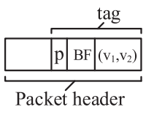
01
Packet Processing
A 16-bit Bloom Filter (BF)
Records switch IDs.
A 2D Vector ((v1,v2))
Captures path state.
A Modulus (p)
Prevents overflow.
Each switch holds a unique 2x2 Characteristic Matrix assigned by the controller.
求实创造 为人师表

Slide 8
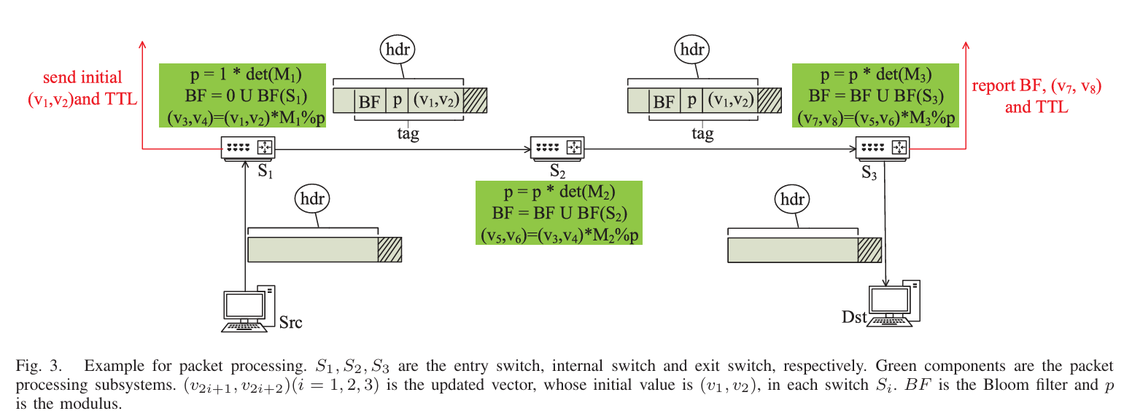
01
Packet Processing
Initialization
Update
Reporting
At the Entry Switch, we sample a flow. We initialize the vector
(v₁,v₂) and the modulus p.
This is the critical part. At each Internal Switch Si, the tag is updated using this formula:
v_{new}=(v_{old}×M_{i})%p.
At the Exit Switch, the tag is stripped and sent to the controller.

Slide 9
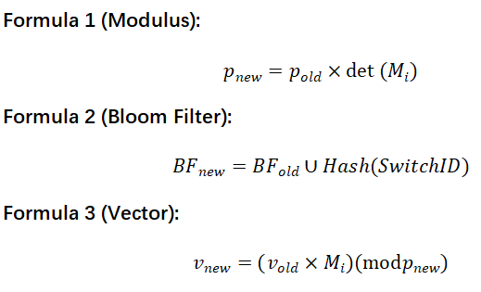
04
Packet Processing
The switch multiplies the current modulus p by its own matrix determinant. pnew=p*det(M). This causes the modulus to grow hop-by-hop.
Modulus Update
Bloom Filter
The switch ORs its ID into the filter to record its presence.
Vector Update
•The vector is multiplied by the switch Matrix M, and then modulo is applied using the newly updated modulus.

Slide 10
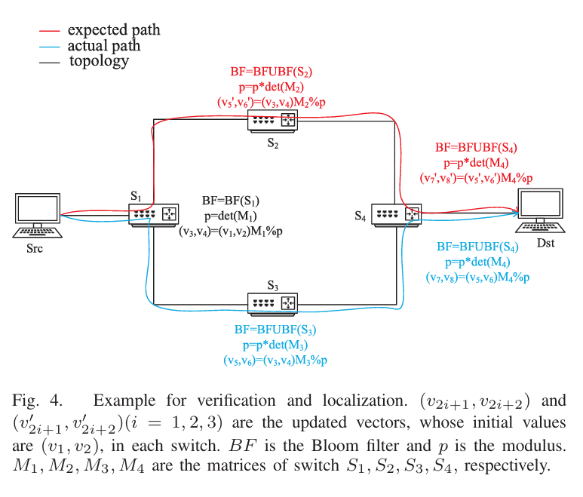
01
Verification
•Controller:
Contains global topology & path expectations.
•Process:
1.Look up Expected Path for Flow F
2.Compute Tag_{correct} using matrices of expected switches.
3.Receive Tag_{reported} from Exit Switch.
4.Compare: if (Tag_rep == Tag_corr) return Consistent;
求实创造 为人师表

Slide 11
03
Localization
Visual
A tree structure rooted at the Exit Switch.
Goal
Find path back to Entry Switch.
Core Idea
Use Inverse Matrix (M−1) to "undo" the multiplication
Stop Condition
Path Length == TTL Difference.
求实创造 为人师表

Slide 12
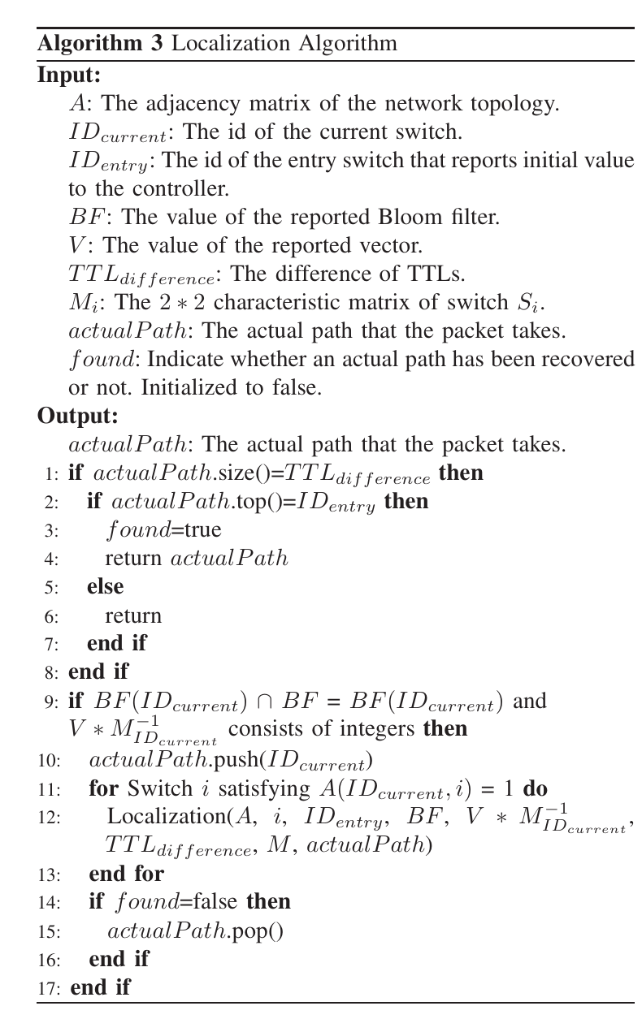
03
Localization
Check1:The Bloom Filter
Is the neighbor's ID present in the reported Bloom Filter? This is a fast filter.
Check2:The Integer Property
This is the mathematical guarantee.
We calculate V×M⁻¹.
求实创造 为人师表

Slide 13

PART-04
Theoretical Rationale

Slide 14
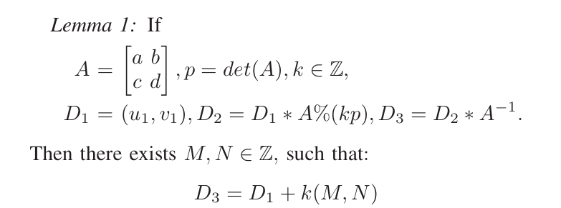
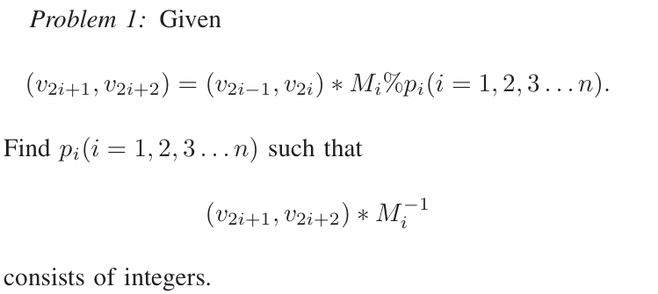
00
Modulus
Now, we must address a theoretical challenge. How to choose Modulus?
Lemma 1
We solved this with Lemma 1.
The Idea: we set the Modulus p to be a multiple of the determinants of the matrices along the path.
The Proof: We proved that Dnew = Dold ∗A−1 will always result in integers if the modulus encompasses the determinant.
Problem 1

Slide 15
01
Other Rationale
1.Column vectors cannot be multiples of each other (to ensure invertibility).
2.Determinants should be small integers (like 3 or 4) to keep the modulus from growing too fast, yet strictly >2 to avoid high false negatives.

Slide 16
PART-05
Evaluation

Slide 17
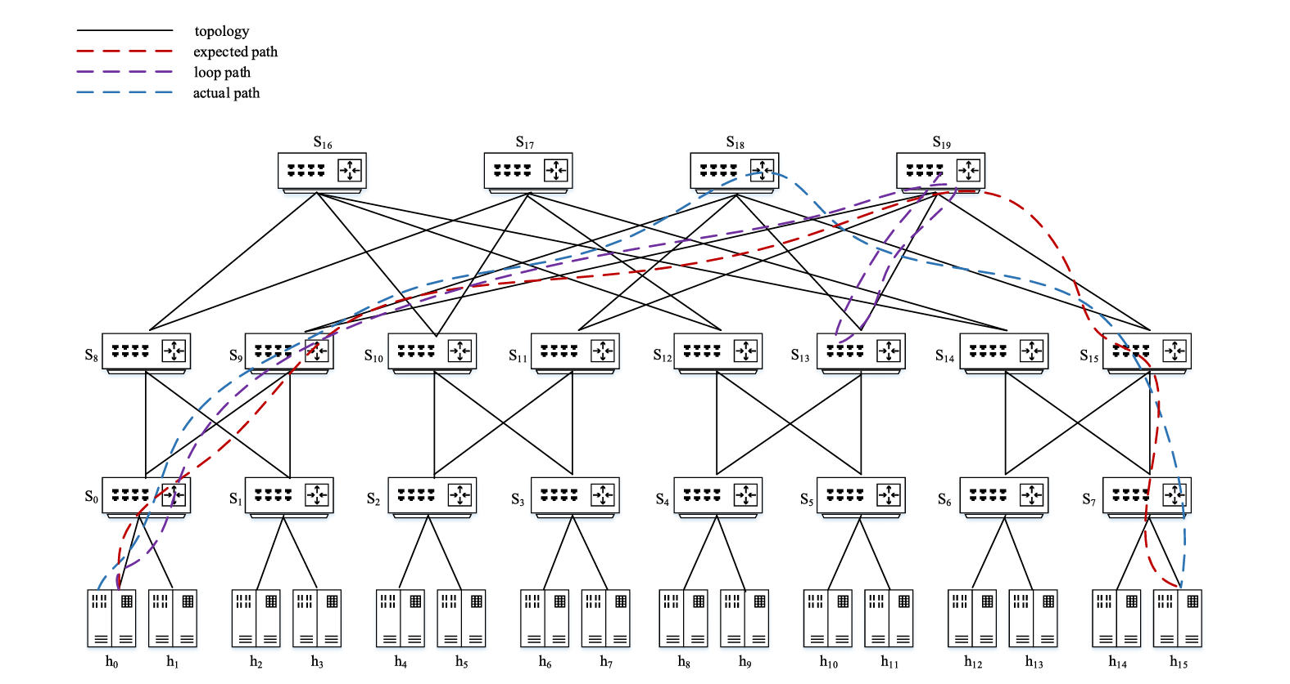
00
Experiment Setup
1、Fat Tree topologies （k=4 and k=6）
Representing standard data center architectures.
2、Stanford Backbone
A real-world wide area network topology to ensure our solution works in complex, non-regular environments.

Slide 18
03
Function Test
Scenario 1: Black Hole.
We modified a switch rule to drop packets. 2MVeri detected the missing tags immediately.
Scenario 2: Path Deviation.
We forced a switch to forward packets to a wrong port. The verification failed because the matrix multiplication result didn't match the expected value. 2MVeri successfully recovered the actual path and located the deviating switch.
Scenario 3: Forwarding Loop.
We created a loop between two switches. The reported tag became inconsistent due to repeated multiplications.
求实创造 为人师表

Slide 19
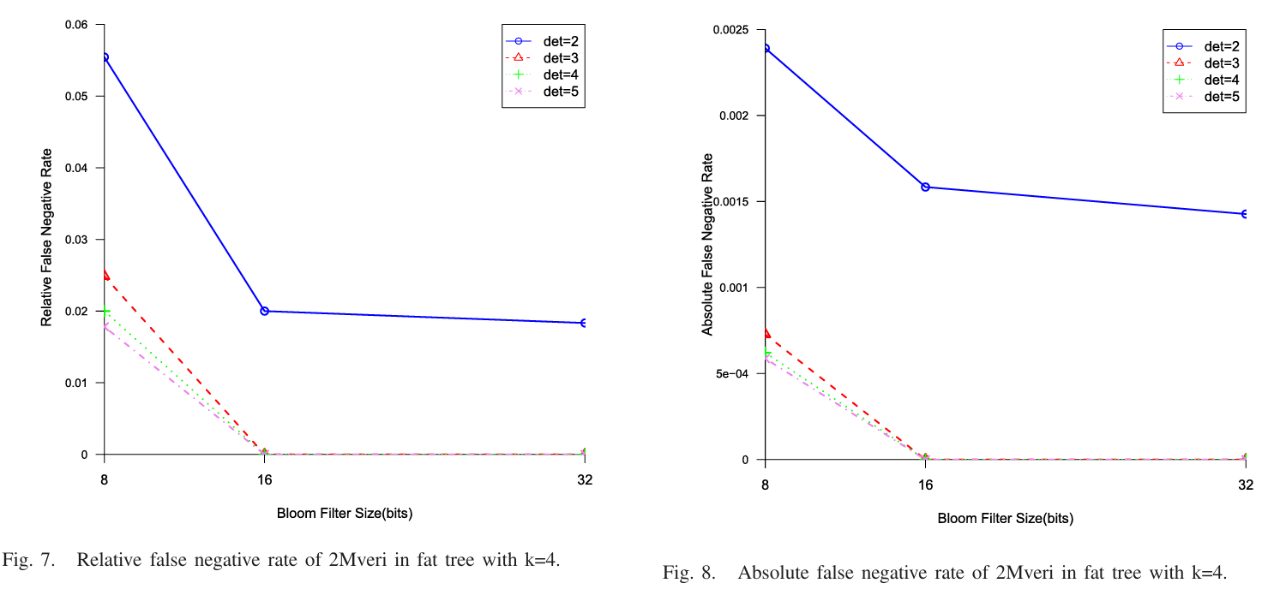
01
Verification Accuracy & Localization Accuracy
Now, let's look at the quantitative data. This is crucial. We analyzed how the Matrix Determinant affects accuracy.
With a determinant ≥3 , 2MVeri achieves 100% Verification Accuracy and 99.8% Localization Accuracy. This empirically proves our theoretical choice of using cumulative determinants (行列式累乘）.

Slide 20
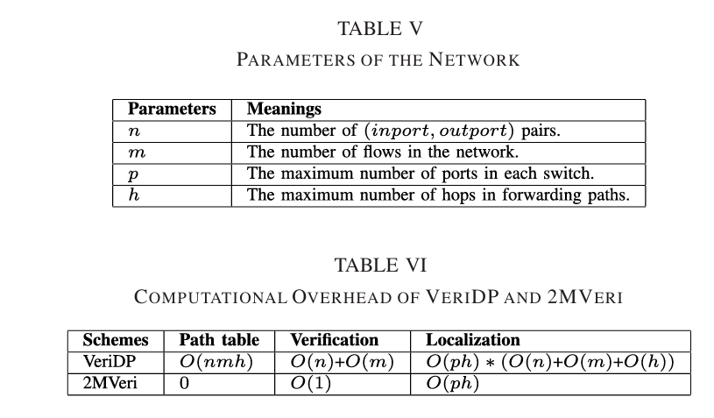
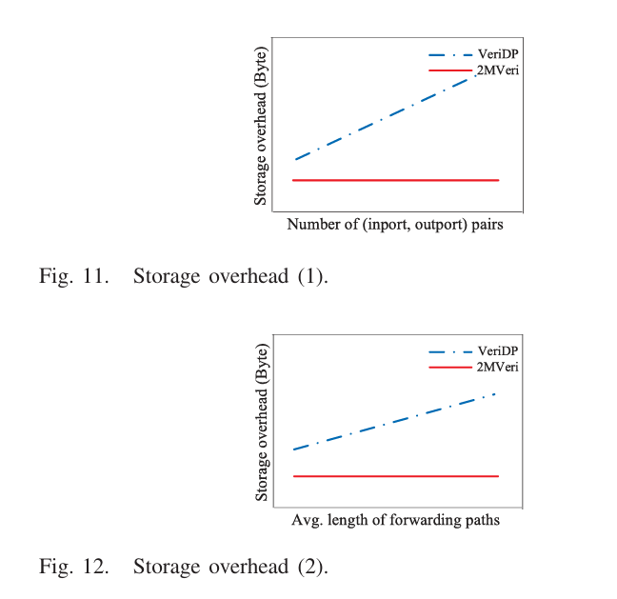
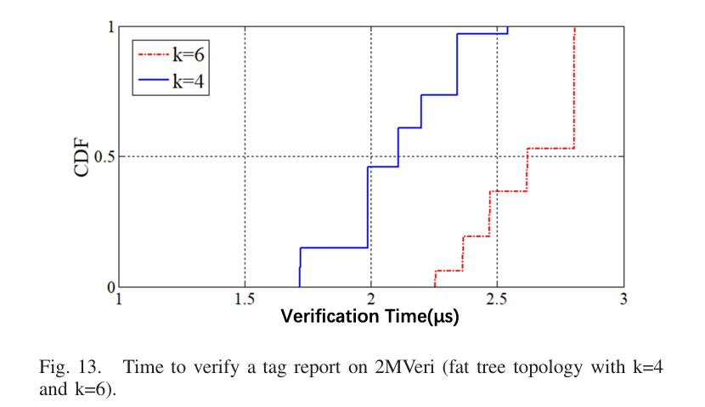
01
Overhead
Storage Overhead
Computation Overhead

Slide 21
PART-06
Futrue Work & Recap

Slide 22
03
Futrue Work
First, Protocol Independence
Currently, our implementation is tailored for the IPv4 scenario. We plan to extend 2MVeri to scenarios where multiple protocols coexist.
Second, P4 Implementation
We are looking to migrate the framework from Open vSwitch to P4 programmable switches. P4 offers greater flexibility and programmability, which would allow 2MVeri to run entirely in the data plane hardware, further reducing latency.
Third, Edge Cases
Our paper notes a specific challenge: what if the actual path is the same as the expected path, but the rules matched on the switches are different? We plan to conduct further research to detect this subtle form of inconsistency.
求实创造 为人师表

Slide 23
03
Advantages Recap
Innovative Design
It is the first framework to exploit Matrix Multiplication combined with Modular Arithmetic for in-band path verification. This theoretically solves the overflow problem while preserving path information.
High Accuracy
Through rigorous math proofs and experiments, we achieved 100% verification accuracy and 99.8% fault localization accuracy, outperforming existing solutions.
Low Overhead
By reusing existing header fields and requiring only constant control plane storage, 2MVeri is highly efficient and scalable for large networks.
求实创造 为人师表

