Slide 1


Personal Computer History

Slide 2
Personal computer history doesn’t begin with IBM or Microsoft, although Microsoft was an early participant in the fledgling PC industry.
Fledge vi. 长羽毛, (幼虫)长翅(变成成虫) vt.喂养, 用羽毛盖上, 装上羽毛
Fledgling n. 羽毛初长的雏鸟, 初出茅庐的人
adj. New and untried or inexperienced
年轻的,无经验的

Slide 3
1975
The first personal computers, introduced in 1975, came as kits: The MITS Altair 8800, followed by the IMSAI 8080, an Altair clone. Both used the Intel 8080 CPU. That was also the year Zilog created the Z-80 processor and MOS Technology produced the 6502. Bill Gates and Paul Allen wrote a BASIC compiler for the Altair and formed Microsoft.
Kit: a set of parts or materials to be assembled
全套元件：用于装配的一套元件或材料

Slide 4
The MITS Altair 8800 was a microcomputer design from 1975, based on the Intel 8080 CPU and sold as a mail-order kit through advertisements in Popular Electronics, Radio-Electronics and other hobbyist magazines. The designers intended to sell only a few hundred to hobbyists, and were surprised when they sold thousands in the first month. Today the Altair is widely recognized as the spark that led to the personal computer revolution of the next few years: The computer bus designed for the Altair was to become a de facto （Actually exercising power though not legally or officially established 事实上的，实际上的 ）standard in the form of the S-100 bus, and the first programming language for the machine was Microsoft's founding product, Altair BASIC.

Slide 5
1975
The IMSAI 8080(IMS Associates.doc）as an early microcomputer released in late 1975, based on the Intel 8080 and later 8085 and S-100 bus^{[1]}. It was compatible with its main competitor, the earlier MITS Altair 8800, by which it was inspired. The IMSAI is largely regarded as the first "clone" computer.

Slide 6
MOS Technology, Inc. (“MOS” being short for Metal Oxide Semiconductor), also known as CSG (Commodore Semiconductor Group), was a semiconductor design and fabrication company based in Norristown, Pennsylvania, in the United States. It is most famous for its 6502 microprocessor, and various designs for Commodore International's range of home computers.

Slide 7
1977
The young industry exploded in 1977 as Apple introduced the Apple II, a color computer with expansion slots and floppy drive support; Radio Shack rolled out the TRS-80; Digital Research released CP/M, the 8-bit operating system that provided the template for MS-DOS; and the first ComputerLand franchise store (then Computer Shack) opened.
explode : To increase suddenly, sharply, and without control
猛增：突然、猛烈而又难以控制的增长

Slide 8
1977
Expansion slot 扩展槽
floppy drive 软盘驱动器
roll sth out：to make a new product available for people to buy or use [= launch]:大量生产
CP/M (Control Program for Microcomputers) is an operating system originally created for Intel 8080/85 based microcomputers by Gary Kildall of Digital Research, Inc.

Slide 9
franchise: Authorization granted to someone to sell or distribute a company's goods or services in a certain area. 特许经营权：特许给个人在特定的领土内销售商品或提供服务的权利
Franchise store 专卖店

Slide 10
1978
Software took center stage in 1978 when Dan Bricklin and Bob Frankston produced VisiCalc, the first spreadsheet. This turned the personal computer into a useful business tool, not just a game machine or replacement for the electric typewriter.
spreadsheet [计] 电子制表软件, 电子数据表
centre stage： if someone or something is centre stage, it has everyone's attention, or is very important:

Slide 11
1978
Atari leveraged their video game experience and household name to enter the personal computing market, and Epson shipped the MX-80, the first low-cost dot matrix printer.
Leverage n. Positional advantage; power to act effectively 位置上的优势；有效的行动 v.tr. = To provide with leverage 利用，借助于
Household adj. Commonly known; familiar 家喻户晓的，熟悉的
Ship vt, vi[ technical]= to make a piece of computer equipment or software available for people to buy 推出(产品）

Slide 12
1979
The third important software category, the database, blasted onto the scene in 1979 with Vulcan, the predecessor of dBase II and its successors.
Blast vi. ＝ To emit a loud, intense sound; blare
吼叫：发出高声尖响
blast onto the scene 登场
dBase II was the first widely used database management system (DBMS) for microcomputers.

Slide 13
1980
But 1980 was the year Commodore opened the floodgates of home computing with the $299 VIC-20. Sinclaire tried to one-up them with a $199 kit computer that was quite popular in Britain, but it was destined to remain a bit player in the PC industry. The same can be said of Radio Shack’s fairly impressive Color Computer, which suffered primarily from complete incompatibility with their TRS-80 line.
Floodgate n. Something that restrains a flood or an outpouring 闸门，出口

Slide 14
1980
One-up vt. To keep one step ahead of (a competitor or an opponent, for example)
胜…一筹：领先一步（例如在比赛中或对抗赛中）
line: n. Merchandise or services of a similar or related nature
形式相似或相关的商品或服务

Slide 15
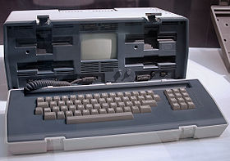
1981
In early 1981, Adam Osborne introduced the first portable computer. The Osborne 1 was about the size of a suitcase, ran CP/M, included a pair of 5.25 ” floppies, and had a tiny 5” display. The innovative machine was bundled with about $1,500-2,000 worth of software, and the whole package sold for $1,899.

Slide 16
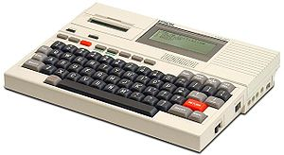
1981
The first laptop computer also arrived in 1981, the Epson HX-20 (a.k.a. Geneva). The HX-20 was about 8.5” by 11 “ and maybe 1.5-2” thick and used a microcassette to store data. If I recall correctly, it displayed 4 lines of 40 characters on an LCD screen above the keyboard.
a.k.a. = also known as 又名，亦称

Slide 17
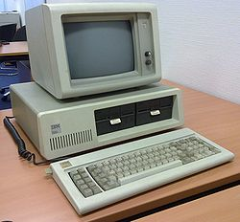
The IBM PC：1981
Of course, the most significant event of 1981 for the personal computing industry was the introduction of the IBM PC on August 12.
IBM PC (model 5150)
Type: Personal computer
Release date: August 12, 1981
Discontinued: April 2, 1987
Operating system: IBM BASIC / PC-DOS 1.0, CP/M-86, UCSD p-System
CPU: Intel 8088 @ 4.77 MHz
Memory: 16 kiB ~ 256 kiB

Slide 18
Buyers could get a fairly loaded machine with …
loaded with something：informal，full of a particular quality, or containing a lot of something
加载…

Slide 19
1981
The second most significant event of 1981 was dependent on the first: Microsoft got IBM to agree that DOS would not be an IBM exclusive. This paved the way for the clone industry, which in the end marginalized the influence of Big Blue.
Big Blue = IBM

Slide 20
1983
Apple Computer introduced the first consumer machine with a mouse and graphical user interface, the Lisa. Of course, at $10,000, not many consumers could afford it, but it paved the way for the Apple Macintosh of 1984. At $2,500, it was much more affordable than the Lisa.

Slide 21
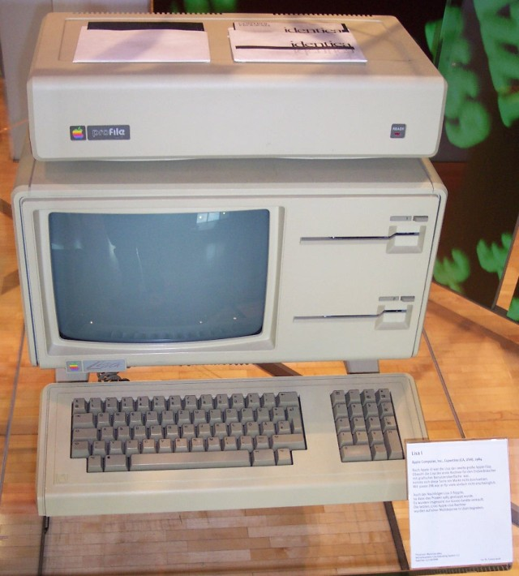
The Lisa

Slide 22
1985
Microsoft first shipped Windows in 1985, and the DOS shell was content to run even an old 4.77 MHz PCs, albeit slowly. That was also the year Aldus invented the fourth major software category by releasing PageMaker. Desktop publishing was born and Apple found a strong niche market for the Macintosh and LaserWriter.
albeit 虽然
Niche n. 1. A situation or an activity specially suited to a person‘s interests, abilities, or nature 适合于人的兴趣、能力或性格的环境或活动 2. A special area of demand for a product or service 产品或服务所需的特殊领域
niche market 市场定位

Slide 23
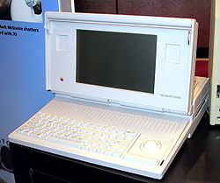
1989
The overall count was about 54 million personal computers in the U.S. in 1989, the vast majority of them running MS-DOS. Apple shipped the heavy (over 16 pounds!) Mac Portable, the first “laptop” computer with a built-in trackball and possibly the first with an active matrix display.

Slide 24
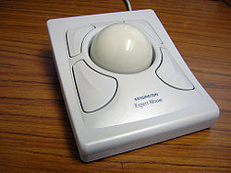
轨迹球（Trackball）是和鼠标等一样的电子计算机定点设备的一种。和机械式鼠标一样，轨迹球通过读取可滚动的球滚动的方向和速度来定位。不同的是，鼠标是基座和球一起动，而轨迹球只是球在基座上滚动，基座相对桌面不动。

Slide 25
1990
Windows moved forward to version 3.0 in 1990, and it was nearly ready for prime time. The first 486-based PCs shipped, and Apple trumped the DOS world’s 33 MHz computers with the “wicked fast” 40 MHz Macintosh II, which was also one of the first personal computers to use an accelerated video card.
prime time n. = The evening hours, generally between 7 and 11 p.m., when the largest television audience is available.
黄金时段，黄金时间：通常指晚间 七时至11时，电视观众最多的时段

Slide 26
Trump vt. = To get the better of (an adversary or a competitor, for example) by using a key, often hidden resource.
出王牌获胜：通过使用关键并隐蔽的手段超过（例如，对手或敌手）

Slide 27
1991
Linus Torvalds created his own version of Unix and named it Linux in August 1991. It remained obscure for a while, but it has grown to become the second major operating systems for Wintel computers and one of the leading examples of free open source software
Obscure adj. = Not readily noticed or seen; inconspicuous:不引人注意的：不会马上被发现的或看见的；
Wintel即Wintel架构。字面上是指由Microsoft Windows操作系统与Intel CPU所组成的个人计算机。实际上指Microsoft与Intel的商业联盟，该联盟意图并成功地取代了IBM公司在个人计算机市场上的主导地位。所以也称为Wintel联盟。这只是一种通俗的非官方说法

Slide 28
1992
Microsoft Windows 3.1 shipped in 1992. Between Windows and the hardware of the day, the resources existed for Windows to become a major player. Windows soon became the default operating system shipped with new PCs.

Slide 29
1995
Although the World Wide Web had been created many years earlier, it was in 1995 that it rocketed into public view.
Rocket v.i. ＝To move swiftly and powerfully, as a rocket.
像火箭般迅速而有力地运动

Slide 30
Tips on Writing
Millionth n.（名词） The ordinal number matching the number million in a series. 第一百万：序数词，为一组中的第一百万个

