Slide 1
Terrible Presentations
(…and how to not give one)
Katherine Compton
Dept. of ECE
UW-Madison
Mark L. Chang
Dept. of ECE
Olin College of Eng.

Slide 2

Why A Good Presentation?
You want people to:
  Understand your work
  Be INTERESTED in your work
  Think you’re great!
What happens if you give a bad one?
  Few pay attention
  They may fall asleep
  Might think your work is not important

Slide 3
Tips For Presenting
How to give GOOD presentations:
  Part I: Presence
    Attitude
    Voice
    Mannerisms
  Part II: Slide style
    Understandable
    Interesting
Will show examples of what NOT to do

Slide 4
Part I
Keep audience interested
Keep them with you
Things that can affect this
  Topic, topic depth
  Attitude/Presence
  Mannerisms

Slide 5
Know Your Topic
Be prepared to get questions!
“What if I don’t know the answer?”
  Know WHEN to say “I don’t know”
  Know HOW to say “I don’t know”
  Don’t just stand there uncomfortably!
Be able to recover from interruptions
Know what to skip if you’re running late
  Don’t just talk faster!

Slide 6
Know Your Audience
Do they have a background like yours?
How much hand-holding?
Can you jump right in to specifics?
How much motivation for your work?
How detailed should you get?

Slide 7

Know Your Location
Need to bring a laptop?
Need to bring a CD, or email
a PPT in advance?
Need to print transparencies?
How far is audience from screen?
Can you point with your hand,
or do you need a laser pointer?

Slide 8

Attitude. (Yours)
Are you INTERESTED in your topic?
  If no, get a different one!
  If yes, ACT LIKE IT
If YOU aren’t excited…
  Can’t expect OTHER people to be!
Don’t talk down to audience
  You know more than them about THIS…
  They know more than you about other stuff

Slide 9
Dead Man Talking
Are you hiding behind the podium?
Are your hands/face motionless?
Are you staring…
  at your advisor/boss?
  at your laptop?
  at the screen?
  at the ceiling?
Is your back to the audience?
IF SO… you’re probably BORING!

Slide 10
I Drank A Case Of Mountain Dew!
Sometimes nerves make for fast talking
Calm down. E-nun-see-ate.
It’s not a race
  People need time to absorb information
Take a bottle of water if necessary
  Bottles if you can work a cap (spillage)
  Glass if you’re using a laser pointer

Slide 11
Is This Thing On <tap tap>?
Feedback kills people!
Most PA systems are tuned so that the microphone can be middle of your chest
  Not 2mm from your mouth
Modulate your voice evenly
Careful – turning head affects volume!
If not using a mic – project your voice!

Slide 12

Where are your hands?
You have a set of “moves”
that repeat during your talk
Make sure they aren’t silly looking
  Don’t point with your middle finger
Can videotape yourself speaking
Do a practice for friends
  Make sure they’re not too nice
  You want real feedback!

Slide 13
Look Ma, I have a L-A-S-E-R!
If necessary, get a laser pointer
  Will depend on your talk
Get it a few weeks before your talk
  Play with it. Circle things. Make shapes.
  Be comfortable
  Get Borg impersonations out of the way
Get a second one for backup, or make sure session chair/host has one

Slide 14
Common Laser Pointer Moves
The circle
The underline
The back-handed flick
The epileptic-seizure inducer
DO NOT POINT AT EVERYTHING
  Not everything is equally important
  Your voice can provide emphasis too

Slide 15

Right Here. See?
Don’t point at your laptop screen
  They can’t see it

Slide 16

Ummmm… The… Uh… Yeah.
Practice makes perfect
  Caveat: OVER practicing can be bad…
Do not read your slides like a script
Most people lose 20 IQ points in front of an audience

Slide 17
Part II: Slide Design
Goals:
  Convey the necessary information
  Be readable/understandable
  Be interesting (enough)
Avoid:
  Over stimulation
  Booooring

Slide 18























Logos
We know you had support
Don’t need to list all of them every slide
If on first slide, don’t obscure title/authors
Maybe save it for last slide

Slide 19
Outline
Title Slide
Introduction
Outline
My Work
Results
Conclusions

Slide 20
Outline Slides
Previous slide didn’t “help” audience
If use outline slide, make it USEFUL
  Everyone (hopefully) introduces their topic
  Everyone explains their work, gives results
  What is specific to YOUR talk?
Talk length correlates to outline need
  Talk is 45 minutes, maybe!
  Talk is 5 minutes… probably not.

Slide 21
README.TXT
Do not attempt to put all the text, code, or explanation of what you are talking about directly onto the slide, especially if it consists of full, long sentences. Or paragraphs. There’s no place for paragraphs on slides. If you have complete sentences, you can probably take something out.
If you do that, you will have too much stuff to read on the slide, which isn’t always a good thing.
Like the previous slide, people do not really read all the stuff on the slides.
  That’s why it’s called a “presentation” and not “a reading” of your work
Practice makes perfect, which is what gets you away from having to have all of you “notes” in textual form on the screen in front of you.
Utilize the Notes function of PowerPoint, have them printed out for your reference.
  The audience doesn’t need to hear the exact same thing that you are reading to them.
  The bullet points are simply talking points and should attempt to summarize the big ideas that you are trying to convey
If you’ve reached anything less than 18 point font, for God’s sake, please:
  Remove some of the text
  Split up the text and put it on separate slides
  Perhaps you are trying to do much in this one slide?
Reading a slide is annoying.
You should not simply be a text-to-speech converter.

Slide 22
Font Size
You are close to your monitor
Your audience is far from the screen
Tahoma
32 pt
28 pt
24 pt
20 pt
18 pt
16 pt
14 pt
12 pt
10 pt
TNR
32 pt
28 pt
24 pt
20 pt
18 pt
16 pt
14 pt
12 pt
10 pt
Courier
32 pt
28 pt
24 pt
20 pt
18 pt
16 pt
14 pt
12 pt
10 pt
Comic
32 pt
28 pt
24 pt
20 pt
18 pt
16 pt
14 pt
12 pt
10 pt
Lucida Sans
32 pt
28 pt
24 pt
20 pt
18 pt
16 pt
14 pt
12 pt
10 pt

Slide 23
Squint City
If you find yourself saying “you probably can’t read/see this, but…”
  Then you probably have a BAD SLIDE!
  There are exceptions, but very few
Test on real screen in conference room
  Not just your computer screen 15” away.

Slide 24
This is a really long title for this single slide, I should have just summarized
Hard to read
Many people don’t read the title anyway
Should have been “Long Slide Titles”

Slide 25
Know Slide Boundaries
People can’t read text that runs off the side of the slide

Slide 26
Bullets Aren’t Everything
How many
  Levels of
    Hierarchy do
      You think
        You need
        * To express
        - Your point?

Slide 27
Speelchick
How samrt will poeple thikn yuo are?
Watch for:
  there/their/they’re
  too/to/two
  its/it’s

Slide 28
Picture This
There are exceptions, but in general
  Don’t have only text on most of your slides
  Try to draw diagrams wherever applicable
(Well-drawn) pictures easier to understand
System Architecture
System Architecture
There’s a CPU, a RAM and an FPGA and they’re all connected
- The FPGA connects to the
CPU’s data cache
- The bus is 32 bits wide
- Blah blah blah blah
You have to visualize it yourself
CPU
data cache
main
memory
32
32
FPGA

Slide 29
Example Diagrams
Compute-intensive sections on hardware
Hardware reconfigured for each
wwwwwwwwwww
wwwwwwwwwww
wwwwwwwww
wwwwwwwwwwwwwww
wwwwwwwwww
wwwwwwwwwwwwww
w
wwwwwwwwwwwwwww
wwwwwwwwww
wwwwwwwwwwwww
wwwwwwwwwwwwww
wwwwwwwwww
wwwwww
wwwwwwwwwwwww
w
w
Source code
FPGA

Slide 30
Example Diagrams
Compute-intensive sections on hardware
Hardware reconfigured for each
wwwwwwwwwww
wwwwwwwwwww
wwwwwwwww
wwwwwwwwwwwwwww
wwwwwwwwww
wwwwwwwwwwwwww
w
wwwwwwwwwwwwwww
wwwwwwwwww
wwwwwwwwwwwww
wwwwwwwwwwwwww
wwwwwwwwww
wwwwww
wwwwwwwwwwwww
w
w
Source code
FPGA

Slide 31
You are not Pixar Studios
Previous slide(s) used “animation”…
Use only where it is USEFUL
Know if presentation system will handle
  Different versions of PowerPoint, Macs, etc.
Or use multiple slides to safely animate
  Flip-book style
Animation
Use it sparingly
Can
(it can be annoying)
Be Very
Distracting

Slide 32
Line ‘Em Up
This is a bad drawing
Put in some effort
FPGA
CPU

Slide 34
The Art of Suspense

Slide 35
The Art of Suspense
Don’t

Slide 36
The Art of Suspense
Don’t
Be

Slide 37
The Art of Suspense
Don’t
Be
A

Slide 38
The Art of Suspense
Don’t
Be
A
Tease

Slide 39
Anticipatory Lecturing
Don’t Be A Tease
Let the audience think at their own pace
It only provides benefit if there’s a “surprise” result

Slide 40
Mommy, my eyes are burning!
Can you look at this for 45 minutes?
Colors look different on every LCD projector
Colors look different between transparencies and projector
Side note: if printing slides, may want to choose white background to save ink!

Slide 41
I See A Ghost
More contrast on monitor than projector
Different projectors == different results
Colors to avoid with white are:
  Light Green
  Light Blue
  Pale Yellow
Your slides should have good contrast
Usually can’t read this…

Slide 42
Contrast Guidelines
White background, black text is clearest
  Can use other (dark) text colors…
  But be careful -- don’t be distracting!
Make sure to not use light-on-white or white-on-light
Don’t using glaring colors
  If not an art major, don’t have to get fancy

Slide 43
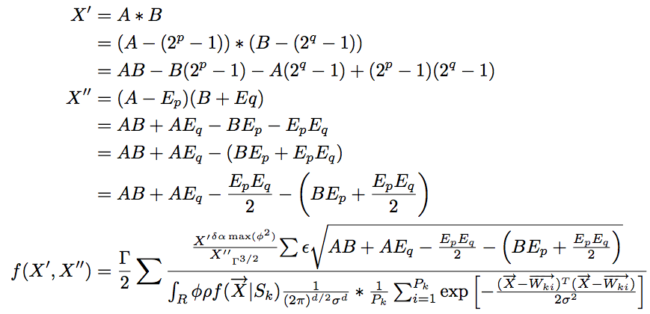
Equations
Ummm… okay…

Slide 44
Keep It Simple
Do you really need all those equations?
  This is very instance-dependent!
  Depends on what you’re discussing
  Depends on your audience
Sometimes you may need them
  Explain the variables and what they mean
  Give a “plain-text” description of it
If you don’t need them, don’t use them!

Slide 45
Use Simple Examples
This isn’t one. It doesn’t help.
BB
D
N
l
g
h
B
A
a
FF
EE
HH
q
V
o
c
GG
F
E
H
n
DD
VV
YY
R
p
II
m
NN
h
K
KK
JJ
Y
OO
k
CC
L
I
t
J
O
TT
QQ
C
X
LL
f
Q
PP
ZZ
M
MM
P
Z
RR
XX
x
r
y
T
u
SS
d
z
G
WW
w
UU
S
W
s
v
b
AA
U
e
j

Slide 46
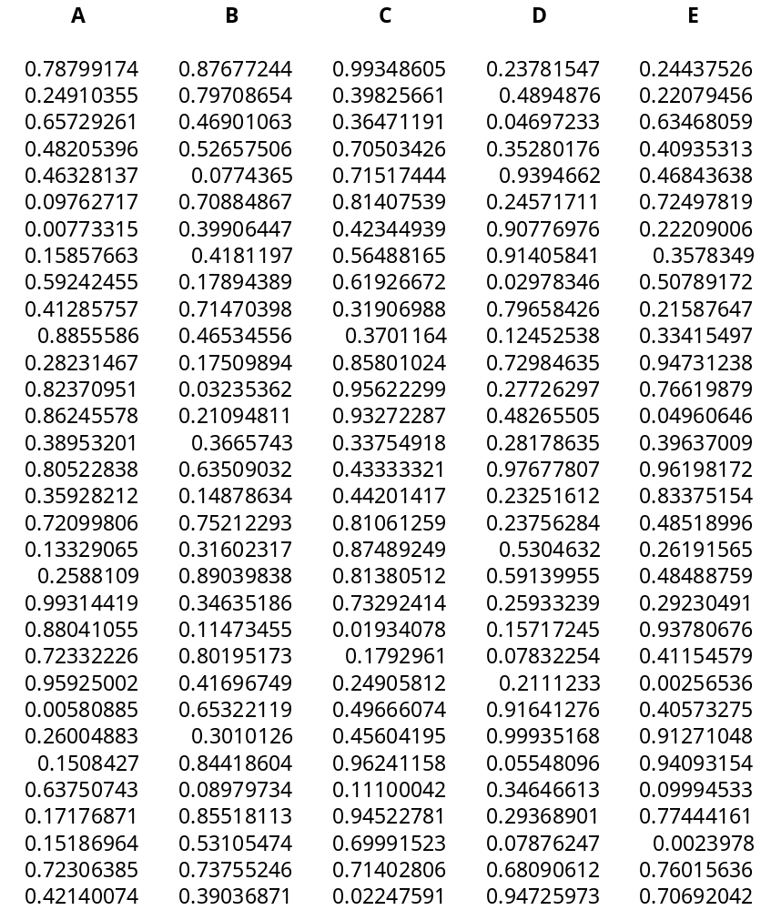
Results
You have
lots of cool
results
  No one can
  read this
  No one can
  understand this
Graphs are
your friend…

Slide 47
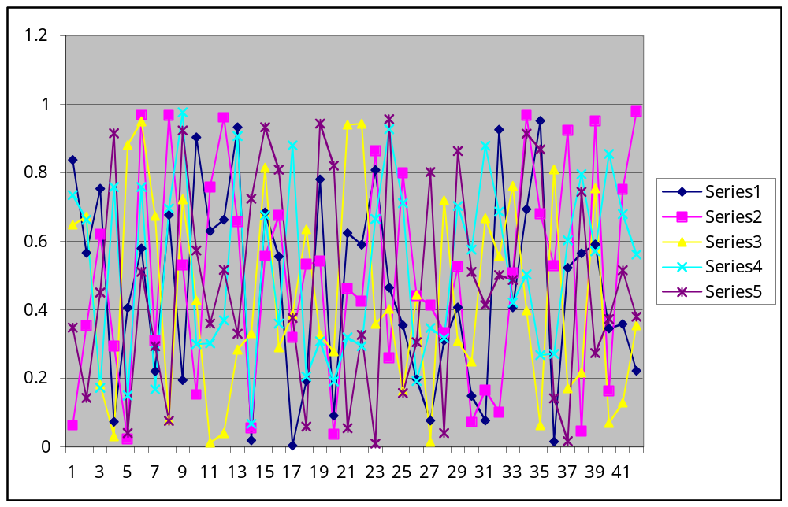
Graphs Can Also Be The Enemy

Slide 48
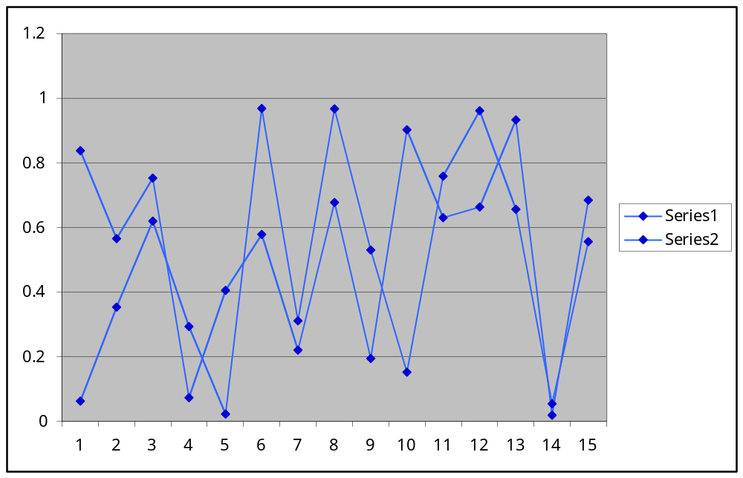
Pick A Line, Any Line

Slide 49
Summary/Conclusion
If your talk is more than 5 minutes, nice to summarize work & results
  Bring people back if they zoned out
  Remind them why you’re great
Give “selling” points here
  30x performance increase with only 10% area penalty
  Described novel method to create clean fuel from used cat litter

Slide 50
Bad Presentations
Audience won’t see your work is great
But will make fun of you from back row
Those are some NASTY colors…
What does that slide say?
Dunno, I’m playing minesweeper
Hey – it matches my tie.
Please let it be OVER…
zzz

Slide 51
Good Presentations
Interesting topic, explained at audience’s level
Slides are understandable and easy to see
Good presentations reflect well on speaker!
I wonder if this technique would work for my problem
I understood this one!
You should
with a PhD…
Let’s talk to them at the break
But it’s outside
my main area
I never thought of that!
Interesting

