Slide 1
Wireless Community Network
Passage Five
Advanced Mobile Computing

Slide 2
Background
New information and communication technologies carry enormous potential to improve the lives of people in sparsely populated areas by connecting them to the global marketplace, improving access to community services, and facilitating participation in policy decisions.
However, many rural areas do not have any electronic data access, putting residents – particularly the poor – at risk of falling further behind the urban world.

Slide 3
Background
As an open standard widely accepted by both industries and consumers, IEEE 802.11 wireless local area networking technology provides an inexpensive and easy way to share bandwidth among multiple users. Such technology makes it possible to implement ad hoc wireless community networks using fixed wireless nodes rather than conventional base stations to link widely dispersed populations.

Slide 4
Wireless community network applications
Application Area | Function
Media libraries | Act as servers when network utilization is low
E-governance | Collect and disseminate information
Telecommunication | Place telephone calls from multimedia-enabled computers using voice over IP
Telmedicine | Argument public health services in rural areas
Community Webs and radio broadcasting | Enable communities to own and operate newspapers, and to create radio content and broadcast it live
Support network for NGOs | Enable easy data-sharing applications such as small savings, rural credit, and agricultural databases.

Slide 5
Infrastructure
A rural ad hoc network, which relies on fixed wireless nodes rather than base stations and is thus not strictly a mobile network.
If two nodes are not within radio range to each other, they can communicate with the help of intermediate nodes. These nodes forward data packets from one to the other; thereby transferring packets from the source node to the destination node. Each wireless node serves as a router, receiving data packets on all its interfaces. A node processes packets that are addressed to it; otherwise, it forwards the packet to one of its neighbors to efficiently router it to the destination.
注意分句的用法。

Slide 6
Infrastructure
The open shortest path first (OSPF) protocol has been widely tested for wired networks and is most suitable for an ad hoc network with separate unidirectional antennas for each link. Implementations of mobile ad hoc protocols are still under development. The number of hops along a route as well as the bandwidth and cost of each interface are important metrics.
The wireless nodes transfer data to a small number of Internet gateways located in areas where wired Internet connectivity is available to route data from the wireless network. If no such connectivity is available in the proximity of the wireless network, the wireless network could use satellite connectivity to transfer the data, although this provides limited bandwidth with high latency.

Slide 7
Infrastructure
Wireless community network employs the IEEE802.11b standard, which utilizes the license-free 2.4GHz industrial, scientific, and medical band for radio-frequency (RF) communication. This enables computers and other devices with an 802.11b network interface card (NIC) to plug into a wireless network. Antennas extend each NIC’s outdoor range well beyond the usual 300 meters. Because water and trees adversely affect 2.4-GHz RF waves, 802.11b links work best when antennas have a clear line of sight.
Note: IEEE 802.11 is a set of standards carrying out wireless local area network (WLAN) computer communication in the 2.4, 3.6 and 5 GHz frequency bands. They are created and maintained by the IEEE LAN/MAN Standards Committee (IEEE 802). The base current version of the standard is IEEE 802.11-2007.

Slide 8
Infrastructure
A rural access terminal’s processing power is less important than its ability to withstand severe weather conditions. A number of companies make processors with low heat dissipation. Solar power can also be useful in such situations. A diskless computer is a good option given that the hard drive, with its intricate mechanical parts, is a major source of computer failures. System suppliers can apply bug fixes and upgrades to the operating system and application software remotely.

Slide 9
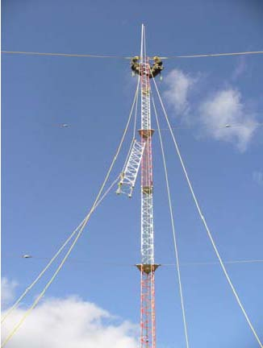
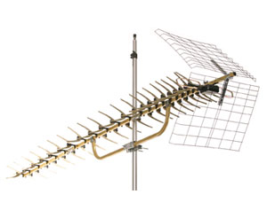
Wireless Links
A wireless community network can use two types of links between nodes.
  Point-to-multipoint links use omnidirectional (radiates equally in all directions) antennas.
  Point-to-point links employ unidirectioanl antennas.

Slide 10
Point-to-multipoint
An monidirectional antenna placed vertically atop a pole radiates RF signals uniformly in circular pattern around the transmitting node. This makes it easy to add new nodes to existing nodes without any reconfiguration.
However, for the same link distance, omnidirectioanl antennas are far more expensive to operate than unidirectional antenna, which required signal amplifiers.
Because an omnidirectional antenna radiates signals in the horizontal direction, all such antennas in the network must be at the same height, which is nearly impossible to achieve.
Ominidirection antennas spread signals in the surrounding area, exposing the network to hackers.

Slide 11
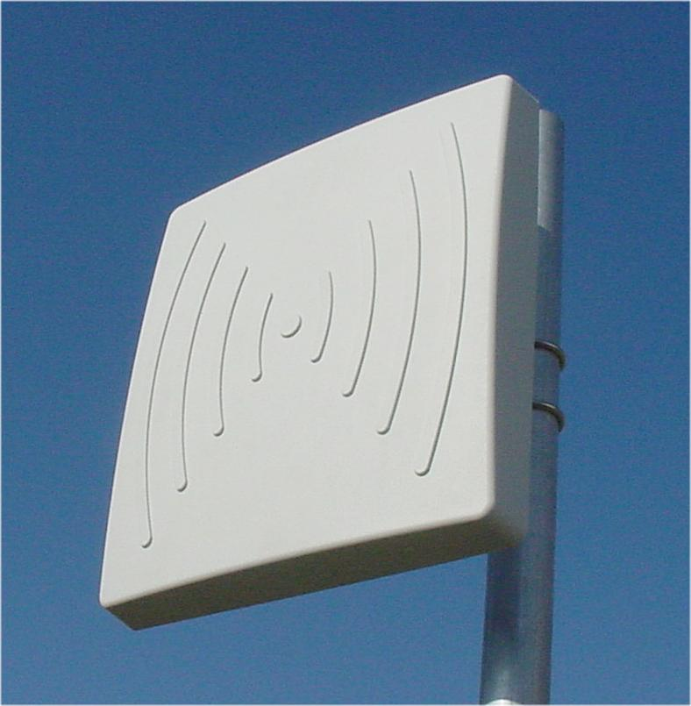
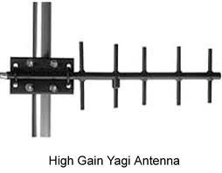
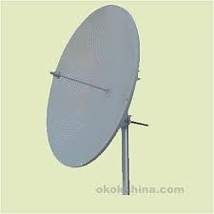
Point-to-point
Unidirectionl antennas are available in many forms. Widely used patch antennas have a low profile, are lightweight, and are relatively inexpensive, but they also have a short range and narrow bandwidth. Yagi antennas are by far the most effective, combining a long range with a good beam width. Paraboloid antennas provide a longer range for the same price, but they focus the beam too sharply, making line-of-sight alignment difficult.

Slide 12
Point-to-point
A network using multiple unidirectional antennas requires separate RF signal feeds for each antenna. An alternative way to provide a point-to-point link between nodes is to use a separate NIC and antenna for each link. The two cards at each end would use a separate channel, thereby avoiding interference, to form a large ad hoc network.
Creating a network form individual point-to-point links offers many advantages. Such a network does not require signal amplifiers and splitters, resulting in better link quality. In addition, the failure of one NIC does not bring down the entire node.

Slide 13
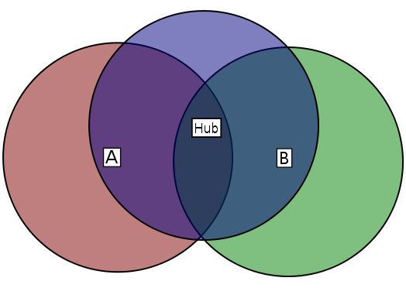
Point-to-point
The 802.11-based media access control(MAC) protocol uses the carrier sense multiple access (CSMA) network control scheme: when a node wishes to transmit, it first senses the medium to check for other transmissions; if the medium is free, the node transmits and while doing so suffers from a hidden node problem. A request-to-send/clear-to-send mechanism can avoid this but introduces signification overhead. Using unidirectional antennas does not create hidden node problem.
In wireless networking, the hidden node problem occurs when a node is visible from a wireless access point (AP), but not from other nodes communicating with said AP. This leads to difficulties in media access control.
In this example, A and B can each communicate with the hub, but are hidden from each other

Slide 14
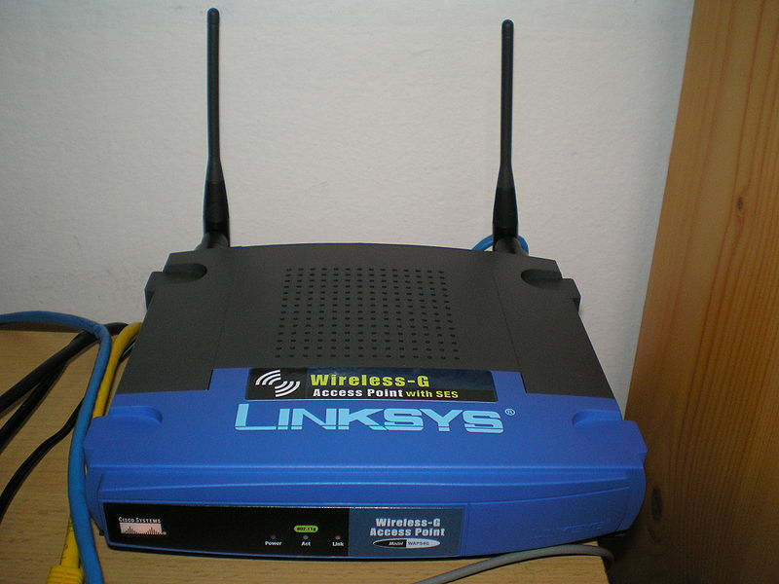
Wireless Access Point
In computer networking, a wireless access point (WAP) is a device that allows wired communication devices to connect to a wireless network using Wi-Fi, Bluetooth or related standards. The WAP usually connects to a router, and can relay data between the wireless devices (such as computers or printers) and wired devices on the network.

