Slide 1

How The Internet Works
Passage 3,
Unit 6 The Internet

Slide 2
Configuring your computer for Internet Access
To connect to the internet, your computer must support Internet networking protocols, called TCP/IP.
You also need communication’s equipment, such as a modem, an ISDN adapter, or an Ethernet card, depending on how you’re planning to access the Internet.

Slide 3
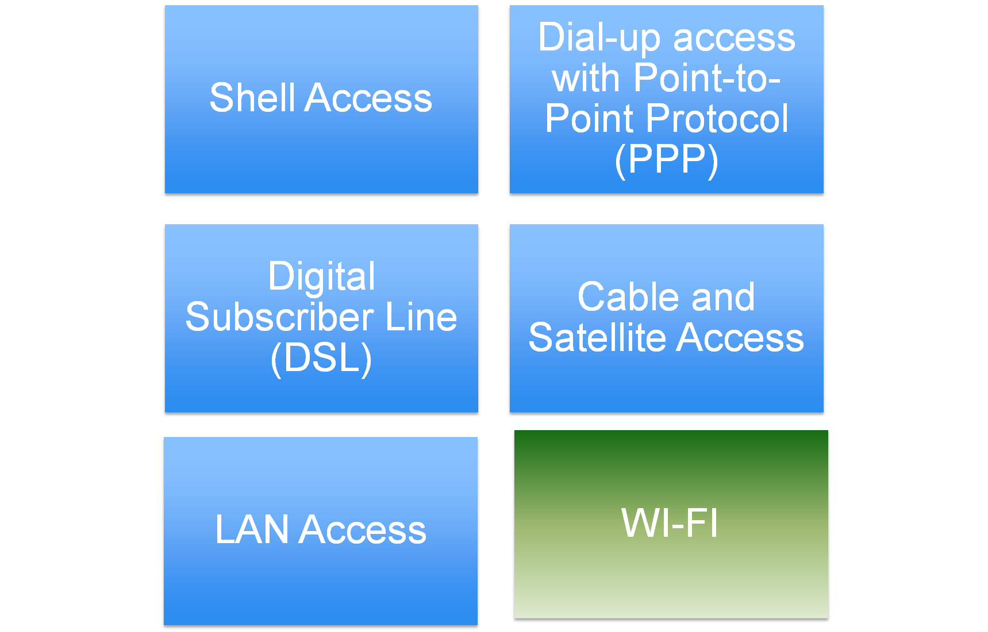
Accessing the Internet

Slide 4
Shell Access
The least expensive type of internet access, this method requires a modem and a phone line.
You get access to the shell (user interface) of a UNIX computer, enabling you to use text-based applications such as E-mail.
UNIX knowledge is required for shell access.
Your computer isn’t really connected to the Internet. You’re using it as a terminal to access a computer that is connected to the Internet.

Slide 5
What is shell access?
Shell access on a Unix-type server is access to a command prompt (命令提示符）on the server itself. This enables you to issue commands as a user of the system - for example, for changing permissions on files, copying, moving, deleting and such. On a dedicated server, you will probably also have "root" access (like Administrator access in Windows) and you will be able to compile and install programs, update and patch your system and a whole lot more.
To access a shell account from your home machine, you can use SSH if you are running Linux, or use the excellent Putty if you are running Windows.

Slide 6
Modem
Modem其实是Modulator（调制器）与Demodulator（解调器）的简称。 所谓调制，就是把数字信号转换成电话线上传输的模拟信号；解调，即把模拟信号转换成数字信号。合称调制解调。
Modem的作用是模拟信号和数字信号的“翻译员”。

Slide 7
Dial-up Access with PPP
Most home users access the Internet this way.
You need a modem and an analog（模拟） phone line, or an ISDN adapter and an ISDN telephone line.
Your computer is directly connected to the Internet, but it’s usually assigned a temporary IP address. For this reason, you can’t conveniently run server software connected to the Internet with PPP (Point-to-Point Protocol).

Slide 8
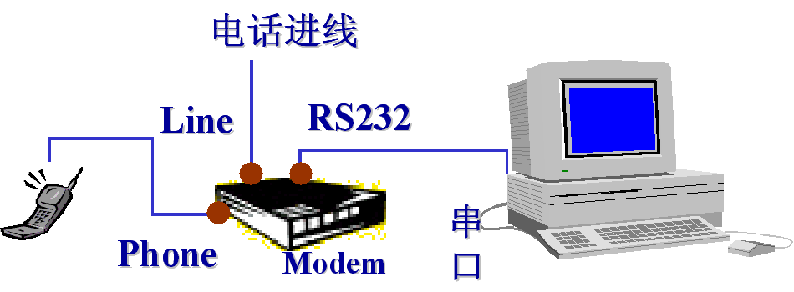

Slide 9
Integrated Services Digital Network综合服务数字网络
在传统的电话网络中，实现了网络内部的数字化，但在用户到电话局之间采用的仍是模拟传输，由于沿途噪声的积累容易引起失真。
ISDN是一个全数字的网络:实现了用户线的数字化，提供端到端的数字连接，传输质量自然大大提高，还可支持包括话音、数据、图像等各种业务。

Slide 10
MODEM v.s. ISDN
ISDN数字信号传输质量好，线路可靠性高，不像模拟信号在传输过程中那样受静电和噪音干扰，数据通信误码更少；
ISDN可以同时使用多个终端。在一条ISDN电话线上，可以保持一个信道通话，而用另一条信道上网；
ISDN的通话建立很快，不需像Modem那样每次有很长的握手过程， ISDN是数字化的，建立连接只需三、五秒钟。

Slide 11
Digital Subscriber Line
Available in many urban areas, DSL（数字用户线路）connections offer high-speed access and a permanent online connection.
One drawback of DSL is that service doesn’t extend more than a few miles from telephone switching stations, so this service is unavailable in rural areas.

Slide 12
Cable and Satellite Access
Cable TV firms are increasingly offering Internet access at speeds much faster than dial-up modems.
Satellite access enables fast downloads but requires a phone line and a modem for uploading data.
Like modem access, these access methods give your computer a temporary IP address.

Slide 13

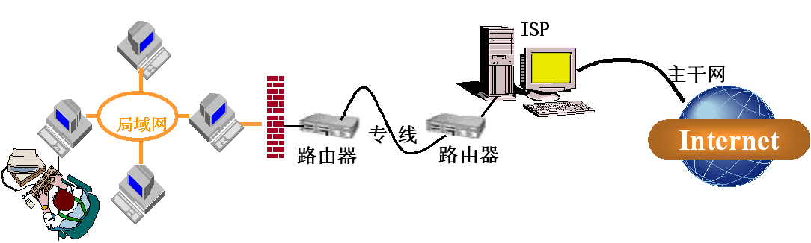

Slide 14
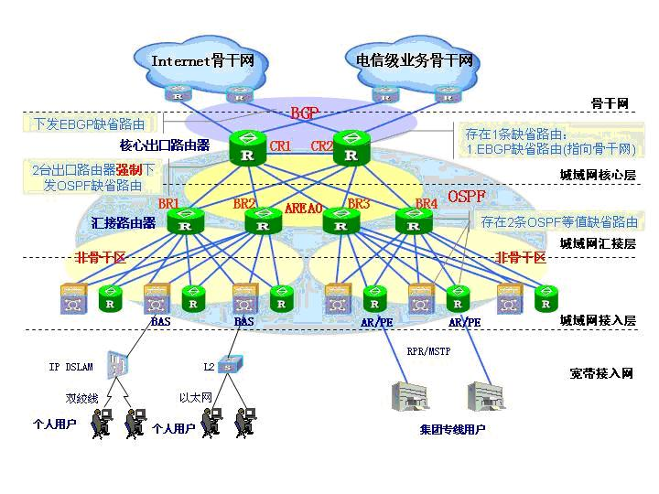
Backbone networks

Slide 15
INTRANET:Using TCP/IP inside the enterprise
Called intranets(企业内部网）, these networks give users the same familiar tools they use on the internet. However, these networks are intended for internal use only and are not accessible from the external Internet.
To insulate the intranet from unwanted external accesses, computers equipped with firewall software screen incoming data, while allowing selected insiders to access external resources.

Slide 16
Insider
1.（组织、团体等）内部的人，会员
2. someone who has a special knowledge of a particular organization because they are part of it [≠ outsider] 知情者，了解内幕的人

Slide 17
Intranets are transforming the way organizations produce and share information.
By moving expensive print-based publications, such as employee manuals and telephone books, to the internal Web, companies can realize enormous savings and greatly reduce the amount of trash that goes to local landfills.

Slide 18
Landfill n.
1 [uncountable] the practice of burying waste under the ground, or the waste buried in this way 垃圾填埋法
2 [countable] a place where waste is buried under the ground 垃圾填埋地

Slide 19
Some companies open their intranets to selected allies, such as research labs, suppliers, or key customers. Called extranets(外部网）, these networks use the external Internet for connection, but the data traverses the Internet in encrypted form, safe from prying eyes.

Slide 20
Traverse v. to move across, over, or through something 通过，穿过
Pry v. to try to find out details about someone else's private life in an impolite way
刺探，窥望

Slide 21
Future of the Internet
Hundreds of millions of people will be connecting with super-fast connections, using technologies such as cable modems and ADSL (Asymmetric Digital Subscriber Line).
ADSL enables download speeds of 1.5Mbps.
According to the Internet experts, key changes must take place to ensure that the Internet doesn’t become overwhelmed by its own success.

Slide 22
Overwhelm :
1. if work or a problem overwhelms someone, it is too much or too difficult to deal with
2. to defeat an army completely 制服，压倒，击败

Slide 23
More Internet Addresses
The IP protocol allows for a total of approximately 4 billion (2^32) unique IP addresses, but that’s not enough. The reason has to do with the way the four-part IP addresses are broken up into distinct categories, called classes.

Slide 24
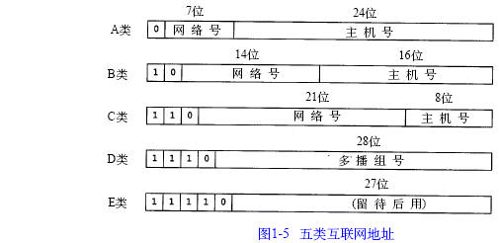
Classes of IP addresses
Class | First octet in binary | Range of first octet | Network ID | Host ID | Nubmer of networks | Number of addresses
A | 0XXXXXXX | 0-127 | a | b.c.d | 2^7=128 | 2^24=16 777 216
B | 10XXXXXX | 128-191 | a.b | c.d | 2^14=16 384 | 2^16=65 536
C | 110XXXXX | 192-223 | a.b.c | d | 2^21=2 097 152 | 2^8=256

Slide 25
The solution lies in a new version of the Internet Protocol, called IPv6, but existing Internet equipment must be modified to work with the new protocol.
IPv6具有比IPv4大得多的地址空间。这是因为IPv6使用了128比特的地址，而IPv4只用32比特。因此新增的地址空间支持2¹²⁸（约3.4 ×10³⁸）个地址。
IPv6保留了由IPv4选项提供的大部分常用工具。

Slide 26
More Bandwidth
Internet 2 (I2) is a collaborative effort between more than 120 U.S. universities, several U.S. Government agencies, and leading computer and telecommunications companies. It is a project of the University Corporation for Advanced Internet Development (UCAID).
The I2 project will develop and test high-performance network and telecommunications techniques. These improvements will eventually find their way to the public Internet.
Find one’s way to = try to reach 设法到达、进入
Notes:
它并不是要取代现有的互联网，也不是为普通用户新建另一个网络。

