Slide 1

Computer Specialized English
Unit 4 Passage One
Desktop Video
SEI.ECNU

Slide 2
Desktop video basics
Definition
  Videos constructed and played using a personal computer
  From Wikipedia, Desktop video refers to a phenomenon lasting from the mid-1980s to the early 1990s when the graphics capabilities of personal computers such as Commodore's Amiga, the Apple Macintosh II and specially-upgraded IBM PC compatibles had advanced to the point where individuals and local broadcasters could use them for analog non-linear editing and vision mixing in video production.
Video is composed of a series of frames
SEI.ECNU

Slide 3
Desktop video basics
Frame
  A still picture which can be stored as a bitmap graphic
Frame rate
  The number of frames shown per second
Frame rate ,帧率,表示图形处理器处理时每秒钟能够更新的次数
SEI.ECNU

Slide 4
Desktop video basics
Produce your own desktop videos
  Shoot the video footage
  Transfer the footage to your computer’s hard disk
  Edit the video and soundtrack
  Output the video in its final format by selecting frame rate, window size, file format, and compression levels
  footage 以英尺表示的长度或距离， (电影或电视的)片段
SEI.ECNU

Slide 5
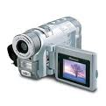
Video cameras
Digital video camera stores footage as a series of bits
Digital Videotape formats
  miniDV,DVCPro,DVCam,MiniDV
SEI.ECNU

Slide 6
Video cameras
Popular Desktop Video File Formats
  AVI
  QuickTime movie
  MPEG
  RealMedia
  ASF
SEI.ECNU

Slide 7
AVI (Audio Video Interleave) .avi
Sometimes called “video for windows”, avi is the most common format for desktop video on the pc platform
Quicktime .mov
Originally developed for the mac platform, quicktime movies are today one of the most popular formats for web videos
MPEG(Moving Picture Experts Group) .mpg
MPEG is one of the most sophisticated digital video formats, used both for desktop videos and DVD movies
Realmedia .rm
Produced by Realnetworks, is a popular format for streaming web videos.
ASF .asf
ASF is Microsoft’s video format for streaming video over the web
SEI.ECNU

Slide 8
Video cameras
Techniques help to produce video footage that maintains good quality as it is edited and processed
  Tripod used to maintain a steady image
  Move slowly
  Zoom in an out slowly
  Direct your subjects to move slowly
  Position your shot
  Ask the subjects to wear solid colored clothing
SEI.ECNU

Slide 9
Video transfer and storage
Send the data over a cable
Analog video footage must be converted into digital format before it is stored on the computer’s hard disk
Video capture software to control the transfer process
analog 模拟(量, 装置, 设备, 系统, 计算机)
analog transmission(远距离通讯中的)模拟传输
digital 数字的,数码的
SEI.ECNU

Slide 10
Desktop video editing and processing
Edit the video footage into the final desktop video using video editing software
  Video consists of video tracks containing video segments and transitions, plus audio tracks containing voices and music
Color image at 1024*768 resolution requires 2359296 bytes for each frame. A two our movie requires 407 683 348 800 bytes – more than 407GB!
resolution 清晰度, 析象分解力，分辨率
SEI.ECNU

Slide 11
Using Cases
Videoconferencing
Windows Movie Maker for Win7
Photostage
SEI.ECNU

Slide 12
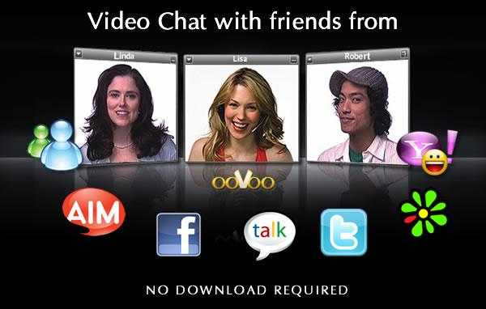
Videoconferencing
A videoconference or video conference (also known as a videoteleconference) is a set of interactive telecommunication technologies which allow two or more locations to interact via two-way video and audio transmissions simultaneously. It has also been called 'visual collaboration' and is a type of groupware.
Videoconferencing differs from videophone calls in that it's designed to serve a conference rather than individuals. It is an intermediate form of videotelephony, first deployed commercially by AT&T during the early 1970s using their Picturephone technology.
SEI.ECNU

Slide 13
Windows Movie Maker for Win7
Step 1: Find photographs
Step 2: Watch a demo (optional)
Step 3: Download Windows Movie Maker – if not on your computer
Step 4: Add photos to Movie Maker
Step 5: familiar with Movie Maker
Step 6: Arrange the photographs
Step 7: Play with effects
Step 8: Play with transitions
Step 9: Change times
Step 10: Add a title and slide credits
Step 11: Download music
Step 12: Add music
Step 13: Publish your slideshow
Step 14: Add narration (optional)
Step 15: Create your slideshow
Step 16: Upload your slideshow
可以在个人电脑上创建、编辑和分享自己制作的家庭电影。
通过简单的拖放操作，精心的筛选画面，然后添加一些效果、音乐和旁白，家庭电影就初具规模了。
SEI.ECNU

Slide 14
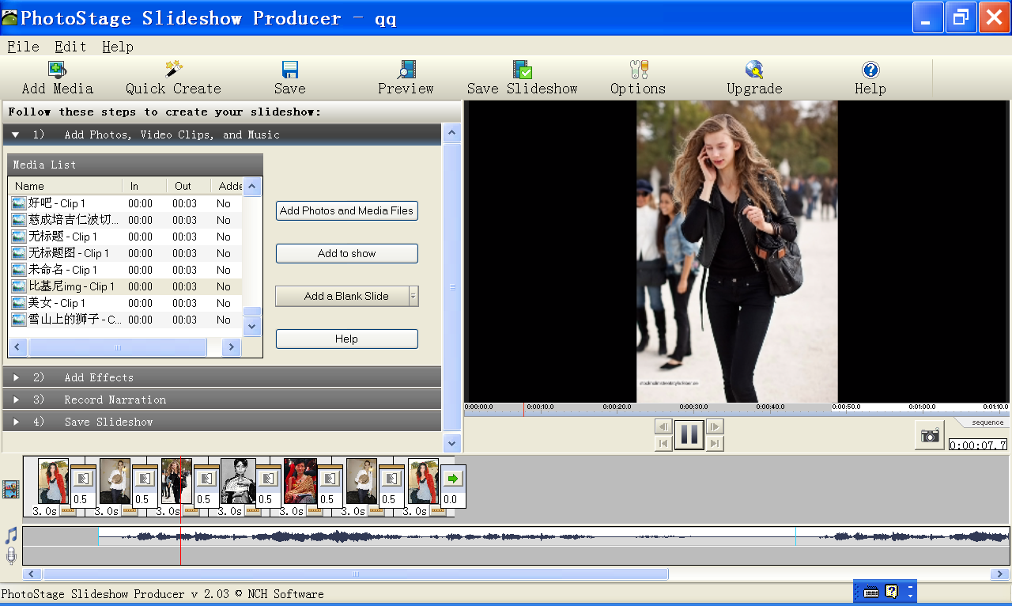

Photostage in WinXp you can download it from http://www.nchsoftware.com/slideshow/index.html
点击下面的图标
播放----→
SEI.ECNU

Slide 15
Audio track声道，音频磁迹; 伴音声迹
Blurriness模糊
Videographer录像制作人
Zoom out缩小
Overflow溢出
Overlay在…铺或盖
SEI.ECNU

Slide 16
Camcorder摄像机
Analog video camera模拟摄像机
Digital video camera数字摄录机
Still picture静态图片
Feature film长片
Sound film有声电影
Intended for 希望…，为…做准备
Account for说明…原因
SEI.ECNU

Slide 17
Thank You !
SEI.ECNU

