Slide 1

Unit 9 Passage One
Artificial Intelligence

Slide 2
What is intelligence?
Intelligent creature can do
  Learn and retain the learned knowledge
  Reason on the basis of this knowledge
  Adapt to new circumstances
  Plan
  Communicate
  Recognize patterns

Slide 3
The turing test
The person typing the question can’t tell the difference between the humans answers and the computers answers, Turing said, the computer is intelligent
Alan Turing
  British computer scientist

Slide 4
Brute force
1997，IBM-designed chess playing system, called deep blue
The first to deny that it possesses anything like human intelligence
  examine more than 200 million alternative plays per second
  Fast program examines a chess situation and calculates the optimum move

Slide 5
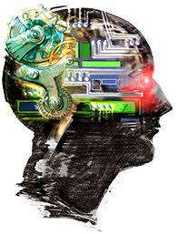
AI achievements
Marvin Minsky, a founder of AI declared that by 1990s computers intelligent enough to converse(交谈) with humans and drive automobiles would be commonplace
AI, artificial intelligence, 人工智能

Slide 6
Natural Language
Refers to the speech people use every day
Natural language understanding may lies in computing’s future, but major advances have been made in speech into text
Continuous speech recognition is the first step toward a true natural language interface

Slide 7
Machine translation
Use computers to translate foreign language text automatically
Problems including how to resolve ambiguity
Automatic translation software
  300 000words per hour
  Can get only three to five errors for every hundred words translated

Slide 8
Expert systems
  Expert systems use rules to make a conclusion , the same way a human expert does
  An expert system relies on a knowledge base, a database of represented knowledge
  To use the expert system, you supply information to the program, based on the information you supply, the program consults its knowledge base and draws a conclusion
  expert system, 专家系统

Slide 9
Expert systems
Eventually replace human experts?
Expert systems work best where they’re limited to sharply defined subjects, such as jet engine maintenance, planning and scheduling, diagnosis and troubleshooting of a specific device, or financial decision-making

Slide 10
Expert systems
Expert system technology is making its appearance in application software too
  Microsoft word used rule-based reasoning to check documents for grammatical errors
  Maijail, a junk e-mail detection accessory for outlook98 screens out unwanted or unsolicited email, or spam
  Created by omron advanced systems,Inc, Mailjail uses more than 600 rules to decide whether an incoming message is a junk mail

Slide 11
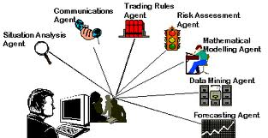
Intelligent agents
Agents(代理)
  A helper inside your computer, one that can converse with you, understand your needs, and offer assistance
  Sample conversations in thousands of newsgroup and recommend items of interest, find human experts who can solve specific problems, negotiate the best price for something you’re trying to buy or understand your interests and scout ahead for Web pages you’ll want to see

Slide 12
Pattern recognition
A computer that can see in a way that goes beyond recording a digitized image
Computers equipped with pattern recognition software can process what they’re seeing and draw connection between the patterns they perceive and stored pattern in a database
Pattern recognition, 模式识别

Slide 13
Pattern recognition
For security use
  A new type of video surveillance camera can detect suspicious movement patterns among shoppers and alert security personnel
Playing an important role in data mining, discovering previously unnoticed trends in massive amounts of transaction data

Slide 14
Robots
Computer-based device programmed to perform motions that can accomplish useful tasks
Robot performing tasks such as assembly, welding, material handling, and material transport
Robots are also exploring hazardous environments, such as the radioactive ruins, medicine, mow the lawn, clean the house, shampoo the carpets

Slide 15
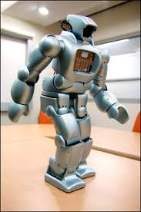
Robots
Personal robot is a decade or two away
Robots are too expensive for consumers right now but will change as market demand grows

