Slide 1
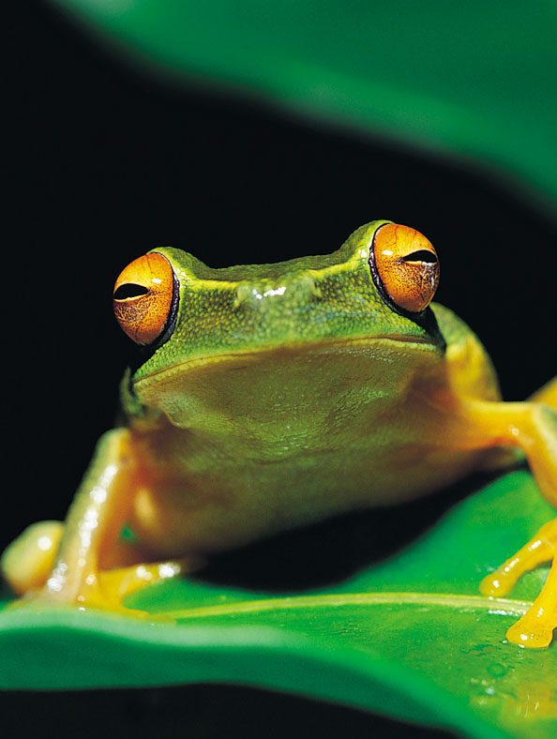
Operating System

Slide 2
THE COMPUTER’S TRAFFIC COP
The computer’s operating system (OS) keeps traffic running smoothly. You can think of the operating system as a computerized version of a traffic cop, standing at the intersection of the computer’s hardware, application programs, and the user.

Slide 3
Because operating systems work closely with the computer’s hardware and with application programs, all of these components must be designed to work together harmoniously.
The operating system requires a specific type of family of processors.

Slide 4
Basic functions of OS
The operating system starts the computer, manage programs, parcels out memory, deals with input and output devices, and provides a means of interacting with the user.

Slide 5
parcel sth. out verb
= to divide or share something among several people:
vt. 划分，分配

Slide 6
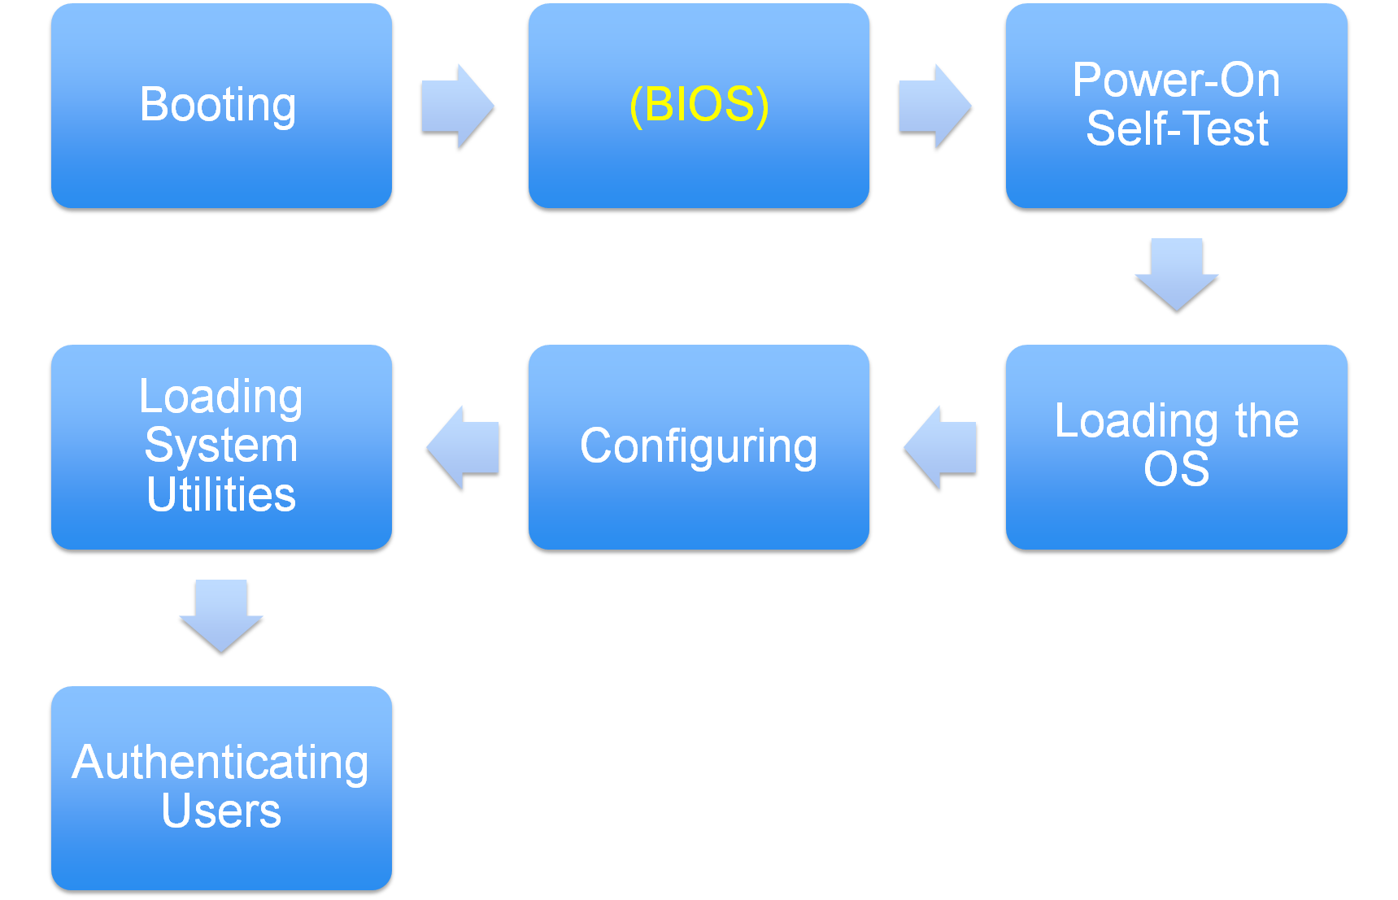
1. STARTING THE COMPUTER

Slide 7
Booting
When you start or restart a computer, it reloads the OS into the computer’s memory. This process is called booting, after the notion that the computer “pulls itself up by its bootstraps”.

Slide 8
Boot vt. To enter (a program) into a computer using a few initial instructions.
引导：使用一些初始命令进入计算机（的一个程序）
bootstrap n 鞋带
pull yourself up by your bootstraps
= to improve your position and get out of a difficult situation by your own efforts, without help from other people 自力更生，自启动

Slide 9
Cold boot: start the computer after the power has been switched off
Warm boot: restart a computer that is already on. This is often necessary after installing new software or after an application crashes. In Pcs, you can initiate a warm boot by pressing Ctrl+Alt+Del.

Slide 10
crash vi & vt
= if a computer crashes, or if you crash the computer, it suddenly stops working:
（计算机）崩溃，死机
E.g. The system crashed and I lost three hours' worth of work.
Initiate v.tr
To set going by taking the first step; begin
展开最初的工作, 开始

Slide 11
In both types of booting, the computer copies the essential portions of the OS, called the kernel or the supervisor program, into the computer’s memory, where they remain during the entire operating session.

Slide 12
The kernel is called memory resident because it “resides” in memory at all times. (So it must kept as small as possible.)
Less frequently used portions of the OS, called nonresident, are copied from the disk as needed.

Slide 13
BIOS screen and Setup Program
BIOS = basic input/output system
When you first turn on or reset a PC, you’ll see the BIOS screen, a text-only screen that provides information about the BIOS software encoded in the computer’s ROM.
BIOS equips the computer with the software needed to accept keyboard input and display information on-screen.
BIOS设置程序是储存在BIOS芯片中的，只有在开机时才可以进行设置。

Slide 14
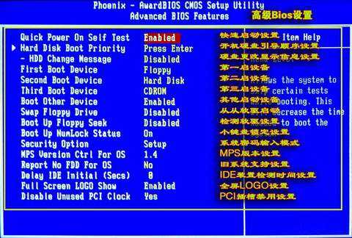

Slide 15
ROM（read-only memory）只读存贮器
通常指固化存储器(一次写入，反复读取)
RAM (random access memory) 随机存取存储器，它的特点是易挥发性，即掉电失忆。

Slide 16
Power-On Self Test (POST)
Goal: to make sure that the computer and associated peripherals are operating correctly.
Among the components tested are the computer’s main memory (RAM), the keyboard, floppy disk drives, and the hard disk.
peripheral n.
An auxiliary device, such as a printer, modem, or storage system, that works in conjunction with a computer. 外部设备, 辅助设备

Slide 17
Loading the OS
Once the POST is successfully completed, the BIOS initiates a search for the OS. When it finds, it loads the OS’s kernel into the memory.
To load a program means to transfer it from a storage device to memory.

Slide 18
Options that are selected in the setup program determine where BIOS looks for the OS. These settings are stored in a type of nonvolatile memory called CMOS (complementary metal-oxide semiconductor互补金属氧化物半导体, 一种大规模应用于集成电路芯片制造的原料).
CMOS is a special type of memory used to store essential startup configuration options, such as the amount of memory that has been installed in the computer.

Slide 19
CMOS主要用于存储BIOS设置程序所设置的参数与数据
CMOS 是微机主板上的一块可读写的ROM芯片，用来保存当前系统的硬件配置和用户对某些参数的设定。CMOS可由主板的电池供电，即使系统掉电，信息也不会丢失。CMOS ROM本身只是一块存储器，只有数据保存功能，而对CMOS中各项参数的设定要通过专门的程序。

Slide 20
On most PCs, BIOS first looks for the OS on the hard disk.
On newer PCs, it’s possible to load an OS from removable media (CD-ROMs, floppy disk drives or flash memory)

Slide 21
Configuring the System
The OS checks the system’s configuration to determine which drives and utility programs are needed.
In Microsoft Windows, configuration information is stored in the registry, a database containing information about installed peripherals and software.

Slide 22
Utility n [countable]
= a piece of computer software that has a particular use:
Utility program 实用程序

Slide 23
Operating systems equipped with plug-and-play (PnP) capabilities can automatically detect new PnP-compatible peripherals that you may have installed while the power was switched off.

Slide 24
Plug-and-play(PnP) 即插即用，是一种计算机硬件的一般术语。指在计算机上加上一个新的外部装置时，能自动侦测与配置系统的资源，而不需要重新组态或手动安装驱动程序。PnP会在每次系统启动时自动侦测及配置；因此，必须先关闭计算机电源，才能安装PnP装置到扩充槽中。
现代的“即插即用”一词又加上了热插拔的意义，它是一个类似的功能，允许使用者在电源开启的状态下，直接新增或移除硬件装置，例如USB或IEEE 1394。

Slide 25
Loading System Utilities
Once the OS has detected and configured all of the system’s hardware, it loads system utilities (such as speaker volume control, antivirus software, and a PC card unplugging utility).

Slide 26
Authenticating Users
When the OS finishes loading, you may see a dialog box asking you to type a user name and password. This process is called authentication (also called login).
Consumer-oriented OSs such as Microsoft Windows and Mac OS donot demand that you supply a user name and password to use the computer.
Authenticate vt
= To establish the authenticity of; prove genuine: 验证：证明其真实

Slide 27
2. MANAGING PROGRAMS
An important operating system function – and the one that most dramatically affects an OS’s overall quality – is the way it manages program execution.

Slide 28
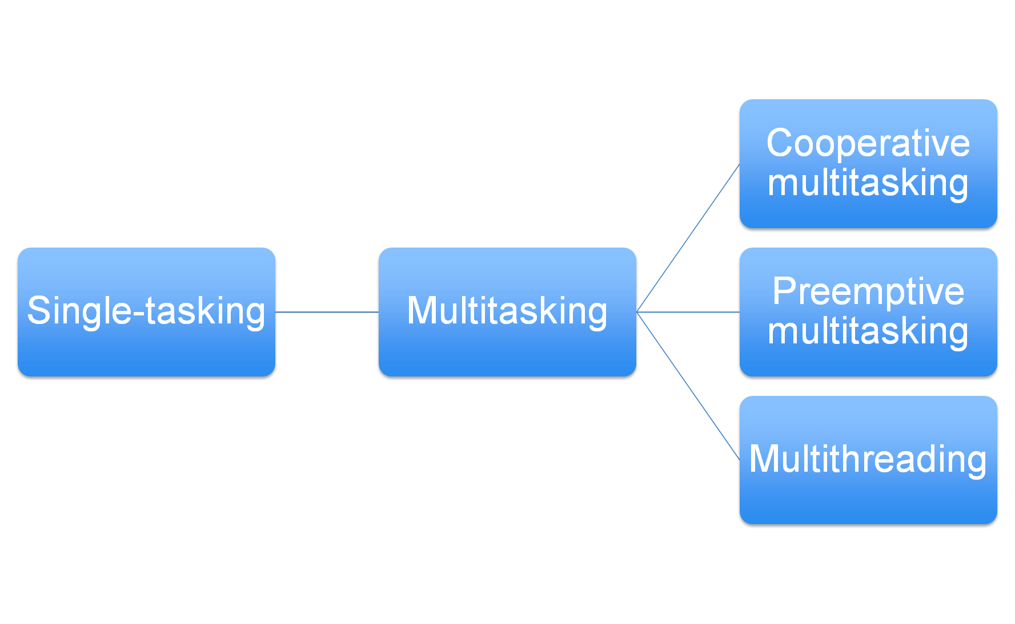

Slide 29
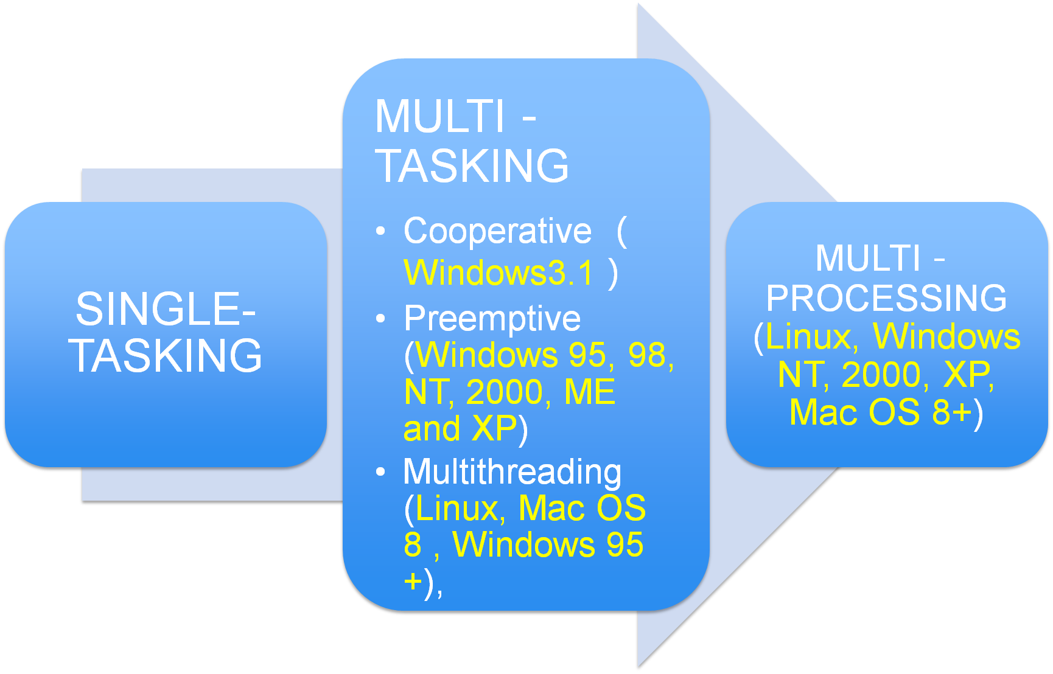

Slide 30
Single-tasking OSs
Single-tasking (单任务）OSs can run only one application at one time, which users find very inconvenient.
To switch programs with a single-tasking OS, you must quit one program and start the second one.

Slide 31
Multitasking OSs
Multitasking（多任务） OSs enable a single user to work with two or more programs at once.
The CPU doesn’t actually run two programs at once; rather, it switches between them as needed.

Slide 32
Cooperative Multitasking
In an early form of multitasking, cooperative multitasking, the foreground application gains control of the CPU and keeps this control until the program’s task is finished. Only then does it relinquish the CPU to other applications.
The crashed program never relinquishes the CPU. In consequence, the computer “freezes” or “hanges”, and the user must restart the computer, losing any unsaved work in any of the applications.

Slide 33
多任务技术，使电脑能同时处理多个程序（如可以边听mp3边上网，与此同时可以将下载的文档打印出来）。一个处理器同一时间只能处理一个程序，要同时处理多个程序，必须将处理器于相对于用户来说相当短的时间，划分给不同的程序运行，以使各个不同程序都能执行部份工作，使用户错觉以为各个程序都同时被执行（例如浏览器能处理“下卷”的动作，同时MP3播放器将声音解码）。
协作式多任务：一个任务得到了 CPU 时间，除非它自己放弃使用 CPU ，否则将完全霸占 CPU，所以协作式多任务要求任务之间需要协作——使用一段时间的 CPU ，放弃使用，其它的任务也如此，才能保证系统的正常运行；但如果有一个任务死锁，则系统也同样死锁

Slide 34
Preemptive Multitasking
A better and more recent type of multitasking, called preemtive multitasking, enables the OS to regain control if an application stops running. You lose any unsaved work in the application that crashed, but the failure of one application doesn’t bring the whole system down.

Slide 35
preemptive adj :
a pre-emptive action is done to prevent something from happening, especially something that will harm you 抢先的，占先
“抢占式多任务”：总控制权在 Windows 手中，Windows 会轮流询问每一个任务是否需要使用 CPU ，需要使用的话就让它用，不过在一定时间后，Windows 会剥夺当前任务的 CPU 使用权，把它排在询问队列的最后，再去询问下一个任务……。有一个任务死锁，系统仍能正常运行。

Slide 36
Multithreading v.s. Multiprocessing
A recent development in multitasking, multithreading（多线程）, enables the computers to execute more than one task in a single program.
Some OSs are designed to faciliate multiprocessing (多进程）, the use of two or more processors at a time. When a program needs to execute a thread, the OS finds an idle processor and assigns the thread to this processor.

Slide 37
进程是程序在计算机上的一次执行活动。运行一个程序，就启动了一个进程。显然，程序是死的(静态的)，进程是活的(动态的)。
多任务：同一个时间里，同一个计算机中允许两个或两个以上的进程处于运行状态。
进程又被细化为线程，也就是一个进程下有多个能独立运行的更小的单位。
进程是操作系统进行资源分配的单位， 线程是CPU调度的最小单位

Slide 38
3. MANAGING MEMORY
The OS gives each running program its own portion of the memory and －by means of cooperative or preemptive multitasking －attempts to keep the running programs from interfering with each other’s use of the memory.

Slide 39
Most of today’s OSs can make the computer’s main memory (RAM memory) seem larger than it really is. This trick is accomplished by means of virtual memory, a method of using the computer’s hard disk as an extension of RAM.

Slide 40
In virtual memory, program instructions and data are divided into units of fixed size, called pages. If memory is full, the OS starts storing copies of pages in a hard disk file, called the swap files. When the pages are needed, they are copied back into memory.

Slide 41
page n.
A quantity of memory storage equal to between 512 and 4,096 bytes.
主记忆体的一种标准计量单位：相当于512到4096个字节的记忆储存量
swap n.
An exchange of one thing for another. 交换

Slide 42
Disks are much slower than RAM chips. For this reason, adding more RAM to your computer is often the best way to improve its performance.

Slide 43
4. HANDLING I/O
A third OS function involves dealing with input and output devices. These devices generate interrupts, signals that informed the OS that something has happened (e.g., the user has pressed a key, the mouse has moved to a new position, or a document has finished printing). The OS provides interrupt handlers, miniprograms that kick in immediately when an interrupt occurs.
kick in [informal] to start or to begin to have an effect 开始起作用

Slide 44
5. USER INTERFACE
From the user’s perspective, what makes or breaks an OS is the quality of the user interface, the part of the OS that interacts with the user.
The three types of user interfaces are
    Command-line
    Menu-driven
    Graphical interface

Slide 45
make or break
＝to cause something or someone either to be very successful or to fail completely
或成或毁， 决定…的成败
Critics can make or break a young performer

Slide 46
Command-Line User Interface
Requires the user to type commands using keywords that tell the OS what to do.
Command-line OSs aren’t popular with most users because they require memorization, and it is easy to make a typing mistake.
Some experienced users actually prefer them, because you can operate the computer quickly after you’ve memorized the keywords and syntax.

Slide 47
Menu-driven user interfaces
Enable the user to avoid memorizing keywords and syntax.
On-screen, text-based menus show all the options available at a given point.

Slide 48
Graphical user interfaces
Are by far the most popular. In an OS, GUIs are used to create the desktop environment, which appears after the OS starts.
In a desktop environment, computer resources (such as programs, data files, and network connections) are represented by small icons. You can initiate many actions by clicking an icon.

