Slide 1
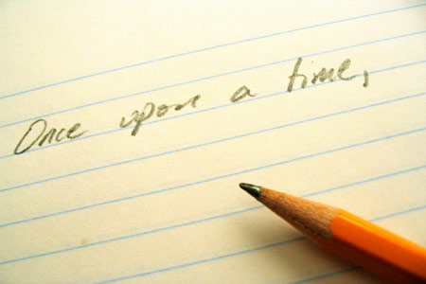
Biography

Slide 2
6 Tips for Writing a Professional Bio
Let's face it, next to public speaking, writing can be the most paralyzing act for most of us. Even if you are a writer, writing a bio can be daunting. That's where our fill-in-the-blank bio templates come to the rescue. Our templates make it easy to write a professional bio in the right style and format without the hours of headaches, web-surfing and procrastination. Here are our top six tips for writing your bio.。
SEI.ECNU

Slide 3
1: Keep it short
I’ve heard a short bio referred to by a variety of terms: biography, about me, work bio, personal profile, business bio, life story, bio resume and my autobiography, to name just a few. While there’s no right or wrong term, it may help you to remember the difference between bio and biography.
Bio = short. Biography = long.
Don’t write a biography when a bio will suffice. Normally it's best to limit your bio to three or four sentences. If it's too long people won't read it. When writing a personal profile or "about me" for your website, you can make it a little longer if you wish.
SEI.ECNU

Slide 4
2: Briefly highlight your main achievement
The purpose of writing a bio is to demonstrate your professional credibility. Unlike a resume (which should include your complete career history), a work bio only needs to cover the "high points" of your career. Here's another way to think about it: your professional bio is a little advertisement for you or your business. Wouldn’t you agree that the best advertisements are memorable because they highlight key features with very few words?
SEI.ECNU

Slide 5
3: Let your personality show
Since your professional bio is an advertisement for you, make it reflect the real you. If you're a down-to-earth person, use unpretentious language. If you have a particular passion, let the reader know. If you love to joke around, include some humor when you write a work bio (but be careful, humor can be tricky). Should you include personal information such as hobbies, family status and pets? This is optional. Some people say that personal information is not relevant in a work bio because it has nothing to do with the job. That may be true, but I find that most readers like getting a sense of who you are outside of your professional role.
SEI.ECNU

Slide 6
4: Tailor your bio to the reader
Wondering how to write a bio that gets you a certain result, such as a scholarship, appointment, business deal or job? Write a bio about you but for the reader. Ideally, your professional bio will address these four reader questions:
1) who you are...
2) your expertise and how it addresses...
3) their problem or goal, and how they can...
4) contact you
SEI.ECNU

Slide 7
5: Make it easy to read
When you write a bio, break the information into short paragraphs (no more than three sentences in each paragraph). Studies show that when people are faced with a large block of text (especially on a computer screen), they just skim over it quickly. By making your paragraphs nice and short, you'll increase the likelihood that people will actually read your bio.
SEI.ECNU

Slide 8
6: Write a bio in third person
What this means is to write a bio as though someone else is talking about you. Instead of writing "I am" and "I graduated", you write "Jane Smith is" and "She graduated". Use your full name (first and last) the first time. After that, it's up to you whether to refer to yourself by your full name, just your first name, or just your last name.
SEI.ECNU

