Slide 1
The System Unit and
Its Motherboard
Passage one
Unit 3 Computer Hardware

Slide 2
The System Unit
The system unit is a box-like case that houses the computer’s main hardware components.

Slide 3
The System Unit
What is the system unit for? It’s more than a box. The ideal system unit provides a sturdy frame for mounting internal components, protects these components form physical damage, and keeps them cool. Cool components are happy components; they last longer, and they are less likely to fail. A good case also provides room for system upgrades, such as additional disk drives. Cases come in a variety of styles. They also vary in their from factor. A form factor is a specification for mounting internal components , such as motherboard.

Slide 4
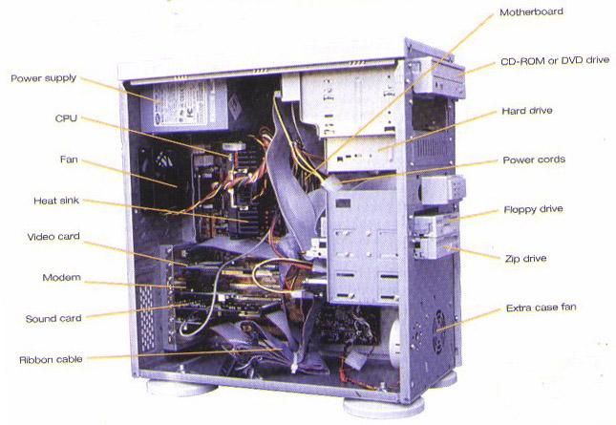
A Typical Desktop System Unit

Slide 5
Components inside a System Unit
Motherboard （主板）
Power supply（电源）
Cooling Fan （冷却风扇）
Speaker （扬声器）
Drive bays （驱动器槽）
…

Slide 6
Motherboard
The motherboard is a large printed circuit board (PCB), a flat piece of plastic or fiberglass that contains thousands of electrical circuits. These circuits are etched into the board’s surface. They connect numerous plug-in receptacles, which accommodate the computer’s most important components (such as the microprocessor).

Slide 7
Power supply
A computer’s power supply can transform the alternating current (AC) available from standard wall outlets into the direct current (DC) needed for the computers operation.
It also steps the voltage down to the low voltage required by the motherboard.
Wall outlets (壁装电源插座)

Slide 8
Cooling Fan
The computer’s components can be damaged if heat accumulates within the system unit. Fans are used to keep the system unit cool. Often, the fan is part of the power supply.

Slide 9
Internal Speaker
The computer’s internal speaker isn’t designed for high-fidelity reproduction. It is useful only for the beeps you hear when the computer encounters an error.
High-fidelity 高保真

Slide 10
Drive bays
They are designed to accommodate the computer disk drives, such as the hard disk drive, floppy disk drive, and CD-ROM or DVD-ROM drive. External drive bays mount drives so that they are accessible from the outside. Internal drive bays do not enable outside access. They are used for hard disks, in which the disk is permanently contained within the drive's case.

Slide 11
Motherboard
A motherboard is the central printed circuit board (PCB) in many modern computers and holds many of the crucial components of the system, while providing connectors for other peripherals.

Slide 12
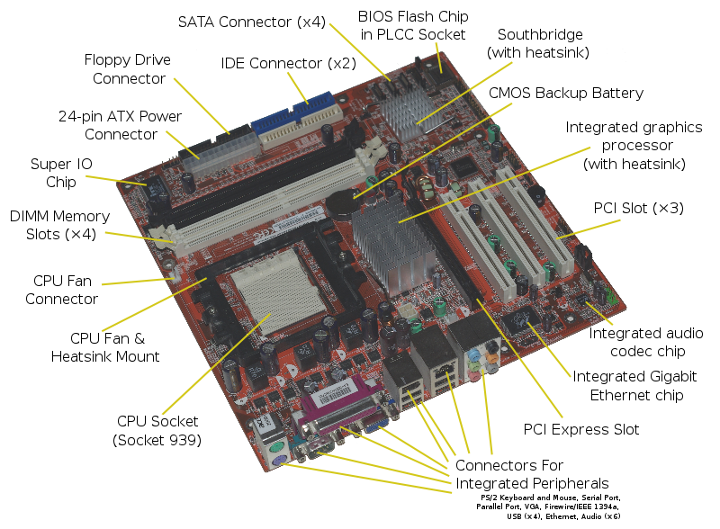
Acer E360 Socket 939 motherboard by Foxconn .svg

Slide 13
System Clock
Within the computer, events happen at a pace controlled by a tiny electronic “drummer”, called the system clock. The component is an electronic circuit that generated pulses at a rapid rate, measured in millions of cycles per second (MHz). Note that the system clock doesn’t have anything to do with keeping the time and date; the system clock synchronizes the computer’s internal activities.
Synchronize : 同步

Slide 14
Processor Slot
Motherboard designers have created special slots and sockets to accommodate microprocessors. Part of the reason is simply that microprocessors are larger and have more pins than most other chips. In addition, microprocessors also generate so much heat that they could destroy themselves or other system components. The microprocessor is generally covered by a heat sink, which drains heat away from the chip. To accomplish this, the heat sink may contain a small auxiliary cooling fan.

Slide 15
CPU
The CPU interprets the instructions given to it by software, and carries out these instructions by processing data and controlling the rest of the computer’s components.

Slide 16
Instruction Set
Every processor can perform a fixed set of operations, such as getting a character from the computers memory or comparing two numbers to see which is larger. Each of these operations has its own unique number, called an instruction. A processor’s list of instructions is called an instruction set.

Slide 17
Control Unit
The control unit coordinates and controls all the other parts of the computer system. Under the direction of a program, the control unit manages four basic operations:
1: Fetch instruction from the instruction memory.
2: Decode the fetched instruction.
3: Execute the operations specified by the instruction.
4: Write back the result to the registers or memory.
Register (寄存器): Some operations require the control unit to store data temporarily. Registers are temporary storage locations in the CPU.

Slide 18
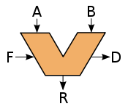
Arithmetic-Logic Unit
The arithmetic-logic unit (ALU), as its name implies, can perform arithmetic of logic operation.

Slide 19
Superscalar design
A superscalar CPU architecture implements a form of parallelism called instruction level parallelism (ILP) within a single processor. It therefore allows faster CPU throughput than would otherwise be possible at a given clock rate. A superscalar processor executes more than one instruction during a clock cycle by simultaneously dispatching multiple instructions to redundant functional units on the processor.

Slide 20
Pipelined Design
Instruction pipelines which are used in processors to allow overlapping execution of multiple instructions with the same circuitry.
Basic CPU design
clock | 1 | 2 | 3 | 4 | 5 | 6
Instruction1 | IF | Dec | Exe | WB
Instruction2 |  |  |  |  | IF | Dec
Pipelined CPU design
clock | 1 | 2 | 3 | 4 | 5 | 6
Instruction1 | IF | Dec | Exe | WB
Instruction2 |  | IF | Dec | Exe | WB
Instruction3 |  |  | IF | Dec | Exe | WB

Slide 21
CISC/RISC
CISC stands for complex instruction set computer (CISC). A CISC chip provides programmers with many instructions, and the processing circuitry includes many special–purpose circuits that carry out these instruction at high speeds.
RISC stands for reduced instruction set computer (RISC). A RISC chip offers a bare-bones instruction set.
CISC vs. RISC
Design | complex | expensive | programming | speed
CISC | more | more | easier | fast
RISC | less | less | harder | slow

Slide 22
Memory
A general term for any devices that enables the computer to retain information.

Slide 23
Volatile vs. Nonvolatile Memory
In volatile memory, the memory’s contents are erased when the computer power is switched off. This is obviously a disadvantage. However, volatile memory technologies provide much higher data transfer rates. Nonvolatile memory, in contrast, retains information even when the power is switched off.
Random-access memory (RAM) is volatile.
Read-only memory (ROM) is nonvolatile.

Slide 24
ROM & BIOS
Rom is nonvolatile. To allow ROM update, most computer use flash memory, also called flash BIOS. The use of flash memory enables the ROM to be upgraded.
In PCs, Rom is used to store the computers basic input/output system (BIOS). When start your computer, BIOS executes a boot sequence. In the boot sequence, the BIOS conducts carious power-on self-tests, including memory tests, configuring and starting the video circuitry, configuring the system’s hardware, and locating the disk drive containing the boot sector.

Slide 25
RAM
The term random-access doesn’t imply that the memory stores data randomly! In random-access memory, each memory location has an address. Using this address, called a memory address, the processor can store and retrieve data by going directly to a single location in memory.
Dynamic random access memory (DRAM) VS. Static random access memory (SRAM). DRAM stores each bit of data in a separate capacitor within an integrated circuit. Since real capacitors leak charge, the information eventually fades unless the capacitor charge is refreshed periodically. Because of this refresh requirement, it is a dynamic memory as opposed to SRAM and other static memory.
现在的内存条用的是基于DRAM的技术，而cache用的是基于SRAM的技术。

Slide 26
Cache
To enable microprocessors to function at maximum speed, computer designers use cache memory. Although generally the cache size is small, cache memory is much faster than RAM, but it is also more expensive. The processor can use the cache to store frequently accessed program instructions and data.
Two types of cache memory are available. The first type, called primary cache, or level 1 (L1) cache, is included in the microprocessor chip. The second, called secondary cache, or level (L2) cache, is included on a separated printed circuit board.

Slide 27
I/O BUS
An I/O bus extends the computers internal data pathways beyond the boundaries of the microprocessor, so that the microprocessor can communicate with input and output devices.
Personal Computer Interface (PCI) bus: supports the Plug and Play (PnP) system. With PnP, the computer detects a new card and configures the system automatically.
Industry Standard Architecture (ISA) bus: was a computer bus standard for IBM compatible computers
Accelerated Graphics Ports (AGP): is a high-speed point-to-point channel for attaching a video card to a computer's motherboard, primarily to assist in the acceleration of 3D computer graphics

