Slide 1
Storage Device
Passage Two
Computer Hardware

Slide 2
Storage
Storage refers collectively to all the various media on which a computer system can store software and data.
Storage devices provide nonvolatile (permanent) storage for programs and data.

Slide 3
Memory vs. Storage
Storage devices are like file drawers in that they hold programs and data. In fact, programs and data are stored in units called files. In turn, the files are stored in digital envelopes called directories on PCs and folders on Macintoshes. When you want to work with the content of a file, the computer transfers the file to the computers memory, a temporary workplace (e.g., the top of your desk).
比喻(Metaphor)的运用。 More intuitive

Slide 4
Types of Storage Devices
Storage media are categorized in various ways, including:
  type of operations (read or read/write)
  the method used to access the information they contained (sequential or random-access)
  the technologies they use (magnetic, optical, ...)
  where they’re located in the storage hierarchy

Slide 5
Sequential vs. Random-Access
In sequential device, such as a tape backup unit, the computer has to go through a fixed sequence of stored items to get to the one that’s needed. Sequential storage devices are sow but inexpensive.
A random-access storage device can go directly to the requested data without having to go through a sequence. Random-access devices are faster but more expensive.

Slide 6
Storage Technologies
Magnetic storage media use disks or tapes that are coated with tiny, magnetically sensitive materials.
Optical storage media use tightly-focused laser beams to read microscopic patterns of data encoded on the surface of plastic disc. Tiny, microscopic indentations, called pits, absorb the laser light in certain areas. The driver’s light-sensing device receives no light from these areas, so it sends a signal to the computer corresponding to a 0 in the computers binary numbering system. Flat, reflective areas, called land, bounce the light back to a light-sensing device, which send s a signal equivalent to a 1.

Slide 7
Capacity of Storage Devices
A storage device’s capability is measured in bytes (a unit of data composed of eight bits). Capabilities range from the floppy disk’s 1.44MB to huge, room-filling arrays of storage devices capable of storing a dozen or more terabytes of data. To provide this much storage with print-based media, you’d need to cut down several million trees.

Slide 8
Speed of Storage Devices
A storage device’s most important performance characteristic -- the speed with which it retrieves the desired data – is measured by its access time, the amount of time it takes for the device to begin reading the data.
Device | Typical Access Time
Static RAM (SRAM) | 5-10 nanoseconds
Dynamic RAM (DRAM) | 50-70 nanoseconds
Solid state disk (SSD) | 0.1 millisecond
Hard disk drive | 6-12 millisecond
CD-ROM drive | 80-800 millisecond

Slide 9
Formatting: Preparing Disks For Use
Before a magnetic disk can be used for storage, it mush be prepared using a process called formatting. This process is necessary because different types of computers store data in different ways.
In the formatting process, the disk drivers read/write head lays down the magnetic patterns of tracks and sectors on the disk’s surface. This pattern enables the disk drive to store data in an organized manner.
Be aware that formatting destroys all the data that has been recorded on a disk. You should never format the computer’s hard disk, unless you have just purchased a new hard disk and are following the installation instructions.

Slide 10
Hard Disk
On most all computers, the hard disk is by far the most important online storage medium. A hard disk is a high-capacity, high-speed storage device that usually consists of several fixed, rapidly rotating disks called platters. Most hard disks are fixed disks, which use platters that are sealed within the mechanism case.

Slide 11
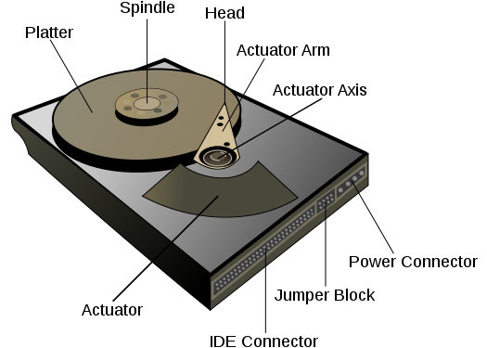
Hard Disk

Slide 12
Hard Disk Interface
To communicate with CPU, hard disks require a hard disk controller. A hard disk controller provides an interface between the CPU and the hard disk electronics.
The most widely used interface for PCs is called Integrated Drive Electronics (IDE), also called ATA (short for AT attachment) of IDE/ATA. IDE drives incorporate the controller within the drive unit. Most IDE/ATA drives are downwardly compatible with earlier standards, so they will work with motherboards that do not support the latest standards.

Slide 13
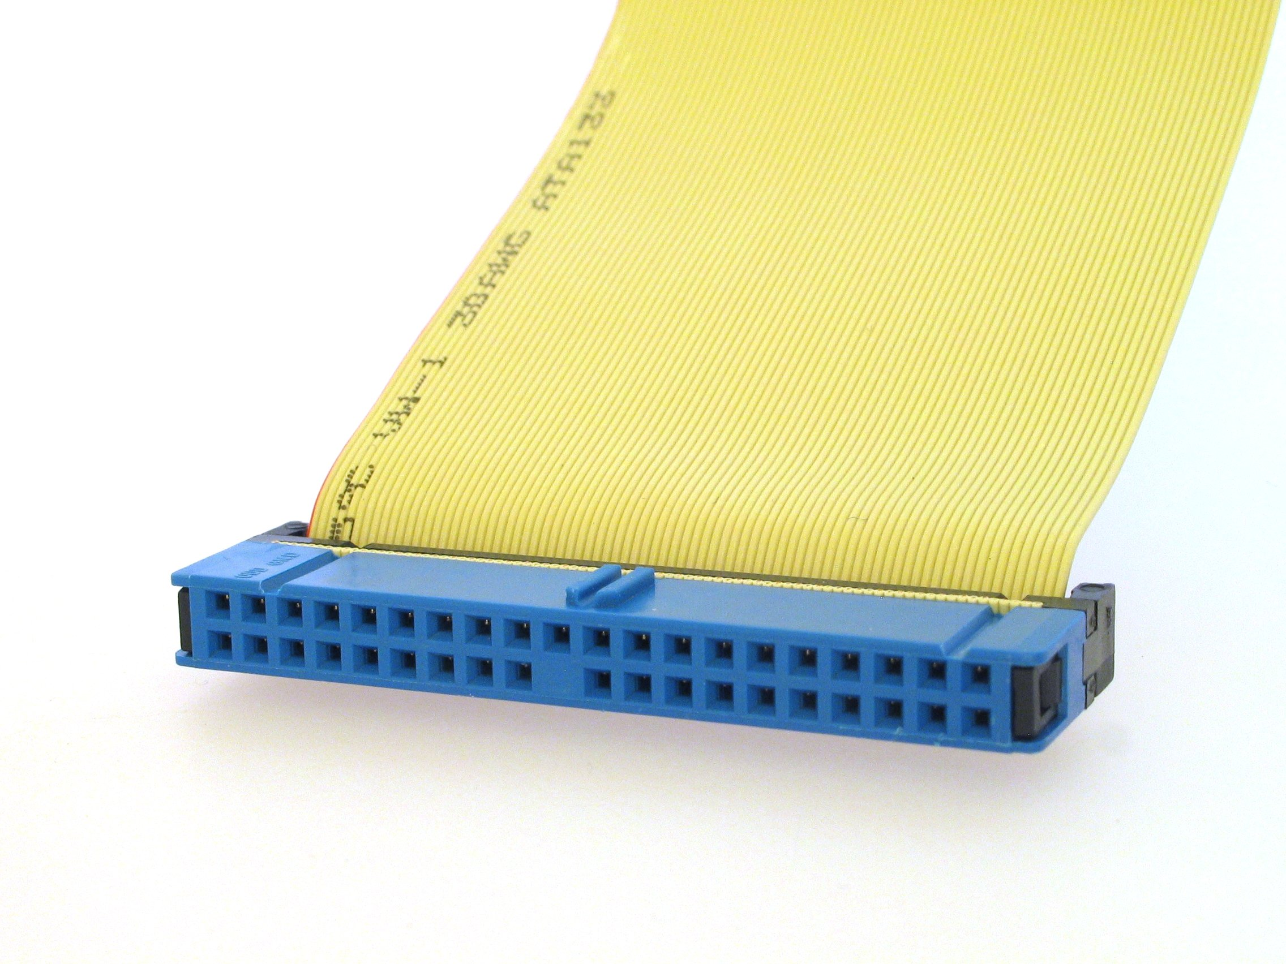
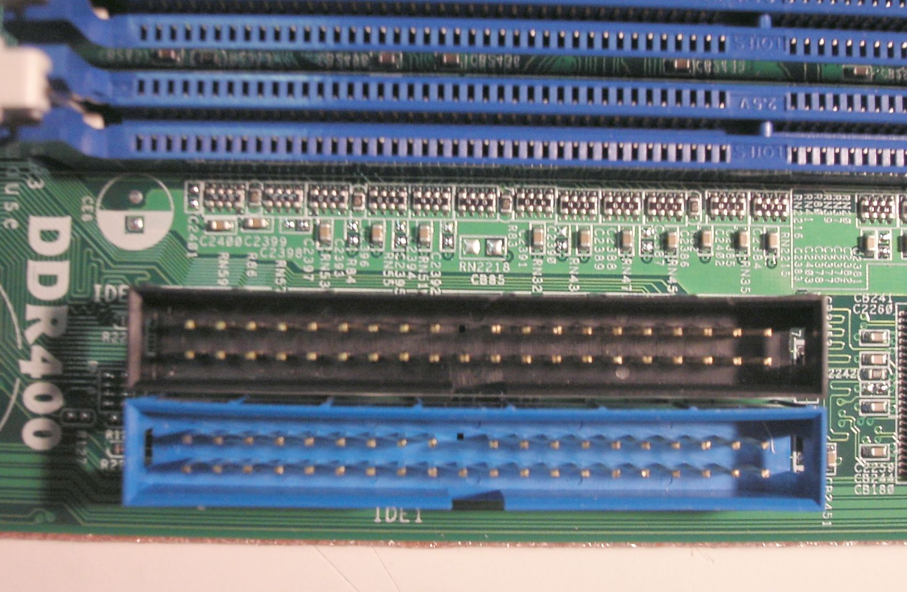
IDE
Parallel ATA (PATA) is an obsolete interface standard for the connection of storage devices such as hard disks, solid-state drives, and CD-ROM drives in computers. It uses the underlying AT Attachment (ATA) and AT Attachment Packet Interface (ATAPI) standards. By the beginning of 2007, it had largely been replaced by Serial ATA (SATA) in new systems.

Slide 14
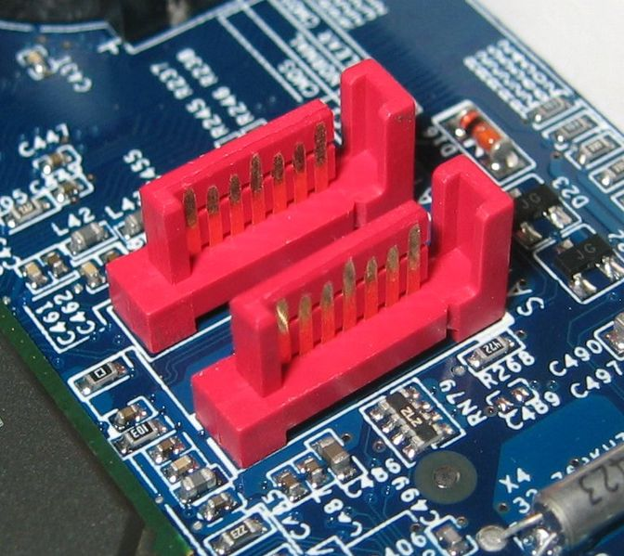
SATA
Serial ATA (SATA or Serial Advanced Technology Attachment) is a computer bus interface for connecting host bus adapters to mass storage devices such as hard disk drives and optical drives. Serial ATA was designed to replace the older ATA (AT Attachment) standard (also known as EIDE).

Slide 15
Removable Hard Disks
Most hard disks are fixed disks, a type of disk that has non-removable platters. Removable hard disks enclose the platters within a cartridge, which can be inserted into the drive and removed, much like a floppy disk.
Removable hard disk are a near-online storage system that is many times larger than the hard disk’s capacity.

Slide 16
CD-ROM DISCS AND DRIVES
The most popular and least expensive type of optical standard is CD-ROM, short for compact disc-read only memory. As the ROM part of the name indicates, this near-online storage medium is strictly read-only; CD-ROM cannot write data to optical disks.

Slide 17
CD-R and CD-RW
Read/write CD technologies, called CD-R and CD-RW, are now available. Declining prices have placed these devices within the budget of many computer owners.
CD-R is a “write-once” technology. After you’ve saved data to the disk, you can’t erase it or write over it.
CD-RW drives provide full read/write capabilities using erasable CD-RW discs, which are more expensive than CD-R discs.

Slide 18
DVD-ROM Discs and Drivers
Digital video disc (DVD), also called digital versatile disk (DVD), is capable of storing an entire digitized movie. DVD discs are designed to work with DVD video players and televisions.
DVD-ROM discs can store up to 17 GB of data, and DVD-ROM drives can transfer data at high speeds (up to 12 Mbps).

Slide 19
Blue-ray Disc
Blue-ray Disc is an optical disc storage medium designed to supersede the standard DVD format. Its main uses are for storing high-definition video, PlayStation 3 video games, and other data, with up to 25 GB per single-layered, and 50 GB per dual-layered disc. The discs have the same physical dimensions as standard DVDs and CDs.
The name Blue-ray Disc derives from the "blue laser" used to read the disc. While a standard DVD uses a 650 nanometer red laser, Blue-ray Disc uses a shorter wavelength 405 nm laser, and allows for over five times more data storage on single-layer and over ten times on double-layer Blue-ray Disc than a standard DVD.
The laser color is called "blue," but is violet to the eye, and is very close to ultraviolet ("blacklight").

