Slide 1

Unit 4 Passage One
What Is a Computer Network?
SEI.ECNU

Slide 2
What is a computer network?
A computer network links two or more computers so that they can exchange data and share resources, including expensive peripherals such as high-performance laser printers.
Peripherals 非本质的; 非主要的, 次要的, 外围的The men are somewhat peripheral to this society.相对于这个社会来说, 人似乎无足轻重。 周围的, 边缘的 n. (计算机的)外围设备, 周边设备
SEI.ECNU

Slide 3
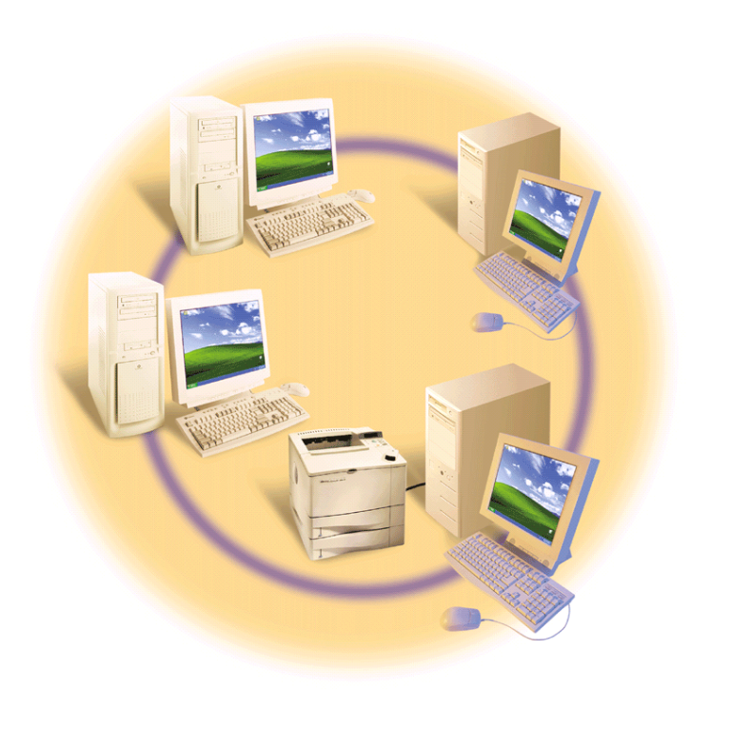
Types of computer networks
Local area network
  Uses direct cables or localized wireless radio or infrared signals to link computers within a small geographic area, such as a building or a group of buildings
SEI.ECNU

Slide 4
Types of computer networks
Metropolitan area network(城域网)
  Uses high-speed fiber-optic lines to connect computers located at various places within a major urban region
  A scottish MAN called FatMan links universities in Scotland with 155 Mbps fiber-optic cables
SEI.ECNU

Slide 5
Types of computer networks
Wide area network
  Uses long-distance transmission media including telecommunications networks to link computers separated by a few miles or even thousands of miles
  The internet is a wide area network open to public use
SEI.ECNU

Slide 6
Types of computer networks
WAN is generally used to refer to other long-distance networks, called public data networks(PDN), that are leased to business and government customers.
PDN offer the security and guaranteed bandwidth that the internet cannot yet ensure.
PDN public data networks, 公共数据网
SEI.ECNU

Slide 7
Networking Synergies in a nutshell
Reducing hardware costs
Enabling shared applications
Building massive information resources
Connecting people
In a nutshell, 简括地
synergy 协同,配合,企业合并后的协力优势或协合作用
SEI.ECNU

Slide 8
Network Fundamentals
Physical media
  Telephone lines, coaxial cable, microwave relay systems, satellites, wireless (radio and infrared), fiber-optic cable
  Coaxial cable 同轴电缆, fiber-optic 光纤,
  Microwave 微波, Relay 继电器
SEI.ECNU

Slide 9
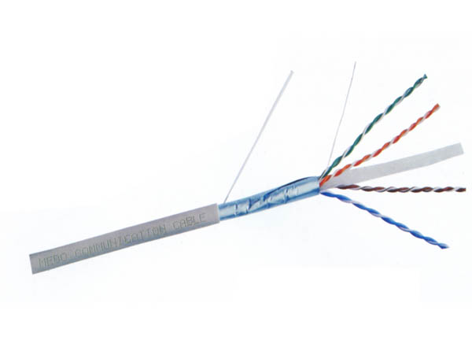
Network Fundamentals
coaxial cable
SEI.ECNU

Slide 10
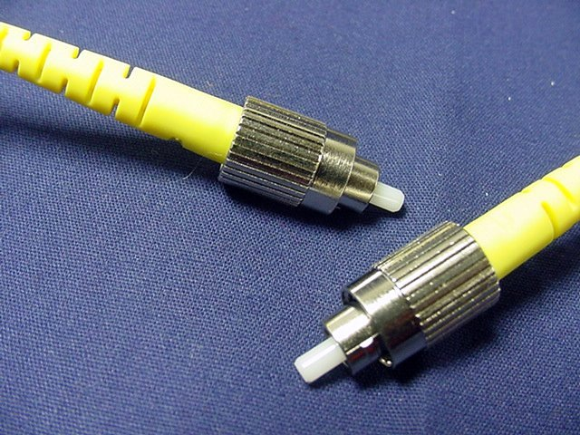
fiber-optic cable
SEI.ECNU

Slide 11
Network Fundamentals
Network can work with an amazing variety of physical media. But
  How does the message get through the maze of cables to the right place
  Who sorts the mail en route
Networks runnel messages to the correct destination using two basic technologies, called circuit switching and packet switching
  Circuit switching 电路交换,电路转化
  Packet switching 包交换,分组交换,报文分组交换技术
SEI.ECNU

Slide 12
Network Fundamentals
Circuit switching
  End-to-end circuit (端到端)
  Better for avoiding delivery delays
  Examples
    Voice, real-time videoconferencing
    Real-time videoconferencing, 实时视频会议
SEI.ECNU

Slide 13
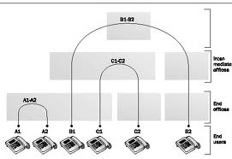
虽然经过多次更新换代，但交换的方式一直都是电路交换(circuit switching)
SEI.ECNU

Slide 14
Network Fundamentals
Packet switching
  In packet switching, outgoing message is divided into data units of a fixed size, called packets
  No guarantee that the packets will arrive in the same order that they were sent
  Connectionless(无链接)
  Congestion 拥塞
SEI.ECNU

Slide 15
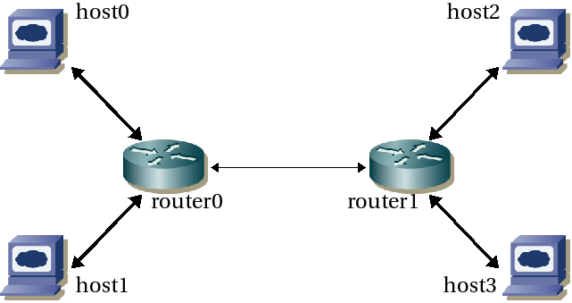
Package switching
SEI.ECNU

Slide 16
Packet Switching VS Circuit Switching
Pros
  It’s more efficient and less expensive than circuit switching.
  What’s more, packet switching networks are more reliable.
Cons
  As it examines a packet, a router delays the packet’s progress by a tiny fraction of a second.
  If the network experiences congestion (overloading), some of the packets may be further delayed.
SEI.ECNU

Slide 17
Network Fundamentals
Protocols
  To specify how the network functions
  A protocol is a set of rules that governs the communications between computers on a network. These rules include guidelines that regulate the following characteristics of a network：access method, allowed physical topologies, types of cabling and speed of data transfer.
  Open protocol
    Networking standard that has been developed and published by an independent organization
SEI.ECNU

Slide 18
Network Fundamentals
Network layers---architecture
  Divide a network architecture into separate layers, each of which has a function that can be isolated and treated separately from other layers.
  Changes within a layer without having to redesign the entire network
SEI.ECNU

Slide 19
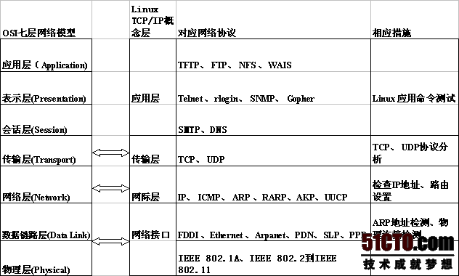
OSI seven levels
SEI.ECNU

Slide 20
Useful Abbreviations
HTML: Hypertext Markup Language
HTTP: Hypertext Transfer Protocol
ISDN: Integrated Services Digital Network
DNS: Domain Name Server
FTP: File Transfer Protocol
P2P: Peer to Peer
C/S: Client/Server
VPN: Virtue Private Network
SEI.ECNU

Slide 21
Useful Abbreviations
NIC: Network Interface Card
MAC address: Media Access Control address
POP: Post Office Protocol
SMPT: Simple Mail Transfer Protocol
TCP/IP: Transmission Control Protocol/Internet Protocol
BBS: Bulletin Board System
WAP: Wireless Access Point
CDMA: Code Division Multiple Access
SEI.ECNU

Slide 22
Thank You !
SEI.ECNU

