Slide 1
课程介绍 授课老师：王丽苹 教授
《数据挖掘》
2025年 秋

Slide 2
我的联系方式
Email : lipingwang@sei.ecnu.edu.cn
Phone : 021-6223110
办公地点: 理科楼A1810
研究兴趣：
智能系统、数据挖掘、数据管理

Slide 3
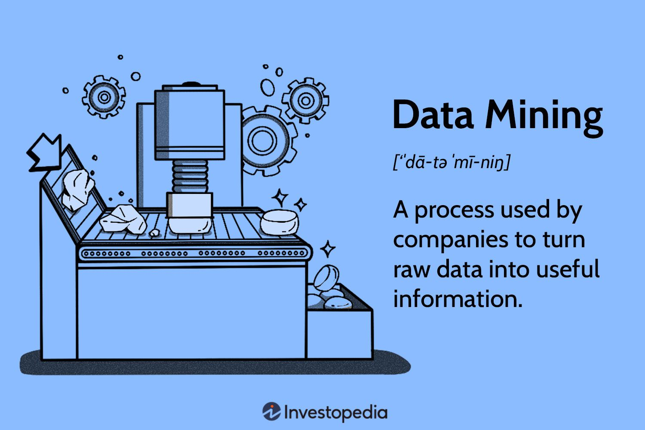

关于这门课
学习数据挖掘的核心算法和模型
培养对数据挖掘理论与应用的兴趣
了解数据挖掘的最新研究和发展
能动手做一些数据挖掘相关的实际开发

Slide 4
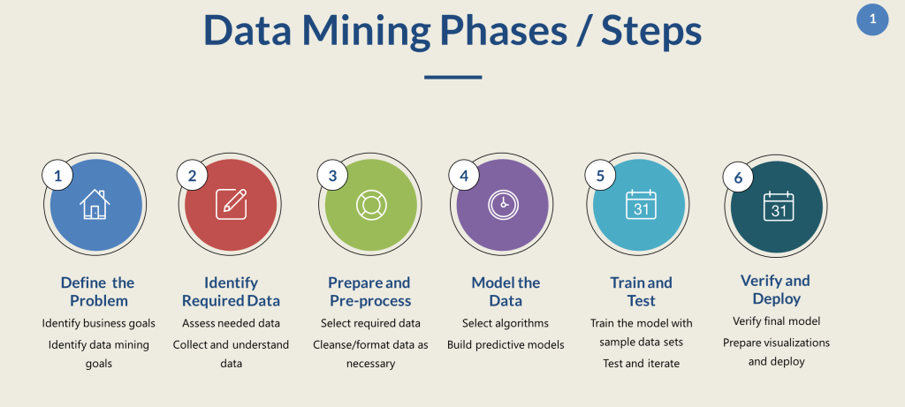
课程介绍
1. 数据预处理与可视化
2. 相关分析
3. 分类：决策树
4. 关联规则挖掘
5. 聚类
6. 集成学习
7. 数据挖掘应用：异常监测、推荐系统等

Slide 5
考核方式
平时和期末 50%+50%
平时包括作业、出勤、课堂表现等情况
课堂情况（10%）：出勤、参与度等
随堂练习（20%）
课后作业（20%）
期末Project：
小组项目（每组1-3人）+个人报告
Kaggle、阿里天池、datafountain
奖励

Slide 6
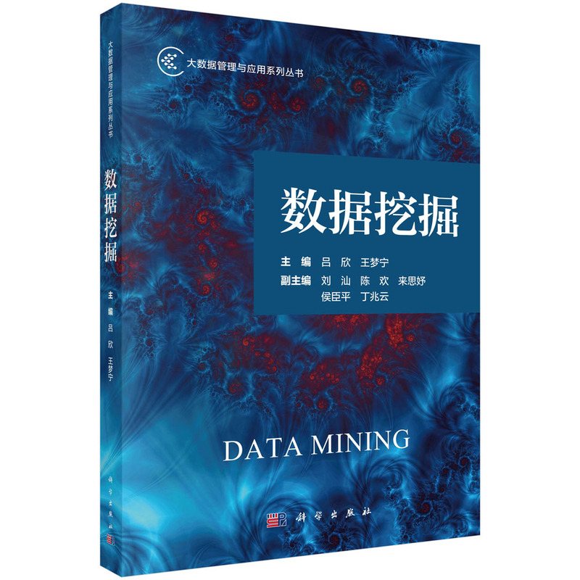
教材
吕欣等，《数据挖掘》，科学出版社

Slide 7
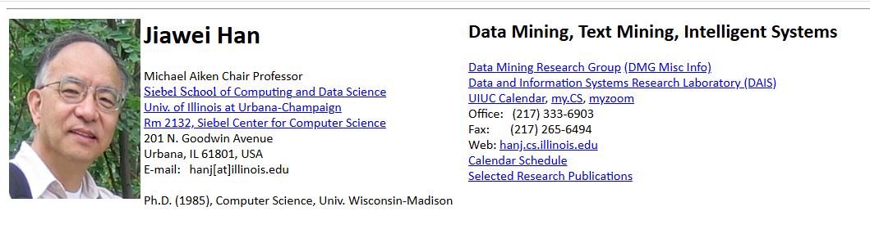
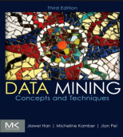
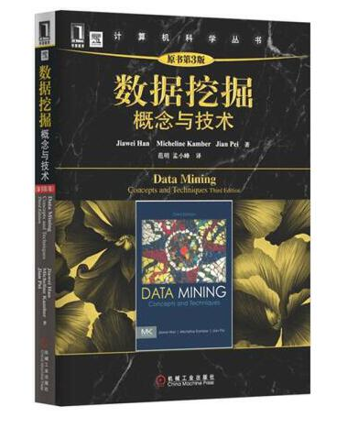
参考教材
J. Han, M. Kamber, and Jian Pei. Data Mining: Concepts and Techniques. https://hanj.cs.illinois.edu/

Slide 8
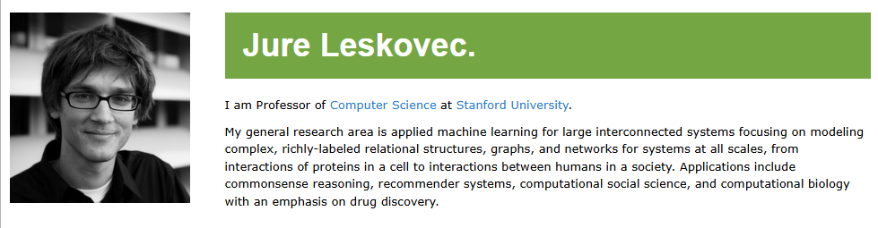
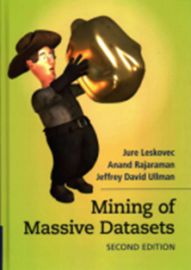

参考教材
Jure Leskovec, Anand Rajaraman, Jeff Ullman. Mining of Massive Datasets. https://cs.stanford.edu/~jure/

Slide 9
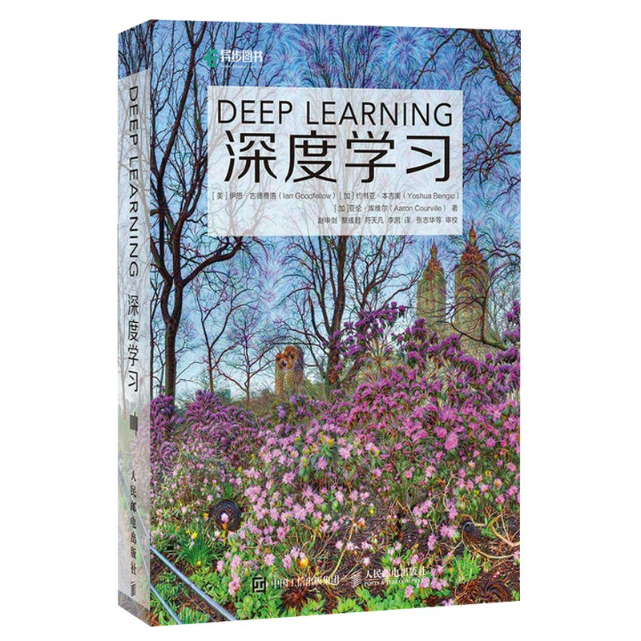
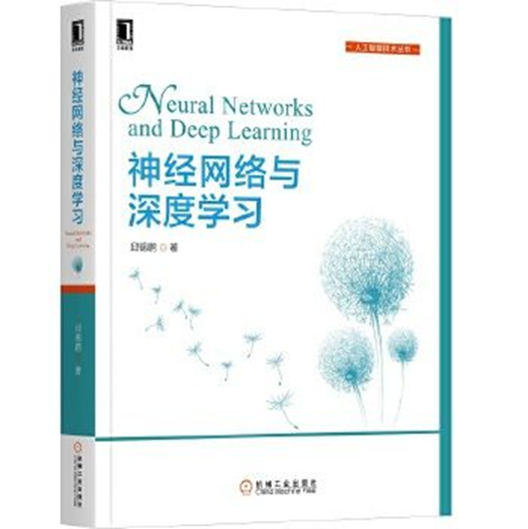
参考教材
《Deep learning》，Ian Goodfellow, Yoshua Bengio and Aaron Courville编著，人民邮电出版社，2016年。
神经网络与深度学习，邱锡鹏，机械工业出版社。

Slide 10
推荐在线课程资源
1. 李宏毅 在线课程《机器学习》
2. Andrew Ng 在线课程《Machine Learning》
3. 斯坦福CS246 Mining of Massive Datasets

Slide 11
Why？
为什么需要数据挖掘？

Slide 12
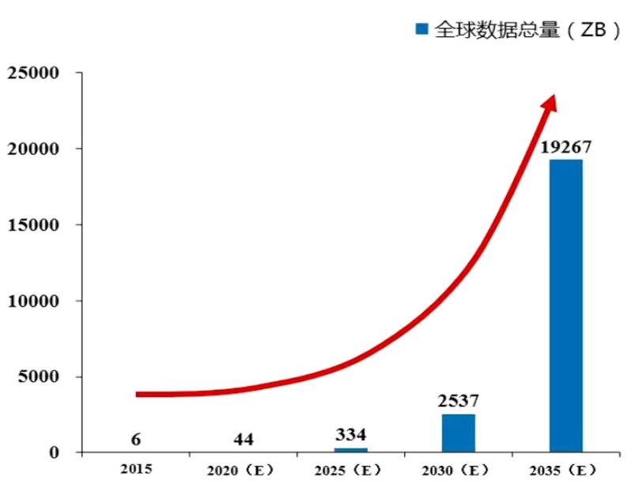
人类已进入一个崭新的信息时代
互联网
感知
……
大数据
计算机
智能
信息
社会

Slide 13
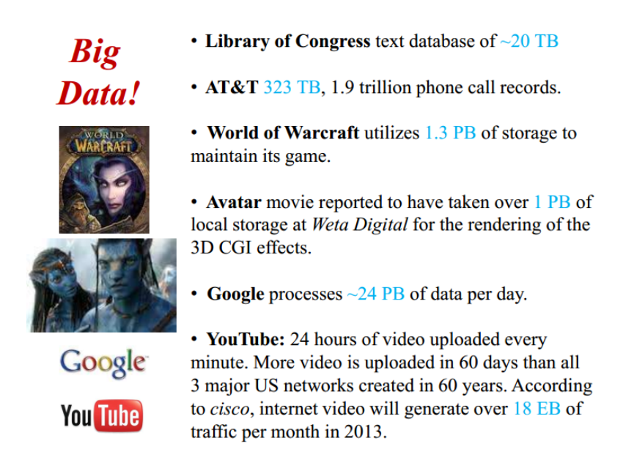
Business promotes DM a lot

Slide 14
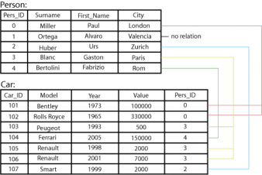
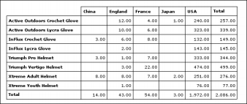
丰富的数据类型-表格数据
• Relational records
– Relational tables, highly structured
• Data matrix, e.g., numerical matrix, crosstabs
• Transaction data
Document 1 | 3 | 0 | 5 | 0 | 2 | 6 | 0 | 2 | 0 | 2
Document 2 | 0 | 7 | 0 | 2 | 1 | 0 | 0 | 3 | 0 | 0
Document 3 | 0 | 1 | 0 | 0 | 1 | 2 | 2 | 0 | 3 | 0
TID | Items
1 | Bread, Coke, Milk
2 | Beer, Bread
3 | Beer, Coke, Diaper, Milk
4 | Beer, Bread, Diaper, Milk
5 | Coke, Diaper, Milk
team
coach
y
pla
bal l
score
game
n
wi
lost
t imeout
season

Slide 15
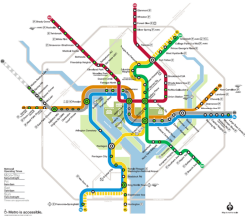
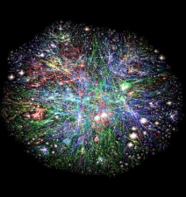
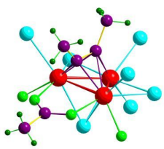
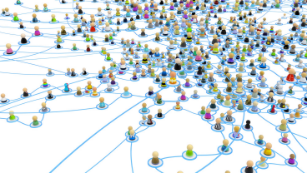
丰富的数据类型-图数据
• Transportation network
• World Wide Web
o Molecular Structures
o Social or information networks

Slide 16
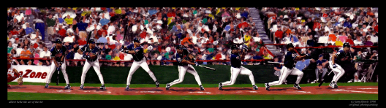
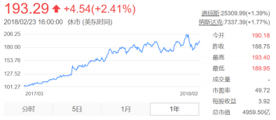
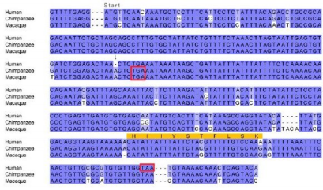
丰富的数据类型-序列数据
• Video data: sequence of images
• Temporal data: time-series
• Sequential Data: transaction
sequences
• Genetic sequence data

Slide 17
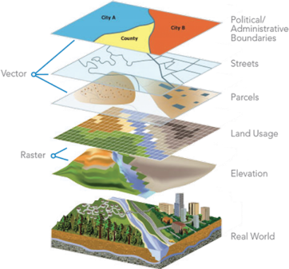
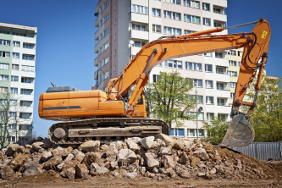
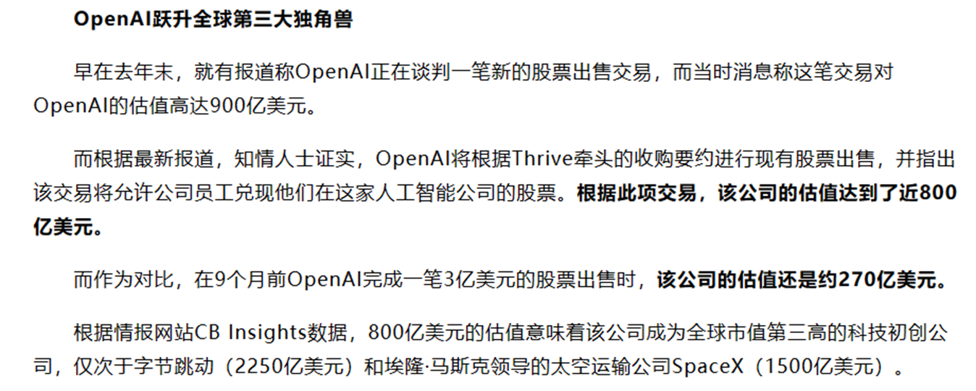
丰富的数据类型-时空数据
• Spatial data: maps
• Image data:
• Textual data:

Slide 18
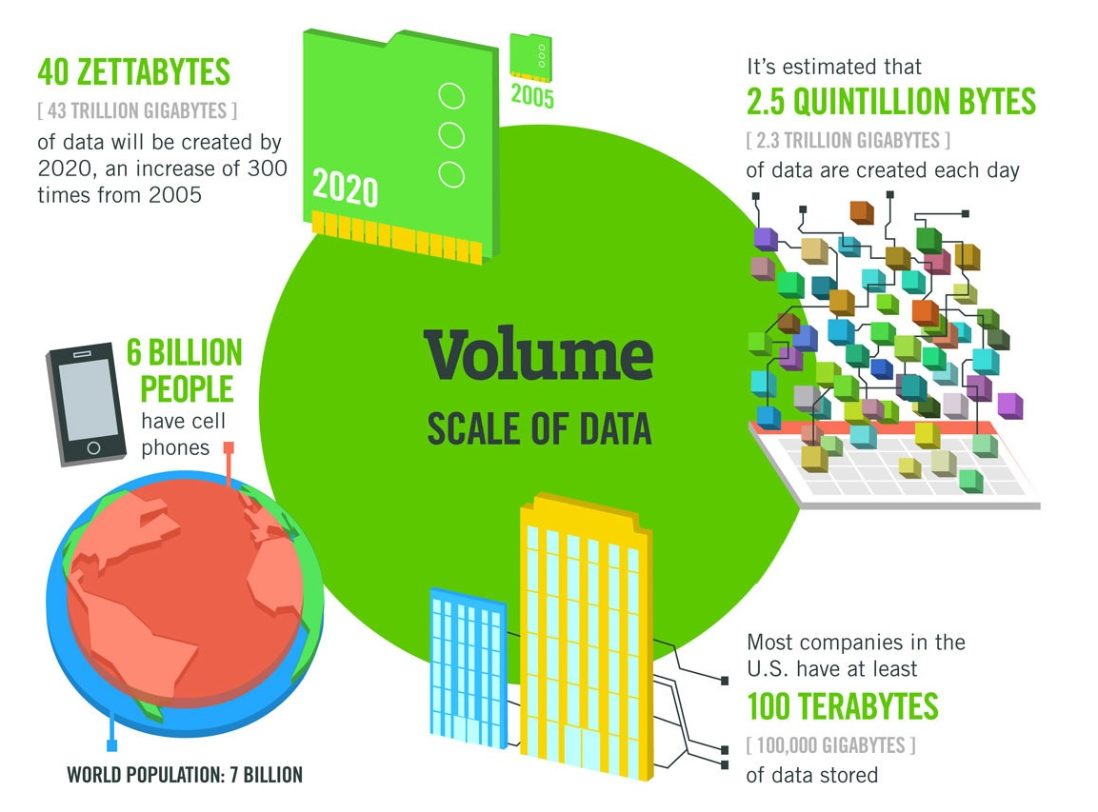
大数据的特点
数据的体量巨大

Slide 19
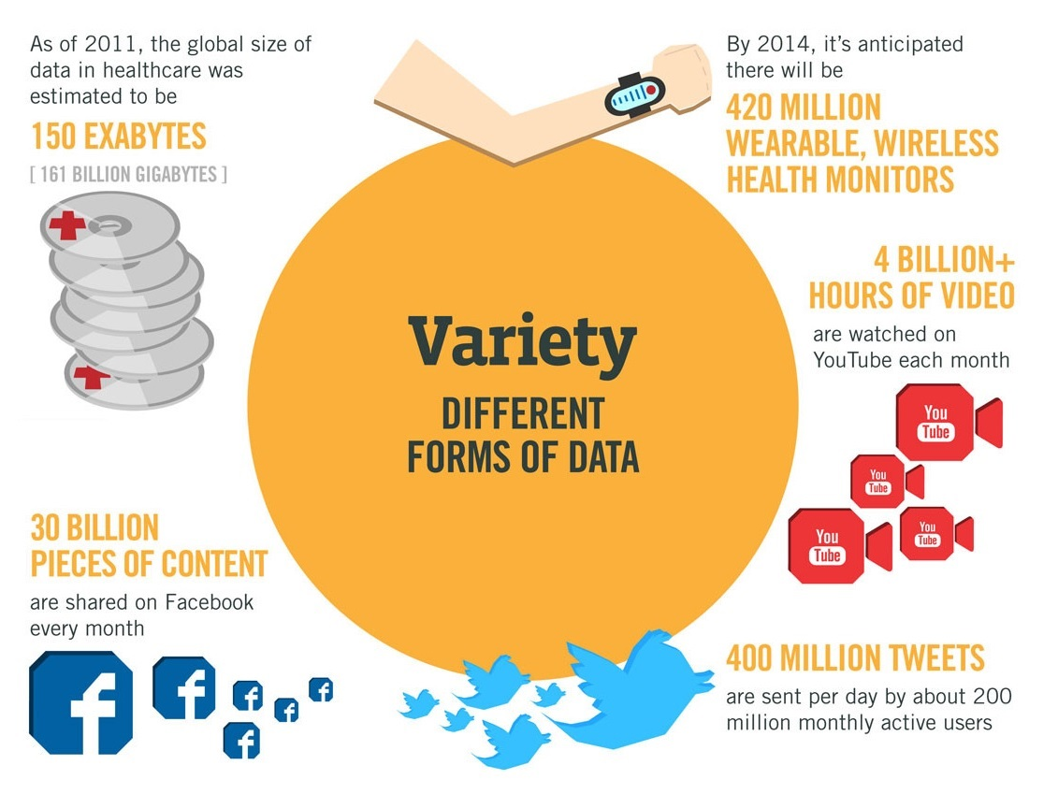
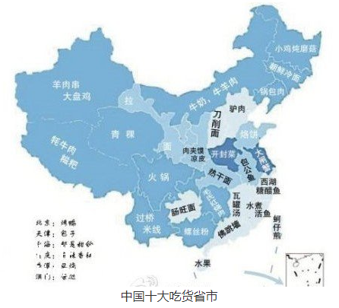
大数据的特点
数据的体量巨大
数据类型繁多

Slide 20
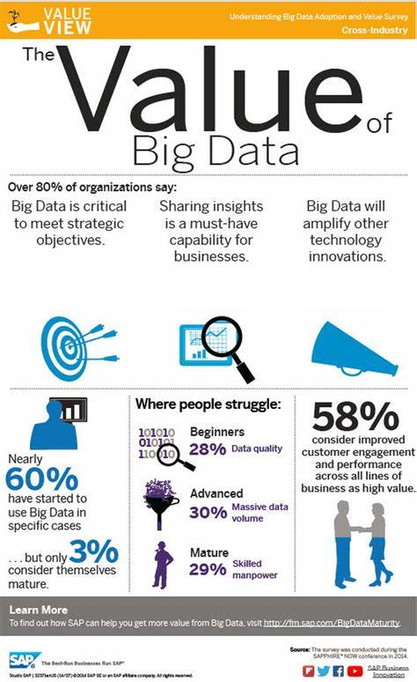
大数据的特点
数据的体量巨大
数据类型繁多
商业价值高，而价值密度却较低

Slide 21
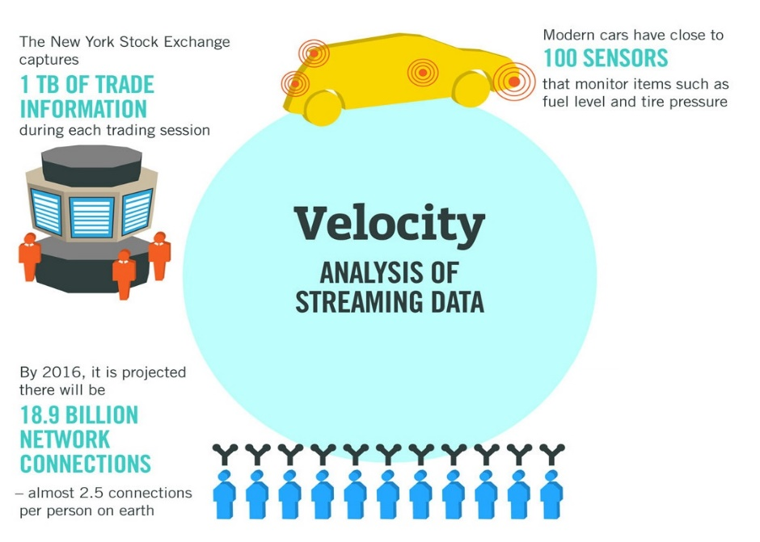
大数据的特点
数据的体量巨大
数据类型繁多
商业价值高，而价值密度却较低
数据产生速度快

Slide 22
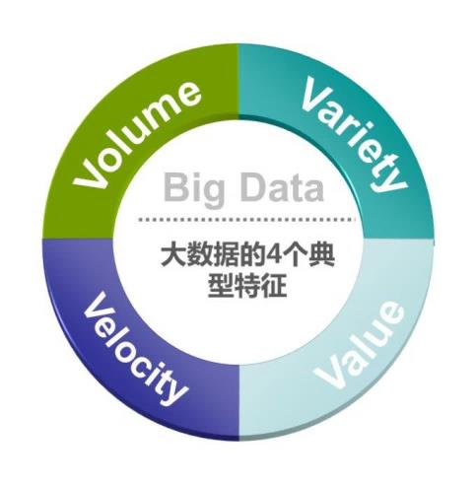
大数据的概念
数据的体量巨大
数据类型繁多
商业价值高，而价值密度却较低
数据产生速度快
处理速度快

Slide 23
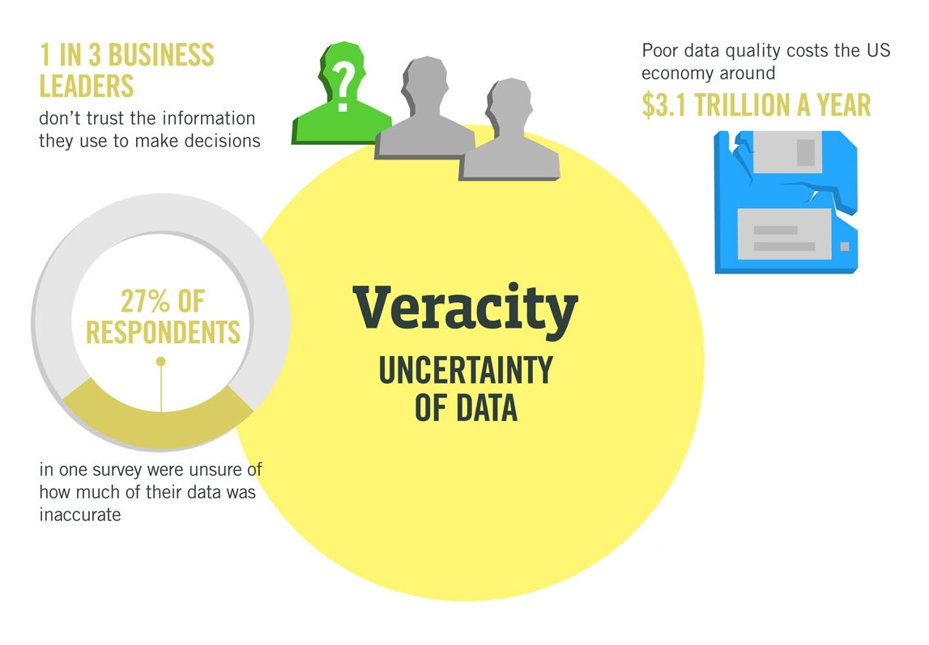
大数据的特点
数据的体量巨大
数据类型繁多
商业价值高，而价值密度却较低
数据产生速度快
数据的真实性
数据的波动性
数据的复杂性

Slide 24
What?
什么是数据挖掘？

Slide 25
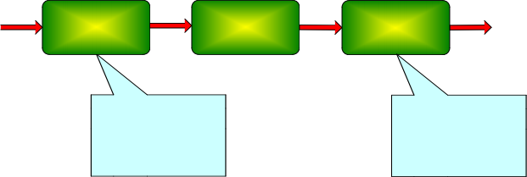
数据挖掘的定义
商业应用角度
数据挖掘是一种新的商业信息处理技术，其主要特点是对商业数据库中的大量业务数据进行抽取、转换、分析和其他模型化处理，从中提取辅助商业决策的关键性数据。
数据处理技术角度
数据挖掘(Data Mining)就是从大量的、不完全的、有噪声的、模糊的、随机的实际应用数据中，提取隐含在其中的、人们事先不知道的、但又是潜在有用的信息和知识的过程
Raw
Data
Data
Preprocessing
Data Mining
Knowledge
Postprocessing
Filtering patterns
Visualization
Pattern Interpretation
Feature Selection
Dimension Reduction Normalization
Data subsetting

Slide 26
数据挖掘的定义
Jiawei Han的定义
从大型数据集中提取有趣的 (非平凡的, 蕴涵的, 先前未知的并且是潜在有用的) 信息或模式
其他定义
在大型数据存储库中，自动地发现有用信息的过程。
Exploration & analysis, by automatic or semi-automatic means, of large quantities of data in order to discover meaningful patterns
Non-trivial extraction of implicit, previously unknown and potentially useful information from data

Slide 27
How？

Slide 28
数据挖掘de特点
数据挖掘是多学科的产物
统计学的抽样、估计和假设检验
数据库系统提供有效的存储、索引和查询处理支持
可视化
算法和高性能计算（最优化、进化计算）
机器学习的搜索算法、建模技术和学习理论
人工智能、模式识别和分布式技术也能帮助处理海量数据
信息论、信号处理、可视化和信息检索
数据挖掘
统计学
可视化
机器学习
高性能计算
数据库技术
人工智能、模式识别

Slide 29
数据挖掘de任务
Predictive Tasks（预测性的任务）
Use some variables to predict unknown values of other variables
Descriptive Tasks（描述性的任务）
Find human-interpretable patterns that describe the data

Slide 30
Data Mining Tasks (1)
n Association Rule Discovery (Descriptive)【关联规则】
- Diaper Beer [0.5%, 75%]
n Regression (Predictive)【回归任务】
- Predict value of a given variable based on values of other variables
n Classification (Predictive)【分类任务】
- Construct models (functions) that describe and distinguish classes or concepts for future prediction
» E.g., label emails as spam or non-spam, …

Slide 31
Data Mining Tasks (2)
n Cluster analysis (Descriptive)【聚类任务】
- Class label is unknown: group data to form new classes
- Maximizing intra-class similarity & minimizing interclass similarity
n Outlier/anomaly detection (Predictive)【异常监测】
- Outlier: a data object that does not comply with the general behavior of the data
- Useful in fraud detection, rare events analysis
n Other pattern-directed or statistical analyses
- Recommender systems (Predictive)【推荐系统】
- NLP Topic models (Descriptive)【主题发掘】

Slide 32
数据挖掘de任务：分类定义
给定一批记录----训练集 (training set )
Each record contains a set of attributes, one of the attributes is the class label (类标号) .
任务: 建立一个模型(model )
类标号属性是其他属性值的函数
目标: previously unseen records should be assigned a class as accurately as possible.
A test set (检验集) is used to determine the accuracy of the model.
Usually, the given data set is divided into training and test sets, with training set used to build the model and test set used to validate it

Slide 33
分类:例子
categorical
categorical
continuous
class
Test
Set
Learn
Classifier
Training
Set
Model

Slide 34
分类:应用1
Direct Marketing
Goal:
Reduce cost of mailing by targeting a set of consumers likely to buy a new cell-phone product.
Approach:
Use the data for a similar product introduced before.
We know which customers decided to buy and which decided otherwise. This {buy, don’t buy} decision forms the class attribute.
Collect various demographic, lifestyle, and company-interaction related information about all such customers.
Type of business, where they stay, how much they earn, etc.
Use this information as input attributes to learn a classifier model.

Slide 35
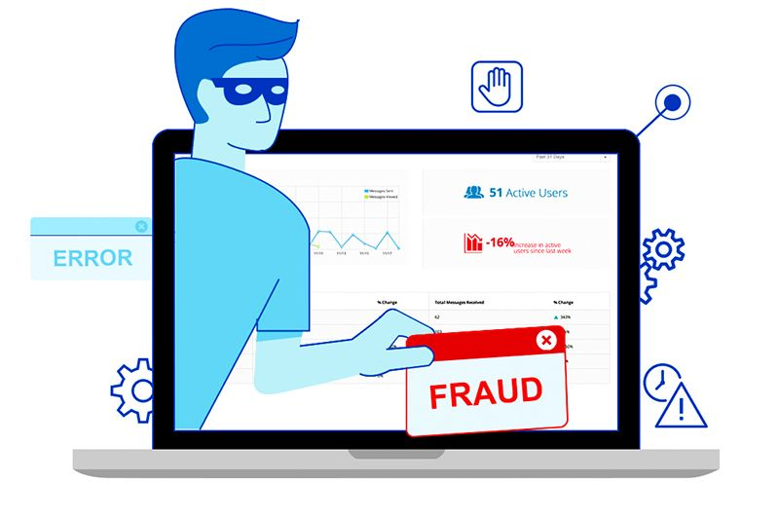
分类:应用2
Fraud Detection
Goal:
Predict fraudulent cases in credit card transactions.
Approach:
Use credit card transactions and the information on its account-holder as attributes.
When does a customer buy
what does he buy
how often he pays on time, etc
Label past transactions as fraud or fair transactions. This forms the class attribute.
Learn a model for the class of the transactions.
Use this model to detect fraud by observing credit card transactions on an account.

Slide 36
分类:应用3
Sky Survey Cataloging
Goal: To predict class (star or galaxy) of sky objects, especially visually faint ones, based on the telescopic survey images (from Palomar Observatory).
3000 images with 23,040 x 23,040 pixels per image.
Approach:
Segment the image.
Measure image attributes (features) - 40 of them per object.
Model the class based on these features.
Success Story: Could find 16 new high red-shift quasars, some of the farthest objects that are difficult to find!

Slide 37
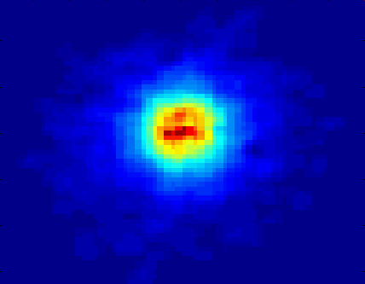
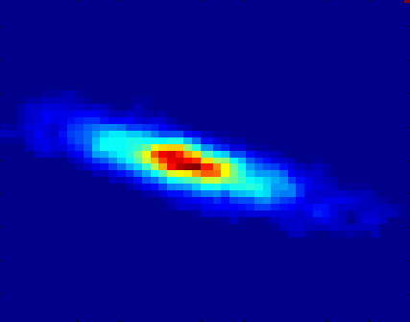
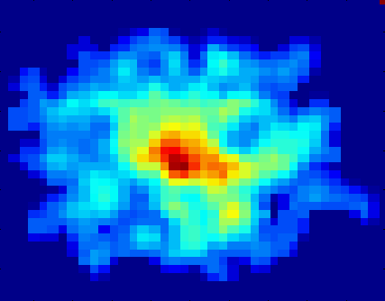
分类:应用3
Courtesy: http://aps.umn.edu
Early
Class:
Stages of Formation
Attributes:
Image features,
Characteristics of light waves received, etc.
Intermediate
Late
Data Size:
72 million stars, 20 million galaxies
Object Catalog: 9 GB
Image Database: 150 GB

Slide 38
数据挖掘de任务：聚类分析
1）定义
聚类 (clustering)：与分类和预测不同，它主要分析数据对象，而不考虑已知的类标记。
一般情况下，训练数据中不提供类标记，因为不知道从何开始。聚类可以用于产生这种标记。
2）聚类或分组的原则
“最大化类内的相似性、最小化类间的相似性”
对象的簇（聚类）的形成办法为：使得在一个簇中的对象具有很高的相似性，而与其它簇中的对象很不相似。所形成的每个簇可以看作一个对象类，由它可以导出规则。

Slide 39
聚类（Clustering）
聚类（Clustering）是将物理或抽象的对象集合分成多个组的过程，聚类生成的组称为簇（Cluster），即簇是数据对象的集合。
聚类就是要让生成的簇内部的任意两个对象之间具有较高的相似度，而属于不同簇的两个对象间具有较高的相异度。

Slide 40
聚类
Intracluster distances
are minimized
Intercluster distances
are maximized

Slide 41
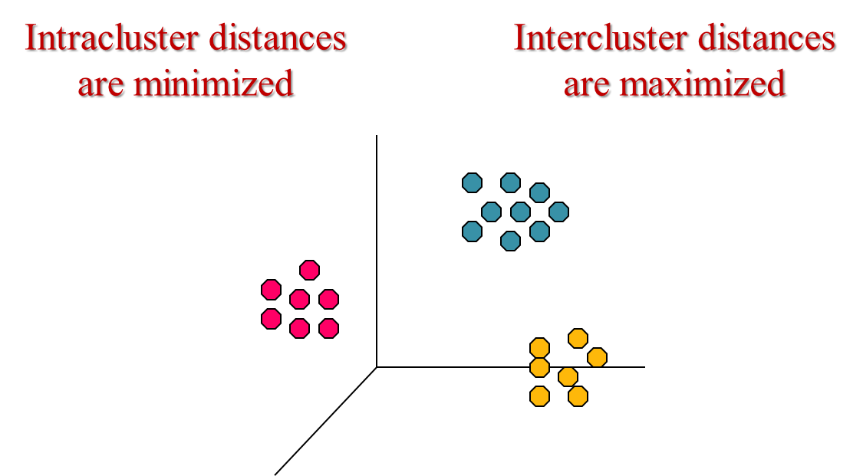
聚类: 定义
给定一组具有多个属性的数据点，以及点与点的相似性衡量方法，则聚类即为使
同一个簇中的点较与其他簇中的点更相似
不同簇中的点比同一个簇中的点的相似性更弱
相似性测度:
欧几里得距离（对于连续属性）
其他针对不同问题的测度方法

Slide 42
聚类: 应用1
Market Segmentation:
Goal:
subdivide a market into distinct subsets of customers where any subset may conceivably be selected as a market target to be reached with a distinct marketing mix.
Approach:
Collect different attributes of customers based on their geographical and lifestyle related information.
Find clusters of similar customers.
Measure the clustering quality by observing buying patterns of customers in same cluster vs. those from different clusters.

Slide 43
聚类: 应用2
Document Clustering:
Goal:
To find groups of documents that are similar to each other based on the important terms appearing in them.
Approach:
To identify frequently occurring terms in each document. Form a similarity measure based on the frequencies of different terms. Use it to cluster.
Gain:
Information Retrieval can utilize the clusters to relate a new document or search term to clustered documents

Slide 44
数据挖掘de任务：关联分析: 定义
用来发现描述数据中强关联特征的模式，所发现的模式通常用蕴涵规则或特征子集的形式表示。由于搜索空间是指数规模的，关联分析的目标是以有效的方式提取最有趣的模式;
找出具有相关功能的基因组、识别一起访问的Web页面、理解地球气候系统不同元素之间的联系.
Rules Discovered:
{Diaper} --> {Milk}
{Diaper, Milk} --> {Beer}

Slide 45
关联规则:定义
关联规则(association rule)
Given a set of records each of which contain some number of items from a given collection;
Produce dependency rules which will predict occurrence of items based on occurrences of other items.
Rules Discovered:
{Milk} --> {Coke}
{Diaper, Milk} --> {Beer}

Slide 46
关联规则:应用1
Marketing and Sales Promotion:
Let the rule discovered be
{Bagels(百吉饼), … } --> {Potato Chips}
Potato Chips as consequent => Can be used to determine what should be done to boost its sales.
Bagels in the antecedent => Can be used to see which products would be affected if the store discontinues selling Bagels.
Bagels in antecedent and Potato chips in consequent => Can be used to see what products should be sold with Bagels to promote sale of Potato chips!

Slide 47
关联规则:应用2
Supermarket shelf management.
Goal:
To identify items that are bought together by sufficiently many customers.
Approach:
Process the point-of-sale data collected with barcode scanners to find dependencies among items.
A classic rule --
If a customer buys diaper and milk, then he is very likely to buy beer.
So, don’t be surprised if you find six-packs stacked next to diapers!

Slide 48
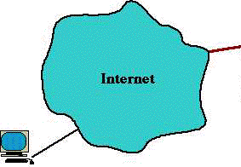
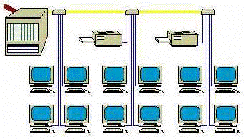
异常检测
识别特征显著不同于其他数据的观测值
应用:
检测欺诈
网络攻击
疾病的不寻常模式
生态系统扰动

Slide 49
异常检测
任务：识别其特征显著不同于其他数据的观测值
这样的观测值称为异常点（anomaly）或离群点（outlier）
发现真正的异常点，而避免错误地将正常的对象标注为异常点
应用
信用卡欺诈检测
网络入侵检测

Slide 50
数据挖掘技术的产生和发展
KDD的发展
第一届KDD国际学术会议（KDD’95）
加拿大蒙特利尔召开
1997
1995
第一本学术刊物《Knowledge Discovery and Data Mining》创刊
Kluwers Publishers出版
1989
基于数据库的知识发现（KDD）一词首次出现在国际人工智能联合大会IJCAI-89 Workshop上。

Slide 51
最新的发展 DBLP、 Google学术
• KDD Conferences
– ACM SIGKDD Int. Conf. on Knowledge Discovery in Databases and Data
Mining (KDD)
– SIAM Data Mining Conf. (SDM)
– (IEEE) Int. Conf. on Data Mining
(ICDM)
– European Conf. on Machine Learning and Principles and practices of
Knowledge Discovery and Data Mining (ECML-PKDD)
– Pacific-Asia Conf. on Knowledge
Discovery and Data Mining (PAKDD)
– Int. Conf. on Web Search and Data Mining (WSDM)
n Other related conferences
n DB conferences: ACM SIGMOD, VLDB, ICDE, EDBT, ICDT, …
n Web and IR conferences: WWW, SIGIR, WSDM
n ML conferences: ICML, NIPS
n PR conferences: CVPR, ICCF
n AI conferences: AAAI, IJCAI
n Journals
n IEEE Trans. On Knowledge and Data Eng. (TKDE)
n ACM Trans. on KDD
n Data Mining and Knowledge Discovery (DAMI or DMKD)

Slide 52
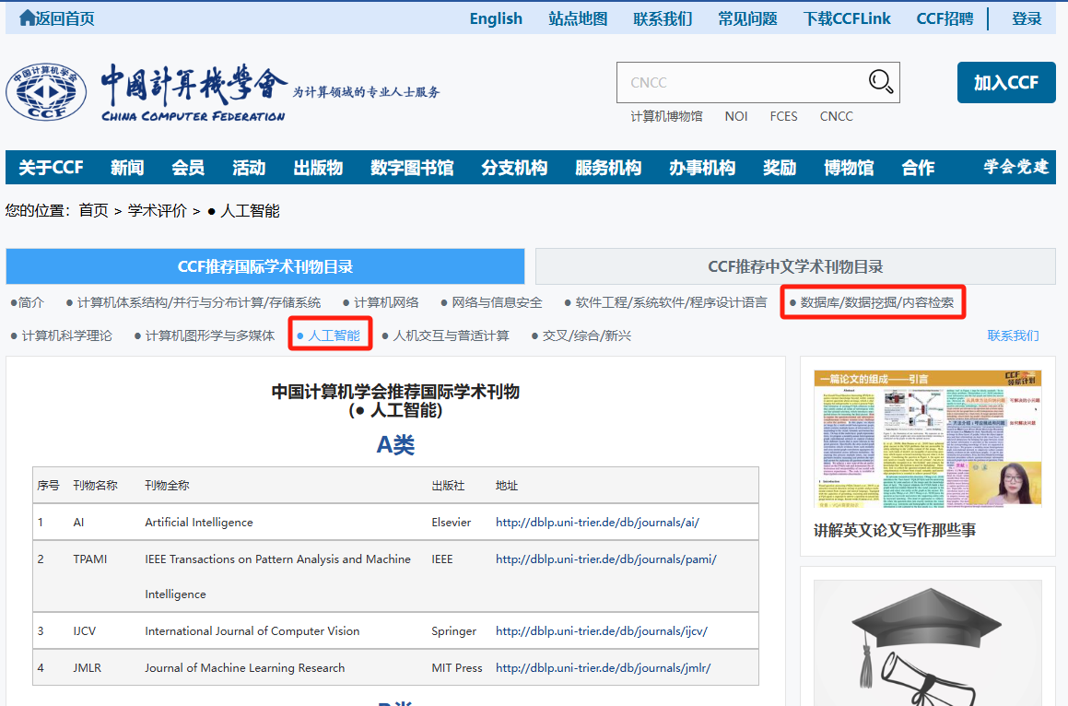
CCF的推荐列表
https://www.ccf.org.cn/Academic_Evaluation/DM_CS/

Slide 53

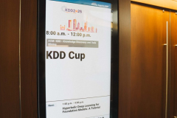

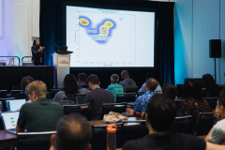
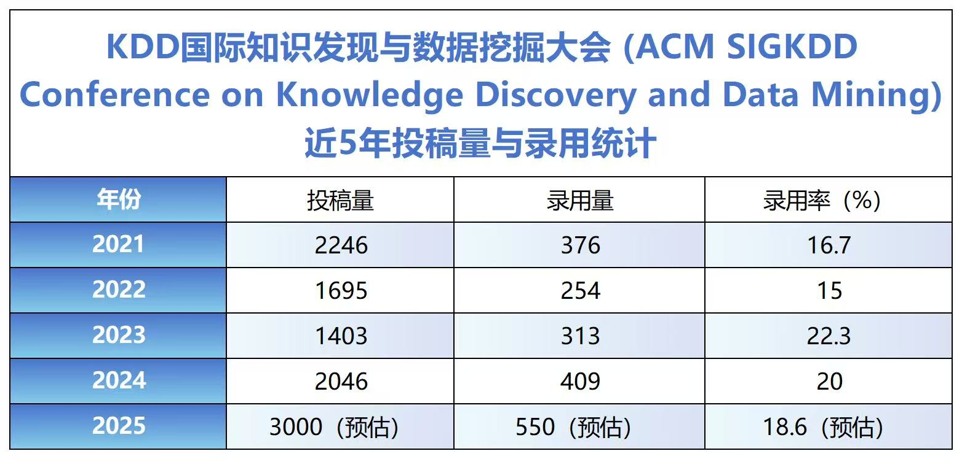
SIGKDD 2025 Toronto Canada
(a): Poster
(b): KDD CUP
(c): 大会主席 Jian Pei
(d): oral

Slide 54

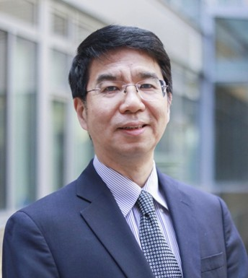


SIGKDD 2025 Keynote Speakers
Caroline Uhler：Causality from Multi-Modal Data
Jason Cong：Deep Learning Meets Chip Design: Driving Next-Gen Efficiency and Innovation
Dan Roth：On Reasoning LLMs: Myths, Merits, and How to Move Forward
Chris Manning：Meaning and Intelligence in Language Models: From History and Philosophy to Universal Transformers and Web Agents
https://kdd2025.kdd.org/keynote-speakers/

Slide 55
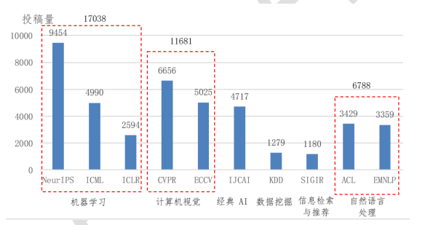
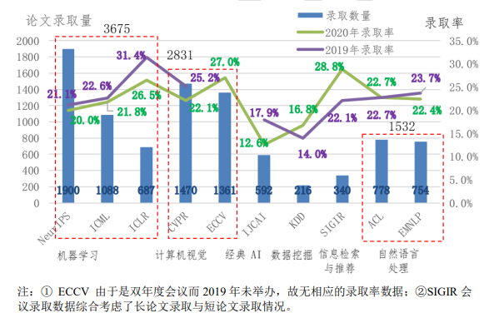
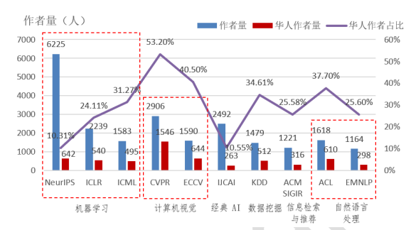
相关顶级国际学术会议的投稿与录用情况
AI相关顶级国际学术会议论文录用情况
AI相关顶级国际学术会议 2020 年的投稿量情况
AAAI 2026 投稿量2.9W篇，是2025年的近两倍；
NeurIPS 2025 投稿量近3W篇；
CVPR 2025 投稿量1.3W篇；
ICML 2025投稿量1.2W篇；
AI相关顶级国际学术会议华人作者占比

Slide 56
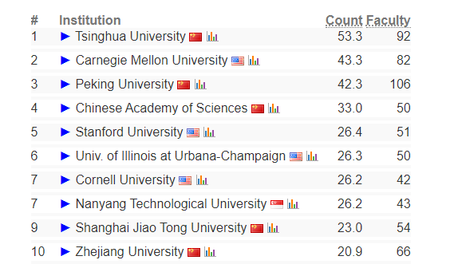
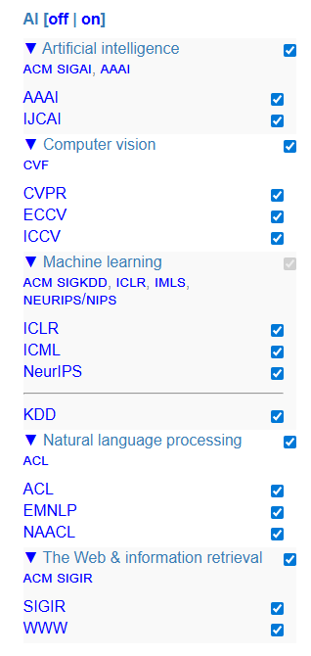
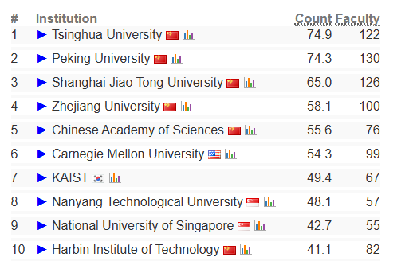
CS Ranking 研究机构排名（AI领域 近5年）
AI的5个领域世界综合排名2016-2021
AI的5个领域世界综合排名2020-2025
AI的5个领域世界综合排名2020-2025

Slide 57
summary
• Why:
– Data contains value and knowledge
– Mining can be performed in a variety of data
• What:
– Data mining: Discovering interesting patterns and knowledge from massive amount of data
• How:
– Association, classification, clustering, outlier and trend analysis, etc
– Many real applications in industry

Slide 58
谢谢！ 下一章：数据预处理 部分课程材料来源于互联网

