Slide 1
Computer Networks
第二章习题讲解
王廷
华东师范大学 软件工程学院 Email: twang@sei.ecnu.edu.cn
Office: 理科大楼B1116室

Slide 2
第二章习题讲解
P1. A noiseless 4-kHz channel is sampled every 1 msec. What is the maximum data rate? How does the maximum data rate change if the channel is noisy, with a signal-to-noise ratio of 30 dB?
Ans: A noiseless channel can carry an arbitrarily large amount of information, no matter how often it is sampled. Just send a lot of data per sample. For the 4- kHz channel, make 8000 samples/sec. If each sample is 16 bits, the channel can send 128 kbps. If each sample is 1024 bits, the channel can send 8.2 Mbps. The key word here is “noiseless.” With a normal 4 kHz channel, the Shannon limit would not allow this. A signal-to-noise ratio of 30 dB means S/N = 1000. So, the Shannon limit is about 39.87 kbps.
无噪声：Max. data rate = 2B log₂V bits/sec
有噪声：Max. data rate = B log₂(1 + S/N) bits/sec
信噪比10log₁₀S/N (dB)
P2. If a binary signal is sent over a 3-kHz channel whose signal-to-noise ratio is 20 dB, what is the maximum achievable data rate?
Ans: A signal-to-noise ratio of 20 dB means S / N = 100. Since log₂ 101 is about 6.658, the Shannon limit is about 19.975 kbps. The Nyquist limit is 6 kbps. The bottleneck is therefore the Nyquist limit, giving a maximum channel capacity of 6 kbps.

Slide 3
第二章习题讲解
P3. What signal-to-noise ratio is needed to put a T1 carrier on a 50-kHz line?
Ans: To send a T1 signal we need Blog₂(1 + S/N) = 1.544 × 10⁶ with B = 50,000. This yields S /N = 2³⁰ − 1, which is about 93 dB. Notes: T1’s maximum data rate: 1.544 Mbps.

Slide 4
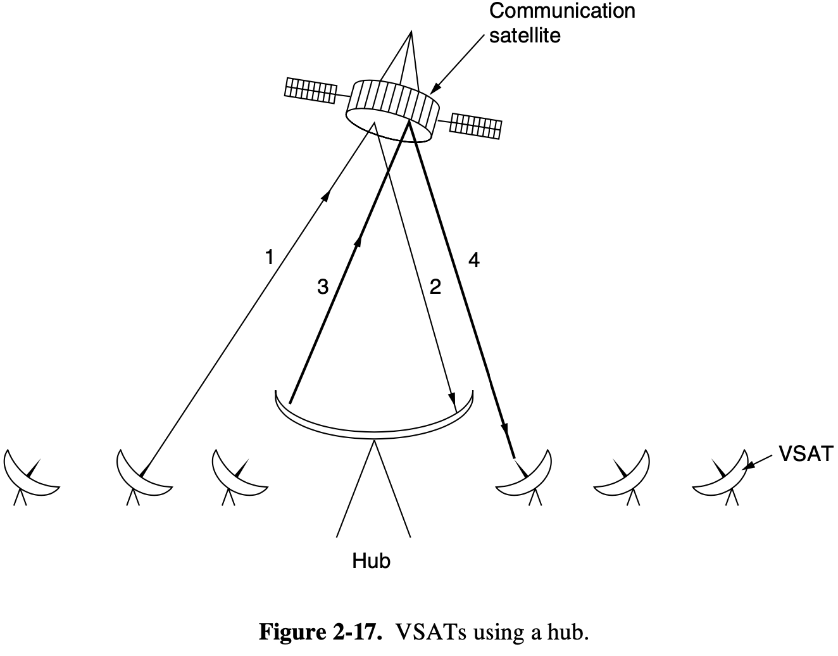
第二章习题讲解
P4. How long will it take to transmit a 1-GB file from one VSAT to another using a hub as shown in Figure 2-17? Assume that the uplink is 1 Mbps, the downlink is 7 Mbps, and circuit switching is used with 1.2 sec circuit setup time.
Ans:
The lowest bandwidth link (1 Mbps) is the bottleneck.
One-way latency = 4 × (35800/300000) = 480 msec.
Total time = 1.2 + 1024*8Mbps/1Mbps + 0.48 = 8193.68 sec.
同步地球卫星位于35800km高空

Slide 5
第二章习题讲解
P5. Calculate the transmit time in the previous problem if packet switching is used instead. Assume that the packet size is 64 KB, the switching delay in the satellite and hub is 10 microseconds, and the packet header size is 32 bytes.
Ans:
Again, the lowest-bandwidth link is the bottleneck.
Number of packets = 1024²KB/64KB = 16384.
One way latency = 480 + 3 × 0.001 = 480.003 msec.
Total bytes transmitted =
1024MB+16384*32/1024/1024MB = 1024.5 MB.
Total time = 1024.5MB*8 / 1Mbps + 0.48 = 8196.48 sec.

Slide 6

End
Chapter 2

