Slide 1
Computer Networks
第五章习题讲解
王廷
华东师范大学 软件工程学院 Email: twang@sei.ecnu.edu.cn
Office: 理科大楼B1116室

Slide 2
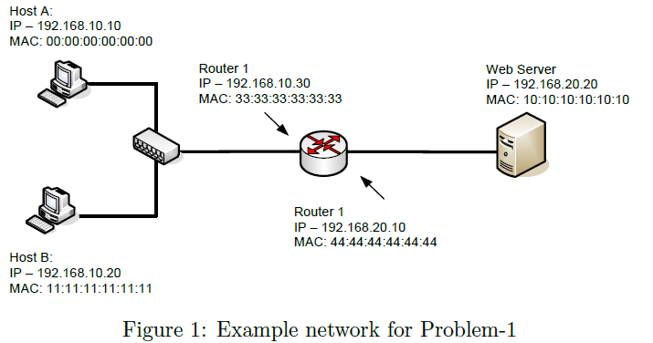
第五章习题讲解
Problem 1：Consider the Figure 1 and assume that network 192.168.10.0 is an Ethernet and therefore, the MTU size is 1500 bytes whereas network 192.168.20.0 is a dialup network using PPP with an MTU size of 512 bytes. Answer the following two questions:

Slide 3
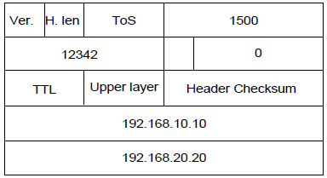
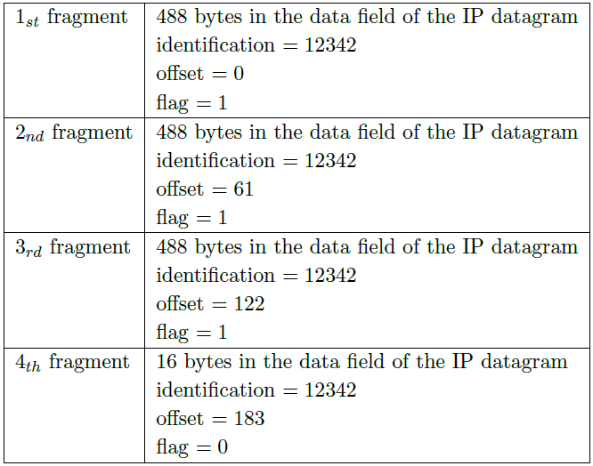
第五章习题讲解
(1) Assume that host A sends a datagram with the following header (as shown right) to the web server. Does the router need to fragment the datagram? If yes, how many fragments needed; also show the characteristics of each fragment. If not, why not?
Ans: Yes. A datagram 1,500 bytes (20 bytes IP header plus 1480 bytes of IP payload) arrives to Router 1, and this datagram should be forwarded to a link with a MTU of 512 bytes.
512 bytes – 20 bytes header = 492 bytes, but 492 mod 8 != 0, so we take 488 bytes as the size of data filed in the IP datagram, and max total length of new IP fragment will be 488 bytes + 20 bytes header = 508 bytes.
This implies that 1,480 data bytes in the original datagram shall be allocated to 4 separate fragments (1480/488 ≈ 4). Notice that the original datagram is stamped with the identiﬁcation number of 12342.

Slide 4
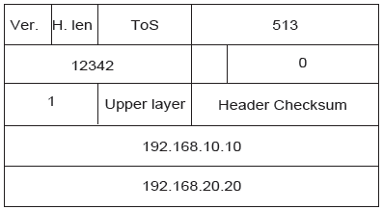
第五章习题讲解
(2) Assume now that host A sends a datagram with the following header (as shown below) to the web server. Does the router need to fragment the datagram? If yes, how many fragments needed; also show the characteristics of each fragment. If not, why not?
Ans: No. When Router 1 receives this datagram, the value of TTL ﬁeld will be decremented by 1 and since the TTL ﬁeld then reaches 0, this datagram shall be dropped directly by Router 1. No segmentation is needed.

Slide 5
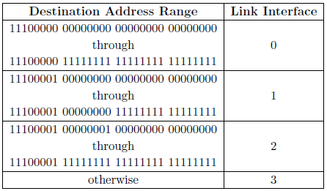
第五章习题讲解
Problem 2： Consider a datagram network using 32-bit host addresses. Suppose a router has four links, numbered 0 to 3, and packets are to be forwarded to the links interfaces as follows:

Slide 6
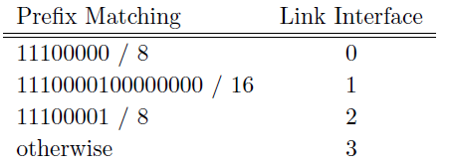
第五章习题讲解
Provide a forwarding table that has four entries, uses longest prefix matching, and forwards packets to the correct link interfaces.
Ans: the forwarding table is as below.

Slide 7
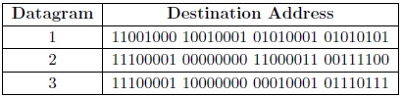
第五章习题讲解
（2）Describe how your forwarding table determines the appropriate link interface for datagrams with destination address separately:
Ans: 11001000 10010001 01010001 01010101 This address matches only the rule for interface 3 and hence it will be forwarded through interface 3. (2) 11100001 00000000 11000011 00111100 This address matches preﬁxes for interface 1 and 2, but the longest match occurs with interface 1. Hence it will be forwarded through interface 1. (3) 11100001 10000000 00010001 01110111This address matches the preﬁx for interface 2. Hence it will be forwarded through interface 2.

Slide 8
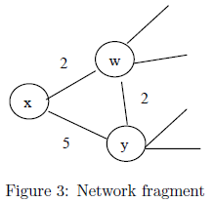
第五章习题讲解
Problem 3： Consider the network fragment shown in the Figure 3. x has only two attached neighbors, w and y. w has a minimum-cost path to destination u (not shown) of 5, and y has a minimum-cost path to u of 6. The complete paths from w and y to u are not shown. All link costs in the network are strictly positive integer values. Give x’s distance vector for destination w, y, and u. Give a link-cost change for either c(x, w) or c(x,y) such that x will inform its neighbors of a new minimum-cost path to u as a result of executing the distance-vector algorithms. Give a link-cost change for either c(x,w) or c(x,y) such that x will NOT inform its neighbors of a new minimum-cost path to u as a result of excecuting the distance-vector algorithm.

Slide 9
第五章习题讲解
Give x’s distance vector for destination w, y, and u.
Ans: D_{x}(w) = min{D_{x}(w) + D_{w}(w), D_{x}(y) + D_{y}(w)} = min{2+0, 5+2} = 2; D_{x}(y) = min{D_{x}(w) + D_{w}(y), D_{x}(y) + D_{y}(y)} = min{2+2, 5+0} = 4; D_{x}(u) = min{D_{x}(w) + D_{w}(u), D_{x}(y) + D_{y}(u)} = min{2+5, 4+6} = 7.

Slide 10
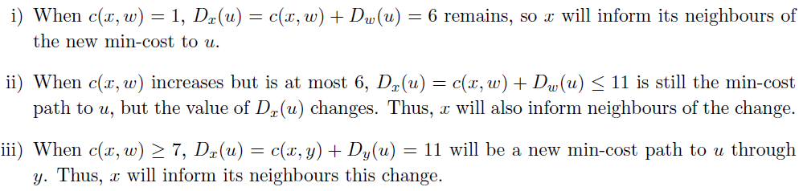
第五章习题讲解
(2) Give a link-cost change for either c(x, w) or c(x,y) such that x will inform its neighbors of a new minimum-cost path to u as a result of executing the distance-vector algorithms.
Ans:
5
10
6
10

Slide 11
第五章习题讲解
(3) Give a link-cost change for either c(x,w) or c(x,y) such that x will NOT inform its neighbors of a new minimum-cost path to u as a result of excecuting the distance-vector algorithm.
Ans:
No matter how c(x,y) changes, increase or decrease, as long as c(x,y) ≥ 1, D_{x}(u)=7 will not change. Thus, x will not inform its neighbors.

Slide 12
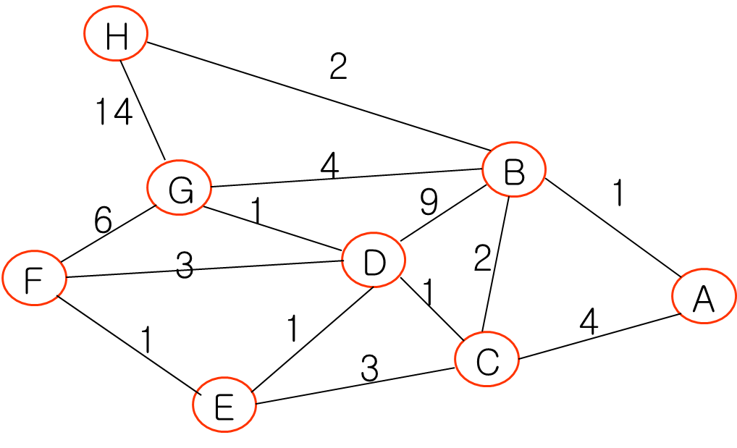
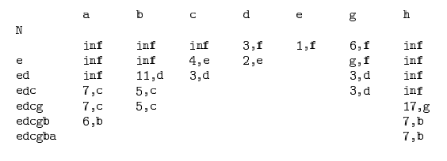
第五章习题讲解
Problem 4： Consider the following network. With the indicated link costs, use Dijkstra’s shortest path algorithm to compute the shortest path from F to all network nodes.

Slide 13
第五章习题讲解
Problem 5：A network on the Internet has a subnet mask of 255.255.240.0. What is the maximum number of hosts it can handle?
Ans:
对于一个B 类网络，高端16 位形成网络号，低端16 位是子网或主机域。
255.255.240.0对应的二进制：11111111 11111111 11110000 00000000
在子网掩码的低端16 位中，最高有效4 位为1111，因此剩下12 位用于主机号。因此，存在4096 个主机地址。但由于全0 和全1 是特别地址，因此最大的主机数目为4094。

Slide 14
第五章习题讲解
Problem 6：Assume one host has a IP 185.18.11.119/27，what is the broadcast IP address for the subnet in which the host locates?
Ans:
185.18.11.119对应的二进制： 10111001.00010010.00001011.01110111 。
子网掩码为/27即11111111.11111111.11111111.11100000
两者“与”操作，可得子网ID为10111001.00010010.00001011.01100000
则该子网的广播地址为10111001.00010010.00001011.01111111，即185.18.11.127

Slide 15

End
Chapter 5

