Slide 1
Computer Networks
第六章习题
王廷
华东师范大学 软件工程学院 Email: twang@sei.ecnu.edu.cn
Office: 理科大楼B1116室

Slide 2
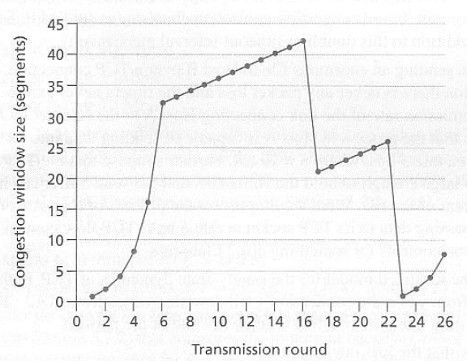
第六章习题
Consider the following plot of TCP congestion window size as a function of the transmission. Explain all your answers below.
Which version of TCP is this, Tahoe or Reno?
Identify the intervals of time when TCP slow start is operating.
Identify the intervals of time when TCP congestion avoidance is operating.
After the 16th transmission round, is segment loss detected by a triple duplicate ACK or by a timeout?
After the 22nd transmission round, is segment loss detected by a triple duplicate ACK or by a timeout?
What is the initial value of Threshold at the first transmission round?
What is the value of Threshold at the 18th transmission round?
What is the value of Threshold at the 24th transmission round?
During what transmission round is the 70th segment sent?
42
32
26

Slide 3
a.Reno
b.慢启动运行的时间间隔为【1，6】，【23，26】
c.拥塞避免操作的时间间隔为【6，16】，【17，22】
d.在第16轮传输后，数据包丢失被一个三重重复的ACK识别而产生的。如果存在超时，则拥塞窗口大小将降至1。
e.在第22轮传输后，检测到超时导致的段丢失，因此拥塞窗口大小设置为1。
f.32
g.21
h.13
i.第七轮

Slide 4

End
Chapter 6

