Slide 1


Slide 2



Our Approach: K-Means Clustering
Data Preparation
Dimensionality Reduction
5,235 songs from Spotify
12 audio features analyzed
Clean Data and Preprocessing
PCA reduced to 8 components
Retained 90% variance
Features Used
Clustering Result
37 distinct playlists created
Silhouette score: approx. 0.106
Used: Energy, danceability, key, valence, tempo,
acousticness, instrumentalness, loudness, mode, speechinees, liveness, duration
Dropped: artist, name, type, ID, timesignature, html

Slide 3

K-Means: Strengths & Limitations
Strengths
Limitations
Fast & Scalable
Works efficiently with 5,000+ songs
Simple to Implement
Requires minimal tuning
Interpretable Results
Clear cluster characteristics
Moderate Cohesion
Silhouette score of 0.11 suggests overlap
Limited Feature Set
Missing genre, lyrics, mood context
Assumes Spherical Clusters
May not capture complex music patterns

Slide 4
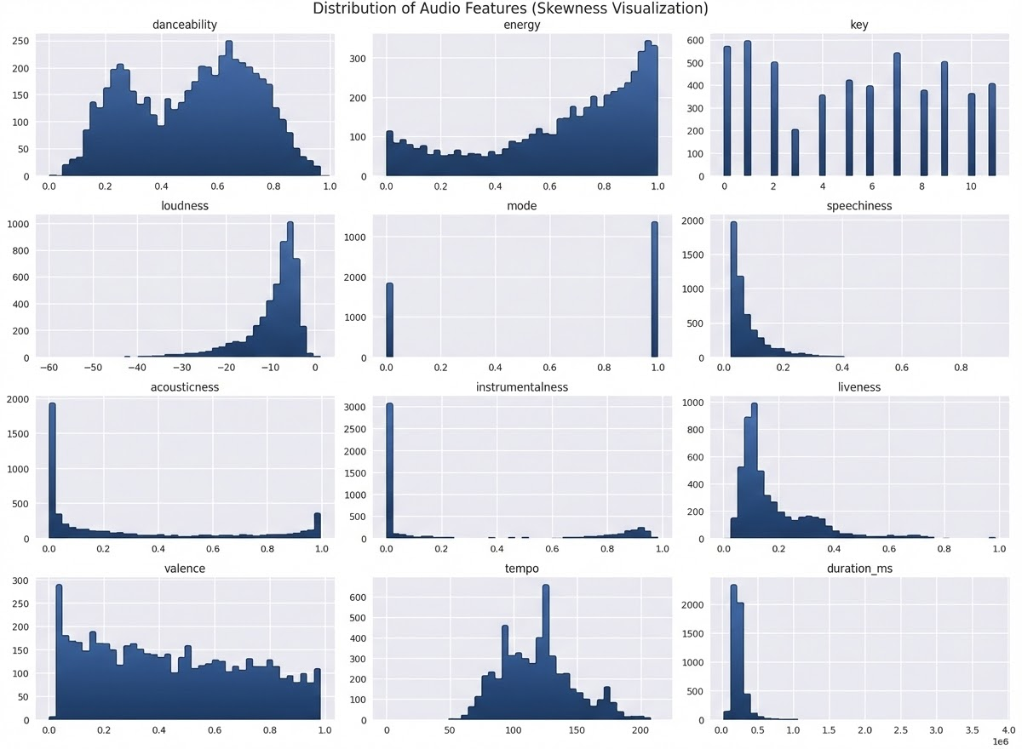
Preprocessing

Slide 5
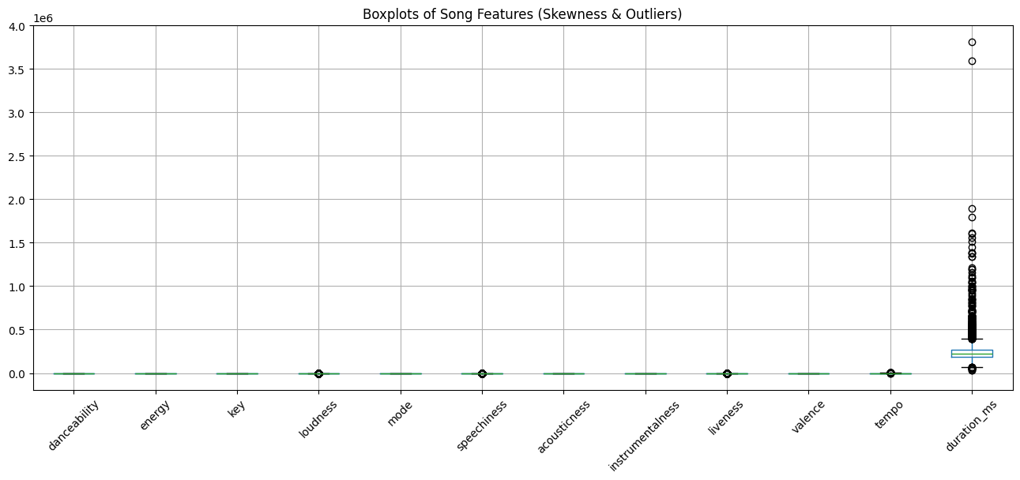
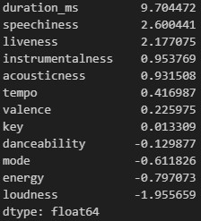
Preprocessing (Cont)
Skewness

Slide 6
Preprocessing (Cont)
PowerTransformer()
RobustScaler()
MinMaxScaler() only for Radar Chart ploting
out_of_range_features = ['tempo', 'duration_ms', 'loudness', 'instrumentalness']
PCA()

Slide 7
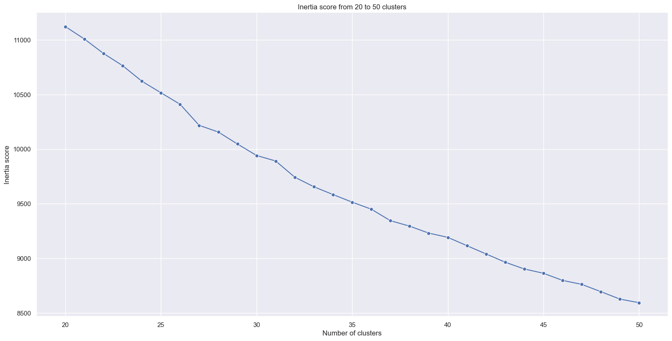
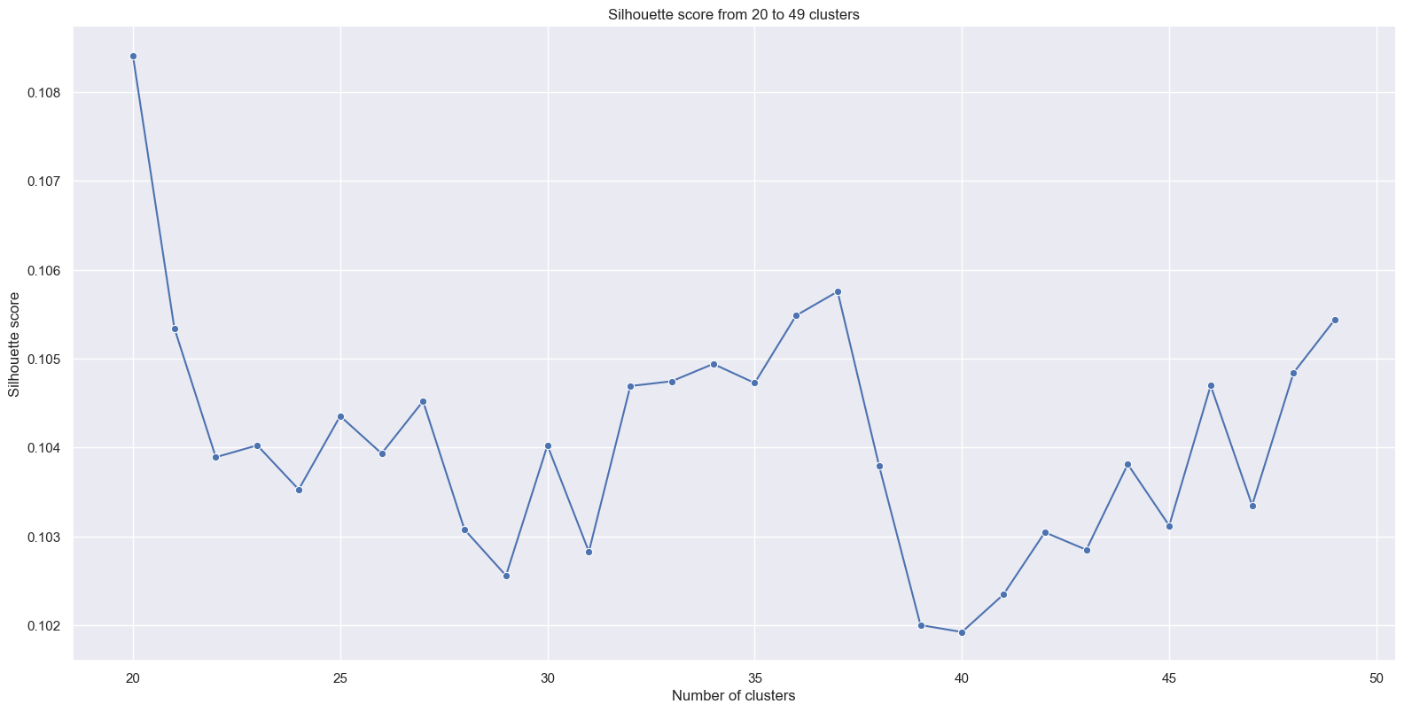
Clusters Estimation
Used Inertia (Elbow) and the Silhouette Score methods to determine the number of clusters

Slide 8
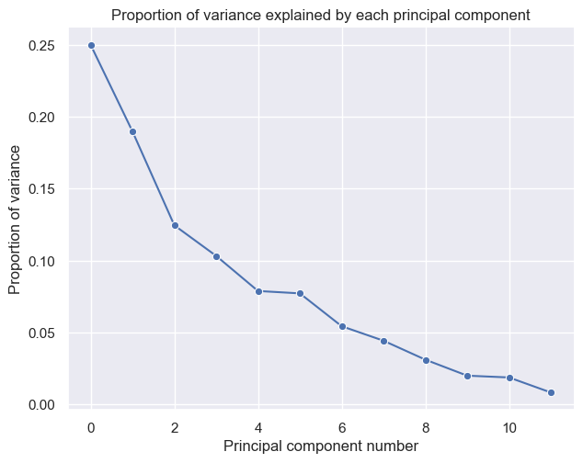
Features Estimation

Slide 9
Next Steps
1
Enhance with Additional Data: Integrate genre tags, user listening history, and collaborative filtering signals
2
Explore Alternative Methods: Test DBSCAN for density-based clustering or hierarchical clustering for better interpretability
3
A/B Test with Customers: Deploy ML playlists alongside human-curated ones and measure satisfaction and retention

Slide 10

Key Takeaway
K-Means clustering shows promise as a scalable solution for automated playlist generation, but would benefit from richer data sources and customer validation before full deployment.
Questions?

Slide 11
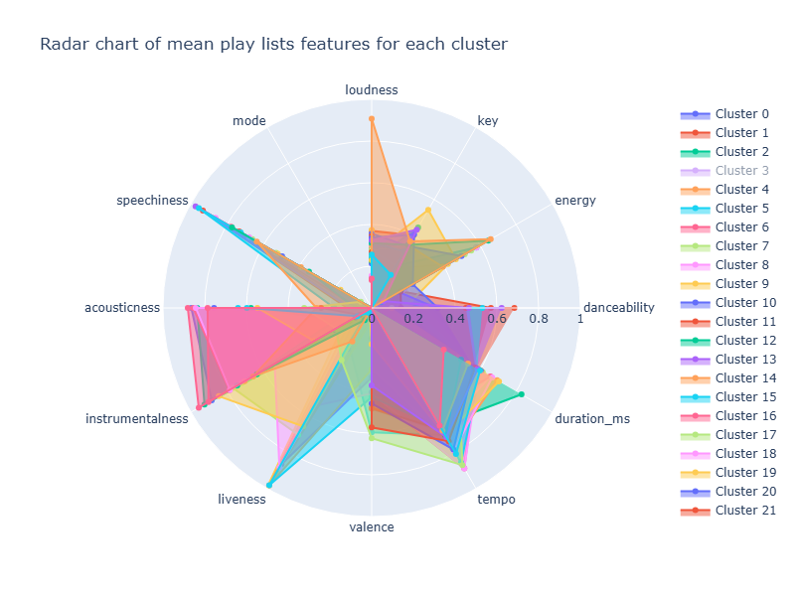
Appendixes: Radar Chart of the Play lists

Slide 12
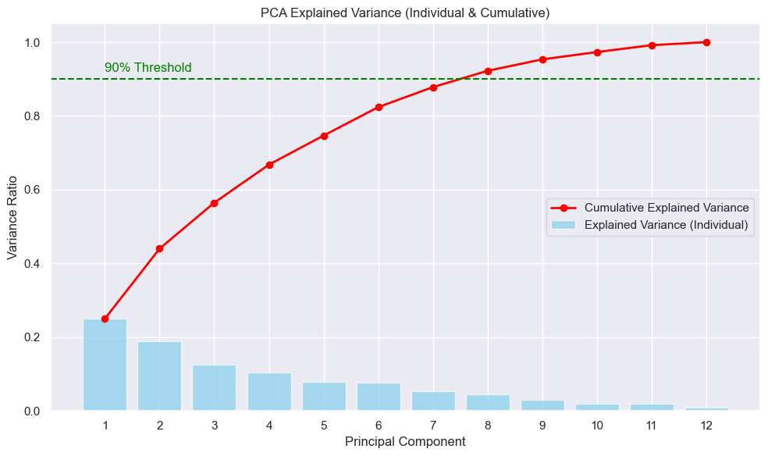
Appendixes: PCA Variance Explained (Individual & Cumulative)

Slide 13
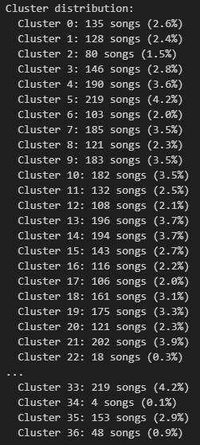
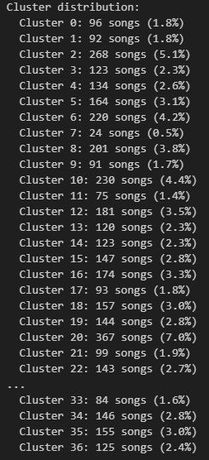
Appendixes: Songs Distribution
after PCA()
before PCA()

Slide 14
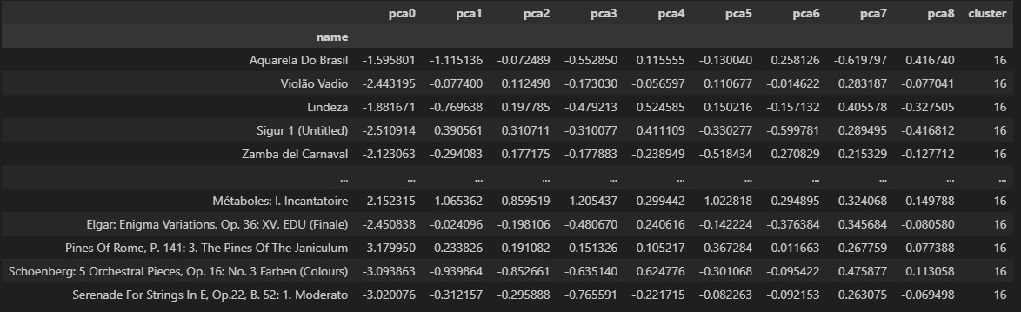
Appendixes: Tracks Examinatin

