Slide 1
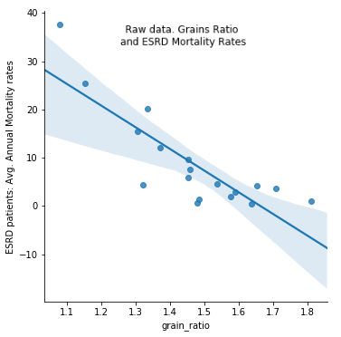
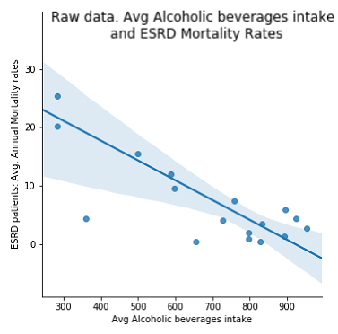
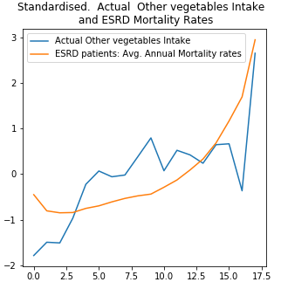
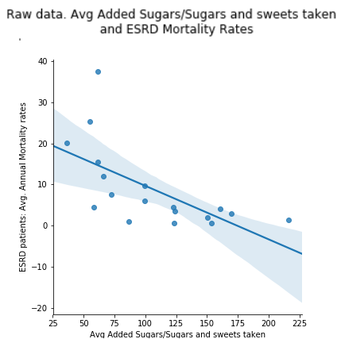
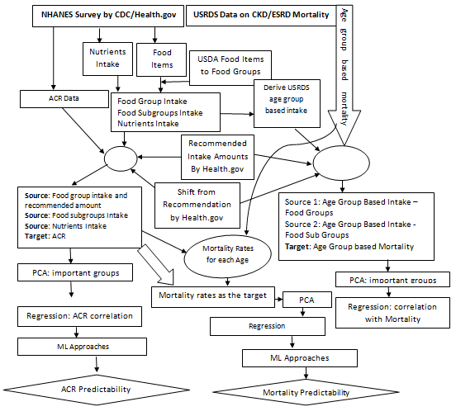
2018-2019 M.Sc. in Data Science and Analytics
Dietary Patterns on Chronic Kidney Disease (CKD) Measures (ACR), and on the Mortality of CKD Patients
Sayed Ahmed Supervisor: Dr. Youcef Derbal
Chronic Kidney Disease (CKD) leading to End Stage Renal Disease (ESRD) is very prevalent today. Over 37 millions of Americans have CKD. CKD/ESRD and other interrelated diseases such as Hypertension, Heart Diseases, and Diabetes cause a majority of the early deaths. In addition to kidney failure, CKD is also a major cause of death from stroke, and heart diseases. Studies show that drugs as well as lifestyle choices can prevent CKD, slow the progression of CKD, delay dialysis and kidney transplantation; consequently can prevent early deaths. There are many studies on the effect of drugs to control CKD and related complications. Little research are there on the effect of dietary patterns on the measure Albumin Creatinine Ratio (ACR) and on the mortality of CKD patients. This research has identified the association between dietary patterns and mortality of CKD patients. This research also studied the effect of dietary patterns on a CKD measure named ACR.
Objective
CKD patients commonly are given dietary advice based on individual nutrients or chemicals or individual food items instead of whole eating patterns. That advice is challenging to adhere to with little evidence in preventing clinical complications. Studying the whole dietary patterns rather than single nutrient or food item is an emerging trend for CKD/ESRD patient diets.
CKD is measured with 1. GFR Blood test (< 60) and 2. Urine Albumin Creatinine Ratio (ACR > 30).
Chen at al. found that higher plant protein ratio causes lower mortality for patients in stage 3 or higher ( eGFR < 60). Gutiérrez et al.’s study found that diets rich in processed and fried foods were associated with higher mortality in CKD patients. However, diets rich in fruits and vegetables were found to be protective. Study by Huang et al. on Mediterranean diet found that adhering to this diet has a lower likelihood of having CKD in elderly men. They also found that adherence can improve survival. Study by Muntner et al. on Life’s Simple 7 factors’ (Smoke, Activity, BMI, Diet, Blood Pressure, Cholesterol, and Glucose) effect in getting ESRD shows that people who have ideal scores in more of these factors have lower likelihood of getting ESRD. Study by Suruya et al. found that patients with unbalanced diet were more likely to have adverse clinical outcomes. Ricardo et al . found that adherence to a healthy lifestyle was associated with lower all-cause mortality risk in CKD.
Most of the studies primarily used direct clinical data of patients for several years and applied statistical analysis primarily. This research primarily utilized public datasets from CDC, USRDS. For association and prediction, PCA, Regression, and several machine learning approaches are heavily utilized. For food groups and subgroups categorization utilized the USDA categorization. Recommended amounts for food groups provided by CDC/Health.gov is used
Food Groups and Mortality
Grains (-0.84) and Fruits (-0.43) showed strong negative correlations with CKD mortality i.e. when Grains and Fruits are taken less, mortality is high. Vegetables show positive (0.58) correlation i.e. when vegetables intakes are high, mortality is moderately high. Though this contradicts with other studies, Vegetable subgroups such as Starchy Vegetables and Other Vegetables (Tomatoes) are not recommended to CKD patients (as this study also finds). Moderate positive correlation considering total vegetables group, and the population subgroup used can be seen consistent with other studies.
Food Subgroups and Mortality
Other vegetables (0.68), Red and orange vegetables (0.55), and Starchy vegetables (0.44) have positive correlations with mortality. Food subgroups such as Alcoholic beverages (-0.79), Sugars/Added Sugars and sweets (-0.64), Whole grains (-0.61), and ‘Nuts, Seeds, and Soy Products’ (-0.55) show the most negative correlations with CKD mortality. These outcome can also be seen consistent with current knowledge except for sugars. CKD is lower in drinkers than non-drinkers, Nuts being Phosphorous rich and Whole Grains being Potassium rich are detrimental to CKD patients.
Fig: Mortality vs Food Groups and Food Subgroups
Whole Grains Alcohol Other Veg. Sugar/Sweet
Food Groups, Food Nutrients, and Albumin Creatinine Ratio Association
The experiments using PCA and Regression showed negligible effect on ACR with food groups and subgroups. However, Dairy, and ‘Sugars, Sweets, and Beverages’, have higher and positive though negligible (0.02) effect than the others where Fruits (-0.01) showed negative effect. For nutrients Poly unsaturated fatty acids (-0.02), iron (-0.02) have negative correlation where Choline (0.02) showed positive correlation. Though the correlation numbers are negligible in this study, the positive and negative correlations are consistent with current knowledge.
Test -Set ACR Prediction
The best test set accuracies for ACR value prediction are found for 10 Fold Cross Validations with Polynomial Regression (95%), Polynomial Bayesian with Cross Validation (68%), Polynomial Regression (57%), Bayesian on Polynomial fit (41%), Cross Validation with Polynomial Random Forest Regression (21%)
Background
Results
Methodology
Chronic Kidney Disease leading to End Stage Renal Disease is very prevalent today; also treatment facilities for dialysis, and donors for transplantation are very limited and many die waiting for the right treatment (recent news on USA, Bloomberg). Majority of the studies focused on drugs where some focused on diets and food items. Controlling CKD using changes to dietary patterns can be both beneficial to the patients and to the economy. Hence, this study focused on effect of dietary patterns on CKD mortality. This research also studied the effect of dietary patterns on CKD measures such as ACR. Additionally, regression models are trained to predict ACR values. This research has utilized both statistical approaches and machine learning approaches. The outcome matched with other studies and current knowledge in most cases where in some cases contradicted with other studies and current knowledge. The outcome requires further study and investigation. ML studies in this research, showed that ACR values could well be predicted in the test dataset; the best performing approach was 10 Fold Cross Validation for Polynomial Regression (95%).
Conclusions

