Slide 1

Wellcome
Team “EUB_Binary”
Students of CSE
European University of Bangladesh
Presentation
Department of Computer Science & Engineering
European University of Bangladesh.

Slide 2
Automatic Night Light System
Project Report
Supervisor
Ariful Islam Arif
Lecturer of CSE
European University of Bangladesh

Slide 3
Submitted By
Team “EUB_Binary”
Students of CSE
European University of Bangladesh
[September 2024]
Department of Computer Science & Engineering
European University of Bangladesh.

Slide 4
Automatic Night Light System
Faculty of Computer Science & Engineering, European University of Bangladesh.
Abstract— Our main goal is to develop an ultramodern and a reliable automatic night light system. Which is used in almost every field in our daily life. For example in house lights, office lights, billboards, street lights etc. To develop this system, we used an LDR sensor, an BC547 transistor, some LEDs, some resistors and some conductors and AC/DC power supply etc.
Introduction
This project is to design and implement a cost-effective, energy-efficient system, that can without humans automatically operate LDR based on ambient light levels. LDR is a light dependent resistor. When we keep lights on all night at home or office, then the performance and life of that light is reduced. In case we have to face financial problems especially in the electrical sector. For example in loss of conductors, lights, and electricity etc.

Slide 5
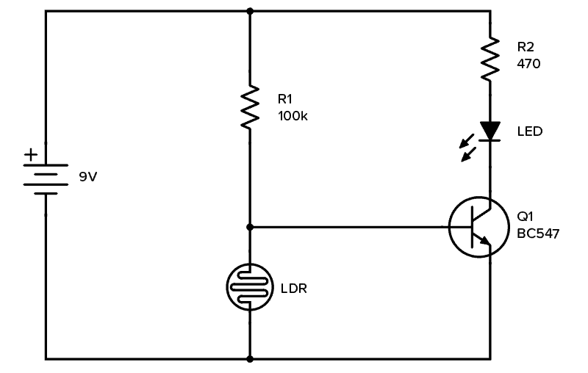
Methodology
Circuit Diagram: To develop this system, we used an LDR sensor, an BC547 transistor, some LEDs, some resistors and some conductors and AC/DC voltages supply etc.
Equipments:
9V Battery
Breadboard
Transistor BC547
Resistor 100 kΩ
Resistor 470 Ω
Light-Emitting Diode (LED)
Photoresistor (around 5kΩ in light, 200kΩ or more in dark)

Slide 6
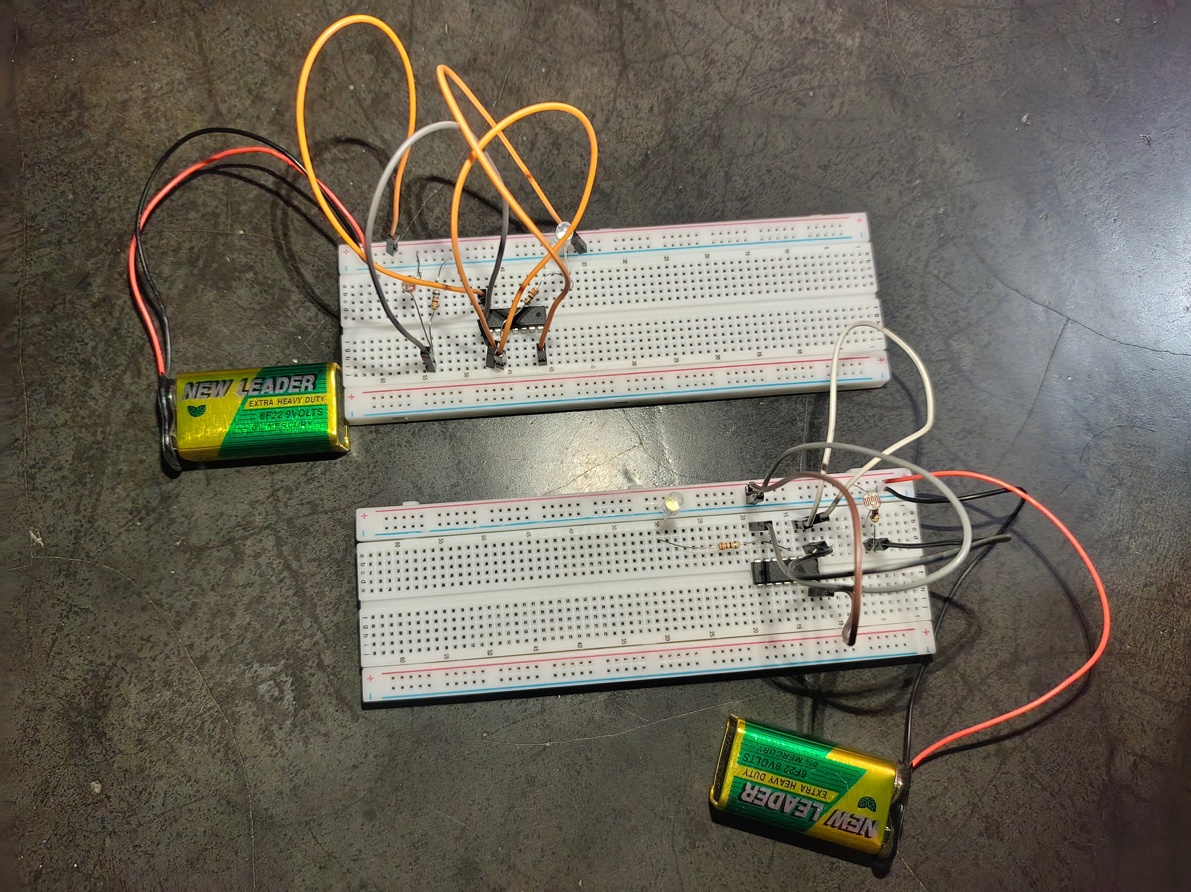
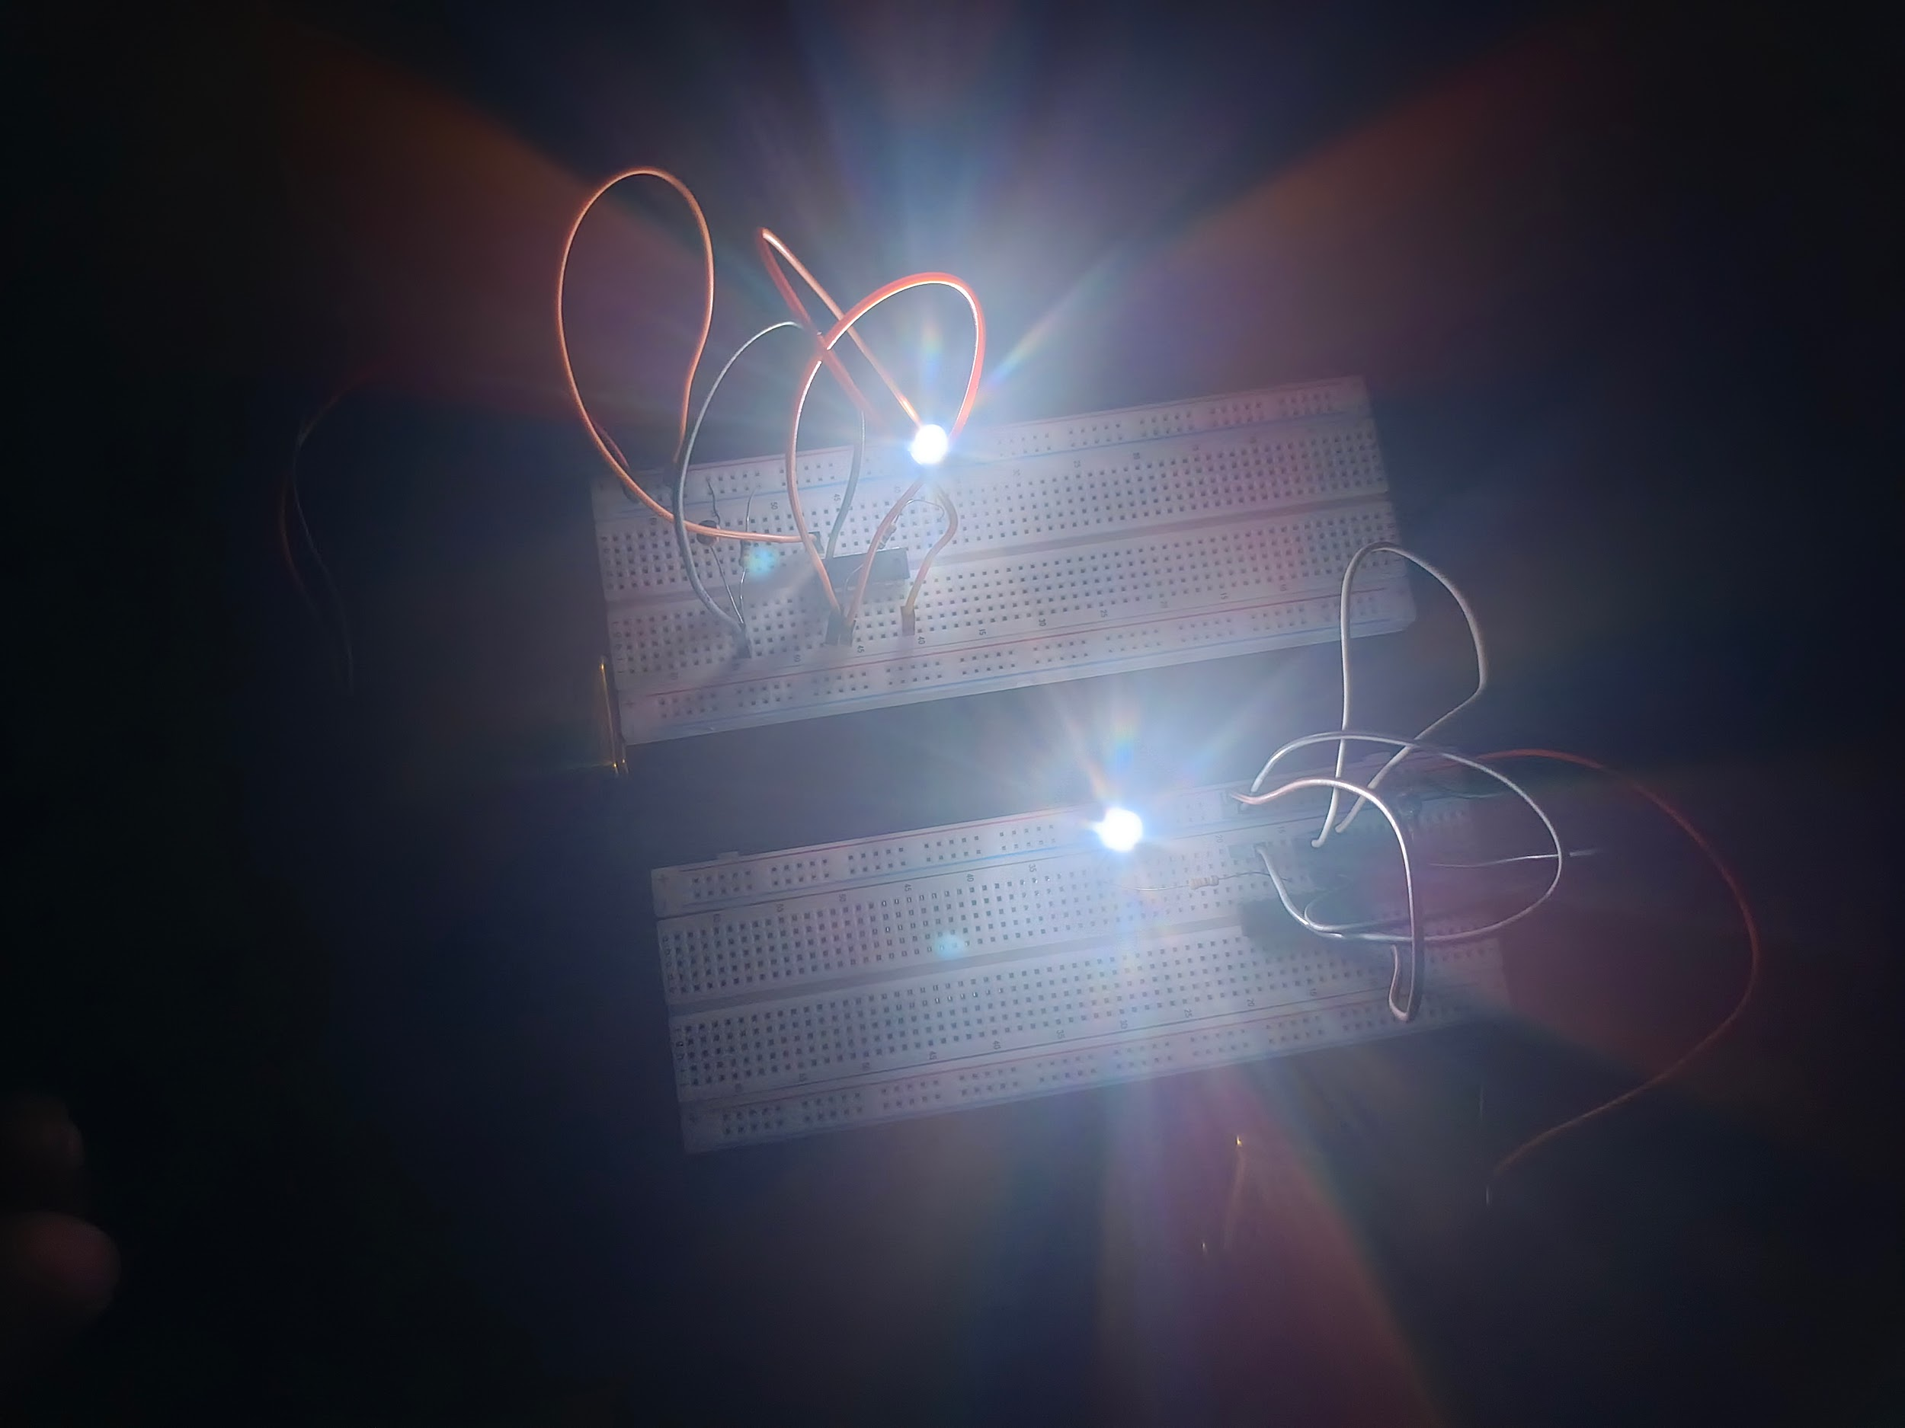
Methodology
Breadboard Testing: To develop this system more precisely. We used a breadboard, an IC7400, an LDR sensor, some resistors and some conductors and some DC 6v batteries etc.
Here, When the resistance is exposed to light, the light flashes off automatically.
Again, when light is directed away from the resistor, then the light flashes on automatically.

Slide 7
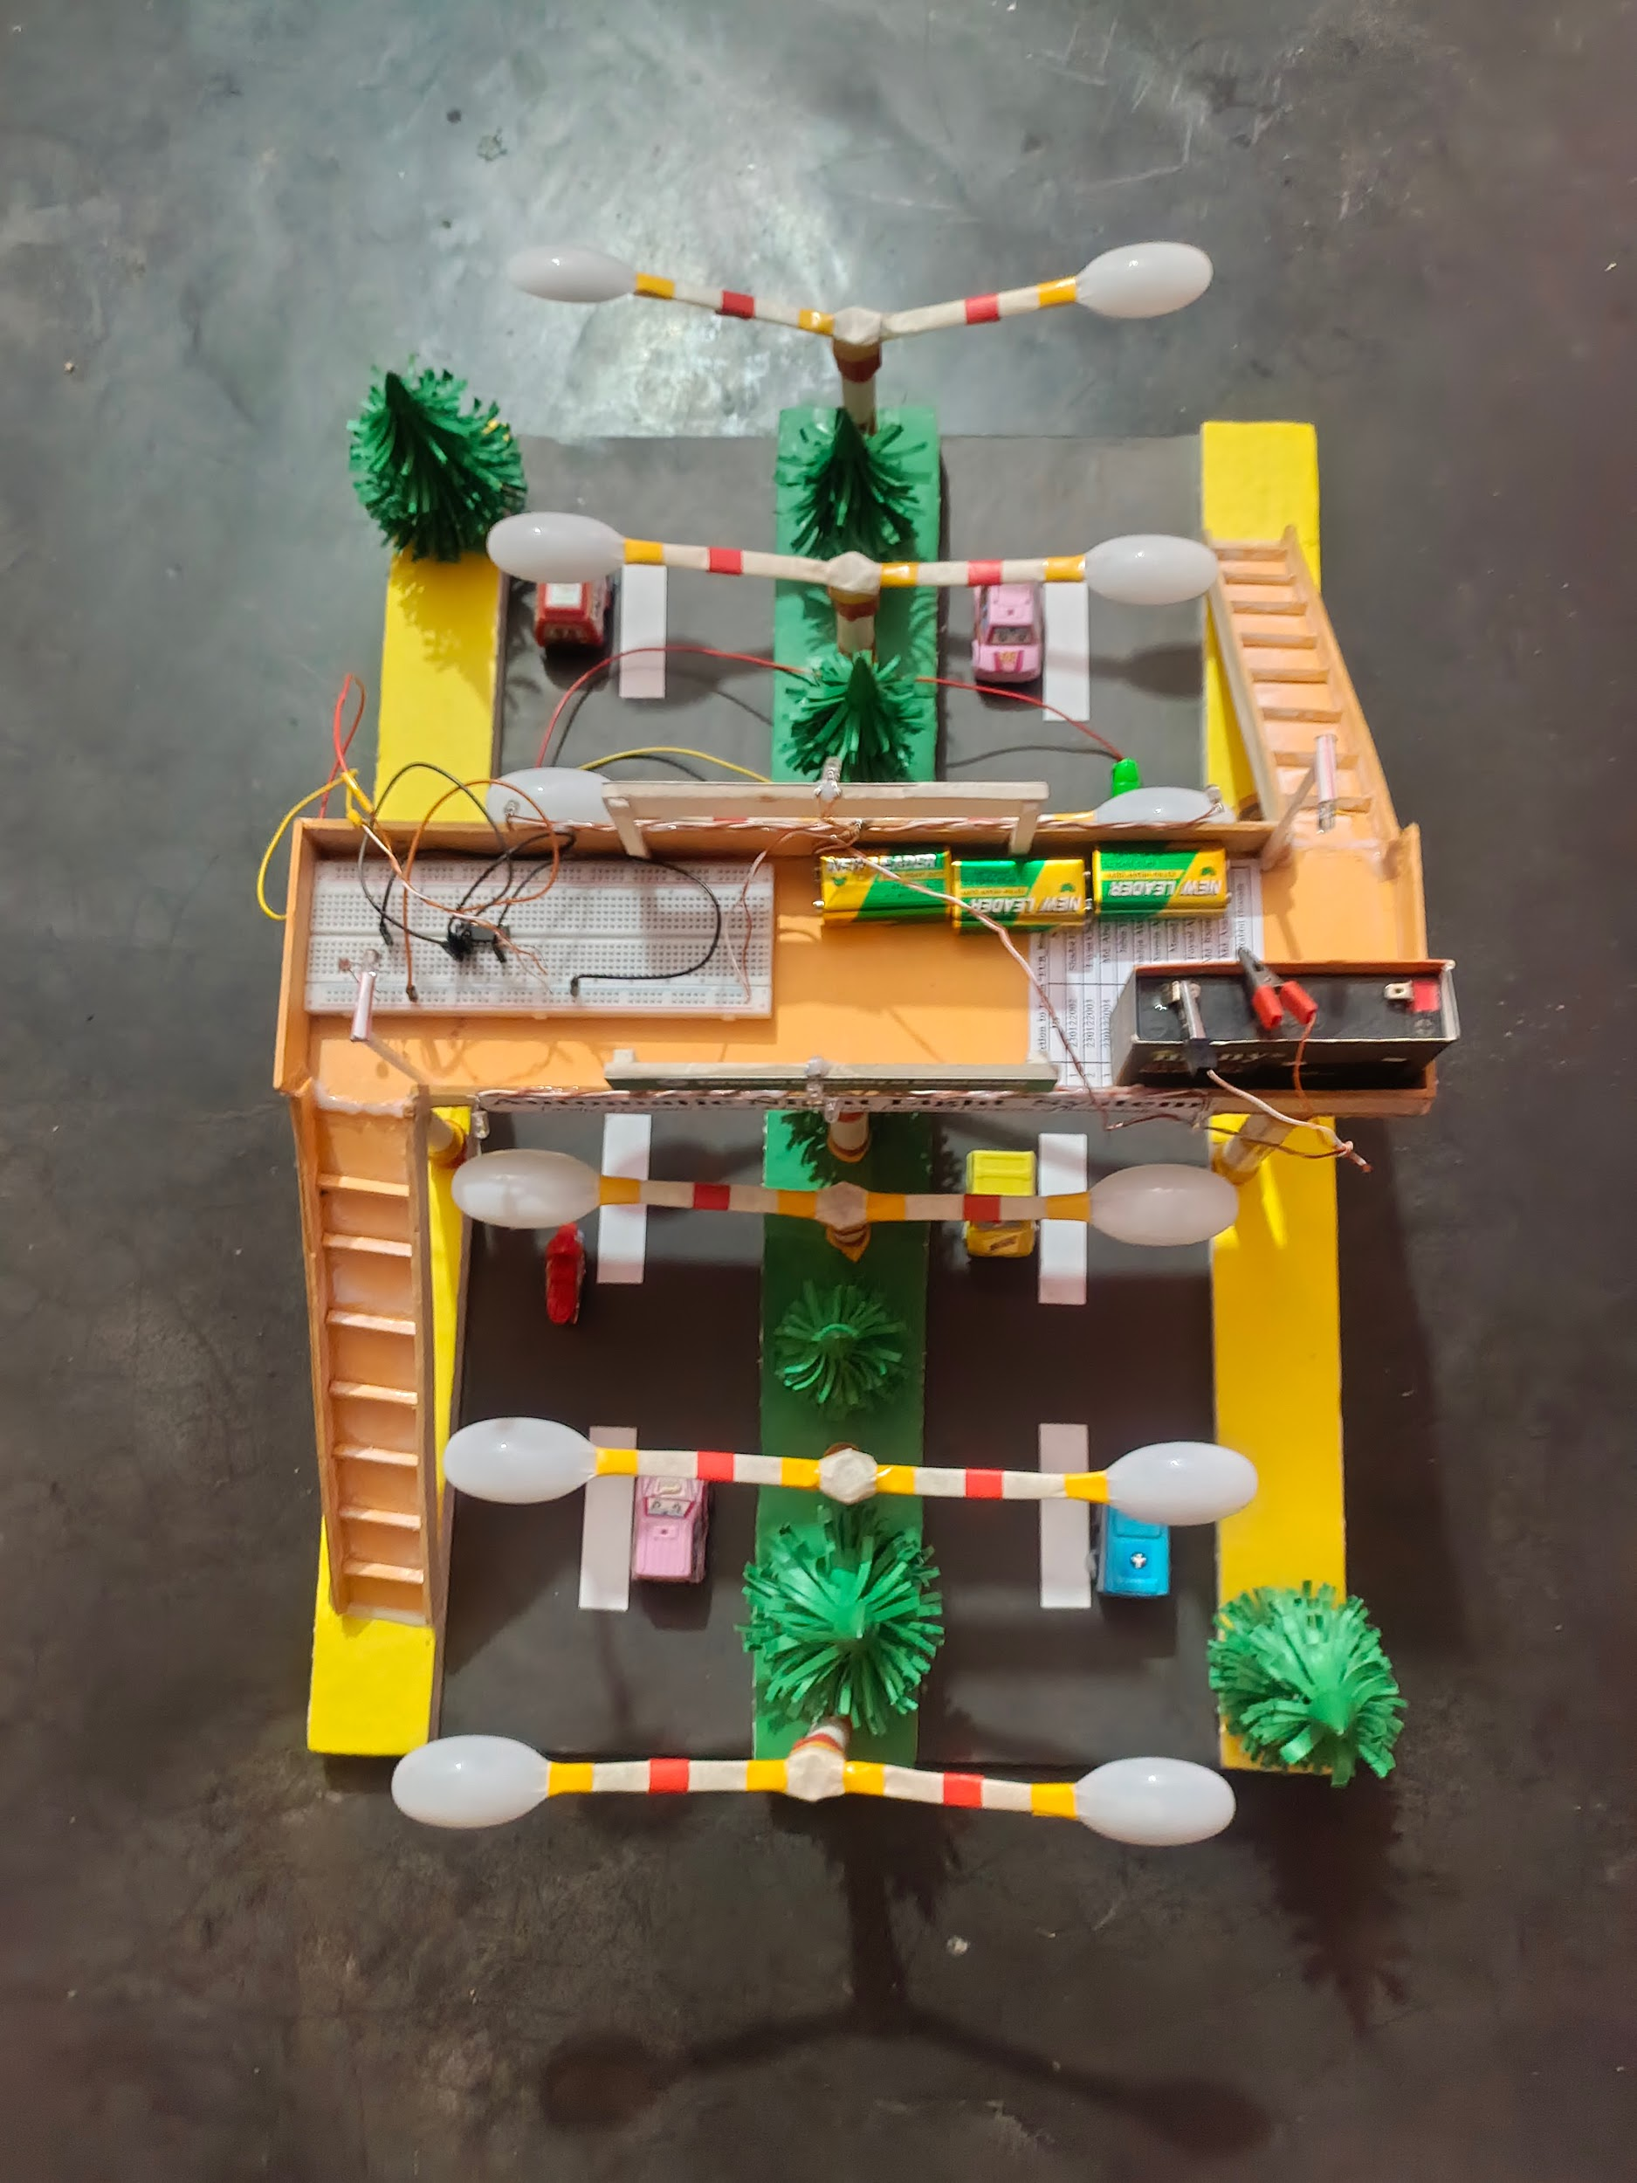
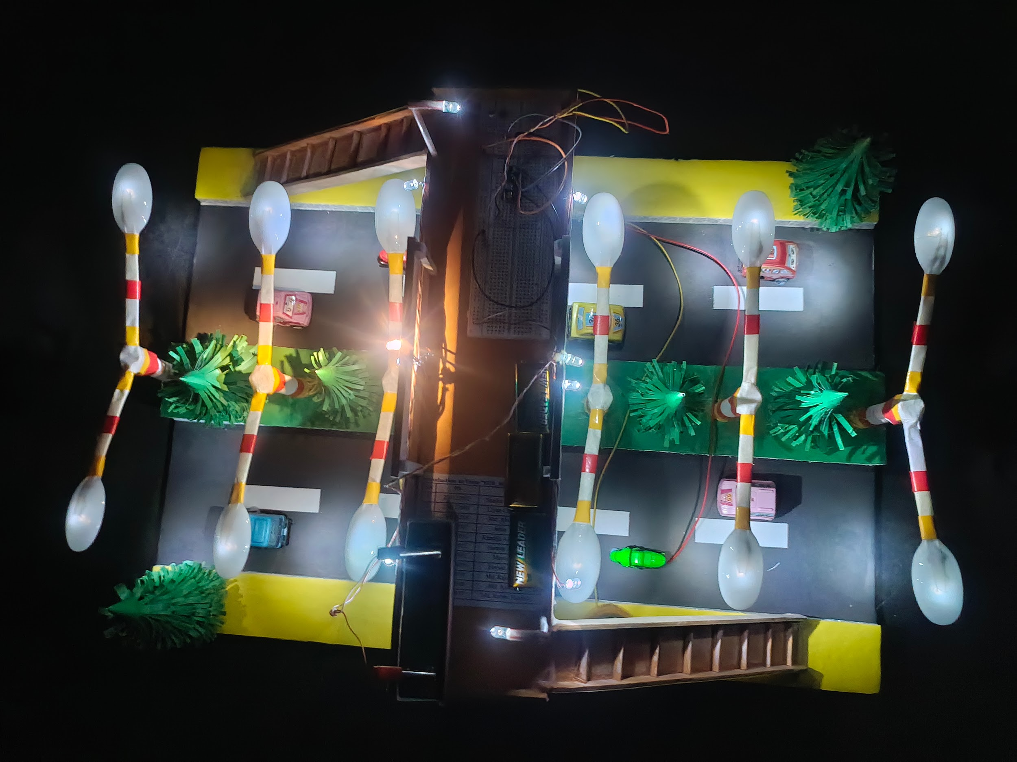
Methodology
Primary Design: There will be a little two-lane road. And in the middle there will be street lights for both sides. And the street lights will be completely controlled by a circuit.
Here, When the resistance is exposed to light, the light flashes off automatically.
Again, when light is directed away from the resistor, then the light flashes on automatically.

Slide 8
Project Scope
Advantages
Energy Efficiency: Reduces energy consumption by ensuring lights are only on when needed.
Convenience: Eliminates the need for manual switching of lights.
Security: Enhances security by ensuring areas are well-lit during the night.
Limitations
Weather Conditions: The system must be robust enough to handle various weather conditions.
Component Durability: Ensuring the longevity and reliability of components used in the system.
Fixed Sensitivity: Requires manual adjustment for different light levels.
Enhancements
Microcontroller Integration: Use Arduino or Raspberry Pi for better control and advanced features.
IoT Connectivity: Add WiFi or Bluetooth modules for remote monitoring.
Motion Sensing: Integrate PIR sensors to operate lights only when motion is detected.

Slide 9
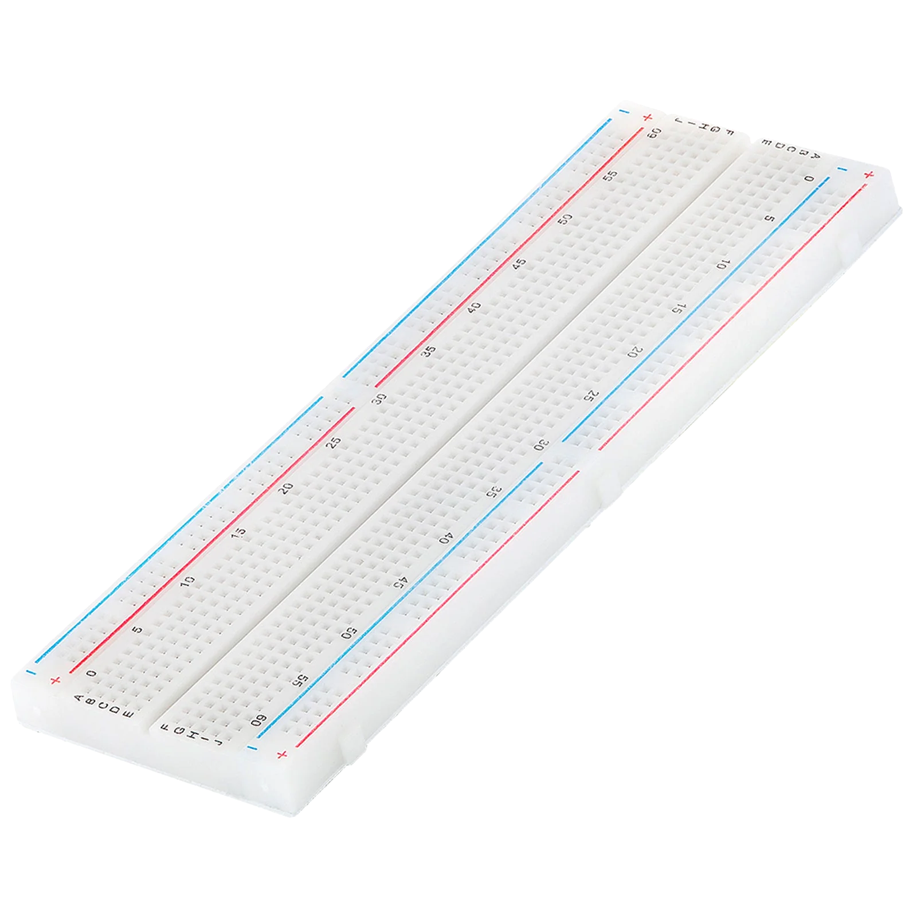
Tools/Technology
Hardware:
BreadBoard
The breadboard is the basic component of any circuit building process. All components, be it input sensors or output display devices are connected to the power supply, microcontroller using wired connections through a breadboard. The holes in the breadboard are in series. There are various sizes like full-sized, half-sized, and mini breadboards.

Slide 10
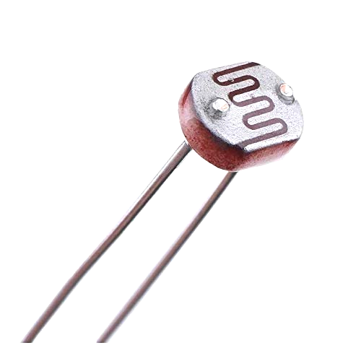
Tools/Technology
Hardware:
LDR (Light Dependent Sensor)
LDR is a photoresistor that works on the principle of photoconductivity. The surface of the LDR is made with a layer of semiconducting material that is responsible for measuring the light intensity. The principle states that when light falls on the surface of the semiconducting material, the electrons receive energy, and movement is caused inside the material.

Slide 11
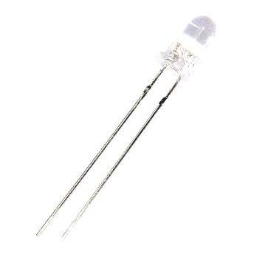
Tools/Technology
Hardware:
LED
Light Emitting Diode is a commonly used light source. It is a semiconductor that emits light when current flows through it.

Slide 12
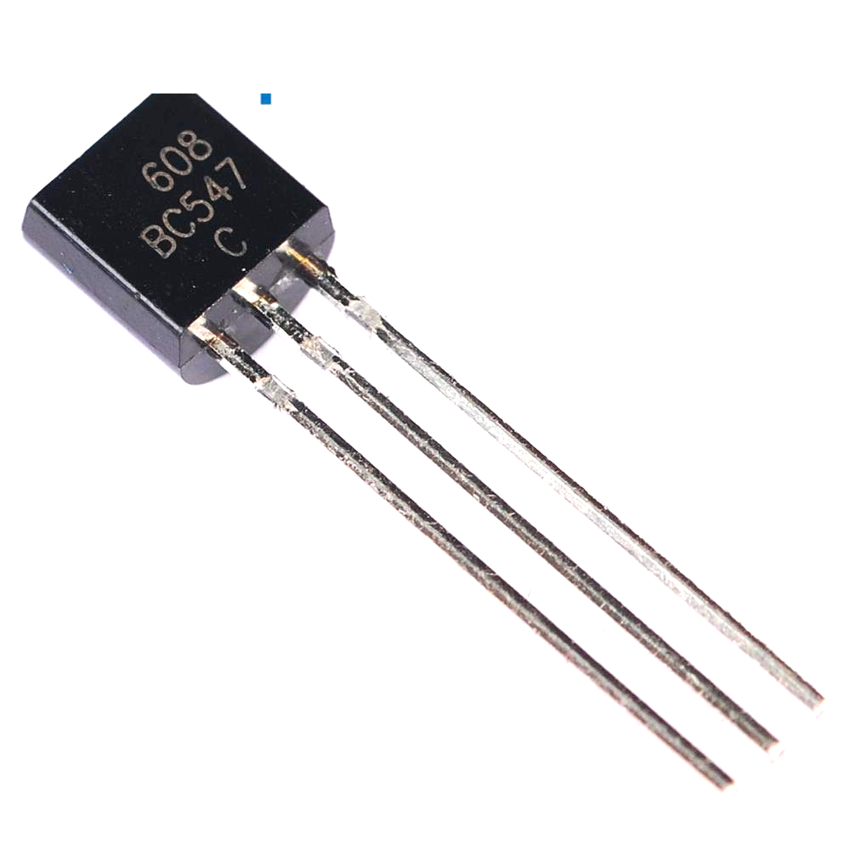
Tools/Technology
Hardware:
BC547 Transistor
BC547 is usually used for current amplifiers, quick switching and pulse-width modulation (PWM). Therefore, if you need to control the speed of a motor or actuator in some of your projects, you can simply use this transistor to achieve it.

Slide 13
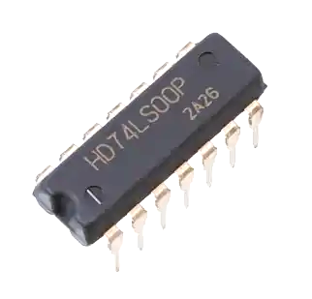
Tools/Technology
Hardware:
IC7400 (NAND)
The IC 7400 is a popular integrated circuit that contains four independent 2-input NAND gates. It’s part of the 7400 series of logic chips, which are widely used in digital electronics. The IC comes in a 14-pin package. Each NAND gate has two input pins and one output pin. The remaining pins are for power supply (VCC) and ground (GND).

Slide 14
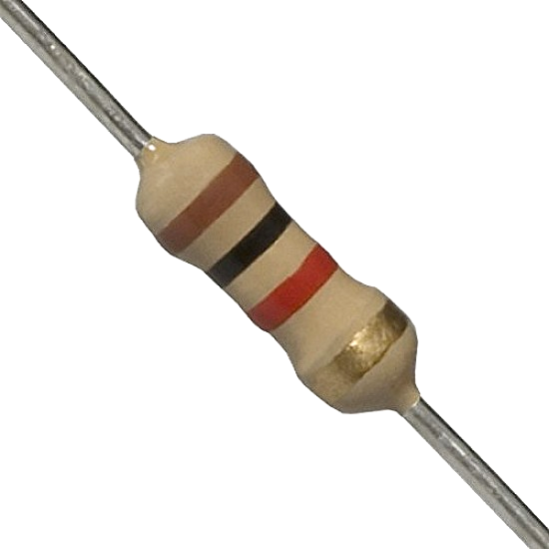
Tools/Technology
Hardware:
Resistors
Resistors are passive devices that restrict the flow of current or divide the voltage through the circuit. The input power passes through these resistors and then to the sensors to avoid damage.

Slide 15
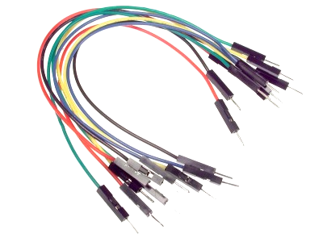
Tools/Technology
Hardware:
Jumper Wires
These are the main components that are used to establish the connections between different devices of the circuit.

Slide 16

Tools/Technology
Software:
Not applicable (if built as a hardware-based project).
For microcontroller-based systems, software like Arduino IDE may be used.
TinkerCad circuit simulation software:

Slide 17
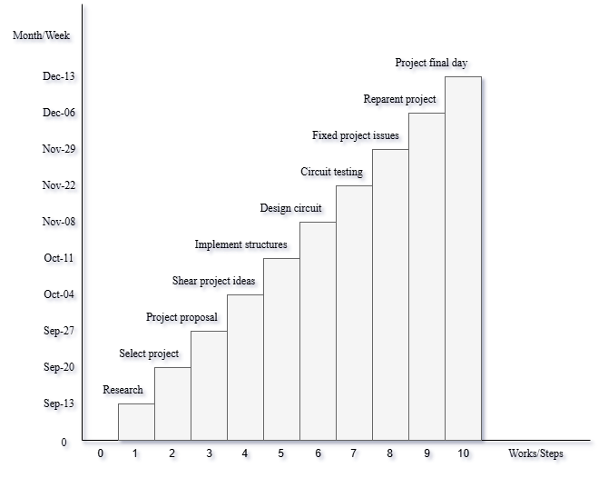
Milestones

Slide 18
Milestones
Project Costs:
SN | Tools Details | Tk
1 | Clip 1 Pair | 20
2 | 2×BB, 2×LDR, 6×Gates, 10×Ohm, 7×LED | 370
3 | 4×Battery 6v | 320
4 | 6×Gate, 2×LDR, 24×LED, BC547, 4×Clip | 230
5 | Glue Gun + Glue Stick | 300
6 | 3×Bike, 6×Car | 200
7 | Iron Soldering Machine | 150
8 | 2×Art Paper, Fevicol, 3×Taps, Box | 170
9 | WiFi Wire | 100
10 | 2×LDR, Iron, Rojon, Hardboards | 470
11 | Wire, 2×PVC, Tree, Algo | 230
12 | 40g Superglue, 2×Converter, Tea | 250
13 | Bus Fare | 100
14 | 2×Battery 6v | 160
15 | 2×Glue Stick, PVCs, | 60
16 | 10×Ohm, Papers, Wires | 220
Total Project Cost |  | 3350

Slide 19
Milestones
Project Costs:
SN | Tools Details | Tk
1 | Clip 1 Pair | 20
2 | 2×BB, 2×LDR, 6×Gates, 10×Ohm, 7×LED | 370
3 | 4×Battery 6v | 320
4 | 6×Gate, 2×LDR, 24×LED, BC547, 4×Clip | 230
5 | Glue Gun + Glue Stick | 300
6 | 3×Bike, 6×Car | 200
7 | Iron Soldering Machine | 150
8 | 2×Art Paper, Fevicol, 3×Taps, Box | 170
9 | WiFi Wire | 100
10 | 2×LDR, Iron, Rojon, Hardboards | 470
11 | Wire, 2×PVC, Tree, Algo | 230
12 | 40g Superglue, 2×Converter, Tea | 250
13 | Bus Fare | 100
14 | 2×Battery 6v | 160
15 | 2×Glue Stick, PVCs, | 60
16 | 10×Ohm, Papers, Wires | 220
Total Project Cost |  | 3350

Slide 20
Conclusion
Conclusion
The Automatic Night Light System is a practical and energy-efficient solution for lighting needs. By automating the process of turning lights on and off based on ambient light, this system saves energy, reduces manual effort, and provides a safer environment.
References
We mentioned all the literature or web references, etc here:
Internet Web page: ResearchGate. “Automatic Night Light Control by Using Arduino UNO”.
https://www.researchgate.net/publication/363265874_Automatic_Night_Light_Control_by_Using_Arduino_UNO

Slide 21
Thank You
Team “EUB_Binary”
Students of CSE
European University of Bangladesh
Presentation
Department of Computer Science & Engineering
European University of Bangladesh.

