Slide 1


Test-Time Adaptation with Token Condensation
Final Presentation
Reproducing and Extending
Token Condensation as Adaptation
Many visual tokens
Condensed tokens
Sayeda Fatema · Project Representation Learning · September 2026
Sayeda Fatema Tuj Zohura· Project Representation Learning · September 2026

Slide 2
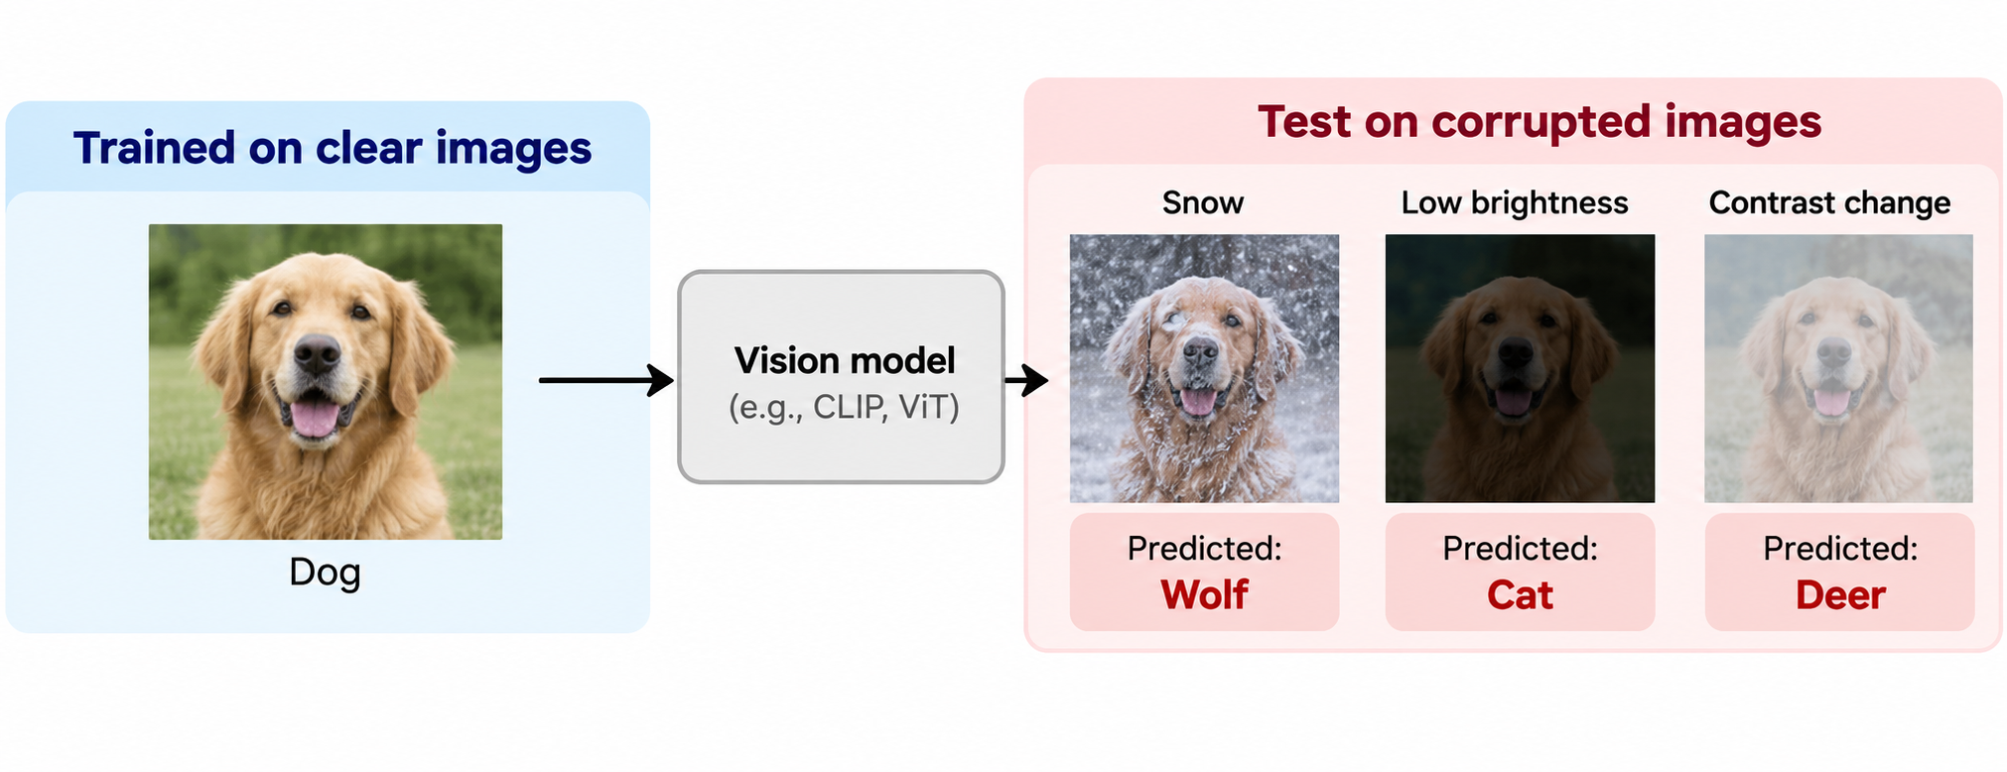
Motivation
Why this matters
A model trained on clear images may perform poorly on snow, brightness, or contrast changes.
Problem
Constraint
Question
Vision-language models such as CLIP often face distribution shift at test time. Real images may come from new datasets or corrupted conditions, so accuracy can drop.
Test-time adaptation should be efficient. If adaptation requires large extra computation, it becomes hard to use in practical settings.
Can token condensation reduce visual computation while preserving accuracy and robustness?
Goal: reproduce TCA and then test how far we can increase token reduction under corrupted data.
Notes:
The motivation is that a model can work well on normal, clear images, but its performance can decrease when the test images are different. For example, an image can have snow, a brightness change, or a contrast change. This is called distribution shift.

Slide 3
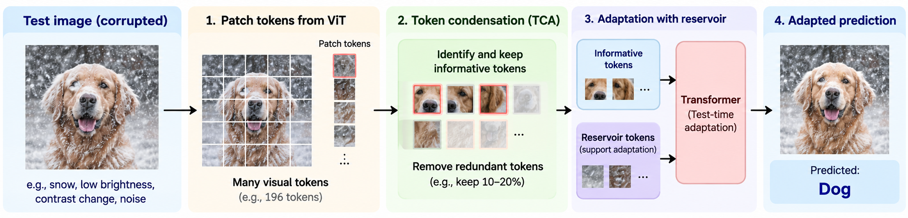
Background
Core idea of TCA
Condense visual tokens at test time, then use a reservoir to support adaptation.
Input tokens
Token condensation
Adapted prediction
Patch tokens from CLIP ViT image encoder
Reduce redundant tokens while keeping informative visual evidence
Training-free test-time adaptation with lower visual cost
class
TCA is attractive because it is training-free: the model is adapted at inference without extra model training.
Notes:
A Vision Transformer does not directly process the whole image as one object. It divides the image into many small patches, and these patches become visual tokens.

Slide 4
Part 1: Reproduction setup
I reproduced the main cross-dataset and robustness results before extending the experiment.
Component
What I used
Purpose
Backbone
CLIP ViT-B/16
Same visual encoder as the selected paper setting
Datasets
10 cross-dataset benchmarks + CIFAR-100-C
Evaluate clean transfer and corrupted robustness
Baselines
CLIP, TDA, EViT, ToMe
Compare accuracy and compute
Main metrics
Top-1 accuracy and GFLOPs
Measure accuracy-efficiency trade-off
Platform
NHR@FAU TinyGPU HPC system
Reproducible batch jobs on HPC
Notes:
I reproduced the main results before doing my own experiment.I used CLIP ViT-B/16, which is the visual encoder used in the selected paper setting.

Slide 5
Original Paper Result vs My Reproduced Result
Here is the direct comparison between the paper and my reproduction.
Method
Original Paper (Reported)
My Reproduction
CLIP
64.59%
65.65%
TDA
67.53%
68.13%
TCA (Wang_TCA)
68.69%
68.30%
Acceptance target: reproduce reported averages within approximately ±2%.
Notes:
This table compares the numbers reported in the original paper with my reproduced result

Slide 6
Reproduction result: cross-dataset average accuracy
The reproduced averages are close to the reported values.
Within tolerance
CLIP, TDA, and TCA were all within the ±2% acceptance range.
Best reproduced method
TCA achieved the highest reproduced cross-dataset average: 68.30%.
Interpretation
The reproduction confirms that the environment and evaluation protocol are reasonable.
Part 1 established a reliable baseline before the own experiment.
Notes:
“This graph shows the same reproduction result visually

Slide 7
Reproduction result: robustness on corrupted data
On selected CIFAR-100-C corruptions, TCA stayed slightly above CLIP on average.
Setting
Mean over 15 settings
CLIP
58.10%
TCA (Ours-0.035)
58.64%
Observation
The graph also shows that accuracy decreases as corruption becomes stronger.
Notes:
Here I tested robustness using selected CIFAR-100-C corruptions.

Slide 8
Computational cost: where the saving comes from
GFLOPs are a measure of the amount of computation. In general, lower GFLOPs means less computation.
Original TCA setting
Ours-0.035
15.710 GFLOPs
10.65% saving
Medium setting
Ours-0.105
11.683 GFLOPs
33.55% saving
Aggressive setting
Ours-0.175
8.826 GFLOPs
49.80% saving
So increasing the pruning strength clearly reduces the computational cost.
Notes:
lower GFLOPs means less computation..

Slide 9
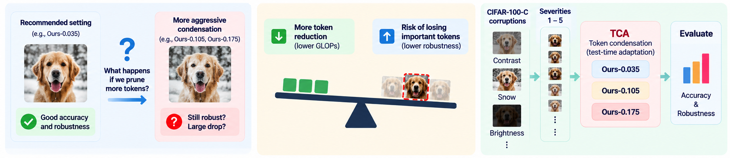
Part 2: Own Experiment Design
I extended the paper by testing different token-pruning strength on corrupted data.
Gap
Hypothesis
Experiment
The paper shows strong performance for a recommended TCA setting, but it does not fully show how robustness changes when token condensation becomes more aggressive.
Greater token reduction should lower GFLOPs, but too much condensation may remove useful visual evidence and reduce robustness under distribution shift.
Run CIFAR-100-C with contrast, snow, and brightness at severities 1–5 for Ours-0.035, Ours-0.105, and Ours-0.175.
The experiment directly tests the compute–robustness trade-off under corrupted inputs.
Notes:
The paper demonstrates strong performance using the recommended TCA setting, but I wanted to investigate what happens when token pruning becomes more aggressive.

Slide 10
Own experiment: computational efficiency improves, but robustness becomes the limiting factor
Used three pruning settings. Ours-0.105 is the medium setting. It gives a good reduction in computation while keeping more accuracy than the aggressive setting
Setting
Saving
Accuracy
Ours-0.035
10.65%
58.64%
Ours-0.105
33.55%
52.33%
Ours-0.175
49.80%
34.71%
Core finding
The trade-off is not linear: the most aggressive setting causes a much larger robustness loss.
Notes:
This is the main result of my own experiment.

Slide 11
Own experiment: corruption-specific results
Also wanted to check whether this behavior was only happening for one type of corruption. So I separated the results into contrast, snow, and brightness. The same general pattern appears for all three
Contrast
Drops from 56.64% to 34.27% when moving from light to aggressive pruning.
Snow
The most difficult corruption under aggressive pruning: 30.70% average.
Brightness
Remains the strongest corruption type, but still declines sharply.
The result is robust across corruption types: stronger pruning consistently lowers corrupted-data accuracy.
Notes:
I also wanted to check whether this behavior was only happening for one type of corruption.So I separated the results into contrast, snow, and brightness.

Slide 12
Severity analysis: the gap widens under stronger shift
This graph shows what happens when the corruption itself becomes stronger. The x-axis represents corruption severity, from 1 to 5. As severity increases, accuracy decreases for all three settings.
Mild shift
At severity 1, medium pruning still keeps around 60.17% average accuracy.
Strong shift
At severity 5, aggressive pruning falls to 25.39% average accuracy.
Interpretation
Harder inputs need more visual evidence.
Notes:
This graph shows what happens when the corruption itself becomes stronger.The x-axis represents corruption severity, from 1 to 5.

Slide 13
Conclusion
TCA is efficient, but robustness sets a practical limit on token reduction.
1. Reproduction works
2. Efficiency improves
3. Robustness decreases
The cross-dataset results were reproduced within the expected tolerance, and TCA remained competitive with the paper results.
Increasing pruning strength reduced the visual encoder cost from 15.710 to 8.826 GFLOPs.
Under CIFAR-100-C corruptions, aggressive pruning caused a large accuracy drop, especially at high severity.

Slide 14
Limitations and next steps
What I would improve if I had more compute and time.
Only three CIFAR-100-C corruption types were tested in the own experiment.
Future work: test all corruption types, more pruning values, and runtime/memory measurements beyond GFLOPs.
More corruptions
Full CIFAR-100-C
More budgets
Finer pruning sweep
More models
Other CLIP backbones

Slide 15
Thank you
Questions?
TCA reduces visual computation, but corrupted-data robustness declines when token condensation becomes too aggressive.

