Slide 1
Intelligent Controllers for Load Frequency Control of a Two-Area Power System
S. A. Azeer
R. Ramjug-Ballgobin
S. Z. Sayed Hassen

Slide 2
Outline of Talk
Frequency Regulation
Power System Modelling
Non-Reheat steam turbine
Reheat steam turbine
Hydraulic turbine
Compensator Design
PID controller
Fuzzy logic controller
ANN controller
Simulation of Compensated Systems
Conclusion

Slide 3
Frequency Regulation
The mismatch between the generating capacity of a power system and the load demand at any given moment in time is reflected in the system’s frequency.
Large deviations from a chosen nominal value of frequency are undesirable.
Power system’s frequency is traditionally regulated using proportional-integral-derivative (PID) controllers.
Frequency is dependent on real power generated.
When real power generated > load demand, frequency increases and vice versa.
The primary control action is performed by the governor (range of seconds)
The secondary control action is performed by the LFC (range of minutes)

Slide 4

Frequency Regulation
Another parameter of interest when dealing with more than area system is the Area Control Error (ACE).
It is a measure of power that is obtained from other area(s) when/after a disturbance has occurred.
A basic guiding principle in power system is that each area must absorb its own load under steady state conditions.
A constant ACE will imply that one area will have to support the other on a steady-state basis.
${ACE}_{1}$ = $∆P_{12}+ B_{1}{∆f}_{1}$
${ACE}_{2}$ = $∆P_{21}+ B_{2}{∆f}_{2}$

Slide 5
Aims
To perform a comparative analysis of three different compensators on systems operating with different turbines.
Design suitable compensators to provide the secondary control actions to the systems based on the following criteria:
Steady-state error for frequency and Area Control Error
Deviation from nominal frequency
Settling time

Slide 6
Power System Modelling
Two types of Power Systems:
Hydro
Thermal
Three types of turbines available:
Hydro Power System→ Hydraulic turbine
Thermal Power System →Reheat and Non-Reheat turbine

Slide 7


Turbine Modelling
Non-Reheat Steam Turbine
$G_{NR}(s)$ = $\frac{1}{1+sT_{CH}}$
$T_{CH}$ is the delay between the change in the valve opening position and the mechanical torque of the turbine.
Reheat Steam Turbine
$$G_{R}\left(s\right)= \frac{1+sF_{HP}T_{RH}}{(1+sT_{CH})(1+sT_{RH})}$$
$T_{RH}$ is the time constant of the reheater
$F_{HP}$ is the rating of the high pressure stage with respect to total generated mechanical power of turbine.
Hydraulic Turbine
$G_{NR}(s)$ = $\frac{1−sT_{w}}{1+s{(T}_{w}/2)}$

Slide 8
Two Area Power System Model

Slide 9
Compensator Design
The three chosen compensators are:
PID
Fuzzy Logic
NARMA-L2
The PID controller was chosen for a proper comparative analysis to be carried out between a conventional controller and intelligent ones

Slide 10
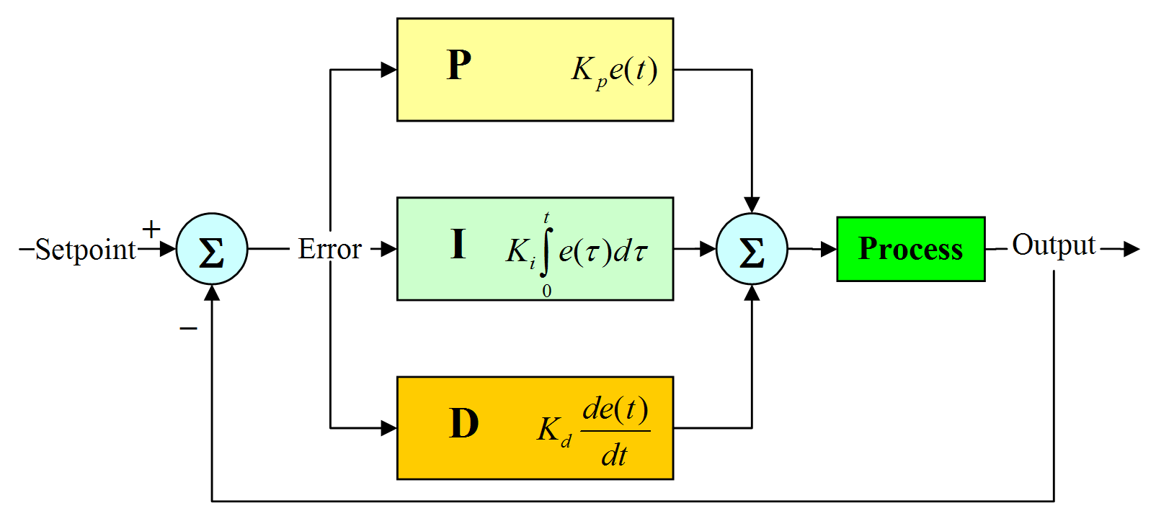
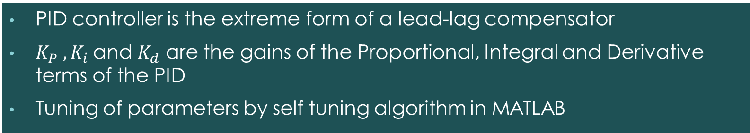
PID Controller
PID controller is the extreme form of a lead-lag compensator
$K_{P} , K_{i}$and $K_{d}$ are the gains of the Proportional, Integral and Derivative terms of the PID
Tuning of parameters by self tuning algorithm in MATLAB

Slide 11
Fuzzy Logic Controller
K1, K2 and K3 are the scale factors of controller
Stages of Fuzzy Logic Controller design:
Fuzzification
Rule base set up
Decision-making stage
Deffuzification

Slide 12
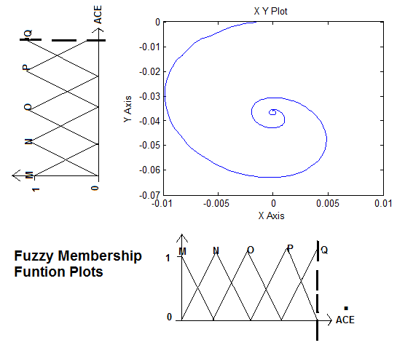
Fuzzy Logic Fuzzification and Rule-base Set-Up
Rule-base Set-Up
M: Large Negative P: Small Positive
N: Small Negative Q: Large Positive
O: Zero

Slide 13
Fuzzy Logic Decision-Making and Defuzzification
Execution of rules according to Rule Table to obtain a Fuzzy control output from the Inference System
Rule Table was taken from previous research on LFC
Defuzzification consists of producing a non-Fuzzy control action from the Inference System that will rectify the ACE output
Method used: centroid

Slide 14
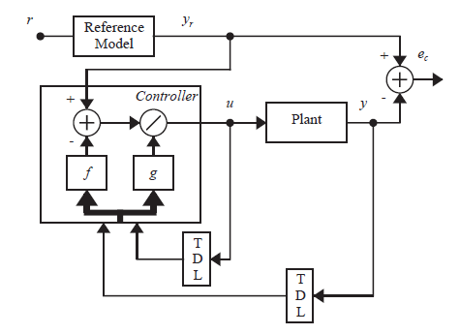
ANN-NARMA-L2 Architecture
Nonlinear Autoregressive Moving Average (NARMA-L2)
ACE output y should follow the reference model output yr to completely eliminate error in the system
Controller should provide control input u to adjust ACE output y by finding the ratio of two previously determined functions.
Design consists of two stages:
Plant Identification
Control Design
$$u\left(k+1\right)= \frac{y_{r}\left(k+d\right) −f[y\left(k\right),…,y\left(k−n+1\right),u\left(k\right),…, u(k−n+1)]}{g[y\left(k\right),…,y\left(k−n+1\right),u\left(k\right),…, u(k−n+1)]}$$

Slide 15
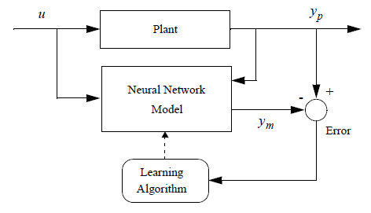
ANN-NARMA-L2 Plant Identification
Training of ANN such that it is representative of the actual dynamics of the plant
The parameters of the Network architecture were chosen from previous published papers
Training data was obtained by importing the input and output data of the PID into the network
Training function chosen was the Levenberg-Marquardt back-propagation algorithm

Slide 16
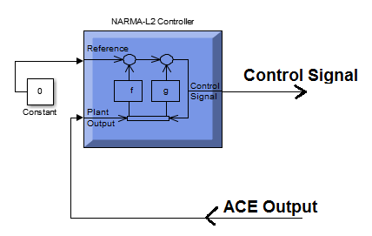
ANN-NARMA-L2 Control Design
The reference model must be zero such that the plant ACE output y follows the reference model output yr and becomes zero
A constant set to ‘0’ is inserted at the reference input of the controller

Slide 17
Hydro-Non Reheat Thermal Power System
Frequency deviation
ACE Output

Slide 18
Hydro-Reheat Thermal Power System
Frequency deviation
ACE Output

Slide 19
Non Reheat-Reheat Thermal Power System
Frequency deviation
ACE Output

Slide 20
Conclusion and Further Works
Percentage frequency overshoot and undershoot have been reduced considerably for the Intelligent controllers c.f. PID controller
The ACE outputs however got worse but ultimately goes to zero !!!
To improve response of systems:
Design of Fuzzy-PID to eliminate errors due to variable load-change
Adaptive membership functions plots of the Fuzzy Logic and adaptive inputs to NARMA-L2 to match variable load-change
Validate results on areas with two or more generating units and with more interconnected areas.

Slide 21
Thank You…

