Slide 1
Data Cleaning: Project Proposal
Smriiti Singhal
Sayed Shazeb Hussain

Slide 2


Objective
Explore the gun violence dataset to analyze the trends related to these crimes across USA.

Slide 3
Dataset
Gun Violence Data
URL - https://www.kaggle.com/jameslko/gun-violence-data#gun-violence-data_01- 2013_03-2018.csv
Source- Kaggle
Data format- csv file
contains 260k gun violence incidents in USA
between January 2013 and March 2018, inclusive.
rows – 239677 columns - 29

Slide 4
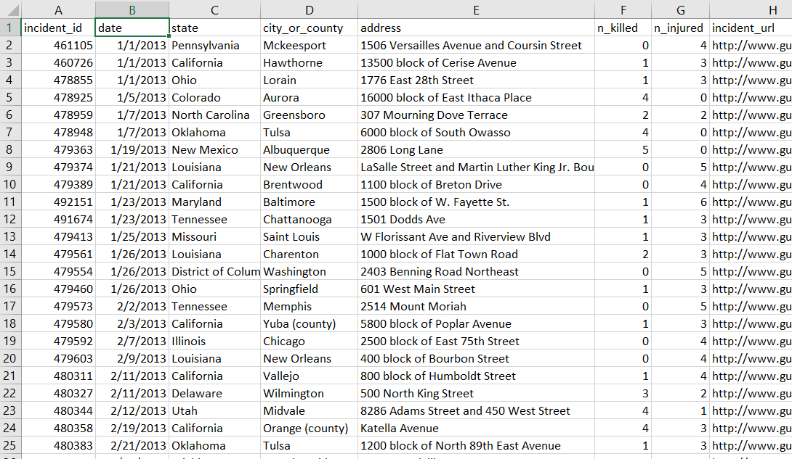

Slide 5
Features of Data
Crime date
Crime country
location
people killed
people injured
Gender
Age
latitude & longitude of Location
Extent of harm done
No. of guns involved
Type of guns
Status of guns (i.e. Unknown, Stolen, etc...)
And many more…….

Slide 6
Why This dataset ?
Very extensive and ‘messy’ dataset
Both numeric & categorical features.
Involves a lot of - Pre-processing
- Data Cleaning

Slide 7
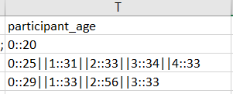
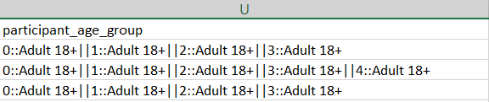
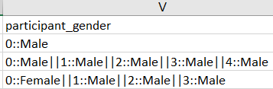
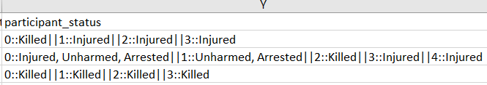
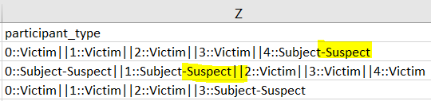

Slide 8
Workflow
Data Cleaning & preprocessing:
Python libraries: pandas, numpy, matplotlib, seaborn
Tableau Prep/Open Refine/ Excel
Visualization:
Tableau dashboard – containing insights from the data.

Slide 9
Thank You !!

