Slide 1
OSS Templates for .NET

Slide 2


SideWaffle | August 2013 | 123K+ downloads
yo aspnet | July 2014 | 118K+ downloads

Slide 3

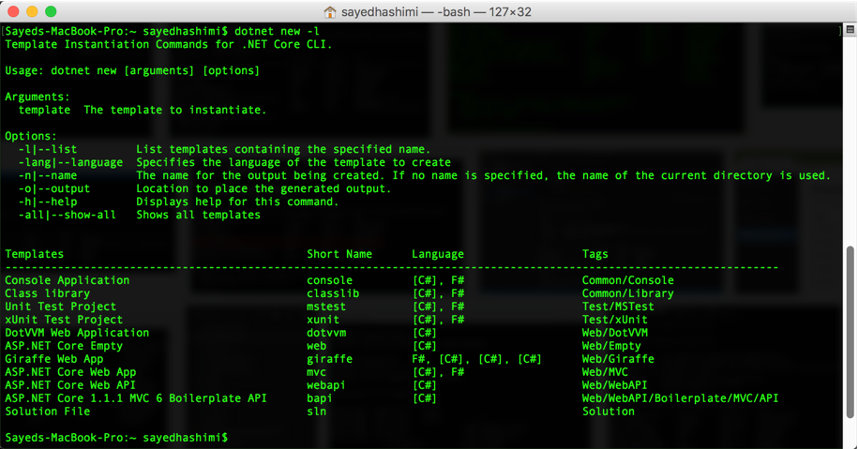
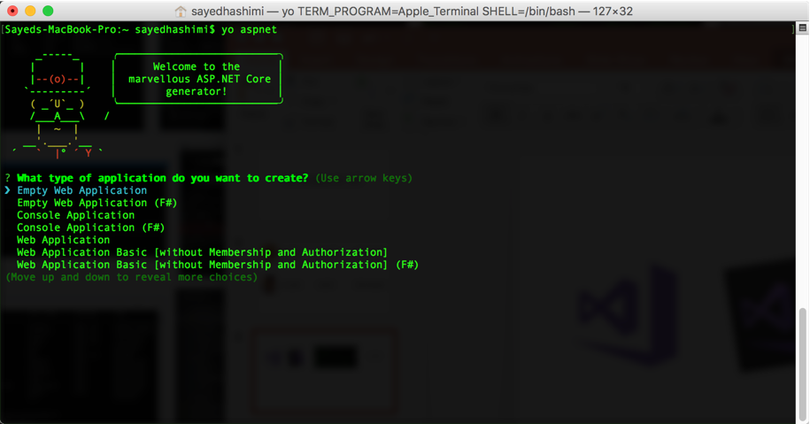

yo aspnet
VS2017
VS4Mac
dotnet new
yo aspnet

Slide 4
yo aspnet
VS2017
VS4Mac
dotnet new
yo aspnet
Template Engine

Slide 5
Demo
Using dotnet new

Slide 6
Demo
Creating a template

Slide 7
Resources
Source - github.com/dotnet/templating
How to create templates - aka.ms/dotnetnew-create-templates
Additional templates - aka.ms/dotnet-new-templates
dotnet new intro - aka.ms/dotnetnew-intro
Wiki - github.com/dotnet/templating/wiki
Samples - aka.ms/dotnetnew-template-samples
Samples from today - github.com/sayedihashimi/channel9-templates-2017.04.11
Twitter - @SayedIHashimi

