Slide 1
What's new for ASP.NET developers using Windows Azure
Sayed Ibrahim Hashimi
SayedHa@Microsoft.com
@SayedIHashimi

Slide 2
Agenda
Why Azure?
Brief overview of Azure offerings
Topics I’ll cover specifically
Azure Active Directory
Web Sites
Web Jobs
Site Extensions
Visual Studio Integration

Slide 3
Why Azure?
Move Faster
Let Azure Virtual Machines, Networking, Storage, SQL manage infrastructure for you
Move even faster with Azure Web Sites and a full suite of App Services
Leverage rich ASP.NET and Visual Studio Integration with Azure
Do More
Scale on demand and globally to handle spikes
Deliver solutions not possible or practical before
Save Money
MSDN Subscribers have existing monthly benefits
Focus on your app, not the plumbing and management
Pay as you go

Slide 4
http://aka.ms/azuremsdn
MSDN Subscribers can activate existing Azure benefits

Slide 5
Brief Overview of Azure

Slide 6
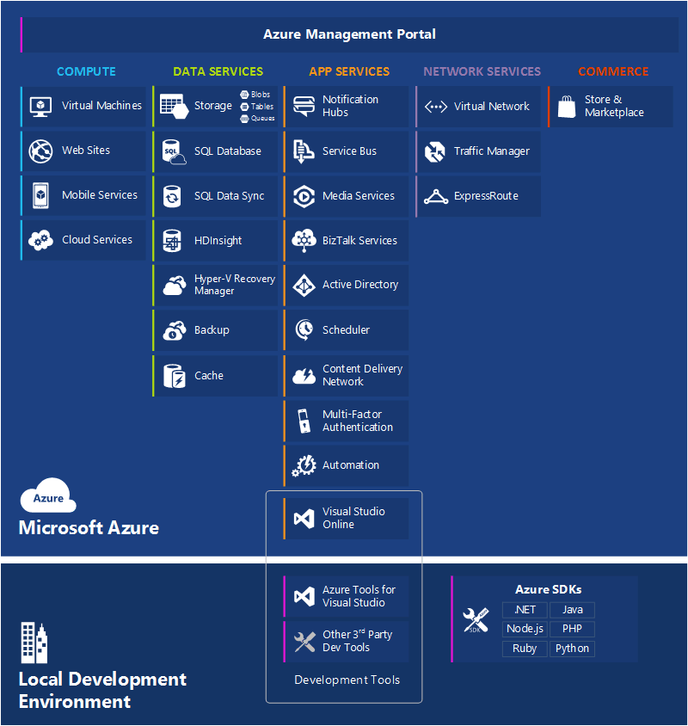

Slide 7
Familiar technology, enhanced in Azure
Feature | On-Premises | Azure
Web Sites | Windows Server + IIS Web Forms + MVC + HTML+ CSS + JavaScript Visual Studio Tooling | Azure Compute (Virtual Machines, WebSites) Distributed Session State, Output Cache Rich Azure Tooling Integration
Identity | Active Directory | Azure Active Directory
Web API | Web API | API Management, Mobile, Notification Service
Jobs | Console, Service | Web Jobs
Real Time | SignalR | Azure Service Bus or Redis Cache Backplane
Cache | AppFabric Cache | Azure Redis Cache or Azure Managed Cache
Traffic Manager | Custom | Azure Traffic Manager

Slide 8
Azure Active Directory

Slide 9
Azure Active Directory
Azure Active Directory
For small organizations you can store your entire directory in AAD
For enterprise organizations you can sync your on-prem AD to AAD
Free for up to 500,000 users
Process for manual setup described at http://msdn.microsoft.com/library/azure/dn151790.aspx
In Visual Studio we have added tooling around this to make it really easy

Slide 10
Demo Time!

Slide 11
Resources
Samples: https://github.com/sayedihashimi/codeonthebeach2014
Web Jobs Samples: https://aspnet.codeplex.com/SourceControl/latest#Samples/AzureWebJobs/BasicSamples/HelloWorld
Web Jobs SDK: http://azure.microsoft.com/en-us/documentation/articles/websites-dotnet-webjobs-sdk-get-started/
AAD Vittorio’s blog: http://cloudidentity.com/
Site extensions gallery: http://siteextensions.net/
Contact Info
@SayedIHashimi
SayedHa@Microsoft.com

