Slide 1
What's new for ASP.NET developers using Windows Azure
#devconnections

Slide 2
Agenda
Why Azure?
Brief overview of Azure offerings
Specific topics for today
  Active Directory
  Websites
  Web Jobs
  Site Extensions
  Visual Studio Integration
#devconnections

Slide 3
Who am I?
@SayedIHashimi
SayedHa@Microsoft.com
Samples at http://bit.ly/sayeddevcon2014
#devconnections

Slide 4
Why Azure?
Move faster
  Let Azure Virtual Machines, Networking, Storage, SQL manage infrastructure for you
  Move even faster with Azure Web Sites and a full suite of App Services
  Leverage rich ASP.NET and Visual Studio Integration with Azure
Do More
  Scale on demand and globally to handle spikes
  Deliver solutions not possible or practical before
Save Money
  MSDN Subscribers have existing monthly benefits
  Focus on your app, not the plumbing and management
  Pay as you go

Slide 5
HTTP://AKA.MS/AZUREMSDN
Activating MSDN Benefits for Azure

Slide 6
BRIEF OVERVIEW OF AZURE
#devconnections

Slide 7
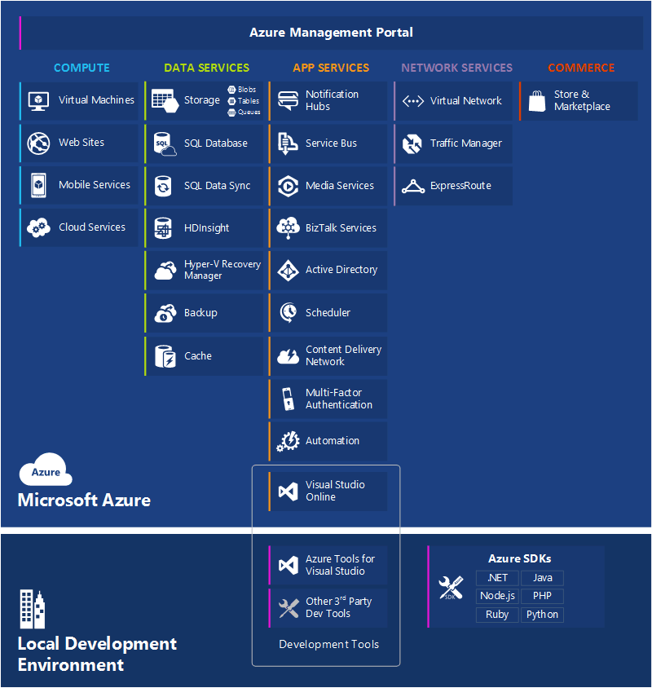
#devconnections

Slide 8
AZURE ACTIVE DIRECTORY
#devconnections

Slide 9
Azure Active Directory
For small organizations you can store your entire directory in AAD
For enterprise organizations you can sync your on-prem AD to AAD
Free for up to 500,000 users
Process for manual setup described at http://msdn.microsoft.com/library/azure/dn151790.aspx
In Visual Studio we have added tooling around this to make it really easy

Slide 10
DEMO TIME!
#devconnections

Slide 11
Info
Samples at http://bit.ly/sayeddevcon2014
@SayedIHashimi
SayedHa@Microsoft.com

Slide 12
Rate This Session Now!
Rate with Mobile App:
Tell Us What You Thought of This Session
Select the session from the
Agenda or Speakers menus
Select the Actions tab
Click Rate Session
Be Entered to
WIN
Prizes!
Rate Using Our Website:
Register at www.devconnections.com/logintoratesession
Go to www.devconnections.com/ratesession
Select this session from the list and rate it

